Slide 1
Welcome to EECS/BioE C106B/206B!
Professor Shankar Sastry
TAs: Tarun Amarnath, Max de Sa, Han Nguyen, Fangyu Wu

Slide 2
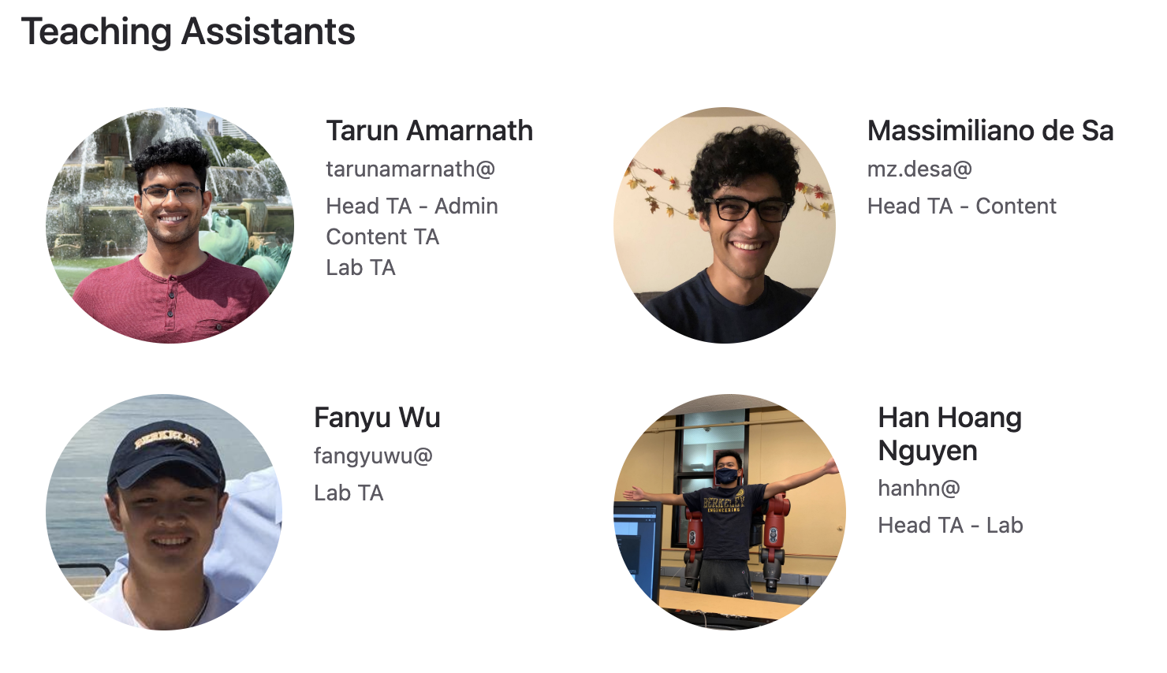

Slide 3
By the end of the course you should...
Be proficient at reading, comprehending, critiquing, and re-implementing research papers in the field of robotics.
Have experience conducting independent research in model-based robotics, vision, and intelligent machines.
Have the tools necessary to reason about nonlinear control systems, robotic manipulators, steering systems subject to non-holonomy, path-planning, active vision, image reconstruction, active vision, robotic grasping, and other advances in robotics.

Slide 4
Prerequisites
106A is strongly recommended
EE 128 is nice to have
Knowledge of linear algebra
Programming in Python
Curiosity about how things work
Interest in experimental work
Willingness to explore

Slide 5
“Supposing is good, but finding out is better.”
Mark Twain

Slide 6
Whom to ask
Homeworks: Max and Tarun
Administrivia: Tarun
Projects: all TAs
Post on Ed for fast responses!
If emailing, please prefix with [EECS C106B]

Slide 7
Lectures
North Gate 105 (but you already knew that!)
T/R 2:00pm-3:30pm
Recorded for asynchronous viewing/review
Topics can be found on the course calendar: https://ucb-ee106.github.io/106b-sp23site/
  Subject to change
  Will likely add content on learning

Slide 8
Discussions
W 1-2pm, F 2-3pm* (Rooms TBD)
Recorded for asynchronous watching and review
Lecture review + problem solving
Do not have to attend the section you’re enrolled in on CalCentral (though I think everyone is in the 999 section right now)

Slide 9
Journal Club
In Cory 105 - required synchronous attendance
Happens instead of formal lab
  Go over any new projects
  2 paper presentations per class, 2 per person through the sem, 2 person groups
  See helpful links in Week 1 on calendar
Times released once TA schedules are finalized
  We’re handling lab assignments internally!
  Paper presentation signups will be released after schedules are finalized

Slide 10
Journal Club This Week
This week, attend any time
  Wednesday 8-9am (Han)
  Wednesday 9-10am (Han)
  Wednesday 11am-12pm (Tarun)
  Thursday 1-2pm (Fangyu)
We will introduce Project 1A
Can use this time to form project teams as well

Slide 11
Projects
Projects ~2 weeks (check calendar)
Deliverables are conference-style reports
~3 people per group
These projects are very different from labs in EECS 106A/206A; they are much more open-ended and are closer to conducting experiments than implementing algorithms. They will take approximately 40-60 person-hours (6-10 hours per week per person).

Slide 12
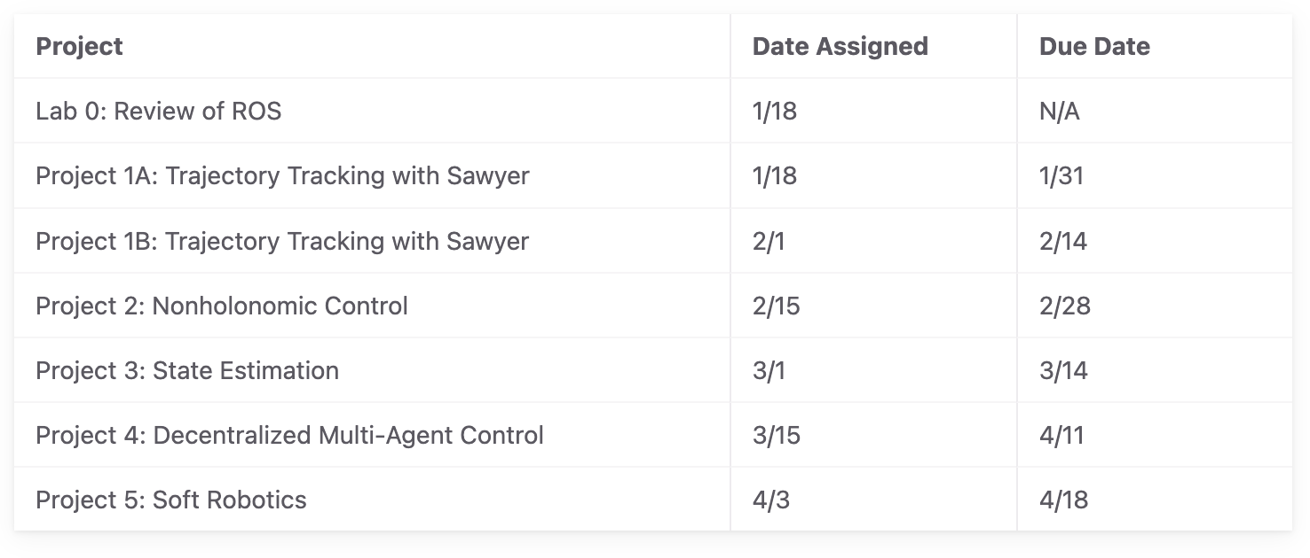
Projects done on your own time!
Will open a booking system for robots
2 hour signups
Can sign up for the next time after current reservation is completed
Lab 0 - optional review
Project 1A
  Don’t need robot
  Due 1/31
  Released in journal club tomorrow

Slide 13
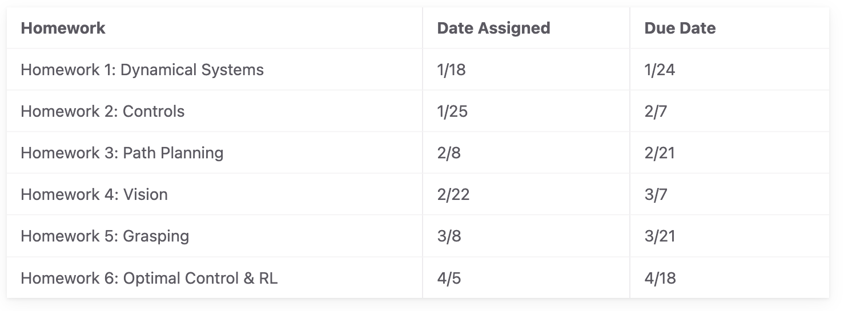
Homeworks
Same as C106A, you get 5 slip days. You can use a maximum of 2 for each assignment.
List your collaborators!
Homework and projects alternate Tuesday deadlines

Slide 14
Midterm
Toward the end of the semester
  Currently scheduled 4/19-4/21
We want it to be low-stress
  Likely open-book, multiple days to do it, take-home
More details later

Slide 15
Final Project
Research-based final project
Last month and a half of the semester
Groups of 4, similar to 106A

Slide 16
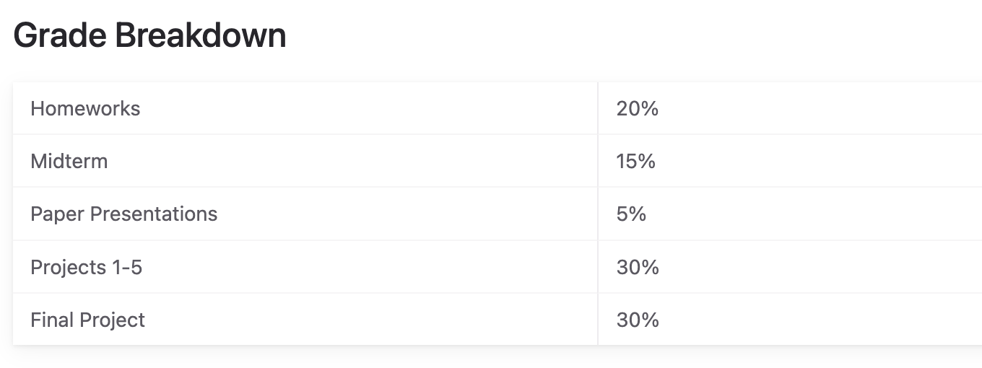

Slide 17
To-Do This Week
HW 1 released tomorrow (due next Tuesday)
Project 1A released tomorrow (due 1/31, next-to-next Tuesday)
Background Assessment
  To get off the waitlist if you haven’t taken 106A
Go to discussion
Go to journal club
Come to lecture!

Slide 18
This class is hard!
It’s okay to be confused and to ask many questions!
We encourage you to collaborate and explore. You get out what you put in.
As always, course staff is here to support you as students AND as people

Slide 19
Any questions?
Happy to field questions offline, on Ed, or at tarunamarnath@berkeley.edu

