Slide 1
Journey with SLAM
Ritika Shrivastava
Fun Activity: Can you count the number of robots in this presentation?

Slide 2
Motivation

Slide 3
Ritika Shrivastava
Berkeley Alumni - Class of 2022
EECS
Master’s Focus in Computer Vision
Currently working at Tesla

Slide 4
01
02
Motivation
Background
03
04
Masters Research
Work @ Tesla
Computer Vision
Pinhole camera model

Slide 5
02.
Background

Slide 6
Computer Vision
Notes:
Field of AI that trains computers to interpret and understand the visual world.
Scene reconstruction
Object recognition
3d pose estimation
Visual servoing
3D scene modeling
Image restoration
Something with the turtle bots

Slide 7
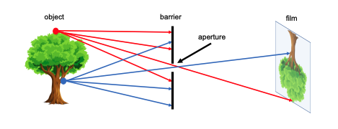
Pinhole Camera Model
Notes:
Let’s design a simple camera system – a system that can record an image of an object or scene in the 3D world. This camera system can be designed by placing a barrier with a small aperture between the 3D object and a photographic film or sensor. As Figure 1 shows, each point on the 3D object emits multiple rays of light outwards. Without a barrier in place, every point on the film will be influenced by light rays emitted from every point on the 3D object. Due to the barrier, only one (or a few) of these rays of light passes through the aperture and hits the film. Therefore, we can establish a oneto-one mapping between points on the 3D object and the film. The result is that the film gets exposed by an “image” of the 3D object by means of this mapping. This simple model is known as the pinhole camera model.

Slide 8
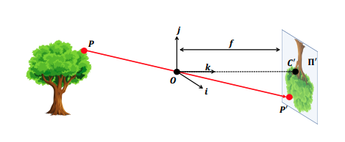
Pinhole Camera Model
Notes:
A more formal construction of the pinhole camera is shown in Figure 2. In this construction, the film is commonly called the image or retinal plane. The aperture is referred to as the pinhole O or center of the camera. The distance between the image plane and the pinhole O is the focal length f. Sometimes, the retinal plane is placed between O and the 3D object at a distance f from O. In this case, it is called the virtual image or virtual retinal plane. Note that the projection of the object in the image plane and the image of the object in the virtual image plane are identical up to a scale (similarity) transformation.

Slide 9
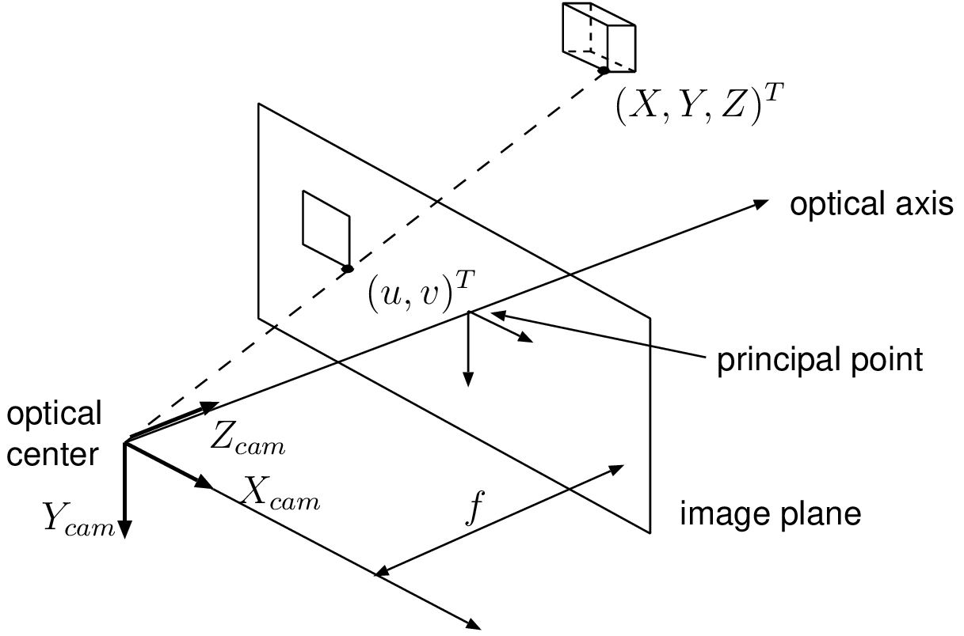
Pinhole Camera Model
Notes:
Notice the axis for the camera model. You have x and y which are parallel to the imaging plane and z which is perpendicular to the imaging plane.
Questions. How can I calculate u and v for the pinhole camera model?
u= Xf/Z and v = Yf/Z

Slide 10
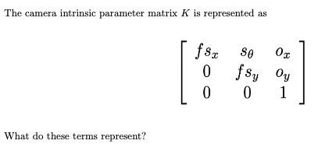
Pinhole Camera Model
Notes:
Here is a representation of the intrinsics matrix of a pinhole camera model

Slide 11
Pinhole Camera Model
Notes:
Here is a representation of the intrinsics matrix of a pinhole camera model

Slide 12
Pinhole Camera Model
Notes:
What is the origin?

Slide 13
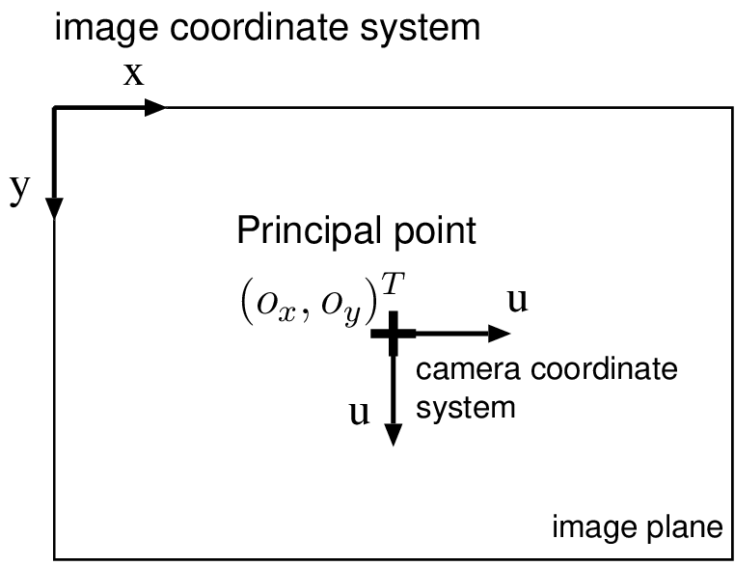
Pinhole Camera Model
Have
Desire
Notes:
What is the origin?

Slide 14
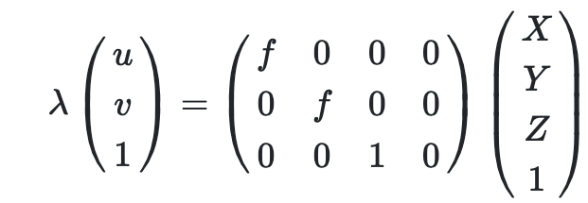
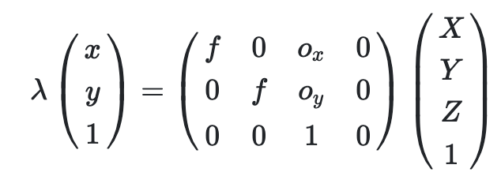
Pinhole Camera Model
Notes:
What is the origin?

Slide 15
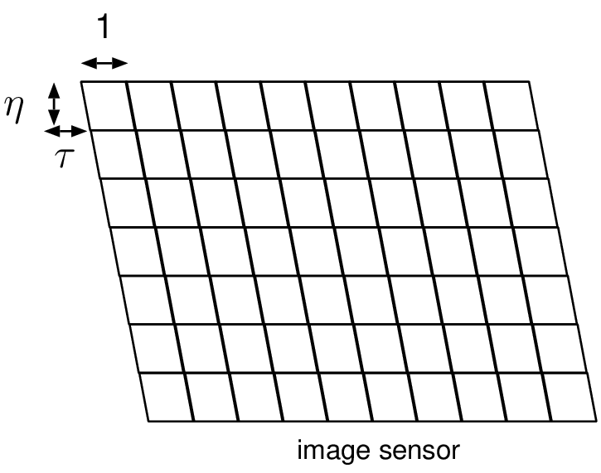
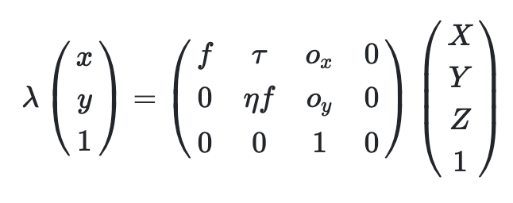
Pinhole Camera Model
Notes:
What is the origin?

Slide 16
03.
Environment Reconstruction with Drones

Slide 17
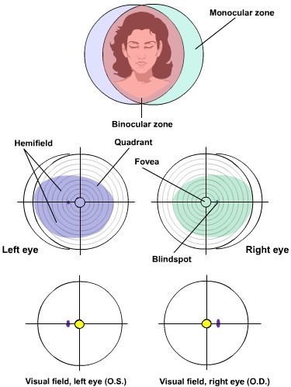
Humans perceive depth from Binocular Vision
Our perception of depth in created through triangulation and visual cues.
We use this to estimate depth in monocular regions of our brains.

Slide 18
Inspired by Human Vision
Point 1
Point 2
Point 3
Make inferences of depth from the regions of binocular vision
Two regions with depth information available
Region with a larger FOV what we want to estimate depth for

Slide 19
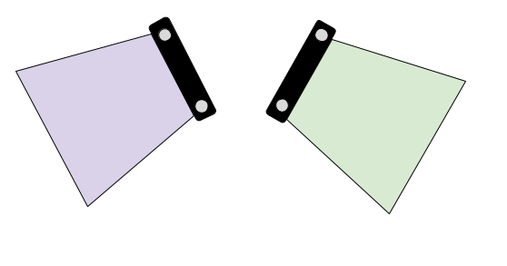
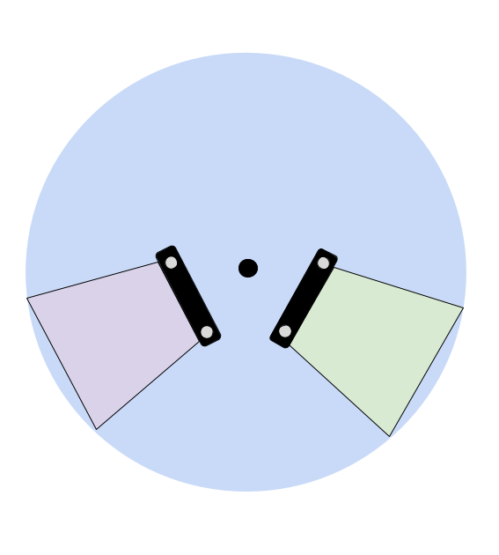
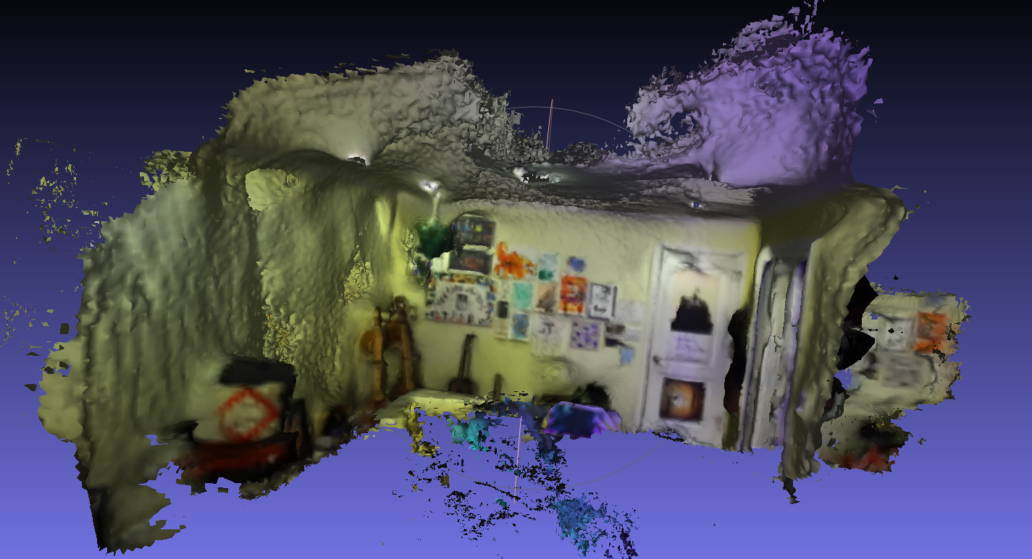
Inspired by Human Vision
Inspired by Human Vision
Point 3
Point 2
Point 3
Point 1
Point 2
Point 1
Make inferences of depth from the regions of binocular vision
Make inferences of depth from the regions of binocular vision
Two regions with depth information available
Two regions with depth information available
Region with a larger FOV what we want to estimate depth for
Region with a larger FOV what we want to estimate depth for

Slide 20
Inspired by Human Vision
Inspired by Human Vision
Point 3
Point 2
Point 3
Point 1
Point 2
Point 1
Implementation
2 ZED2 cameras
110° (H) x 70° (V) x 120° (D)
IMX219 – 200
200° (Diagonal)

Slide 21
Steps taken
Consolidating Hardware: Jetson Nano, 2 Zed2 cameras, Fisheye camera
Setting up Python on the Jetson
Designing and building the mount
Calibrating the Cameras (Fisheye was slightly different)
Calculating the Rotation and Translation between the cameras
Structure from Motion on the fisheye camera
Stereo vision depth information from the Zed camera
Consolidating the point clouds

Slide 22
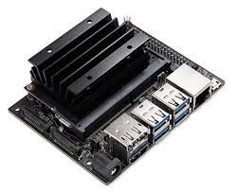
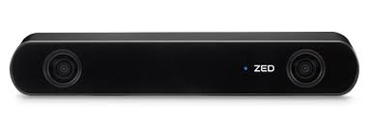
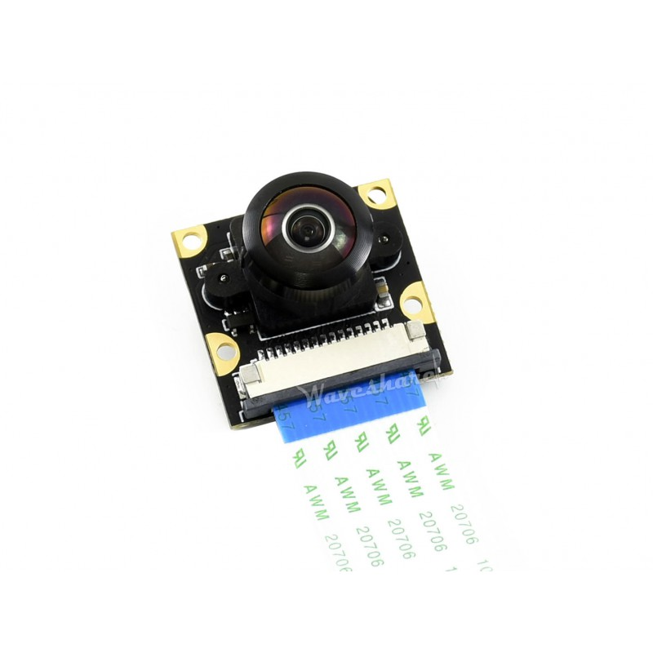
Hardware used:

Slide 23
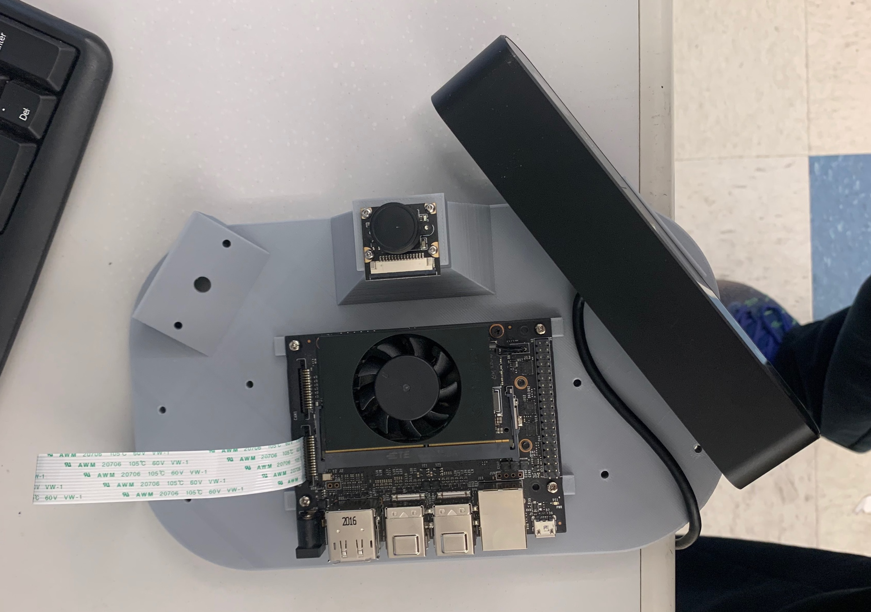
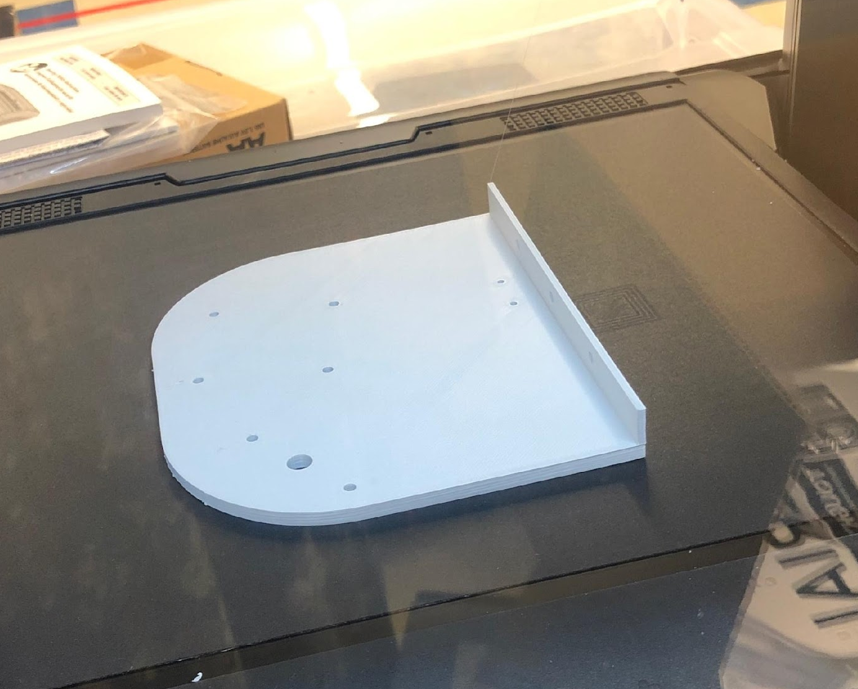
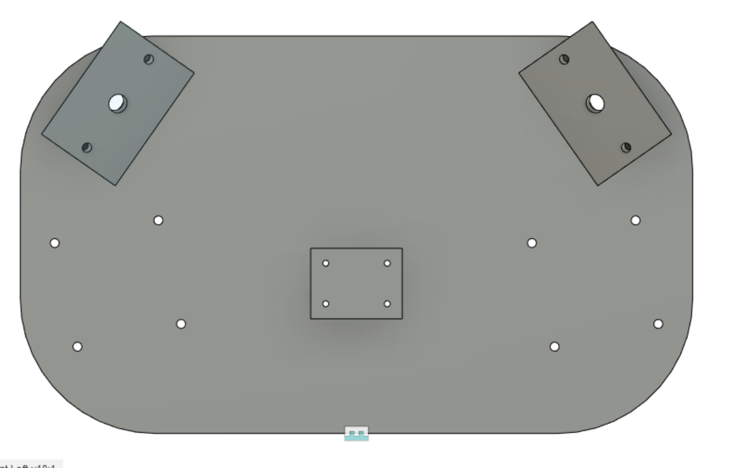
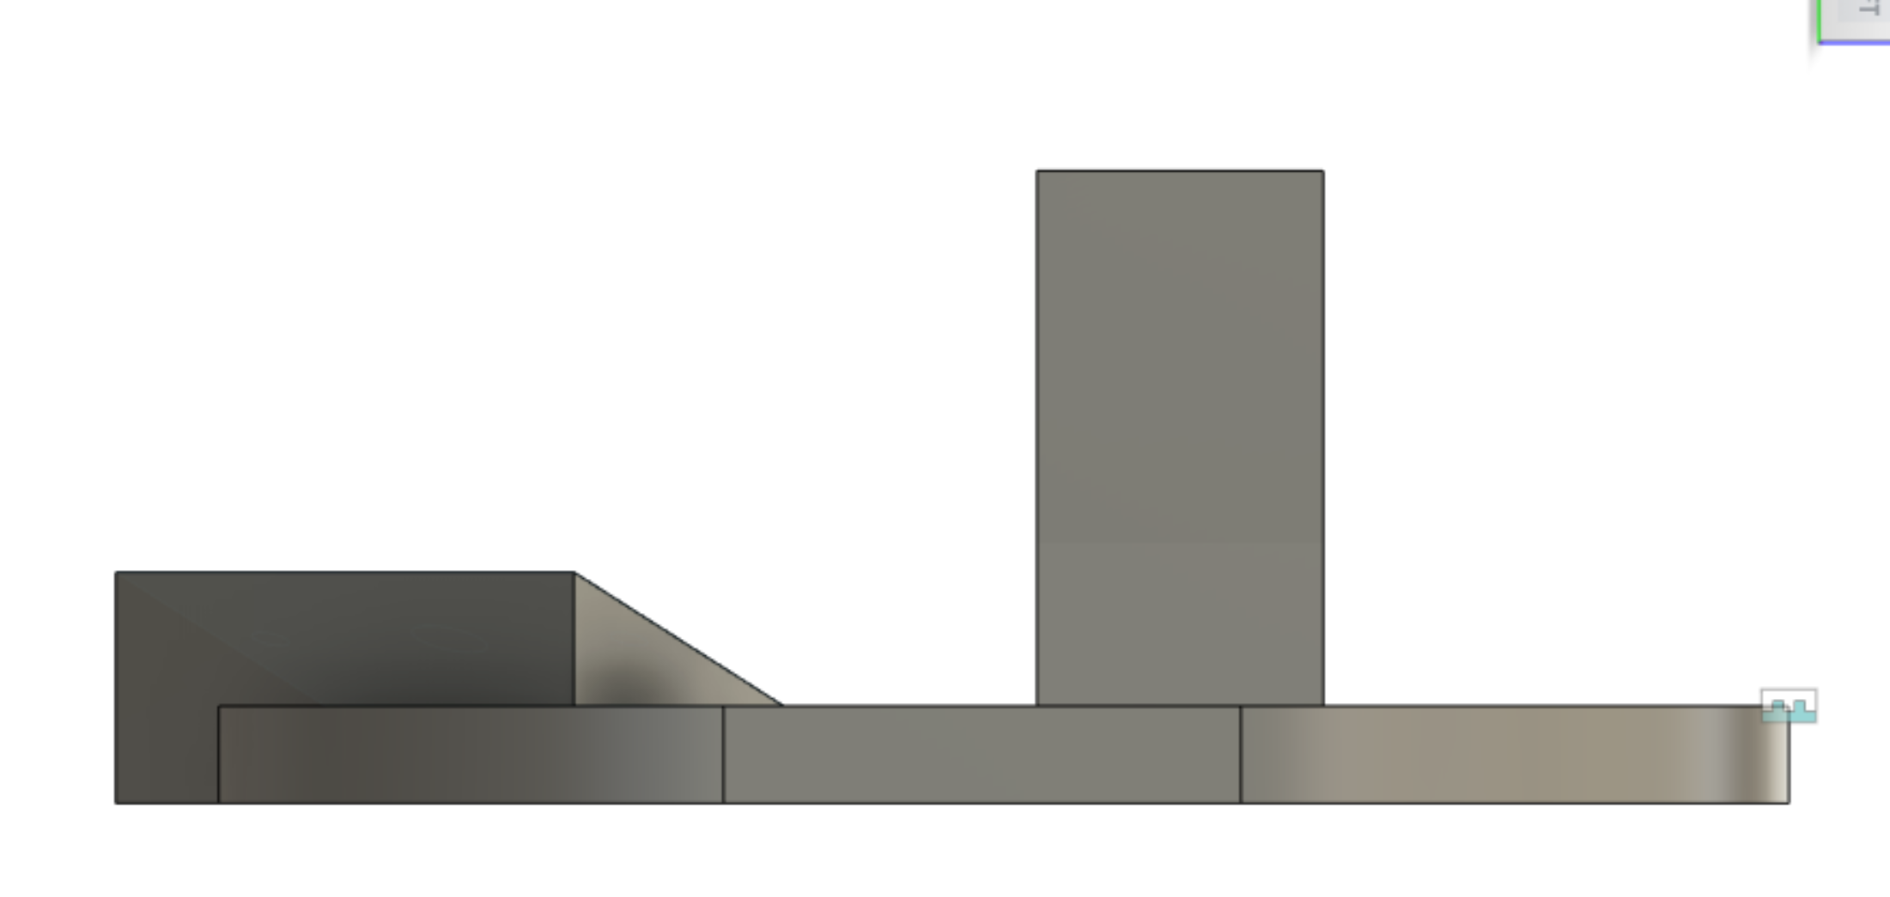
Designing and Iterations of the Mounts:

Slide 24
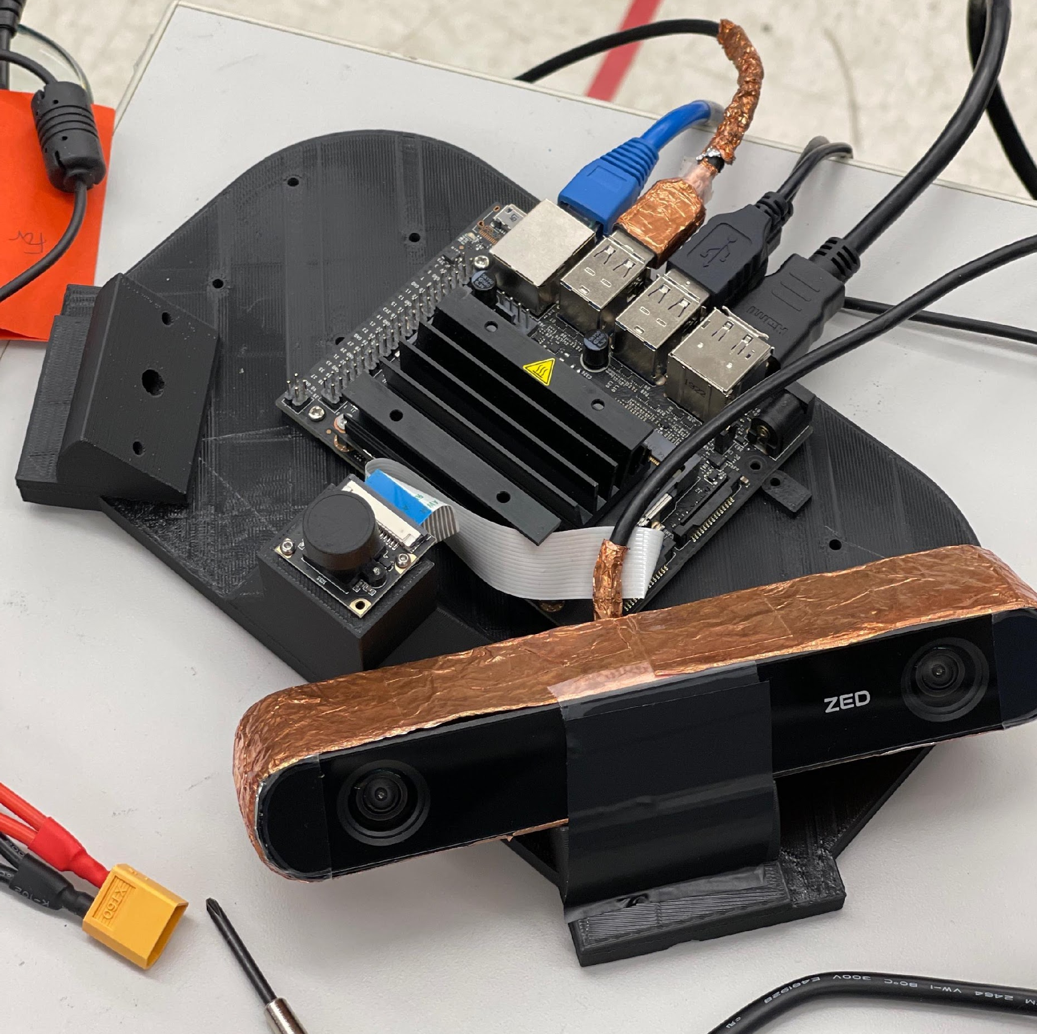
Designing and Iterations of the Mounts:

Slide 25
Hardware used:

Slide 26
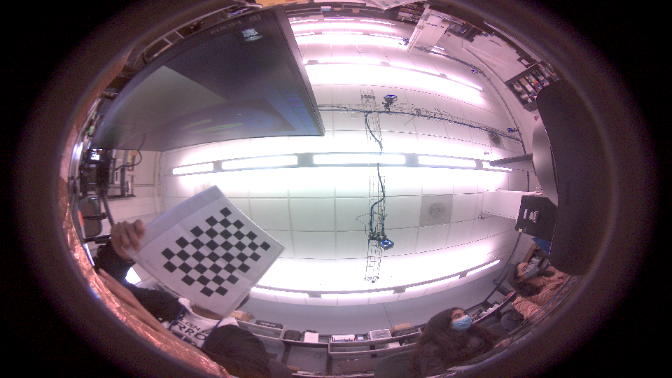
Camera Calibration:

Slide 27
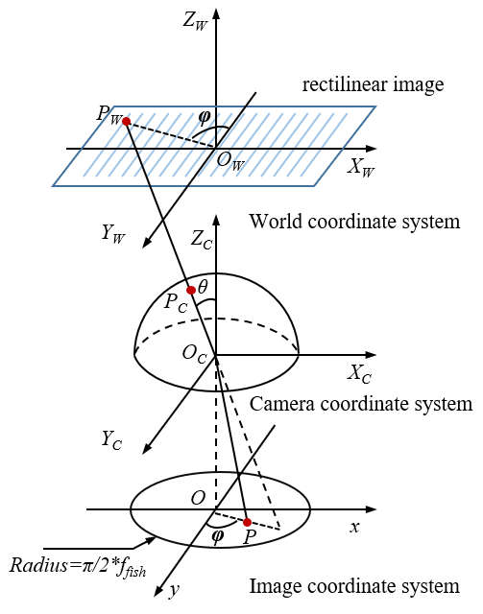
Camera Calibration:

Slide 28
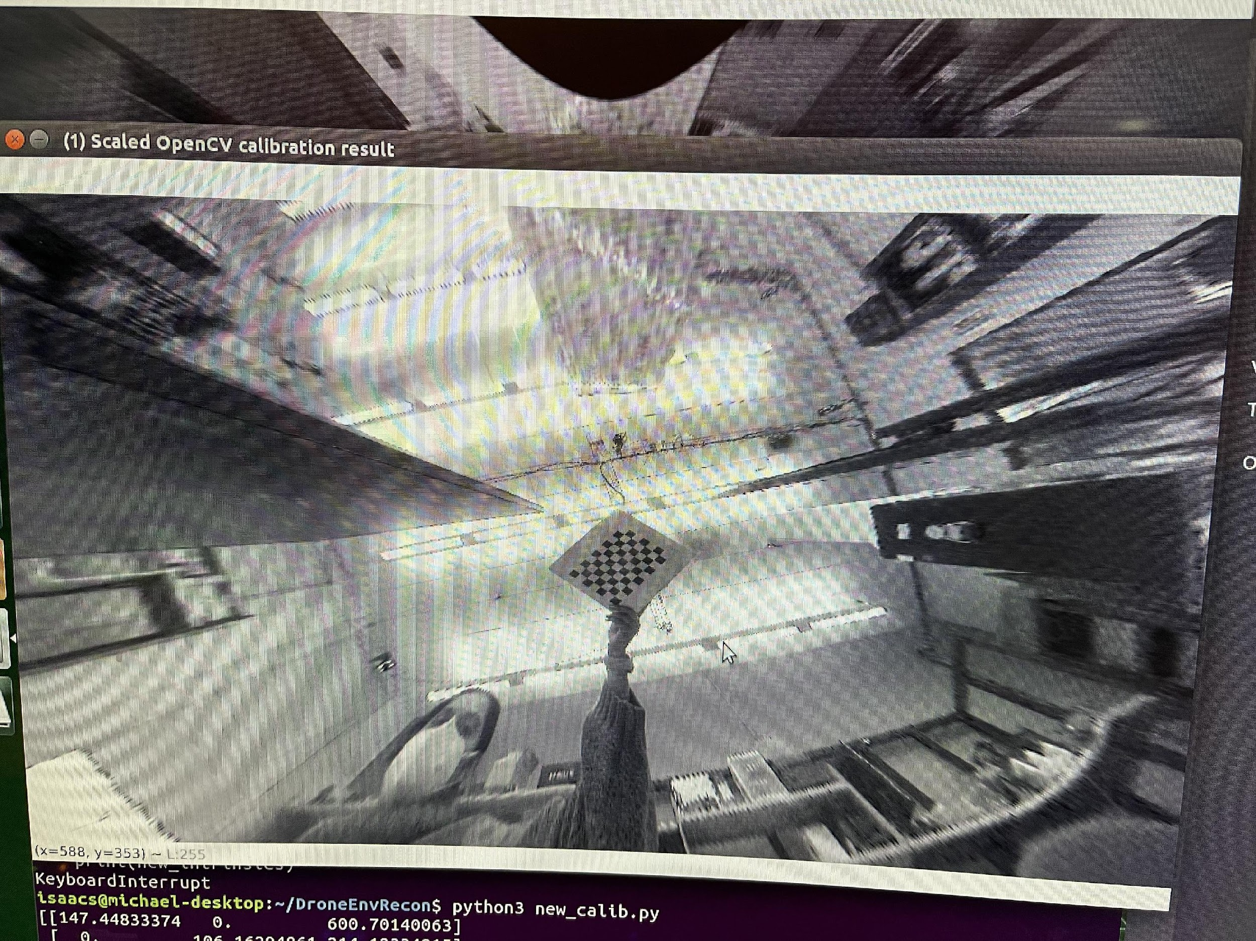
Camera Calibration:

Slide 29
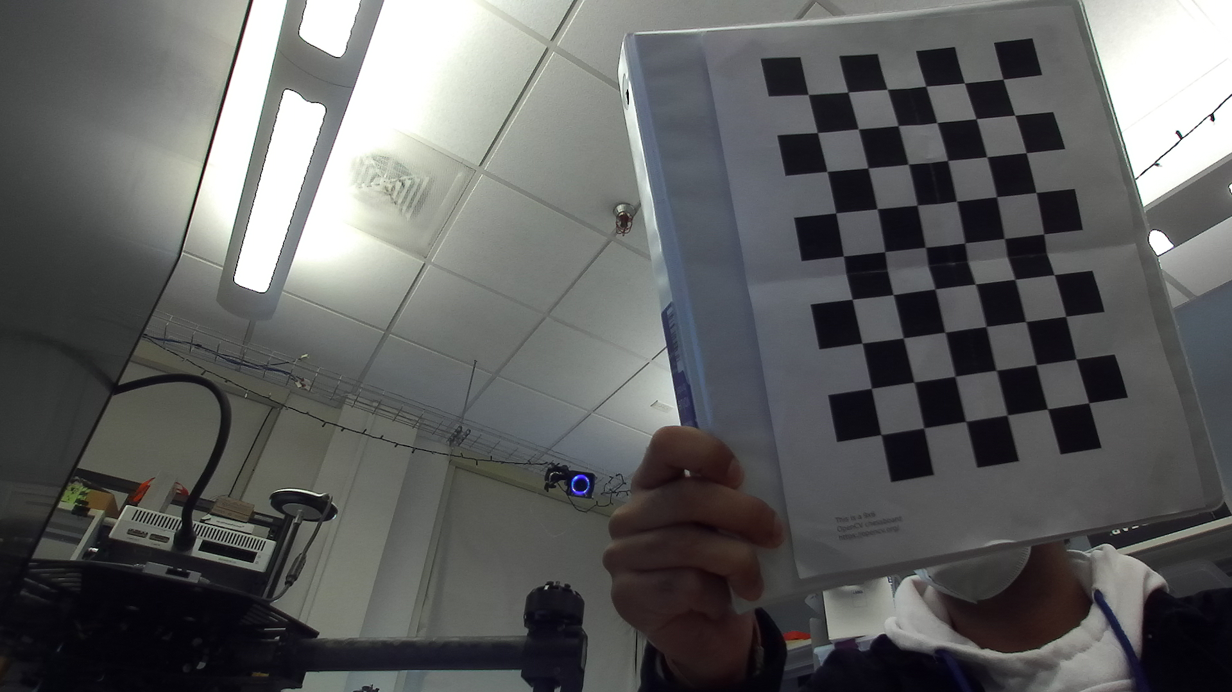
Rotation and Translation between ZED and Fisheye:

Slide 30
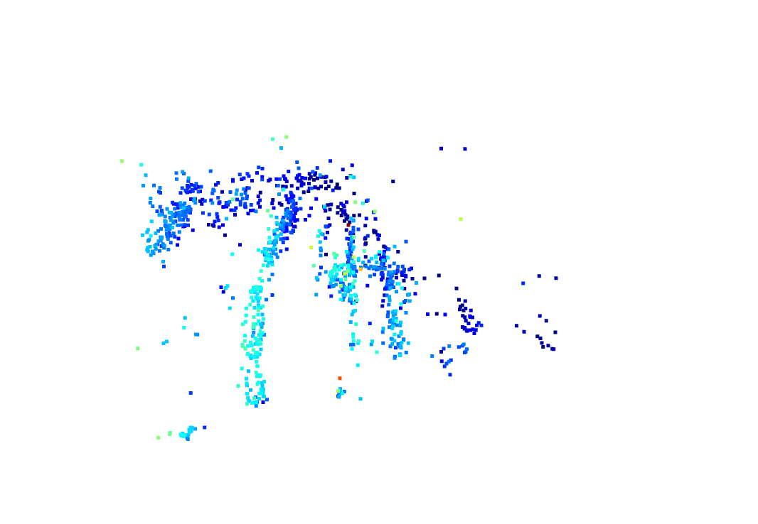
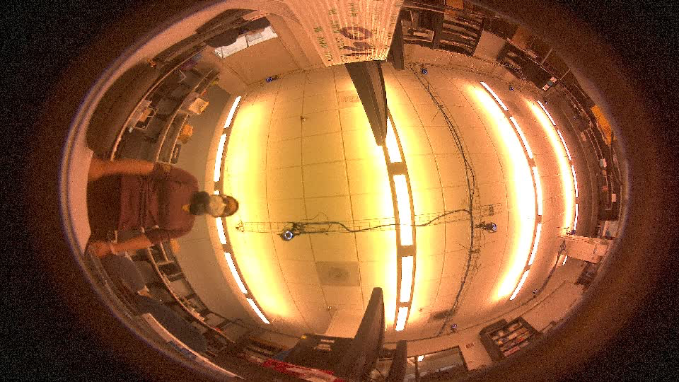
Structure from Motion on Fisheye:
Using consecutive frames from the fisheye camera
Detect common features
Calculate the R and T between the features
Triangulate to get their 3D points

Slide 31
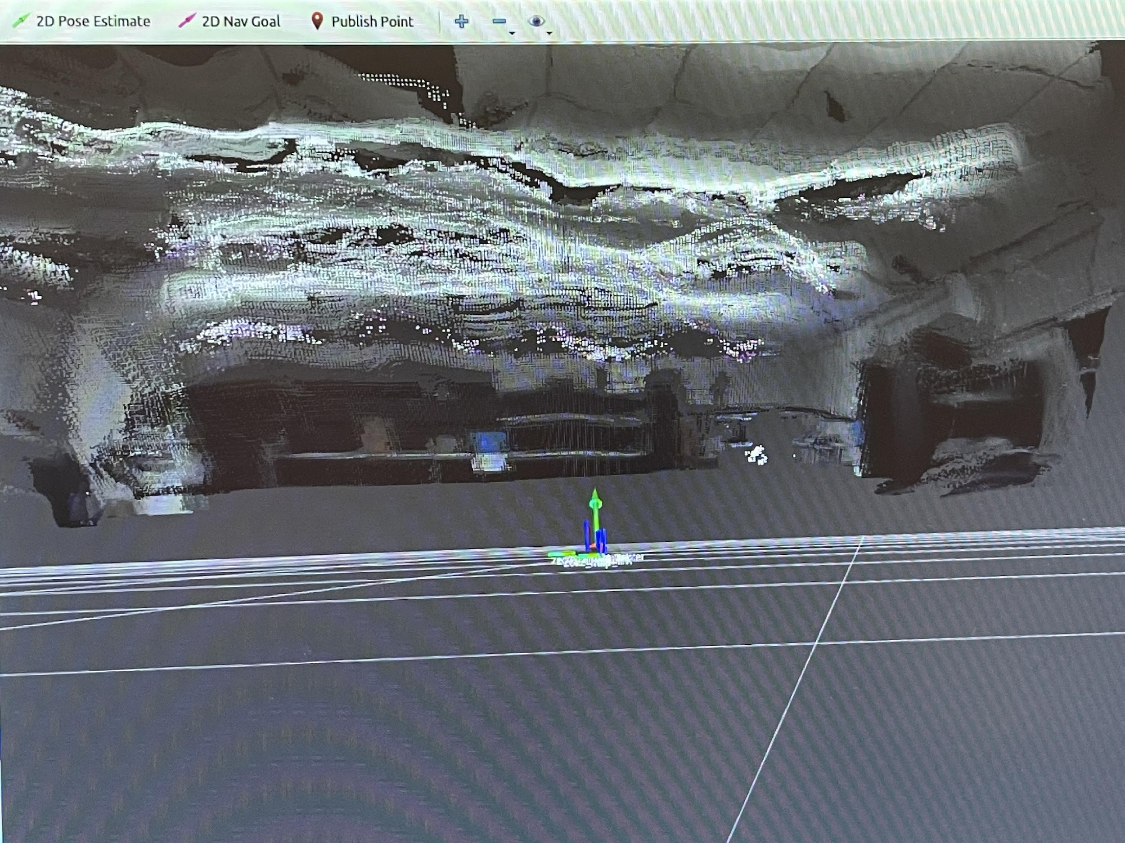
Stereo Depth from ZED cameras:

Slide 32
Benefits
Recreate More
Cost
With this implementation, more of the scene can be recreated faster. Below, the result from one camera is scene. With 3, we can recreate more of the space in lesser time.
Fisheye cameras cost significantly less than ZED cameras. If we can get similar level of performance with both, it would allow for better recreation at a smaller cost.

Slide 33
02.
Current Work

Slide 34

Geometric Vision
@ Autopilot
Motivation
High Precision Trajectory
Multi-Trip Reconstruction

Slide 35
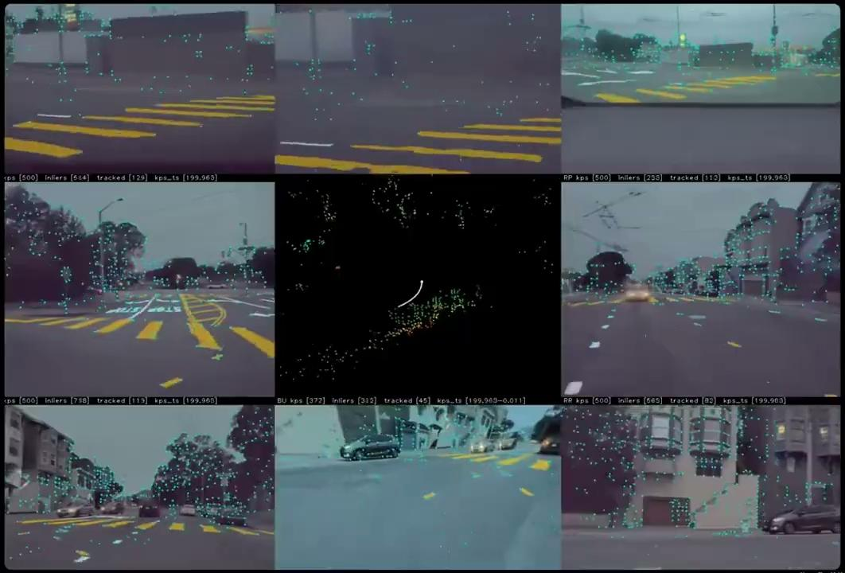
High Precision Trajectory
Input
Video, Imu, Odometry
System
2 cpu threads: tracking & optimization
nn inferences: feature extraction
Features
points, polylines, pano-seg, ground
Output
6 dof trajectory @ 100 hz
3d struction and road detail
camera/sensor calibration

Slide 36
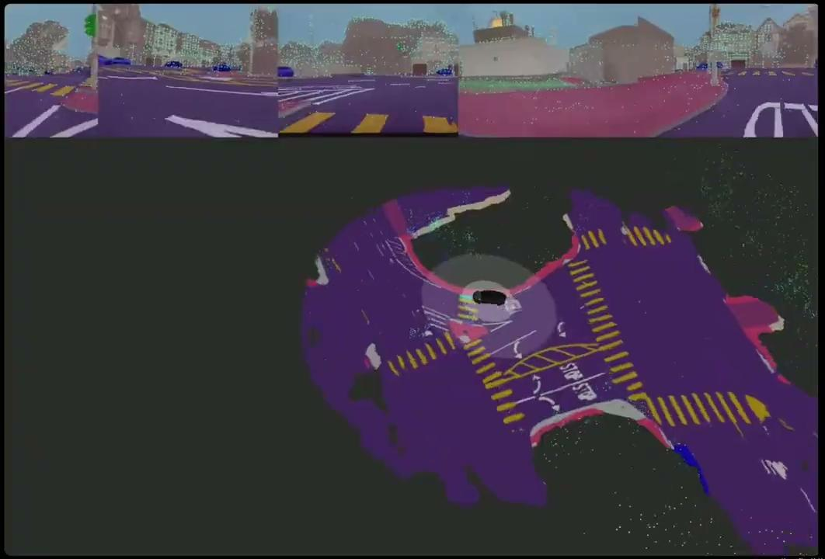
Multi-trip Reconstruction
Internal Steps
Course alignment
Pairwise matching
Joint Optimization
Surface Refinement
System
Parallelize on the cluster
1 - 2 hrs per reconstruction

Slide 37
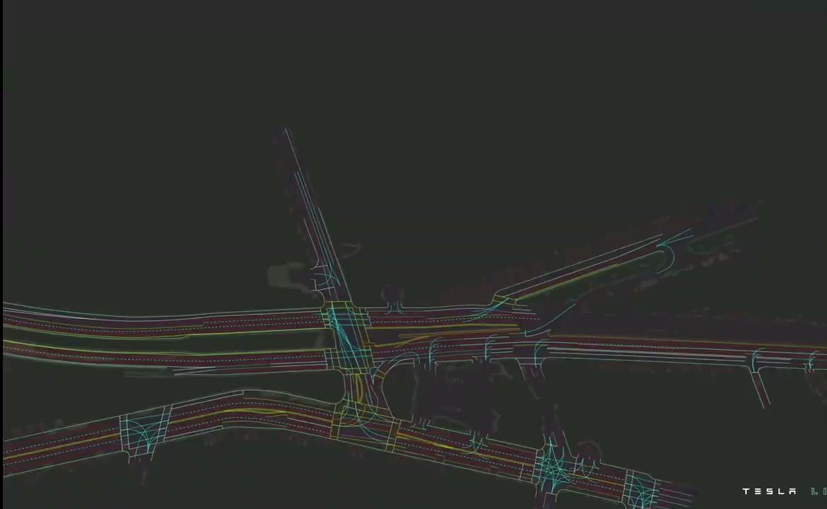

Slide 38
Resources
AI Day presentation: https://www.youtube.com/watch?v=ODSJsviD_SU
Careers Page: https://www.tesla.com/careers/search/?site=US
Email: rshrivastava@tesla.com

Slide 39
Thanks!
Does anyone have any questions?
rshrivastava@tesla.com
Careers Page: https://www.tesla.com/careers/search/?site=US
Total Robot Count: 16

