Slide 1
EECS C106B Week 3 Lab
Project 1B Intro and Lab 0

Slide 2
Agenda
1
2
Project 1B Intro
Some relevant info for Project 1B
Project 0
Get (re)acquainted with the robots!

Slide 3
Project 1B

Slide 4
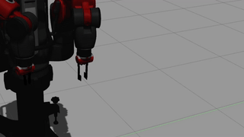
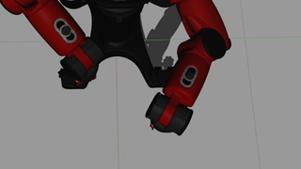
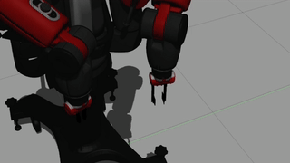
Goals
Should already have trajectories defined (line, circle, arbitrary) in terms of SE(3) pose and se(3) body velocity at every point in time
Implement 3 closed-loop controllers
  Jointspace Velocity
  Workspace Velocity
  Jointspace Torque
Compare trajectory tracking performance amongst your own controllers and MoveIt!
Present findings in conference paper format

Slide 5
Controllers
1
2
3
Workspace
Jointspace Velocity
Jointspace Torque
Given: desired workspace positions, velocities, and accelerations
Produce: control input as joint velocities
Given: desired joint positions, velocities, and accelerations
Produce: control input as joint velocities
Given: desired joint positions, velocities, and accelerations
Produce: control input as joint torques

Slide 6
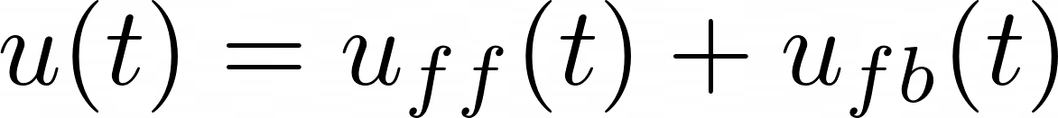
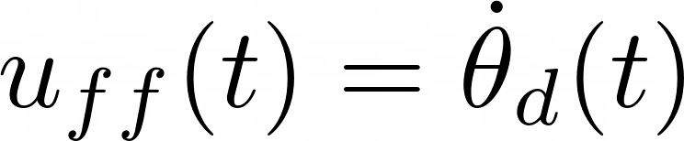
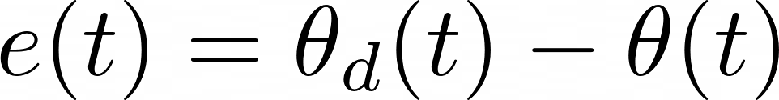
Jointspace Velocity Controller
u(t): control input
u_{ff}(t) and u_{fb}(t): feedforward and feedback terms
𝛉(t) and 𝛉_{d}(t): actual and desired joint positions
K_{p} and K_{v}: proportional and derivative terms for PD controller
e(t): error in joint positions

Slide 7
Jointspace Torque Controller
M(𝛉): inertia matrix
C(𝛉): coriolis matrix
G(𝛉): gravity vector
Augmented PD Control Law (MLS p. 194)
Computed Torque Control Law (MLS p. 191)
Notes:
We can ignore coriolis matrix because we have low joint velocities

Slide 8
Workspace Controller
g_{t} and g_{d}: current and desired robot frames
K_{p}: 6x6 positive diagonal matrix of proportional controller gains
ξ_{td}: velocity which reduces error between frames
V_{d}^{b}: velocity in desired frame
Ad_{gtd}: Adjoint of g_{td} frame
(J^{s}_{st}(𝛉))✝: spatial Jacobian pseudo-inverse
USE PROJECT DOC FOR UPDATED FORMULAS

Slide 9
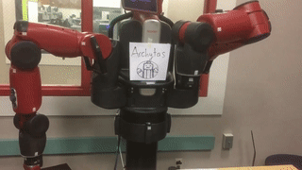
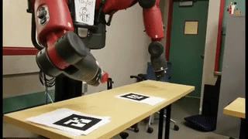
Advice
Don’t expect things to work perfectly
  Explain why in your report
Implementation difficulty (probably)
  Jointspace Velocity < Jointspace Torque < Workspace Velocity
  Tackle an easier controller first to understand the codebase and get something working
Test open-loop controllers before adding feedback terms
Remember to tune the proportional term first, then the derivative term

Slide 10
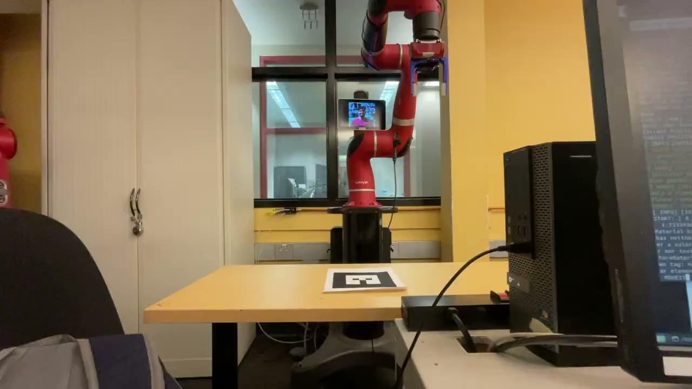

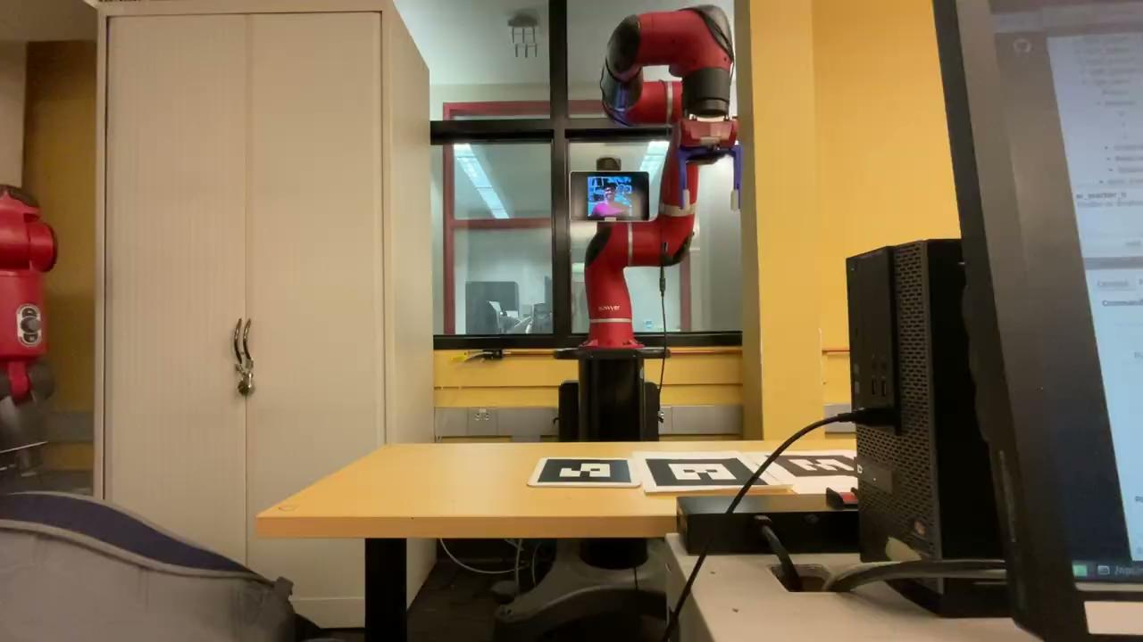
Line
Circle
Polygon
Visual Servo

Slide 11
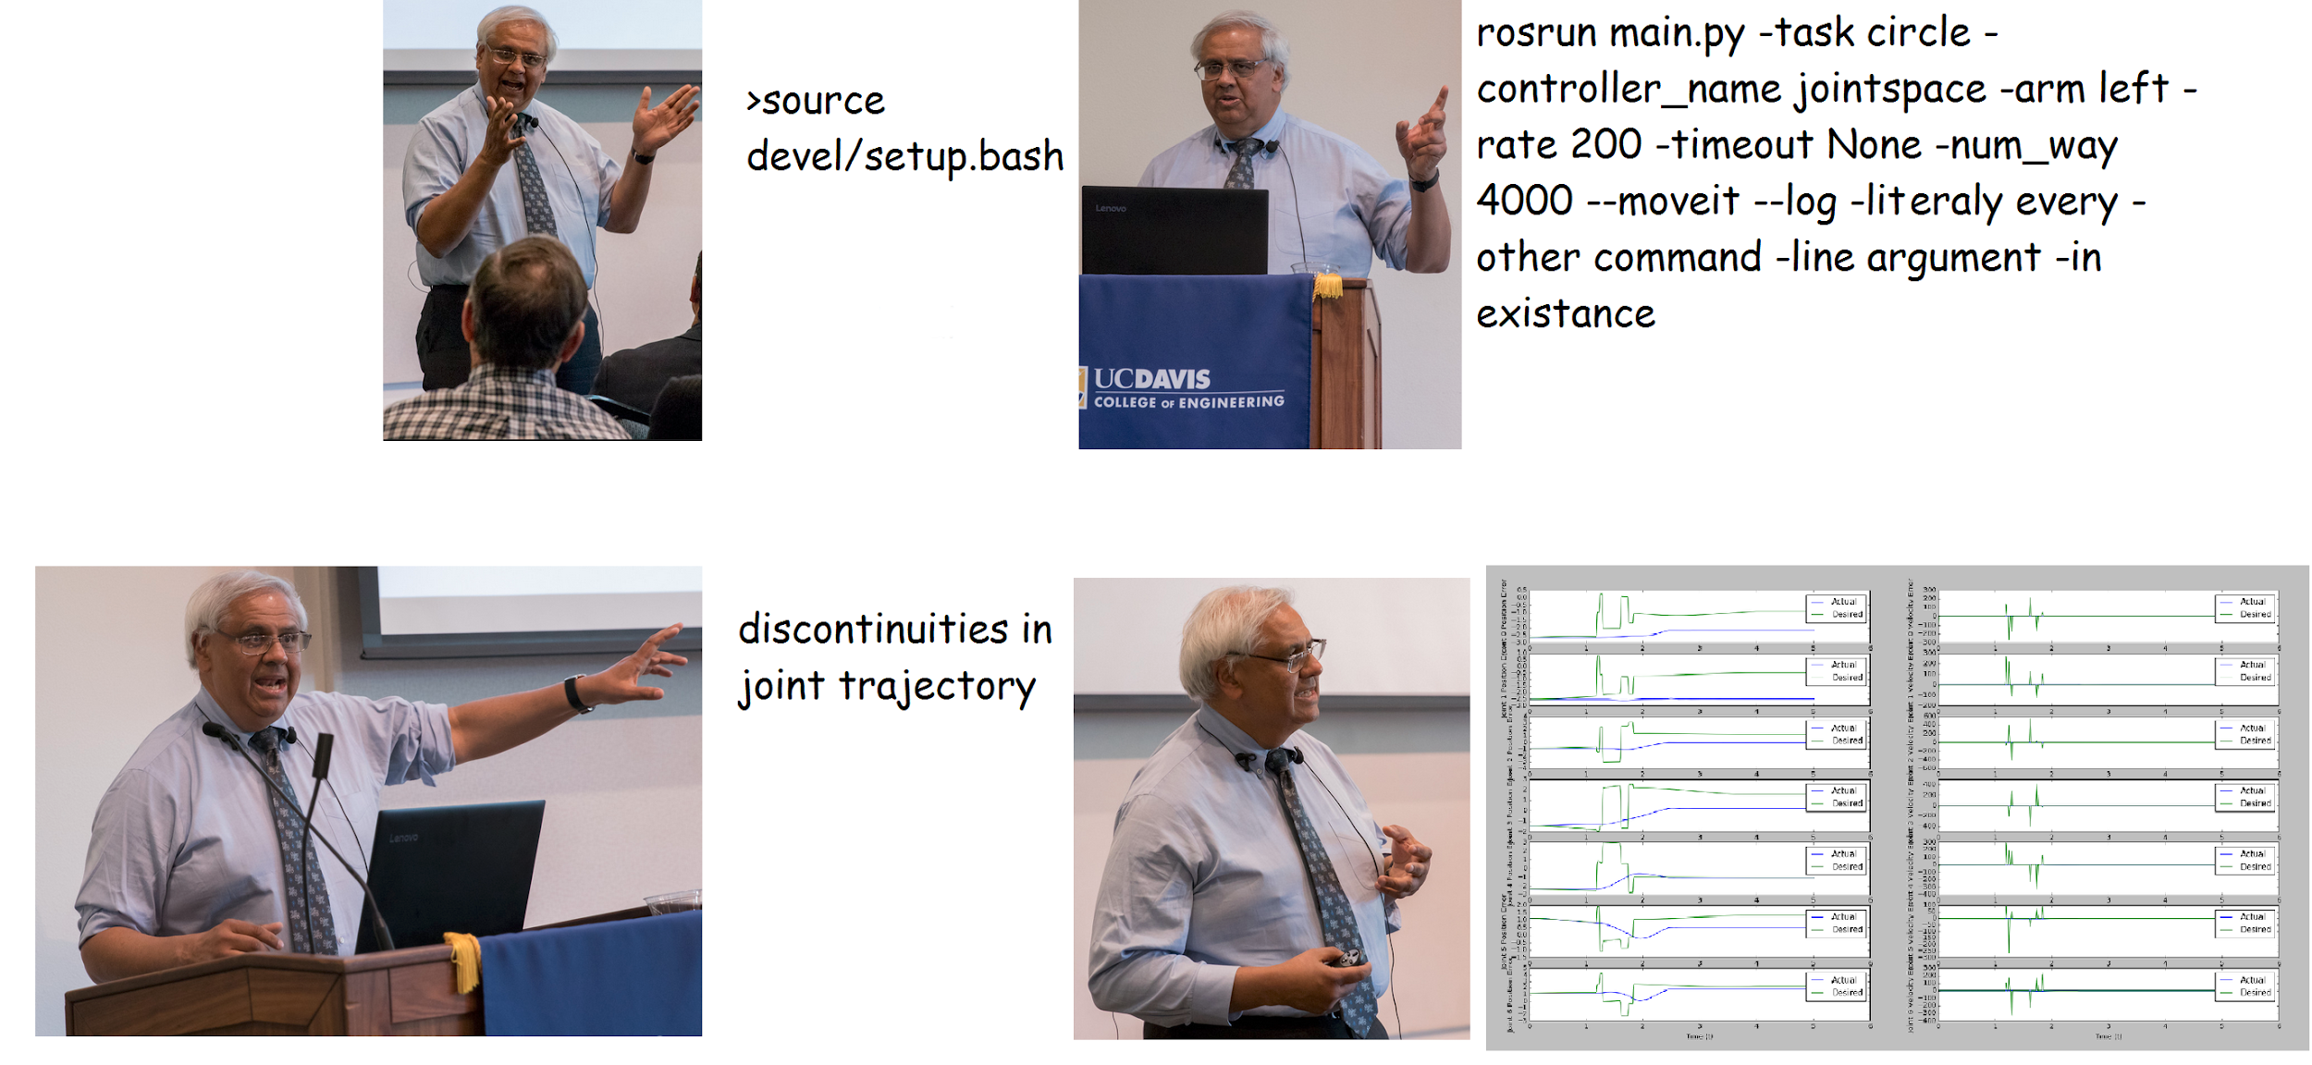
Levity

Slide 12
Project 0

Slide 13
Project 0
Learn how to use lab robots safely - Sawyer, Turtlebots
Work in pairs to complete Project 0, does not have to be a project group member
Make sure you know how to do concept checkpoints!
Notes:
https://drive.google.com/file/d/1z4_BVMHntMqSE-_dU5k1SZVJitZFy0zT/view?usp=sharing

Slide 14
DEMO

Slide 15
Timeline of the Near Future
Sign Up for Papers
HW2
First paper presentation is next week. Skim the first paper before your next lab section
Due 2/7
Complete Robot Usage Quiz!
Project 1B
Due 2/14

Slide 16
Urgent To Dos!
Proj 1B Team Registration
Optional Project 1A Peer Eval
https://docs.google.com/forms/d/e/1FAIpQLSflnxcwP4Bxc73h-jBlbQ1N-hy4L91Gf1KjwAhYKw1qs6_W5g/viewform
Allows us to assign robots for Project 1B
https://forms.gle/zeSaR6VzwuunMmgy9
Robot Reservations!
Link

