Slide 1
HTML/CSS/JS + Paper.js LIVE
Heuristic Evaluation
LECTURE 6.5
Tuesday, July 5
CS 160 · User Interface Design and Development · Summer 2022
Shm Garanganao Almeda & Diyah Mettupalli

Slide 2
Live coding with HTML, CSS, JavaScript, Bootstrap, Paper.js, and Shm!
10 Heuristics of Usability Design + Heuristic Evaluation Overview
Heuristic Evaluation Activity + Sharing

Slide 3
10 HEURISTICS OF USABILITY DESIGN

Slide 4
Ten Heuristics of Usability Design
Visibility of system status
Match between system and the real world
User control and freedom
Consistency and standards
Error prevention
Recognition rather than recall
Flexibility and efficiency of use
Aesthetics and minimalist design
Help users recognize, diagnose, and recover from errors
Help and documentation
10 Usability Heuristics for User Interface Design

Slide 5
10 Usability Heuristics
Visibility of system status
Match between system and the real world
User control and freedom
Consistency and standards
Error prevention
Recognition rather than recall
Flexibility and efficiency of use
Aesthetics and minimalist design
Help users recognize, diagnose, and recover from errors
Help and documentation

Slide 6
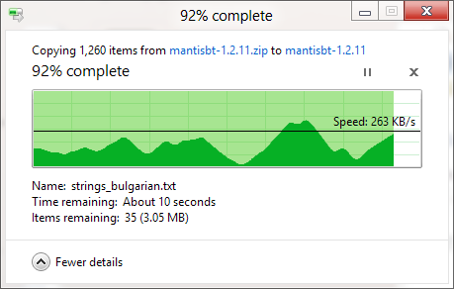
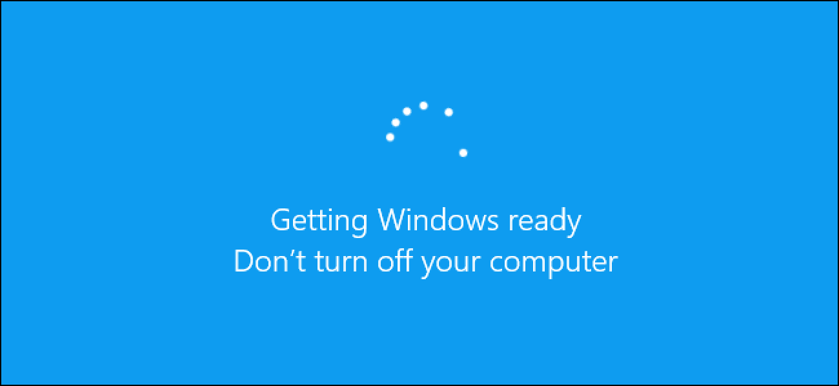
1. Visibility of System Status
We want to know what a computer is doing!
Shows progress, time estimates, etc
Describes status, but vague, and how long is that loading spinner going to go for?

Slide 7



2. Match between system and the real world
The interface should behave reasonably – if the user is unfamiliar with it, it should behave like similar things that the user has seen before.
Icons on our laptops indicate the same purpose that their real world counterparts have
When you move your mouse to the right, the cursor on-screen also moves to the right

Slide 8
3. User control and freedom
Don’t lock the user into something, let them come and go as they please.
Example: Long forms where you can save your progress and return to it later (couldn’t find a screenshot because I’m not in this situation right now…)

Slide 9
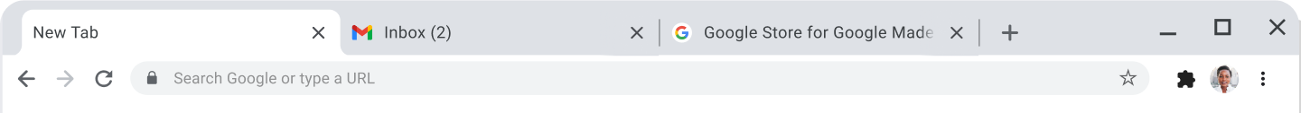
4. Consistency and standards
Use widely-understood, recognizable designs.
Nowadays, web browsers all have a uniform tab design.

Slide 10


5. Error Prevention
Help users avoid mistakes!
Gmail allows you to Undo an email send
Google Docs autosaves to prevent you from losing your work!

Slide 11
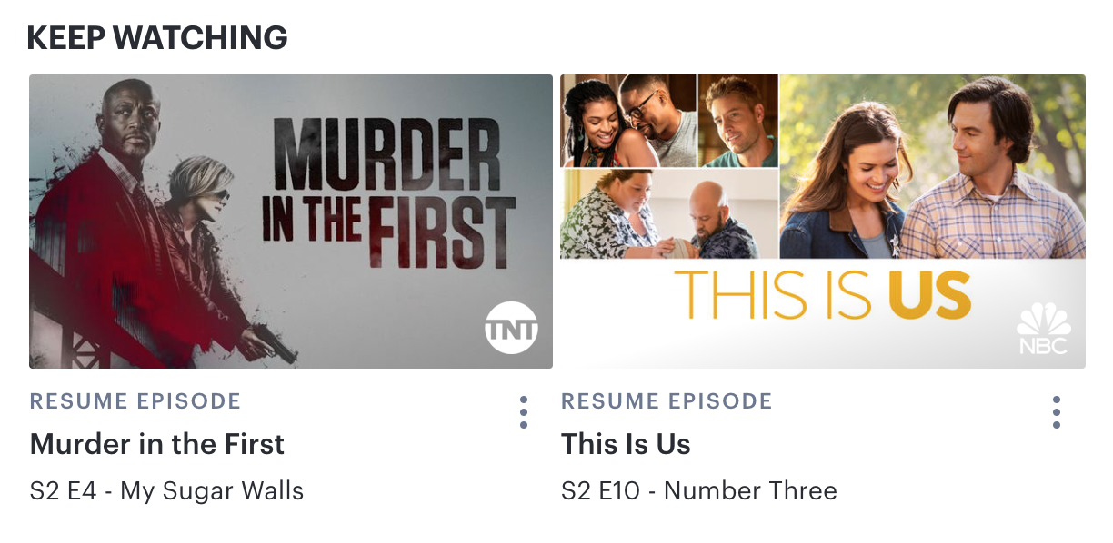
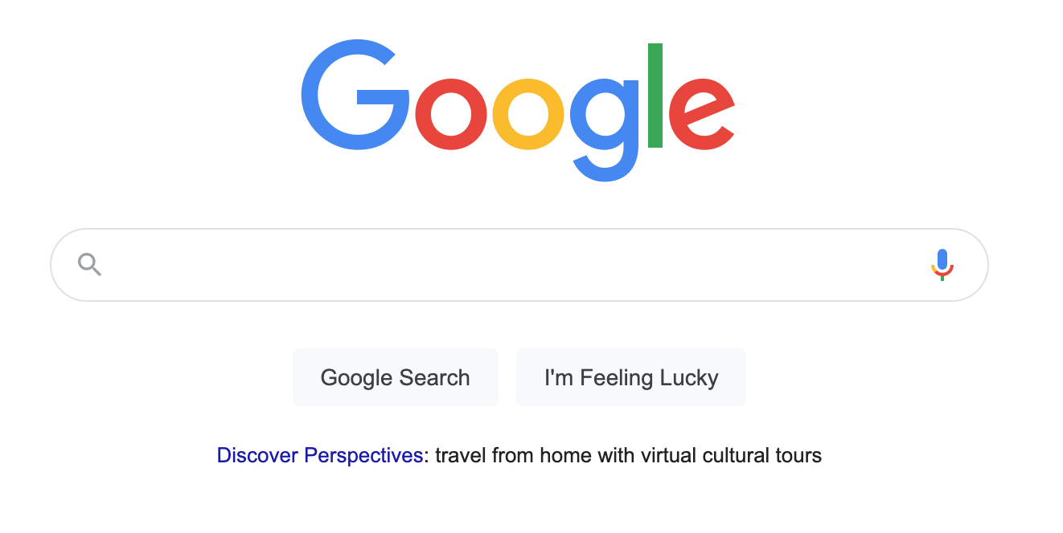
6. Recognition rather than recall
Help the user by providing relevant information, so they don’t have to think as much
“Recently Viewed”-type sections help recall what you browsed the last time you were on this app
Sometimes just a search bar where you can type literally anything can be pretty daunting!

Slide 12
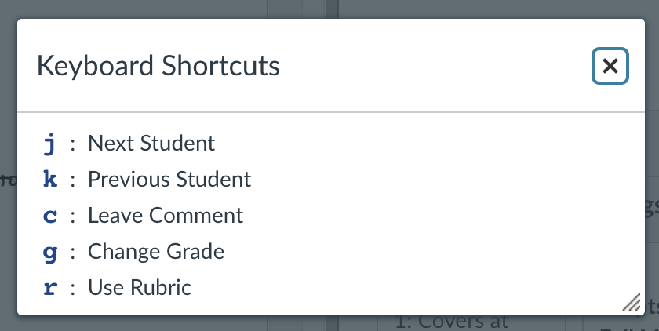
7. Flexibility and efficiency of use
Provide different options or ways of using the interface, since not all users will use it in the same way.
Keyboard shortcuts can help users be more efficient

Slide 13
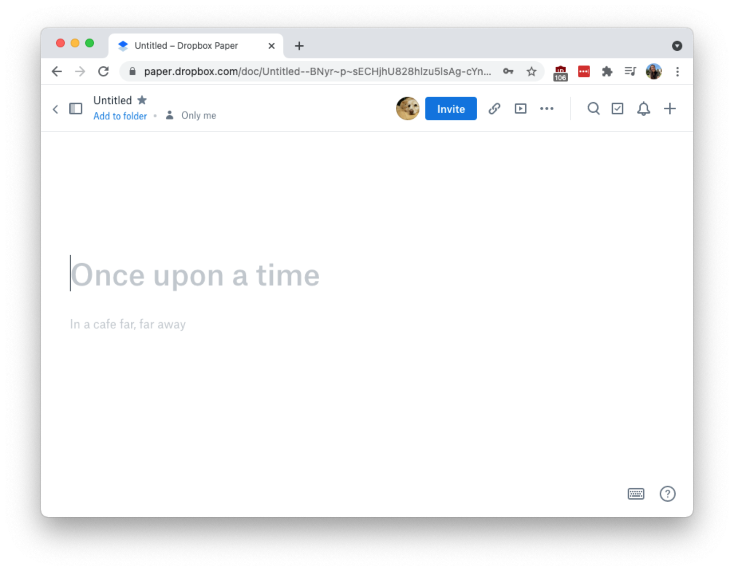
8. Aesthetics and minimalist design
Put only as much information/controls as the user needs at the time, depending on the purpose of your interface.
Dropbox Paper isn’t as powerful as Microsoft Word or Google Docs, but its minimal interface encourages the user to focus on writing.

Slide 14
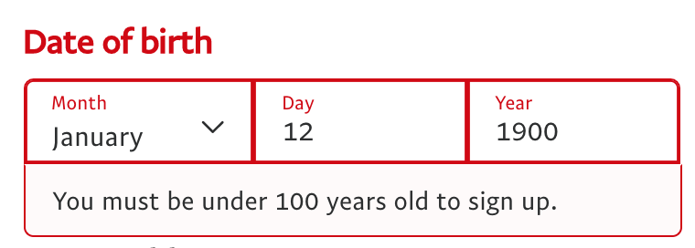
Help users recognize, diagnose, and recover from errors
Show where the error occurs, what is wrong, and how to address the issue.
Provide specific error messages near where the error occurs

Slide 15
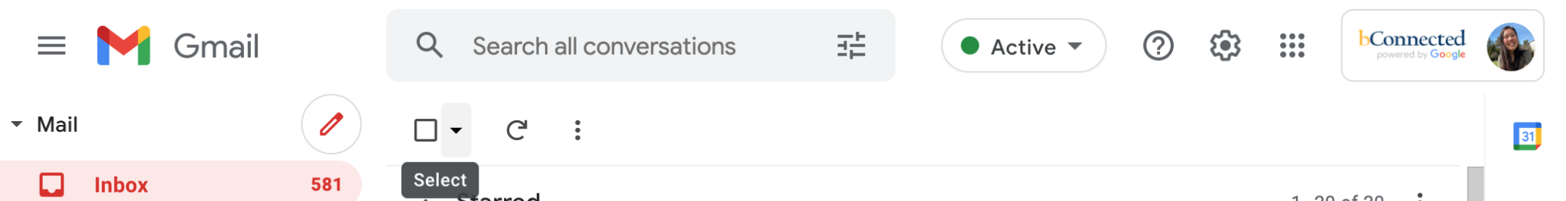
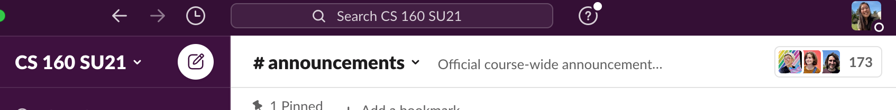
10. Help and documentation
If the user still cannot figure out how to use the interface, they should at least be able to get help easily.
Question mark icons located at the top of Gmail and Slack

Slide 16
Heuristic Evaluation
Heuristic evaluation involves having a small set of evaluators examine the interface and judge its compliance with recognized usability principles (the “heuristics”).

Slide 17
Heuristic Evaluation
Heuristic evaluation involves having a small set of evaluators examine the interface and judge its compliance with recognized usability principles (the “heuristics”).
It is difficult for a single individual to do a heuristic evaluation
One person can’t find all of the usability problems with an interface
Research shows that different people find different usability problems

Slide 18
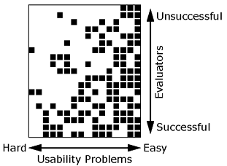
Heuristic Evaluation Study (1992)
19 evaluators were used to find 16 usability problems
Each black square represents one usability problem found by an evaluator
While there is overlap between evaluators, there are also problems that were found by only a few evaluators
The best evaluator for a system isn’t always consistent across projects

Slide 19
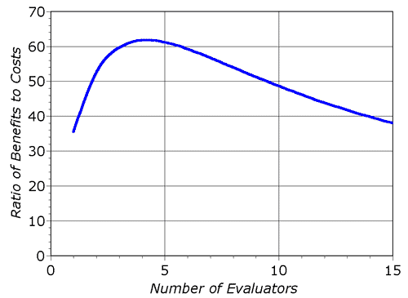
Heuristic Evaluation Study (1992)
19 evaluators were used to find 16 usability problems
Each black square represents one usability problem found by an evaluator
While there is overlap between evaluators, there are also problems that were found by only a few evaluators
The best evaluator for a system isn’t always consistent across projects
Results: Use three to five evaluators since not much is gained by adding additional evaluators

Slide 20
Perform a (Formal) Heuristic Evaluation
Evaluator: Each individual evaluator inspects the interface alone
Ensure independent and unbiased evaluations
Evaluator goes through the interface several times to inspect various dialogue elements and compare them with the usability heuristics
Observer: (Ideally) one observer across all evaluations
Synthesize findings at the end
Can answer questions and provide hints (different from traditional user testing)

Slide 21
Activity: Practicing the heuristics of evaluation
Get to know your breakout group and talk about the week (5 minutes or so)
Select an app or website that everyone in your breakout group regularly uses (the more rare the better…) If you are having trouble with this take a look at our list!
Select two heuristics that this app/website do especially well
Select two heuristics that perhaps are not met soooo strongly. Ideally try to come up with a new feature that would address some of these issues…
Put these down into a (beautiful, informative, amazing) slide and get ready to present back to the class!
https://docs.google.com/presentation/d/1_ErN1U3x09YwjoVWwTC5Xs01FoLaE68voBKwaKaSK8s/edit?usp=sharing

Slide 22
List of things
NYT Cooking: https://cooking.nytimes.com/
Bcourses: https://bcourses.berkeley.edu/
Piazza: https://piazza.com/
Federal Student Aid: https://studentaid.gov/
Jacobs Institute: https://jacobsinstitute.berkeley.edu
Google Slides: https://docs.google.com/presentation/u/0/
Craigslist: https://craigslist.org/
IMDB: https://imdb.com/
Django tutorial: https://tutorialspoint.com/django/index.htm
Stack Overflow: https://stackoverflow.com

Slide 23
Heuristic Evaluation: Severity Rating
Frequency with which the problem occurs: Is it common or rare?
Impact of the problem if it occurs: Will it be easy or difficult for the users to overcome?
Persistence of the problem: Is it a one-time problem that users can overcome once they know about it or will users repeatedly be bothered by the problem?
https://www.nngroup.com/articles/how-to-rate-the-severity-of-usability-problems/

Slide 24
Heuristic Evaluation: Severity Rating
0 = I don't agree that this is a usability problem at all
1 = Cosmetic problem only: need not be fixed unless extra time is available on project
2 = Minor usability problem: fixing this should be given low priority
3 = Major usability problem: important to fix, so should be given high priority
4 = Usability catastrophe: imperative to fix this before product can be released
https://www.nngroup.com/articles/how-to-rate-the-severity-of-usability-problems/

Slide 25
Giving Critique
Imagine that you are the user. Think of yourself going through the interface flow.
Give candid and complete feedback.
  “I think _______ is confusing because _______.”
  “I can’t understand your writing or your sketches.”
Always give constructive feedback.
  “If you add more ________ to ________, that would improve the clarity of your design.”
Mention positive aspects.
  “The parallelism between the two screens was very effective.”
In the early stages, give “big picture” feedback.
  “Have you considered displaying locations on a map, rather than a list?”
Use the compliment sandwich!
  1 “good” thing about the design, a few “constructive” feedbacks, 1 “good” thing about the design

Slide 26
Receiving Critique
Listen, take notes, and ask clarifying questions.
  “You mentioned that parts of the design were confusing, can you elaborate?”
Critique is not a personal attack on your abilities.
  “My design has room to improve and I can learn how to improve it.”
Identify the type of feedback you’re interested in receiving.
  “I would like feedback on how my app navigates between the primary and secondary screen.”

Slide 27
Parting Thoughts
Heuristics can be helpful for guiding principles when evaluating a design
Heuristics are not a checklist

