Slide 1

Quantitative Studies
Lecture 07
Wednesday, July 6
https://tinyurl.com/cs160su22-lecture7
CS 160/260 · User Interface Design and Development · Summer 2022
Diyah Mettupalli and Shm Garanganao Almeda

Slide 2
video on!
(if you can & are comfortable with it!)

Slide 3
Slack #questions
during lecture, post your questions to:

Slide 4
Designing Quantitative Experiments
Self-Report Data
  Likert Scales
Data Analysis
  Exploring Data
  Statistics

Slide 5
Designing Quantitative Experiments

Slide 6
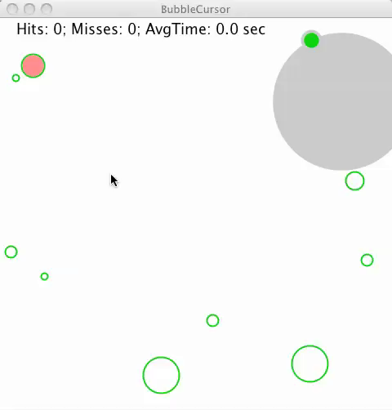
Example: Bubble Cursor
New way to “select” targets
As the mouse tracks closer to the target, the closest target highlights

Slide 7
Example: Bubble Cursor
New way to “select” targets
As the mouse tracks closer to the target, the closest target highlights
Q: Does this help users select targets?

Slide 8
So Far: Qualitative Studies
We’ve talked about Qualitative Studies
Answer questions about “how,” “what,” and “why”
Faster, less expensive
Great for early stages of design
Observations, contextual inquiry, qualitative interviews, ...

Slide 9
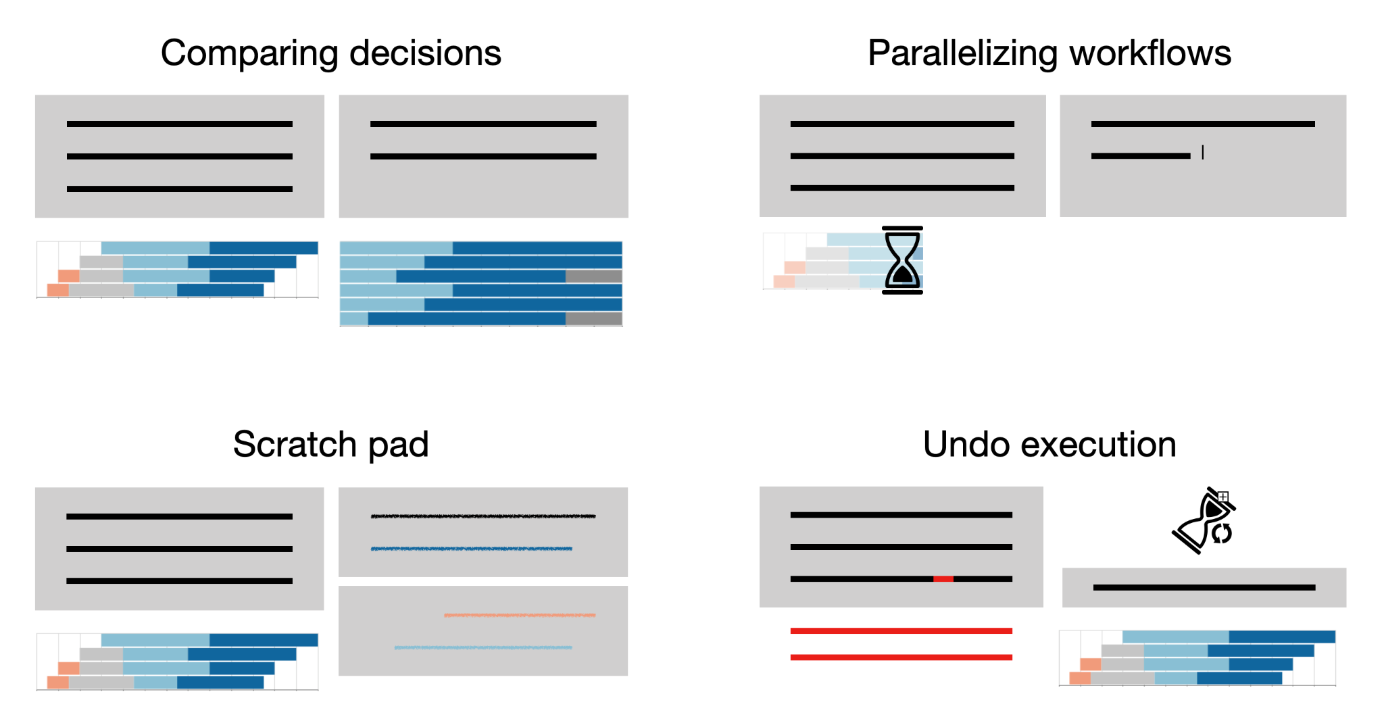
So Far: Qualitative Studies

Slide 10
So Far: Qualitative Studies
We’ve talked about Qualitative Studies
Answer questions about “how,” “what,” and “why”
Faster, less expensive
Great for early stages of design
Observations, contextual inquiry, qualitative interviews, …
Q: Does this help users select targets?

Slide 11
Quantitative Studies
Let’s talk about Quantitative Studies
Collection and analysis of numerical data
Produces reliable, repeatable, generalizable results
Great for proving things about designed artifacts
Controlled experiments, quantitative log analysis, Likert questions, ...

Slide 12
Empirical Studies
Understand a system by repeatedly measuring it
Empirical studies let us:
Reliably measure some aspect of an interface
Compare 2+ designs on a measurable aspect
Contribute to the theory of Human-Computer Interaction

Slide 13
Steps to Designing an Experiment
Craft a clear, testable, important hypothesis
Identify variables (independent, dependent, etc.)
Design the study protocol
Get appropriate ethics review
Run pilot studies (check the data!)
Run the experiment
Perform statistical analysis
Draw conclusions

Slide 14
Steps to Designing an Experiment
Craft a clear, testable, important hypothesis
Identify variables (independent, dependent, etc.)
Design the study protocol
Get appropriate ethics review
Run pilot studies (check the data!)
Run the experiment
Perform statistical analysis
Draw conclusions

Slide 15
Bubble Cursor: Hypothesis
New way to “select” targets
As the mouse tracks closer to the target, the closest target highlights
Q: Does this help users select targets?
Clear, Testable, Important

Slide 16
Steps to Designing an Experiment
Craft a clear, testable, important hypothesis
Identify variables (independent, dependent, etc.)
Design the study protocol
Get appropriate ethics review
Run pilot studies (check the data!)
Run the experiment
Perform statistical analysis
Draw conclusions

Slide 17
Independent and Dependent Variables
Goal: Find a causal relationship
The bubble cursor, compared to traditional cursors, allows users to select
their targets faster.

Slide 18
Independent and Dependent Variables
Goal: Find a causal relationship
The bubble cursor, compared to traditional cursors, allows users to select
their targets faster.
Independent (factors)
The attribute we manipulate to cause a change in dependent variable(s)
Values are called “levels”
Dependent (response)
The outcome(s) of the experiment that we measure

Slide 19
Common Dependent Variables in HCI
Performance
Task success (binary or multi-level)
Task completion time
Errors per task
Cognitive efficiency
Physical efficiency
Learning curve
Satisfaction (self-report)
Ease of use
Frustration

Slide 20
Steps to Designing an Experiment
Craft a clear, testable, important hypothesis
Identify variables (independent, dependent, etc.)
Design the study protocol
Get appropriate ethics review
Run pilot studies (check the data!)
Run the experiment
Perform statistical analysis
Draw conclusions

Slide 21
Making the Study Protocol
Participants: Who can you recruit that represents your target population?
Tasks: What tasks are feasible and reflect your hypotheses?
Conditions: What are all the conditions?
Trials: How often to repeat each condition?
Varying treatment: Which participants see which conditions?
Bias mitigation: How can the results be as defensible as possible?

Slide 22
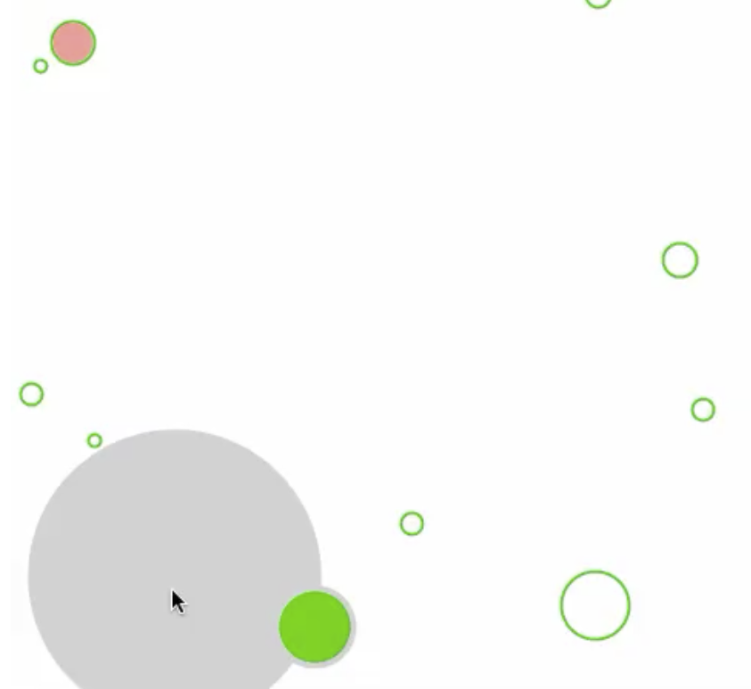
What can go wrong with experiments?
Goal: We are testing the bubble cursor to understand if it helps laptop owners open files on their desktop faster.
Experiment design:
We recruit students that received an A- or higher in CS160.
All participants use both cursors: men start with the bubble cursor, other students
start with the traditional cursor.
Participants select different sized bubbles, as in the image.
Each participant goes through every combination of
target size (sm, med, lg) and density (sm, med, lg)

Slide 23
What can go wrong with experiments?
Goal: We are testing the bubble cursor to understand if it helps laptop owners open files on their desktop faster.
Experiment design:
We recruit students that received an A- or higher in CS160.
All participants use both cursors: men start with the bubble cursor, other students
start with the traditional cursor.
Participants select different sized bubbles, as in the image.
Each participant goes through every combination of
target size (sm, med, lg) and density (sm, med, lg)
Breakout Rooms: How many issues can you find?

Slide 24
Choosing Participants
Pick a balanced sample to represent the intended user population:
Novices vs. experts
Age group
Socioeconomic background
Gender
Race
...

Slide 25
Confounds
Unmeasured attributes that very with the independent variable
Makes it difficult to draw conclusions

Slide 26
Confounds
Unmeasured attributes that vary with the independent variable
Makes it difficult to draw conclusions
Independent: Cursor Dependent: Speed

Slide 27
Confounds
Unmeasured attributes that very with the independent variable
Makes it difficult to draw conclusions
Confound: Gender
Independent: Cursor Dependent: Speed
Treatment Selection
Affinity for tinkering with new tech

Slide 28
Control and Random Variables
Control Variables: Attributes that are fixed throughout the experiment
Types of users recruited
Tasks selected for users
Specific devices used
...
Random Variables: Attributes that are randomly sampled
Variance within recruited users
Ordering of interfaces or tasks
Pre or post meal
...

Slide 29
Validity
Internal validity: How confident are we that the manipulation of the independent variable is the cause of our measured change in dependent variable?
Eliminate confounding variables
Randomization is your friend
External validity: How confident are we will see similar causations in other settings?
Carefully select control variables

Slide 30
Validity
Let’s assume a big difference in behavior in age. Younger people do better with the bubble mouse, older people do better with the traditional mouse.
Age as independent variable: We now have many more treatments to consider, hurting internal validity because of a lower sample size.
Age as control variable: We only observed the impact on a particular age range, hurting external validity because we don’t know anything about other age ranges.
Age as random variable: We now see no difference between the groups, because the competing preferences cancelled each other out, hurting internal validity.

Slide 31
Number of Conditions
Factorial design: To isolate the effects of each independent variable, consider all combinations of levels of all independent variables.
(2 cursor types) * (3 target sizes) * (3 densities) = 18 conditions
New levels or factors can yield many more combinations, requiring more participants for statistical analysis.

Slide 32

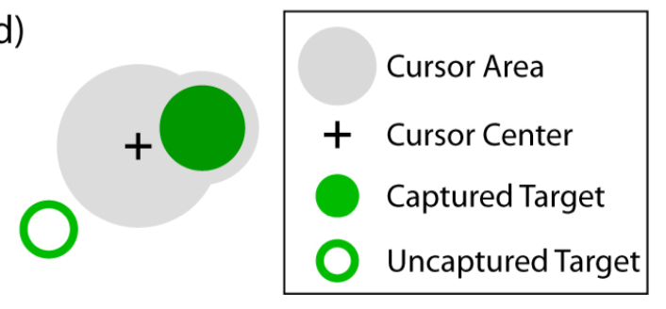
Between-Subject

Slide 33
Within-Subject

Slide 34
Within-Subject

Slide 35
Between- vs. Within-
Between Subjects
+ Collect more data for a condition in the same amount of time
- May need more participants
Within Subjects
+ Isolate effects of individual difference (e.g., 1 exceptional participant)
+ Can ask participants to compare, state preference
- Fatigue effects
- Biases due to ordering

Slide 36
Better Experiment
Goal: We are testing the bubble cursor to understand if it helps laptop owners open files on their desktop faster.
Experiment design:
We recruit students that received an A- or higher in CS160.
All participants use both cursors: men start with the bubble cursor, other students
start with the traditional cursor.
Participants select different sized bubbles, as in the image.
Each participant goes through every combination of
target size (sm, med, lg) and density (sm, med, lg)

Slide 37
Better Experiment
Goal: We are testing the bubble cursor to understand if it helps laptop owners open files on their desktop faster.
Experiment design:
We recruit students that received an A- or higher in CS160.
All participants use both cursors: men start with the bubble cursor, other students
start with the traditional cursor.
Participants select different sized bubbles, as in the image.
Each participant goes through every combination of
target size (sm, med, lg) and density (sm, med, lg)
A representative set of users (e.g., through reddit)

Slide 38
Better Experiment
Goal: We are testing the bubble cursor to understand if it helps laptop owners open files on their desktop faster.
Experiment design:
We recruit students that received an A- or higher in CS160.
All participants use both cursors: men start with the bubble cursor, other students
start with the traditional cursor.
Participants select different sized bubbles, as in the image.
Each participant goes through every combination of
target size (sm, med, lg) and density (sm, med, lg)
A representative set of users (e.g., through reddit)
Group A
Group B

Slide 39
Better Experiment
Goal: We are testing the bubble cursor to understand if it helps laptop owners open files on their desktop faster.
Experiment design:
We recruit students that received an A- or higher in CS160.
All participants use both cursors: men start with the bubble cursor, other students
start with the traditional cursor.
Participants select different sized bubbles, as in the image.
Each participant goes through every combination of
target size (sm, med, lg) and density (sm, med, lg)
A representative set of users (e.g., through reddit)
Group A
Group B
Uniform, gridded

Slide 40
Better Experiment
Goal: We are testing the bubble cursor to understand if it helps laptop owners open files on their desktop faster.
Experiment design:
We recruit students that received an A- or higher in CS160.
All participants use both cursors: men start with the bubble cursor, other students
start with the traditional cursor.
Participants select different sized bubbles, as in the image.
Each participant goes through every combination of
A representative set of users (e.g., through reddit)
Group A
Group B
Uniform, gridded
Three tasks with each cursor

Slide 41
Study Protocol Checklist
With my population, do my results matter?
Am I randomizing everything I can?
Will I have enough participants to see a difference for my conditions?
Am I testing anything besides my independent variable?
Is my dependent variable stable enough to find differences?

Slide 42
Steps to Designing an Experiment
Craft a clear, testable, important hypothesis
Identify variables (independent, dependent, etc.)
Design the study protocol
Get appropriate ethics review
Run pilot studies (check the data!)
Run the experiment
Perform statistical analysis
Draw conclusions

Slide 43
Attendance
https://tinyurl.com/2yfxmebx

Slide 44
Self-Report Data

Slide 45
Common Dependent Variables in HCI
Performance
Task success (binary or multi-level)
Task completion time
Errors per task
Cognitive efficiency
Physical efficiency
Learning curve
Satisfaction (self-report)
Ease of use
Frustration

Slide 46
When to Use Self-Report
Self-report data can be a quick and effective way to gauge users’ perceptions and experiences with your design
Sometimes key insights can not be seen from the outside

Slide 47
When to Use Self-Report
Self-report data can be a quick and effective way to gauge users’ perceptions and experiences with your design
Sometimes key insights can not be seen from the outside
Like interviews, it can be misleading if done improperly
user says != user does

Slide 48

Likert Scale Data
Semantically-anchored
Agreement Disagreement
“The terminology in this interface is clear.”
Tullis, Measuring the User Experience

Slide 49
Likert Scale Design Principles
5-point Likert Scale
Strongly disagree
Disagree
Neutral
Agree
Strongly agree
Likert Scale questions ask participants to express the degree to which they agree with a statement.
5-point and 7-point are the most common scales.
We recommend always having an odd number of response options (middle is neutral)

Slide 50
Likert Scale Design Principles
Avoid adverbs and use unmodified adjectives
(do not use the words very, slightly, absolutely, …)
Instead of: “My final coloring creation is absolutely beautiful.”

Slide 51
Likert Scale Design Principles
Avoid adverbs and use unmodified adjectives
(do not use the words very, slightly, absolutely, …)
Instead of: “My final coloring creation is absolutely beautiful.”
“My final coloring creation is beautiful.”

Slide 52
Likert Scale Design Principles
Choose and maintain a neutral valence; avoid logical loops
(be careful with the words not, unless, if,l then, while)
Instead of: “I did not hate my coloring creation”, “My final coloring creation is beautiful”, “I love my final coloring creation”, ...

Slide 53
Likert Scale Design Principles
Choose and maintain a neutral valence; avoid logical loops
(be careful with the words not, unless, if,l then, while)
Instead of: “I did not hate my coloring creation”, “My final coloring creation is beautiful”, “I love my final coloring creation”, ...
“I am satisfied with my final coloring creation”

Slide 54
Likert Scale Questions
Breakout room!
Find 1-2 things wrong with each of the following Likert questions:
“I am satisfied with my final coloring creation”
1 (I hate my final coloring creation) - 10 (I love my final coloring creation)
“I found the coloring tool impossible to use”
1 (strongly disagree) - 5 (strongly agree)

Slide 55
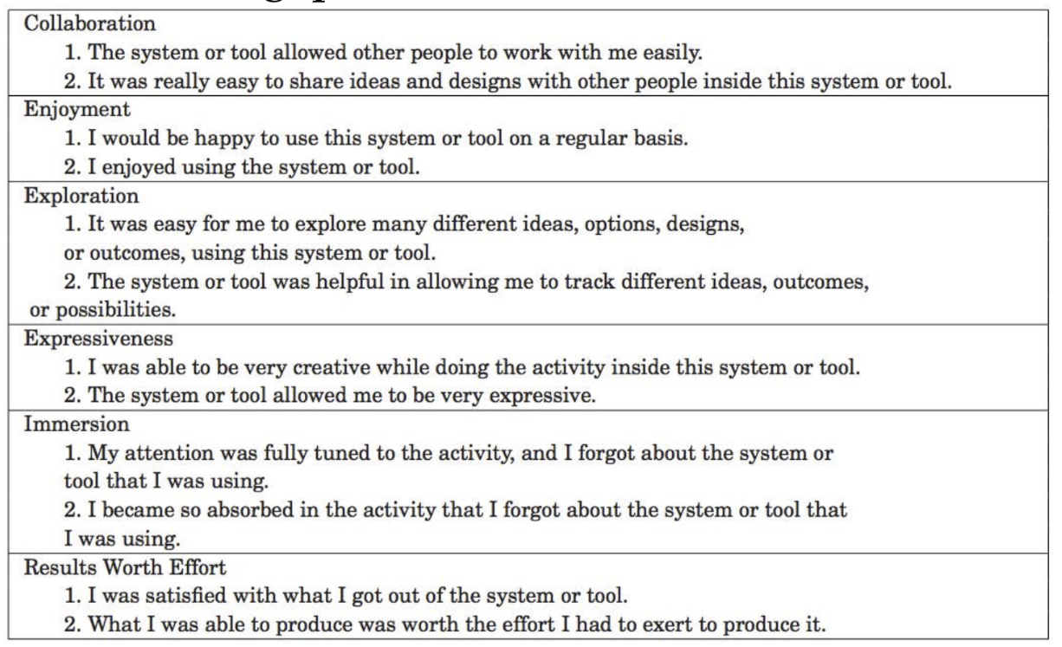
Likert Scale Questions
When in doubt, leverage prior work and research studies
Erin Cherry and Celine Latulipe, Creativity Support Index

Slide 56
Collecting Self-Report Data
Online or on paper
If online, consider using Google Forms or Qualtrics
Try not to ask in person: Social desirability bias says participants are more likely to give the answers they believe the facilitator wants to not disappoint them

Slide 57
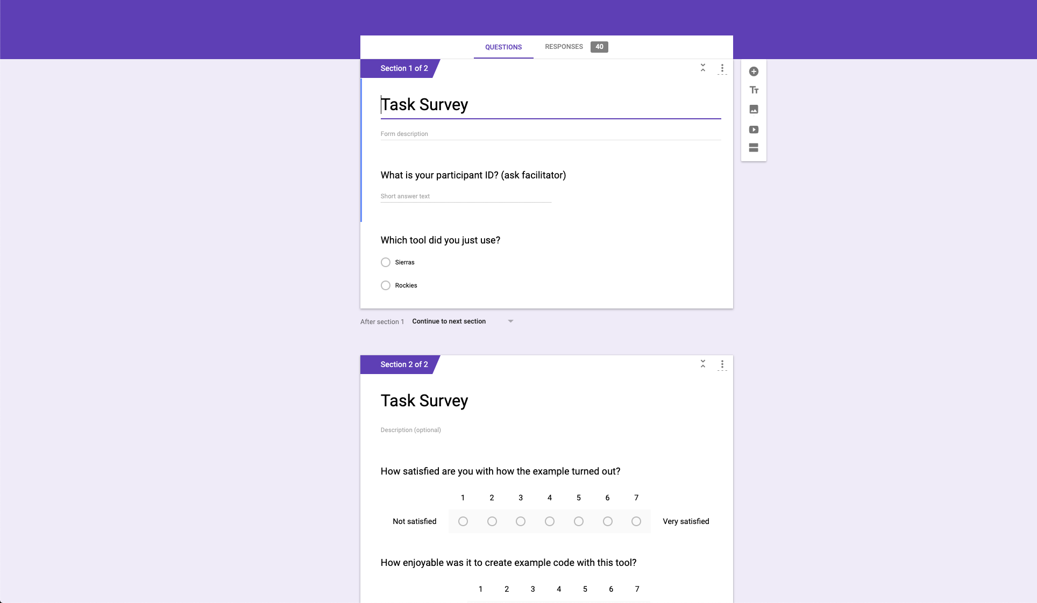
Google forms are great

Slide 58
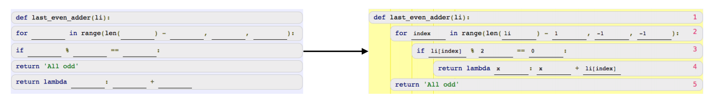
Aside: Qualitative Data
If you have time, also ask “why?” for critical questions
Which do you prefer?

Slide 59
Data Analysis

Slide 60
Bubble Cursor
New way to “select” targets
As the mouse tracks closer to the target, the closest target highlights
Q: Does this help users select targets?
H1: Bubble cursor allows faster selection
H2: Bubble cursor results in fewer errors

Slide 61
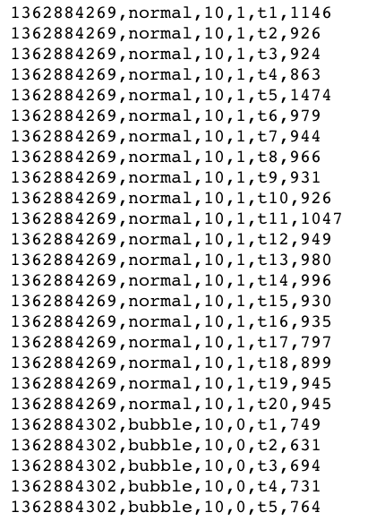
Data

Slide 62
Average Statistics
5680 trials
Regular Cursor (baseline) Bubble Cursor
Mean time: 976.1ms Mean time: 809.4ms
Mean errors: 2.56 Mean errors: 0.29

Slide 63
Exploratory Data Analysis
Let’s dig deeper into the descriptive statistics.
EDA: Look at your data from different perspectives to get a better understanding for what it means
Inspect raw data
Use different visualizations: histograms, scatterplots, box plots, etc.

Slide 64
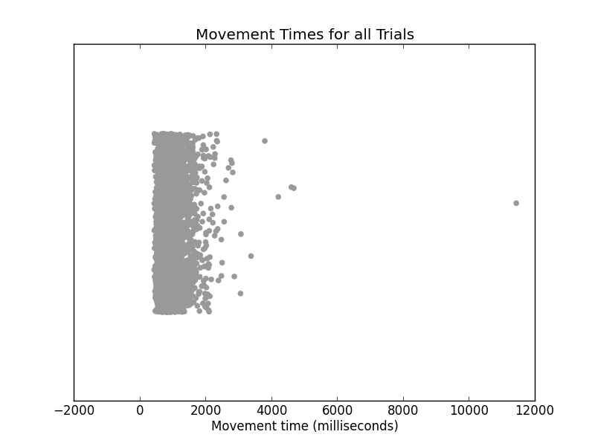
Scatter plot with jitter, all trials

Slide 65
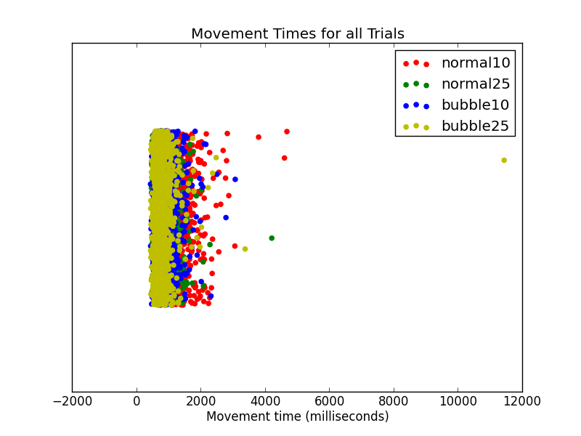
Scatter plot, colored by condition

Slide 66
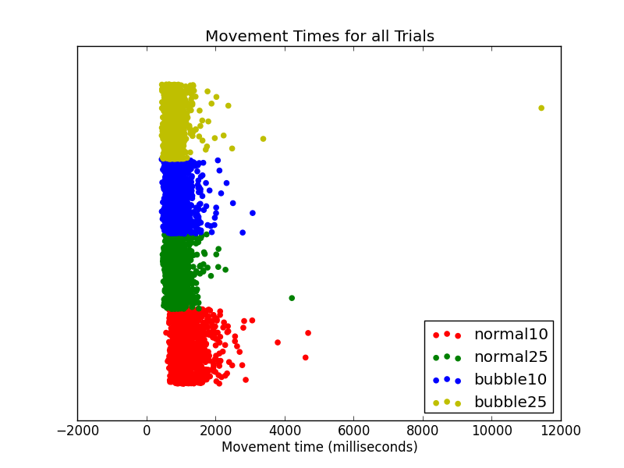

Scatter plot, split by condition

Slide 67
Cleaning Data
Don’t discard data just because it doesn’t fit your expectation!
But...extreme outliers sometimes can be discarded if they reflect users not following a task protocol
Outlier 1: No questions right
Outlier 2: Questions taking a long time

Slide 68
Cleaning Data
Don’t discard data just because it doesn’t fit your expectation!
But...extreme outliers sometimes can be discarded if they reflect users not following a task protocol
Outlier 1: No questions right
Outlier 2: Questions taking a long time

Slide 69
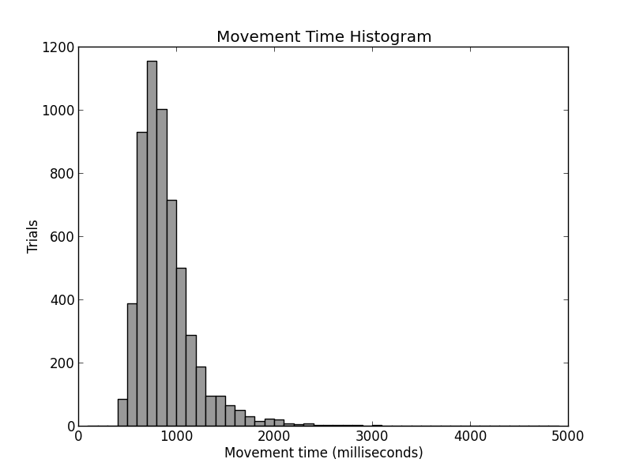
Histogram

Slide 70
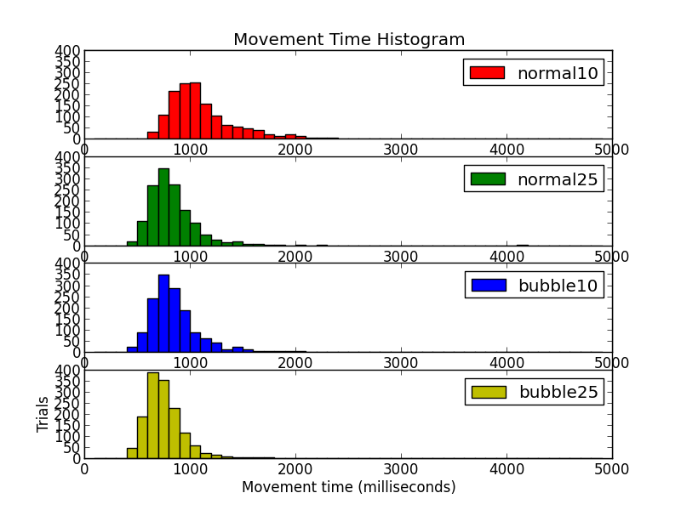
Histograms, split by condition

Slide 71
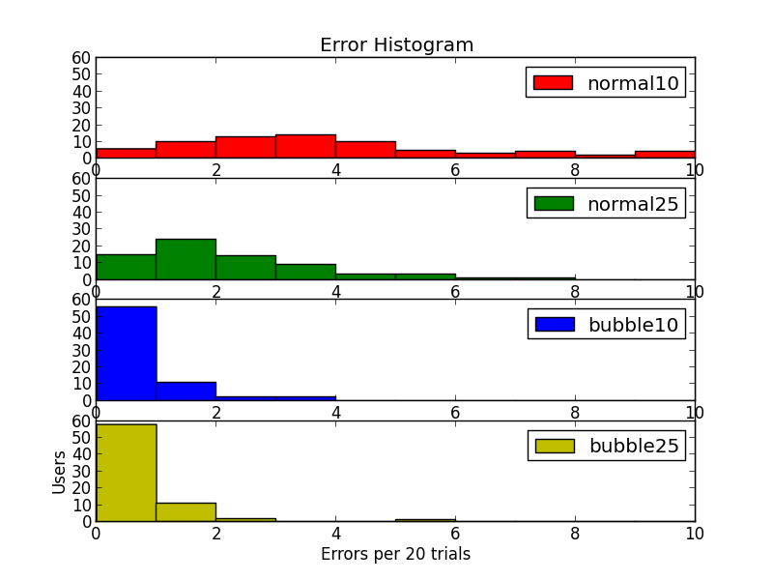
Histograms, split by condition

Slide 72
Some Descriptive Statistics
Central tendency
Mean, Median, Mode
Dispersion
Range, Median
Shape of distribution
Skew, kurtosis
Categorical data (XS, S, M, L, XL)
Frequency distributions

Slide 73
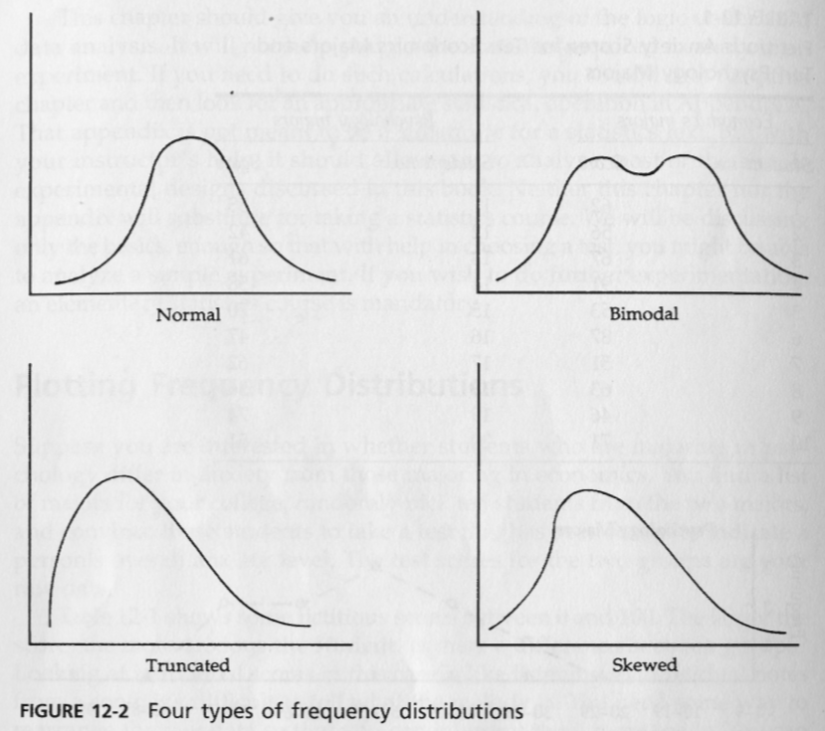
Common distributions
Martin, Doing Psychology Experiments

Slide 74
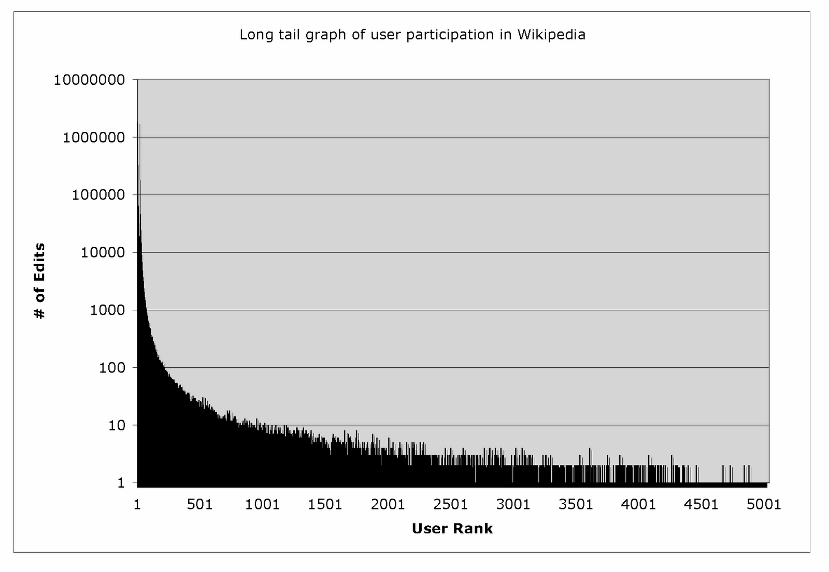
Power Law Distribution
Ed Chi

Slide 75
Center of Data
Mean: Average of all values
Median: Middle value in a sorted list of values
Mode: most common value
Normal distribution: median = mean = mode
With skews or outliers: Median is more robust

Slide 76
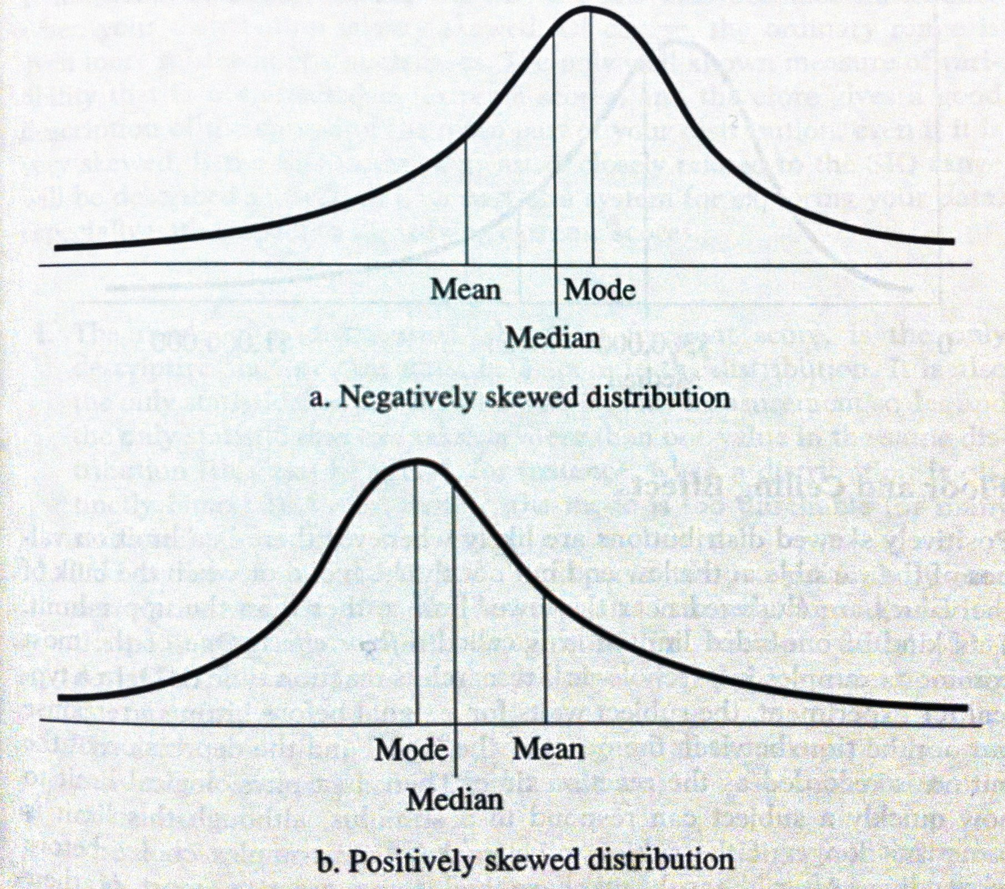
Skewed Diagram

Slide 77
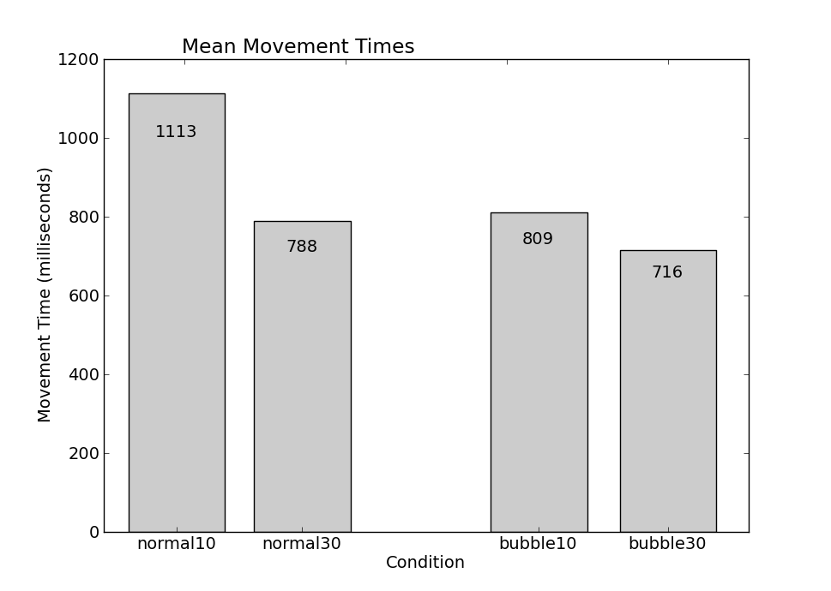
Bar Plots – Back to Speed

Slide 78
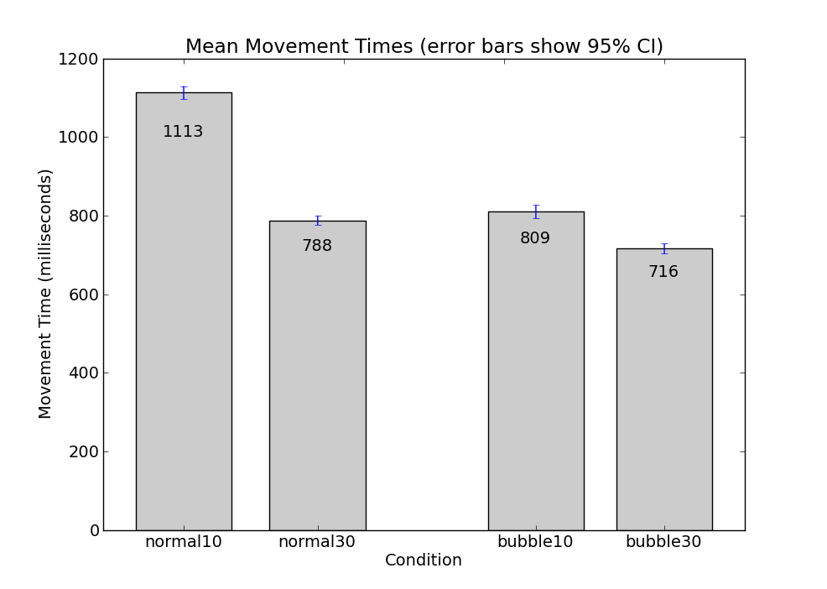
Bar Plots – Confidence Intervals

Slide 79
Confidence intervals
Confidence interval: Indicate how descriptive statistics would vary if the research were repeated. Inferred from mean and dispersion.
+/- figure often reported in newspaper or TV opinion poll results.

Slide 80
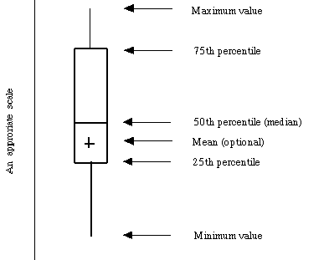
Box Plots: Bar Plot’s Cousin
Box plots visualize center (median, mean), dispersion (range, outliers, percentiles), in a very small space.
They enable easy visual comparison of many descriptive statistics across groups.

Slide 81
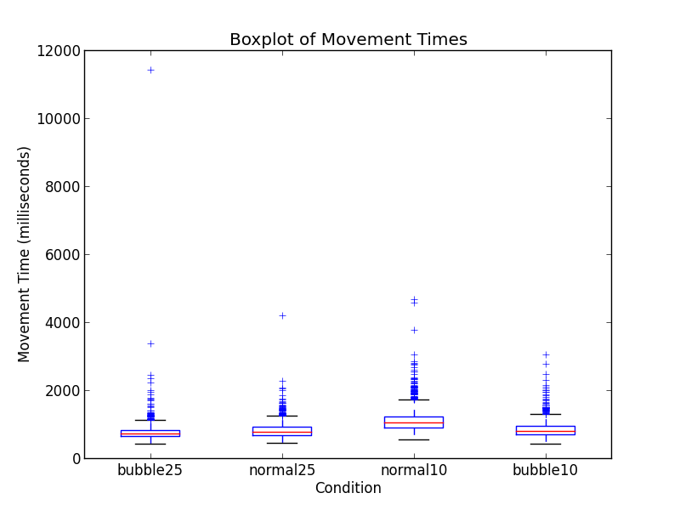
Box Plots: Bar Plot’s Cousin

Slide 82
Are the Results Meaningful?
Use statistical tests to determine how confident you can be that your observations imply your conclusions.
Hypothesis testing: Testing whether an observed change in the dependent variable is sufficiently extreme to rule out the possibility of reasonable chance variation.
Statistical significance (p-value): Likelihood that the results are indeed due to chance. p<.05 is the magic number.

Slide 83
Significance, Significance, and Significance
Significance 1: p<.05. Did we find something that is not easily explained by chance?

Slide 84
Significance, Significance, and Significance
Significance 1: p<.05. Did we find something that is not easily explained by chance?
Significance 2: Proportional or absolute difference. Is the difference we found large enough to actually matter?

Slide 85
Significance, Significance, and Significance
Significance 1: p<.05. Did we find something that is not easily explained by chance?
Significance 2: Proportional or absolute difference. Is the difference we found large enough to actually matter?
Significance 3: Importance of measurements. Did we pick tasks with users that actually matter?

Slide 86
t-test
Compare the means of 2 groups. Determine if the means are different enough that the difference is not due to chance.
Assumptions:
Samples are normally distributed
Population variances are equal
Individual observations in samples are independent

Slide 87
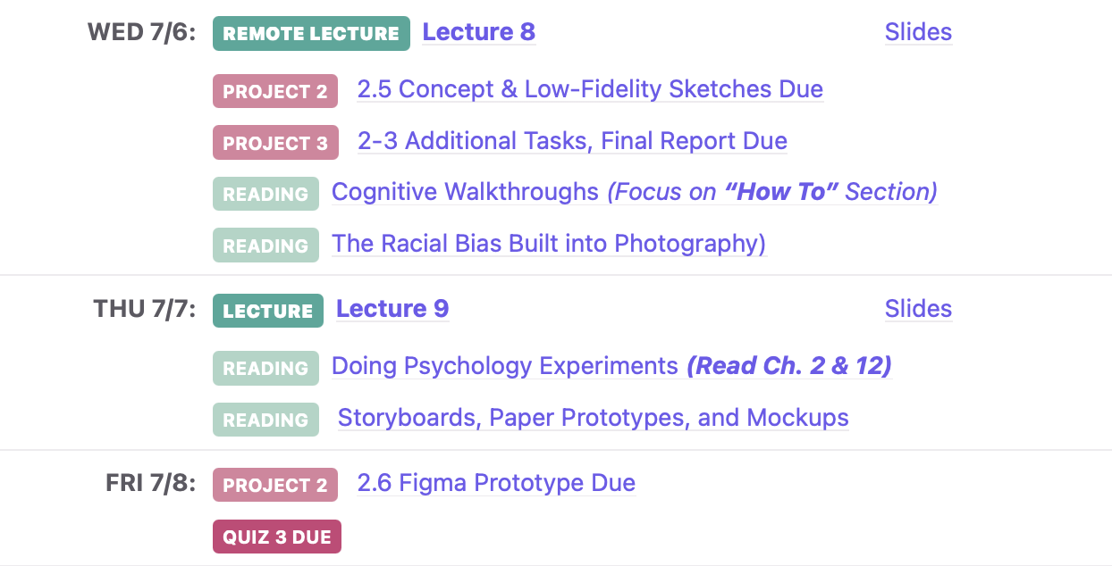
Upcoming Deadlines

