Slide 1

Activity: Practicing the heuristics of evaluation
Get to know your group
Select an app or website that everyone in your group regularly uses (the more rare the better…) If you are having trouble with this take a look at our list!
Select two heuristics that this app/website does especially well
Select two heuristics that perhaps are not met soooo strongly. Ideally try to come up with a new feature that would address some of these issues…
Put these down into a (beautiful, informative, amazing) slide and get ready to potentially present back to the class!
Describe your favorite usability heuristic (or just pick one) for today’s Participation Activity: https://forms.gle/JJ4BbF64f3BsetCa6

Slide 2
List of things
NYT Cooking: https://cooking.nytimes.com/
Bcourses: https://bcourses.berkeley.edu/
Piazza: https://piazza.com/
Federal Student Aid: https://studentaid.gov/
Jacobs Institute: https://jacobsinstitute.berkeley.edu
Google Slides: https://docs.google.com/presentation/u/0/
Craigslist: https://craigslist.org/
IMDB: https://imdb.com/
My Anime List: https://myanimelist.net/
Stack Overflow: https://stackoverflow.com

Slide 3
Ten Heuristics of Usability Design
Visibility of system status
Match between system and the real world
User control and freedom
Consistency and standards
Error prevention
Recognition rather than recall
Flexibility and efficiency of use
Aesthetics and minimalist design
Help users recognize, diagnose, and recover from errors
Help and documentation
10 Usability Heuristics for User Interface Design

Slide 4
Shm’s Example: Slack
Things Slack does well:
Help users recognize, diagnose, and recover from errors
  Can delete messages that were accidentally sent
Help and documentation
  Question mark help button available at the top of the page
Things Slack does less well:
Recognition rather than recall
  The Direct Messages panel can get really crowded and confusing especially when you have multiple group messages. It’s hard to recall which group DM is which !!
Aesthetics and minimalist design
  Again, the panel to the left can get so crowded with channels and direct group messages. I think this information could be portrayed more minimalistically/efficiently

Slide 5
Lecture Party — YouTube
Things YouTube does well:
User control & freedom — users are able to select any video from the entire site made by creators across the world
Consistency & standards — consistent layout
Things YouTube does less well:
Help and documentation — there’s no user guide, people have to learn how to navigate YouTube on their own
Aesthetics & minimal design — a lot of videos are thrown at the user all at once… lacks the minimalist-type layout

Slide 6
Google Maps Heuristics
2 Bad Heuristics:
Not always the most efficient, doesn’t recognize shortcuts
  Maps and data needs to be updated/AI improved
Doesn’t really always route you to the nearest location
  Sometimes favors the location you’ve been to the most
  Should use your current location as a reference
2 Good Heuristics:
Save recent searches
  Users like to refer back to favorite/past locations
Terrain Options
  Not everyone drives/walks/etc.
Jihoo Kang, Utsav Savalia, Prachi Oza
, Abigail Delgado, William Xu, Jihoo Kang

Slide 7

Breakout Room 8 - Netflix
Members:Ian Blair, Kenneth Martinez, Willy Wu
Heuristics:
Consistency and standards - Netflix has had a very consistent user interface and layout for around a decade. They have always given categories and recommendations, as well as a “continue watching” option to the user.
Aesthetics and minimalist design - Netflix doesn't need to do much in terms of design other than make clear what the user can watch.

Slide 8
Breakout Room 10
Members: Grace Jung, Caedi Seim, Janice Liu
App: Gmail
Heuristics app does well:
Visibility of system status: Unread/read emails, title + beginning part of email text, Snoozed, and other email status variations.
Help users recognize, diagnose, and recover from errors: when the recipient email doesn’t exist, you receive a email from Google that the message did not send.
Heuristics app does not do well:
Flexibility and efficiency of use - Mobile app does not allow for easy tagging; have to manually scroll through list of tags versus website typing into a search bar.
Help users recognize, diagnose, and recover from errors - unsend emails?
Aesthetic and minimalist design. The setting part is confusing and not minimize.

Slide 9
Breakout Room 11
Good Heuristics
Consistency and Standards
Aesthetics and minimalist design
Bad Heuristics
Help and documentation
Help users recognize, diagnose, and recover from errors
Participants:
Hridhay Suresh,

Slide 10

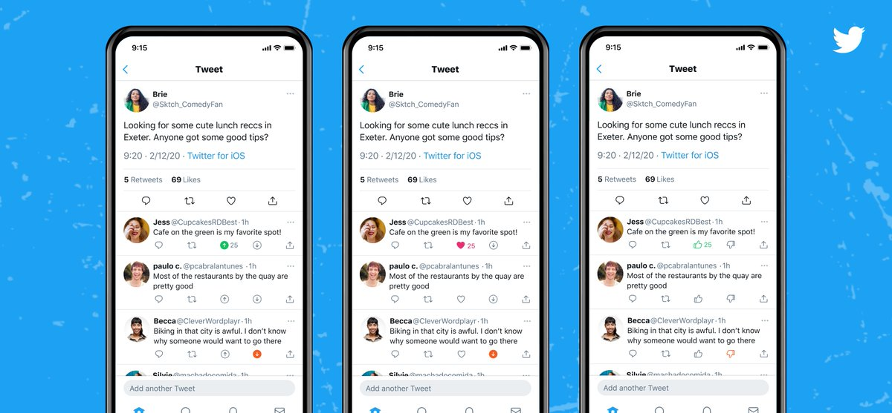
Breakout Room 14 - Twitter
Visibility of system status
  Active/Inactive status
Match between system and the real world
User control and freedom
  Search bar, freedom to express mind
Consistency and standards
  Consistent.
Error prevention
  Not really, but there is flagging and reports enabled
  You can delete tweets you accidentally posted
Recognition rather than recall
  Has a history of previous searches
Flexibility and efficiency of use
Aesthetics and minimalist design
Help users recognize, diagnose, and recover from errors
  Not the most desirable, gives vague generic message when tweet could not be sent, making it hard to troubleshoot whether it’s an internet problem or a twitter specific outage problem.
Help and documentation
Kai Wang, Darren Sun, Harry Wu, Anirudh Rengarajan

Slide 11
Breakout room 9 – Course Website!
+
Aesthetics and minimalist design
Error prevention
–
Match between system and the real world
User control and freedom

Slide 12
Breakout Room 7: Piazza
done well:
error prevention
  necessary parts of a post are clearly signaled, able to post anonymously
flexibility + efficiency of use
  able to use different text editors within the platform, insert LaTex/Markdown/code/screenshots
done not so well:
aesthetics + minimalist design
  cluttered interface :~( it is a little ugly
recognition rather than recall
  difficult to find threads, so users have to remember how they accessed them before

Slide 13
Breakout Room 6
Facebook
Select two heuristics that this app/website does especially well
  User control and freedom
  Consistency and Standards
Select two heuristics that perhaps are not met soooo strongly. Ideally try to come up with a new feature that would address some of these issues…
Error prevention
Help and Documentation

Slide 14
In person group- Piazza
Name: Enqian Zheng, Alex Zhang, Xiaowen Liu, David Long
Website: Piazza
Two heuristics that works well: 1. User control and freedom, Error prevention
Two heuristics that works not really well: Help and document, Aesthetic and minimalist design

Slide 15
Breakout Room 1
Members: Ziyu Song, Eloy Ye, Catherine Wong
App: Google Slides
Heuristic #1 (Does well): Recognition rather than recall: recent presentation on dashboard help people navigate to the most recent slides they are working on.
Heuristic #2 (Does well): Visibility of system status: Users can see who is viewing and editing the slides.
Heuristic #1 (Does not so well): Cannot select slides to download to a .pdf, can only download entire presentation. Must make copy of presentation with selected slides in order to download as .pdf.
Heuristic #2 (Does not so well): not exactly compatible with another populer slide software, Microsoft Power Point - must pre-plan by downloading presentations first.

Slide 16
Breakout Room 2
Member: Rebecca, Ola, Xinyue
Select an app or website that everyone in your group regularly uses (the more rare the better…) If you are having trouble with this take a look at our list!
Piazza
Select two heuristics that this app/website does especially well
Match between system and the real world; recognition rather than recall
Select two heuristics that perhaps are not met soooo strongly. Ideally try to come up with a new feature that would address some of these issues…
Visibility of system status; user control and freedom
Put these down into a (beautiful, informative, amazing) slide and get ready to potentially present back to the class!
Describe your favorite usability heuristic (or just pick one) for today’s Participation Activity: https://forms.gle/JJ4BbF64f3BsetCa6

Slide 17
Breakout room 3
Members: Eunice, Ryan Situ, Mohammad Amin
1. Two good heuristics:
a. visibility of system status
b. Aesthetics and minimalist design
2. Two bad heuristics:
(omg that was fast)
a.

Slide 18
Breakout room 13 - Slack
Members: Minghua, Ziqian, Nathaniel, Lisa
Heuristics they are doing well:
User control & freedom
Consistency and standards
Heuristics they are not doing so well:
Aesthetic and minimalist design
Visibility of system status

Slide 19
Breakout Room

Slide 20
In Person Group
StackOverflow
Members: Lena, Inseon Hwang, Angelica, Seolyeong, Sandra
Good Usability:
The website does a good job for employing consistency and standards for using familiar icons denoting common functionalities such as the menu bar
Recommendation over recall is good (sidebar with related topics/current activity)(#6)
Usability issues:
I had to fill out a captcha to search the website, meanwhile google… (#7)
Is it minimalist? Lots of buttons, suggestions (though less-important information is partitioned well) – might be visually chaotic (#8)

Slide 21
In Person Group (Ruben Pulido)
Instagram
Two Heuristics it uses well: User control & freedom, Flexibility and efficiency of use
Two Heuristics it does not use well: Help and documentation, Consistency and standards

Slide 22
Shaikh and Dingwen - NY Times
Good Heuristics:
User Control and Freedom
Consistency and standards
Bad Heuristics:
Aesthetic and Minimalist Design
Error Prevention

Slide 23
Good Huersitics:
Pretty minimal overall nothing overly fancy:
  The bar to expand was pretty clear
Bad:
I don’t really feel it is

