Slide 1
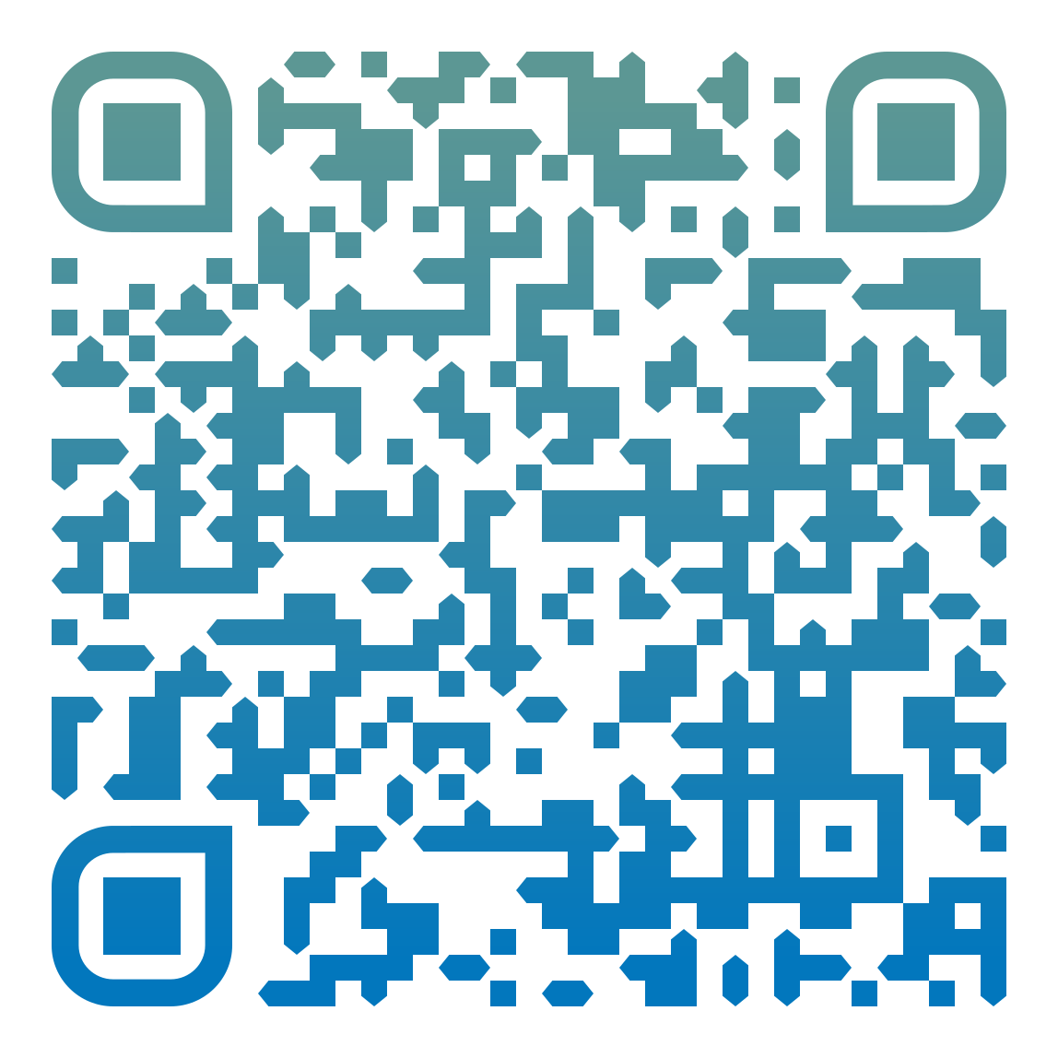
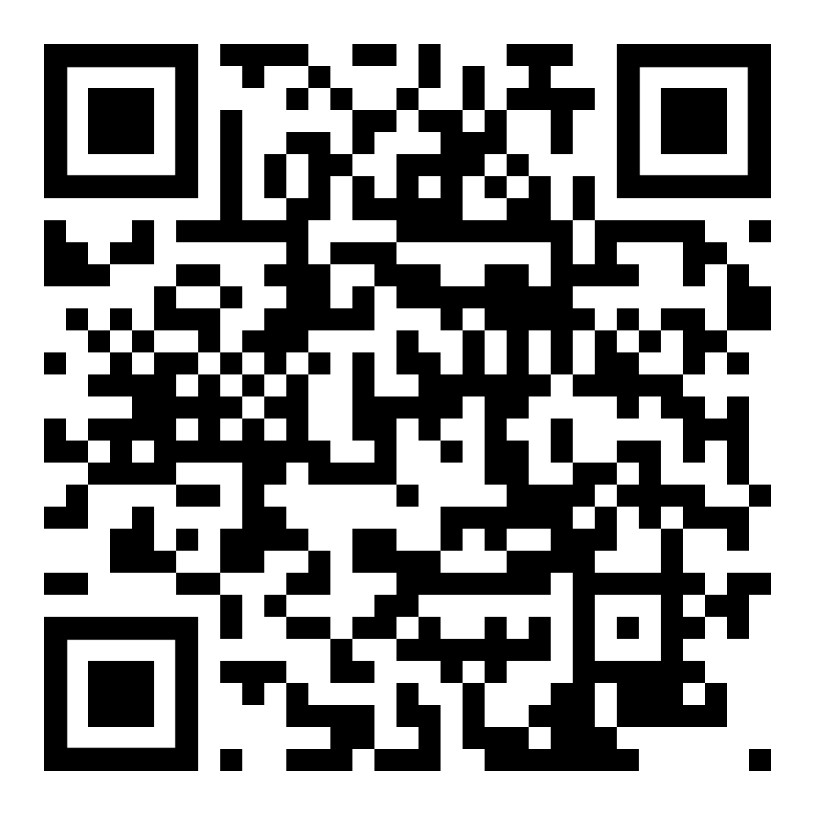
Let’s make a drawing application with paper.js!
NOW PLAYING:
LECTURE 6.5
Add to the Collaborative Spotify Playlist
GET THESE SLIDES
By Shm
FOR CS160: USER INTERFACE DESIGN & DEVELOPMENT
SUMMER 2022
https://tinyurl.com/
cs160su22-lectureslidefolder

Slide 2
Setting Up

Slide 3
Node server set-up from Project 1 (very similar App.js, but even simpler)
<!DOCTYPE html>
<html>
<head>
</head>
<body>
Hello world!
</body>
</html>
(some super simple HTML boilerplate)

Slide 4
2) Let’s get paper-full.js downloaded from here: http://paperjs.org/download/ and put it in a safe place in our directory. (In this case, public/js/ )

Slide 5
3) Link to paper-full.js in the <head> of our HTML document to load in the Paper.js library.
<!-- Load the Paper.js library -->
<script type="text/javascript" src="js/paper-full.js"></script>

Slide 6
4) Let’s make a separate JavaScript file to build our app inside
Here’s some code (a simple circle) for us to put in it for now.
  var shape = new Shape.Circle(new Point(80, 50), 30);
  shape.strokeColor = 'black';

Slide 7
5) Let’s link to that JavaScript - or really, PaperScript - code in our HTML file…
<script type="text/paperscript" src="js/my-drawing-app.js"> </script>

Slide 8
6) We need to put an HTML Canvas object into our document as a container for our Paper code to actually appear inside.
<script type="text/paperscript" src="js/my-drawing-app.js" canvas="my-canvas"> </script>
…
<body>
<canvas id="my-canvas" height="600" width="800"></canvas>
</body>

Slide 9
Set-up done! Let’s test our set-up by running the server (node App.js) and navigating our web browser to localhost:8000/

Slide 10
Mouse Events

Slide 11
Create an onMouseDown event handler that activates some code when the user clicks their mouse.
tool.onMouseDown = function(event) {
var shape = new Shape.Circle(new Point(80, 50), 30);
shape.strokeColor = 'black';
}
http://paperjs.org/reference/tool/#onmousedown

Slide 12
2) Create an onMouseDrag event handler that activates some code when the user drags their mouse.
tool.onMouseDrag = function(event) {
var shape = new Shape.Circle(new Point(50, 80), 30);
shape.strokeColor = 'black';
}
http://paperjs.org/reference/tool/#onmousedown

Slide 13
3) Get mouse coordinate data from event.point
tool.onMouseDrag = function(event) {
var center = event.point;
var shape = new Shape.Circle(new Point(center), 30);
shape.strokeColor = 'black';
}
http://paperjs.org/reference/tool/#onmousedown

Slide 14
Side note: Getting debug data via printed to the console
console.log("Mouse clicked!");
console.log(event.point);
https://www.w3schools.com/jsref/met_console_log.asp

Slide 15
Drawing Application Flair

Slide 16
Change our “brush”
var path;
// Create a new path every time the mouse is clicked
path = new Path();
path.add(event.point);
path.strokeColor = 'black';
…
path.add(event.point);
http://paperjs.org/reference/tool/#onmousedrag

Slide 17
2) Change line quality
path.strokeColor = 'black';
path.strokeWidth = 15;
http://paperjs.org/tutorials/paths/using-color-and-style/

Slide 18
3a) Brush Options - Adding buttons
<button type="button">Default</button>
<button type="button">Activate Thick Greenness</button>

Slide 19
3b) Optional: Make buttons nice
In head:
<!-- add Bootstrap -->
<link rel="stylesheet" href="https://maxcdn.bootstrapcdn.com/bootstrap/3.4.1/css/bootstrap.min.css">
…
In body:
<button type="button" class="btn">Default</button>
<button type="button" class="btn btn-success">Activate Thick Greenness</button>
https://www.w3schools.com/bootstrap/bootstrap_buttons.asp

Slide 20
3c) Make the buttons Actually Do Something: with jQuery
In HTML <head>:
<!-- add jQuery -->
<script src="https://ajax.googleapis.com/ajax/libs/jquery/3.6.0/jquery.min.js"></script>
…
In HTML <body>:
<button type="button" class="btn" id = "mybutton" >Default</button>
In JavaScript:
$('#mybutton').on('click', function (e) {
console.log("test successful!")
})
https://api.jquery.com/click/

Slide 21
3c) Make the buttons Actually Do Something: with variables
At the top:
var currentColor = 'black'
var currentWidth = 5
…
In onMouseDown event:
path.strokeColor = currentColor;
path.strokeWidth = currentWidth;
…
Add button functionality:
$('#default').on('click', function (e) {
currentColor = 'black'
currentWidth = 5
})
https://api.jquery.com/click/

Slide 22
3c) Make the buttons Actually Do Something (cont.)
At the top:
var currentColor = 'black'
var currentWidth = 5
…
In onMouseDown event:
path.strokeColor = currentColor;
path.strokeWidth = currentWidth;
…
Add button functionality:
$('#default').on('click', function (e) {
currentColor = 'black'
currentWidth = 5
})
https://api.jquery.com/click/

Slide 23
4) Accidentally make an “increase stroke size” button
$('#default').on('click', function (e) {
currentColor = 'black'
currentWidth += 5
})
https://api.jquery.com/click/

Slide 24
5) Add an eraser
In HTML:
<button type="button" class="btn" id = "eraser" >Eraser</button>
In JS:
$('#eraser').on('click', function (e) {
currentColor = 'white'
currentWidth = 20
})

Slide 25
6) Add some pizzazz with icons!
Glyphicons (only works with Bootstrap 3, not Bootstrap 4): https://getbootstrap.com/docs/3.3/components/
FontAwesome: https://fontawesome.com/
Google Material Design Icons: https://developers.google.com/fonts/docs/material_icons
<link rel="stylesheet" href="https://fonts.googleapis.com/css2?family=Material+Symbols+Outlined:opsz,wght,FILL,GRAD@20..48,100..700,0..1,-50..200" />
Add a pencil icon:
https://fonts.google.com/icons?icon.query=pencil

Slide 26
Make it your own!

