Slide 1
BGP and Transport Layer (TCP and UDP)
CS 161 Spring 2024 - Lecture 18

Slide 2
Last Time: Low-Level Network Attacks
Classes of attackers:
  Off-path: Can’t see, modify, or drop packets
  On-path: Can see packets, but can’t modify or drop packets
  MITM: Can see, modify, and drop packets
ARP: A protocol to translate local IP addresses to MAC addresses
  Ask everyone on the network, “Who has the IP 1.2.3.4?”
  Attack: The attacker can respond instead of the true device with 1.2.3.4, and packets will get routed to the attacker!
  Defense: Switches
  Defense: Rely on higher layers
DHCP: A protocol for a new client to receive a network configuration
  Ask everyone on the network, “What is the network configuration to use?”
  Attack: The attacker can respond with a malicious configuration
  Defense: Rely on higher layers

Slide 3
Last Time: Low-Level Network Attacks
WPA: A protocol to encrypt Wi-Fi connections at layer 1
  Messages between the client and the AP are encrypted with keys
  Handshake uses MICs (cryptographic MACs) to verify that both parties have the same PSK and nonces
  WPA-PSK: Use a password to derive a PSK, which is used in a handshake to arrive at a key
    Attack: Attacker can pretend to be an AP
    Attack: Brute-force the password after recording a handshake
    Vulnerability: No forward secrecy
  WPA-Enterprise: Use a third party to provide a one-time “replacement PSK,” used in the same handshake
    Solves the attacks on WPA-PSK

Slide 4
Today: Transport Layer Protocols
Transmission Control Protocol (TCP): Reliably sending packets
User Datagram Protocol (UDP): Non-reliably sending packets

Slide 5
Border Gateway Protocol (BGP)
Textbook Chapter 29

Slide 6
Review: Internet Protocol (IP)
Internet Protocol (IP): The universal layer-3 protocol that all devices use to transmit data over the Internet
IP address: An address that identifies a device on the Internet
  IPv4 is 32 bits (e.g. 35.163.72.93)
  IPv6 is 128 bits (e.g. 2607:f140:8801:0000:0000:0000:0001:0023)
    Shorthand: omit sets of zeros: 2607:f140:8801::1:23
  Globally unique from any single perspective
    For now, you can think of them as just being globally unique
  IP addresses help nodes make decisions on where to forward the packet

Slide 7
Subnets
Recall: Layer 3 routes packets across multiple nodes on different LANs
  A packet might make many hops across different local networks before it can reach its destination
IP routes by subnets, which are groups of addresses with a common prefix
  A subnet is written as a prefix followed by the length of the prefix
    Example: 128.32.0.0/16 is an IPv4 subnet with all addresses that begin with the prefix of 128.32.*
    Since an IPv4 is a 32-bit address and there are 16 bits in the prefix, this subnet represents 2³² ⁻ ¹⁶ = 2¹⁶ addresses

Slide 8
Routing Packets
To send a packet to a computer within the local network:
  Verify that the destination IP is in the same subnet
  Use ARP (or contact a switch) to get the destination MAC address
  Send the packet directly to the destination using the destination MAC address
To send a packet to a computer that is not within the local network:
  Send the packet to the gateway
  Past the gateway, the packet goes to the Internet
  It’s the gateway’s job to deliver the packet closer to the destination

Slide 9
Autonomous Systems
Once your system sends the packet to the gateway, the packet has to be routed through the Internet
The Internet is a network of networks, comprised of many autonomous systems (AS)
  Each AS handles its own internal routing
  Each AS is uniquely identified by its autonomous system number (ASN)
  Each AS is comprised of one or more LANs
  The AS can forward packet to other connected ASes
The protocol for communicating between different Autonomous Systems is Border Gateway Protocol (BGP)
  Each router announces what networks it can provide and the path onward from the router
  The most precise route with the shortest path and no loops is the preferred route

Slide 10
BGP
I can reach {AS4->AS6->Recipient}
I can reach {AS5->AS6->Recipient}
I can reach {AS6->Recipient}
AS 5
Recipient
AS 1
AS 3
AS 6
AS 2
I can reach {Recipient}
Sender
AS 4
I can reach {AS4->AS6->Recipient}
I can reach {AS6->Recipient}
Notes:
Note that AS1 has a choice of whether to use AS2, AS3, or AS4. It chooses AS4 since AS4 provides the most direct path. If the AS1-AS4 link drops, AS1 will recalculate and choose either AS1->AS3->AS5->AS6 or AS1->AS2->AS4->AS6. So the decision of which path to choose is a dynamic problem that has to be continuously calculated. You cannot figure out the path before, thats the point of hop by hop.

Slide 11
IP and BGP Attacks
Each AS implicitly trusts the surrounding ASes and accepts advertised routes
IP spoofing: Malicious clients can send IP packets with source IP values set to a spoofed value
  Edge ASes should block packets with source IPs set to the wrong value, but some don’t
  Enables packets that look like they’re coming from someone else!
  We rely on defenses provided by higher layers to further prevent this (“defense in depth”)
BGP hijacking: A malicious autonomous system can lie and claims itself to be responsible for a network which it isn’t
  Example: AS3 broadcasts that it is responsible for 128.32.0.0/16
    Now, the malicious AS can act as a MITM for traffic to 128.32.0.0!
  No real defenses on this level, so we rely on defenses from higher levels

Slide 12
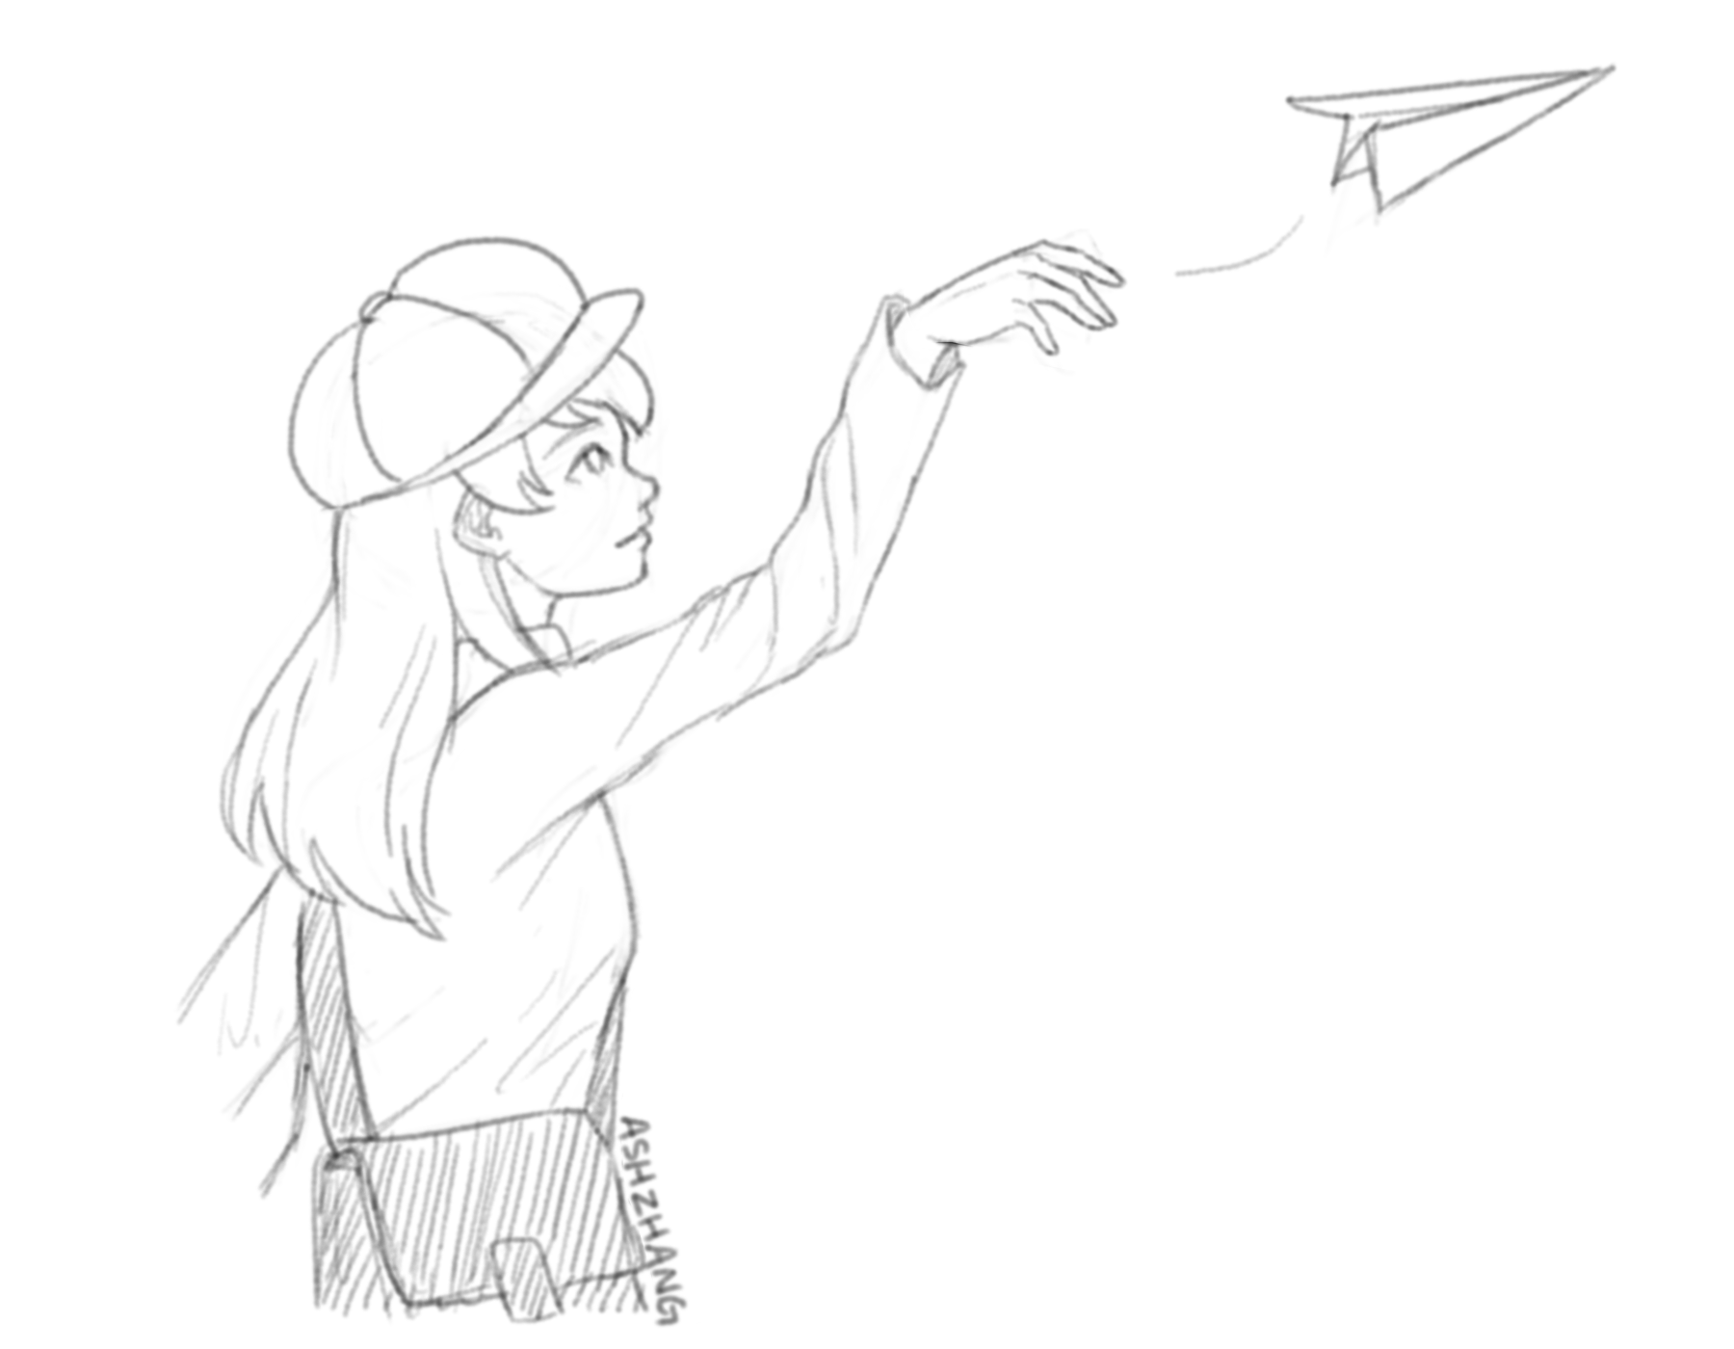
Transmission Control Protocol (TCP)
Textbook Chapter 30

Slide 13
Review: IP Reliability
Reliability ensures that packets are received correctly
  If the packet has been changed (random error or malicious tampering), it should not be correctly received
  IP packets include a checksum (unkeyed function, protects against random errors)
  However, there is no cryptographic MAC, so there are no guarantees if an attacker maliciously modifies packets (and modifies the checksum accordingly)
IP is unreliable and only provides a best effort delivery service, which means:
  Packets may be lost (“dropped”)
  Packets may be corrupted
  Packets may be delivered out of order
It is up to higher level protocols to ensure that the connection is reliable

Slide 14
Scratchpad: Let’s Design It Together
Problem: IP packets have a limited size. To send longer messages, we have to manually break messages into packets
  When sending packets: TCP will automatically split up messages
  When receiving packets: TCP will automatically reassemble the packets
  Now the user doesn’t need to manually split up messages!
Problem: Packets can arrive out of order
  When sending packets: TCP labels each byte of the message with increasing numbers
  When receiving packets: TCP can use the numbers to rearrange bytes in the correct order
Problem: Packets can be dropped
  When receiving packets: TCP sends an extra message acknowledging that a packet has been received
  When sending packets: If the acknowledgement doesn’t arrive, re-send the packet

Slide 15
Transmission Control Protocol (TCP)
Provides a byte stream abstraction
  Bytes go in one end of the stream at the source and come out at the other end at the destination
  TCP automatically breaks streams into segments, which are sent as layer 3 packets
Provides ordering
  Segments contain sequence numbers, so the destination can reassemble the stream in order
Provides reliability
  The destination sends acknowledgements (ACKs) for each sequence number received
  If the source doesn’t receive the ACK, the source sends the packet again
Provides ports
  Multiple services can share the same IP address by using different ports

Slide 16
Ports: An Analogy
Alice is pen pals with Bob. Alice’s roommate, Carol, is also pen pals with Bob
Bob’s replies are addressed to the same global (IP) address
  How can we tell which letters are for Alice and which are for Carol?
Solution: Add a room number (port number) inside the letter
  In private homes, usually a port number is meaningless
  But, in public offices (servers), like Cory Hall, the port numbers are constant and known

Slide 17
Ports
Ports help us distinguish between different applications on the same computer or server
  On private computers, port numbers can be random
  On public servers, port numbers should be constant and well-known (so users can access the right port)
Remember: TCP is built on top of IP, so the IP header (and therefore the IP address) is still present
IP Header: send to: 1.2.3.4
TCP Header: send to: port 80
I am hungry.
Notes:
Hammer in the concept that we build messages from high to low so headers of higher layers are put first into the message packets so therefore end up “below” the headers of the lower layers

Slide 18
Establishing Sequence Numbers
Each TCP connection requires two sets of sequence numbers
  One sequence number for messages from the client to the server
  One sequence number for messages from the server to the client
Before starting a TCP connection, the client and server must agree on two initial sequence numbers (ISNs)
  The ISNs are different and random for every connection (for security reasons, as we’ll see soon)
H | e | l | l | o |  | s | e | r | v | e | r
50 | 51 | 52 | 53 | 54 | 55 | 56 | 57 | 58 | 59 | 60 | 61
Messages from the client are numbered starting at 50.
H | e | l | l | o |  | c | l | i | e | n | t
25 | 26 | 27 | 28 | 29 | 30 | 31 | 32 | 33 | 34 | 35 | 36
Messages from the server are numbered starting at 25.

Slide 19
TCP: 3-Way Handshake
Client chooses an initial sequence number x its bytes and sends a SYN (synchronize) packet to the server
Client
Server
SYN. Seq = x
Server chooses an initial sequence number y for its bytes and responds with a SYN-ACK packet
SYN-ACK. Seq = y, Ack = x+1
ACK. Seq = x+1, Ack = y+1
Client then returns with an ACK packet
Once both hosts have synchronized sequence numbers, the connection is “established”
Data

Slide 20
TCP: Sending and Receiving Data
The TCP handlers on each side track which TCP segments have been received for each connection
  A connection is identified by these 5 values (sometimes called a 5-tuple)
    Source IP
    Destination IP
    Source Port
    Destination Port
    Protocol
Data from the bytestream can be presented to the application when all data before has been received and presented
  Recall: TCP presents data to the application as a bytestream, so the order must be preserved from one end to the other, even if packets are received out of order

Slide 21
TCP: Sending and Receiving Data
Byte i of the bytestream is represented by sequence number x + i
  The first byte is byte i = 1, since sequence number x was used for the SYN packet and y for the SYN-ACK packet
A packet’s sequence number is the number of the first byte of its data
  This number is from the sender’s set of sequence numbers
A packet’s ACK number, if the ACK flag is set, is the number of the byte immediately after the last received byte
  This number is from the receiver’s set of sequence numbers
  This would be (sequence number) + (length of data) for the last received packet

Slide 22
TCP: Sending and Receiving Data
Client
Server
ACK. Seq = x+1, Ack = y+1. Data, length A
ACK. Seq = y+1, Ack = x+1+A. Data, length B
ACK. Seq = x+1+A, Ack = y+1+B. Data, length C
ACK. Seq = y+1+B, Ack = x+1+A+C. Data, length D
Notes:
TODO

Slide 23
TCP: Retransmission
If a packet is dropped (lost in transit):
  The recipient will not send an ACK, so the sender will not receive the ACK
  The sender repeatedly tries to send the packet again until it receives the ACK
If a packet is received, but the ACK is dropped:
  The sender tries to send the packet again since it didn’t receive the ACK
  The recipient ignores the duplicate data and sends the ACK again
When packets are dropped in TCP, TCP assumes that there is congestion and sends the data at a slower rate

Slide 24
TCP: Ending/Aborting a Connection
To end a connection, one side sends a packet with the FIN (finish) flag set, which should then be acknowledged
  This means “I will no longer be sending any more packets, but I will continue to receive packets”
  Once the other side is no longer sending packets, it sends a packet with the FIN flag set
To abort a connection, one side sends a packet with the RST (reset) flag set
  This means “I will no longer be sending nor receiving packets on this connection”
  RST packets are not acknowledged since they usually mean that something went wrong

Slide 25
TCP Flags
ACK
  Indicator that the user is acknowledging the receipt of something (in the ack number)
  Pretty much always set except the very first packet
SYN
  Indicator of the beginning of the connection
FIN
  One way to end the connection
  Requires an acknowledgement
  No longer sending packets, but will continue to receive
RST
  One way to end a connection
  Does not require an acknowledgement
  No longer sending or receiving packets

Slide 26
TCP Packet Structure
Source Port (16 bits) |  |  |  | Destination Port (16 bits)
Sequence Number (32 bits)
Acknowledgement Number (32 bits)
Data Offset (4 bits) | Flags (12 bits) |  |  | Window Size (16 bits)
Checksum (16 bits) |  |  |  | Urgent Pointer (16 bits)
Options (variable length)
Data (variable length)
TCP segment header
Notes:
Notice: Ports, sequence number, ACK number, flags, checksum, and data

Slide 27
TCP Attacks
TCP hijacking: Tampering with an existing session to modify or inject data into a connection
  Data injection: Spoofing packets to inject malicious data into a connection
    Need to know: The sender’s sequence number
    Easy for MITM and on-path attackers, but off-path attackers must guess 32-bit sequence number (called blind injection/hijacking, considered difficult)
    For on-path attackers, this becomes a race condition since they must beat the server’s legitimate response
  RST injection: Spoofing a RST packet to forcibly terminate a connection
    Same requirements as packet injection, so easy for on-path and MITM attackers, but hard for off-path attackers
    Often used in censorship scenarios to block access to sites

Slide 28
TCP Data Injection
Client
Server
ACK. Seq = x+1, Ack = y+1. Data, length A
This packet will be ignored by the client since the client already processed the malicious packet!
Seq = y+1. Evil data, length B
ACK. Seq = y+1, Ack = x+1+A. Real data, length B
Notes:
TODO

Slide 29
TCP Attacks
TCP spoofing: Spoofing a TCP connection to appear to come from another source IP address
  Recall: IP packets can often be spoofed if the AS doesn’t block source addresses
  Need to know: Sequence number in the server’s response SYN-ACK packet
  Easy for MITM and on-path attackers, but off-path attackers must guess 32-bit sequence number (called blind spoofing, also considered difficult)
  For on-path attackers, this is a race condition, since the real client will send a RST upon receiving the server’s SYN-ACK!

Slide 30
TCP Spoofing
SYN. Seq = x
Client
Server
SYN-ACK. Seq = y, Ack = x+1
ACK. Seq = x+1, Ack = y+1. Evil data
An on-path attacker must send the evil data before the server receives the real client’s RST!
RST. Seq = x+1
A MITM attack could just drop the client’s packets, however
Notes:
TODO

Slide 31
TCP Attacks
TCP provides no confidentiality or integrity
  Instead, we rely on higher layers (like TLS, more on this next time) to prevent those kind of attacks
Defense against off-path attackers rely on choosing random sequence numbers
  Bad randomness can lead to trivial off-path attacks: TCP sequence numbers used to be based on the system clock!

Slide 32
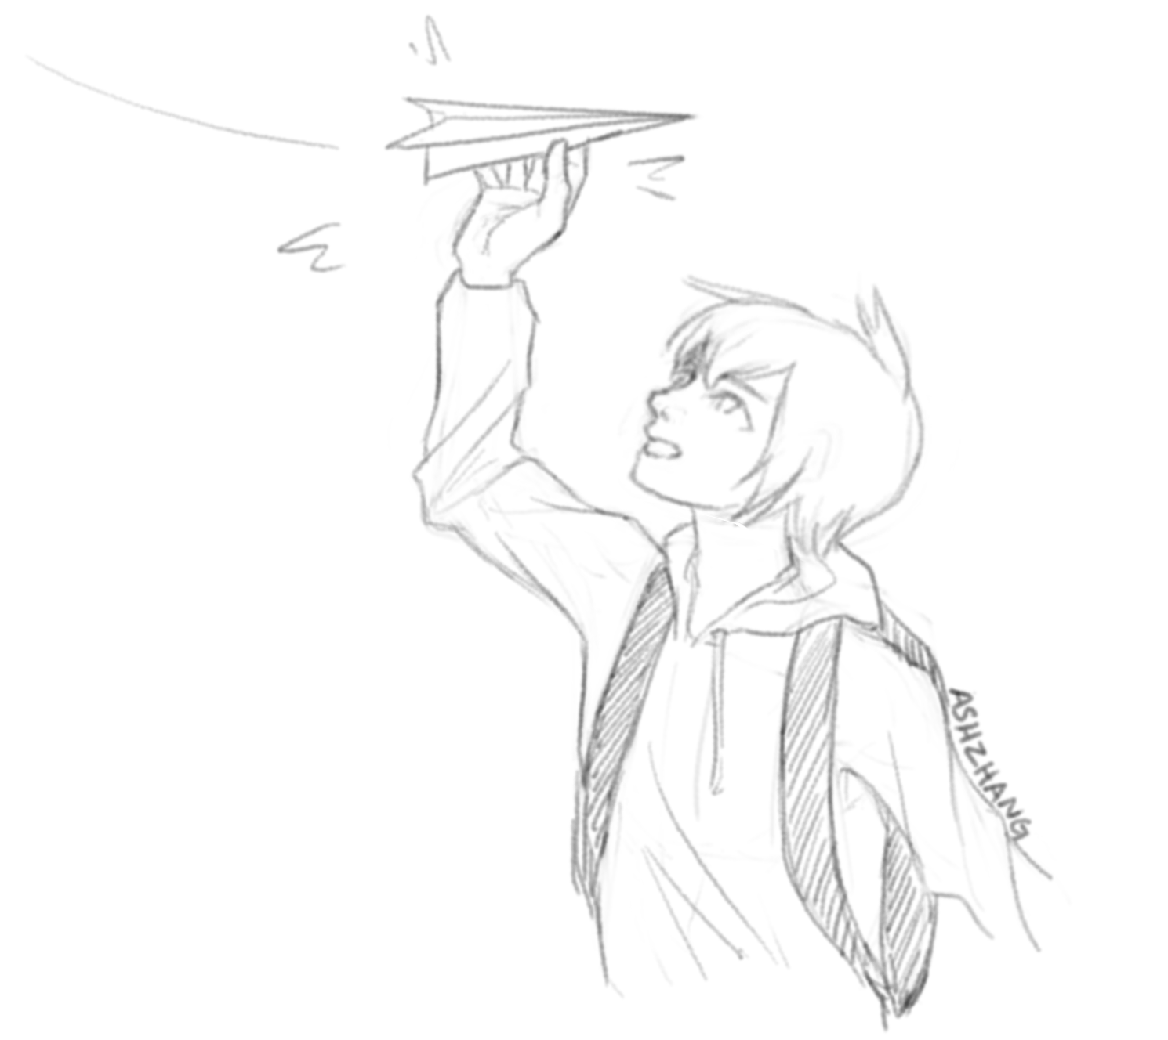
User Datagram Protocol (UDP)
Textbook Chapter 30

Slide 33
User Datagram Protocol (UDP)
Provides a datagram abstraction
  A message, sent in a single layer 3 packet (though layer 3 could fragment the packet)
  Max size limited by max size of packet
  Applications break their data into datagrams, which are sent and received as a single unit
    Contrast with TCP, where the application can use a bytestream abstraction
No reliability or ordering guarantees, but adds ports
  It still has best effort delivery
Much faster than TCP, since there is no 3-way handshake
  Usually used by low-latency, high-speed applications where errors are okay (e.g. video streaming, games)

Slide 34
UDP Attacks
No sequence numbers, so relatively easy to inject data into a connection or spoof connections
  Higher layers must provide their own defenses against these attacks!

Slide 35
UDP Packet Structure
Source Port (16 bits) | Destination Port (16 bits)
Length (16 bits) | Checksum (16 bits)
Data (variable length)
UDP datagram header
Notes:
Notice: Ports, checksum, data

Slide 36
Summary
Border Gateway Protocol (BGP): Routing packets
  The Internet is made of smaller autonomous systems (AS)
  Each AS broadcasts the shortest routes it knows of (dependent on the shortest routes of its neighbors and distance to neighbors)

Slide 37
Summary
Transmission Control Protocol (TCP): Reliably sending packets
  3-way handshake: Client sends SYN, server sends SYN-ACK, client sends ACK
  Provides reliability, ordering, and ports
  Attack: TCP hijacking through data injection or RST injection
    Blind attacks must guess the client’s or server’s sequence numbers
  Attack: TCP spoofing by sending a spoofed SYN packet
    Blind attacks must guess the server’s sequence number
User Datagram Protocol (UDP): Non-reliably sending packets
  No reliability or ordering, only ports
  Same injection and spoofing attacks as TCP, but easier

