Slide 1

One-Time Pad & Block Ciphers
CS 161 Spring 2024 - Lecture 6

Slide 2
Project 1 Parties
Project 1 is due this Friday, February 9, 11:59pm.
Project 1 Party this Wednesday, February 7th 5-6:30pm in Cory 540AB.
Project 1 Party this Thursday, February 8th 5-7pm in Cory 540AB.
My office hours: Monday 2-3pm, Soda 729

Slide 3

Recall the IND-CPA security definition
Eve (adversary)
Alice (challenger)
Eve may choose plaintexts to send to Alice and receives their ciphertexts
Eve issues a pair of plaintexts M0 and M1 to Alice
Alice randomly chooses either M0 or M1 to encrypt and sends the encryption back
  Alice does not tell Eve which one was encrypted!
Eve may again choose plaintexts to send to Alice and receives their ciphertexts
Eventually, Eve outputs a guess as to whether Alice encrypted M0 or M1
An encryption scheme is IND-CPA secure if for all polynomial time attackers Eve:
Eve can win with probability ≤ 1/2 + Ɛ, where Ɛ is negligible.
Keygen()
M
(repeat)
Enc(K, M)
M0 and M1
pick b
Enc(K, Mb)
M
(repeat)
Enc(K, M)
Guess b = 0 or b = 1
Notes:
Let’s stop to chew on this.

Slide 4
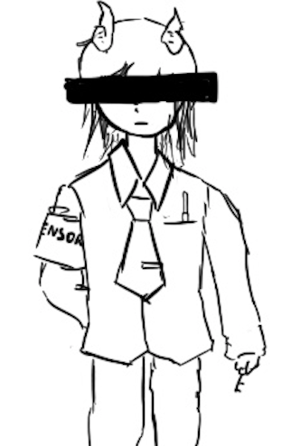
One-Time Pads
Textbook Chapter 6.2 & 6.3

Slide 5
Cryptography Roadmap
 | Symmetric-key | Asymmetric-key
Confidentiality | One-time pads Block ciphers with chaining modes (e.g. AES-CBC) Stream ciphers | RSA encryption ElGamal encryption
Integrity, Authentication | MACs (e.g. HMAC) | Digital signatures (e.g. RSA signatures)
Hash functions
Pseudorandom number generators
Public key exchange (e.g. Diffie-Hellman)
Key management (certificates)
Password management

Slide 6
Review: XOR
The XOR operator takes two bits and outputs one bit:
Useful properties of XOR:
0 ⊕ 0 = 0
0 ⊕ 1 = 1
1 ⊕ 0 = 1
1 ⊕ 1 = 0
x ⊕ 0 = x
x ⊕ x = 0
x ⊕ y = y ⊕ x
(x ⊕ y) ⊕ z = x ⊕ (y ⊕ z)
(x ⊕ y) ⊕ x = y

Slide 7
Review: XOR Algebra
Algebra works on XOR too
y ⊕ 1 = 0 | Goal: Solve for y
y ⊕ 1 ⊕ 1 = 0 ⊕ 1 | XOR both sides by 1
y = 1 | Simplify with identities

Slide 8
One-Time Pads: Key Generation
Alice
K
0 | 1 | 1 | 0 | 0 | 1 | 0 | 1 | 0 | 1 | 1 | 1
The key K is a randomly-chosen bitstring.
Recall: We are in the symmetric-key setting, so we’ll assume Alice and Bob both know this key.

Slide 9
One-Time Pads: Encryption
Alice
K
0 | 1 | 1 | 0 | 0 | 1 | 0 | 1 | 0 | 1 | 1 | 1
M
1 | 0 | 0 | 1 | 1 | 0 | 0 | 1 | 0 | 1 | 0 | 0
The plaintext M is the bitstring that Alice wants to encrypt.
Idea: Use XOR to scramble up M with the bits of K.

Slide 10
One-Time Pads: Encryption
Alice
K
0 | 1 | 1 | 0 | 0 | 1 | 0 | 1 | 0 | 1 | 1 | 1
⊕ | ⊕ | ⊕ | ⊕ | ⊕ | ⊕ | ⊕ | ⊕ | ⊕ | ⊕ | ⊕ | ⊕
M
1 | 0 | 0 | 1 | 1 | 0 | 0 | 1 | 0 | 1 | 0 | 0
↓ | ↓ | ↓ | ↓ | ↓ | ↓ | ↓ | ↓ | ↓ | ↓ | ↓ | ↓
C
1 | 1 | 1 | 1 | 1 | 1 | 0 | 0 | 0 | 0 | 1 | 1
Encryption algorithm: XOR each bit of K with the matching bit in M.
The ciphertext C is the encrypted bitstring that Alice sends to Bob over the insecure channel.

Slide 11
One-Time Pads: Decryption
Bob
K
0 | 1 | 1 | 0 | 0 | 1 | 0 | 1 | 0 | 1 | 1 | 1
C
1 | 1 | 1 | 1 | 1 | 1 | 0 | 0 | 0 | 0 | 1 | 1
Bob receives the ciphertext C. Bob knows the key K. How does Bob recover M?

Slide 12
One-Time Pads: Decryption
Bob
K
0 | 1 | 1 | 0 | 0 | 1 | 0 | 1 | 0 | 1 | 1 | 1
⊕ | ⊕ | ⊕ | ⊕ | ⊕ | ⊕ | ⊕ | ⊕ | ⊕ | ⊕ | ⊕ | ⊕
C
1 | 1 | 1 | 1 | 1 | 1 | 0 | 0 | 0 | 0 | 1 | 1
↓ | ↓ | ↓ | ↓ | ↓ | ↓ | ↓ | ↓ | ↓ | ↓ | ↓ | ↓
M
1 | 0 | 0 | 1 | 1 | 0 | 0 | 1 | 0 | 1 | 0 | 0
Decryption algorithm: XOR each bit of K with the matching bit in C.

Slide 13
One-Time Pad
KeyGen()
  Randomly generate an n-bit key, where n is the length of your message
    Recall: For today, we assume that Alice and Bob can securely share this key
    For one-time pads, we generate a new key for every message
Enc(K, M) = K ⊕ M
  Bitwise XOR M and K to produce C
    In other words: XOR the ith bit of the plaintext with the ith bit of the key.
    Ci = Ki ⊕ Mi
  Alice and Bob use a different key for each encryption (this is the “one-time” in one-time pad).
Dec(K, C) = K ⊕ C
  Bitwise XOR C and K to produce M
    Mi = Ki ⊕ Ci
Notes:
Ask students if they can produce the decryption equation before showing it to them

Slide 14
One-Time Pad: Correctness
Correctness: If we encrypt and then decrypt, we should get the original message back
Enc(K, M) | = | K ⊕ M | Definition of encryption
Dec(K, Enc(K, M)) | = | Dec(K, K ⊕ M) | Decrypting the ciphertext
 | = | K ⊕ (K ⊕ M) | Definition of decryption
 | = | M | XOR property

Slide 15
One-Time Pad: Security
Recall our definition of confidentiality: The ciphertext should not give the attacker any additional information about the plaintext
Recall our preliminary experiment (before IND-CPA) to test confidentiality from earlier:
  If the probability that Eve correctly guesses
which message was sent is 1/2, then the
encryption scheme is confidential
Eve (adversary)
Alice (challenger)
pick b
KeyGen():K
M0 and M1
Enc(K, Mb)
Guess b = 0 or b = 1
‹#›

Slide 16
One-Time Pad: Security
Possibility 0: Alice sends Enc(K, M0)
Possibility 1: Alice sends Enc(K, M1)
The ciphertext is C = K ⊕ M0
Therefore, K = C ⊕ M0
The ciphertext is C = K ⊕ M1
Therefore, K = C ⊕ M1
K was chosen randomly, so both possibilities are equally possible
By “perfectly” we mean that any attacker has chance of winning the security game exactly ½ (not ½+epsilon)
Eve has learned no new information, so the scheme is perfectly secure

Slide 17
Two-Time Pads?
Alice
K
Insecure Channel
M0
OTP Enc
K ⊕ M0
Eve sees two ciphertexts over the insecure channel.
K
M1
OTP Enc
K ⊕ M1
What if we use the same key K to encrypt two different messages?

Slide 18
Two-Time Pads?
Alice
K
Insecure Channel
Eve
M0
OTP Enc
K ⊕ M0
(K ⊕ M0) ⊕ (K ⊕ M1)
= M0 ⊕ M1
K
⊕
M1
OTP Enc
K ⊕ M1
If Eve XORs the two ciphertexts, she learns M0 ⊕ M1!

Slide 19
Two-Time Pads?
What if we use the same key twice?
  Alice encrypts M0 and M1 with the same key
  Eve observes K ⊕ M0 and K ⊕ M1
  Eve computes (K ⊕ M0) ⊕ (K ⊕ M1) = M0 ⊕ M1
    Recall the XOR property: the K's cancel out
Eve has learned M0 ⊕ M1. This is partial information about the messages!
  In other words, Eve knows which bits in M0 match bits in M1
  If Eve knows M0, she can deduce M1 (and vice-versa)
  Eve can also guess M0 and check that M1 matches her guess for M0
Result: One-time pads are not secure if the key is reused
  Alice and Bob must use a different key for every message!

Slide 20
OTP does not offer IND-CPA
Eve (adversary)
Alice (challenger)
What is an attack strategy?
Many possible, e.g.
  In the trial phase and the challenge phase, ask for “00” and “11”, it is deterministic.
Keygen()
M
(repeat)
Enc(K, M)
M0 and M1
pick b
Enc(K, Mb)
M
(repeat)
Enc(K, M)
Guess b = 0 or b = 1
Notes:
Let’s stop to chew on this.

Slide 21
Impracticality of One-Time Pads
Problem #1: Key generation
  For security to hold, keys must be randomly generated for every message, and never reused
  Randomness is expensive, as we’ll see later
Problem #2: Key distribution
  To communicate an n-bit message, we need to securely communicate an n-bit key first
  But if we have a way to securely communicate an n-bit key, we could have communicated the message directly!
Communicate keys in advance
  You have a secure channel now, but you won’t have it later
  Use the secure channel now to communicate keys in advance
  Use one-time pad later to communicate over the insecure channel
  And people can compute this by hand without computers!

Slide 22
Is one-time pad IND-CPA secure?
Eve may choose plaintexts to send to Alice and receives their ciphertexts
Eve issues a pair of plaintexts M0 and M1 to Alice
Alice randomly chooses either M0 or M1 to encrypt and sends the encryption back
  Alice does not tell Eve which one was encrypted!
Eve may again choose plaintexts to send to Alice and receives their ciphertexts
Eventually, Eve outputs a guess as to whether Alice encrypted M0 or M1
An encryption scheme is IND-CPA secure if for all polynomial time attackers Eve: Eve can win with probability <= 1/2 + Ɛ, where Ɛ is negligible.
Eve (adversary)
Alice (challenger)
M
(repeat)
Enc(K, M)
M0 and M1
pick b
Enc(K, Mb)
M
(repeat)
Enc(K, M)
A: No, because it requires that the scheme is able to reuse a key K without helping the attacker distinguish. In repeat phase, attacker can ask for M₀
Guess b = 0 or b = 1
Notes:
Let’s stop to chew on this.

Slide 23
One-Time Pads in Practice: Spies
At home base, the spy obtains a large amount of key material (e.g. a book of random bits)
In the field, the spy listens for secret messages from their home country
  There are shortwave and terrestrial radio “number stations”
  At a regular time, a voice gets on the air and reads a series of numbers
  If you don’t know the key, this looks like a meaningless sequence of random numbers
  If you know the key, you can decrypt the spy message!
What if you don’t want to send anything to any spies?
  Read out a list of random numbers anyway
  Because one-time pad leaks no information, an eavesdropper can’t distinguish between an encrypted message and random numbers!

Slide 24
Two-Time Pads in Practice: VENONA
Soviet spies used one-time pads for communication from their spies in the US
During WWII, the Soviets started reusing key material
  Uncertain whether it was just the cost of generating pads or what…
VENONA was a US cryptanalysis project designed to break these messages
  Included confirming/identifying the spies targeting the US Manhattan project
  Project continued until 1980!
Not declassified until 1995!
  So secret even President Truman wasn’t informed about it
  The Soviets found out about it in 1949 through their spy Ken Philby, but their one-time pad reuse was fixed after 1948 anyway
Takeaway: Otherwise-secure cryptographic systems can fail very badly if used improperly!
Notes:
TODO Nick

Slide 25
Summary for one-time pads
Symmetric encryption scheme: Alice and Bob share a secret key.
Encryption and decryption: Bitwise XOR with the key.
No information leakage if the key is never reused.
Information leaks if the key is reused.
Impractical for real-world usage, unless you’re a spy.

Slide 26
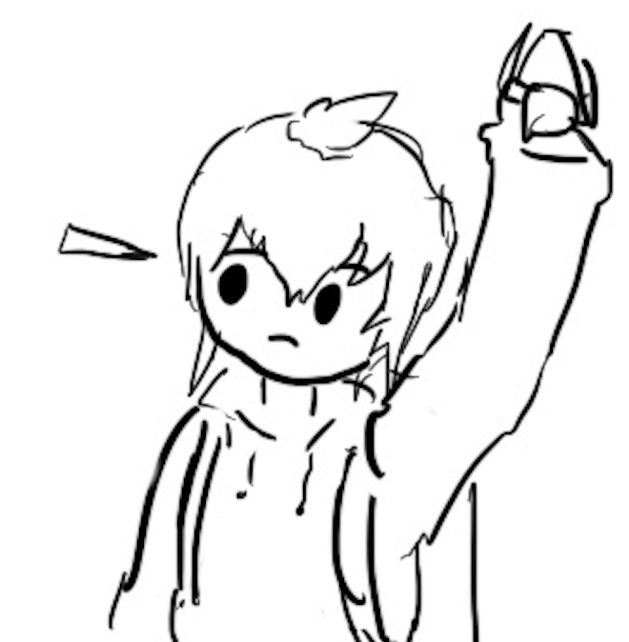
Block Ciphers
Textbook Chapter 6.4 & 6.5

Slide 27
Cryptography Roadmap
 | Symmetric-key | Asymmetric-key
Confidentiality | One-time pads Block ciphers with chaining modes (e.g. AES-CBC) Stream ciphers | RSA encryption ElGamal encryption
Integrity, Authentication | MACs (e.g. HMAC) | Digital signatures (e.g. RSA signatures)
Hash functions
Pseudorandom number generators
Public key exchange (e.g. Diffie-Hellman)
Key management (certificates)
Password management

Slide 28
Block Ciphers: Definition
plaintext
Block cipher: A cryptographic scheme consisting of encode/decode algorithms for a fixed-sized block of bits:
EK(M) → C: Encode
  Inputs: k-bit key K and an n-bit plaintext M
  Output: An n-bit ciphertext C
  Sometimes written as: {0, 1}^{k} × {0, 1}^{n} → {0, 1}^{n}
DK(C) → M: Decode
  Inputs: a k-bit key, and an n-bit ciphertext C
  Output: An n-bit plaintext
  Sometimes written as: {0, 1}^{k} × {0, 1}^{n} → {0, 1}^{n}
  The inverse of the encryption function
Properties
  Correctness: EK is a permutation, DK is its inverse
  Efficiency: Encode/decode should be fast
  Security: E behaves like a random permutation
n bits
K
k bits
E
n bits
ciphertext
ciphertext
n bits
K
k bits
D
n bits
plaintext

Slide 29
Block Ciphers: Correctness
EK(M) must be a permutation (bijective function) on n-bit strings
  Each input must correspond to exactly one unique output
Intuition
  Suppose EK(M) is not bijective
  Then two inputs might correspond to the same output: E(K, x1) = E(K, x2) = y
  Given ciphertext y, you can’t uniquely decode. D(K, y) = x1? D(K, y) = x2?
00
01
10
11
00
01
10
11
00
01
10
11
00
01
10
11
Not bijective: Two inputs encode to the same output
Bijective: Each input maps to exactly one unique output

Slide 30
Block Ciphers: Security
A secure block cipher behaves like a randomly chosen permutation permutation from the set of all permutations on n-bit strings
  A random permutation: Each n-bit input is mapped to one randomly-chosen n-bit output
Defined by a distinguishing game
  Eve gets two boxes: One is a randomly chosen permutation, and one is EK with a randomly chosen key K
  Eve should not be able to tell which is which with probability > ½+negl
00
01
10
11
00
01
10
11
00
01
10
11
00
01
10
11
??
One of these is EK with a randomly chosen K, and the other one is a randomly chosen permutation. Eve can’t distinguish them.

Slide 31
Block ciphers: Brute-force attacks?
How hard is it to run a brute-force attack on a 128-bit key?
  We have to try 2¹²⁸ possibilities. How big is 2¹²⁸?
Handy approximation: 2¹⁰ ≈ 10³
  2¹²⁸ = 2^{10*12.8} ≈ (10³)^{12.8} ≈ (10³)¹³ = 10³⁹
Suppose we have massive hardware that can try 10⁹ (1 billion) keys in 1 nanosecond (a billionth of a second). That’s 10¹⁸ keys per second
  We’ll need 10³⁹ / 10¹⁸ = 10²¹ seconds. How long is that?
  One year ≈ 3×10⁷ seconds
  10²¹ seconds / 3×10⁷ ≈ 3×10¹³ years ≈ 30 trillion years
Takeaway: Brute-forcing a 128-bit key takes astronomically long.
Don’t even try.

Slide 32
Block ciphers: Brute-force attacks?
How hard is it to run a brute-force attack on a 256-bit key in the same time?
  We need 10⁵² of the brute-force devices from before
  If each brute-force device from before is 1 cubic millimeter, this would take 10⁴³ cubic meters of space
  That’s the volume of 7×10¹⁵ suns!
  For reference, the Milky Way galaxy has just 10¹¹ stars
Takeaway: Brute-force attacks on modern block ciphers are not possible, assuming the key is random and secret
  128-bit key? Definitely not happening.
  256-bit key? Lol no.

Slide 33
Block Ciphers: Efficiency
Encryption and decryption should be computable in microseconds
  Formally: KeyGen(), Enc(), and Dec(), should not take exponential time
Block cipher algorithms typically use operations like XOR, bit-shifting, and small table lookups
  Very fast on modern processors
Modern CPUs provide dedicated hardware support for block ciphers
Notes:
TODO This should be E and D, not KeyGen, Enc, and Dec

Slide 34
DES (Data Encryption Standard)
Designed in late 1970s
Block size 64 bits (n = 64)
Key size 56 bits (k = 56)
NSA influenced two facets of its design
  Altered some subtle internal workings in a mysterious way
  Reduced key size from 64 bits to 56 bits
  Made brute force attacks feasible for an attacker with massive computational resources (by 1970s standards)
The algorithm remains essentially unbroken 40 years later
  The NSA’s tweaking hardened it against an attack publicly revealed a decade later
However, modern computer speeds make it completely unsafe due to small key size
  ~6.4 × 10¹⁶, say 10¹⁰ tries per second on my single desktop computer's Nvidia graphics card: Takes ~6.4 × 10⁶ seconds or ~70 days

Slide 35
AES (Advanced Encryption Standard)
1997–2000: NIST (National Institute of Standards and Technology) in the US held a competition to pick a new block cipher standard
  One of the finalists, Twofish, was designed by Berkeley professor and occasional CS 161 instructor David Wagner!
Out of the 5 finalists:
  Rijndael, Twofish, and Serpent had really good performance
  RC6 had okay performance
  Mars had bad performance
On any given computing platform, Rijndael was never the fastest
But on every computing platform, Rijndael was always the second-fastest
  Twofish and Serpent each had at least one compute platform they were bad at
Rijndael was selected as the new block cipher standard

Slide 36
Are Block Ciphers IND-CPA Secure?
Eve (adversary)
Alice (challenger)
Consider the following adversary:
  Eve sends two different messages M0 and M1
  Eve receives either EK(M0) or EK(M1)
  Eve requests the encryption of M0 again
  Strategy: If the encryption of M0 matches what she received, guess b = 0. Else, guess b = 1.
Eve can win the IND-CPA game with probability 1!
  Block ciphers are not IND-CPA secure because they are deterministic
M
(repeat)
Enc(K, M)
M0 and M1
pick b
Enc(K, Mb)
M
(repeat)
Enc(K, M)
Guess b = 0 or b = 1

Slide 37
AES (Advanced Encryption Standard)
Key size 128, 192, or 256 bits (k = 128, 192, or 256)
  Use key size 256 these days
Block size 128 bits (n = 128)
  Note: The block size is still always 128 bits, regardless of key size
You don’t need to know how AES works, but you do need to know its parameters
  here’s a comic

Slide 38
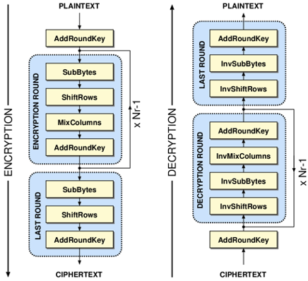
AES Algorithm
Different key sizes use different numbers of rounds
  10 rounds for 128-bit keys
  12 rounds for 192-bit keys
  14 rounds for 256-bit keys
Each round uses its own “round key” derived from the cipher key
Each round:
  SubBytes()
  ShiftRows()
  MixColumns() (if not last round)
  AddRoundKey()
Notes:
AES slides, credit Kevin Orr

Slide 39
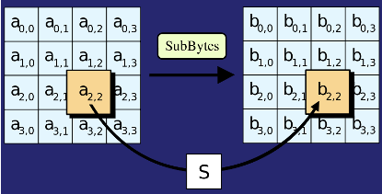
AES Algorithm: SubBytes()
Replace each byte in the block with another byte using an 8-bit substitution box

Slide 40
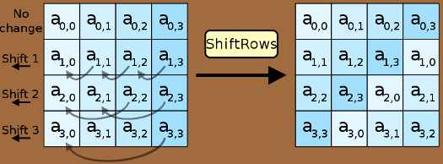
AES Algorithm: ShiftRows()
Cyclically shifts the bytes in each row by a certain offset
The number of places each byte is shifted differs for each row

Slide 41
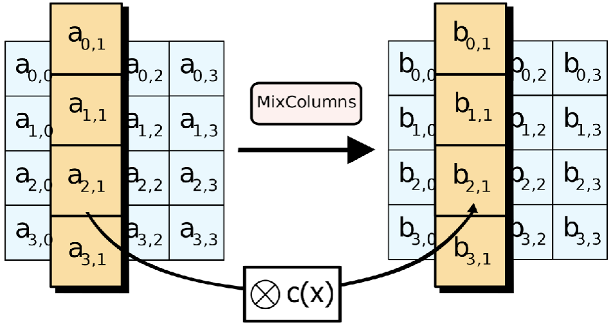
AES Algorithm: MixColumns()
Treats the 16-byte block as a 4 × 4 matrix and multiply it by by another matrix

Slide 42
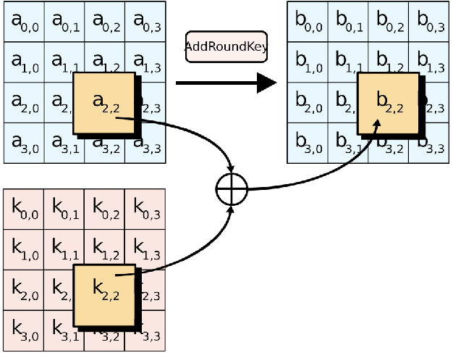
AES Algorithm: AddRoundKey()
XOR the 16-byte block with the 16-byte round key

Slide 43
AES (Advanced Encryption Standard)
There is no formal proof that AES is secure (indistinguishable from a random permutation)
However, in 20 years, nobody has been able to break it, so it is assumed to be secure
  The NSA uses AES-256 for secrets they want to keep secure for the 40 years (even in the face of unknown breakthroughs in research)
Takeaway: AES is the modern standard block cipher algorithm
  The standard key size (128 bits) is large enough to prevent brute-force attacks

Slide 44
Issues with Block Ciphers
Block ciphers are not IND-CPA secure, because they’re deterministic
  A scheme is deterministic if the same input always produces the same output
  No deterministic scheme can be IND-CPA secure because the adversary can always tell if the same message was encrypted twice
Block ciphers can only encrypt messages of a fixed size
  For example, AES can only encrypt-decrypt 128-bit messages
  What if we want to encrypt something longer than 128 bits?
To address these problems, we’ll add modes of operation that use block ciphers as a building block!
Notes:
Ask for any other issues students can think of after describing deterministic schemes

Slide 45
Summary: Block Ciphers
Encryption: input a k-bit key and n-bit plaintext, receive n-bit ciphertext
Decryption: input a k-bit key and n-bit ciphertext, receive n-bit plaintext
Correctness: when the key is fixed, EK(M) should be bijective
Security
  Without the key, EK(m) is computationally indistinguishable from a random permutation
  Brute-force attacks take astronomically long and are not possible
Efficiency: algorithms use XORs and bit-shifting (very fast)
Implementation: AES is the modern standard
Issues
  Not IND-CPA secure because they’re deterministic
  Can only encrypt n-bit messages

Slide 46
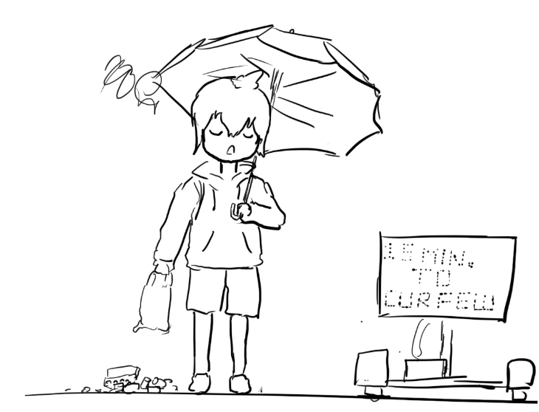
Block Cipher Modes of Operation
Textbook Chapter 6.6–6.9

Slide 47
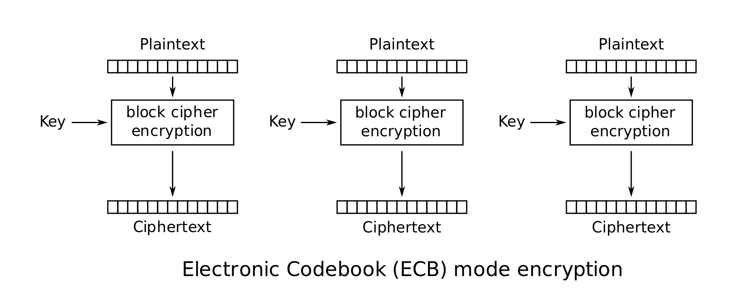
Scratchpad: Let’s design it together
Here’s an AES block. Remember that it can only encrypt 128-bit messages.
How can we use AES to encrypt a longer message (say, 256 bits?)

Slide 48
Scratchpad: Let’s design it together
Idea: Let’s use AES twice!
First 128 bits of message
Second 128 bits of message

Slide 49
Scratchpad: Let’s design it together
Note that we are using the same key twice. We want to avoid a situation like one-time pads where we need very long keys.

Slide 50
ECB Mode
We’ve just designed electronic code book (ECB) mode
  Enc(K, M) = C1 || C2 || … || Cm
  Assume m is the number of blocks of plaintext in M, each of size n
AES-ECB is not IND-CPA secure. Why?
  Because ECB is deterministic

Slide 51

ECB Mode: Penguin
Original image

Slide 52

ECB Mode: Penguin
Encrypted with ECB

Slide 53
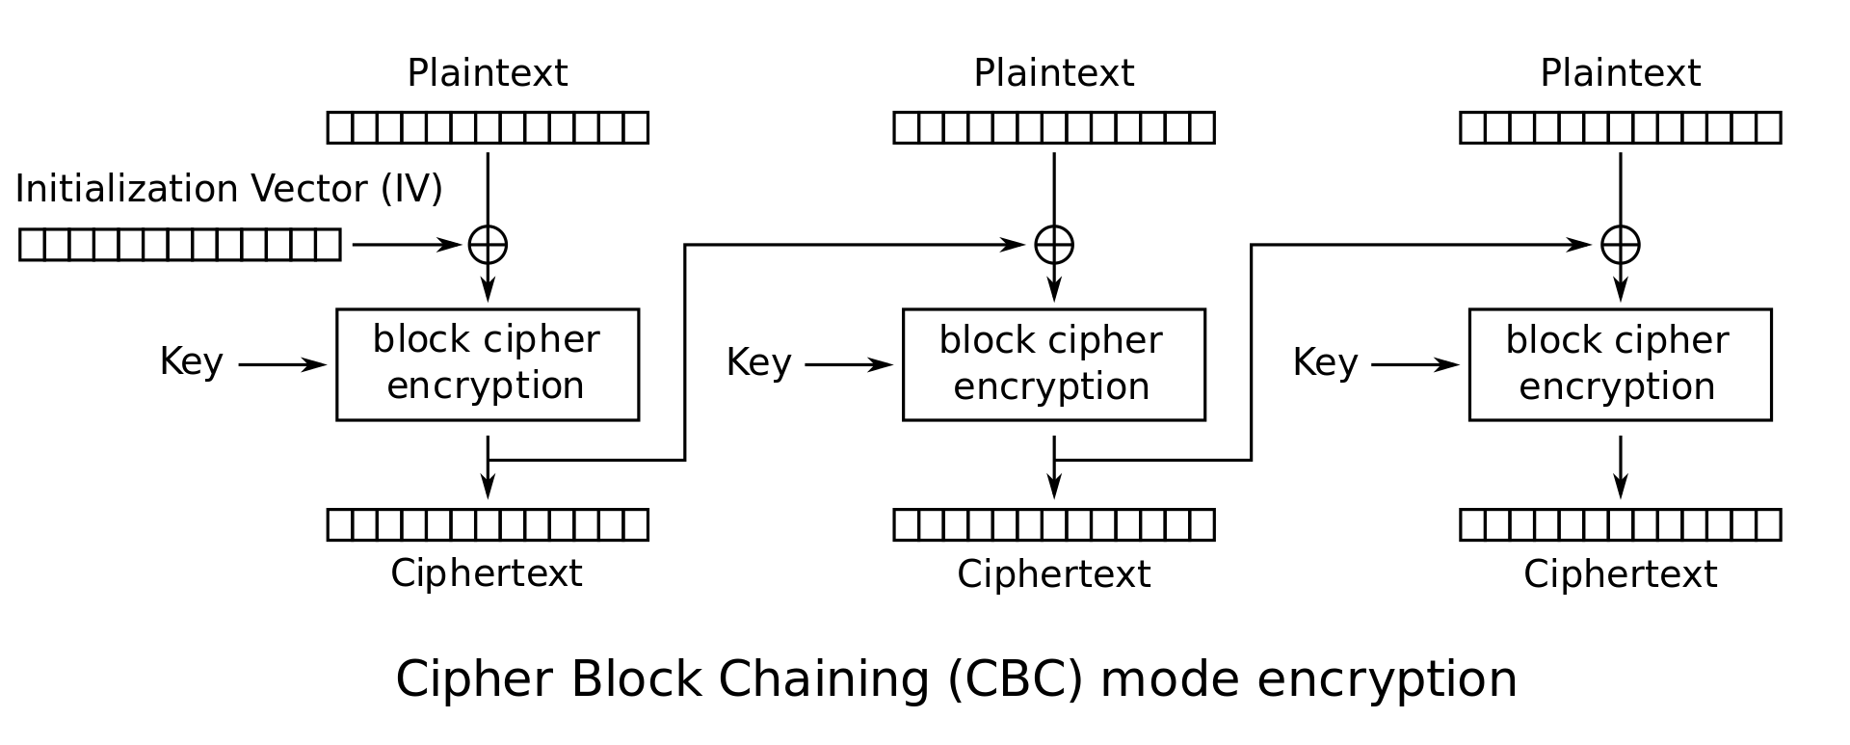
Scratchpad: Let’s design it together
Here’s ECB mode. It’s not IND-CPA secure because it’s deterministic.
Let’s fix that by adding some randomness.
Notes:
If students propose adding

Slide 54
Scratchpad: Let’s design it together
The Initialization Vector (IV) is different for every encryption. Now the first ciphertext block will be different for every encryption!
Okay, but the other blocks are still deterministic...
Notes:
If students propose adding

Slide 55
Scratchpad: Let’s design it together
Idea: The first ciphertext block was computed with some randomness. Let’s use it to add randomness to the second block.
Notes:
If students propose adding

Slide 56
Scratchpad: Let’s design it together
Now the second ciphertext block has some randomness in it. Let’s use it to add randomness to the third block.
Notes:
If students propose adding

Slide 57
CBC Mode
We’ve just designed cipher block chaining (CBC) mode
Ci = EK(Mi ⊕ Ci-1); C0 = IV
Enc(K, M):
  Split M in m plaintext blocks P₁ … P_{m} each of size n
  Choose a random IV
  Compute and output (IV, C₁, …, C_{m}) as the overall ciphertext
How do we decrypt?
P₁
P₂
P_{m}

Slide 58
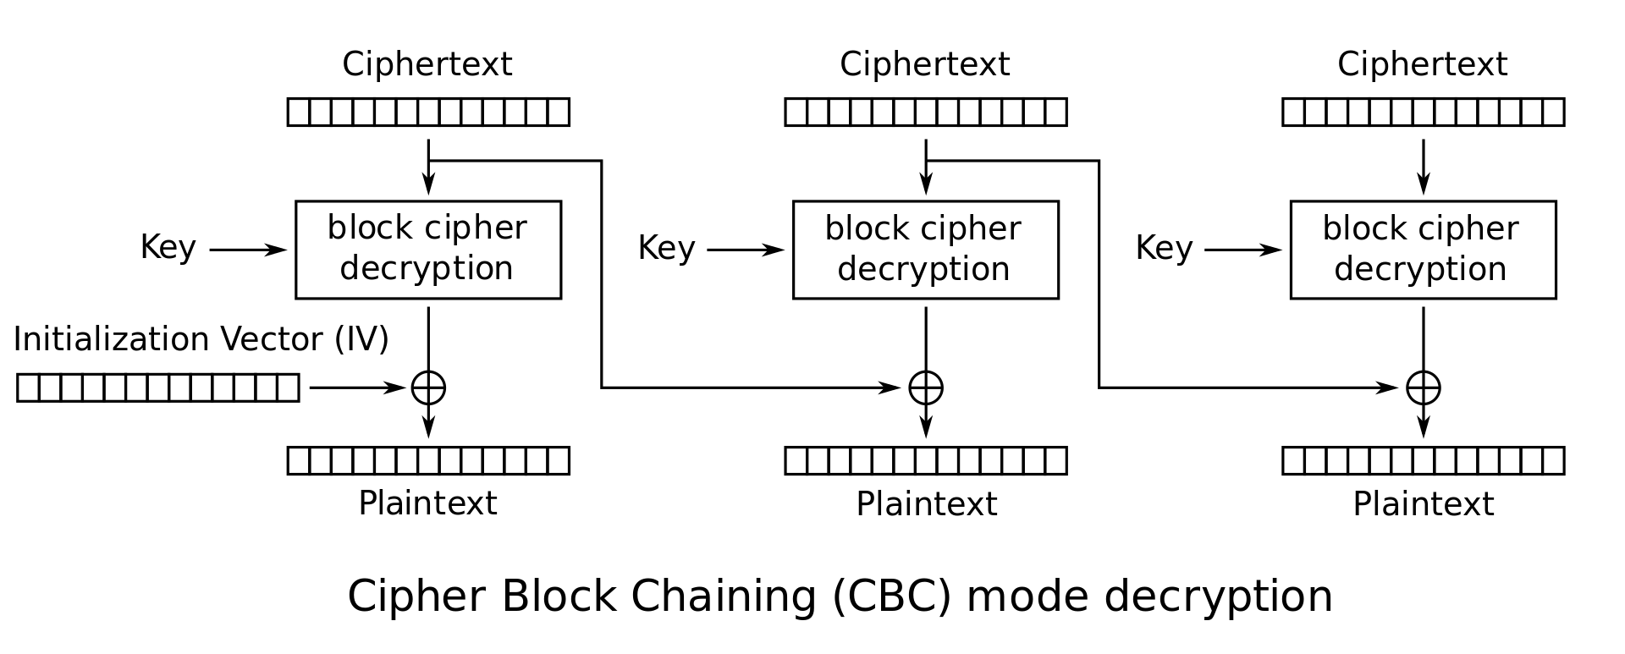
CBC Mode: Decryption
How do we decrypt CBC mode?
  Parse ciphertext as (IV, C₁, …, C_{m})
  Decrypt each ciphertext and then XOR with IV or previous ciphertext

Slide 59
CBC Mode: Decryption
Ci | = | EK(Mi ⊕ Ci-1) | Definition of encryption
DK(Ci) | = | DK(EK(Mi ⊕ Ci-1)) | Decrypting both sides
DK(Ci) | = | Mi ⊕ Ci-1 | Decryption and encryption cancel
DK(Ci) ⊕ Ci-1 | = | Mi ⊕ Ci-1 ⊕ Ci-1 | XOR both sides with Ci-1
DK(Ci) ⊕ Ci-1 | = | Mi | XOR property

Slide 60
CBC Mode: Efficiency & Parallelism
Can encryption be parallelized?
  No, we have to wait for block i to finish before encrypting block i+1
Can decryption be parallelized?
  Yes, decryption only requires ciphertext as input

Slide 61
CBC Mode: Padding
What if you want to encrypt a message that isn’t a multiple of the block size?
  AES-CBC is only defined if the plaintext length is a multiple of the block size
Solution: Pad the message until it’s a multiple of the block size
  Padding: Adding dummy bytes at the end of the message until it’s the proper length

Slide 62
CBC Mode: Padding
What padding scheme should we use?
  Padding with 0’s?
    Doesn’t work: What if our message already ends with 0’s?
  Padding with 1’s?
    Same problem
We need a scheme that can be unpadded without ambiguity
  One scheme that works: Append a 1, then pad with 0’s
    If plaintext is multiple of n, you still need to pad with an entire block
  Another scheme: Pad with the number of padding bytes
    So if you need 1 byte, pad with 01; if you need 3 bytes, pad with 03 03 03
    If you need 0 padding bytes, pad an entire dummy block
    This is called PKCS #7
Notes:
Ask: Ideas for unambiguous padding schemes

Slide 63
CBC Mode: Security
AES-CBC is IND-CPA secure. With what assumption?
  The IV must be randomly generated and never reused
What happens if you reuse the IV?
  The scheme becomes deterministic: No more IND-CPA security

Slide 64
CBC Mode: IV Reuse
Consider two three-block messages: P1P2P3 and P1P2P4
  The first two blocks are the same for both messages, but the last block is different
  What if we encrypt them with the same IV?
When the IV is reused, CBC mode reveals when two messages start with the same plaintext blocks, up to the first different plaintext block

Slide 65
CBC Mode is IND-CPA (when used correctly)
Enc(K, M):
  Split M in m plaintext blocks P1 … Pm each of size n
  Choose random IV, compute and output (IV, C1, …, Cm) as the overall ciphertext
Why IND-CPA?
  If there exists an attacker that wins in the IND-CPA game, then there exists an attacker that breaks the block cipher security. Proof is out of scope.
P₁
P₂
P_{m}

Slide 66
CBC Mode: Penguin
Original image

Slide 67

CBC Mode: Penguin
Encrypted with CBC, with random IVs

