Slide 1
Sessions, CSRF and XSS
CS 161 Fall 2024

Slide 2
Last Time: Cookies
Cookie: a piece of data used to maintain state across multiple requests
  Set by the browser or server
  Stored by the browser
  Attributes: Name, value, domain, path, secure, HttpOnly, expires
Cookie policy
  Server with domain X can set a cookie with domain attribute Y if the domain attribute is a domain suffix of the server’s domain, and the domain attribute Y is not a top-level domain (TLD)
  The browser attaches a cookie on a request if the domain attribute is a domain suffix of the server’s domain, and the path attribute is a prefix of the server’s path
  Cookie domain: example.com and cookie path: /some/path will be included in request to https://foo/example/com/some/path/index.html

Slide 3
Session Authentication
Session: A sequence of requests and responses associated with the same authenticated user
  Example: When you check all your unread emails, you make many requests to Gmail. The Gmail server needs a way to know all these requests are from you
  When the session is over (you log out, or the session expires), future requests are not associated with you
Naïve solution: Type your username and password before each request
  Problem: Very inconvenient for the user!
Better solution: Is there a way the browser can automatically send some information in a request for us?
  Yes: Cookies!

Slide 4
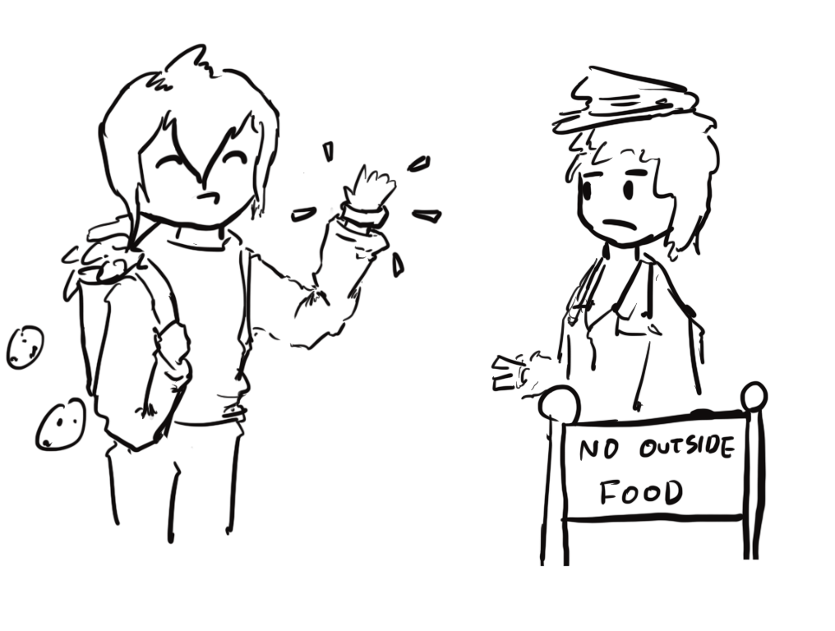
Session Authentication: Intuition
Imagine you’re attending a concert
The first time you enter the venue:
  Present your ticket and ID
  The doorperson checks your ticket and ID
  If they’re valid, you receive a wristband
If you leave and want to re-enter later
  Just show your wristband!
  No need to present your ticket and ID again

Slide 5
Session Tokens
Session token: A secret value used to associate requests with an authenticated user
The first time you visit the website:
  Present your username and password
  If they’re valid, you receive a session token
  The server associates you with the session token
When you make future requests to the website:
  Attach the session token in your request
  The server checks the session token to figure out that the request is from you
  No need to re-enter your username and password!

Slide 6
Session Tokens with Cookies
Session tokens can be implemented with cookies
  Cookies can be used to save any state across requests (e.g. dark mode)
  Session tokens are just one way to use cookies
The first time you visit a website:
  Make a request with your username and password
  If they’re valid, the server sends you a cookie with the session token
  The server associates you with the session token
When you make future requests to the website:
  The browser attaches the session token cookie in your request
  The server checks the session token to figure out that the request is from you
  No need to re-enter your username and password!
When you log out (or when the session times out):
  The browser and server delete the session token

Slide 7
Session Tokens: Security
If an attacker steals your session token, they can log in as you!
  The attacker can make requests and attach your session token
  The browser will think the attacker’s requests come from you
Servers need to generate session tokens randomly and securely
Browsers need to make sure malicious websites cannot steal session tokens
  Enforce isolation with cookie policy and same-origin policy
Browsers should not send session tokens to the wrong websites
  Enforced by cookie policy

Slide 8
Session Token Cookie Attributes
What attributes should the server set for the session token?
  Domain and Path: Set so that the cookie is only sent on requests that require authentication
  Secure: Can set to True to so the cookie is only sent over secure HTTPS connections
  HttpOnly: Can set to True so JavaScript can’t access session tokens
  Expires: Set so that the cookie expires when the session times out
Name | token
Value | {random value}
Domain | mail.google.com
Path | /
Secure | True
HttpOnly | True
Expires | {15 minutes later}
(other fields omitted)

Slide 9
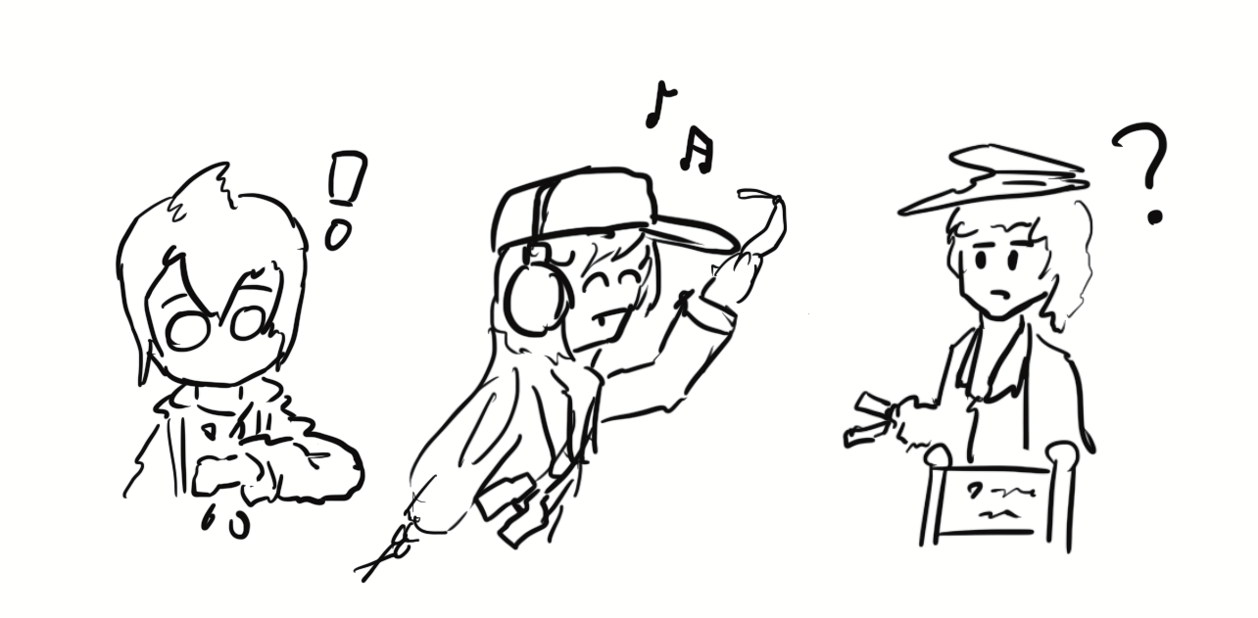
Cross-Site Request Forgery (CSRF)

Slide 10
Review: Cookies and Session Tokens
Session token cookies are used to associate a request with a user
The browser automatically attaches relevant cookies in every request

Slide 11
Cross-Site Request Forgery (CSRF)
Idea: What if the attacker tricks the victim into making an unintended request?
  The victim’s browser will automatically attach relevant cookies
  The server will think the request came from the victim!
Cross-site request forgery (CSRF or XSRF): An attack that exploits cookie-based authentication to perform an action as the victim

Slide 12
Steps of a CSRF Attack
User
Server
Attacker

Slide 13

Steps of a CSRF Attack
User authenticates to the server
  User receives a cookie with a valid session token
User
1. Login
Server
Attacker

Slide 14
Steps of a CSRF Attack
User authenticates to the server
  User receives a cookie with a valid session token
Attacker tricks the victim into making a malicious request to the server
User
1. Login
Server
2. Make this request
Attacker

Slide 15
Steps of a CSRF Attack
User authenticates to the server
  User receives a cookie with a valid session token
Attacker tricks the victim into making a malicious request to the server
The server accepts the malicious request from the victim
  Recall: The cookie is automatically attached in the request
User
1. Login
Server
2. Make this request
3. Malicious request
Attacker

Slide 16
Steps of a CSRF Attack
User authenticates to the server
  User receives a cookie with a valid session token
Attacker tricks the victim into making a malicious request to the server
The server accepts the malicious request from the victim
  Recall: The cookie is automatically attached in the request

Slide 17
Executing a CSRF Attack
How might we trick the victim into making a GET request?
Strategy #1: Trick the victim into clicking a link
  Later we’ll see how to trick a victim into clicking a link
  The link can directly make a GET request:
  https://www.bank.com/transfer?amount=100&to=Mallory
  The link can open an attacker’s website, which contains some JavaScript that makes the actual malicious request
Strategy #2: Put some HTML on a website the victim will visit
  Example: The victim will visit a forum. Make a post with some HTML on the forum
  HTML to automatically make a GET request to a URL:
  <img src="https://www.bank.com/transfer?amount=100&to=Mallory">
    This HTML will probably return an error or a blank 1 pixel by 1 pixel image, but the GET request will still be sent...with the relevant cookies!

Slide 18
Executing a CSRF Attack
How might we trick the victim into making a POST request?
  Example POST request: Submitting a form
Strategy #1: Trick the victim into clicking a link
  Note: Clicking a link in your browser makes a GET request, not a POST request, so the link cannot directly make the malicious POST request
  The link can open an attacker’s website, which contains some JavaScript that makes the actual malicious POST request
Strategy #2: Put some JavaScript on a website the victim will visit
  Example: Pay for an advertisement on the website, and put JavaScript in the ad
  Recall: JavaScript can make a POST request

Slide 19
Top 25 Most Dangerous Software Weaknesses (2020)
Rank | ID | Name | Score
[1] | CWE-79 | Improper Neutralization of Input During Web Page Generation (’Cross-site Scripting’) | 46.82
[2] | CWE-787 | Out-of-bounds Write | 46.17
[3] | CWE-20 | Improper Input Validation | 33.47
[4] | CWE-125 | Out-of-bounds Read | 26.50
[5] | CWE-119 | Improper Restriction of Operations within the Bounds of a Memory Buffer | 23.73
[6] | CWE-89 | Improper Neutralization of Special Elements used in an SQL Command (’SQL Injection’) | 20.69
[7] | CWE-200 | Exposure of Sensitive Information to an Unauthorized Actor | 19.16
[8] | CWE-416 | Use After Free | 18.87
[9] | CWE-352 | Cross-Site Request Forgery (CSRF) | 17.29
[10] | CWE-78 | Improper Neutralization of Special Elements used in an OS Command (’OS Command Injection’) | 16.44
[11] | CWE-190 | Integer Overflow or Wraparound | 15.81
[12] | CWE-22 | Improper Limitation of a Pathname to a Restricted Directory (’Path Traversal’) | 13.67
[13] | CWE-476 | NULL Pointer Dereference | 8.35
[14] | CWE-287 | Improper Authentication | 8.17
[15] | CWE-434 | Unrestricted Upload of File with Dangerous Type | 7.38
[16] | CWE-732 | Incorrect Permission Assignment for Critical Resource | 6.95
[17] | CWE-94 | Improper Control of Generation of Code (’Code Injection’) | 6.53
Notes:
https://cwe.mitre.org/top25/archive/2020/2020_cwe_top25.html

Slide 20
CSRF Example: YouTube
2008: Attackers exploit a CSRF vulnerability on YouTube
By forcing the victim to make a request, the attacker could:
  Add any videos to the victim’s "Favorites"
  Add any user to the victim’s "Friend" or "Family" list
  Send arbitrary messages as the victim
  Make the victim flag any videos as inappropriate
  Make the victim share a video with their contacts
  Make the victim subscribe to any channel
  Add any videos to the user’s watchlist
Takeaway: With a CSRF attack, the attacker can force the victim to perform a wide variety of actions!

Slide 21

CSRF Example: Facebook
 | Link
Facebook Hit by Cross-Site Request Forgery Attack
Sean Michael Kerner | August 21, 2009
Nevertheless, that Facebook accounts were compromised in the wild is noteworthy because the attack used a legitimate HTML tag to violate users’ privacy. According to Zilberman’s disclosure, the attack simply involved the malicious HTML image tag residing on any site, including any blog or forum that permits the use of image tags even in the comments section. "The attack elegantly ends with a valid image so the page renders normally, and the attacked user does not notice that anything peculiar has happened," Zilberman said.
Takeaway: The HTML image tag can be used to execute a CSRF attack
Notes:
http://www.internetnews.com/security/article.php/3835596/Facebook+Hit+by+CrossSite+Request+Forgery+Attack.htm

Slide 22
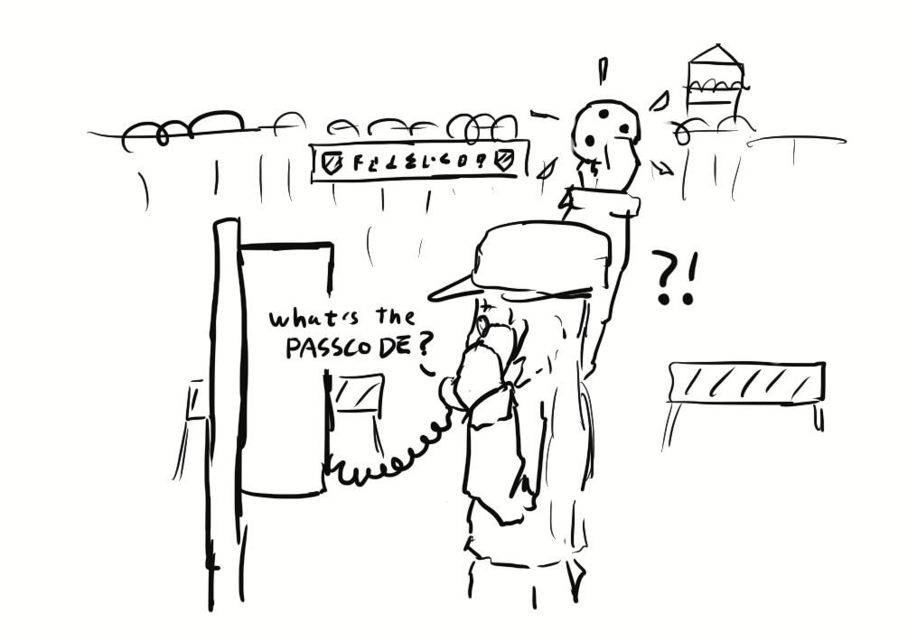
CSRF Defenses

Slide 23
CSRF Defenses
CSRF defenses are implemented by the server (not the browser)
Defense: CSRF tokens
Defense: Referer validation
Defense: SameSite cookie attribute

Slide 24
CSRF Tokens
Idea: Add a secret value in the request that the attacker doesn’t know
  The server only accepts requests if it has a valid secret
  Now, the attacker can’t create a malicious request without knowing the secret
CSRF token: A secret value provided by the server to the user. The user must attach the same value in the request for the server to accept the request.
  CSRF tokens cannot be sent to the server in a cookie!
    The token must be sent somewhere else (e.g. a header, GET parameter, or POST content)
  CSRF tokens are usually valid for only one or two requests
Notes:
Ask: Why not in a cookie?

Slide 25
CSRF Tokens: Usage
Example: HTML forms
  Forms are vulnerable to CSRF
    If the victim visits the attacker’s page, the attacker’s JavaScript can make a POST request with a filled-out form
CSRF tokens are a defense against this attack
  Every time the user requests a form from the legitimate website, the server attaches a CSRF token as a hidden form field (in the HTML, but not visible to the user)
  When the user submits the form, the form contains the CSRF token
  The attacker’s JavaScript won’t be able to create a valid form, because they don’t know the CSRF token!
  The attacker can try to fetch their own CSRF token, but it will only be valid for the attacker, not the victim

Slide 26
CSRF Tokens: Usage
User
Server
token in form
1. Login
2. Get token
4. Make request
3. Make this request with attacker token
Attacker
The request in step 4 will fail, because the attacker doesn’t know the token!

Slide 27
Referer Header
Idea: In a CSRF attack, the victim usually makes the malicious request from a different website
Referer header: A header in an HTTP request that indicates which webpage made the request
  “Referer” is a 30-year typo in the HTTP standard (supposed to be “Referrer”)!
  Example: If you type your username and password into the Facebook homepage, the Referer header for that request is https://www.facebook.com
  Example: If an img HTML tag on a forum forces your browser to make a request, the Referer header for that request is the forum’s URL
  Example: If JavaScript on an attacker’s website forces your browser to make a request, the Referer header for that request is the attacker’s URL

Slide 28
Referer Header
Checking the Referer header
  Allow same-site requests: The Referer header matches an expected URL
    Example: For a login request, expect it to come from https://bank.com/login
  Disallow cross-site requests: The Referer header does not match an expected URL
If the server sees a cross-site request, reject it

Slide 29
Referer Header: Issues
The Referer header may leak private information
  Example: If you made the request on a top-secret website, the Referer header might show you visited http://intranet.corp.apple.com/projects/iphone/competitors.html
  Example: If you make a request to an advertiser, the Referer header gives the advertiser information about how you saw the ad
The Referer header might be removed before the request reaches the server
  Example: Your company firewall removes the header before sending the request
  Example: The browser removes the header because of your privacy settings
The Referer header is optional. What if the request leaves the header blank?
  Allow requests without a header?
    Less secure: CSRF attacks might be possible
  Deny requests without a header?
    Less usable: Legitimate requests might be denied
  Need to consider fail-safe defaults: No clear answer

Slide 30
SameSite Cookie Attribute
Idea: Implement a flag on a cookie that makes it unexploitable by CSRF attacks
  This flag must specify that cross-site requests will not contain the cookie
SameSite flag: A flag on a cookie that specifies it should be sent only when the domain of the cookie exactly matches the domain of the origin
  SameSite=None: No effect
  SameSite=Strict: The cookie will not be sent if the cookie domain does not match the origin domain
  Example: If https://evil.com/ causes your browser to make a request to https://bank.com/transfer?to=mallory, cookies for bank.com will not be sent if SameSite=Strict, because the origin domain (evil.com) and cookie domain (bank.com) are different
Issue: Not yet implemented on all browsers

Slide 31
Cookies: Summary
Cookie: a piece of data used to maintain state across multiple requests
  Set by the browser or server
  Stored by the browser
  Attributes: Name, value, domain, path, secure, HttpOnly, expires
Cookie policy
  Server with domain X can set a cookie with domain attribute Y if the domain attribute is a domain suffix of the server’s domain, and the domain attribute Y is not a top-level domain (TLD)
  The browser attaches a cookie on a request if the domain attribute is a domain suffix of the server’s domain, and the path attribute is a prefix of the server’s path

Slide 32
Session Authentication: Summary
Session authentication
  Use cookies to associate requests with an authenticated user
  First request: Enter username and password, receive session token (as a cookie)
  Future requests: Browser automatically attaches the session token cookie
Session tokens
  If an attacker steals your session token, they can log in as you
  Should be randomly and securely generated by the server
  The browser should not send tokens to the wrong place

Slide 33
CSRF: Summary
Cross-site request forgery (CSRF or XSRF): An attack that exploits cookie-based authentication to perform an action as the victim
  User authenticates to the server
    User receives a cookie with a valid session token
  Attacker tricks the victim into making a malicious request to the server
  The server accepts the malicious request from the victim
    Recall: The cookie is automatically attached in the request
Attacker must trick the victim into creating a request
  GET request: click on a link
  POST request: use JavaScript

Slide 34
CSRF Defenses: Summary
CSRF token: A secret value provided by the server to the user. The user must attach the same value in the request for the server to accept the request.
  The attacker does not know the token when tricking the user into making a request
Referer Header: Allow same-site requests, but disallow cross-site requests
  Header may be blank or removed for privacy reasons
Same-site cookie attribute: The cookie is sent only when the domain of the cookie exactly matches the domain of the origin
  Not implemented on all browsers

Slide 35
Cross-Site Scripting (XSS)
Textbook Chapter 22

Slide 36
Top 25 Most Dangerous Software Weaknesses (2020)
Rank | ID | Name | Score
[1] | CWE-79 | Improper Neutralization of Input During Web Page Generation (’Cross-site Scripting’) | 46.82
[2] | CWE-787 | Out-of-bounds Write | 46.17
[3] | CWE-20 | Improper Input Validation | 33.47
[4] | CWE-125 | Out-of-bounds Read | 26.50
[5] | CWE-119 | Improper Restriction of Operations within the Bounds of a Memory Buffer | 23.73
[6] | CWE-89 | Improper Neutralization of Special Elements used in an SQL Command (’SQL Injection’) | 20.69
[7] | CWE-200 | Exposure of Sensitive Information to an Unauthorized Actor | 19.16
[8] | CWE-416 | Use After Free | 18.87
[9] | CWE-352 | Cross-Site Request Forgery (CSRF) | 17.29
[10] | CWE-78 | Improper Neutralization of Special Elements used in an OS Command (’OS Command Injection’) | 16.44
[11] | CWE-190 | Integer Overflow or Wraparound | 15.81
[12] | CWE-22 | Improper Limitation of a Pathname to a Restricted Directory (’Path Traversal’) | 13.67
[13] | CWE-476 | NULL Pointer Dereference | 8.35
[14] | CWE-287 | Improper Authentication | 8.17
[15] | CWE-434 | Unrestricted Upload of File with Dangerous Type | 7.38
[16] | CWE-732 | Incorrect Permission Assignment for Critical Resource | 6.95
[17] | CWE-94 | Improper Control of Generation of Code (’Code Injection’) | 6.53
Notes:
https://cwe.mitre.org/top25/archive/2020/2020_cwe_top25.html

Slide 37
Review: Same-Origin Policy
Two webpages with different origins should not be able to access each other’s resources
  Example: JavaScript on http://evil.com cannot access the information on http://bank.com

Slide 38
Review: JavaScript
JavaScript: A programming language for running code in the web browser
JavaScript is client-side
  Code sent by the server as part of the response
  Runs in the browser, not the web server!
Used to manipulate web pages (HTML and CSS)
  Makes modern websites interactive
  JavaScript can be directly embedded in HTML with <script> tags
Most modern webpages involve JavaScript
  JavaScript is supported by all modern web browsers
You don’t need to know JavaScript syntax
  However, knowing common attack functions helps

Slide 39
Review: JavaScript
JavaScript can create a pop-up message
HTML (with embedded JavaScript)
<script>alert("Happy Birthday!")</script>
Webpage
Happy Birthday!
When the browser loads this HTML, it will run the embedded JavaScript and cause a pop-up to appear.
OK

Slide 40
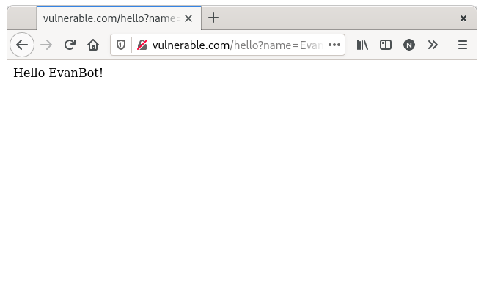
A Go HTTP Handler
Handler
func handleSayHello(w http.ResponseWriter, r *http.Request) {
name := r.URL.Query()["name"][0]
fmt.Fprintf(w, "<html><body>Hello %s!</body></html>", name)
}
URL
https://vulnerable.com/hello?name=EvanBot
Response
<html><body>Hello EvanBot!</body></html>

Slide 41
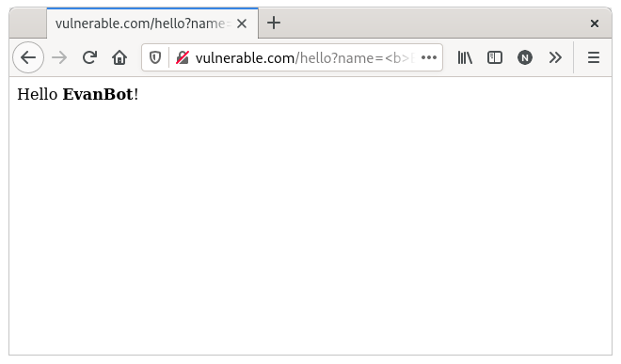
A Go HTTP Handler
Handler
func handleSayHello(w http.ResponseWriter, r *http.Request) {
name := r.URL.Query()["name"][0]
fmt.Fprintf(w, "<html><body>Hello %s!</body></html>", name)
}
URL
https://vulnerable.com/hello?name=<b>EvanBot</b>
Response
<html><body>Hello <b>EvanBot</b>!</body></html>

Slide 42
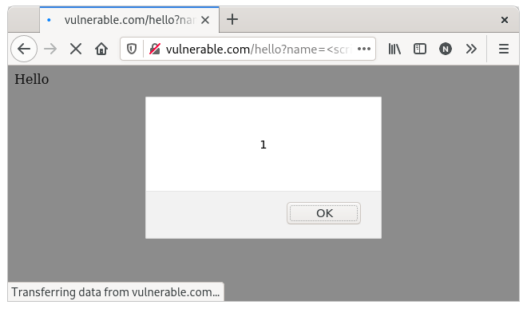
A Go HTTP Handler
Problem: This input represents control data (HTML), not just text!
Handler
func handleSayHello(w http.ResponseWriter, r *http.Request) {
name := r.URL.Query()["name"][0]
fmt.Fprintf(w, "<html><body>Hello %s!</body></html>", name)
}
URL
https://vulnerable.com/hello?name=<script>alert(1)</script>
Response
<html><body>Hello <script>alert(1)</script>!</body></html>

Slide 43
A Go HTTP Handler
Not just %s: It can happen with any string manipulation
Handler
func handleSayHello(w http.ResponseWriter, r *http.Request) {
name := r.URL.Query()["name"][0]
content := "<html><body>Hello "+name+"!</body></html>"
fmt.Fprint(w, content)
}
URL
https://vulnerable.com/hello?name=<script>alert(1)</script>
Response
<html><body>Hello <script>alert(1)</script>!</body></html>

Slide 44
Cross-Site Scripting (XSS)
Idea: The attacker adds malicious JavaScript to a legitimate website
  The legitimate website will send the attacker’s JavaScript to browsers
  The attacker’s JavaScript will run with the origin of the legitimate website
  Now the attacker’s JavaScript can access information on the legitimate website!
Cross-site scripting (XSS): Injecting JavaScript into websites that are viewed by other users
  Cross-site scripting subverts the same-origin policy
Two main types of XSS
  Stored XSS
  Reflected XSS

Slide 45
Stored XSS
Stored XSS (persistent XSS): The attacker’s JavaScript is stored on the legitimate server and sent to browsers
Classic example: Facebook pages
  Anybody can load a Facebook page with content provided by users
  An attacker puts some JavaScript on their Facebook page
  Anybody who loads the attacker’s page will see JavaScript (with the origin of Facebook)
Stored XSS requires the victim to load the page with injected JavaScript
Remember: Stored XSS is a server-side vulnerability!

Slide 46
Stored XSS
bank.com
2. Request content
3. Receive malicious script
5b. Make malicious requests
Victim
1. Inject malicious script
5a. Steal valuable data (e.g. session token)
4. Victim browser executes malicious script
Attacker

Slide 47
Reflected XSS
Reflected XSS: The attacker causes the victim to input JavaScript into a request, and the content is reflected (copied) in the response from the server
Classic example: Search
  If you make a request to http://google.com/search?q=evanbot, the response will say “10,000 results for evanbot”
  If you make a request to http://google.com/search?q=<script>alert(1)</script>, the response will say “10,000 results for <script>alert(1)</script>”
Reflected XSS requires the victim to make a request with injected JavaScript

Slide 48
Reflected XSS
bank.com
2. Request URL under attacker’s control
3. Reflect malicious script
5b. Make malicious requests
Victim
1. Cause malicious request (e.g. click on link)
4. Victim browser executes malicious script
5a. Steal valuable data (e.g. session token)
Attacker

Slide 49
Reflected XSS: Making a Request
How do we force the victim to make a request to the legitimate website with injected JavaScript?
  Trick the victim into visiting the attacker’s website, and include an embedded iframe that makes the request
    Can make the iframe very small (1 pixel x 1 pixel), so the victim doesn’t notice it:
    <iframe height=1 width=1 src="http://google.com/search?q=<script>alert(1)</script>">
  Trick the victim into clicking a link (e.g. posting on social media, sending a text, etc.)
  Trick the victim into visiting the attacker’s website, which redirects to the reflected XSS link
  … and many more!

Slide 50
Reflected XSS is not CSRF
Reflected XSS and CSRF both require the victim to make a request to a link
  XSS: An HTTP response contains maliciously inserted JavaScript, executed on the client side
  CSRF: A malicious HTTP request is made (containing the user’s cookies), executing an effect on the server side

Slide 51
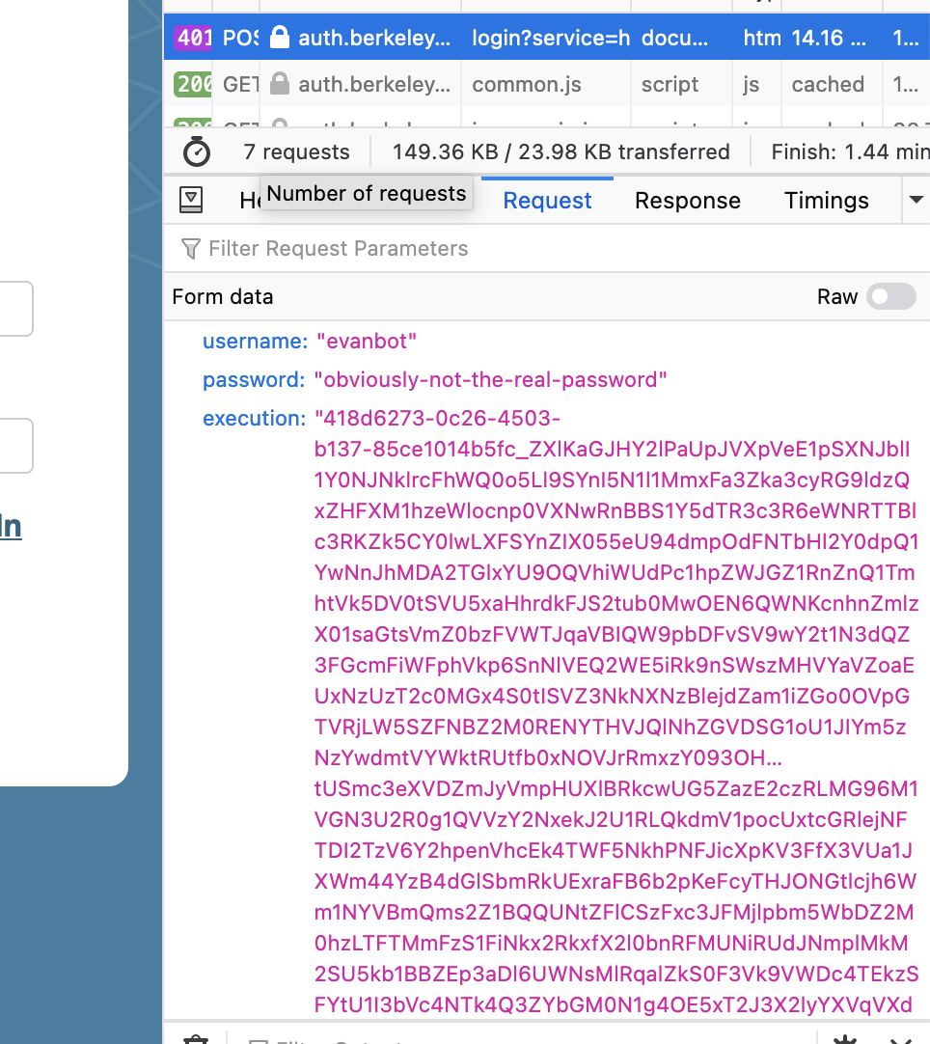
XSS in the Wild… On CalNet?!
In 2021, 61C student Rohan Mathur was exploring the CalNet login page
Fields submitted when logging in:
  username: What user am I logging in as?
  password: What’s the user’s password?
  execution: Server-side state (like a CSRF token with extra data)

Slide 52
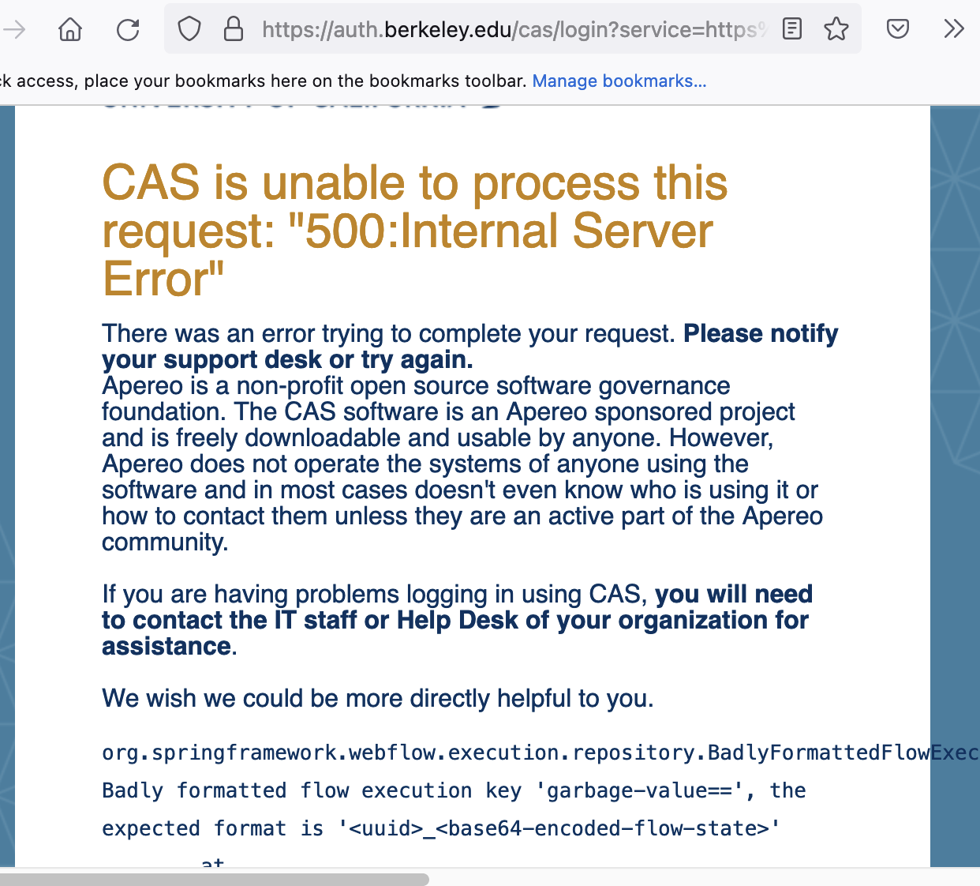
XSS in the Wild… On CalNet?!
The server expects execution to be in a specific format that contains its server-side state
  What if you muck with execution?
The “corrupted” execution key is placed into the error message in the HTML to aid debugging
  … and CalNet at the time did not escape the execution key
Garbage execution value in HTML

Slide 53
Constructing an Attack on CalNet
Attack: Force a POST request to CalNet!
<html>
<head>
<script>
// When the malicious page finishes loading, automatically submit the form!
document.addEventListener('DOMContentLoaded', () => {
document.getElementById('form').submit();
});
</script>
</head>
<body>
<!-- Malicious form containing our malicious execution data. -->
<form id="form" action="https://auth.berkeley.edu/cas/login" method="POST">
<input name="username" type="text" value="evanbot" />
<input name="password" type="text" value="obviously-not-the-real-password" />
<input name="execution" type="text" value="<script>alert('XSS!')</script>" />
</form>
</body>
</html>

Slide 54
So What Happened?
CalNet also accepts execution parameters over URL query parameters
  A link like https://auth.berkeley.edu/cas/login?execution=<script>alert('XSS!')</script> would result in the same attack
It would only fire if you clicked the button to show the error
… But if clicked, the injected JavaScript could
  Present a fake login prompt
  Steal your CalNet password
  Log you in as the attacker’s account
  Steal your authentication session token
Root cause: A >5 year old sample page modified by CalNet
  CalNet uses software from Apereo, which comes with sample pages for logging in
  Apereo fixed that bug many years before, but sample pages don’t get included in bug fixes!

Slide 55
XSS Defenses
<html>
<body>
Hello &lt;script&gt;alert(1)&lt;/script&gt;!
</body>
</html>
Defense: HTML sanitization
  Idea: Certain characters are special, so create sequences that represent those characters as data, rather than as HTML
Start with an ampersand (&) and end with a semicolon (;)
  Instead of <, use &lt;
  Instead of ", use &quot;
  And many more!
    It is important to escape all dangerous characters (lists of them can be found), or you will still be vulnerable!
Note: You should always rely on trusted libraries to do this for you!

Slide 56
XSS Defenses: Escaping
Handler
func handleSayHello(w http.ResponseWriter, r *http.Request) {
name := r.URL.Query()["name"][0]
fmt.Fprintf(w, "<html><body>Hello %s!</body></html>", html.EscapeString(name))
}
URL
https://vulnerable.com/hello?name=<script>alert(1)</script>
Response
<html><body>Hello &lt;script&gt;alert(1)&lt;/script&gt;!</body></html>

Slide 57
XSS Defenses: Escaping
<html>
<body>
Hello {{.name}}!
</body>
</html>
Example: Golang HTML template
If a programmer has to take an action for every usage…
  They are going to screw up (e.g. CalNet)
  Recall: Consider human factors!
Nowadays, escaping is generally achieved through templating
  HTML templates are essentially their own language, where you declare what data goes where
  The templating engine handles all the escaping internally
  The HTTP library gets very angry if you don’t use templates
  Recall (again): Consider human factors!

Slide 58
XSS Defenses: CSP
Defense: Content Security Policy (CSP)
  Idea: Instruct the browser to only use resources loaded from specific places
  Uses additional headers to specify the policy
Standard approach:
  Disallow all inline scripts (JavaScript code directly in HTML), which prevents inline XSS
    Example: Disallow <script>alert(1)</script>
  Only allow scripts from specified domains, which prevents XSS from linking to external scripts
    Example: Disallow <script src="https://cs161.org/hack.js">
Also works with other content (e.g. iframes, images, etc.)
Relies on the browser to enforce security, so more of a mitigation for defense-in-depth

Slide 59
Summary: XSS
Websites use untrusted content as control data
  <html><body>Hello EvanBot!</body></html>
  <html><body>Hello <script>alert(1)</script>!</body></html>
Stored XSS
  The attacker’s JavaScript is stored on the legitimate server and sent to browsers
  Classic example: Make a post on a social media site (e.g. Facebook) with JavaScript
Reflected XSS
  The attacker causes the victim to input JavaScript into a request, and the content it’s reflected (copied) in the response from the server
  Classic example: Create a link for a search engine (e.g. Google) query with JavaScript
  Requires the victim to click on the link with JavaScript

Slide 60
Summary: XSS Defenses
Defense: HTML sanitization
  Replace control characters with data sequences
    < becomes &lt;
    " becomes &quot;
  Use a trusted library to sanitize inputs for you
Defense: Content Security Policy (CSP)
  Instruct the browser to only use resources loaded from specific places
  Limits JavaScript: only scripts from trusted sources are run in the browser
  Enforced by the browser

