Slide 1
Web wrap-up &
Intro to networking
CS 161 Spring 2024

Slide 2
Announcements
This is the last week to sign up for Project 2 design review.
Please sign up if you haven't already!
The Mid-Semester Survey has been released and is due Friday, March 22nd at 11:59 PM PT. If 70% of the class fills out this form, we’ll give you 0.5 extra credit points post curve!
Notes:
Slide for SP24

Slide 3
Last Time: SQL Injection
Web servers interact with databases to store data
  Web servers use SQL to interact with databases
SQL injection: Untrusted input is used as parsed SQL
  The attacker can construct their own queries to run on the SQL server!
  Blind SQL injection: SQLi with little to no feedback from the SQL query
  Defense: Input sanitization
    Difficult to implement correctly
  Defense: Prepared statements
    Data only ever treated as data; bulletproof!
Command injection: Untrusted input is used as any parsed language
  Defense: Keep it simple and use safe API calls

Slide 4

Web attacks demo!

Slide 5
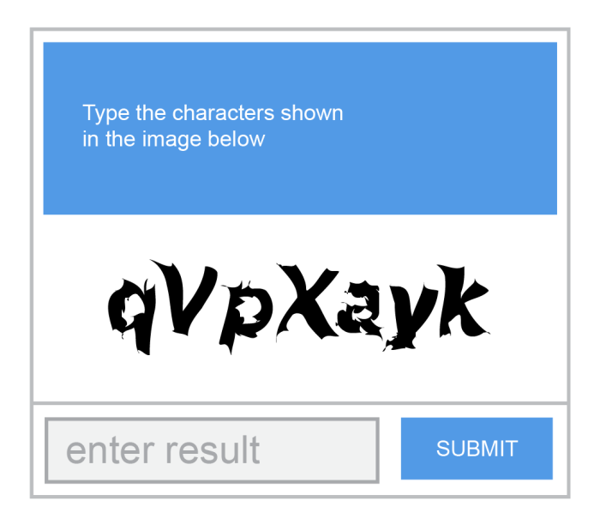

CAPTCHAs
?????

Slide 6
Websites are for Humans
Most websites are designed for human usage, not robot usage
  Example: A login page is for users to submit their password, not for an attacker to automate a brute-force attack
Robot access of websites can lead to attacks
  Denial of service: Overwhelming a web server by flooding it with requests
    We’ll see more denial-of-service later in the networking unit
  Spam
  More specific exploitation (e.g. scalping tickets/graphics cards when they go on sale)

Slide 7
CAPTCHAs: Definition
CAPTCHA: A challenge that is easy for a human to solve, but hard for a computer to solve
  “Completely Automated Public Turing test to tell Computers and Humans Apart”
  Sometimes called a “reverse Turing test”
  Used to distinguish web requests made by humans and web requests made by robots
Usage: Administer a CAPTCHA, and if it passes, assume that the user is human and allow access

Slide 8
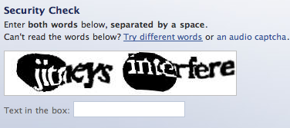
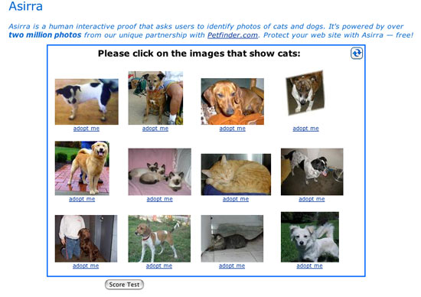
CAPTCHAs: Examples
Reading distorted text
Identifying images
Listening to an audio clip and typing out the words spoken

Slide 9
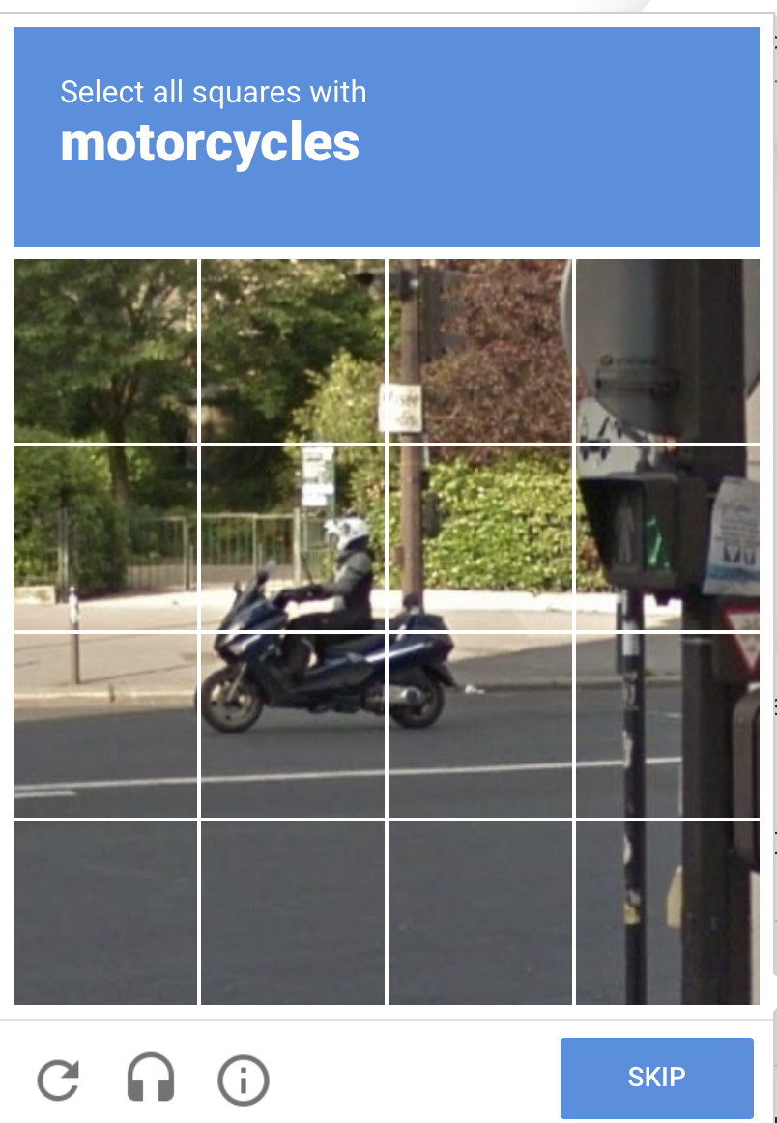
CAPTCHAs and Machine Learning
Modern CAPTCHAs have another purpose: Training machine learning algorithms
  Machine learning often requires manually-labeled datasets
  CAPTCHAs crowdsource human power to help manually label these big datasets
  Example: Machine vision problems require manually-labeled examples: “This is a stop sign”

Slide 10
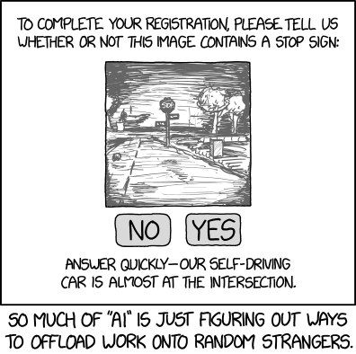
CAPTCHAs and Machine Learning
Takeaway: Modern CAPTCHAs are used to train machine learning algorithms
Notes:
https://xkcd.com/1897/

Slide 11
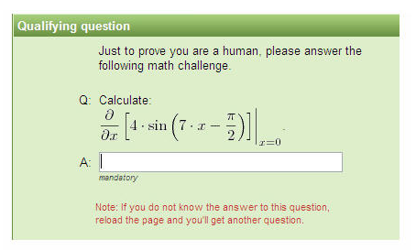
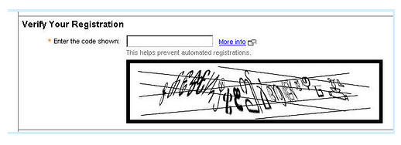
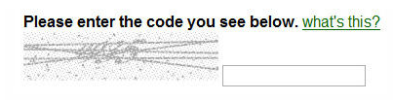
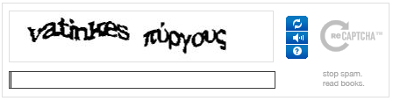
CAPTCHAs: Issues
Arms race: As computer algorithms get smarter, CAPTCHAs need to get harder
Accessibility: As CAPTCHAs get harder, not all humans are able to solve them easily
Ambiguity: CAPTCHAs might be so hard that the validator doesn’t know the solution either!
Not all bots are bad: CAPTCHAs can distinguish bots from humans, but not good bots from bad bots
  Example: Crawler bots help archive webpages

Slide 12

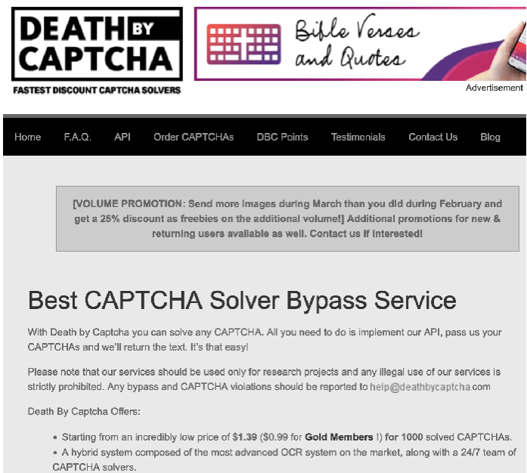
CAPTCHAs: Attacks
Outsourcing attack: Pay humans to solve CAPTCHAs for you
  CAPTCHAs only verify that there is a human in the loop; everything else can be automated
  Usually costs a few cents per CAPTCHA
  CAPTCHAs end up just distinguishing which attackers are willing to spend money
    Remember: Security is economics!

Slide 13
Web security
Intro to web
Same origin policy
Cookies
CSRF & defenses
XSS & defenses
SQL injection & defenses
UI attacks & defenses
CAPTCHAs

Slide 14
Intro to Networking
CS 161 Spring 2024 - Lecture 16

Slide 15
Intro to Networking
Internet: A global network of computers
OSI model: A layered model of protocols

Slide 16
What’s the Internet?
Textbook Chapter 25

Slide 17
What’s the Internet?
Network: A set of connected machines that can communicate with each other
  Machines on the network agree on a protocol, a set of rules for communication
Internet: A global network of computers
  The web sends data between browsers and servers using the Internet
  The Internet can be used for more than the web (e.g. SSH)

Slide 18
Protocols
A protocol is an agreement on how to communicate that specifies syntax and semantics
  Syntax: How a communication is specified and structured (format, order of messages)
  Semantics: What a communication means (actions taken when sending/receiving messages)
Example: Protocol for asking a question in lecture?
The student should raise their hand
The student should wait to be called on by the speaker or wait for the speaker to pause
The student should speak the question after being called on or after waiting
If the student has been unrecognized after some time: Vocalize with “Excuse me!”

Slide 19
Internet Analogy: Mail

Slide 20
What’s the goal of the Internet?
Move data from one location to another
Analogy: I write a message on a piece of paper. How do I send this message to you?
Solution: Postal system

Slide 21
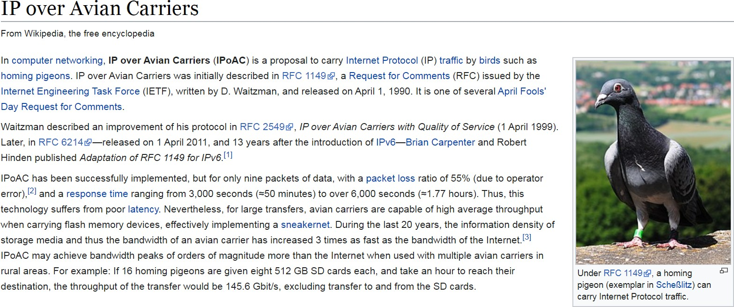
Building block 1: Something That Moves Data
Mailman, Pony Express, carrier pigeon, etc.
Are pigeons faster than the Internet?

Slide 22


Building block 1: Something That Moves Data
The Internet is built on technology that moves bits across space
Voltages on wires, wireless technology, radio waves, etc.
An example of packet loss.

Slide 23

Building block 2: Talking to the Apartment Complex
Using building block 1, we can link up people within a local apartment complex
Forms a local area network (LAN)
Building block 1: wires
Building block 2: local network

Slide 24



Building block 3: Post offices
A post office connects two or more apartment complexes
Forms a wide area network
Building block 1: wires
Building block 2: local network
Building block 3: wide area network

Slide 25
Building block 3: The Internet
Connect the entire world using post offices
Messages may pass through multiple post offices before reaching destination
Building block 1: wires
Building block 2: local network
Building block 3: the Internet

Slide 26
Layers of abstraction
Layer 3: Connect many local networks to form a global network
Layer 2: Create links in a local area
Layer 1: Move bits across space
A change in layer 1 implementation (wireless instead of wires) doesn’t affect the other layers
A change in layer 2 protocols doesn’t affect the other layers

Slide 27
Layering: The OSI Model

Slide 28

Layering
Internet design is partitioned into various layers. Each layer…
  Has a protocol
  Relies on services provided by the layer below it
  Provides services to the layer above it
Analogous to the structure of an application and the “services” that each layer relies on and provides
Code You Write
Run-Time Library
System Calls
Device Drivers
Fully isolated from user programs
Voltage Levels/Magnetic Domains

Slide 29
OSI Model
OSI model: Open Systems Interconnection model, a layered model of Internet communication
  Originally divided into 7 layers
    But layers 5 and 6 aren’t used in the real world, so we ignore them
Same reliance upon abstraction
  A layer can be implemented in different ways without affecting other layers
  A layer’s protocol can be substituted with another protocol without affecting other layers
7
Application
4
Transport
3
(Inter) Network
2
Link
1
Physical

Slide 30
Layer 1: Physical Layer
Provides: Sending bits from one device to another
  Encodes bits to send them over a physical link
    Patterns of voltage levels
    Photon intensities
    RF modulation
Examples
  Wi-Fi radios (IEEE 802.11)
  Ethernet voltages (IEEE 802.3)
7
Application
4
Transport
3
(Inter) Network
2
Link
1
Physical

Slide 31
Layer 1: Physical Layer
Physical layer: “How do I transmit this sequence of 0’s and 1’s from A to B?”
7
Application
4
Transport
A
01110111…01
B
3
(Inter) Network
2
Link
1
Physical
Next: How do we talk to more than one device?

Slide 32
Layer 2: Link Layer
Provides: Sending frames directly from one device to another
  Relies upon: Sending bits from one device to another
  Encodes messages into groups of bits called “frames”
Examples
  Ethernet frames (IEEE 802.3)
7
Application
4
Transport
3
(Inter) Network
2
Link
1
Physical

Slide 33
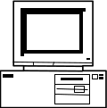
Layer 2: Link Layer
Local area network (LAN): A set of computers on a shared network that can directly address one another
  Consists of multiple physical links
Frames must consist of at least 3 things:
  Source (“Who is this message coming from?”)
  Destination (“Who is this message going to?”)
  Data (“What does this message say?”)
Source: A
Destination: C
“Hello, this is A…”
A
B
C
D

Slide 34
Layer 2: Link Layer
In reality, computers aren’t all connected to the same wire
  Instead, local networks are a set of point-to-point links
However, Layer 2 still allows direct addressing between any two devices
  Enabled by transmitting a frame across multiple physical links until it reaches its destination
Source: A
Dest: C
“Hello, this is A…”
B
A
E
D
C

Slide 35
Ethernet and MAC Addresses
Ethernet: A common layer 2 protocol that most endpoint devices use
MAC address: A 6-byte address that identifies a piece of network equipment (e.g. your phone’s Wi-Fi antenna)
  Typically represented as 6 hex bytes: 13:37:ca:fe:f0:0d
  The first 3 bytes are assigned to manufacturers (i.e. who made the equipment)
    This is useful in identifying a device
  The last 3 bytes are device-specific

Slide 36
Layer 2: Link Layer
Link layer: “How do I transmit this frame from A to C, making sure that no one else thinks the message is for them?”
7
Application
Source: A
Dest: C
“Hello, this is A…”
4
Transport
3
(Inter) Network
A
B
C
D
2
Link
1
Physical
Next: How do we address every device in existence?

Slide 37
Layer 3: Network Layer
Provides: Sending packets from any device to any other device
  Relies upon: Sending frames directly from one device to another
  Encodes messages into groups of bits called “packets”
  Bridges multiple LANs to provide global addressing
Examples
  Internet Protocol (IP)
7
Application
4
Transport
3
(Inter) Network
2
Link
1
Physical

Slide 38
Layer 3: Network Layer
Recall the ideal layer 2 model: All devices can directly address all other devices
  This would not scale to the size of the Internet!
Instead, allow packets to be routed across different devices to reach the destination
  Each hop is allowed to use its own physical and link layers!
A
B
C
D
Router
E
F
G
H

Slide 39
Layer 3: Network Layer
C
Source: A
Destination: D
“Hello, this is A…”
A
D
Router
Router
Router
Router
Router
E
B
Router
Router

Slide 40
Layer 3: Network Layer
This link could be Wi-Fi
C
Source: A
Destination: D
“Hello, this is A…”
And this link could be Ethernet
A
D
Router
Router
Router
But the Internet protocol stays the same, end to end
Router
Router
E
B
Router
Router

Slide 41
Layer 3: Network Layer
Packets must consist of at least 3 things:
  Source (“Who is this message coming from?”)
  Destination (“Who is this message going to?”)
  Data (“What does this message say?”)
  Similar to frames (layer 2)
Packets may be fragmented into smaller packets
  Different links might support different maximum packet sizes
  Up to the recipient to reassemble fragments into the original packet
Each router forwards a given packet to the next hop
  We will cover how a router knows how to forward—and attacks on it—in the future
Packets are not guaranteed to take a given route
  Two packets with the same source and destination may take different routes
Notes:
Ask: Why take different routes? What might happen?

Slide 42
Internet Protocol (IP)
Internet Protocol (IP): The universal layer-3 protocol that all devices use to transmit data over the Internet
IP address: An address that identifies a device on the Internet
  IPv4 is 32 bits, typically written as 4 decimal octets, e.g. 35.163.72.93
  IPv6 is 128 bits, typically written as 8 groups of 2 hex bytes: 2607:f140:8801::1:23
    If digits or groups are missing, fill with 0’s, so 2607:f140:8801:0000:0000:0000:0001:0023
  Globally unique from any single perspective
    For now, you can think of them as just being globally unique
  IP addresses help nodes make decisions on where to forward the packet

Slide 43
Reliability
Reliability ensures that packets are received correctly or, if random errors occur, not at all
  This is implemented with a checksum
  However, there is no cryptographic MAC, so there are no guarantees if an attacker modifies packets
IP is unreliable and only provides a best effort delivery service, which means:
  Packets may be lost (“dropped”)
  Packets may be corrupted
  Packets may be delivered out of order
It is up to higher level protocols to ensure that the connection is reliable

Slide 44
Layer 3: Network Layer
Layer 3: “How do I get this packet from A to D?”
C
Source: A
Destination: D
“Hello, this is A…”
Next: How do we reliably send any length of data, not just packets?
A
D
Router
Router
Router
Router
Router
E
B
Router
Router

Slide 45
Layer 4: Transport Layer
Provides: Transportation of variable-length data from any point to any other point
  Relies upon: Sending packets from any device to any other device
  Builds abstractions that are useful to applications on top of layer 3 packets
Useful abstractions
  Reliability: Transmit data reliably, in order
  Ports: Provide multiple “addresses” per real IP address
Examples
  TCP: Provides reliability and ports
  UDP: Provides ports, but no reliability
7
Application
4
Transport
3
(Inter) Network
2
Link
1
Physical

Slide 46
Layer 4: Transport Layer
I am now sending an arbitrary length message that will probably be broken into several packets…
Unreliable Internet
A
D
Layer 4: “How do I transport this arbitrary data over an unreliable medium?”

Slide 47
Layer 7: Application Layer
Provides: Applications and services to users!
  Relies upon: Transportation of variable-length data from any point to any other point
Every online application is Layer 7
  Web browsing
  Online video games
  Messaging services
  Video calls (Zoom)
7
Application
4
Transport
3
(Inter) Network
2
Link
1
Physical

Slide 48
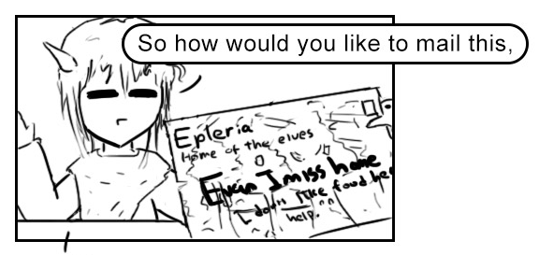
Headers

Slide 49


Example: Sending Mail
Alice
Bob
I am hungry.

Slide 50

Example: Sending Mail
Alice
Bob
Send to: Bob
I am hungry.

Slide 51
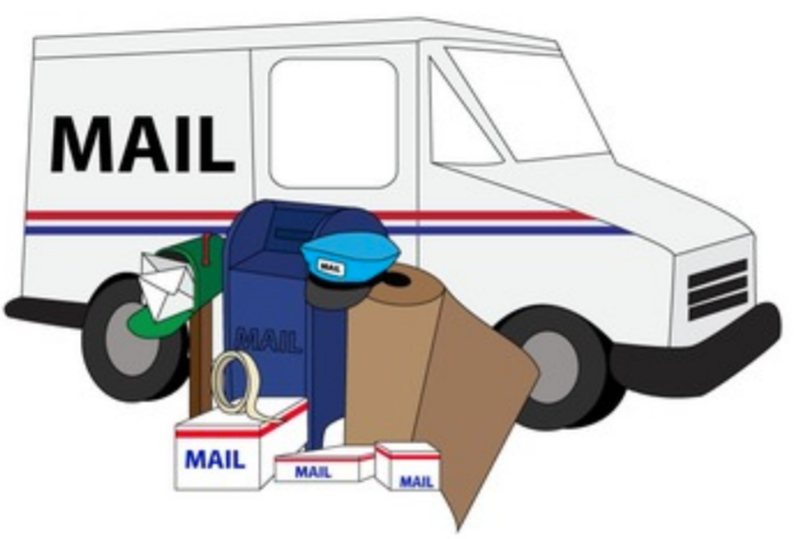
Example: Sending Mail
Alice
Bob
Mail to: 123 Bob St
Send to: Bob
I am hungry.

Slide 52
Example: Sending Mail
Alice
Bob
Mail to: 123 Bob St
Send to: Bob
I am hungry.

Slide 53
Example: Sending Mail
Alice
Bob
Send to: Bob
I am hungry.

Slide 54
Example: Sending Mail
Alice
Bob
I am hungry.

Slide 55
Example: Sending Mail
Each layer communicates with each other, relying on abstractions below them!
Alice
Bob
Relies upon: Sending messages to people
Provides: Sending messages to people
Relies upon: Sending messages to addresses
Provides: Sending messages to addresses

Slide 56
Layers of Abstraction and Headers
As you move to lower layers, we wrap additional headers around the message
As you move to higher layers, you peel off headers around the message
Mail to: 123 Bob St
Send to: Bob
Send to: Bob
I’m hungry.
I’m hungry.
I’m hungry.
Higher layer, fewer headers
Lower layer, more headers

Slide 57
Layers of Abstraction and Headers
As you move to lower layers, you wrap additional headers around the message
As you move to higher layers, you peel off headers around the message
When sending a message we go from the highest to the lowest layer
When receiving a message we go from the lowest to highest layer

Slide 58
Layer 2 Header
Source MAC Address (6 bytes)
Destination MAC Address (6 bytes)
VLAN Tag (4 bytes) |  |  |  | Type (2 bytes)
Data (variable-length)
Ethernet and MAC address headers

Slide 59
Layer 3 Header
Version (4 bits) |  | Header Length (4 bits) |  | Type of Service (6 bits) |  |  | ECN (2 bits) | Total Length (16 bits)
Identification (16 bits) |  |  |  |  |  |  |  | Flags (3 bits) |  | Fragment Offset (13 bits)
Time to Live (8 bits) |  |  |  | Protocol (8 bits) |  |  |  | Header Checksum (16 bits)
Source Address (32 bits)
Destination Address (32 bits)
Options (variable length)
Data (variable length)
IPv4 header
Notes:
Notice: Source address, destination address, header checksum, fragment offset, and data

Slide 60
Example: HTTP Request
HTTP
GET / HTTP/1.1
...
HTTP
TCP
TCP
IP
IP
Ethernet
Ethernet
Wires
Wires

Slide 61
Example: HTTP Request
HTTP
HTTP
From: Port 1234
To: Port 80
TCP
GET / HTTP/1.1
...
TCP
IP
IP
Ethernet
Ethernet
Wires
Wires

Slide 62
Example: HTTP Request
HTTP
HTTP
Final destination
From: 1.2.3.4
To: 5.6.7.8
TCP
TCP
From: Port 1234
To: Port 80
IP
GET / HTTP/1.1
...
IP
Ethernet
Ethernet
Wires
Wires

Slide 63
Example: HTTP Request
HTTP
HTTP
Address of next hop
TCP
From: 20:61:84:3a:a9:52
To: 6d:36:ff:4a:32:92
TCP
From: 1.2.3.4
To: 5.6.7.8
IP
IP
From: Port 1234
To: Port 80
Ethernet
GET / HTTP/1.1
...
Ethernet
Wires
Wires

Slide 64
Example: HTTP Request
HTTP
HTTP
TCP
TCP
Converted into bits and transmitted
IP
From: 20:61:84:3a:a9:52
To: 6d:36:ff:4a:32:92
IP
From: 1.2.3.4
To: 5.6.7.8
Ethernet
Ethernet
From: Port 1234
To: Port 80
GET / HTTP/1.1
...
Wires
Wires

Slide 65
Example: HTTP Request
HTTP
HTTP
TCP
TCP
Received over the physical medium
IP
From: 89:8d:33:25:47:24
To: d5:a9:20:68:e0:80
IP
Notice: The MAC addresses changed because the recipient is on a different network
From: 1.2.3.4
To: 5.6.7.8
Ethernet
Ethernet
From: Port 1234
To: Port 80
GET / HTTP/1.1
...
Wires
Wires

Slide 66
Example: HTTP Request
HTTP
HTTP
TCP
TCP
From: 89:8d:33:25:47:24
To: d5:a9:20:68:e0:80
From: 1.2.3.4
To: 5.6.7.8
IP
IP
From: Port 1234
To: Port 80
Ethernet
GET / HTTP/1.1
...
Ethernet
Wires
Wires

Slide 67
Example: HTTP Request
HTTP
HTTP
From: 1.2.3.4
To: 5.6.7.8
TCP
TCP
From: Port 1234
To: Port 80
IP
GET / HTTP/1.1
...
IP
Ethernet
Ethernet
Wires
Wires

Slide 68
Example: HTTP Request
HTTP
HTTP
From: Port 1234
To: Port 80
TCP
GET / HTTP/1.1
...
TCP
IP
IP
Ethernet
Ethernet
Wires
Wires

Slide 69
Example: HTTP Request
HTTP
GET / HTTP/1.1
...
HTTP
TCP
TCP
IP
IP
Ethernet
Ethernet
Wires
Wires

Slide 70
Example: HTTP Request
Relies upon: Transport of data
HTTP
HTTP
Provides: Transport of data
Relies upon: Global packet delivery
TCP
TCP
Provides: Global packet delivery
Relies upon: Local frame delivery
IP
IP
Provides: Local frame delivery
Relies upon: Communication of bits
Ethernet
Ethernet
Provides: Communication of bits
Wires
Wires

Slide 71
Intro to Networking: Summary
Internet: A global network of computers
  Protocols: Agreed-upon systems of communication
OSI model: A layered model of protocols
  Layer 1: Communication of bits
  Layer 2: Local frame delivery
    Ethernet: The most common Layer 2 protocol
    MAC addresses: 6-byte addressing system used by Ethernet
  Layer 3: Global packet delivery
    IP: The universal Layer 3 protocol
    IP addresses: 4-byte (or 16-byte) addressing system used by IP
  Layer 4: Transport of data (more on this next time)
  Layer 7: Applications and services (the web)
7
Application
4
Transport
3
(Inter) Network
2
Link
1
Physical

Slide 72
Announcements
This is the last week to sign up for Project 2 design review.
Please sign up if you haven't already!
The Mid-Semester Survey has been released and is due Friday, March 22nd at 11:59 PM PT. If 70% of the class fills out this form, we’ll give you 0.5 extra credit points post curve!
Notes:
Slide for SP24

Slide 73
Last Time: SQL Injection
Web servers interact with databases to store data
  Web servers use SQL to interact with databases
SQL injection: Untrusted input is used as parsed SQL
  The attacker can construct their own queries to run on the SQL server!
  Blind SQL injection: SQLi with little to no feedback from the SQL query
  Defense: Input sanitization
    Difficult to implement correctly
  Defense: Prepared statements
    Data only ever treated as data; bulletproof!
Command injection: Untrusted input is used as any parsed language
  Defense: Keep it simple and use safe API calls

Slide 74
Web attacks demo!

Slide 75
CAPTCHAs
?????

Slide 76
Websites are for Humans
Most websites are designed for human usage, not robot usage
  Example: A login page is for users to submit their password, not for an attacker to automate a brute-force attack
Robot access of websites can lead to attacks
  Denial of service: Overwhelming a web server by flooding it with requests
    We’ll see more denial-of-service later in the networking unit
  Spam
  More specific exploitation (e.g. scalping tickets/graphics cards when they go on sale)

Slide 77
CAPTCHAs: Definition
CAPTCHA: A challenge that is easy for a human to solve, but hard for a computer to solve
  “Completely Automated Public Turing test to tell Computers and Humans Apart”
  Sometimes called a “reverse Turing test”
  Used to distinguish web requests made by humans and web requests made by robots
Usage: Administer a CAPTCHA, and if it passes, assume that the user is human and allow access

Slide 78
CAPTCHAs: Examples
Reading distorted text
Identifying images
Listening to an audio clip and typing out the words spoken

Slide 79
CAPTCHAs and Machine Learning
Modern CAPTCHAs have another purpose: Training machine learning algorithms
  Machine learning often requires manually-labeled datasets
  CAPTCHAs crowdsource human power to help manually label these big datasets
  Example: Machine vision problems require manually-labeled examples: “This is a stop sign”

Slide 80
CAPTCHAs and Machine Learning
Takeaway: Modern CAPTCHAs are used to train machine learning algorithms
Notes:
https://xkcd.com/1897/

Slide 81
CAPTCHAs: Issues
Arms race: As computer algorithms get smarter, CAPTCHAs need to get harder
Accessibility: As CAPTCHAs get harder, not all humans are able to solve them easily
Ambiguity: CAPTCHAs might be so hard that the validator doesn’t know the solution either!
Not all bots are bad: CAPTCHAs can distinguish bots from humans, but not good bots from bad bots
  Example: Crawler bots help archive webpages

Slide 82
CAPTCHAs: Attacks
Outsourcing attack: Pay humans to solve CAPTCHAs for you
  CAPTCHAs only verify that there is a human in the loop; everything else can be automated
  Usually costs a few cents per CAPTCHA
  CAPTCHAs end up just distinguishing which attackers are willing to spend money
    Remember: Security is economics!

Slide 83
Web security
Intro to web
Same origin policy
Cookies
CSRF & defenses
XSS & defenses
SQL injection & defenses
UI attacks & defenses
CAPTCHAs

Slide 84
Intro to Networking
CS 161 Spring 2024 - Lecture 16

Slide 85
Intro to Networking
Internet: A global network of computers
OSI model: A layered model of protocols

Slide 86
What’s the Internet?
Textbook Chapter 25

Slide 87
What’s the Internet?
Network: A set of connected machines that can communicate with each other
  Machines on the network agree on a protocol, a set of rules for communication
Internet: A global network of computers
  The web sends data between browsers and servers using the Internet
  The Internet can be used for more than the web (e.g. SSH)

Slide 88
Protocols
A protocol is an agreement on how to communicate that specifies syntax and semantics
  Syntax: How a communication is specified and structured (format, order of messages)
  Semantics: What a communication means (actions taken when sending/receiving messages)
Example: Protocol for asking a question in lecture?
The student should raise their hand
The student should wait to be called on by the speaker or wait for the speaker to pause
The student should speak the question after being called on or after waiting
If the student has been unrecognized after some time: Vocalize with “Excuse me!”

Slide 89
Internet Analogy: Mail

Slide 90
What’s the goal of the Internet?
Move data from one location to another
Analogy: I write a message on a piece of paper. How do I send this message to you?
Solution: Postal system

Slide 91
Building block 1: Something That Moves Data
Mailman, Pony Express, carrier pigeon, etc.
Are pigeons faster than the Internet?

Slide 92
Building block 1: Something That Moves Data
The Internet is built on technology that moves bits across space
Voltages on wires, wireless technology, radio waves, etc.
An example of packet loss.

Slide 93
Building block 2: Talking to the Apartment Complex
Using building block 1, we can link up people within a local apartment complex
Forms a local area network (LAN)
Building block 1: wires
Building block 2: local network

Slide 94
Building block 3: Post offices
A post office connects two or more apartment complexes
Forms a wide area network
Building block 1: wires
Building block 2: local network
Building block 3: wide area network

Slide 95
Building block 3: The Internet
Connect the entire world using post offices
Messages may pass through multiple post offices before reaching destination
Building block 1: wires
Building block 2: local network
Building block 3: the Internet

Slide 96
Layers of abstraction
Layer 3: Connect many local networks to form a global network
Layer 2: Create links in a local area
Layer 1: Move bits across space
A change in layer 1 implementation (wireless instead of wires) doesn’t affect the other layers
A change in layer 2 protocols doesn’t affect the other layers

Slide 97
Layering: The OSI Model

Slide 98
Layering
Internet design is partitioned into various layers. Each layer…
  Has a protocol
  Relies on services provided by the layer below it
  Provides services to the layer above it
Analogous to the structure of an application and the “services” that each layer relies on and provides
Code You Write
Run-Time Library
System Calls
Device Drivers
Fully isolated from user programs
Voltage Levels/Magnetic Domains

Slide 99
OSI Model
OSI model: Open Systems Interconnection model, a layered model of Internet communication
  Originally divided into 7 layers
    But layers 5 and 6 aren’t used in the real world, so we ignore them
Same reliance upon abstraction
  A layer can be implemented in different ways without affecting other layers
  A layer’s protocol can be substituted with another protocol without affecting other layers
7
Application
4
Transport
3
(Inter) Network
2
Link
1
Physical

Slide 100
Layer 1: Physical Layer
Provides: Sending bits from one device to another
  Encodes bits to send them over a physical link
    Patterns of voltage levels
    Photon intensities
    RF modulation
Examples
  Wi-Fi radios (IEEE 802.11)
  Ethernet voltages (IEEE 802.3)
7
Application
4
Transport
3
(Inter) Network
2
Link
1
Physical

Slide 101
Layer 1: Physical Layer
Physical layer: “How do I transmit this sequence of 0’s and 1’s from A to B?”
7
Application
4
Transport
A
01110111…01
B
3
(Inter) Network
2
Link
1
Physical
Next: How do we talk to more than one device?

Slide 102
Layer 2: Link Layer
Provides: Sending frames directly from one device to another
  Relies upon: Sending bits from one device to another
  Encodes messages into groups of bits called “frames”
Examples
  Ethernet frames (IEEE 802.3)
7
Application
4
Transport
3
(Inter) Network
2
Link
1
Physical

Slide 103
Layer 2: Link Layer
Local area network (LAN): A set of computers on a shared network that can directly address one another
  Consists of multiple physical links
Frames must consist of at least 3 things:
  Source (“Who is this message coming from?”)
  Destination (“Who is this message going to?”)
  Data (“What does this message say?”)
Source: A
Destination: C
“Hello, this is A…”
A
B
C
D

Slide 104
Layer 2: Link Layer
In reality, computers aren’t all connected to the same wire
  Instead, local networks are a set of point-to-point links
However, Layer 2 still allows direct addressing between any two devices
  Enabled by transmitting a frame across multiple physical links until it reaches its destination
Source: A
Dest: C
“Hello, this is A…”
B
A
E
D
C

Slide 105
Ethernet and MAC Addresses
Ethernet: A common layer 2 protocol that most endpoint devices use
MAC address: A 6-byte address that identifies a piece of network equipment (e.g. your phone’s Wi-Fi antenna)
  Typically represented as 6 hex bytes: 13:37:ca:fe:f0:0d
  The first 3 bytes are assigned to manufacturers (i.e. who made the equipment)
    This is useful in identifying a device
  The last 3 bytes are device-specific

Slide 106
Layer 2: Link Layer
Link layer: “How do I transmit this frame from A to C, making sure that no one else thinks the message is for them?”
7
Application
Source: A
Dest: C
“Hello, this is A…”
4
Transport
3
(Inter) Network
A
B
C
D
2
Link
1
Physical
Next: How do we address every device in existence?

Slide 107
Layer 3: Network Layer
Provides: Sending packets from any device to any other device
  Relies upon: Sending frames directly from one device to another
  Encodes messages into groups of bits called “packets”
  Bridges multiple LANs to provide global addressing
Examples
  Internet Protocol (IP)
7
Application
4
Transport
3
(Inter) Network
2
Link
1
Physical

Slide 108
Layer 3: Network Layer
Recall the ideal layer 2 model: All devices can directly address all other devices
  This would not scale to the size of the Internet!
Instead, allow packets to be routed across different devices to reach the destination
  Each hop is allowed to use its own physical and link layers!
A
B
C
D
Router
E
F
G
H

Slide 109
Layer 3: Network Layer
C
Source: A
Destination: D
“Hello, this is A…”
A
D
Router
Router
Router
Router
Router
E
B
Router
Router

Slide 110
Layer 3: Network Layer
This link could be Wi-Fi
C
Source: A
Destination: D
“Hello, this is A…”
And this link could be Ethernet
A
D
Router
Router
Router
But the Internet protocol stays the same, end to end
Router
Router
E
B
Router
Router

Slide 111
Layer 3: Network Layer
Packets must consist of at least 3 things:
  Source (“Who is this message coming from?”)
  Destination (“Who is this message going to?”)
  Data (“What does this message say?”)
  Similar to frames (layer 2)
Packets may be fragmented into smaller packets
  Different links might support different maximum packet sizes
  Up to the recipient to reassemble fragments into the original packet
Each router forwards a given packet to the next hop
  We will cover how a router knows how to forward—and attacks on it—in the future
Packets are not guaranteed to take a given route
  Two packets with the same source and destination may take different routes
Notes:
Ask: Why take different routes? What might happen?

Slide 112
Internet Protocol (IP)
Internet Protocol (IP): The universal layer-3 protocol that all devices use to transmit data over the Internet
IP address: An address that identifies a device on the Internet
  IPv4 is 32 bits, typically written as 4 decimal octets, e.g. 35.163.72.93
  IPv6 is 128 bits, typically written as 8 groups of 2 hex bytes: 2607:f140:8801::1:23
    If digits or groups are missing, fill with 0’s, so 2607:f140:8801:0000:0000:0000:0001:0023
  Globally unique from any single perspective
    For now, you can think of them as just being globally unique
  IP addresses help nodes make decisions on where to forward the packet

Slide 113
Reliability
Reliability ensures that packets are received correctly or, if random errors occur, not at all
  This is implemented with a checksum
  However, there is no cryptographic MAC, so there are no guarantees if an attacker modifies packets
IP is unreliable and only provides a best effort delivery service, which means:
  Packets may be lost (“dropped”)
  Packets may be corrupted
  Packets may be delivered out of order
It is up to higher level protocols to ensure that the connection is reliable

Slide 114
Layer 3: Network Layer
Layer 3: “How do I get this packet from A to D?”
C
Source: A
Destination: D
“Hello, this is A…”
Next: How do we reliably send any length of data, not just packets?
A
D
Router
Router
Router
Router
Router
E
B
Router
Router

Slide 115
Layer 4: Transport Layer
Provides: Transportation of variable-length data from any point to any other point
  Relies upon: Sending packets from any device to any other device
  Builds abstractions that are useful to applications on top of layer 3 packets
Useful abstractions
  Reliability: Transmit data reliably, in order
  Ports: Provide multiple “addresses” per real IP address
Examples
  TCP: Provides reliability and ports
  UDP: Provides ports, but no reliability
7
Application
4
Transport
3
(Inter) Network
2
Link
1
Physical

Slide 116
Layer 4: Transport Layer
I am now sending an arbitrary length message that will probably be broken into several packets…
Unreliable Internet
A
D
Layer 4: “How do I transport this arbitrary data over an unreliable medium?”

Slide 117
Layer 7: Application Layer
Provides: Applications and services to users!
  Relies upon: Transportation of variable-length data from any point to any other point
Every online application is Layer 7
  Web browsing
  Online video games
  Messaging services
  Video calls (Zoom)
7
Application
4
Transport
3
(Inter) Network
2
Link
1
Physical

Slide 118
Headers

Slide 119
Example: Sending Mail
Alice
Bob
I am hungry.

Slide 120
Example: Sending Mail
Alice
Bob
Send to: Bob
I am hungry.

Slide 121
Example: Sending Mail
Alice
Bob
Mail to: 123 Bob St
Send to: Bob
I am hungry.

Slide 122
Example: Sending Mail
Alice
Bob
Mail to: 123 Bob St
Send to: Bob
I am hungry.

Slide 123
Example: Sending Mail
Alice
Bob
Send to: Bob
I am hungry.

Slide 124
Example: Sending Mail
Alice
Bob
I am hungry.

Slide 125
Example: Sending Mail
Each layer communicates with each other, relying on abstractions below them!
Alice
Bob
Relies upon: Sending messages to people
Provides: Sending messages to people
Relies upon: Sending messages to addresses
Provides: Sending messages to addresses

Slide 126
Layers of Abstraction and Headers
As you move to lower layers, we wrap additional headers around the message
As you move to higher layers, you peel off headers around the message
Mail to: 123 Bob St
Send to: Bob
Send to: Bob
I’m hungry.
I’m hungry.
I’m hungry.
Higher layer, fewer headers
Lower layer, more headers

Slide 127
Layers of Abstraction and Headers
As you move to lower layers, you wrap additional headers around the message
As you move to higher layers, you peel off headers around the message
When sending a message we go from the highest to the lowest layer
When receiving a message we go from the lowest to highest layer

Slide 128
Layer 2 Header
Source MAC Address (6 bytes)
Destination MAC Address (6 bytes)
VLAN Tag (4 bytes) |  |  |  | Type (2 bytes)
Data (variable-length)
Ethernet and MAC address headers

Slide 129
Layer 3 Header
Version (4 bits) |  | Header Length (4 bits) |  | Type of Service (6 bits) |  |  | ECN (2 bits) | Total Length (16 bits)
Identification (16 bits) |  |  |  |  |  |  |  | Flags (3 bits) |  | Fragment Offset (13 bits)
Time to Live (8 bits) |  |  |  | Protocol (8 bits) |  |  |  | Header Checksum (16 bits)
Source Address (32 bits)
Destination Address (32 bits)
Options (variable length)
Data (variable length)
IPv4 header
Notes:
Notice: Source address, destination address, header checksum, fragment offset, and data

Slide 130
Example: HTTP Request
HTTP
GET / HTTP/1.1
...
HTTP
TCP
TCP
IP
IP
Ethernet
Ethernet
Wires
Wires

Slide 131
Example: HTTP Request
HTTP
HTTP
From: Port 1234
To: Port 80
TCP
GET / HTTP/1.1
...
TCP
IP
IP
Ethernet
Ethernet
Wires
Wires

Slide 132
Example: HTTP Request
HTTP
HTTP
Final destination
From: 1.2.3.4
To: 5.6.7.8
TCP
TCP
From: Port 1234
To: Port 80
IP
GET / HTTP/1.1
...
IP
Ethernet
Ethernet
Wires
Wires

Slide 133
Example: HTTP Request
HTTP
HTTP
Address of next hop
TCP
From: 20:61:84:3a:a9:52
To: 6d:36:ff:4a:32:92
TCP
From: 1.2.3.4
To: 5.6.7.8
IP
IP
From: Port 1234
To: Port 80
Ethernet
GET / HTTP/1.1
...
Ethernet
Wires
Wires

Slide 134
Example: HTTP Request
HTTP
HTTP
TCP
TCP
Converted into bits and transmitted
IP
From: 20:61:84:3a:a9:52
To: 6d:36:ff:4a:32:92
IP
From: 1.2.3.4
To: 5.6.7.8
Ethernet
Ethernet
From: Port 1234
To: Port 80
GET / HTTP/1.1
...
Wires
Wires

Slide 135
Example: HTTP Request
HTTP
HTTP
TCP
TCP
Received over the physical medium
IP
From: 89:8d:33:25:47:24
To: d5:a9:20:68:e0:80
IP
Notice: The MAC addresses changed because the recipient is on a different network
From: 1.2.3.4
To: 5.6.7.8
Ethernet
Ethernet
From: Port 1234
To: Port 80
GET / HTTP/1.1
...
Wires
Wires

Slide 136
Example: HTTP Request
HTTP
HTTP
TCP
TCP
From: 89:8d:33:25:47:24
To: d5:a9:20:68:e0:80
From: 1.2.3.4
To: 5.6.7.8
IP
IP
From: Port 1234
To: Port 80
Ethernet
GET / HTTP/1.1
...
Ethernet
Wires
Wires

Slide 137
Example: HTTP Request
HTTP
HTTP
From: 1.2.3.4
To: 5.6.7.8
TCP
TCP
From: Port 1234
To: Port 80
IP
GET / HTTP/1.1
...
IP
Ethernet
Ethernet
Wires
Wires

Slide 138
Example: HTTP Request
HTTP
HTTP
From: Port 1234
To: Port 80
TCP
GET / HTTP/1.1
...
TCP
IP
IP
Ethernet
Ethernet
Wires
Wires

Slide 139
Example: HTTP Request
HTTP
GET / HTTP/1.1
...
HTTP
TCP
TCP
IP
IP
Ethernet
Ethernet
Wires
Wires

Slide 140
Example: HTTP Request
Relies upon: Transport of data
HTTP
HTTP
Provides: Transport of data
Relies upon: Global packet delivery
TCP
TCP
Provides: Global packet delivery
Relies upon: Local frame delivery
IP
IP
Provides: Local frame delivery
Relies upon: Communication of bits
Ethernet
Ethernet
Provides: Communication of bits
Wires
Wires

Slide 141
Intro to Networking: Summary
Internet: A global network of computers
  Protocols: Agreed-upon systems of communication
OSI model: A layered model of protocols
  Layer 1: Communication of bits
  Layer 2: Local frame delivery
    Ethernet: The most common Layer 2 protocol
    MAC addresses: 6-byte addressing system used by Ethernet
  Layer 3: Global packet delivery
    IP: The universal Layer 3 protocol
    IP addresses: 4-byte (or 16-byte) addressing system used by IP
  Layer 4: Transport of data (more on this next time)
  Layer 7: Applications and services (the web)
7
Application
4
Transport
3
(Inter) Network
2
Link
1
Physical

