Slide 1
Low Level Network Attacks
CS 161 Spring 2024 - Lecture 17

Slide 2
Last Time: Intro to Networking
Internet: A global network of computers
  Protocols: Agreed-upon systems of communication
OSI model: A layered model of protocols
  Layer 1: Communication of bits
  Layer 2: Local frame delivery
    Ethernet: The most common Layer 2 protocol
    MAC addresses: 6-byte addressing system used by Ethernet
  Layer 3: Global packet delivery
    IP: The universal Layer 3 protocol
    IP addresses: 4-byte (or 16-byte) addressing system used by IP
  Layer 4: Transport of data (more on this next time)
  Layer 7: Applications and services (the web)
7
Application
4
Transport
3
(Inter) Network
2
Link
1
Physical

Slide 3
Today: Low-Level Network Attacks
Network Attackers
  Man-in-the-middle attacker
  On-path attacker
  Off-path attacker
ARP: Translate IP addresses to MAC addresses
WPA: Communicate securely in a wireless local network
DHCP: Get configurations when first connecting to a network

Slide 4

Network Attackers

Slide 5
Types of Network Attackers
Threat model: There are 3 types of attackers we’ll consider
 | Can modify or delete packets | Can read packets
Man-in-the-middle attacker | ✓ | ✓
On-path attacker |  | ✓
Off-path attacker

Slide 6
Spoofing
Anybody can send their own packets through the network
Spoofing: Lying about the identity of the sender
  Example: Mallory sends a message and says the message is from Alice
  The attacker can lie about the source address in the packet header
All types of attackers can spoof packets
  However, some spoofing attacks may be harder if the attacker can’t read or modify packets

Slide 7
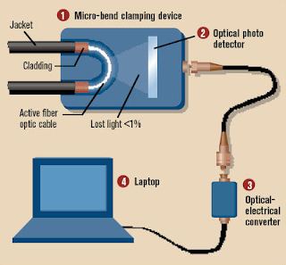
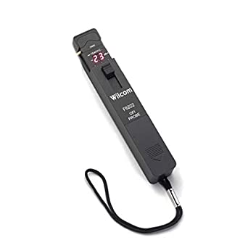
Real-World On-Path Attackers
How might a real-life attacker read packets?
Layer 1 attack: Use a special device to read bits being transmitted across space

Slide 8

Real-World On-Path Attackers
Operation Ivy Bells
Matthew Carle | February 6, 2017
In an effort to alter the balance of the Cold War, divers from the USS Halibut scoured the ocean floor for a five-inch diameter cable that carried secret Soviet communications between military bases. The divers found the cable and installed a listening device. Upon their return to the United States, the NSA analyzed the recordings and found that a surprising amount of sensitive Soviet information travelled through the lines without encryption. The original tap was later discovered by the Soviets and is now on exhibit at the KGB museum in Moscow.
Notes:
https://www.military.com/history/operation-ivy-bells.html

Slide 9
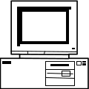
Real-World On-Path Attackers
Layer 2 attack: Read packets sent across the local area network (LAN)
Recall: A LAN is a network of connected machines
  Any machine on the LAN can send packets to any other machine on the LAN
Some LANs use broadcast technologies
  Every packet gets sent to every machine on the LAN
  Each machine agrees to ignore packets where the destination is a different machine
A machine can break the agreement and read packets meant for other machines
  This is called promiscuous mode
  May require root access on the machine
A
B
C
D

Slide 10
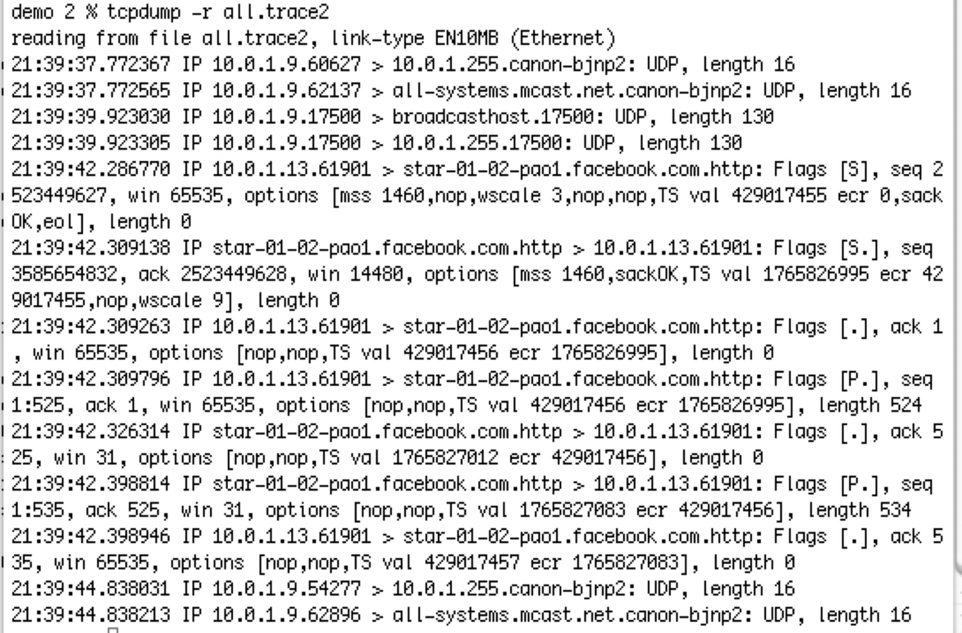
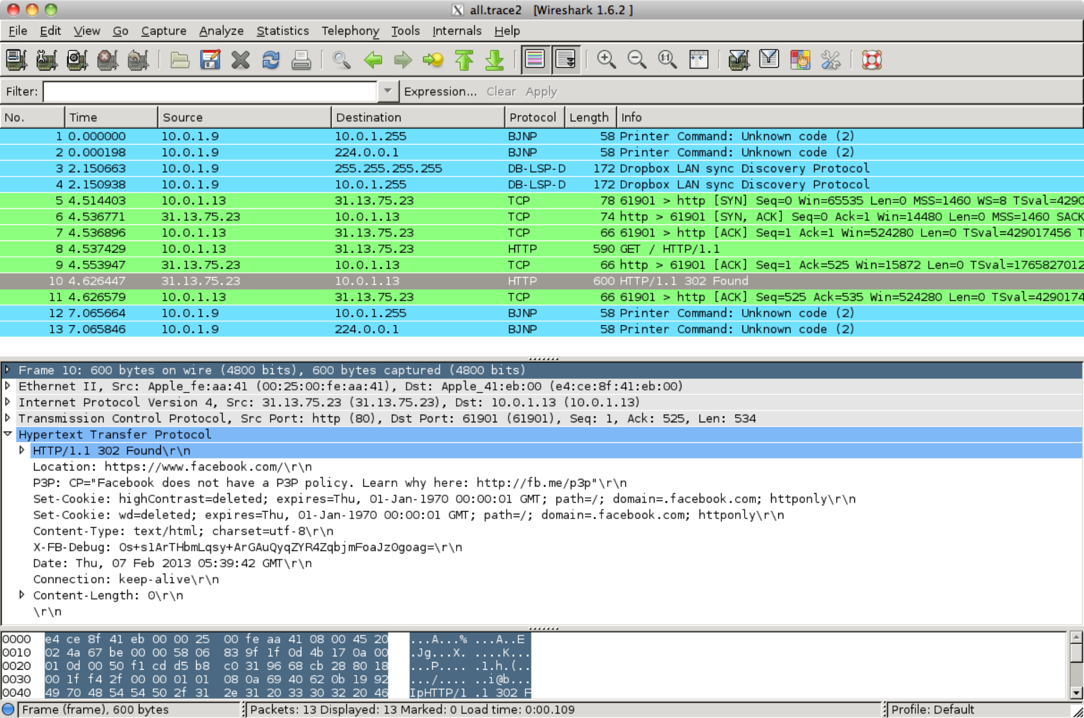
Real-World On-Path Attackers
tcpdump: A program for reading packets on the local network
  Uses promiscuous mode to read other machines’ packets in broadcast techonlogies
Wireshark: A graphical user interface (GUI) for analyzing tcpdump packets

Slide 11
Real-World On-Path Attackers
Some layer 2 (Ethernet) devices can be configured to also send a copy of every packet to the attacker
The attacker could also use this device to modify packets (man-in-the-middle attack)
Example: DualComm DCGS-2005
  Newer model: ETAP-2003R
  Cost: $200
  Powered with USB (no extra power supply needed)
Alice
To: Bob
“Hi”
Ethernet Device
To: Bob
“Hi”
To: Bob
“Hi”
Attacker
Bob

Slide 12
Address Resolution Protocol (ARP)

Slide 13
Review: Layer 2 and Layer 3
Local area network (LAN): A set of machines connected in a local network
  The MAC identifies devices on layer 2
Internet protocol (IP): Many LANs connected together with routers
  The IP identifies devices on layer 3
A
B
C
D
Router
E
F
G
H

Slide 14
Address Resolution Protocol (ARP)
ARP: Translates layer 3 IP addresses to layer 2 MAC addresses
  Example: Alice wants to send a message to Bob on the local network, but Alice only knows Bob’s IP address (1.2.3.4). To use layer 2 protocols, she must learn Bob’s MAC address.
Steps of the protocol
Alice checks her cache to see if she already knows Bob’s MAC address.
If Bob’s MAC address is not in the cache, Alice broadcasts to everyone on the LAN:
“What is the MAC address of 1.2.3.4?”
Bob responds by sending a message only to Alice: “My IP is 1.2.3.4 and my MAC address is ca:fe:f0:0d:be:ef.” Everyone else does nothing.
Alice caches Bob’s MAC address.

Slide 15
Address Resolution Protocol (ARP)
Alice knows Bob’s IP address (1.2.3.4) but wants to learn Bob’s MAC address.
Bob
Charlie
Alice’s cache
IP | MAC
Alice
Dave
Router
1. Alice checks her cache to see if she already knows the MAC address corresponding to 1.2.3.4.
Since her cache is empty, she must make a request to find out.

Slide 16
Address Resolution Protocol (ARP)
Alice knows Bob’s IP address (1.2.3.4) but wants to learn Bob’s MAC address.
Bob
Charlie
Alice’s cache
IP | MAC
Alice
Dave
Router
2. Alice asks everyone else on the local network: “What is the MAC address of 1.2.3.4?”

Slide 17
Address Resolution Protocol (ARP)
Alice knows Bob’s IP address (1.2.3.4) but wants to learn Bob’s MAC address.
Bob
Charlie
Alice’s cache
IP | MAC
Alice
Dave
Router
3. Bob responds: “My IP is 1.2.3.4 and my MAC address is ca:fe:f0:0d:be:ef.”
Everybody else ignores the request.

Slide 18
Address Resolution Protocol (ARP)
Alice knows Bob’s IP address (1.2.3.4) but wants to learn Bob’s MAC address.
Bob
Charlie
Alice’s cache
IP | MAC
1.2.3.4 | ca:fe:f0:0d:be:ef
Alice
Dave
Router
4. Alice adds Bob’s MAC address to her cache.

Slide 19
Address Resolution Protocol (ARP)
If Bob is outside of the LAN, the router will respond with its MAC address
  If Alice wants to send a packet to Bob, she sends the packet to the router
  The router can forward the packet to other LANs to reach Bob
  Alternatively, if Alice knows what addresses belong to the LAN, she will request the router’s IP
All received ARP replies are cached, even if no request was sent

Slide 20
Attacks on ARP
Alice knows Bob’s IP address (1.2.3.4) but wants to learn Bob’s MAC address.
Bob
Charlie
Alice’s cache
IP | MAC
Alice
Mallory
Router
1. Alice checks her cache to see if she already knows the MAC address corresponding to 1.2.3.4.
Since her cache is empty, she must make a request to find out.

Slide 21
Attacks on ARP
Alice knows Bob’s IP address (1.2.3.4) but wants to learn Bob’s MAC address.
Bob
Charlie
Alice’s cache
IP | MAC
Alice
Mallory
Router
2. Alice asks everyone else on the local network: “What is the MAC address of 1.2.3.4?”

Slide 22
Attacks on ARP
Alice knows Bob’s IP address (1.2.3.4) but wants to learn Bob’s MAC address.
Bob
Charlie
Alice’s cache
IP | MAC
Alice
Mallory
Router
3. Before Bob’s response can arrive, Mallory sends a malicious response: “My IP is 1.2.3.4 and my MAC address is 66:66:66:66:66:66.”

Slide 23
Attacks on ARP
Alice knows Bob’s IP address (1.2.3.4) but wants to learn Bob’s MAC address.
Bob
Charlie
Alice’s cache
IP | MAC
1.2.3.4 | 66:66:66:66:66:66
Alice
Mallory
Router
4. Alice adds Mallory’s malicious address to her cache.

Slide 24
Attack: ARP Spoofing
Alice has no way of verifying the ARP response
  Spoofing: Any attacker on the network can claim to have the requested IP address
Alice is only expecting one machine to respond, so she will accept the first response
  Race condition: As long as the attacker responds faster, the requester will accept the attacker’s response
ARP spoofing requires Mallory to be in the same LAN as Alice
ARP spoofing lets Mallory become a man-in-the-middle (MITM) attacker
  Alice thinks that Bob’s MAC address is 66:66:66:66:66:66 (Mallory’s MAC address)
  When Alice sends a message to Bob, she is actually sending the message to Mallory
  Mallory can modify the message and then send the modified message to Bob

Slide 25
ARP Spoofing: Defenses
Use switches to avoid broadcasts and ARP requests
  When Alice wants to send a message to Bob, she sends the message to a switch on the LAN
  The switch maintains a cache of IP/MAC mappings
    Since everyone is using the switch, its cache is larger than an individual user’s cache
  If Bob’s MAC address is in the cache, the switch sends the message directly to Bob
  Otherwise, the switch broadcasts the message
Benefits of switches
  Security: Reduces the number of messages broadcast to the entire LAN
  Efficiency: Fewer broadcast requests means more requests can be sent per second
  Isolation: Smarter switches implement virtual local area networks (VLANs), which split a LAN into several isolated parts
    One part of the VLAN cannot directly interact with other parts of the VLAN
Tools like arpwatch track ARP responses and make sure that there is no suspicious activity

Slide 26
Dynamic Host Configuration Protocol (DHCP)

Slide 27
DHCP: Initial Network Configuration
To connect to a network, a user needs:
  An IP address so that other people can contact the user
  The IP address of the DNS server (we’ll see this soon)
  The IP address of the router (gateway) so that the user can contact machines outside of the LAN
The first time a user connects, they don’t have this information yet
  The user also doesn’t know who to ask for this information
DHCP gives the user a configuration when they first join the network

Slide 28
Steps of the DHCP Handshake
Client Discover: The client broadcasts a request for a configuration
DHCP Offer: Any DHCP server can respond with a configuration offer
  Usually only one DHCP server responds
  The offer includes an IP address for the client, the DNS server’s IP address, and the (gateway) router’s IP address
  The offer also has an expiration time (how long the user can use this configuration)
Client Request: The client broadcasts which configuration it has chosen
  If multiple DHCP servers made offers, the ones that were not chosen discard their offer
  The chosen DHCP server gives the offer to the client
DHCP Acknowledgement: The chosen server confirms that its configuration has been given to the client

Slide 29
Dynamic Host Configuration Protocol (DHCP)
Bob
DHCP Server 1
Alice’s configuration
My IP | ???
DNS Server | ???
Gateway | ???
Alice
DHCP Server 2
Router
Alice wants to connect to the network, but she’s missing a configuration.

Slide 30
Dynamic Host Configuration Protocol (DHCP)
Bob
“Can anyone give me a configuration?”
DHCP Server 1
Alice’s configuration
My IP | ???
DNS Server | ???
Gateway | ???
Alice
DHCP Server 2
Router
1. Client Discover: Alice broadcasts a request for a configuration.

Slide 31
Dynamic Host Configuration Protocol (DHCP)
Bob
“You can use IP x, DNS server y, and gateway z”
DHCP Server 1
Alice’s configuration
My IP | ???
DNS Server | ???
Gateway | ???
Alice
“You can use IP a, DNS server b, and gateway c”
DHCP Server 2
Router
2. DHCP Offer: Any DHCP server can reply with an offer for Alice.

Slide 32
Dynamic Host Configuration Protocol (DHCP)
Bob
“I’ll use DHCP Server 1”
DHCP Server 1
Alice’s configuration
My IP | ???
DNS Server | ???
Gateway | ???
Alice
DHCP Server 2
Router
3. Client Request: Alice broadcasts which configuration she has chosen.

Slide 33
Dynamic Host Configuration Protocol (DHCP)
Bob
Reserved for Alice: IP x, DNS y, gateway z
DHCP Server 1
Alice’s configuration
My IP | x
DNS Server | y
Gateway | z
Alice
DHCP Server 2
Router
4. DHCP Acknowledgement: The chosen DHCP server confirms that the configuration has been set for Alice.

Slide 34
DHCP Attacks
Alice has no way of verifying the DHCP response
  Spoofing: Any attacker on the network can claim to have a configuration
Alice usually expects only one DHCP server to respond, so she will accept the first response
  Race condition: As long as the attacker responds faster, Alice will accept the attacker’s response
DHCP attacks require Mallory to be in the same LAN as Alice
DHCP attacks let Mallory become a man-in-the-middle (MITM) attacker
  Mallory claims the gateway router’s address is Mallory’s address
    When Alice sends a message to the rest of the Internet, she actually sends it to Mallory
    Mallory can modify the message before sending it to its destination
  Mallory can also claim the DNS server’s address is Mallory’s address

Slide 35
ARP and DHCP
The attacks on ARP and DHCP are very similar
  Spoofing: The attacker claims to have an answer
  Race condition: The requester accepts the first response. As long as the attacker’s response arrives first, it is accepted
Main vulnerabilities
  Broadcast protocols: Requests are sent to everyone on the LAN, so the attacker can see every request
  No trust anchor: There is no way to verify that responses are legitimate

Slide 36
DHCP Defenses
DHCP is hard to defend against
  No root of trust: When we first connect, there’s nobody we can trust
Instead, we rely on defenses provided in higher layers

Slide 37

Wireless Local Networks

Slide 38
Wi-Fi
Wi-Fi: A layer 2 protocol that wirelessly connects machines in a LAN
  Alternative is Ethernet, which uses wires to connect machines in a LAN
Parts of a Wi-Fi network
  Access point: A machine that will help you connect to the network
  SSID (service set identifier): The name of the Wi-Fi network
  Password: Optionally, a password to secure Wi-Fi communications

Slide 39
WPA2
Wi-Fi Protected Access 2 (WPA2): A protocol for securing Wi-Fi network communications with cryptography
Design goals
  Everyone with the Wi-Fi password can join the network
  Messages sent over the network are encrypted with keys
  An attacker who does not know the Wi-Fi password cannot learn the keys

Slide 40
WPA Handshake
Client
Access Point
Authentication Request
Derive PSK from wifi password
Derive PSK from wifi password
The client sends an authentication request to the access point
ANonce
Both use the password to derive the PSK (pre-shared key)
SNonce
Both exchange random nonces
Both use the PSK, nonces, and MAC addresses to derive the PTK (pairwise transport keys)
Derive PTK from PSK, nonces, MAC addresses
Derive PTK from PSK, nonces, MAC addresses
Both exchange MICs (these are MACs from the crypto unit) to ensure no one has tampered with the nonces, and that the PTK was correctly derived
MIC
MIC
The access point encrypts and sends the GTK (group temporal key) to the client, used for broadcasts that anyone can decrypt
GTK
ACK
The client acknowledges receiving the GTK

Slide 41
WPA Handshake
Both sides derive secret keys for communication
  Wi-Fi password → PSK
  PSK + nonces + MAC addresses → PTK
  The PTK is used to encrypt and authenticate all future communication
  Note: The PTK is different for every user, because of the nonces
The access point encrypts and sends the GTK to the client
  The GTK is used for messages broadcast to the entire network
  Everyone on the network uses the same GTK
The optimized version of the handshake decreases the number of messages sent back and forth

Slide 42
Optimized WPA 4-Way Handshake
Client
Access Point
Authentication Request
The client sends an authentication request to the access point
Derive PSK from wifi password
Derive PSK from wifi password
ANonce
Both use the password to derive the PSK (pre-shared key)
Derive PTK from PSK, nonces, MAC addresses
The AP sends ANonce to the client
The client generates SNonce, uses the PSK, nonces, and MAC addresses to derive the PTK (pairwise transport keys)
SNonce + MIC
The client sends SNonce and its MIC to the AP
Derive PTK from PSK, nonces, MAC addresses
The AP uses the PSK, nonces, and MAC addresses to derive the PTK (pairwise transport keys)
MIC + GTK
The AP sends its MIC and GTK to the client
ACK
The client acknowledges receiving the GTK

Slide 43
WPA-PSK Attacks
Client
Access Point
Authentication Request
Derive PSK from wifi password
Derive PSK from wifi password
Rogue AP: Pretend to be an AP, and offer your own ANonce to the client
  If you know the password/PSK, you can complete the 4-way handshake with the client and become a MITM!
ANonce
SNonce
Derive PTK from PSK, nonces, MAC addresses
Derive PTK from PSK, nonces, MAC addresses
MIC
MIC
GTK
ACK

Slide 44
WPA-PSK Attacks
Client
Access Point
Authentication Request
Derive PSK from wifi password
Derive PSK from wifi password
Offline brute-force attack: People tend to choose bad passwords, and you have enough information to know if you guessed the password correctly
  Nonces are sent unencrypted, and client and AP MAC addresses are public
  Eavesdropper guesses a password and derives:
    Wi-Fi password → PSK
    PSK + nonces + MAC addresses → PTK
    Eavesdropper checks that the MIC from the guess matches the MIC that was sent
ANonce
SNonce
Derive PTK from PSK, nonces, MAC addresses
Derive PTK from PSK, nonces, MAC addresses
MIC
MIC
GTK
ACK

Slide 45
WPA-PSK Attacks
Client
Access Point
Authentication Request
Derive PSK from wifi password
Derive PSK from wifi password
No forward secrecy: An eavesdropper who records the values of ANonce and SNonce can derive the key if they later learn the password or PSK
  Compare to Diffie-Hellman: An eavesdropper can’t learn the key even if the record gª and g^{b} and later compromise Alice’s computer
ANonce
SNonce
Derive PTK from PSK, nonces, MAC addresses
Derive PTK from PSK, nonces, MAC addresses
MIC
MIC
GTK
ACK

Slide 46
WPA-Enterprise
Core issue: Every client starts with the same PSK to derive the PTK
  Fix: Have each user use their own username and password, instead
    This is the model that AirBears2 and eduroam use!
Instead of using a PSK, use a randomly generated key by an authentication server
  For your client to trust the authentication server, you accept a digital certificate
  Form a secure channel to the authentication server, which lets you enter your username and password
  If the username and password are correct, the authentication server sends a one-time key to use instead of a PSK to both the client and the AP (also over a secure channel)
The rest of the handshake proceeds normally

Slide 47
WPA-Enterprise Attacks
WPA Enterprise defends against the previous attacks
  Rogue AP attack: The APs must authenticate themselves to the server, which the attacker can’t do
  Brute-force attack: The generated PSK replacement is long and random, too long to brute-force
  No forward secrecy: The generated PSK replacement is used once and then discarded, so no information is retained that allows the PTK to be recovered later
However, it is still vulnerable to higher-layer attacks such as ARP or DHCP spoofing
  WPA is really a layer 1 protocol, so it can’t provide defenses for this!

Slide 48
Summary
Classes of attackers:
  Off-path: Can’t see, modify, or drop packets
  On-path: Can see packets, but can’t modify or drop packets
  MITM: Can see, modify, and drop packets
ARP: A protocol to translate local IP addresses to MAC addresses
  Ask everyone on the network, “Who has the IP 1.2.3.4?”
  Attack: The attacker can respond instead of the true device with 1.2.3.4, and packets will get routed to the attacker!
  Defense: Switches
  Defense: Rely on higher layers
DHCP: A protocol for a new client to receive a network configuration
  Ask everyone on the network, “What is the network configuration to use?”
  Attack: The attacker can respond with a malicious configuration
  Defense: Rely on higher layers

Slide 49
Summary
WPA: A protocol to encrypt Wi-Fi connections at layer 1
  Messages between the client and the AP are encrypted with keys
  Handshake uses MICs (cryptographic MACs) to verify that both parties have the same PSK and nonces
  WPA-PSK: Use a password to derive a PSK, which is used in a handshake to arrive at a key
    Attack: Attacker can pretend to be an AP
    Attack: Brute-force the password after recording a handshake
    Vulnerability: No forward secrecy
  WPA-Enterprise: Use a third party to provide a one-time “replacement PSK,” used in the same handshake
    Solves the attacks on WPA-PSK

