Slide 1
CS162
Operating Systems and
Systems Programming
Lecture 2
Four Fundamental OS Concepts
January 18th, 2024
Prof. John Kubiatowicz
http://cs162.eecs.Berkeley.edu

Slide 2



Recall: What is an Operating System?
Referee
  Manage protection, isolation, and sharing of resources
    Resource allocation and communication
Illusionist
  Provide clean, easy-to-use abstractions of physical resources
    Infinite memory, dedicated machine
    Higher level objects: files, users, messages
    Masking limitations, virtualization
Glue
  Common services
    Storage, Window system, Networking
    Sharing, Authorization
    Look and feel

Slide 3
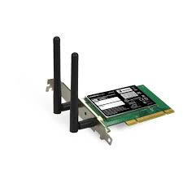
Recall: OS Protection
Compiled
Program 1
Compiled
Program 2
System Libs
System Libs
Compiler
Process 1
Process 2
Threads
Address Spaces
Files
Sockets
Threads
Address Spaces
Files
Sockets
Operating System
ISA
Processor
PgTbl
& TLB
Storage
Networks
Memory
Hardware
OS
Mem
I/O Ctrlr

Slide 4
Recall: OS Protection
Segmentation fault (core dumped)
Compiled
Program 1
Compiled
Program 2
System Libs
System Libs
Compiler
Process 1
Process 2
Threads
Address Spaces
Files
Sockets
Threads
Address Spaces
Files
Sockets
Operating System
ISA
Processor
PgTbl
& TLB
Storage
Networks
Memory
Hardware
OS
Mem
I/O Ctrlr

Slide 5
Challenge: Complexity
Applications consisting of…
  … a variety of software modules that …
  … run on a variety of devices (machines) that
    … implement different hardware architectures
    … run competing applications
    … fail in unexpected ways
    … can be under a variety of attacks
Not feasible to test software for all possible environments and combinations of components and devices
  The question is not whether there are bugs but how serious are the bugs!
Complexity of software keeps growing!

Slide 6
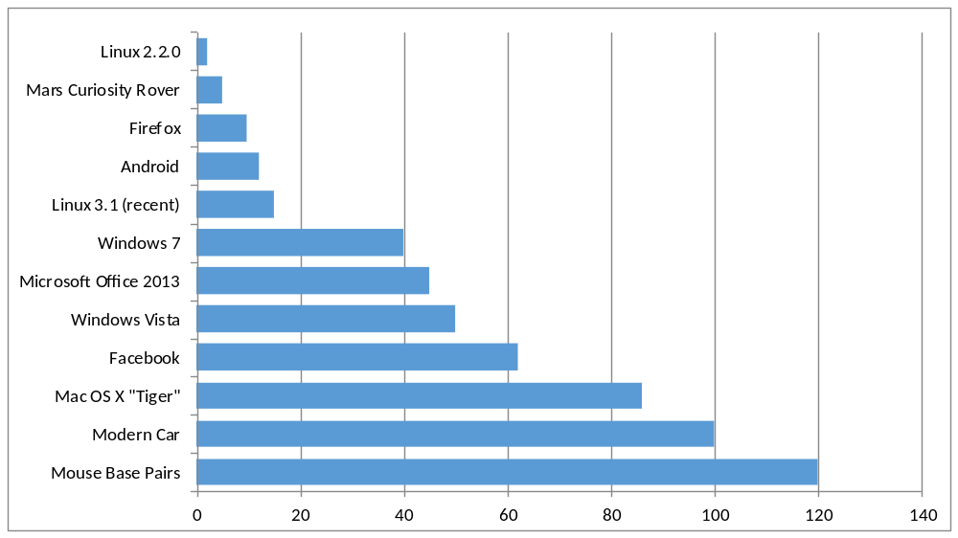
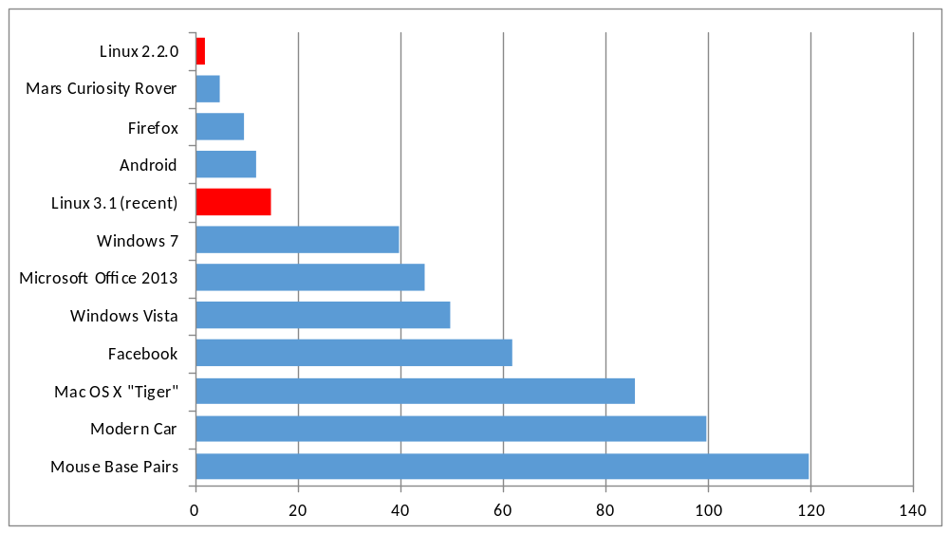
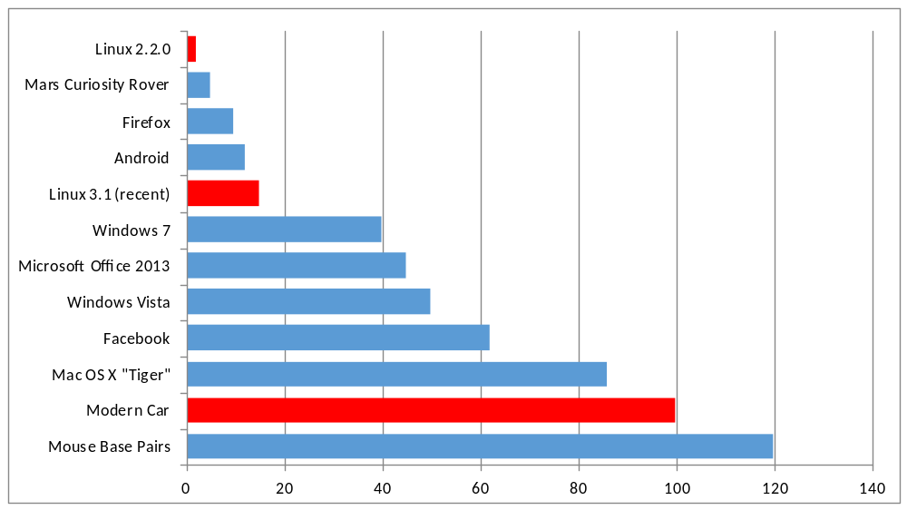
For Instance: Software Complexity keeps growing!
New Versions (much) larger than older versions!
Cars getting really complex!
Millions of Lines of Code
(source https://informationisbeautiful.net/visualizations/million-lines-of-code/)

Slide 7
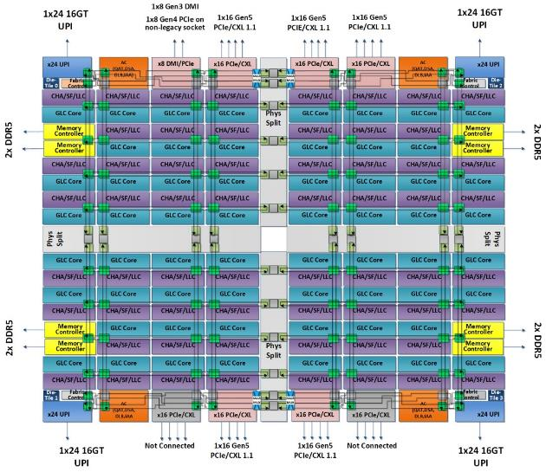
The World Is Parallel: e.g. Intel Saphire Rapids (2023)
Up to 60 cores, 120 threads/package (socket)
  Up to 4 “chiplets” bonded together
Network:
  On-chip Mesh Interconnect
  Fast off-chip network (UPI):
  directly connects 8-chips
  480 cores/shared memory domain!
Each Core Has:
  80 KB L1 Cache
  2 MB L2 Cache
  Fraction of up to 112.5 MB L3 Cache
DRAM/chips
  Up to 4 TiB of DDR5 memory
Many Accellerators of different types
  Graphics, Encryption, AI, Security
Saphire Rapids 4-chiplet single package

Slide 8
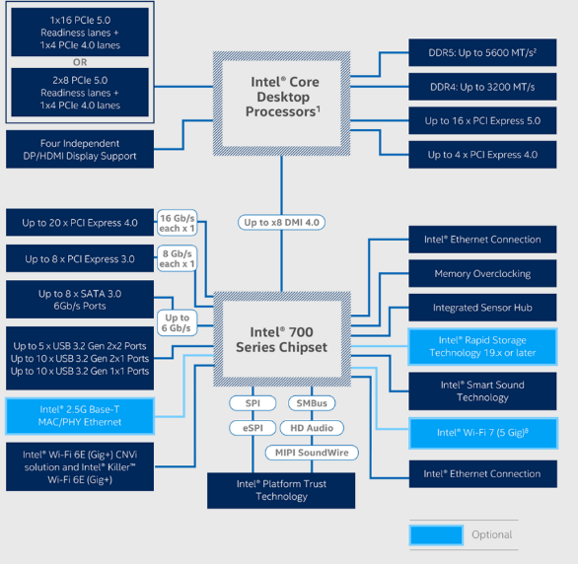
HW Functionality comes with great complexity!
Memory Channels
(High BW DRAM)
Really High Speed I/O (e.g. graphics)
Direct Media Interface
(8-16 GBytes/sec)
High-Speed I/O devices (PCI Exp)
Integrated Ethernet
Disks (8 x SATA 3.0)
RAID 0/1/5/10
Slower I/O (USB)
HD Audio
Integrated 2.5G Ethernet
Integrated WiFi 7
Integrated WiFi 6E
Intel Management Engine (ME) and BIOS Support
[remote management]
Intel 700 Chipset I/O Configuration

Slide 9
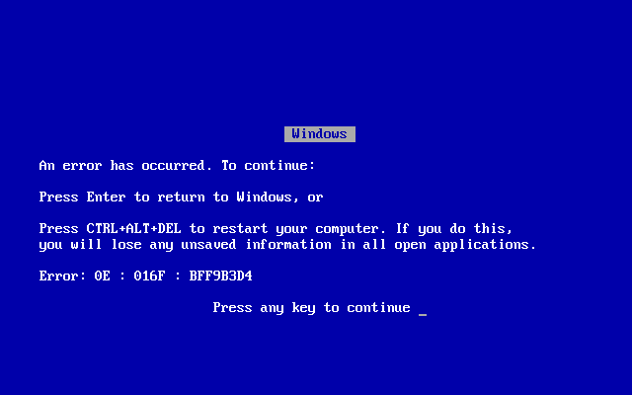

Complexity leaks into OS if not properly designed:
Third-party device drivers are one of the most unreliable aspects of OS
  Poorly written by non-stake-holders
  Ironically, the attempt to provide clean abstractions can lead to crashes!
Holes in security model or bugs in OS lead to instability and privacy breaches
  Great Example: Meltdown (2017)
    Extract data from protected kernel space!
Version skew on Libraries can lead to problems with application execution
Data breaches, DDOS attacks, timing channels….
  Heartbleed (SSL)

Slide 10
OS Abstracts Underlying Hardware to help Tame Complexity
Processor → Thread
Memory → Address Space
Disks, SSDs, … → Files
Networks → Sockets
Machines → Processes
OS as an Illusionist:
  Remove software/hardware quirks (fight complexity)
  Optimize for convenience, utilization, reliability, … (help the programmer)
For any OS area (e.g. file systems, virtual memory, networking, scheduling):
  What hardware interface to handle? (physical reality)
  What’s software interface to provide? (nicer abstraction)
Application
Operating System
Hardware
Abstract Machine Interface
Physical Machine Interface

Slide 11
Today: Four Fundamental OS Concepts
Thread: Execution Context
  Fully describes program state
  Program Counter, Registers, Execution Flags, Stack
Address space (with or w/o translation)
  Set of memory addresses accessible to program (for read or write)
  May be distinct from memory space of the physical machine
  (in which case programs operate in a virtual address space)
Process: an instance of a running program
  Protected Address Space + One or more Threads
Dual mode operation / Protection
  Only the “system” has the ability to access certain resources
  Combined with translation, isolates programs from each other and the OS from programs

Slide 12

OS Bottom Line: Run Programs
Executable
0xFFF…
Program Source
OS
int main()
{ … ;
}
compiler
data
Load & Execute
stack
editor
instructions
Memory
heap
foo.c
a.out
data
Write them and compile them
Load instruction and data segments of executable file into memory
Create stack and heap
“Transfer control to program”
Provide services to program
While protecting OS and program
instructions
0x000…
PC:
registers
Processor

Slide 13
Recall (61C): Instruction Fetch/Decode/Execute
The instruction cycle
Memory
Processor
next
PC:
Instruction fetch
instruction
Decode
decode
Registers
Execute
ALU
data

Slide 14
First OS Concept: Thread of Control
Thread: Single unique execution context
  Program Counter, Registers, Execution Flags, Stack, Memory State
A thread is executing on a processor (core) when it is resident in the processor registers
Resident means: Registers hold the root state (context) of the thread:
  Including program counter (PC) register & currently executing instruction
    PC points at next instruction in memory
    Instructions stored in memory
  Including intermediate values for ongoing computations
    Can include actual values (like integers) or pointers to values in memory
  Stack pointer holds the address of the top of stack (which is in memory)
  The rest is “in memory”
A thread is suspended (not executing) when its state is not loaded (resident) into the processor
  Processor state pointing at some other thread
  Program counter register is not pointing at next instruction from this thread
  Often: a copy of the last value for each register stored in memory

Slide 15
Recall (61C): What happens during program execution?
Addr 2³²-1
R0
…
R31
F0
…
F30
PC
…
Data1
Data0
Inst237
Inst236
…
Inst5
Inst4
Inst3
Inst2
Inst1
Inst0
Fetch
Exec
Execution sequence:
  Fetch Instruction at PC
  Decode
  Execute (possibly using registers)
  Write results to registers/mem
  PC = Next Instruction(PC)
  Repeat
PC
PC
PC
PC
Addr 0

Slide 16
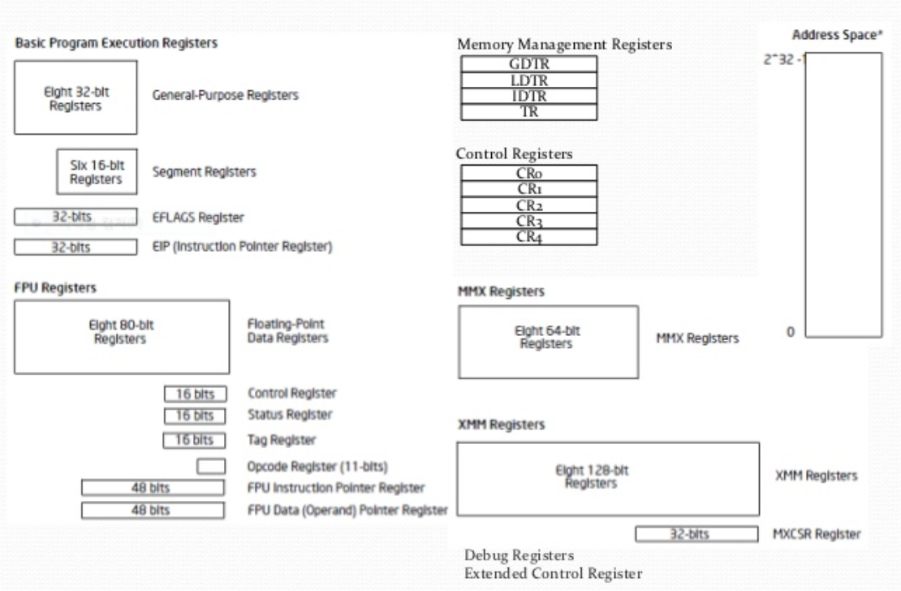
Registers: RISC-V ⇒ x86
Load/Store Arch (RISC-V)
with software conventions
Complex mem-mem arch (x86) with specialized registers and “segments”
CS61C does RISC-V. Will need to learn x86…
Section will cover this architecture

Slide 17
Illusion of Multiple Processors with single core
Assume a single processor (core). How do we provide the illusion of multiple processors?
  Multiplex in time!
Threads are virtual cores
Contents of virtual core (thread):
  Program counter, stack pointer
  Registers
Where is “it” (the thread)?
  On the real (physical) core, or
  Saved in chunk of memory – called the Thread Control Block (TCB)
vCPU1
vCPU2
vCPU3
Shared Memory
vCPU1
vCPU2
vCPU3
vCPU1
vCPU2
Programmer’s View
Time

Slide 18
Illusion of Multiple Processors (Continued)
Consider:
  At T1: vCPU1 on real core, vCPU2 in memory
  At T2: vCPU2 on real core, vCPU1 in memory
What happened?
  OS Ran [how?]
  Saved PC, SP, … in vCPU1's thread control block (memory)
  Loaded PC, SP, … from vCPU2's TCB, jumped to PC
What triggered this switch?
  Timer, voluntary yield, I/O, other things we will discuss
vCPU1
vCPU2
vCPU3
T1
T2
Shared Memory
vCPU1
vCPU2
vCPU3
vCPU1
vCPU2
Programmer’s View
Time

Slide 19
Multiprogramming - Multiple Threads of Control
Proc 1
Proc 2
Proc n
stack
…
heap
OS
Static Data
code
stack
Thread Control Block (TCB)
  Holds contents of registers when thread not running
  What other information?
Where are TCBs stored?
  For now, in the kernel
PINTOS? – read thread.h and thread.c
heap
Static Data
code
stack
heap
Static Data
code

Slide 20
Administrivia: Getting started
Should be working on Homework 0 already! ⇒ Due Wednesday (1/24)
  cs162-xx account, Github account, registration survey
  VM environment for the course
  Get familiar with all the cs162 tools, submitting to autograder via git
Start Project 0 Monday!
  To be done on your own – like a homework
Reminder of Resources for you (look at Resources tab on homepage!)
  Quick tutorial about C: Ladder
  Oreilly Books on: C language, Git environment, Rust (for later)
Slip days: I’d bank these and not spend them right away!
  You have 4 slip days for homework
  You have 5 slip days for projects
  (Very) Limited credit when late and run out of slip days
Please don’t use slip days on Homework 0 / Project 0!
  You will start off on wrong foot!

Slide 21
Administrivia (Con’t)
Monday is an optional REVIEW session for C
  Time and location/Zoom link TBA
  May be recorded
Class size is fixed at 404 students, 13 sections
  Will be moving more students from waitlist ⇒ class as students drop
  If you are on waitlist, assume you could get into the class at any time in next week or so!
  Keep up with work (until you drop or we close the class)
    If cannot get credentials for autograder, contact us (I believe we have an Ed thread for that!)
Friday (1/26) is drop day for this class!
  Very hard to drop afterwards…
  Please drop sooner if you are going to anyway ⇒ Let someone else in!

Slide 22


CS 162 Collaboration Policy
Explaining a concept to someone in another group
Discussing algorithms/testing strategies with other groups
Discussing debugging approaches with other groups
Searching online for generic algorithms (e.g., hash table)
Sharing code or test cases with another group
Copying OR reading another group’s code or test cases
Copying OR reading online code or test cases from prior years
Helping someone in another group to debug their code
We compare all project submissions against prior year submissions and online solutions and will take actions (described on the course overview page) against offenders
Don’t put a friend in a bad position by asking for help that they shouldn’t give!

Slide 23
Second OS Concept: Address Space
Address space ⇒ the set of accessible addresses + state associated with them:
  For 32-bit processor: 2³² = 4 billion (10⁹) addresses
  For 64-bit processor: 2⁶⁴ = 18 quintillion (10¹⁸) addresses
What happens when you read or write to an address?
  Perhaps acts like regular memory
  Perhaps ignores writes
  Perhaps causes I/O operation
    (Memory-mapped I/O)
  Perhaps causes exception (fault)
  Communicates with another program
  ….
0xFFF…
stack
heap
Static Data
code
0x000…

Slide 24
Address Space: In a Picture
0xFFF…
stack
PC:
SP:
heap
Processor
registers
Static Data
instruction
Code Segment
0x000…
What’s in the code segment? Static data segment?
What’s in the Stack Segment?
  How is it allocated? How big is it?
What’s in the Heap Segment?
  How is it allocated? How big?

Slide 25
Previous discussion of threads: Very Simple Multiprogramming
All vCPU's share non-CPU resources
  Memory, I/O Devices
Each thread can read/write memory
  Perhaps data of others
  can overwrite OS ?
Unusable?
This approach is used in
  Very early days of computing
  Embedded applications
  MacOS 1-9/Windows 3.1 (switch only with voluntary yield)
  Windows 95-ME (switch with yield or timer)
However it is risky…
vCPU1
vCPU2
vCPU3
vCPU1
vCPU2
Time

Slide 26
Simple Multiplexing has no Protection!
Operating System must protect itself from user programs
  Reliability: compromising the operating system generally causes it to crash
  Security: limit the scope of what threads can do
  Privacy: limit each thread to the data it is permitted to access
  Fairness: each thread should be limited to its appropriate share of system resources (CPU time, memory, I/O, etc)
OS must protect User programs from one another
  Prevent threads owned by one user from impacting threads owned by another user
  Example: prevent one user from stealing secret information from another user

Slide 27
What can the hardware do to help the OS protect itself from programs???
How about: Limit the ACCESS that threads have to memory

Slide 28
Simple Protection: Base and Bound (B&B)
0000…
0000…
code
code
Static Data
Static Data
heap
heap
stack
0100…
stack
Base
0010…
1000…
1000…
code
>=
Program
address
1010…
Static Data
heap
Bound
<
1100…
stack
1100…
FFFF…

Slide 29
Simple Protection: Base and Bound (B&B)
0000…
0000…
code
code
Static Data
Static Data
heap
heap
stack
0100…
stack
Base
0010…
1000…
1000…
code
>=
Program
address
1010…
Static Data
heap
Addresses translated when program loaded
Bound
<
1100…
stack
1100…
Still protects OS and isolates program
Requires relocating loader
No addition on address path
FFFF…

Slide 30
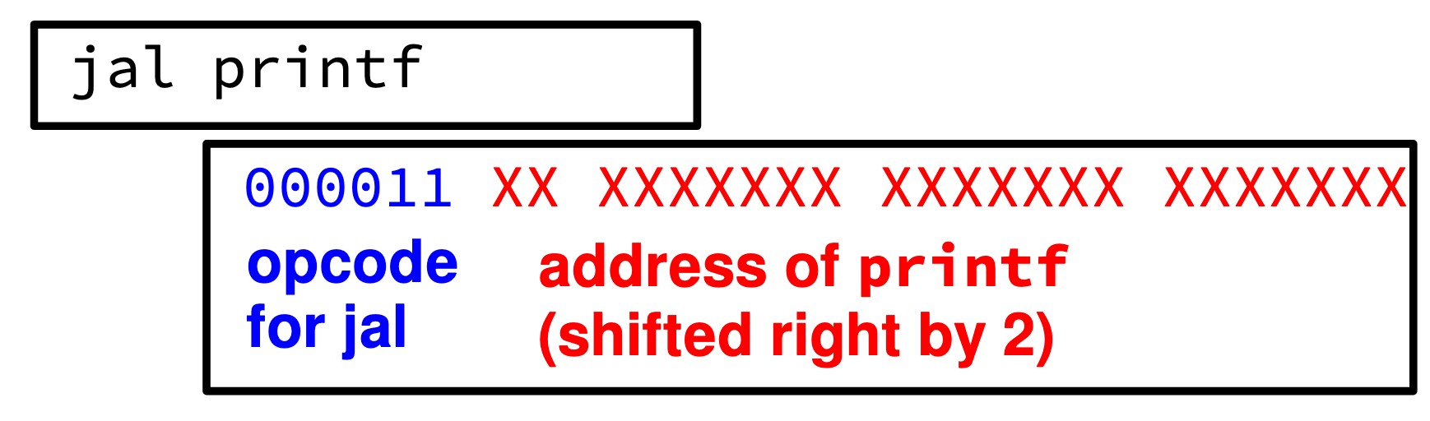
61C Review: Relocation
Compiled .obj file linked together in an .exe
All address in the .exe are as if it were loaded at memory address 00000000
File contains a list of all the addresses that need to be adjusted when it is “relocated” to somewhere else.

Slide 31
Simple address translation with Base and Bound
0000…
code
0000…
code
Static Data
heap
Addresses translated
on-the-fly
Static Data
heap
stack
0100…
stack
Base Address
1000…
code
1000…
0010…
Program
address
0010…
Static Data
1010…
heap
Bound
<
stack
1100…
0100…
Hardware relocation
Can the program touch OS?
Can it touch other programs?
FFFF…

Slide 32
x86 – segments and stacks
code
static data
heap
Processor Registers
CS
EIP
stack
SS
ESP
CS:
EIP:
code
EAX
DS
EBX
ES
ECX
static data
EDX
ESI
EDI
heap
Start address, length and access rights associated with each segment register
SS:
ESP:
stack

Slide 33
Another idea: Address Space Translation
Program operates in an address space that is distinct from the physical memory space of the machine
“physical address”
0x000…
“virtual address”
Processor
translator
Memory
Registers
0xFFF…

Slide 34
Paged Virtual Address Space
What if we break the entire virtual address space into equal size chunks (i.e., pages) have a base for each?
All pages same size, so easy to place each page in memory!
Hardware translates address using a page table
  Each page has a separate base
  The “bound” is the page size
  Special hardware register stores pointer to page table
  Treat memory as page size frames and put any page into any frame …
Another cs61C review…

Slide 35
Paged Virtual Address (from 61C)
Memory
Processor
Registers
<Page #>
Page Table
<Frame Addr>
instruction
<Page Offset>
Page (eg, 4 kb)
<Virtual Address> =
<Page #> <Page Offset>
PT Addr
Instructions operate on virtual addresses
  Instruction address, load/store data address
Translated to a physical address through a Page Table by the hardware
Any Page of address space can be in any (page sized) frame in memory
  Or not-present (access generates a page fault)
Special register holds page table base address (of the process)
Notes:
Q: For a 64-bit address space and 16kb pages, which bits are used for indexing into the page table? Which for the page offset?
Q: How many page frames in 4 GB of memory? How many bits are needed for the Frame Address field?
Q: If the entire address space of a process is mapped and each entry is 32 bits in size (4 bytes), how large is the page table?
Q: In the above, how much of the memory would it occupy?
Q: Given how address space tends to be structured, how would you reduce the storage overhead of the page table?
Q: Assuming the address space is used sparsely, how else might you compress the size of the page table?
Q: If multiple instances of the same application are running, how could you reduce the memory footprint overall?
Q: What happens if a process has multiple threads?

Slide 36
Third OS Concept: Process
Definition: execution environment with Restricted Rights
  (Protected) Address Space with One or More Threads
  Owns memory (address space)
  Owns file descriptors, file system context, …
  Encapsulate one or more threads sharing process resources
Application program executes as a process
  Complex applications can fork/exec child processes [later!]
Why processes?
  Protected from each other!
  OS Protected from them
  Processes provides memory protection
Fundamental tradeoff between protection and efficiency
  Communication easier within a process
  Communication harder between processes

Slide 37
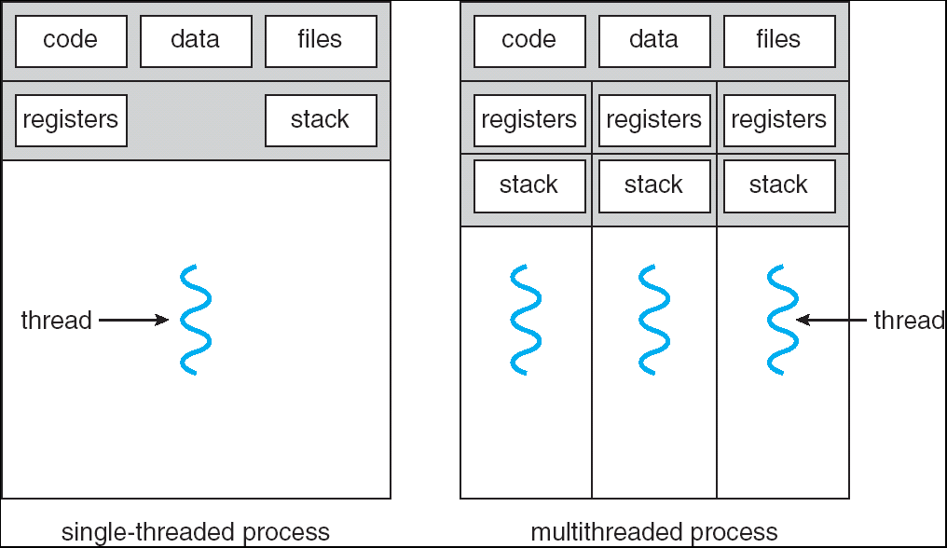
Single and Multithreaded Processes
Threads encapsulate concurrency:
  “Active” component
Address spaces encapsulate protection:
  “Passive” component
  Keeps buggy programs from crashing
  the system
Why have multiple threads per address space?
  Parallelism: take advantage of actual hardware parallelism (e.g. multicore)
  Concurrency: ease of handling I/O and other simultaneous events
Notes:
Sometimes need parallelism for a single job, and processes are very expensive – to start, switch between, and to communicate between

Slide 38
Protection and Isolation
Why Do We Need Processes??
  Reliability: bugs can only overwrite memory of process they are in
  Security and privacy: malicious or compromised process can’t read or write other process’ data
  (to some degree) Fairness: enforce shares of disk, CPU
Mechanisms:
  Address translation: address space only contains its own data
  BUT: why can’t a process change the page table pointer?
    Or use I/O instructions to bypass the system?
  Hardware must support privilege levels

Slide 39
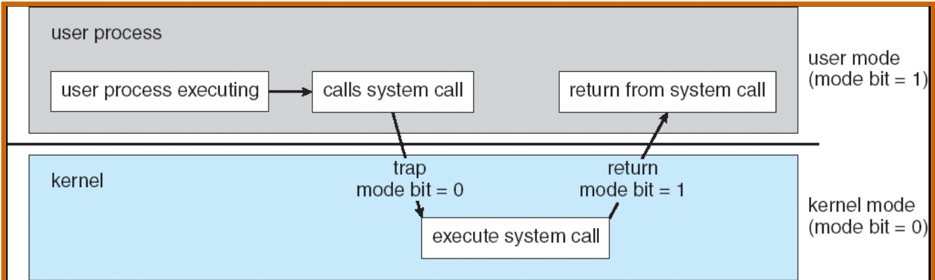
Fourth OS Concept: Dual Mode Operation
Hardware provides at least two modes (at least 1 mode bit):
  Kernel Mode (or “supervisor” mode)
  User Mode
Certain operations are prohibited when running in user mode
  Changing the page table pointer, disabling interrupts, interacting directly w/ hardware, writing to kernel memory
Carefully controlled transitions between user mode and kernel mode
  System calls, interrupts, exceptions

Slide 40
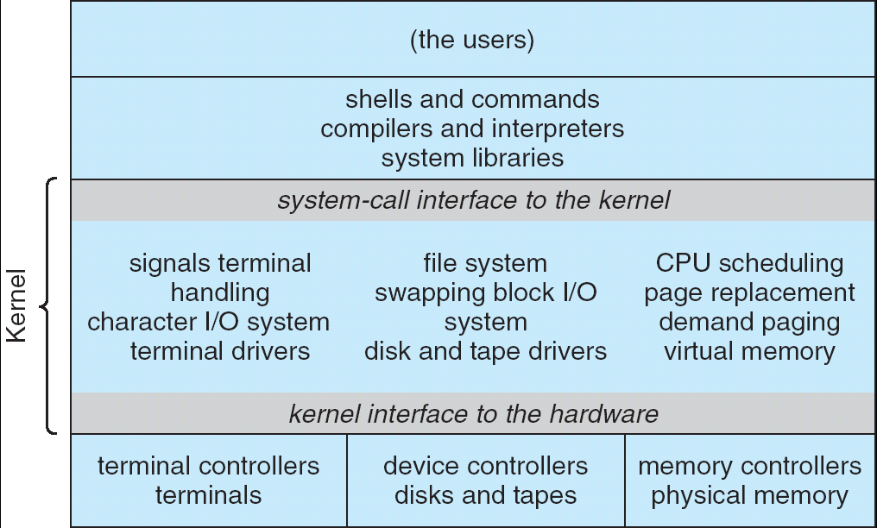
For example: UNIX System Structure
Applications
User Mode
Standard Libs
Kernel Mode
Hardware

Slide 41
User/Kernel (Privileged) Mode
User Mode
interrupt
exception
syscall
rtn
rfi
Kernel Mode
exit
exec
Limited HW access
Full HW access

Slide 42
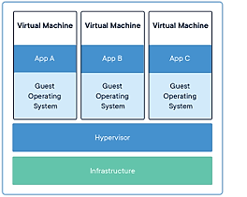
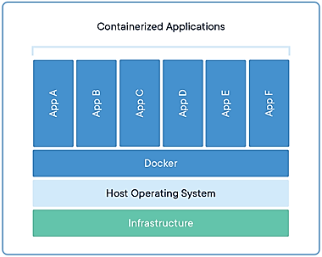
Additional Layers of Protection for Modern Systems
Additional layers of protection through virtual machines or containers
  Run a complete operating system in a virtual machine
  Package all the libraries associated with an app into a container for execution
More on these ideas later in the class

Slide 43
Tying it together: Simple B&B: OS loads process
0000…
Proc 1
Proc 2
Proc n
code
…
Static Data
OS
heap
stack
sysmode
1
1000…
code
Base
xxxx …
0000…
Static Data
Bound
xxxx…
FFFF…
heap
uPC
xxxx…
stack
1100…
PC
code
3000…
regs
Static Data
…
heap
stack
3080…
FFFF…

Slide 44
Simple B&B: OS gets ready to execute process
0000…
Proc 1
Proc 2
Proc n
code
RTU
…
Static Data
OS
heap
stack
sysmode
1
1000…
code
Base
1000 …
0000…
Static Data
Bound
1100…
FFFF…
heap
uPC
0001…
stack
1100…
Privileged Inst: set special registers
RTU (Return To Usermode)
PC
code
3000…
regs
00FF…
Static Data
…
heap
stack
3080…
FFFF…

Slide 45
Simple B&B: User Code Running
0000…
Proc 1
Proc 2
Proc n
code
…
Static Data
OS
heap
stack
sysmode
0
1000…
code
Base
1000 …
0000…
Static Data
Bound
1100…
FFFF…
heap
How does kernel switch between processes?
First question: How to return to system?
uPC
xxxx…
stack
1100…
PC
0001…
code
3000…
regs
00FF…
Static Data
…
heap
stack
3080…
FFFF…

Slide 46
3 types of User ⇒ Kernel Mode Transfer
Syscall
  Process requests a system service, e.g., exit
  Like a function call, but “outside” the process
  Does not have the address of the system function to call
  Like a Remote Procedure Call (RPC) – for later
  Marshall the syscall id and args in registers and exec syscall
Interrupt
  External asynchronous event triggers context switch
  e. g., Timer, I/O device
  Independent of user process
Trap or Exception
  Internal synchronous event in process triggers context switch
  e.g., Protection violation (segmentation fault), Divide by zero, …
All 3 are an UNPROGRAMMED CONTROL TRANSFER
  Where does it go?

Slide 47
How do we get the system target address of the “unprogrammed control transfer?”

Slide 48
Interrupt Vector
Address and properties of each interrupt handler
interrupt number (i)
intrpHandler_i () {
….
}
Where else do you see this dispatch pattern?

Slide 49
Simple B&B: User => Kernel
0000…
Proc 1
Proc 2
Proc n
code
…
Static Data
OS
heap
stack
sysmode
0
1000…
code
Base
1000 …
0000…
Static Data
Bound
1100…
FFFF…
heap
uPC
xxxx…
stack
1100…
PC
0000 1234
code
3000…
regs
00FF…
Static Data
So: How to return to system?
  Timer Interrupt
  I/O requests
  Other things
…
heap
stack
3080…
FFFF…

Slide 50
Simple B&B: Interrupt
0000…
Proc 1
Proc 2
Proc n
code
…
Static Data
OS
heap
stack
sysmode
1
1000…
code
Base
1000 …
0000…
Static Data
Bound
1100 …
FFFF…
heap
uPC
0000 1234
stack
1100…
PC
IntrpVector[i]
code
3000…
regs
00FF…
Static Data
How to save registers and set up system stack?
…
heap
stack
3080…
FFFF…

Slide 51
Simple B&B: Switch User Process
0000…
Proc 1
Proc 2
Proc n
code
RTU
…
Static Data
OS
heap
stack
sysmode
1
1000…
1000 …
code
Base
3000 …
0000…
Static Data
1100 …
Bound
0080 …
FFFF…
heap
0000 1234
uPC
0000 0248
regs
stack
1100…
PC
0001 0124
00FF…
code
3000…
regs
00D0…
Static Data
How to save registers and set up system stack?
…
heap
stack
3080…
FFFF…

Slide 52
Simple B&B: “resume”
0000…
Proc 1
Proc 2
Proc n
code
RTU
…
Static Data
OS
heap
stack
sysmode
0
1000…
1000 …
code
Base
3000 …
0000…
Static Data
1100 …
Bound
0080 …
FFFF…
heap
0000 1234
uPC
xxxx xxxx
regs
stack
1100…
PC
000 0248
00FF…
code
3000…
regs
00D0…
Static Data
How to save registers and set up system stack?
…
heap
stack
3080…
FFFF…

Slide 53
Running Many Programs ???
We have the basic mechanism to
  switch between user processes and the kernel,
  the kernel can switch among user processes,
  Protect OS from user processes and processes from each other
Questions ???
How do we decide which user process to run?
How do we represent user processes in the OS?
How do we pack up the process and set it aside?
How do we get a stack and heap for the kernel?
Aren’t we wasting are lot of memory?
…

Slide 54
Process Control Block
Kernel represents each process as a process control block (PCB)
  Status (running, ready, blocked, …)
  Register state (when not ready)
  Process ID (PID), User, Executable, Priority, …
  Execution time, …
  Memory space, translation, …
Kernel Scheduler maintains a data structure containing the PCBs
Scheduling algorithm selects the next one to run

Slide 55
Scheduler
if ( readyProcesses(PCBs) ) {
nextPCB = selectProcess(PCBs);
run( nextPCB );
} else {
run_idle_process();
}

Slide 56
Conclusion: Four Fundamental OS Concepts
Thread: Execution Context
  Fully describes program state
  Program Counter, Registers, Execution Flags, Stack
Address space (with or w/o translation)
  Set of memory addresses accessible to program (for read or write)
  May be distinct from memory space of the physical machine
  (in which case programs operate in a virtual address space)
Process: an instance of a running program
  Protected Address Space + One or more Threads
Dual mode operation / Protection
  Only the “system” has the ability to access certain resources
  Combined with translation, isolates programs from each other and the OS from programs

