Slide 1
CS162
Operating Systems and
Systems Programming
Lecture 17
Memory 4: Demand Paging Policies
March 19th, 2024
Prof. John Kubiatowicz
http://cs162.eecs.Berkeley.edu

Slide 2
Recall 61C: Average Memory Access Time
Proc
Used to compute access time probabilistically:
AMAT = Hit Rate_{L1} x Hit Time_{L1} + Miss Rate_{L1} x Miss Time_{L1}
Hit Rate_{L1} + Miss Rate_{L1} = 1
Hit Time_{L1} = Time to get value from L1 cache.
Miss Time_{L1} = Hit Time_{L1} + Miss Penalty_{L1}
Miss Penalty_{L1} = AVG Time to get value from lower level (DRAM)
So, AMAT = Hit Time_{L1} + Miss Rate_{L1} x Miss Penalty_{L1}
What about more levels of hierarchy?
AMAT = Hit Time_{L1} + Miss Rate_{L1} x Miss Penalty_{L1}
Miss Penalty_{L1} = AVG time to get value from lower level (L2)
= Hit Time_{L2} + Miss Rate_{L2} x Miss Penalty_{L2}
Miss Penalty_{L2} = Average Time to fetch from below L2 (DRAM)
AMAT = Hit Time_{L1} +
Miss Rate_{L1} x (Hit Time_{L2} + Miss Rate_{L2} x Miss Penalty_{L2})
And so on … (can do this recursively for more levels!)
L1 Cache
DRAM
Proc
L1 Cache
L2 Cache
DRAM

Slide 3
Recall: Caching Applied to Address Translation
Virtual
Address
TLB
Physical
Memory
CPU
Physical
Address
Cached?
Yes
No
Save
Result
Translate
(MMU)
Data Read or Write (untranslated)
Question is one of page locality: does it exist?
  Instruction accesses spend a lot of time on same page (accesses are sequential)
  Stack accesses have definite locality of reference
  Data accesses have less page locality, but still some…
Can we have a TLB hierarchy?
  Sure: multiple levels at different sizes/speeds

Slide 4
What Actually Happens on a TLB Miss?
Hardware traversed page tables (x86, many others):
  On TLB miss, hardware in MMU looks at current page table to fill TLB (may walk multiple levels)
    If PTE valid, hardware fills TLB and processor never knows
    If PTE marked as invalid, causes Page Fault, after which kernel decides what to do afterwards
Software traversed Page tables (like MIPS):
  On TLB miss, processor receives TLB fault
  Kernel traverses page table to find PTE
    If PTE valid, fills TLB and returns from fault
    If PTE marked as invalid, internally calls Page Fault handler
Most chip sets provide hardware traversal
  Modern operating systems tend to have more TLB faults since they use translation for many things
  Examples:
    shared segments
    user-level portions of an operating system

Slide 5
Transparent Exceptions: Page fault
User
Faulting
Inst 1
Restart
Inst 1
Faulting
Inst 2
Restart
Inst 2
Page Faults
OS
Copy on Write/
Update PTE
Fetch page/sleep on queue
Later: Update PTE/restart
How to transparently restart faulting instructions?
  (Consider load or store that gets Page fault)
  Could we just skip faulting instruction?
    No: need to perform load or store after reconnecting physical page!
Hardware must help out by saving:
  Faulting instruction and partial state
    Need to know which instruction caused fault
    Is single PC sufficient to identify faulting position????
  Processor State: sufficient to restart user thread
    Save/restore registers, stack, etc
What if an instruction has side-effects?

Slide 6
Consider weird things that can happen
What if an instruction has side effects?
  Options:
    Unwind side-effects (easy to restart)
    Finish off side-effects (messy!)
  Example 1: mov (sp)+,10
    What if page fault occurs when writing to stack pointer?
    Did sp get incremented before or after the page fault?
  Example 2: strcpy (r1), (r2)
    Source and destination overlap: can’t unwind in principle!
    IBM S/370 and VAX solution: execute twice – once read-only
What about “RISC” processors?
  For instance delayed branches?
    Example: bne somewhere
    ld r1,(sp)
    Restart after page fault: need two PCs, PC and nPC!
  Delayed exceptions:
    Example: div r1, r2, r3
    ld r1, (sp)
    What if takes many cycles to discover divide by zero, but load has already caused page fault?
Notes:
Nachos and other systems: hardware saves state, to help you. Role of nextPC, LoadReg, etc.
Other examples: 68000 was non-virtualizable. Couldn’t restart after a fault
So Apollo Computers put 2 68000 in every workstation:
Executes user code (hangs on fault)
Handles fault (no overlapped I/O)
Intel i860 (came out same time as 486): doesn’t provide failing virtual address. Have to go back and disassemble instruction to figure out what failed…
Moral: have to know lots of stuff to do hardware design: hardware/compilers/OS

Slide 7
Precise Exceptions
Precise ⇒ state of the machine is preserved as if program executed up to the offending instruction
  All previous instructions completed
  Offending instruction and all following instructions act as if they have not even started
  Same system code will work on different implementations
  Difficult in the presence of pipelining, out-of-order execution, ...
  x86 takes this position
Imprecise ⇒ system software has to figure out what is where and put it all back together
Performance goals often lead designers to forsake precise interrupts
  system software developers, user, markets etc. usually wish they had not done this
Modern techniques for out-of-order execution and branch prediction help implement precise interrupts

Slide 8
Recent Intel x86 (Skylake, Cascade Lake)
(L1) Instruction TLB
Reorder Buffer
(Precise Exceptions)
(L2) Unified TLB
(L1) Data TLB

Slide 9
Recent Example: Memory Hierarchy
Caches (all 64 B line size)
  L1 I-Cache: 32 KiB/core, 8-way set assoc.
  L1 D Cache: 32 KiB/core, 8-way set assoc., 4-5 cycles load-to-use, Write-back policy
  L2 Cache: 1 MiB/core, 16-way set assoc., Inclusive, Write-back policy, 14 cycles latency
  L3 Cache: 1.375 MiB/core, 11-way set assoc., shared across cores, Non-inclusive victim cache, Write-back policy, 50-70 cycles latency
TLB
  L1 ITLB, 128 entries; 8-way set assoc. for 4 KB pages
    8 entries per thread; fully associative, for 2 MiB / 4 MiB page
  L1 DTLB 64 entries; 4-way set associative for 4 KB pages
    32 entries; 4-way set associative, 2 MiB / 4 MiB page translations:
    4 entries; 4-way associative, 1G page translations:
  L2 STLB: 1536 entries; 12-way set assoc. 4 KiB + 2 MiB pages
    16 entries; 4-way set associative, 1 GiB page translations:

Slide 10
What happens on a Context Switch?
Need to do something, since TLBs map virtual addresses to physical addresses
  Address Space just changed, so TLB entries no longer valid!
Options?
  Invalidate (“Flush”) TLB: simple but might be expensive
    What if switching frequently between processes?
  Include ProcessID in TLB
    This is an architectural solution: needs hardware
What if translation tables change?
  For example, to move page from memory to disk or vice versa…
  Must invalidate TLB entry!
    Otherwise, might think that page is still in memory!
  Called “TLB Consistency”
Aside: with Virtually-Indexed, Virtually-Tagged cache, need to flush cache!
  Everyone has their own version of the address “0” and can’t distinguish them
  This is one advantage of Virtually-Indexed, Physically-Tagged caches..

Slide 11
Putting Everything Together: Address Translation
Physical
Memory:
Virtual Address:
Virtual
P1 index
Virtual
P2 index
Offset
PageTablePtr
Physical Address:
Physical
Page #
Offset
Page Table
(1st level)
Page Table
(2nd level)

Slide 12
Putting Everything Together: TLB
Physical
Memory:
Virtual Address:
Virtual
P1 index
Virtual
P2 index
Offset
PageTablePtr
Physical Address:
Physical
Page #
Physical
Page #
Offset
Page Table
(1st level)
Page Table
(2nd level)
TLB:
…

Slide 13
Putting Everything Together: Cache
Physical
Memory:
Virtual Address:
Virtual
P1 index
Virtual
P2 index
Offset
PageTablePtr
Physical Address:
Physical
Page #
Offset
Page Table
(1st level)
tag
index
byte
cache:
Page Table
(2nd level)
tag:
block:
TLB:
…
…

Slide 14

Administrivia
Still grading exam!
  Hopefully have it by early next week
Project 2 in full swing
  Stay on top of this one. Don’t wait until last moment to get pieces together
  Decide how to your team is going divide up project 2
Homework 4 also in full swing
Make sure to fill out survey!
  We really want to hear how you think we are doing
  Also, will get a chance to suggest topics for the special topics lecture
Complete form quickly
for attendance credit

Slide 15
Page Fault Handling
The Virtual-to-Physical Translation fails
  PTE marked invalid, Privilege Level Violation, Access violation, or does not exist
  Causes an Fault / Trap
    Not an interrupt because synchronous to instruction execution
  May occur on instruction fetch or data access
  Protection violations typically terminate the process
Other Page Faults engage operating system to fix the situation and retry the instruction
  Allocate an additional stack page, or
  Make the page accessible – (Copy on Write),
  Bring page in from secondary storage to memory – demand paging
Fundamental inversion of the hardware / software boundary
  Need to execute software to allow hardware to proceed!

Slide 16
Page Fault ⇒ Demand Paging
Process
virtual address
physical address
MMU
page#
PT
instruction
frame#
retry
page fault
offset
exception
frame#
Operating System
offset
update PT entry
Page Fault Handler
load page from disk
scheduler

Slide 17
Demand Paging
Modern programs require a lot of physical memory
  Memory per system growing faster than 25%-30%/year
But they don’t use all their memory all of the time
  90-10 rule: programs spend 90% of their time in 10% of their code
  Wasteful to require all of user’s code to be in memory
Solution: use main memory as “cache” for disk
Processor
caching
paging
Control
Tertiary
Storage
(TAPE?)
Second
Level
Cache
(SRAM)
Main
Memory
(DRAM)
Secondary
Storage
(SSD/DISK)
Datapath
On-Chip
Cache

Slide 18
Management & Access to the Memory Hierarchy
Managed in
Hardware
Managed in Software - OS
?
Processor
Secondary
Storage
(Disk)
TLB
PT
L2 Cache
Registers
L1 Cache
Secondary
Storage
(SSD)
PT
PT
Main
Memory
(DRAM)
PT
TLB
L3 Cache
(shared)
L2 Cache
Registers
L1 Cache
Accessed in Hardware
Speed (ns):
0.3
1
3
10-30
100
100,000
(0.1 ms)
10,000,000
(10 ms)
Size (bytes):
100Bs
10kBs
100kBs
MBs
GBs
100GBs
TBs
Notes:
The design goal is to present the user with as much memory as is available in the cheapest technology (points to the disk).
While by taking advantage of the principle of locality, we like to provide the user an average access speed that is very close to the speed that is offered by the fastest technology.
(We will go over this slide in details in the next lecture on caches).
+1 = 16 min. (X:56)

Slide 19
Demand Paging as Caching, …
What “block size”? - 1 page (e.g, 4 KB)
What “organization” ie. direct-mapped, set-assoc., fully-associative?
  Fully associative since arbitrary virtual → physical mapping
How do we locate a page?
  First check TLB, then page-table traversal
What is page replacement policy? (i.e. LRU, Random…)
  This requires more explanation… (kinda LRU)
What happens on a miss?
  Go to lower level to fill miss (i.e. disk)
What happens on a write? (write-through/write back?)
  Definitely write-back – need dirty bit!

Slide 20
Illusion of Infinite Memory
∞
TLB
Page
Table
Physical
Memory
512 MB
Disk
500GB
Virtual
Memory
4 GB
Disk is larger than physical memory ⇒
  In-use virtual memory can be bigger than physical memory
  Combined memory of running processes much larger than physical memory
    More programs fit into memory, allowing more concurrency
Principle: Transparent Level of Indirection (page table)
  Supports flexible placement of physical data
    Data could be on disk or somewhere across network
  Variable location of data transparent to user program
    Performance issue, not correctness issue

Slide 21
Review: What is in a PTE?
What is in a Page Table Entry (or PTE)?
  Pointer to next-level page table or to actual page
  Permission bits: valid, read-only, read-write, write-only
Example: Intel x86 architecture PTE:
  2-level page tabler (10, 10, 12-bit offset)
  Intermediate page tables called “Directories”
  P: Present (same as “valid” bit in other architectures)
  W: Writeable
  U: User accessible
  PWT: Page write transparent: external cache write-through
  PCD: Page cache disabled (page cannot be cached)
  A: Accessed: page has been accessed recently
  D: Dirty (PTE only): page has been modified recently
  PS: Page Size: PS=1⇒4MB page (directory only).
  Bottom 22 bits of virtual address serve as offset
Page Frame Number
(Physical Page Number)
Free
(OS)
0
PS
D
A
PCD
PWT
U
W
P
31-12
11-9
8
7
6
5
4
3
2
1
0

Slide 22
Demand Paging Mechanisms
PTE makes demand paging implementatable
  Valid ⇒ Page in memory, PTE points at physical page
  Not Valid ⇒ Page not in memory; use info in PTE to find it on disk when necessary
Suppose user references page with invalid PTE?
  Memory Management Unit (MMU) traps to OS
    Resulting trap is a “Page Fault”
  What does OS do on a Page Fault?:
    Choose an old page to replace
    If old page modified (“D=1”), write contents back to disk
    Change its PTE and any cached TLB to be invalid
    Load new page into memory from disk
    Update page table entry, invalidate TLB for new entry
    Continue thread from original faulting location
  TLB for new page will be loaded when thread continued!
  While pulling pages off disk for one process, OS runs another process from ready queue
    Suspended process sits on wait queue
Cache

Slide 23
Origins of Paging
Keep most of the address space on disk
Disks provide most of the storage
Actively swap pages to/from
Relatively small memory, for many processes
Keep memory full of the frequently accesses pages
P
Many clients on dumb terminals running different programs
. . .

Slide 24

Very Different Situation Today
Powerful system
Huge memory
Huge disk
Single user

Slide 25
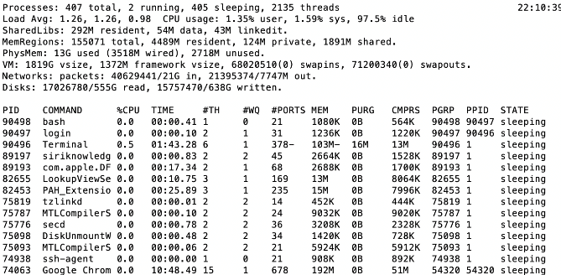
A Picture on one machine
Memory stays about 75% used, 25% for dynamics
A lot of it is shared 1.9 GB

Slide 26
Many Uses of Virtual Memory and “Demand Paging” …
Extend the stack
  Allocate a page and zero it
Extend the heap (sbrk of old, today mmap)
Process Fork
  Create a copy of the page table
  Entries refer to parent pages – NO-WRITE
  Shared read-only pages remain shared
  Copy page on write
Exec
  Only bring in parts of the binary in active use
  Do this on demand
MMAP to explicitly share region (or to access a file as RAM)

Slide 27
Classic: Loading an executable into memory
disk (huge)
memory
info
data
code
exe
.exe
  lives on disk in the file system
  contains contents of code & data segments, relocation entries and symbols
  OS loads it into memory, initializes registers (and initial stack pointer)
  program sets up stack and heap upon initialization:
  crt0 (C runtime init)

Slide 28
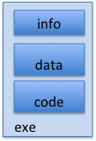
Create Virtual Address Space of the Process
disk (huge)
process VAS
memory
kernel
user page
frames
stack
sbrk
user pagetable
heap
data
kernel code & data
code
Utilized pages in the VAS are backed by a page block on disk
  Called the backing store or swap file
  Typically in an optimized block store, but can think of it like a file

Slide 29
Create Virtual Address Space of the Process
disk (huge, TB)
process VAS (GBs)
memory
kernel
stack
user page
frames
stack
heap
heap
user pagetable
data
data
code
kernel code & data
code
User Page table maps entire VAS
All the utilized regions are backed on disk
  swapped into and out of memory as needed
For every process

Slide 30
Create Virtual Address Space of the Process
VAS
[per process]
disk (huge, TB)
PT
memory
kernel
stack
user page
frames
stack
heap
heap
user pagetable
data
data
code
kernel code & data
code
User Page table maps entire VAS
  Resident pages to the frame in memory they occupy
  The portion of it that the HW needs to access must be resident in memory

Slide 31
Provide Backing Store for VAS
VAS
[per process]
disk (huge, TB)
memory
kernel
stack
user page
frames
stack
heap
heap
user pagetable
data
data
code
kernel code & data
code
User Page table maps entire VAS
Resident pages mapped to memory frames
For all other pages, OS must record where to find them on disk
  Many ways to do this, but might use remaining bits of PTE when P=0

Slide 32
What Data Structure Maps
Non-Resident Pages to Disk?
FindBlock(PID, page#) → disk_block
  Some OSs utilize spare space in PTE for paged blocks
  Like the PT, but purely software
Where to store it?
  In memory – can be compact representation if swap storage is contiguous on disk
  Could use hash table (like Inverted PT)
Usually want backing store for resident pages too
May map code segment directly to on-disk image
  Saves a copy of code to swap file
May share code segment with multiple instances of the program

Slide 33
Provide Backing Store for VAS
disk (huge, TB)
VAS 1
PT 1
memory
kernel
stack
stack
stack
heap
user page
frames
heap
heap
data
VAS 2
PT 2
data
code
user pagetable
data
kernel
code
stack
kernel code & data
heap
data
code

Slide 34
On page Fault …
disk (huge, TB)
VAS 1
PT 1
memory
kernel
stack
stack
stack
heap
user page
frames
heap
heap
data
VAS 2
PT 2
data
code
user pagetable
data
kernel
code
stack
kernel code
& data
heap
data
active process & PT
code

Slide 35
On page Fault … find & start load
disk (huge, TB)
VAS 1
PT 1
memory
kernel
stack
stack
stack
heap
user page
frames
heap
heap
data
VAS 2
PT 2
data
code
user pagetable
data
kernel
code
stack
kernel code & data
heap
data
active process & PT
code

Slide 36
On page Fault … schedule other P or T
disk (huge, TB)
VAS 1
PT 1
memory
kernel
stack
stack
stack
heap
user page
frames
heap
heap
data
VAS 2
PT 2
data
code
user pagetable
data
kernel
code
stack
kernel code & data
heap
data
active process & PT
code

Slide 37
On page Fault … update PTE
disk (huge, TB)
VAS 1
PT 1
memory
kernel
stack
stack
stack
heap
user page
frames
heap
heap
data
VAS 2
PT 2
data
code
user pagetable
data
kernel
code
stack
kernel code & data
heap
data
active process & PT
code

Slide 38
Eventually reschedule faulting thread
disk (huge, TB)
VAS 1
PT 1
memory
kernel
stack
stack
stack
heap
user page
frames
heap
heap
data
VAS 2
PT 2
data
code
user pagetable
data
kernel
code
stack
kernel code & data
heap
data
active process & PT
code

Slide 39
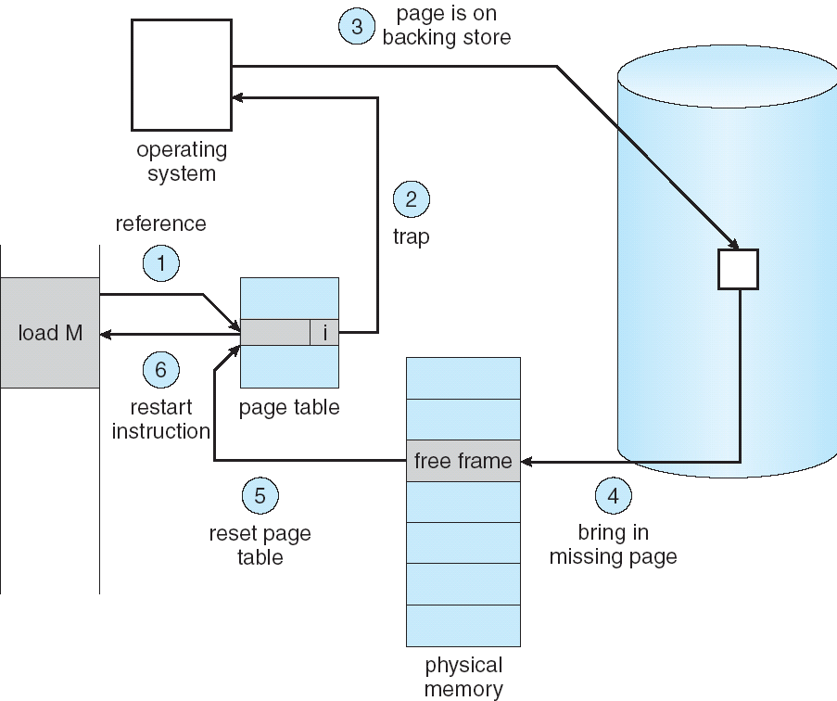
Summary: Steps in Handling a Page Fault

Slide 40
Some questions we need to answer!
During a page fault, where does the OS get a free frame?
  Keeps a free list
  Unix runs a “reaper” if memory gets too full
    Schedule dirty pages to be written back on disk
    Zero (clean) pages which haven’t been accessed in a while
  As a last resort, evict a dirty page first
How can we organize these mechanisms?
  Work on the replacement policy
How many page frames/process?
  Like thread scheduling, need to “schedule” memory resources:
    Utilization? fairness? priority?
  Allocation of disk paging bandwidth

Slide 41
Working Set Model
As a program executes it transitions through a sequence of “working sets” consisting of varying sized subsets of the address space
Address
Time

Slide 42
Cache Behavior under WS model
1
new working set fits
Hit Rate
0
Cache Size
Amortized by fraction of time the Working Set is active
Transitions from one WS to the next
Capacity, Conflict, Compulsory misses
Applicable to memory caches and pages. Others ?

Slide 43
Another model of Locality: Zipf
Likelihood of accessing item of rank r is α 1/rª
Although rare to access items below the top few, there are so many that it yields a “heavy tailed” distribution
Substantial value from even a tiny cache
Substantial misses from even a very large cache

Slide 44
Demand Paging Cost Model
Since Demand Paging like caching, can compute average access time! (“Effective Access Time”)
  EAT = Hit Rate x Hit Time + Miss Rate x Miss Time
  EAT = Hit Time + Miss Rate x Miss Penalty
Example:
  Memory access time = 200 nanoseconds
  Average page-fault service time = 8 milliseconds
  Suppose p = Probability of miss, 1-p = Probably of hit
  Then, we can compute EAT as follows:
EAT = 200ns + p x 8 ms
= 200ns + p x 8,000,000ns
If one access out of 1,000 causes a page fault, then EAT = 8.2 μs:
  This is a slowdown by a factor of 40!
What if want slowdown by less than 10%?
  EAT < 200ns x 1.1 ⇒ p < 2.5 x 10⁻⁶
  This is about 1 page fault in 400,000!

Slide 45
What Factors Lead to Misses in Page Cache?
Compulsory Misses:
  Pages that have never been paged into memory before
  How might we remove these misses?
    Prefetching: loading them into memory before needed
    Need to predict future somehow! More later
Capacity Misses:
  Not enough memory. Must somehow increase available memory size.
  Can we do this?
    One option: Increase amount of DRAM (not quick fix!)
    Another option: If multiple processes in memory: adjust percentage of memory allocated to each one!
Conflict Misses:
  Technically, conflict misses don’t exist in virtual memory, since it is a “fully-associative” cache
Policy Misses:
  Caused when pages were in memory, but kicked out prematurely because of the replacement policy
  How to fix? Better replacement policy

Slide 46
Page Replacement Policies
Why do we care about Replacement Policy?
  Replacement is an issue with any cache
  Particularly important with pages
    The cost of being wrong is high: must go to disk
    Must keep important pages in memory, not toss them out
FIFO (First In, First Out)
  Throw out oldest page. Be fair – let every page live in memory for same amount of time.
  Bad – throws out heavily used pages instead of infrequently used
RANDOM:
  Pick random page for every replacement
  Typical solution for TLB’s. Simple hardware
  Pretty unpredictable – makes it hard to make real-time guarantees
MIN (Minimum):
  Replace page that won’t be used for the longest time
  Great (provably optimal), but can’t really know future…
  But past is a good predictor of the future …

Slide 47
Summary
“Translation Lookaside Buffer” (TLB)
  Small number of PTEs and optional process IDs (< 512)
  Often Fully Associative (Since conflict misses expensive)
  On TLB miss, page table must be traversed and if located PTE is invalid, cause Page Fault
  On change in page table, TLB entries must be invalidated
Demand Paging: Treating the DRAM as a cache on disk
  Page table tracks which pages are in memory
  Any attempt to access a page that is not in memory generates a page fault, which causes OS to bring missing page into memory

