Slide 1
CS162
Operating Systems and
Systems Programming
Lecture 18
Demand Paging (Finished),
General I/O
March 21th, 2024
Prof. John Kubiatowicz
http://cs162.eecs.Berkeley.edu

Slide 2
Recall: Page Fault ⇒ Demand Paging
Process
virtual address
physical address
MMU
page#
PT
instruction
frame#
retry
page fault
offset
exception
frame#
Operating System
offset
update PT entry
Page Fault Handler
load page from disk
scheduler

Slide 3
Recall: Demand Paging Mechanisms
PTE makes demand paging implementatable
  Valid ⇒ Page in memory, PTE points at physical page
  Not Valid ⇒ Page not in memory; use info in PTE to find it on disk when necessary
Suppose user references page with invalid PTE?
  Memory Management Unit (MMU) traps to OS
    Resulting trap is a “Page Fault”
  What does OS do on a Page Fault?:
    Choose an old page to replace
    If old page modified (“D=1”), write contents back to disk
    Change its PTE and any cached TLB to be invalid
    Load new page into memory from disk
    Update page table entry, invalidate TLB for new entry
    Continue thread from original faulting location
  TLB for new page will be loaded when thread continued!
  While pulling pages off disk for one process, OS runs another process from ready queue
    Suspended process sits on wait queue
Cache

Slide 4
Recall: Demand Paging Cost Model
Since Demand Paging like caching, can compute average access time! (“Effective Access Time”)
  EAT = Hit Rate x Hit Time + Miss Rate x Miss Time
  EAT = Hit Time + Miss Rate x Miss Penalty
Example:
  Memory access time = 200 nanoseconds
  Average page-fault service time = 8 milliseconds
  Suppose p = Probability of miss, 1-p = Probably of hit
  Then, we can compute EAT as follows:
EAT = 200ns + p x 8 ms
= 200ns + p x 8,000,000ns
If one access out of 1,000 causes a page fault, then EAT = 8.2 μs:
  This is a slowdown by a factor of 40!
What if want slowdown by less than 10%?
  EAT < 200ns x 1.1 ⇒ p < 2.5 x 10⁻⁶
  This is about 1 page fault in 400,000!

Slide 5
What Factors Lead to Misses in Page Cache?
Compulsory Misses:
  Pages that have never been paged into memory before
  How might we remove these misses?
    Prefetching: loading them into memory before needed
    Need to predict future somehow! More later
Capacity Misses:
  Not enough memory. Must somehow increase available memory size.
  Can we do this?
    One option: Increase amount of DRAM (not quick fix!)
    Another option: If multiple processes in memory: adjust percentage of memory allocated to each one!
Conflict Misses:
  Technically, conflict misses don’t exist in virtual memory, since it is a “fully-associative” cache
Policy Misses:
  Caused when pages were in memory, but kicked out prematurely because of the replacement policy
  How to fix? Better replacement policy

Slide 6
Page Replacement Policies
Why do we care about Replacement Policy?
  Replacement is an issue with any cache
  Particularly important with pages
    The cost of being wrong is high: must go to disk
    Must keep important pages in memory, not toss them out
FIFO (First In, First Out)
  Throw out oldest page. Be fair – let every page live in memory for same amount of time.
  Bad – throws out heavily used pages instead of infrequently used
RANDOM:
  Pick random page for every replacement
  Typical solution for TLB’s. Simple hardware
  Pretty unpredictable – makes it hard to make real-time guarantees
MIN (Minimum):
  Replace page that won’t be used for the longest time
  Great (provably optimal), but can’t really know future…
  But past is a good predictor of the future …

Slide 7
Replacement Policies (Con’t)
LRU (Least Recently Used):
  Replace page that hasn’t been used for the longest time
  Programs have locality, so if something not used for a while, unlikely to be used in the near future.
  Seems like LRU should be a good approximation to MIN.
How to implement LRU? Use a list:
  On each use, remove page from list and place at head
  LRU page is at tail
Problems with this scheme for paging?
  Need to know immediately when page used so that can change position in list…
  Many instructions for each hardware access
In practice, people approximate LRU (more later)
Page 6
Page 7
Page 1
Page 2
Head
Tail (LRU)

Slide 8
Example: FIFO (strawman)
Suppose we have 3 page frames, 4 virtual pages, and following reference stream:
  A B C A B D A D B C B
Consider FIFO Page replacement:
FIFO: 7 faults
When referencing D, replacing A is bad choice, since need A again right away
Ref:
Page:
A
B
C
A
B
D
A
D
B
C
B
1
A
D
C
2
B
A
3
C
B

Slide 9
Example: MIN / LRU
Suppose we have the same reference stream:
  A B C A B D A D B C B
Consider MIN Page replacement:
MIN: 5 faults
  Where will D be brought in? Look for page not referenced farthest in future
What will LRU do?
  Same decisions as MIN here, but won’t always be true!
Ref:
Page:
A
B
C
A
B
D
A
D
B
C
B
1
A
C
2
B
3
C
D

Slide 10
Is LRU guaranteed to perform well?
Consider the following: A B C D A B C D A B C D
LRU Performs as follows (same as FIFO here):
  Every reference is a page fault!
Fairly contrived example of working set of N+1 on N frames
Ref:
Page:
A
B
C
D
A
B
C
D
A
B
C
D
1
A
D
C
B
2
B
A
D
C
3
C
B
A
D

Slide 11
When will LRU perform badly?
Consider the following: A B C D A B C D A B C D
LRU Performs as follows (same as FIFO here):
  Every reference is a page fault!
MIN Does much better:
Ref:
Page:
A
B
C
D
A
B
C
D
A
B
C
D
1
A
D
C
B
2
B
A
D
C
3
C
B
A
D
Ref:
Page:
A
B
C
D
A
B
C
D
A
B
C
D
1
A
B
2
B
C
3
C
D

Slide 12
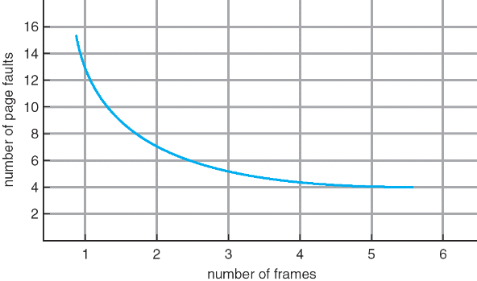
Graph of Page Faults Versus The Number of Frames
One desirable property: When you add memory the miss rate drops (stack property)
  Does this always happen?
  Seems like it should, right?
No: Bélády’s anomaly
  Certain replacement algorithms (FIFO) don’t have this obvious property!

Slide 13
Adding Memory Doesn’t Always Help Fault Rate
Does adding memory reduce number of page faults?
  Yes for LRU and MIN
  Not necessarily for FIFO! (Called Bélády’s anomaly)
After adding memory:
  With FIFO, contents can be completely different
  In contrast, with LRU or MIN, contents of memory with X pages are a subset of contents with X+1 Page
Ref:
Page:
A
B
C
D
A
B
E
A
B
C
D
E
1
A
D
E
2
B
A
C
3
C
B
D
Ref:
Page:
A
B
C
D
A
B
E
A
B
C
D
E
1
A
E
D
2
B
A
E
3
C
B
4
D
C

Slide 14

Administrivia
Still grading exam
  Really sorry!
  I’m promised that midterms will be released tonight…
Project 2 in full swing
  Stay on top of this one. Don’t wait until last moment to get pieces together
  Decide how to your team is going divide up project 2
Homework 4 also in full swing
  Learn about memory allocation
Make sure to fill out survey!
  We really want to hear how you think we are doing
  Also, will get a chance to suggest topics for the special topics lecture
    Have talked about a wide variety of things in the past
Spring Break!!!
  Hope you all have a relaxing week.

Slide 15
Approximating LRU: Recall PTE bits
Which bits of a PTE entry can help us approximate LRU?
Remember Intel PTE:
  The “Present” bit (called “Valid” elsewhere):
    P==0: Page is invalid and a reference will cause page fault
    P==1: Page frame number is valid and MMU is allowed to proceed with translation
  The “Writable” bit (could have opposite sense and be called “Read-only”):
    W==0: Page is read-only and cannot be written.
    W==1: Page can be written
  The “Accessed” bit (called “Use” elsewhere):
    A==0: Page has not been accessed (or used) since last time software set A→0
    A==1: Page has been accessed (or used) since last time software set A→0
  The “Dirty” bit (called “Modified” elsewhere):
    D==0: Page has not been modified (written) since PTE was loaded
    D==1: Page has changed since PTE was loaded
PTE:
Page Frame Number
(Physical Page Number)
Free
(OS)
0
PS
D
A
PCD
PWT
U
W
P
31-12
11-9
8
7
6
5
4
3
2
1
0

Slide 16

Approximating LRU: Clock Algorithm
Set of all pages
in Memory
Single Clock Hand:
  Advances only on page fault!
  Check for pages not used recently
  Mark pages as not used recently
Clock Algorithm: Arrange physical pages in circle with single clock hand
  Approximate LRU (approximation to approximation to MIN)
  Replace an old page, not the oldest page
Details:
  Hardware “use” bit per physical page (called “accessed” in Intel architecture):
    Hardware sets use bit on each reference
    If use bit isn’t set, means not referenced in a long time
    Some hardware sets use bit in the TLB; must be copied back to PTE when TLB entry gets replaced
  On page fault:
    Advance clock hand (not real time)
    Check use bit: 1→ used recently; clear and leave alone
    0→ selected candidate for replacement

Slide 17
Clock Algorithm: More details
Set of all pages
in Memory
Single Clock Hand
Will always find a page or loop forever?
  Even if all use bits set, will eventually loop
  all the way around ⇒ FIFO
What if hand moving slowly?
  Good sign or bad sign?
    Not many page faults
    or find page quickly
What if hand is moving quickly?
  Lots of page faults and/or lots of reference bits set
One way to view clock algorithm:
  Crude partitioning of pages into two groups: young and old
  Why not partition into more than 2 groups?

Slide 18
N^{th} Chance version of Clock Algorithm
N^{th} chance algorithm: Give page N chances
  OS keeps counter per page: # sweeps
  On page fault, OS checks use bit:
    1 → clear use and also clear counter (used in last sweep)
    0 → increment counter; if count=N, replace page
  Means that clock hand has to sweep by N times without page being used before page is replaced
How do we pick N?
  Why pick large N? Better approximation to LRU
    If N ~ 1K, really good approximation
  Why pick small N? More efficient
    Otherwise might have to look a long way to find free page
What about “modified” (or “dirty”) pages?
  Takes extra overhead to replace a dirty page, so give dirty pages an extra chance before replacing?
  Common approach:
    Clean pages, use N=1
    Dirty pages, use N=2 (and write back to disk when N=1)

Slide 19
Clock Algorithms Variations
Do we really need hardware-supported “modified” bit?
  No. Can emulate it using read-only bit
    Need software DB of which pages are allowed to be written (needed this anyway)
    We will tell MMU that pages have more restricted permissions than the actually do to force page faults (and allow us notice when page is written)
  Algorithm (Clock-Emulated-M):
    Initially, mark all pages as read-only (W→0), even writable data pages.
    Further, clear all software versions of the “modified” bit → 0 (page not dirty)
    Writes will cause a page fault. Assuming write is allowed, OS sets software “modified” bit → 1, and marks page as writable (W→1).
    Whenever page written back to disk, clear “modified” bit → 0, mark read-only

Slide 20
Clock Algorithms Variations (continued)
Do we really need a hardware-supported “use” bit?
  No. Can emulate it similar to above (e.g. for read operation)
    Kernel keeps a “use” bit and “modified” bit for each page
  Algorithm (Clock-Emulated-Use-and-M):
    Mark all pages as invalid, even if in memory.
    Clear emulated “use” bits → 0 and “modified” bits → 0 for all pages (not used, not dirty)
    Read or write to invalid page traps to OS to tell use page has been used
    OS sets “use” bit → 1 in software to indicate that page has been “used”.
    Further:
    1) If read, mark page as read-only, W→0 (will catch future writes)
    2) If write (and write allowed), set “modified” bit → 1, mark page as writable (W→1)
    When clock hand passes, reset emulated “use” bit → 0 and mark page as invalid again
    Note that “modified” bit left alone until page written back to disk
Remember, however, clock is just an approximation of LRU!
  Can we do a better approximation, given that we have to take page faults on some reads and writes to collect use information?
  Need to identify an old page, not oldest page!
  Answer: second chance list

Slide 21
Second-Chance List Algorithm (VAX/VMS)
LRU victim
Directly
Mapped Pages
Marked: RW
List: FIFO
Overflow
Second
Chance List
Marked: Invalid
List: LRU
Access
Page-in
From disk
New
Active Pages
New
SC Victims
Split memory in two: Active list (RW), SC list (Invalid)
Access pages in Active list at full speed
Otherwise, Page Fault
  Always move overflow page from end of Active list to front of Second-chance list (SC) and mark invalid
  Desired Page On SC List: move to front of Active list, mark RW
  Not on SC list: page in to front of Active list, mark RW; page out LRU victim at end of SC list

Slide 22
Second-Chance List Algorithm (continued)
How many pages for second chance list?
  If 0 ⇒ FIFO
  If all ⇒ LRU, but page fault on every page reference
Pick intermediate value. Result is:
  Pro: Few disk accesses (page only goes to disk if unused for a long time)
  Con: Increased overhead trapping to OS (software / hardware tradeoff)
With page translation, we can adapt to any kind of access the program makes
  Later, we will show how to use page translation / protection to share memory between threads on widely separated machines
History: The VAX architecture did not include a “use” bit.
Why did that omission happen???
  Strecker (architect) asked OS people, they said they didn’t need it, so didn’t implement it
  He later got blamed, but VAX did OK anyway

Slide 23
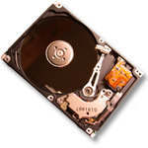
Free List
Set of all pages
in Memory
Single Clock Hand: Advances as needed to keep freelist full (“background”)
D
D
Free Pages
For Processes
Keep set of free pages ready for use in demand paging
  Freelist filled in background by Clock algorithm or other technique (“Pageout demon”)
  Dirty pages start copying back to disk when enter list
Like VAX second-chance list
  If page needed before reused, just return to active set
Advantage: faster for page fault
  Can always use page (or pages) immediately on fault

Slide 24
Reverse Page Mapping (Sometimes called “Coremap”)
When evicting a page frame, how to know which PTEs to invalidate?
  Hard in the presence of shared pages (forked processes, shared memory, …)
Reverse mapping mechanism must be very fast
  Must hunt down all page tables pointing at given page frame when freeing a page
  Must hunt down all PTEs when seeing if pages “active”
Implementation options:
  For every page descriptor, keep linked list of page table entries that point to it
    Management nightmare – expensive
  Linux: Object-based reverse mapping
    Link together memory region descriptors instead (much coarser granularity)

Slide 25
Allocation of Page Frames (Memory Pages)
How do we allocate memory among different processes?
  Does every process get the same fraction of memory? Different fractions?
  Should we completely swap some processes out of memory?
Each process needs minimum number of pages
  Want to make sure that all processes that are loaded into memory can make forward progress
  Example: IBM 370 – 6 pages to handle SS MOVE instruction:
    instruction is 6 bytes, might span 2 pages
    2 pages to handle from
    2 pages to handle to
Possible Replacement Scopes:
  Global replacement – process selects replacement frame from set of all frames; one process can take a frame from another
  Local replacement – each process selects from only its own set of allocated frames

Slide 26
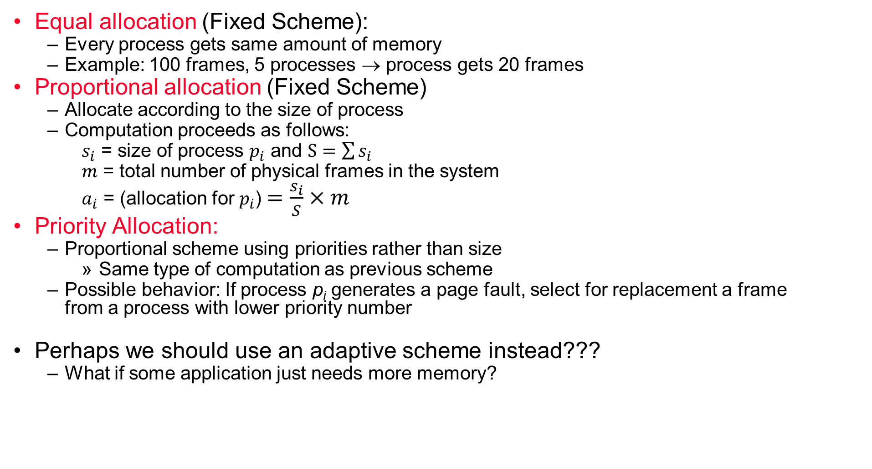
Fixed/Priority Allocation
Equal allocation (Fixed Scheme):
  Every process gets same amount of memory
  Example: 100 frames, 5 processes → process gets 20 frames
Proportional allocation (Fixed Scheme)
  Allocate according to the size of process
  Computation proceeds as follows:
  $s_{i}$ = size of process $p_{i}$ and $S=\sum{s_{i}}$
  $m$ = total number of physical frames in the system
  $a_{i}$ = (allocation for $p_{i}$)$=\frac{s_{i}}{S}×m$
Priority Allocation:
  Proportional scheme using priorities rather than size
    Same type of computation as previous scheme
  Possible behavior: If process p_{i} generates a page fault, select for replacement a frame
  from a process with lower priority number
Perhaps we should use an adaptive scheme instead???
  What if some application just needs more memory?

Slide 27
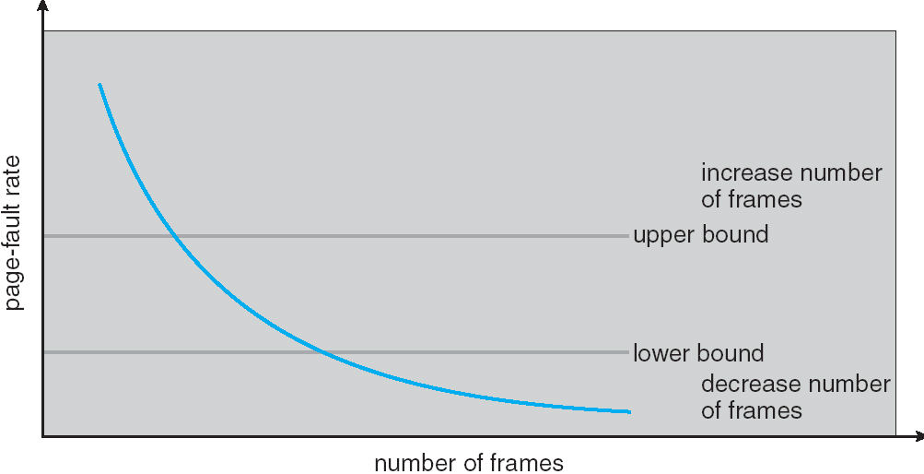
Page-Fault Frequency Allocation
Can we reduce Capacity misses by dynamically changing the number of pages/application?
Establish “acceptable” page-fault rate
  If actual rate too low, process loses frame
  If actual rate too high, process gains frame
Question: What if we just don’t have enough memory?

Slide 28
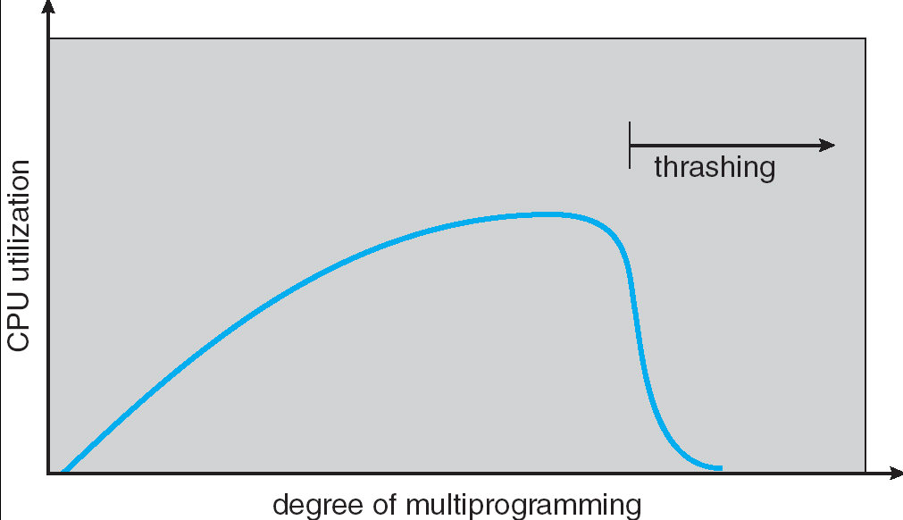
Thrashing
If a process does not have “enough” pages, the page-fault rate is very high.
This leads to:
  low CPU utilization
  operating system spends most of its time swapping to disk
Thrashing ≡ a process is busy swapping pages in and out with little or no actual progress
Questions:
  How do we detect Thrashing?
  What is best response to Thrashing?
Notes:
Example: one program, touches 50 pages (each equally likely). Have only 40 physical page frames.
How bad is this?
- Does your program run at 80% speed?
- Does your program run at 20% speed?
Performance is really bad
If we have enough pages, 200 ns/ref, but if too few pages, assume every 5th page reference causes a page fault
= 4 refs x 200 ns
1 page fault x 10 ms for disk I/O
= 5 refs, 10 ms + 800 ns => 2 ms/ref (not 100 MIPS, but 500 IPS! Factor of 10,000)
Machine appears to have stopped!

Slide 29
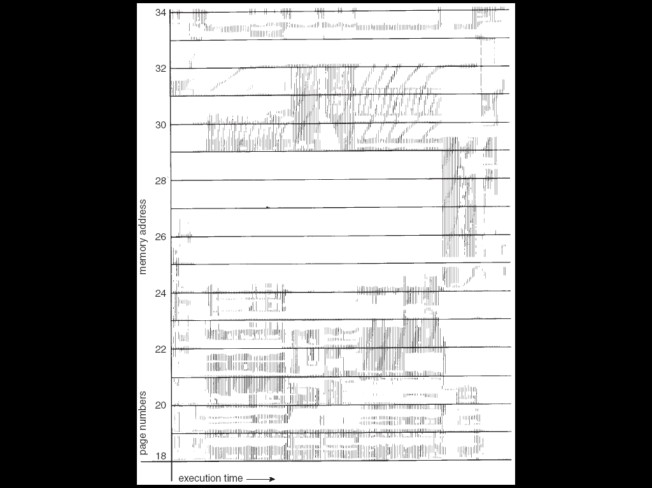
Locality In A Memory-Reference Pattern
Program Memory Access Patterns have temporal and spatial locality
  Group of Pages accessed along a given time slice called the “Working Set”
  Working Set defines minimum number of pages for process to behave well
Not enough memory for Working Set ⇒ Thrashing
  Better to swap out process?

Slide 30
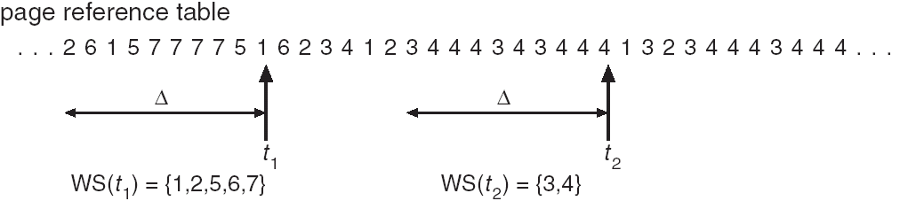
Working-Set Model Take 2
Δ ≡ working-set window ≡ fixed number of page references
  Example: 10,000 instructions
WSi (working set of Process Pi) = total set of pages referenced in the most recent Δ (varies in time)
  if Δ too small will not encompass entire locality
  if Δ too large will encompass several localities
  if Δ = ∞ ⇒ will encompass entire program
D = Σ|WSi| ≡ total demand frames
if D > m ⇒ Thrashing
  Policy: if D > m, then suspend/swap out processes
  This can improve overall system behavior by a lot!

Slide 31
What about Compulsory Misses?
Recall that compulsory misses are misses that occur the first time that a page is seen
  Pages that are touched for the first time
  Pages that are touched after process is swapped out/swapped back in
Clustering:
  On a page-fault, bring in multiple pages “around” the faulting page
  Since efficiency of disk reads increases with sequential reads, makes sense to read several sequential pages
Working Set Tracking:
  Use algorithm to try to track working set of application
  When swapping process back in, swap in working set

Slide 32
Linux Memory Details?
Memory management in Linux considerably more complex than the examples we have been discussing
Memory Zones: physical memory categories
  ZONE_DMA: < 16MB memory, DMAable on ISA bus
  ZONE_NORMAL: 16MB → 896MB (mapped at 0xC0000000)
  ZONE_HIGHMEM: Everything else (> 896MB)
Each zone has 1 freelist, 2 LRU lists (Active/Inactive)
Many different types of allocation
  SLAB allocators, per-page allocators, mapped/unmapped
Many different types of allocated memory:
  Anonymous memory (not backed by a file, heap/stack)
  Mapped memory (backed by a file)
Allocation priorities
  Is blocking allowed/etc

Slide 33
Linux Virtual memory map (Pre-Meltdown)
0xFFFFFFFF
0xFFFFFFFFFFFFFFFF
Kernel
Addresses
1GB
Kernel
Addresses
128TiB
896MB
Physical
64 TiB
Physical
0xC0000000
User
Addresses
0xFFFF800000000000
3GB Total
Empty
Space
“Canonical Hole”
0x00007FFFFFFFFFFF
128TiB
User
Addresses
0x00000000
0x0000000000000000
32-Bit Virtual Address Space
64-Bit Virtual Address Space

Slide 34
Pre-Meltdown Virtual Map (Details)
Kernel memory not generally visible to user
  Exception: special VDSO (virtual dynamically linked shared objects) facility that maps kernel code into user space to aid in system calls (and to provide certain actual system calls such as gettimeofday())
Every physical page described by a “page” structure
  Collected together in lower physical memory
  Can be accessed in kernel virtual space
  Linked together in various “LRU” lists
For 32-bit virtual memory architectures:
  When physical memory < 896MB
    All physical memory mapped at 0xC0000000
  When physical memory >= 896MB
    Not all physical memory mapped in kernel space all the time
    Can be temporarily mapped with addresses > 0xCC000000
For 64-bit virtual memory architectures:
  All physical memory mapped above 0xFFFF800000000000

Slide 35
Post Meltdown Memory Map
Meltdown flaw (2018, Intel x86, IBM Power, ARM)
  Exploit speculative execution to observe contents of kernel memory
  1: // Set up side channel (array flushed from cache)
  2: uchar array[256 * 4096];
  3: flush(array); // Make sure array out of cache (not an instruction!)
  4: try { // … catch and ignore SIGSEGV (illegal access)
  5: uchar result = *(uchar *)kernel_address; // Try access!
  6: uchar dummy = array[result * 4096]; // leak info!
  7: } catch(){;} // Could use signal() and setjmp/longjmp
  8: // scan through 256 array slots to determine which loaded
  Some details:
    Reason we skip 4096 for each value: avoid hardware cache prefetch
    Note that value detected by fact that one cache line is loaded
    Catch and ignore page fault: set signal handler for SIGSEGV, can use setjump/longjmp….
Patch: Need different page tables for user and kernel
  Without PCID tag in TLB, flush TLB twice on syscall (800% overhead!)
  Need at least Linux v 4.14 which utilizes PCID tag in new hardware to avoid flushing when change address space
Fix: better hardware without timing side-channels

Slide 36
Conclusion
Replacement policies
  FIFO: Place pages on queue, replace page at end
  MIN: Replace page that will be used farthest in future
  LRU: Replace page used farthest in past
Working Set:
  Set of pages touched by a process recently
  Point of Replacement algorithms is to try to keep working set in memory
Clock Algorithm: Approximation to LRU
  Arrange all pages in circular list
  Sweep through them, marking as not “in use”
  If page not “in use” for one pass, than can replace
Nth-chance clock algorithm: Another approximate LRU
  Give pages multiple passes of clock hand before replacing
Second-Chance List algorithm: Yet another approximate LRU
  Divide pages into two groups, one of which is truly LRU and managed on page faults.

