Slide 1
Discussion 8
File Systems
04/05/24
Staff

Slide 2
Announcements
Sunday | Monday | Tuesday | Wednesday | Thursday | Friday | Saturday
 |  |  | Homework 4 Due | Homework 5 Release | Project 2 Due
Project 3 Release |  |  |  |  | RPC Lab Deadline
 | Project 3 Design Doc Due |  |  |  | HW5 Checkpoint Deadline

Slide 3
Queueing Theory

Slide 4
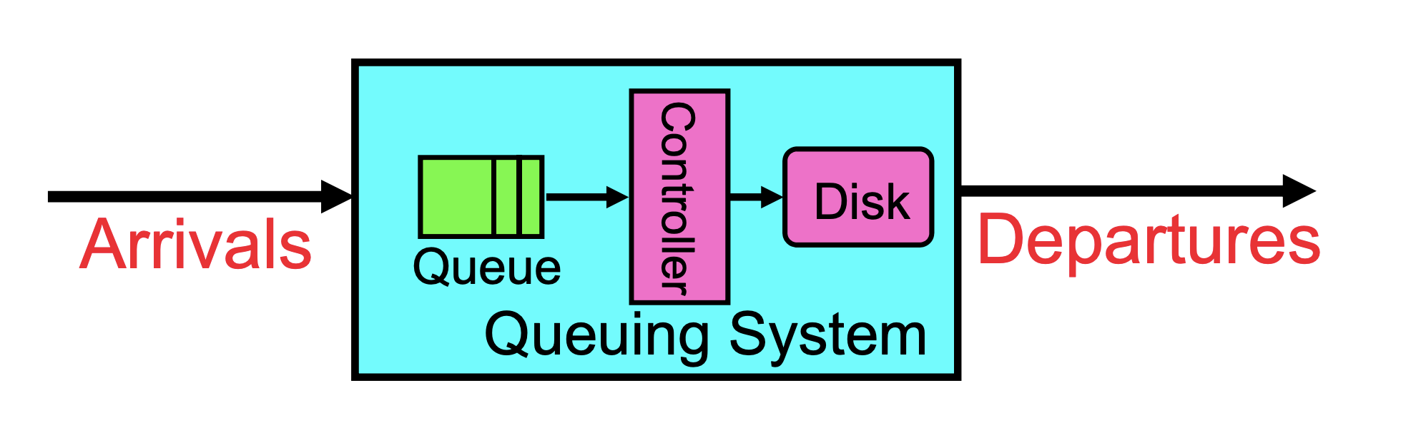
Introduction
Arrivals and departures are both characterized by some probabilistic distributions
Queueing Theory applies to long-term, steady-state behavior
  Arrival rate = Departure rate

Slide 5
Little’s Law
In any stable system, average arrival rate = average departure rate
Average arrival rate 𝝺
Average time spent in queue L
Average number of jobs in queue N = 𝝺 x L
This holds regardless of instantaneous variations (remember, this is long–term behavior)
Arrivals (w/ rate 𝝺)
N jobs in queue
Departures

Slide 6
Computing L (aka T_{Q})
To use Little’s Law, we needed to know L, the average amount of time spent waiting in the queue
  Notation: L is also often called T_{Q}
Parameters that define our system:
  𝝺: mean arrival rate
  T_{ser}: mean service time (time to service a job/customer/etc.)
  C = 𝞂² / T²_{ser} : squared coefficient of variation
    Let X be the random variable representing service time
    C = Var(X) / E[X]²
Arrival rate 𝝺
Queue
Service rate 𝛍 = 1 / T_{ser}
Server

Slide 7
Computing T_{Q}
Parameters that define our system:
  𝝺: mean arrival rate
  T_{ser}: mean service time (time to service a job/customer/etc.)
  C = 𝞂² / T²_{ser} : squared coefficient of variation
    Let X be the random variable representing service time
    C = Var(X) / E[X]²
From these parameters, we can calculate the following useful intermediate values:
  𝝻 = 1 / T_{ser} : mean service rate
  u = 𝝺 / 𝝻 = 𝝺 x T_{ser}
Arrival rate 𝝺
Queue
Service rate 𝛍 = 1 / T_{ser}
Server

Slide 8
Computing T_{Q}
Results:
  Memoryless Service Time Distribution (M/M/1 Queue):
    C = 1
    T_{Q} = T_{ser} × u / (1 - u)
  General Service Time Distribution (M/G/1 Queue):
    T_{Q} = T_{ser} × ½ (1 + C) × u / (1 - u)
Arrival rate 𝝺
Queue
Service rate 𝛍 = 1 / T_{ser}
Server

Slide 9
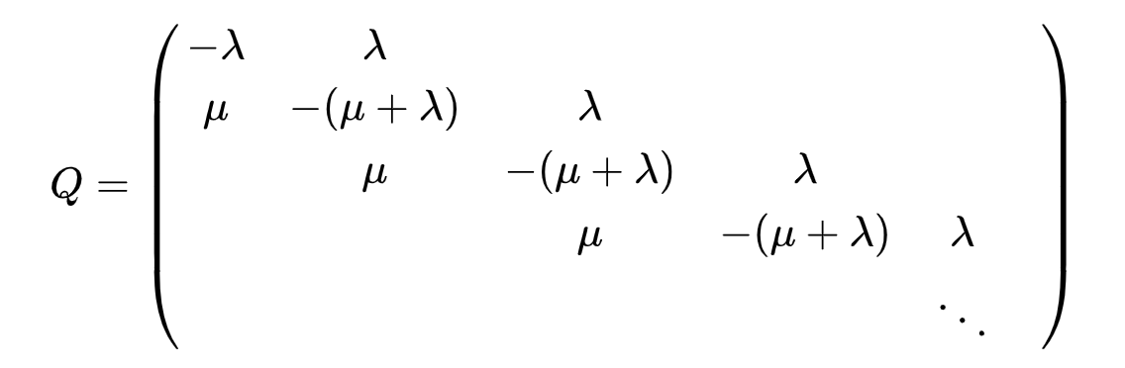
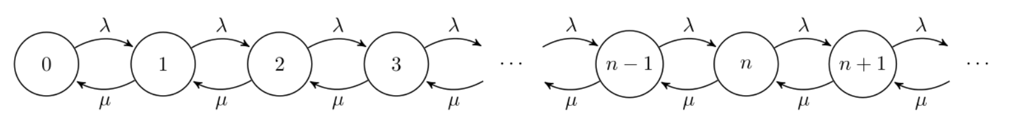
Derivation of M/M/1 Queue formula (out of scope)
Model the system as a CTMC with the transition matrix
This is just the following birth-death chain
System is stable only when u = 𝝺 / 𝝁 < 1.

Slide 10
Derivation of M/M/1 Queue formula (out of scope)
The stationary distribution for number of jobs in system (queue + being served) is ~ Geo(1 - u), i.e. P[X = k] = (1 - u) × u^{k} where X is the number of jobs
N, the average number of jobs in the system is simply E[X] = u / (1 - u)
By Little’s Law, N = 𝝺W
  𝝺W = u / (1 - u) => W = 1 / (𝝻 - 𝝺)
T_{Q} = W - T_{ser} = [1 / (𝝻 - 𝝺)] - [1 / 𝝻] = u / (𝝻 - 𝝺) = (1 / 𝝻) * 𝝺 / (𝝻 - 𝝺) = T_{ser} × u / (1 - u)

Slide 11
Concept Check
Explain intuitively why response time is nonlinear with utilization. Draw a plot of utilization (x axis) vs. response time (y-axis) and label the endpoints on the x-axis.

Slide 12
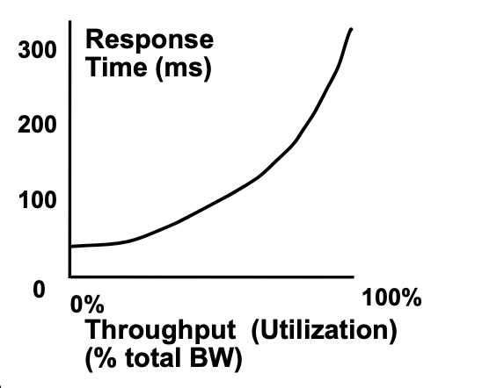
Concept Check
Explain intuitively why response time is nonlinear with utilization. Draw a plot of utilization (x axis) vs. response time (y-axis) and label the endpoints on the x-axis.
As long as utilization is less than 100%, the server will be idle for some non-zero portion of the time. This idling time is wasted and can’t be recovered (“anti-wasted”). Because of this asymmetry, the length of the queue builds up over time.

Slide 13
Concept Check
If 50 jobs arrive at a system every second and the average response time for any particular job is 100ms, how many jobs are in the system (either queued or being serviced) on average at a particular moment? Which law describes this relationship?
Is it better to have N queues, each of which is serviced at the rate of 1 job per second, or 1 queue that is serviced at the rate of N jobs per second? Give reasons to justify your answer.

Slide 14
Concept Check
If 50 jobs arrive at a system every second and the average response time for any particular job is 100ms, how many jobs are in the system (either queued or being serviced) on average at a particular moment? Which law describes this relationship?
50 jobs/s × 0.1 s = 5 jobs (at any time). This is Little’s law - arrival rate × average response time = average length of the queue.
Is it better to have N queues, each of which is serviced at the rate of 1 job per second, or 1 queue that is serviced at the rate of N jobs per second? Give reasons to justify your answer.

Slide 15
Concept Check
If 50 jobs arrive at a system every second and the average response time for any particular job is 100ms, how many jobs are in the system (either queued or being serviced) on average at a particular moment? Which law describes this relationship?
50 jobs/s × 0.1 s = 5 jobs (at any time). This is Little’s law - arrival rate × average response time = average length of the queue.
Is it better to have N queues, each of which is serviced at the rate of 1 job per second, or 1 queue that is serviced at the rate of N jobs per second? Give reasons to justify your answer.
One queue that can process N jobs per second is faster (i.e the second option).
Better response time (1 / N sec vs 1 sec) and better utilization (no load-balancing problems), which gives you lower queuing delays on average.
With the single, fast queue, every arriving request gets the same fast average service. In the multiple-queue case, you only get the same service speed when all N servers are serving customers, i.e. only in the cases when a burst of items arrives quickly enough to get every server busy.

Slide 16
Concept Check
What is the average queuing time for a work queue with 1 server, average arrival rate of λ, average service time S, and squared coefficient of variation of service time C?
What does it mean if C = 0? What does it mean if C = 1?

Slide 17
Concept Check
What is the average queuing time for a work queue with 1 server, average arrival rate of λ, average service time S, and squared coefficient of variation of service time C?
S is another name for T_{ser}.
T_{Q} = S × ½ (1 + C) × u / (1 - u) where u = 𝝺 × S
What does it mean if C = 0? What does it mean if C = 1?

Slide 18
Concept Check
What is the average queuing time for a work queue with 1 server, average arrival rate of λ, average service time S, and squared coefficient of variation of service time C?
S is another name for T_{ser}.
T_{Q} = S × ½ (1 + C) × u / (1 - u) where u = 𝝺 × S
What does it mean if C = 0? What does it mean if C = 1?
If C = 0, then your service rate is regular and deterministic, which means that tasks are completed at a constant rate. If C = 1, then your arrivals can be modeled as a Poisson Process, and the interval between jobs being serviced can be modeled as a exponential distribution.

Slide 19
File Systems

Slide 20
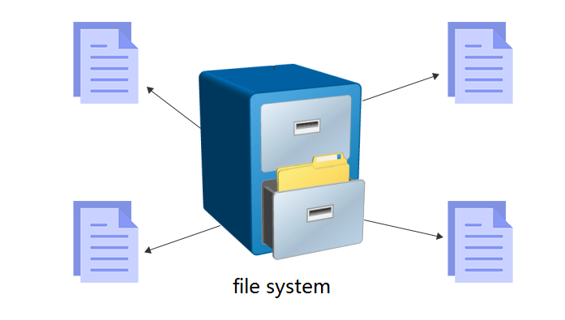
File System
File system provides persistent, named data to the user.
Abstraction layer maintained by the OS to make it easy for user and programs to interact with files.
File is a named collection of data in a file system.
Allow an arbitrary amount of data to be referred to by a single, meaningful name.
Metadata contains information about a file needed by the OS (e.g. size, owner, access control).
Data is the actual content of the file.
  Can be interpreted to be something meaningful (e.g. text editors, PDF readers), but at its core is just a raw sequence of bytes.

Slide 21
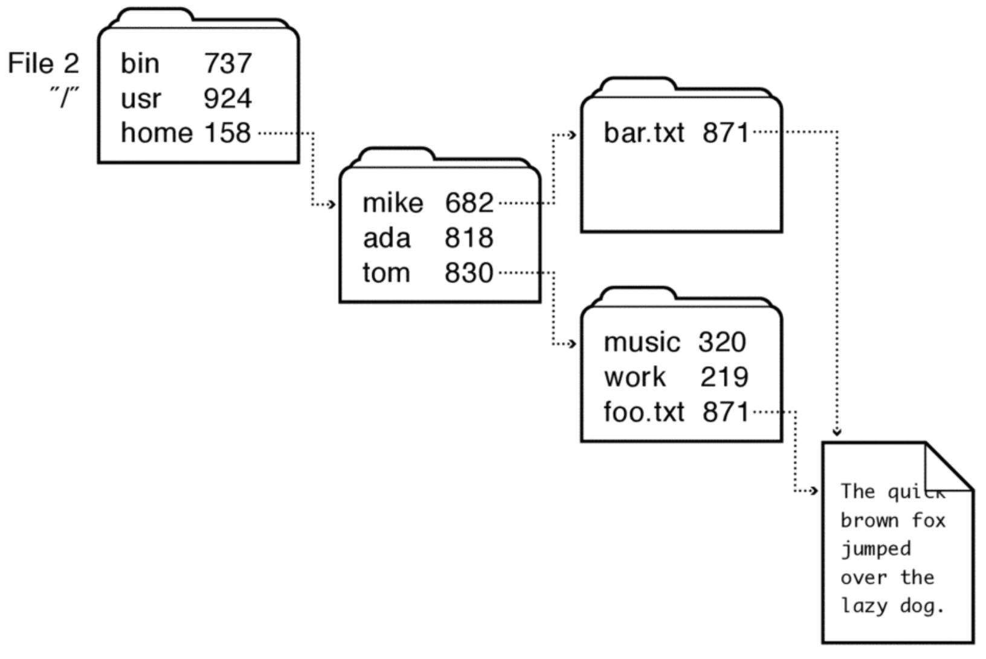
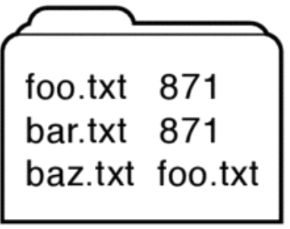
File System
A directory is a list of mappings from human-readable file names to specific underlying files or directories.
Hard links are directory entries that map different names to the same file number.
  Allow for one underlying file to have many names.
  Can’t span across multiple file systems.
  Create using ln [target] [dest].
Soft/symbolic links are directory entries that map a name to another name.
  Can move across different file systems.
  Create using ln -s [target] [dest].
When analyzing file system implementations, focus on index structure, directory structure, and free space management.

Slide 22
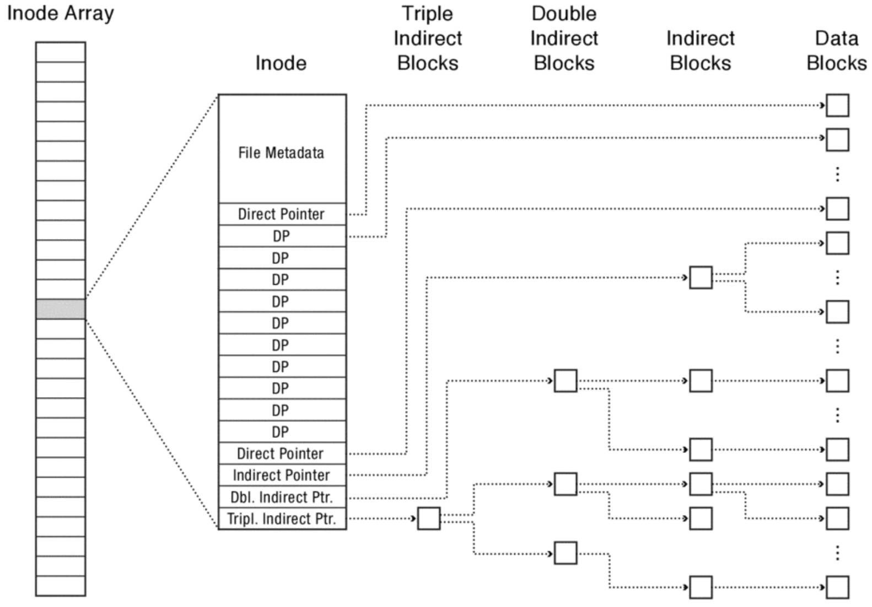
Fast File System (FFS)
Index structure
Fixed, asymmetric tree called a multi-level index.
Each index is rooted at an inode that stores the file’s metadata and pointers to data.
  Doesn’t actually store file name or any data in the inode.
  Inodes stores on a fixed block on disk in an inode array.
Pointers are just block numbers.
  Direct pointers point directly to the block (i.e. the pointer is a block number of a block that contains the file’s data).
  Indirect pointer points to an indirect block which is an array of direct pointers.
  Double indirect pointer points to a double indirect block which is an array of indirect pointers.
  Typically see up to triple indirect pointer.

Slide 23
Fast File System (FFS)
Directory Structure
Index of an inode in the inode array is the inumber which is used as the file number.
Metadata stored in inode, not directory entry → hard links!
Free Space Management
Bitmap where each bit corresponds to a block and indicates whether the block is free.
Allocate disk blocks using block group placement which places file’s inode block and data blocks near each other.
  Reserve a fraction of disk space for optimal block group placement.

Slide 24
Concept Check
Consider an inode-based file system with 2 KiB blocks and 32-bit disk and file block pointers. Each inode has 12 direct pointers, an indirect pointer, a double indirect pointer, and a triple indirect pointer. How large of a disk can this file system support? What is the maximum file size?

Slide 25
Concept Check
Consider an inode-based file system with 2 KiB blocks and 32-bit disk and file block pointers. Each inode has 12 direct pointers, an indirect pointer, a double indirect pointer, and a triple indirect pointer. How large of a disk can this file system support? What is the maximum file size?
32-bit disk → 2³² blocks → max disk size = 2³² blocks ✕ 2¹¹ bytes/block = 8 TiB

Slide 26
Concept Check
Consider an inode-based file system with 2 KiB blocks and 32-bit disk and file block pointers. Each inode has 12 direct pointers, an indirect pointer, a double indirect pointer, and a triple indirect pointer. How large of a disk can this file system support? What is the maximum file size?
32-bit disk → 2³² blocks → max disk size = 2³² blocks ✕ 2¹¹ bytes/block = 8 TiB
# pointers/block = 2¹¹ bytes/block ÷ 4 bytes/pointer = 512 pointers per block

Slide 27
Concept Check
Consider an inode-based file system with 2 KiB blocks and 32-bit disk and file block pointers. Each inode has 12 direct pointers, an indirect pointer, a double indirect pointer, and a triple indirect pointer. How large of a disk can this file system support? What is the maximum file size?
32-bit disk → 2³² blocks → max disk size = 2³² blocks ✕ 2¹¹ bytes/block = 8 TiB
# pointers/block = 2¹¹ bytes/block ÷ 4 bytes/pointer = 512 pointers per block
Max file size = block size ✕ number of all direct pointers (including ones from indirect pointers)
= 2048 ✕ (12 + 512 + 512² + 512³)
= 24 KiB + 513 MiB + 256 GiB

Slide 28
Concept Check
Compare bitmap-based allocation of blocks on disk with a free block list.
For inode-based file systems, what is the point of having direct pointers? Why not just have indirect pointers since they can point to much more data than a single direct pointer?

Slide 29
Concept Check
Compare bitmap-based allocation of blocks on disk with a free block list.
Bitmap = fixed size proportional to size of disk → better for contiguous allocation
Free block list = shrinks as disk space is used up → better when disk utilization is high
For inode-based file systems, what is the point of having direct pointers? Why not just have indirect pointers since they can point to much more data than a single direct pointer?

Slide 30
Concept Check
Compare bitmap-based allocation of blocks on disk with a free block list.
Bitmap = fixed size proportional to size of disk → better for contiguous allocation
Free block list = shrinks as disk space is used up → better when disk utilization is high
For inode-based file systems, what is the point of having direct pointers? Why not just have indirect pointers since they can point to much more data than a single direct pointer?
Most files are small enough to be contained within direct pointers → no need to waste an extra block read with indirect pointers.

Slide 31
Concept Check
List the set of disk blocks that must be read into memory in order to read the file /home/cs162/pintos.bean in its entirety from a UNIX BSD 4.2 file system (10 direct pointers, an indirect pointer, a double indirect pointer, and a triple indirect pointer) on a magnetic disk with 1 KiB block size. The /home/cs162/pintos.bean file is 15,234 bytes. Assume that the directories in question all fit into a single disk block each and the inode array is resident in memory (i.e. don’t count inode array disk accesses).

Slide 32
Concept Check
List the set of disk blocks that must be read into memory in order to read the file /home/cs162/pintos.bean in its entirety from a UNIX BSD 4.2 file system (10 direct pointers, an indirect pointer, a double indirect pointer, and a triple indirect pointer) on a magnetic disk with 1 KiB block size. The /home/cs162/pintos.bean file is 15,234 bytes. Assume that the directories in question all fit into a single disk block each and the inode array is resident in memory (i.e. don’t count inode array disk accesses).
 | Inode Array
0
1
2 | /
3 | /bin
4 | /home
5 | /opt
6 | /usr
7 | /bin/cat
8 | /home/cs152
9 | /home/cs162
10 | /opt/spark
11 | /home/cs189_rant.txt
12 | /usr/bin
13 | /home/cs162/kidney.bean
14 | /home/cs189/hw1
15 | /home/cs162/pintos.bean

Slide 33
Concept Check
List the set of disk blocks that must be read into memory in order to read the file /home/cs162/pintos.bean in its entirety from a UNIX BSD 4.2 file system (10 direct pointers, an indirect pointer, a double indirect pointer, and a triple indirect pointer) on a magnetic disk with 1 KiB block size. The /home/cs162/pintos.bean file is 15,234 bytes. Assume that the directories in question all fit into a single disk block each and the inode array is resident in memory (i.e. don’t count inode array disk accesses).
1. Read in inode for root directory.
 | Inode Array
0
1
2 | /
3 | /bin
4 | /home
5 | /opt
6 | /usr
7 | /bin/cat
8 | /home/cs152
9 | /home/cs162
10 | /opt/spark
11 | /home/cs189_rant.txt
12 | /usr/bin
13 | /home/cs162/kidney.bean
14 | /home/cs189/hw1
15 | /home/cs162/pintos.bean

Slide 34
Concept Check
List the set of disk blocks that must be read into memory in order to read the file /home/cs162/pintos.bean in its entirety from a UNIX BSD 4.2 file system (10 direct pointers, an indirect pointer, a double indirect pointer, and a triple indirect pointer) on a magnetic disk with 1 KiB block size. The /home/cs162/pintos.bean file is 15,234 bytes. Assume that the directories in question all fit into a single disk block each and the inode array is resident in memory (i.e. don’t count inode array disk accesses).
1. Read in inode for root directory.
 | Inode Array
0
1
2 | /
3 | /bin
4 | /home
5 | /opt
6 | /usr
7 | /bin/cat
8 | /home/cs152
9 | /home/cs162
10 | /opt/spark
11 | /home/cs189_rant.txt
12 | /usr/bin
13 | /home/cs162/kidney.bean
14 | /home/cs189/hw1
15 | /home/cs162/pintos.bean
 | Inode
DP | 17
DP
DP
DP
DP
DP
DP
DP
DP
DP
IP
DIP
TIP

Slide 35
Concept Check
List the set of disk blocks that must be read into memory in order to read the file /home/cs162/pintos.bean in its entirety from a UNIX BSD 4.2 file system (10 direct pointers, an indirect pointer, a double indirect pointer, and a triple indirect pointer) on a magnetic disk with 1 KiB block size. The /home/cs162/pintos.bean file is 15,234 bytes. Assume that the directories in question all fit into a single disk block each and the inode array is resident in memory (i.e. don’t count inode array disk accesses).
2. Read in block pointed to by the the first direct pointer for root inode.
 | Inode Array
0
1
2 | /
3 | /bin
4 | /home
5 | /opt
6 | /usr
7 | /bin/cat
8 | /home/cs152
9 | /home/cs162
10 | /opt/spark
11 | /home/cs189_rant.txt
12 | /usr/bin
13 | /home/cs162/kidney.bean
14 | /home/cs189/hw1
15 | /home/cs162/pintos.bean
 | Inode
DP | 17
DP
DP
DP
DP
DP
DP
DP
DP
DP
IP
DIP
TIP
Name | File Number
bin | 3
home | 4
opt | 5
usr | 6

Slide 36
Concept Check
List the set of disk blocks that must be read into memory in order to read the file /home/cs162/pintos.bean in its entirety from a UNIX BSD 4.2 file system (10 direct pointers, an indirect pointer, a double indirect pointer, and a triple indirect pointer) on a magnetic disk with 1 KiB block size. The /home/cs162/pintos.bean file is 15,234 bytes. Assume that the directories in question all fit into a single disk block each and the inode array is resident in memory (i.e. don’t count inode array disk accesses).
3. Read in block pointed to by the the first direct pointer for home inode.
 | Inode Array
0
1
2 | /
3 | /bin
4 | /home
5 | /opt
6 | /usr
7 | /bin/cat
8 | /home/cs152
9 | /home/cs162
10 | /opt/spark
11 | /home/cs189_rant.txt
12 | /usr/bin
13 | /home/cs162/kidney.bean
14 | /home/cs189/hw1
15 | /home/cs162/pintos.bean
 | Inode
DP | 17
DP
DP
DP
DP
DP
DP
DP
DP
DP
IP
DIP
TIP
Name | File Number
bin | 3
home | 4
opt | 5
usr | 6

Slide 37
Concept Check
List the set of disk blocks that must be read into memory in order to read the file /home/cs162/pintos.bean in its entirety from a UNIX BSD 4.2 file system (10 direct pointers, an indirect pointer, a double indirect pointer, and a triple indirect pointer) on a magnetic disk with 1 KiB block size. The /home/cs162/pintos.bean file is 15,234 bytes. Assume that the directories in question all fit into a single disk block each and the inode array is resident in memory (i.e. don’t count inode array disk accesses).
3. Read in inode for home directory.
 | Inode Array
0
1
2 | /
3 | /bin
4 | /home
5 | /opt
6 | /usr
7 | /bin/cat
8 | /home/cs152
9 | /home/cs162
10 | /opt/spark
11 | /home/cs189_rant.txt
12 | /usr/bin
13 | /home/cs162/kidney.bean
14 | /home/cs189/hw1
15 | /home/cs162/pintos.bean
 | Inode
DP | 28
DP
DP
DP
DP
DP
DP
DP
DP
DP
IP
DIP
TIP

Slide 38
Concept Check
List the set of disk blocks that must be read into memory in order to read the file /home/cs162/pintos.bean in its entirety from a UNIX BSD 4.2 file system (10 direct pointers, an indirect pointer, a double indirect pointer, and a triple indirect pointer) on a magnetic disk with 1 KiB block size. The /home/cs162/pintos.bean file is 15,234 bytes. Assume that the directories in question all fit into a single disk block each and the inode array is resident in memory (i.e. don’t count inode array disk accesses).
4. Read in block pointed to by the the first direct pointer for home inode.
 | Inode Array
0
1
2 | /
3 | /bin
4 | /home
5 | /opt
6 | /usr
7 | /bin/cat
8 | /home/cs152
9 | /home/cs162
10 | /opt/spark
11 | /home/cs189_rant.txt
12 | /usr/bin
13 | /home/cs162/kidney.bean
14 | /home/cs189/hw1
15 | /home/cs162/pintos.bean
 | Inode
DP | 28
DP
DP
DP
DP
DP
DP
DP
DP
DP
IP
DIP
TIP
Name | File Number
cs152 | 8
cs162 | 9
cs189_rant.txt | 11

Slide 39
Concept Check
List the set of disk blocks that must be read into memory in order to read the file /home/cs162/pintos.bean in its entirety from a UNIX BSD 4.2 file system (10 direct pointers, an indirect pointer, a double indirect pointer, and a triple indirect pointer) on a magnetic disk with 1 KiB block size. The /home/cs162/pintos.bean file is 15,234 bytes. Assume that the directories in question all fit into a single disk block each and the inode array is resident in memory (i.e. don’t count inode array disk accesses).
5. Read in inode for cs162 directory.
 | Inode Array
0
1
2 | /
3 | /bin
4 | /home
5 | /opt
6 | /usr
7 | /bin/cat
8 | /home/cs152
9 | /home/cs162
10 | /opt/spark
11 | /home/cs189_rant.txt
12 | /usr/bin
13 | /home/cs162/kidney.bean
14 | /home/cs189/hw1
15 | /home/cs162/pintos.bean
 | Inode
DP | 28
DP
DP
DP
DP
DP
DP
DP
DP
DP
IP
DIP
TIP
Name | File Number
cs152 | 8
cs162 | 9
cs189_rant.txt | 11

Slide 40
Concept Check
List the set of disk blocks that must be read into memory in order to read the file /home/cs162/pintos.bean in its entirety from a UNIX BSD 4.2 file system (10 direct pointers, an indirect pointer, a double indirect pointer, and a triple indirect pointer) on a magnetic disk with 1 KiB block size. The /home/cs162/pintos.bean file is 15,234 bytes. Assume that the directories in question all fit into a single disk block each and the inode array is resident in memory (i.e. don’t count inode array disk accesses).
5. Read in inode for cs162 directory.
 | Inode Array
0
1
2 | /
3 | /bin
4 | /home
5 | /opt
6 | /usr
7 | /bin/cat
8 | /home/cs152
9 | /home/cs162
10 | /opt/spark
11 | /home/cs189_rant.txt
12 | /usr/bin
13 | /home/cs162/kidney.bean
14 | /home/cs189/hw1
15 | /home/cs162/pintos.bean
 | Inode
DP | 68
DP
DP
DP
DP
DP
DP
DP
DP
DP
IP
DIP
TIP

Slide 41
Concept Check
List the set of disk blocks that must be read into memory in order to read the file /home/cs162/pintos.bean in its entirety from a UNIX BSD 4.2 file system (10 direct pointers, an indirect pointer, a double indirect pointer, and a triple indirect pointer) on a magnetic disk with 1 KiB block size. The /home/cs162/pintos.bean file is 15,234 bytes. Assume that the directories in question all fit into a single disk block each and the inode array is resident in memory (i.e. don’t count inode array disk accesses).
6. Read in block pointed to by the the first direct pointer for /home/cs162 inode.
 | Inode Array
0
1
2 | /
3 | /bin
4 | /home
5 | /opt
6 | /usr
7 | /bin/cat
8 | /home/cs152
9 | /home/cs162
10 | /opt/spark
11 | /home/cs189_rant.txt
12 | /usr/bin
13 | /home/cs162/kidney.bean
14 | /home/cs189/hw1
15 | /home/cs162/pintos.bean
 | Inode
DP | 68
DP
DP
DP
DP
DP
DP
DP
DP
DP
IP
DIP
TIP
Name | File Number
kidney.bean | 13
pintos.bean | 15

Slide 42
Concept Check
List the set of disk blocks that must be read into memory in order to read the file /home/cs162/pintos.bean in its entirety from a UNIX BSD 4.2 file system (10 direct pointers, an indirect pointer, a double indirect pointer, and a triple indirect pointer) on a magnetic disk with 1 KiB block size. The /home/cs162/pintos.bean file is 15,234 bytes. Assume that the directories in question all fit into a single disk block each and the inode array is resident in memory (i.e. don’t count inode array disk accesses).
7. Read in inode for /home/cs162/pintos.bean file.
 | Inode Array
0
1
2 | /
3 | /bin
4 | /home
5 | /opt
6 | /usr
7 | /bin/cat
8 | /home/cs152
9 | /home/cs162
10 | /opt/spark
11 | /home/cs189_rant.txt
12 | /usr/bin
13 | /home/cs162/kidney.bean
14 | /home/cs189/hw1
15 | /home/cs162/pintos.bean
 | Inode
DP | 68
DP
DP
DP
DP
DP
DP
DP
DP
DP
IP
DIP
TIP
Name | File Number
kidney.bean | 13
pintos.bean | 15

Slide 43
Concept Check
List the set of disk blocks that must be read into memory in order to read the file /home/cs162/pintos.bean in its entirety from a UNIX BSD 4.2 file system (10 direct pointers, an indirect pointer, a double indirect pointer, and a triple indirect pointer) on a magnetic disk with 1 KiB block size. The /home/cs162/pintos.bean file is 15,234 bytes. Assume that the directories in question all fit into a single disk block each and the inode array is resident in memory (i.e. don’t count inode array disk accesses).
7. Read in inode for /home/cs162/pintos.bean file.
 | Inode Array
0
1
2 | /
3 | /bin
4 | /home
5 | /opt
6 | /usr
7 | /bin/cat
8 | /home/cs152
9 | /home/cs162
10 | /opt/spark
11 | /home/cs189_rant.txt
12 | /usr/bin
13 | /home/cs162/kidney.bean
14 | /home/cs189/hw1
15 | /home/cs162/pintos.bean
 | Inode
DP | 280
DP | 281
DP | 282
DP | 290
DP | 291
DP | 292
DP | 293
DP | 294
DP | 295
DP | 300
IP | 305
DIP
TIP

Slide 44
Concept Check
List the set of disk blocks that must be read into memory in order to read the file /home/cs162/pintos.bean in its entirety from a UNIX BSD 4.2 file system (10 direct pointers, an indirect pointer, a double indirect pointer, and a triple indirect pointer) on a magnetic disk with 1 KiB block size. The /home/cs162/pintos.bean file is 15,234 bytes. Assume that the directories in question all fit into a single disk block each and the inode array is resident in memory (i.e. don’t count inode array disk accesses).
8-17. Read in each block pointed to by each direct pointer for /home/cs162/pintos.bean inode.
Bytes read = 1024 x 10 = 10240
Data
 | Inode Array
0
1
2 | /
3 | /bin
4 | /home
5 | /opt
6 | /usr
7 | /bin/cat
8 | /home/cs152
9 | /home/cs162
10 | /opt/spark
11 | /home/cs189_rant.txt
12 | /usr/bin
13 | /home/cs162/kidney.bean
14 | /home/cs189/hw1
15 | /home/cs162/pintos.bean
Data
 | Inode
DP | 280
DP | 281
DP | 282
DP | 290
DP | 291
DP | 292
DP | 293
DP | 294
DP | 295
DP | 300
IP | 305
DIP
TIP
Data
Data
Data
Data
Data
Data
Data
Data

Slide 45
Concept Check
List the set of disk blocks that must be read into memory in order to read the file /home/cs162/pintos.bean in its entirety from a UNIX BSD 4.2 file system (10 direct pointers, an indirect pointer, a double indirect pointer, and a triple indirect pointer) on a magnetic disk with 1 KiB block size. The /home/cs162/pintos.bean file is 15,234 bytes. Assume that the directories in question all fit into a single disk block each and the inode array is resident in memory (i.e. don’t count inode array disk accesses).
18. Read in indirect block from the indirect pointer in /home/cs162/pintos.bean inode.
Bytes read = 1024 x 10 = 10240
 | Inode Array
0
1
2 | /
3 | /bin
4 | /home
5 | /opt
6 | /usr
7 | /bin/cat
8 | /home/cs152
9 | /home/cs162
10 | /opt/spark
11 | /home/cs189_rant.txt
12 | /usr/bin
13 | /home/cs162/kidney.bean
14 | /home/cs189/hw1
15 | /home/cs162/pintos.bean
 | Inode
DP | 280
DP | 281
DP | 282
DP | 290
DP | 291
DP | 292
DP | 293
DP | 294
DP | 295
DP | 300
IP | 305
DIP
TIP
Indirect Block
306
307
510
511
512

Slide 46
Concept Check
List the set of disk blocks that must be read into memory in order to read the file /home/cs162/pintos.bean in its entirety from a UNIX BSD 4.2 file system (10 direct pointers, an indirect pointer, a double indirect pointer, and a triple indirect pointer) on a magnetic disk with 1 KiB block size. The /home/cs162/pintos.bean file is 15,234 bytes. Assume that the directories in question all fit into a single disk block each and the inode array is resident in memory (i.e. don’t count inode array disk accesses).
19-23. Read in direct blocks corresponding to the first five direct pointers in the indirect block. Last block is partially full.
Bytes read = 1024 x 10 + 1024 x 5 = 10240 + 5120 = 15,360
Data
 | Inode Array
0
1
2 | /
3 | /bin
4 | /home
5 | /opt
6 | /usr
7 | /bin/cat
8 | /home/cs152
9 | /home/cs162
10 | /opt/spark
11 | /home/cs189_rant.txt
12 | /usr/bin
13 | /home/cs162/kidney.bean
14 | /home/cs189/hw1
15 | /home/cs162/pintos.bean
 | Inode
DP | 280
DP | 281
DP | 282
DP | 290
DP | 291
DP | 292
DP | 293
DP | 294
DP | 295
DP | 300
IP | 305
DIP
TIP
Indirect Block
306
307
510
511
512
Data
Data
Data
Data

