Slide 1
CS162
Operating Systems and
Systems Programming
Lecture 22
Filesystems 2: Filesystem Design (Con’t),
Filesystem Case Studies
April 11th, 2024
Prof. John Kubiatowicz
http://cs162.eecs.Berkeley.edu

Slide 2
Recall: A Few Queuing Theory Results
Assumptions:
  System in equilibrium; No limit to the queue
  Time between successive arrivals is random and memoryless
Parameters that describe our system:
  λ: mean number of arriving customers/second
  T_{ser}: mean time to service a customer (“m1”)
  C: squared coefficient of variance = σ²/m1²
  μ: service rate = 1/T_{ser}
  u: server utilization (0≤u≤1): u = λ/μ = λ × T_{ser}
Parameters we wish to compute:
  T_{q}: Time spent in queue
  L_{q}: Length of queue = λ × T_{q} (by Little’s law)
Results:
  Memoryless service distribution (C = 1): (an “M/M/1 queue”):
    T_{q} = T_{ser} x u/(1 – u)
  General service distribution (no restrictions), 1 server (an “M/G/1 queue”):
    T_{q} = T_{ser} x ½(1+C) x u/(1 – u)
Why does response/queueing delay grow unboundedly even though the utilization is < 1 ?
Queue
Server
Arrival Rate
λ
Service Rate
μ=1/T_{ser}
300
Response
Time (ms)
200
100
0
0%
100%
Throughput (Utilization)
(% total BW)

Slide 3

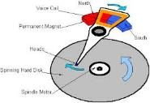




Recall: I/O and Storage Layers
Application / Service
High Level I/O
Streams
Low Level I/O
File Descriptors
What we covered in Lecture 4
Syscall
open(), read(), write(), close(), …
Open File Descriptions
File System
Files/Directories/Indexes
What we will cover next…
I/O Driver
Commands and Data Transfers
Disks, Flash, Controllers, DMA
What we just covered…

Slide 4
From Storage to File Systems
I/O API and
syscalls
Variable-Size Buffer
Memory Address
Logical Index,
Typically 4 KB
File System
Block
Flash Trans. Layer
Hardware Devices
Sector(s)
Sector(s)
Sector(s)
Phys. Block
Phys Index., 4KB
Physical Index,
512B or 4KB
Erasure Page
HDD
SSD

Slide 5
Building a File System
File System: Layer of OS that transforms block interface of disks (or other block devices) into Files, Directories, etc.
Classic OS situation: Take limited hardware interface (array of blocks) and provide a more convenient/useful interface with:
  Naming: Find file by name, not block numbers
  Organize file names with directories
  Organization: Map files to blocks
  Protection: Enforce access restrictions
  Reliability: Keep files intact despite crashes, hardware failures, etc.

Slide 6
Recall: User vs. System View of a File
User’s view:
  Durable Data Structures
System’s view (system call interface):
  Collection of Bytes (UNIX)
  Doesn’t matter to system what kind of data structures you want to store on disk!
System’s view (inside OS):
  Collection of blocks (a block is a logical transfer unit, while a sector is the physical transfer unit)
  Block size ≥ sector size; in UNIX, block size is 4KB

Slide 7

Translation from User to System View
File
(Bytes)
File
System
What happens if user says: “give me bytes 2 – 12?”
  Fetch block corresponding to those bytes
  Return just the correct portion of the block
What about writing bytes 2 – 12?
  Fetch block, modify relevant portion, write out block
Everything inside file system is in terms of whole-size blocks
  Actual disk I/O happens in blocks
  read/write smaller than block size needs to translate and buffer

Slide 8
Disk Management
Basic entities on a disk:
  File: user-visible group of blocks arranged sequentially in logical space
  Directory: user-visible index mapping names to files
The disk is accessed as linear array of sectors
How to identify a sector?
  Physical position
    Sectors is a vector [cylinder, surface, sector]
    Not used anymore
    OS/BIOS must deal with bad sectors
  Logical Block Addressing (LBA)
    Every sector has integer address
    Controller translates from address ⇒ physical position
    Shields OS from structure of disk

Slide 9
What Does the File System Need?
Track free disk blocks
  Need to know where to put newly written data
Track which blocks contain data for which files
  Need to know where to read a file from
Track files in a directory
  Find list of file's blocks given its name
Where do we maintain all of this?
  Somewhere on disk

Slide 10
Data Structures on Disk
Different than data structures in memory
  Must load from disk into memory to manipulate
  Modifications to disk data are really expensive, so only change when needed
Access a block at a time
  Can't efficiently read/write a single word
  Have to read/write full block containing it
  Ideally want sequential access patterns
Durability
  Ideally, file system is in meaningful state upon shutdown
  This obviously isn't always the case…

Slide 11
File System Design

Slide 12
Critical Factors in File System Design
(Hard) Disks Performance !!!
  Maximize sequential access, minimize seeks
Open before Read/Write
  Can perform protection checks and look up where the actual file resource are, in advance
Size is determined as they are used !!!
  Can write (or read zeros) to expand the file
  Start small and grow, need to make room
Organized into directories
  What data structure (on disk) for that?
Need to carefully allocate / free blocks
  Such that access remains efficient

Slide 13
Components of a File System
File path
Directory
Structure
File
Header
Structure
One Block = multiple sectors
Ex: 512 sector, 4K block
File number
“inumber”
Data blocks
“inode”
…

Slide 14
Recall: Abstract Representation of a Process
Process
Suppose that we execute
open(“foo.txt”)
and that the result is 3
Next, suppose that we execute
read(3, buf, 100)
and that the result is 100
Thread’s Regs
Address Space (Memory)
…
User Space
Kernel Space
File Descriptors
Open File Description
3
Not shown: Initially contains 0, 1, and 2 (stdin, stdout, stderr)
File: foo.txt
Position: 100

Slide 15
Components of a File System
Process
Open file description is better described as remembering the inumber (file number) of the file, not its name
Thread’s Regs
Address Space (Memory)
…
User Space
Kernel Space
File Descriptors
Open File Description
3
File: foo.txt inumber
Position: 100
Not shown: Initially contains 0, 1, and 2 (stdin, stdout, stderr)

Slide 16
Components of a File System
file name
offset
file number
offset
storage block
directory structure
index structure
(“inode”)
Open performs Name Resolution
  Translates path name into a “file number”
Read and Write operate on the file number
  Use file number as an “index” to locate the blocks
4 components:
  directory, index structure, storage blocks, free space map

Slide 17

Administrivia
Homework 5: RPC deadline this Thursday (4/12)
Project 3: Design doc due Monday (4/15)
Midterm 3: April 25th
  Everything fair game with focus on last 1/3 of class
  Three hand-written cheat-sheets, double sided
Class attendance: No credit for people who use the same photo!
Data4All@Berkeley: Tomorrow (Friday!)
  Friday 4/12, 12:00-1:00 in Wozniak lounge (MOVED!)
  Undergraduate or Masters students interested in Systems broadly defined (DB, Arch, Sec, Networking, Systems, etc.) who identify as an URM in Computer Science
  Come by for free lunch to meet fellow students
    Sign up – look for link on Ed
  Talk to relevant faculty, discuss possible classes, research opportunities in systems, as well as the best pizza topping!
https://tinyurl.com/bdhx8hfc

Slide 18
How to get the File Number?
Look up in directory structure
A directory is a file containing <file_name : file_number> mappings
  File number could be a file or another directory
  Operating system stores the mapping in the directory in a format it interprets
  Each <file_name : file_number> mapping is called a directory entry
Process isn’t allowed to read the raw bytes of a directory
  The read function doesn’t work on a directory
  Instead, see readdir, which iterates over the map without revealing the raw bytes
Why shouldn’t the OS let processes read/write the bytes of a directory?

Slide 19
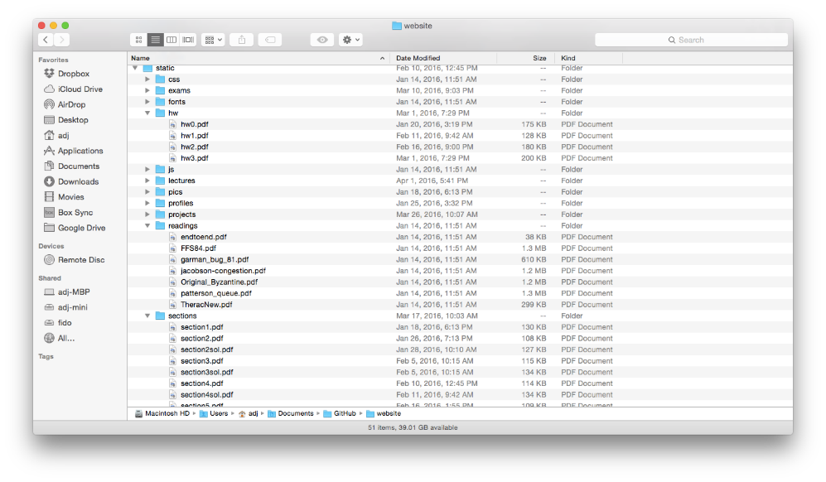
Directories

Slide 20
Directory Abstraction
Directories are specialized files
  Contents: List of pairs <file name, file number>
System calls to access directories
  open / creat / readdir traverse the structure
  mkdir / rmdir add/remove entries
  link / unlink (rm)
libc support
  DIR * opendir (const char *dirname)
  struct dirent * readdir (DIR *dirstream)
  int readdir_r (DIR *dirstream, struct dirent *entry,
  struct dirent **result)
/usr
/usr/lib
/usr/lib4.3
/usr/lib4.3/foo

Slide 21
Directory Structure
How many disk accesses to resolve “/my/book/count”?
  Read in file header for root (fixed spot on disk)
  Read in first data block for root
    Table of file name/index pairs.
    Search linearly – ok since directories typically very small
  Read in file header for “my”
  Read in first data block for “my”; search for “book”
  Read in file header for “book”
  Read in first data block for “book”; search for “count”
  Read in file header for “count”
Current working directory: Per-address-space pointer to a directory used for resolving file names
  Allows user to specify relative filename instead of absolute path (say CWD=“/my/book” can resolve “count”)

Slide 22
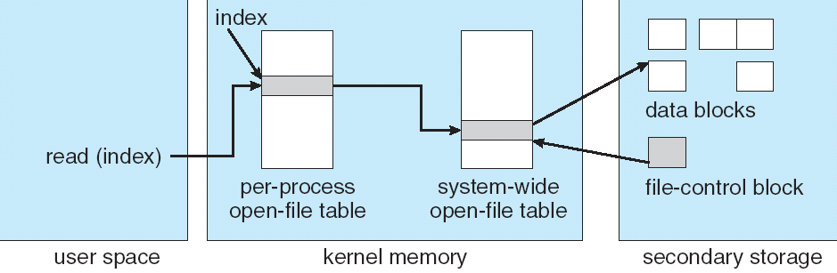
In-Memory File System Structures
fd
(fd)
inode
Open syscall: find inode on disk from pathname (traversing directories)
  Create “in-memory inode” in system-wide open file table
  One entry in this table no matter how many instances of the file are open
Read/write syscalls look up in-memory inode using the file handle

Slide 23
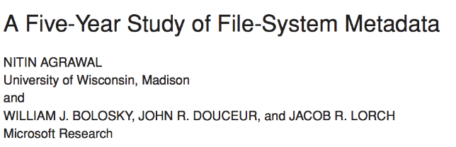
Characteristics of Files
Published in FAST 2007

Slide 24
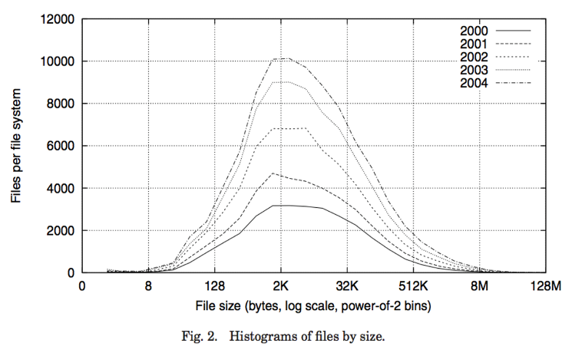
Observation #1: Most Files Are Small

Slide 25
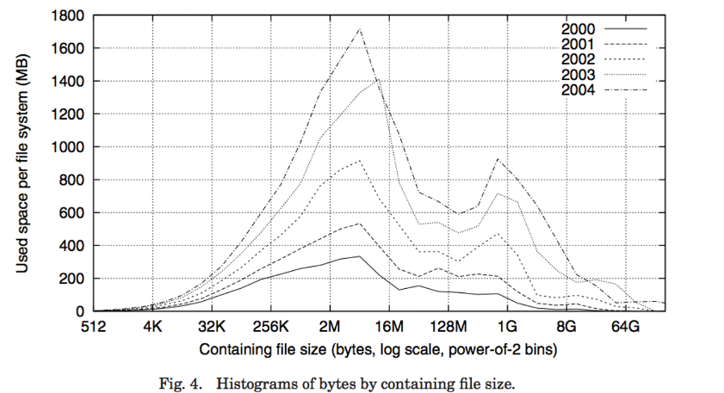
Observation #2: Most Bytes are in Large Files

Slide 26
Case Study:
FAT: File Allocation Table
MS-DOS, 1977
Still widely used!

Slide 27
FAT (File Allocation Table)
Assume (for now) we have a
way to translate a path to
a “file number”
  i.e., a directory structure
Disk Storage is a collection of Blocks
  Just hold file data (offset o = < B, x >)
Example: file_read 31, < 2, x >
  Index into FAT with file number
  Follow linked list to block
  Read the block from disk
  into memory
FAT
Disk Blocks
0:
0:
File number
31:
File 31, Block 0
File 31, Block 1
File 31, Block 2
File 31, Block 2
N-1:
N-1:
memory

Slide 28
FAT (File Allocation Table)
File is a collection of disk blocks
FAT is linked list 1-1 with blocks
File number is index of root of block list for the file
File offset: block number and offset within block
Follow list to get block number
Unused blocks marked free
  Could require scan to find
  Or, could use a free list
FAT
Disk Blocks
0:
0:
File number
31:
File 31, Block 0
File 31, Block 1
free
File 31, Block 2
N-1:
N-1:
memory

Slide 29
FAT (File Allocation Table)
File is a collection of disk blocks
FAT is linked list 1-1 with blocks
File number is index of root of block list for the file
File offset: block number and offset within block
Follow list to get block number
Unused blocks marked free
  Could require scan to find
  Or, could use a free list
FAT
Disk Blocks
0:
0:
File number
31:
File 31, Block 0
File 31, Block 1
free
File 31, Block 2
N-1:
N-1:
memory

Slide 30
FAT (File Allocation Table)
File is a collection of disk blocks
FAT is linked list 1-1 with blocks
File number is index of root of block list for the file
File offset: block number and offset within block
Follow list to get block number
Unused blocks marked free
  Could require scan to find
  Or, could use a free list
Ex: file_write(31, < 3, y >)
  Grab free block
  Linking them into file
FAT
Disk Blocks
0:
0:
File number
31:
File 31, Block 0
File 31, Block 1
File 31, Block 3
free
File 31, Block 2
N-1:
N-1:
memory

Slide 31
FAT (File Allocation Table)
Where is FAT stored?
  On disk
How to format a disk?
  Zero the blocks, mark FAT entries “free”
How to quick format a disk?
  Mark FAT entries “free”
Simple: can implement in device firmware
FAT
Disk Blocks
0:
0:
File #1
31:
File 31, Block 0
File 31, Block 1
File 31, Block 3
free
File #2
File 31, Block 2
N-1:
N-1:
memory

Slide 32
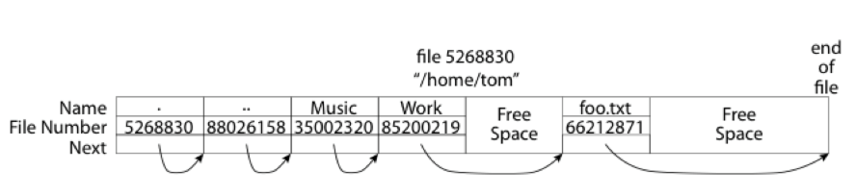
FAT: Directories
A directory is a file containing <file_name: file_number> mappings
Free space for new/deleted entries
In FAT: file attributes are kept in directory (!!!)
  Not directly associated with the file itself
Each directory a linked list of entries
  Requires linear search of directory to find particular entry
Where do you find root directory (“/”)?
  At well-defined place on disk
  For FAT, this is at block 2 (there are no blocks 0 or 1)
  Remaining directories

Slide 33
FAT Discussion
Suppose you start with the file number:
Time to find block?
Block layout for file?
Sequential access?
Random access?
Fragmentation?
Small files?
Big files?
FAT
Disk Blocks
0:
0:
File #1
31:
File 31, Block 0
File 31, Block 1
File 31, Block 3
free
File #2
File 31, Block 2
N-1:
N-1:
memory

Slide 34
Case Study:
Unix File System (Berkeley FFS)

Slide 35
Inodes in Unix (Including Berkeley FFS)
File Number is index into set of inode arrays
Index structure is an array of inodes
  File Number (inumber) is an index into the array of inodes
  Each inode corresponds to a file and contains its metadata
    So, things like read/write permissions are stored with file, not in directory
    Allows multiple names (directory entries) for a file
Inode maintains a multi-level tree structure to find storage blocks for files
  Great for little and large files
  Asymmetric tree with fixed sized blocks
Original inode format appeared in BSD 4.1 (more following)
  Berkeley Standard Distribution Unix!
  Part of your heritage!
  Similar structure for Linux Ext 2/3

Slide 36
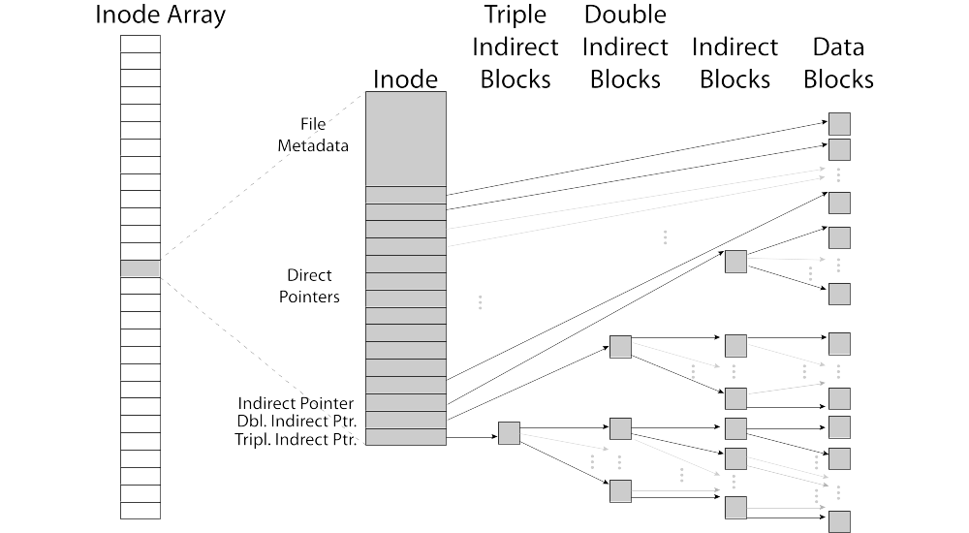
Inode Structure

Slide 37
File Atributes
User
Group
9 basic access control bits
- UGO x RWX
SetUID bit
- execute at owner permissions
rather than user
SetGID bit
- execute at group’s permissions

Slide 38

Small Files: 12 Pointers Direct to Data Blocks
Direct pointers
4kB blocks ⇒ sufficient for files up to 48KB

Slide 39
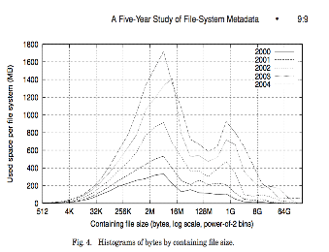
Large Files: 1-, 2-, 3-level indirect pointers
Indirect pointers
- point to a disk block
containing only pointers
- 4 kB blocks => 1024 ptrs
=> 4 MB @ level 2
=> 4 GB @ level 3
=> 4 TB @ level 4
48 KB
+4 MB
+4 GB
+4 TB

Slide 40
Putting it All Together: On-Disk Index
Sample file in multilevel
indexed format:
  10 direct ptrs, 1K blocks
  How many accesses for
  block #23? (assume file
  header accessed on open)?
    Two: One for indirect block,
    one for data
  How about block #5?
    One: One for data
  Block #340?
    Three: double indirect block,
    indirect block, and data

Slide 41
Recall: Critical Factors in File System Design
(Hard) Disk Performance !!!
  Maximize sequential access, minimize seeks
Open before Read/Write
  Can perform protection checks and look up where the actual file resource are, in advance
Size is determined as they are used !!!
  Can write (or read zeros) to expand the file
  Start small and grow, need to make room
Organized into directories
  What data structure (on disk) for that?
Need to carefully allocate / free blocks
  Such that access remains efficient

Slide 42
Recall: Magnetic Disks
Track
Sector
Cylinders: all the tracks under the
head at a given point on all surfaces
Read/write data is a three-stage process:
  Seek time: position the head/arm over the proper track
  Rotational latency: wait for desired sector to rotate under r/w head
  Transfer time: transfer a block of bits (sector) under r/w head
Head
Cylinder
Platter
Disk Latency = Queueing Time + Controller time +
Seek Time + Rotation Time + Xfer Time
Software
Queue
(Device Driver)
Hardware
Controller
Media Time
(Seek+Rot+Xfer)
Request
Result

Slide 43
Fast File System (BSD 4.2, 1984)
Same inode structure as in BSD 4.1
  same file header and triply indirect blocks like we just studied
  Some changes to block sizes from 1024⇒4096 bytes for performance
Paper on FFS: “A Fast File System for UNIX”
  Marshall McKusick, William Joy, Samuel Leffler and Robert Fabry
  Off the “resources” page of course website – Take a look!
Optimization for Performance and Reliability:
  Distribute inodes among different tracks to be closer to data
  Uses bitmap allocation in place of freelist
  Attempt to allocate files contiguously
  10% reserved disk space
  Skip-sector positioning (mentioned later)

Slide 44
FFS Changes in Inode Placement: Motivation
In early UNIX and DOS/Windows’ FAT file system, headers stored in special array in outermost cylinders
  Fixed size, set when disk is formatted
    At formatting time, a fixed number of inodes are created
    Each is given a unique number, called an “inumber”
Problem #1: Inodes all in one place (outer tracks)
  Head crash potentially destroys all files by destroying inodes
  Inodes not close to the data that the point to
    To read a small file, seek to get header, seek back to data
Problem #2: When create a file, don’t know how big it will become (in UNIX, most writes are by appending)
  How much contiguous space do you allocate for a file?
  Makes it hard to optimize for performance

Slide 45
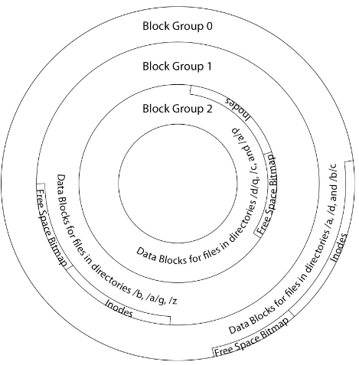
FFS Locality: Block Groups
The UNIX BSD 4.2 (FFS) distributed the header information (inodes) closer to the data blocks
  Often, inode for file stored in same “cylinder group”
  as parent directory of the file
  makes an “ls” of that directory run very fast
File system volume divided into set of block groups
  Close set of tracks
Data blocks, metadata, and free space
interleaved within block group
  Avoid huge seeks between user data and
  system structure
Put directory and its files in common block group

Slide 46
FFS Locality: Block Groups (Con’t)
First-Free allocation of new file blocks
  To expand file, first try successive blocks in bitmap, then
  choose new range of blocks
  Few little holes at start, big sequential runs at
  end of group
  Avoids fragmentation
  Sequential layout for big files
Important: keep 10% or more free!
  Reserve space in the Block Group
Summary: FFS Inode Layout Pros
  For small directories, can fit all data, file headers,
  etc. in same cylinder ⇒ no seeks!
  File headers much smaller than whole block
  (a few hundred bytes), so multiple headers fetched from disk at same time
  Reliability: whatever happens to the disk, you can find many of the files (even if directories disconnected)

Slide 47
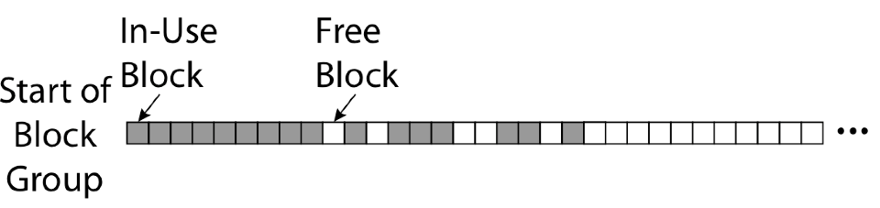
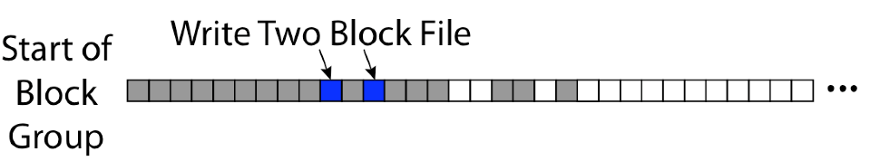
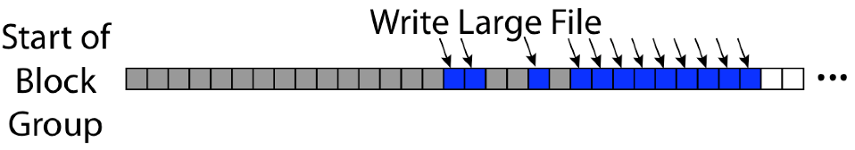
UNIX 4.2 BSD FFS First Fit Block Allocation
Fills in the small holes at the start of block group
Avoids fragmentation, leaves contiguous free space at end

Slide 48
Attack of the Rotational Delay
Problem 3: Missing blocks due to rotational delay
  Issue: Read one block, do processing, and read next block. In meantime, disk has continued turning: missed next block! Need 1 revolution/block!
  Solution1: Skip sector positioning (“interleaving”)
    Place the blocks from one file on every other block of a track: give time for processing to overlap rotation
    Can be done by OS or in modern drives by the disk controller
  Solution 2: Read ahead: read next block right after first, even if application hasn’t asked for it yet
    This can be done either by OS (read ahead)
    By disk itself (track buffers) - many disk controllers have internal RAM that allows them to read a complete track
Modern disks + controllers do many things “under the covers”
  Track buffers, elevator algorithms, bad block filtering
Skip Sector
Track Buffer
(Holds complete track)

Slide 49
UNIX 4.2 BSD FFS
Pros
  Efficient storage for both small and large files
  Locality for both small and large files
  Locality for metadata and data
  No defragmentation necessary!
Cons
  Inefficient for tiny files (a 1 byte file requires both an inode and a data block)
  Inefficient encoding when file is mostly contiguous on disk
  Need to reserve 10-20% of free space to prevent fragmentation

Slide 50
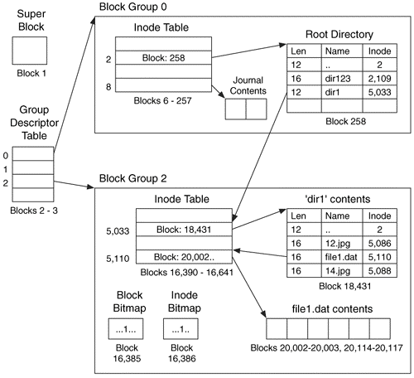
Linux Example: Ext2/3 Disk Layout
Disk divided into block groups
  Provides locality
  Each group has two block-sized bitmaps (free blocks/inodes)
  Block sizes settable at format time:
  1K, 2K, 4K, 8K…
Actual inode structure similar to 4.2 BSD
  with 12 direct pointers
Ext3: Ext2 with Journaling
  Several degrees of protection with comparable overhead
  We will talk about Journalling later
Example: create a file1.dat
under /dir1/ in Ext3

Slide 51
Recall: Directory Abstraction
Directories are specialized files
  Contents: List of pairs <file name, file number>
System calls to access directories
  open / creat traverse the structure
  mkdir /rmdir add/remove entries
  link / unlink (rm)
libc support
  DIR * opendir (const char *dirname)
  struct dirent * readdir (DIR *dirstream)
  int readdir_r (DIR *dirstream, struct dirent *entry,
  struct dirent **result)
/usr
/usr/lib
/usr/lib4.3
/usr/lib4.3/foo

Slide 52
Hard Links
Hard link
  Mapping from name to file number in the directory structure
  First hard link to a file is made when file created
  Create extra hard links to a file with the link() system call
  Remove links with unlink() system call
When can file contents be deleted?
  When there are no more hard links to the file
  Inode maintains reference count for this purpose
/usr
/usr/lib
/usr/lib4.3
/usr/lib4.3/foo

Slide 53
Soft Links (Symbolic Links)
Soft link or Symbolic Link or Shortcut
  Directory entry contains the path and name of the file
  Map one name to another name
Contrast these two different types of directory entries:
  Normal directory entry: <file name, file #>
  Symbolic link: <file name, dest. file name>
OS looks up destination file name each time program accesses
source file name
  Lookup can fail (error result from open)
Unix: Create soft links with symlink syscall

Slide 54
Directory Traversal
What happens when we open /home/cs162/stuff.txt?
“/” - inumber for root inode configured into kernel, say 2
  Read inode 2 from its position in inode array on disk
  Extract the direct and indirect block pointers
  Determine block that holds root directory (say block 49358)
  Read that block, scan it for “home” to get inumber for this directory (say 8086)
Read inode 8086 for /home, extract its blocks, read block (say 7756), scan it for “cs162” to get its inumber (say 732)
Read inode 732 for /home/cs162, extract its blocks, read block (say 12132), scan it for “stuff.txt” to get its inumber, say 9909
Read inode 9909 for /home/cs162/stuff.txt
Set up file description to refer to this inode so reads / write can access the data blocks referenced by its direct and indirect pointers
Check permissions on the final inode and each directory’s inode…
inode
block 49358
2
“home”:8086
732
block 12132
“stuff.txt”:9909
8086
block 7756
“cs162”:732
Blocks of stuff.txt
9909
2:
9099:
“home”:8086
732:
8086:
“cs162”:732
“stuff.txt”:9909
Memory

Slide 55
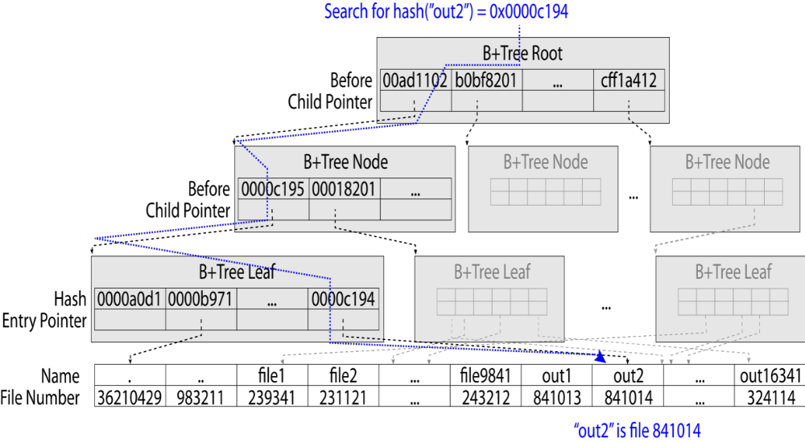
Large Directories: B-Trees (dirhash)
in FreeBSD, NetBSD, OpenBSD

Slide 56
Conclusion
File System:
  Transforms blocks into Files and Directories
  Optimize for access and usage patterns
  Maximize sequential access, allow efficient random access
File (and directory) defined by header, called “inode”
Naming: translating from user-visible names to actual sys resources
  Directories used for naming for local file systems
  Linked or tree structure stored in files
File Allocation Table (FAT) Scheme
  Linked-list approach
  Very widely used: Cameras, USB drives, SD cards
  Simple to implement, but poor performance and no security
Look at actual file access patterns
  Many small files, but large files take up all the space!
4.2 BSD Fast File System: Multi-level inode header to describe files
  Inode contains ptrs to actual blocks, indirect blocks, double indirect blocks, etc.
  Optimizations for sequential access: start new files in open ranges of free blocks, rotational optimization

