Slide 1
Discussion 9
Filesystems, Reliability
04/12/24
Staff

Slide 2
Announcements
Sunday | Monday | Tuesday | Wednesday | Thursday | Friday | Saturday
 |  |  |  |  | RPC Lab Deadline
 | Project 3 Design Doc Due |  |  |  | HW5 Checkpoint Deadline

Slide 3
FAT File System

Slide 4
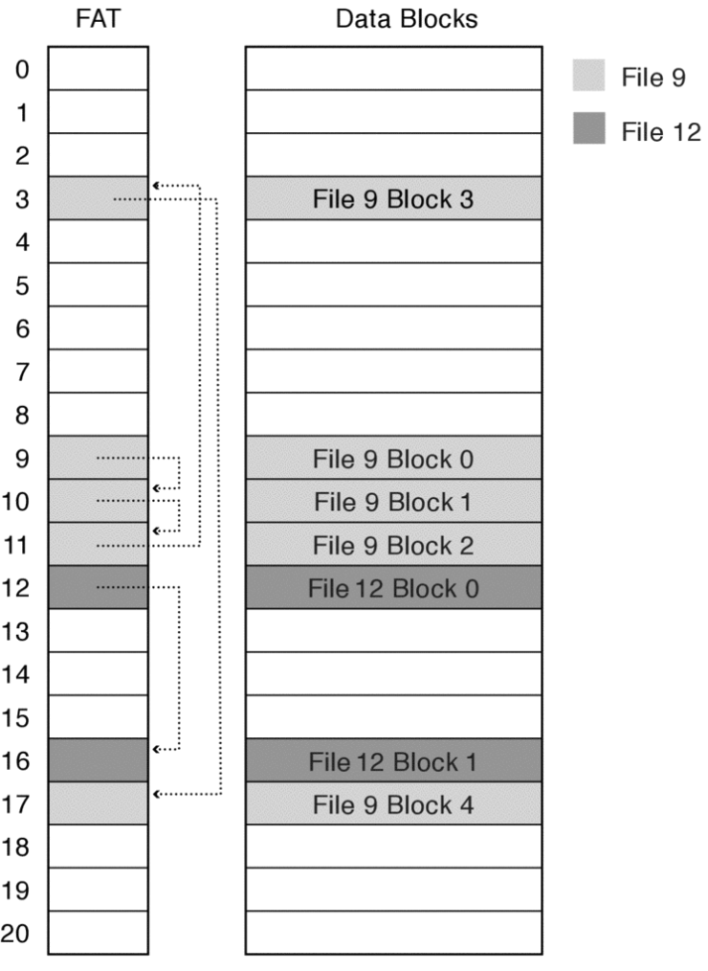
File Allocation Table (FAT)
Index structure
File allocation table is an array where each element corresponds to a disk block.
Each file corresponds to a linked list of FAT entries containing a pointer to the next FAT entry.
The index of the first entry of a file (i.e. the index which it starts at) is set to be the file number.
Commonly found on many portable and embedded devices due to its simplicity and support.
Bad random access since accessing a specific offset requires traversing through the linked list.
File size encoded in 32-bits → file size limited to 4 GiB.

Slide 5
File Allocation Table (FAT)
Directory Structure
FAT needs to store metadata as part of a directory entry.
Free Space Management
FAT array is used for free space tracking.
Entry = 0 → free space.
Use next fit allocation strategy for a new file/file growth.
Allocation of multiple sectors takes a long time.
Disk blocks within one file may not be able to exploit spatial locality → poor disk performance.

Slide 6
Concept Check
What does it mean to format a FAT file system? Approximately how many bytes of data need to be written in order to format a 2 GiB flash drive (with 4 KiB blocks and a FAT entry size of 4 bytes) using the FAT file system?
Your friend who has never taken an Operating Systems class wants to format their external hard drive with the FAT32 file system. The external hard drive will be used to share home videos with your friend’s family. Give one reason why FAT32 might be the right choice. Then, give one reason why your friend should consider other options.

Slide 7
Concept Check
What does it mean to format a FAT file system? Approximately how many bytes of data need to be written in order to format a 2 GiB flash drive (with 4 KiB blocks and a FAT entry size of 4 bytes) using the FAT file system?
Quick format = mark all blocks as free (i.e. 0), full format = quick format + zero out data blocks
Your friend who has never taken an Operating Systems class wants to format their external hard drive with the FAT32 file system. The external hard drive will be used to share home videos with your friend’s family. Give one reason why FAT32 might be the right choice. Then, give one reason why your friend should consider other options.

Slide 8
Concept Check
What does it mean to format a FAT file system? Approximately how many bytes of data need to be written in order to format a 2 GiB flash drive (with 4 KiB blocks and a FAT entry size of 4 bytes) using the FAT file system?
Quick format = mark all blocks as free (i.e. 0), full format = quick format + zero out data blocks
Need to zero out # FAT entries = FAT volume size ÷ block size = 2³¹ ÷ 2¹² = 2¹⁹ entries = 2²¹ bytes
Your friend who has never taken an Operating Systems class wants to format their external hard drive with the FAT32 file system. The external hard drive will be used to share home videos with your friend’s family. Give one reason why FAT32 might be the right choice. Then, give one reason why your friend should consider other options.

Slide 9
Concept Check
What does it mean to format a FAT file system? Approximately how many bytes of data need to be written in order to format a 2 GiB flash drive (with 4 KiB blocks and a FAT entry size of 4 bytes) using the FAT file system?
Quick format = mark all blocks as free (i.e. 0), full format = quick format + zero out data blocks
Need to zero out # FAT entries = FAT volume size ÷ block size = 2³¹ ÷ 2¹² = 2¹⁹ entries = 2²¹ bytes
Your friend who has never taken an Operating Systems class wants to format their external hard drive with the FAT32 file system. The external hard drive will be used to share home videos with your friend’s family. Give one reason why FAT32 might be the right choice. Then, give one reason why your friend should consider other options.
Pro: widely compatible → good for sharing with other people

Slide 10
Concept Check
What does it mean to format a FAT file system? Approximately how many bytes of data need to be written in order to format a 2 GiB flash drive (with 4 KiB blocks and a FAT entry size of 4 bytes) using the FAT file system?
Quick format = mark all blocks as free (i.e. 0), full format = quick format + zero out data blocks
Need to zero out # FAT entries = FAT volume size ÷ block size = 2³¹ ÷ 2¹² = 2¹⁹ entries = 2²¹ bytes
Your friend who has never taken an Operating Systems class wants to format their external hard drive with the FAT32 file system. The external hard drive will be used to share home videos with your friend’s family. Give one reason why FAT32 might be the right choice. Then, give one reason why your friend should consider other options.
Pro: widely compatible → good for sharing with other people
Con: 4 GiB size limit → can’t share large videos.

Slide 11
Concept Check
From a software perspective, explain how an operating system reads a file like D:\My Files\Video.mp4 from a FAT volume.

Slide 12
Concept Check
From a software perspective, explain how an operating system reads a file like D:\My Files\Video.mp4 from a FAT volume.
1. Read in blocks of / directory until My Files entry is found.
 | /
 | /My Files
 | /My Files/Video.mp4
 | FAT
0
1
2 | 3
3 | 13
4 | EOF
5 | 6
6 | EOF
7
8
9 | 10
10 | 11
11 | 4
12
13 | EOF
14
15
 | Disk
0
1
2 | / block 0
3 | / block 1
4 | /My Files/Video.mp4 block 3
5 | /My Files block 0
6 | /My Files block 1
7
8
9 | /My Files/Video.mp4 block 0
10 | /My Files/Video.mp4 block 1
11 | /My Files/Video.mp4 block 2
12
13 | / block 2
14
15

Slide 13
Concept Check
From a software perspective, explain how an operating system reads a file like D:\My Files\Video.mp4 from a FAT volume.
1. Read in blocks of / directory until My Files entry is found.
 | /
 | /My Files
 | /My Files/Video.mp4
 | FAT
0
1
2 | 3
3 | 13
4 | EOF
5 | 6
6 | EOF
7
8
9 | 10
10 | 11
11 | 4
12
13 | EOF
14
15
 | Disk
0
1
2 | / block 0
3 | / block 1
4 | /My Files/Video.mp4 block 3
5 | /My Files block 0
6 | /My Files block 1
7
8
9 | /My Files/Video.mp4 block 0
10 | /My Files/Video.mp4 block 1
11 | /My Files/Video.mp4 block 2
12
13 | / block 2
14
15
Name | File Number
bin | 20
usr | 31
… | …

Slide 14
Concept Check
From a software perspective, explain how an operating system reads a file like D:\My Files\Video.mp4 from a FAT volume.
1. Read in blocks of / directory until My Files entry is found.
 | /
 | /My Files
 | /My Files/Video.mp4
 | FAT
0
1
2 | 3
3 | 13
4 | EOF
5 | 6
6 | EOF
7
8
9 | 10
10 | 11
11 | 4
12
13 | EOF
14
15
 | Disk
0
1
2 | / block 0
3 | / block 1
4 | /My Files/Video.mp4 block 3
5 | /My Files block 0
6 | /My Files block 1
7
8
9 | /My Files/Video.mp4 block 0
10 | /My Files/Video.mp4 block 1
11 | /My Files/Video.mp4 block 2
12
13 | / block 2
14
15
Name | File Number
bin | 20
usr | 31
… | …
Name | File Number
…
Pictures | 35
… | …

Slide 15
Concept Check
From a software perspective, explain how an operating system reads a file like D:\My Files\Video.mp4 from a FAT volume.
1. Read in blocks of / directory until My Files entry is found.
 | /
 | /My Files
 | /My Files/Video.mp4
 | FAT
0
1
2 | 3
3 | 13
4 | EOF
5 | 6
6 | EOF
7
8
9 | 10
10 | 11
11 | 4
12
13 | EOF
14
15
 | Disk
0
1
2 | / block 0
3 | / block 1
4 | /My Files/Video.mp4 block 3
5 | /My Files block 0
6 | /My Files block 1
7
8
9 | /My Files/Video.mp4 block 0
10 | /My Files/Video.mp4 block 1
11 | /My Files/Video.mp4 block 2
12
13 | / block 2
14
15
Name | File Number
bin | 20
usr | 31
… | …
Name | File Number
…
Pictures | 35
… | …
Name | File Number
…
My Files | 5
… | …

Slide 16
Concept Check
From a software perspective, explain how an operating system reads a file like D:\My Files\Video.mp4 from a FAT volume.
2. Read in blocks of /My Files until Video.mp4 entry is found.
 | /
 | /My Files
 | /My Files/Video.mp4
 | FAT
0
1
2 | 3
3 | 13
4 | EOF
5 | 6
6 | EOF
7
8
9 | 10
10 | 11
11 | 4
12
13 | EOF
14
15
 | Disk
0
1
2 | / block 0
3 | / block 1
4 | /My Files/Video.mp4 block 3
5 | /My Files block 0
6 | /My Files block 1
7
8
9 | /My Files/Video.mp4 block 0
10 | /My Files/Video.mp4 block 1
11 | /My Files/Video.mp4 block 2
12
13 | / block 2
14
15

Slide 17
Concept Check
From a software perspective, explain how an operating system reads a file like D:\My Files\Video.mp4 from a FAT volume.
2. Read in blocks of /My Files until Video.mp4 entry is found.
 | /
 | /My Files
 | /My Files/Video.mp4
 | FAT
0
1
2 | 3
3 | 13
4 | EOF
5 | 6
6 | EOF
7
8
9 | 10
10 | 11
11 | 4
12
13 | EOF
14
15
 | Disk
0
1
2 | / block 0
3 | / block 1
4 | /My Files/Video.mp4 block 3
5 | /My Files block 0
6 | /My Files block 1
7
8
9 | /My Files/Video.mp4 block 0
10 | /My Files/Video.mp4 block 1
11 | /My Files/Video.mp4 block 2
12
13 | / block 2
14
15
Name | File Number
Picture.jpg | 55
Video.mp4 | 9
… | …

Slide 18
Concept Check
From a software perspective, explain how an operating system reads a file like D:\My Files\Video.mp4 from a FAT volume.
3. Read in all blocks of /My Files/Video.mp4 until EOF.
 | /
 | /My Files
 | /My Files/Video.mp4
 | FAT
0
1
2 | 3
3 | 13
4 | EOF
5 | 6
6 | EOF
7
8
9 | 10
10 | 11
11 | 4
12
13 | EOF
14
15
 | Disk
0
1
2 | / block 0
3 | / block 1
4 | /My Files/Video.mp4 block 3
5 | /My Files block 0
6 | /My Files block 1
7
8
9 | /My Files/Video.mp4 block 0
10 | /My Files/Video.mp4 block 1
11 | /My Files/Video.mp4 block 2
12
13 | / block 2
14
15

Slide 19
Concept Check
From a software perspective, explain how an operating system reads a file like D:\My Files\Video.mp4 from a FAT volume.
3. Read in all blocks of /My Files/Video.mp4 until EOF.
 | /
 | /My Files
 | /My Files/Video.mp4
 | FAT
0
1
2 | 3
3 | 13
4 | EOF
5 | 6
6 | EOF
7
8
9 | 10
10 | 11
11 | 4
12
13 | EOF
14
15
 | Disk
0
1
2 | / block 0
3 | / block 1
4 | /My Files/Video.mp4 block 3
5 | /My Files block 0
6 | /My Files block 1
7
8
9 | /My Files/Video.mp4 block 0
10 | /My Files/Video.mp4 block 1
11 | /My Files/Video.mp4 block 2
12
13 | / block 2
14
15
Data

Slide 20
Concept Check
From a software perspective, explain how an operating system reads a file like D:\My Files\Video.mp4 from a FAT volume.
3. Read in all blocks of /My Files/Video.mp4 until EOF.
 | /
 | /My Files
 | /My Files/Video.mp4
 | FAT
0
1
2 | 3
3 | 13
4 | EOF
5 | 6
6 | EOF
7
8
9 | 10
10 | 11
11 | 4
12
13 | EOF
14
15
 | Disk
0
1
2 | / block 0
3 | / block 1
4 | /My Files/Video.mp4 block 3
5 | /My Files block 0
6 | /My Files block 1
7
8
9 | /My Files/Video.mp4 block 0
10 | /My Files/Video.mp4 block 1
11 | /My Files/Video.mp4 block 2
12
13 | / block 2
14
15
Data
Data

Slide 21
Concept Check
From a software perspective, explain how an operating system reads a file like D:\My Files\Video.mp4 from a FAT volume.
3. Read in all blocks of /My Files/Video.mp4 until EOF.
 | /
 | /My Files
 | /My Files/Video.mp4
 | FAT
0
1
2 | 3
3 | 13
4 | EOF
5 | 6
6 | EOF
7
8
9 | 10
10 | 11
11 | 4
12
13 | EOF
14
15
 | Disk
0
1
2 | / block 0
3 | / block 1
4 | /My Files/Video.mp4 block 3
5 | /My Files block 0
6 | /My Files block 1
7
8
9 | /My Files/Video.mp4 block 0
10 | /My Files/Video.mp4 block 1
11 | /My Files/Video.mp4 block 2
12
13 | / block 2
14
15
Data
Data
Data

Slide 22
Concept Check
From a software perspective, explain how an operating system reads a file like D:\My Files\Video.mp4 from a FAT volume.
3. Read in all blocks of /My Files/Video.mp4 until EOF.
 | /
 | /My Files
 | /My Files/Video.mp4
 | FAT
0
1
2 | 3
3 | 13
4 | EOF
5 | 6
6 | EOF
7
8
9 | 10
10 | 11
11 | 4
12
13 | EOF
14
15
 | Disk
0
1
2 | / block 0
3 | / block 1
4 | /My Files/Video.mp4 block 3
5 | /My Files block 0
6 | /My Files block 1
7
8
9 | /My Files/Video.mp4 block 0
10 | /My Files/Video.mp4 block 1
11 | /My Files/Video.mp4 block 2
12
13 | / block 2
14
15
Data
Data
Data
Data

Slide 23
File growth in Pintos

Slide 24
File Growth
In this question, we will explore how to grow a file in Pintos. This will be very similar to one of your tasks in Project File System.
In Pintos, struct inode_disk from filesys/inode.c represents an inode. Let’s examine a modified struct inode_disk with 12 direct pointers and an indirect pointer.
#define BLOCK_SECTOR_SIZE 512
typedef uint32_t block_sector_t;
struct inode_disk {
block_sector_t direct[12]; /* Direct pointers */
block_sector_t indirect; /* Indirect pointer */
off_t length; /* File size in bytes. */
uint32_t unused[114]; /* Not used. */
};
What is the purpose of the unused member in struct inode_disk?
What is the maximum file size supported by this file system?
What data structure should you use to represent an indirect block?
Notes:
We write the bytes of an inode_disk struct to disk.

Slide 25
File Growth
In this question, we will explore how to grow a file in Pintos. This will be very similar to one of your tasks in Project File System.
In Pintos, struct inode_disk from filesys/inode.c represents an inode. Let’s examine a modified struct inode_disk with 12 direct pointers and an indirect pointer.
#define BLOCK_SECTOR_SIZE 512
typedef uint32_t block_sector_t;
struct inode_disk {
block_sector_t direct[12]; /* Direct pointers */
block_sector_t indirect; /* Indirect pointer */
off_t length; /* File size in bytes. */
uint32_t unused[114]; /* Not used. */
};
What is the purpose of the unused member in struct inode_disk?
Make the size of an inode equivalent to the block size.
What is the maximum file size supported by this file system?
What data structure should you use to represent an indirect block?

Slide 26
File Growth
In this question, we will explore how to grow a file in Pintos. This will be very similar to one of your tasks in Project File System.
In Pintos, struct inode_disk from filesys/inode.c represents an inode. Let’s examine a modified struct inode_disk with 12 direct pointers and an indirect pointer.
#define BLOCK_SECTOR_SIZE 512
typedef uint32_t block_sector_t;
struct inode_disk {
block_sector_t direct[12]; /* Direct pointers */
block_sector_t indirect; /* Indirect pointer */
off_t length; /* File size in bytes. */
uint32_t unused[114]; /* Not used. */
};
What is the purpose of the unused member in struct inode_disk?
Make the size of an inode equivalent to the block size.
What is the maximum file size supported by this file system?
512 bytes ÷ 4 bytes/pointer = 128 direct pointers per indirect block.
Max file size is 512 ✕ (12 + 128) = 70 KiB.
What data structure should you use to represent an indirect block?

Slide 27
File Growth
In this question, we will explore how to grow a file in Pintos. This will be very similar to one of your tasks in Project File System.
In Pintos, struct inode_disk from filesys/inode.c represents an inode. Let’s examine a modified struct inode_disk with 12 direct pointers and an indirect pointer.
#define BLOCK_SECTOR_SIZE 512
typedef uint32_t block_sector_t;
struct inode_disk {
block_sector_t direct[12]; /* Direct pointers */
block_sector_t indirect; /* Indirect pointer */
off_t length; /* File size in bytes. */
uint32_t unused[114]; /* Not used. */
};
What is the purpose of the unused member in struct inode_disk?
Make the size of an inode equivalent to the block size.
What is the maximum file size supported by this file system?
512 bytes ÷ 4 bytes/pointer = 128 direct pointers per indirect block.
Max file size is 512 ✕ (12 + 128) = 70 KiB.
What data structure should you use to represent an indirect block?
An indirect block is just an array of direct pointers, and direct pointers are unsigned 32-bit integers → block_sector_t[128]

Slide 28
File Growth
In this question, we will explore how to grow a file in Pintos. This will be very similar to one of your tasks in Project File System.
In Pintos, struct inode_disk from filesys/inode.c represents an inode. Let’s examine a modified struct inode_disk with 12 direct pointers and an indirect pointer.
#define BLOCK_SECTOR_SIZE 512
typedef uint32_t block_sector_t;
struct inode_disk {
block_sector_t direct[12]; /* Direct pointers */
block_sector_t indirect; /* Indirect pointer */
off_t length; /* File size in bytes. */
uint32_t unused[114]; /* Not used. */
};
/* Allocates a disk sector and returns its number. */
block_sector_t block_allocate(void);
/* Frees disk sector N. */
void block_free(block_sector_t n);
/* Reads contents of disk sector N into BUFFER. */
void block_read(block_sector_t n, uint8_t buffer[512]);
/* Write contents of BUFFER to disk sector N. */
void block_write(block_sector_t n, uint8_t buffer[512]);
Implement inode_resize to grow or shrink the inode based on the given size. If the resize operation fails for any reason, the inode should be unchanged and the function should return false. Assume unallocated block pointers have value 0.

Slide 29
File Growth
In this question, we will explore how to grow a file in Pintos. This will be very similar to one of your tasks in Project File System.
In Pintos, struct inode_disk from filesys/inode.c represents an inode. Let’s examine a modified struct inode_disk with 12 direct pointers and an indirect pointer.
#define BLOCK_SECTOR_SIZE 512
typedef uint32_t block_sector_t;
struct inode_disk {
block_sector_t direct[12]; /* Direct pointers */
block_sector_t indirect; /* Indirect pointer */
off_t length; /* File size in bytes. */
uint32_t unused[114]; /* Not used. */
};
/* Allocates a disk sector and returns its number. */
block_sector_t block_allocate(void);
/* Frees disk sector N. */
void block_free(block_sector_t n);
/* Reads contents of disk sector N into BUFFER. */
void block_read(block_sector_t n, uint8_t buffer[512]);
/* Write contents of BUFFER to disk sector N. */
void block_write(block_sector_t n, uint8_t buffer[512]);
Implement inode_resize to grow or shrink the inode based on the given size. If the resize operation fails for any reason, the inode should be unchanged and the function should return false. Assume unallocated block pointers have value 0.
/* Handle direct pointers. */
for (int i = 0; i < 12; i++) {
if (size <= BLOCK_SECTOR_SIZE * i && id->direct[i] != 0) {
/* Shrink. */
________________________________;
________________________________;
} else if (size > BLOCK_SECTOR_SIZE * i && id->direct[i] == 0) {
/* Grow. */
________________________________;
}
}

Slide 30
File Growth
In this question, we will explore how to grow a file in Pintos. This will be very similar to one of your tasks in Project File System.
In Pintos, struct inode_disk from filesys/inode.c represents an inode. Let’s examine a modified struct inode_disk with 12 direct pointers and an indirect pointer.
#define BLOCK_SECTOR_SIZE 512
typedef uint32_t block_sector_t;
struct inode_disk {
block_sector_t direct[12]; /* Direct pointers */
block_sector_t indirect; /* Indirect pointer */
off_t length; /* File size in bytes. */
uint32_t unused[114]; /* Not used. */
};
/* Allocates a disk sector and returns its number. */
block_sector_t block_allocate(void);
/* Frees disk sector N. */
void block_free(block_sector_t n);
/* Reads contents of disk sector N into BUFFER. */
void block_read(block_sector_t n, uint8_t buffer[512]);
/* Write contents of BUFFER to disk sector N. */
void block_write(block_sector_t n, uint8_t buffer[512]);
Implement inode_resize to grow or shrink the inode based on the given size. If the resize operation fails for any reason, the inode should be unchanged and the function should return false. Assume unallocated block pointers have value 0.
/* Handle direct pointers. */
for (int i = 0; i < 12; i++) {
if (size <= BLOCK_SECTOR_SIZE * i && id->direct[i] != 0) {
/* Shrink. */
block_free(id->direct[i]);
id->direct[i] = 0;
} else if (size > BLOCK_SECTOR_SIZE * i && id->direct[i] == 0) {
/* Grow. */
________________________________;
}
}

Slide 31
File Growth
In this question, we will explore how to grow a file in Pintos. This will be very similar to one of your tasks in Project File System.
In Pintos, struct inode_disk from filesys/inode.c represents an inode. Let’s examine a modified struct inode_disk with 12 direct pointers and an indirect pointer.
#define BLOCK_SECTOR_SIZE 512
typedef uint32_t block_sector_t;
struct inode_disk {
block_sector_t direct[12]; /* Direct pointers */
block_sector_t indirect; /* Indirect pointer */
off_t length; /* File size in bytes. */
uint32_t unused[114]; /* Not used. */
};
/* Allocates a disk sector and returns its number. */
block_sector_t block_allocate(void);
/* Frees disk sector N. */
void block_free(block_sector_t n);
/* Reads contents of disk sector N into BUFFER. */
void block_read(block_sector_t n, uint8_t buffer[512]);
/* Write contents of BUFFER to disk sector N. */
void block_write(block_sector_t n, uint8_t buffer[512]);
Implement inode_resize to grow or shrink the inode based on the given size. If the resize operation fails for any reason, the inode should be unchanged and the function should return false. Assume unallocated block pointers have value 0.
/* Handle direct pointers. */
for (int i = 0; i < 12; i++) {
if (size <= BLOCK_SECTOR_SIZE * i && id->direct[i] != 0) {
/* Shrink. */
block_free(id->direct[i]);
id->direct[i] = 0;
} else if (size > BLOCK_SECTOR_SIZE * i && id->direct[i] == 0) {
/* Grow. */
id->direct[i] = block_allocate();
}
}

Slide 32
File Growth
In this question, we will explore how to grow a file in Pintos. This will be very similar to one of your tasks in Project File System.
In Pintos, struct inode_disk from filesys/inode.c represents an inode. Let’s examine a modified struct inode_disk with 12 direct pointers and an indirect pointer.
#define BLOCK_SECTOR_SIZE 512
typedef uint32_t block_sector_t;
struct inode_disk {
block_sector_t direct[12]; /* Direct pointers */
block_sector_t indirect; /* Indirect pointer */
off_t length; /* File size in bytes. */
uint32_t unused[114]; /* Not used. */
};
/* Allocates a disk sector and returns its number. */
block_sector_t block_allocate(void);
/* Frees disk sector N. */
void block_free(block_sector_t n);
/* Reads contents of disk sector N into BUFFER. */
void block_read(block_sector_t n, uint8_t buffer[512]);
/* Write contents of BUFFER to disk sector N. */
void block_write(block_sector_t n, uint8_t buffer[512]);
Implement inode_resize to grow or shrink the inode based on the given size. If the resize operation fails for any reason, the inode should be unchanged and the function should return false. Assume unallocated block pointers have value 0.
/* Check if indirect pointers are needed. */
if (id->indirect == 0 && size <= 12 * 512) {
id->length = size;
return true;
}
block_sector_t buffer[128];
memset(buffer, 0, 512);
if (id->indirect == 0) {
/* Allocate indirect block. */
________________________________;
} else {
/* Read in indirect block. */
________________________________;
}

Slide 33
File Growth
In this question, we will explore how to grow a file in Pintos. This will be very similar to one of your tasks in Project File System.
In Pintos, struct inode_disk from filesys/inode.c represents an inode. Let’s examine a modified struct inode_disk with 12 direct pointers and an indirect pointer.
#define BLOCK_SECTOR_SIZE 512
typedef uint32_t block_sector_t;
struct inode_disk {
block_sector_t direct[12]; /* Direct pointers */
block_sector_t indirect; /* Indirect pointer */
off_t length; /* File size in bytes. */
uint32_t unused[114]; /* Not used. */
};
/* Allocates a disk sector and returns its number. */
block_sector_t block_allocate(void);
/* Frees disk sector N. */
void block_free(block_sector_t n);
/* Reads contents of disk sector N into BUFFER. */
void block_read(block_sector_t n, uint8_t buffer[512]);
/* Write contents of BUFFER to disk sector N. */
void block_write(block_sector_t n, uint8_t buffer[512]);
Implement inode_resize to grow or shrink the inode based on the given size. If the resize operation fails for any reason, the inode should be unchanged and the function should return false. Assume unallocated block pointers have value 0.
/* Check if indirect pointers are needed. */
if (id->indirect == 0 && size <= 12 * 512) {
id->length = size;
return true;
}
block_sector_t buffer[128];
memset(buffer, 0, 512);
if (id->indirect == 0) {
/* Allocate indirect block. */
id->indirect = block_allocate();
} else {
/* Read in indirect block. */
block_read(id->indirect, buffer);
}

Slide 34
File Growth
In this question, we will explore how to grow a file in Pintos. This will be very similar to one of your tasks in Project File System.
In Pintos, struct inode_disk from filesys/inode.c represents an inode. Let’s examine a modified struct inode_disk with 12 direct pointers and an indirect pointer.
#define BLOCK_SECTOR_SIZE 512
typedef uint32_t block_sector_t;
struct inode_disk {
block_sector_t direct[12]; /* Direct pointers */
block_sector_t indirect; /* Indirect pointer */
off_t length; /* File size in bytes. */
uint32_t unused[114]; /* Not used. */
};
/* Allocates a disk sector and returns its number. */
block_sector_t block_allocate(void);
/* Frees disk sector N. */
void block_free(block_sector_t n);
/* Reads contents of disk sector N into BUFFER. */
void block_read(block_sector_t n, uint8_t buffer[512]);
/* Write contents of BUFFER to disk sector N. */
void block_write(block_sector_t n, uint8_t buffer[512]);
Implement inode_resize to grow or shrink the inode based on the given size. If the resize operation fails for any reason, the inode should be unchanged and the function should return false. Assume unallocated block pointers have value 0.
/* Handle indirect pointers. */
for (int i = 0; i < 128; i++) {
if (size <= (12 + i) * BLOCK_SECTOR_SIZE && buffer[i] != 0) {
/* Shrink. */
________________________________;
________________________________;
} else if (size > (12 + i) * BLOCK_SECTOR_SIZE) && buffer[i] == 0) {
/* Grow. */
________________________________;
}
}
if (size <= 12 * BLOCK_SECTOR_SIZE) {
________________________________;
________________________________;
} else {
________________________________;
}
id->length = size;

Slide 35
File Growth
In this question, we will explore how to grow a file in Pintos. This will be very similar to one of your tasks in Project File System.
In Pintos, struct inode_disk from filesys/inode.c represents an inode. Let’s examine a modified struct inode_disk with 12 direct pointers and an indirect pointer.
#define BLOCK_SECTOR_SIZE 512
typedef uint32_t block_sector_t;
struct inode_disk {
block_sector_t direct[12]; /* Direct pointers */
block_sector_t indirect; /* Indirect pointer */
off_t length; /* File size in bytes. */
uint32_t unused[114]; /* Not used. */
};
/* Allocates a disk sector and returns its number. */
block_sector_t block_allocate(void);
/* Frees disk sector N. */
void block_free(block_sector_t n);
/* Reads contents of disk sector N into BUFFER. */
void block_read(block_sector_t n, uint8_t buffer[512]);
/* Write contents of BUFFER to disk sector N. */
void block_write(block_sector_t n, uint8_t buffer[512]);
Implement inode_resize to grow or shrink the inode based on the given size. If the resize operation fails for any reason, the inode should be unchanged and the function should return false. Assume unallocated block pointers have value 0.
/* Handle indirect pointers. */
for (int i = 0; i < 128; i++) {
if (size <= (12 + i) * BLOCK_SECTOR_SIZE && buffer[i] != 0) {
/* Shrink. */
block_free(buffer[i]);
buffer[i] = 0;
} else if (size > (12 + i) * BLOCK_SECTOR_SIZE) && buffer[i] == 0) {
/* Grow. */
buffer[i] = block_allocate();
}
}
if (size <= 12 * BLOCK_SECTOR_SIZE) {
________________________________;
________________________________;
} else {
________________________________;
}
id->length = size;

Slide 36
File Growth
In this question, we will explore how to grow a file in Pintos. This will be very similar to one of your tasks in Project File System.
In Pintos, struct inode_disk from filesys/inode.c represents an inode. Let’s examine a modified struct inode_disk with 12 direct pointers and an indirect pointer.
#define BLOCK_SECTOR_SIZE 512
typedef uint32_t block_sector_t;
struct inode_disk {
block_sector_t direct[12]; /* Direct pointers */
block_sector_t indirect; /* Indirect pointer */
off_t length; /* File size in bytes. */
uint32_t unused[114]; /* Not used. */
};
/* Allocates a disk sector and returns its number. */
block_sector_t block_allocate(void);
/* Frees disk sector N. */
void block_free(block_sector_t n);
/* Reads contents of disk sector N into BUFFER. */
void block_read(block_sector_t n, uint8_t buffer[512]);
/* Write contents of BUFFER to disk sector N. */
void block_write(block_sector_t n, uint8_t buffer[512]);
Implement inode_resize to grow or shrink the inode based on the given size. If the resize operation fails for any reason, the inode should be unchanged and the function should return false. Assume unallocated block pointers have value 0.
/* Handle indirect pointers. */
for (int i = 0; i < 128; i++) {
if (size <= (12 + i) * BLOCK_SECTOR_SIZE && buffer[i] != 0) {
/* Shrink. */
block_free(buffer[i]);
buffer[i] = 0;
} else if (size > (12 + i) * BLOCK_SECTOR_SIZE) && buffer[i] == 0) {
/* Grow. */
buffer[i] = block_allocate();
}
}
if (size <= 12 * BLOCK_SECTOR_SIZE) {
/* We shrank the inode such that indirect pointers are no longer required. */
block_free(id->indirect);
id->indirect = 0;
} else {
/* Write updates to the indirect block back to disk.*/
block_write(id->indirect, buffer);
}
id->length = size;

Slide 37
File Growth
In this question, we will explore how to grow a file in Pintos. This will be very similar to one of your tasks in Project File System.
In Pintos, struct inode_disk from filesys/inode.c represents an inode. Let’s examine a modified struct inode_disk with 12 direct pointers and an indirect pointer.
#define BLOCK_SECTOR_SIZE 512
typedef uint32_t block_sector_t;
struct inode_disk {
block_sector_t direct[12]; /* Direct pointers */
block_sector_t indirect; /* Indirect pointer */
off_t length; /* File size in bytes. */
uint32_t unused[114]; /* Not used. */
};
/* Allocates a disk sector and returns its number. */
block_sector_t block_allocate(void);
/* Frees disk sector N. */
void block_free(block_sector_t n);
/* Reads contents of disk sector N into BUFFER. */
void block_read(block_sector_t n, uint8_t buffer[512]);
/* Write contents of BUFFER to disk sector N. */
void block_write(block_sector_t n, uint8_t buffer[512]);
How would you modify your solution to the previous question to handle sector allocation failures (i.e. disk runs out of space)?

Slide 38
File Growth
In this question, we will explore how to grow a file in Pintos. This will be very similar to one of your tasks in Project File System.
In Pintos, struct inode_disk from filesys/inode.c represents an inode. Let’s examine a modified struct inode_disk with 12 direct pointers and an indirect pointer.
#define BLOCK_SECTOR_SIZE 512
typedef uint32_t block_sector_t;
struct inode_disk {
block_sector_t direct[12]; /* Direct pointers */
block_sector_t indirect; /* Indirect pointer */
off_t length; /* File size in bytes. */
uint32_t unused[114]; /* Not used. */
};
/* Allocates a disk sector and returns its number. */
block_sector_t block_allocate(void);
/* Frees disk sector N. */
void block_free(block_sector_t n);
/* Reads contents of disk sector N into BUFFER. */
void block_read(block_sector_t n, uint8_t buffer[512]);
/* Write contents of BUFFER to disk sector N. */
void block_write(block_sector_t n, uint8_t buffer[512]);
How would you modify your solution to the previous question to handle sector allocation failures (i.e. disk runs out of space)?
Any time a new sector is allocated using block_allocate, you should add a check that resembles the following.
sector = allocate_block();
if (sector == 0) {
inode_resize(id, id->length);
return false;
}

Slide 39
Reliability

Slide 40
Availability
Availability is the probability that the system can accept and process requests.
Measured in “nines” of probability (e.g. 99.9% = “3-nines of availability”)
Maximize independence of failures

Slide 41
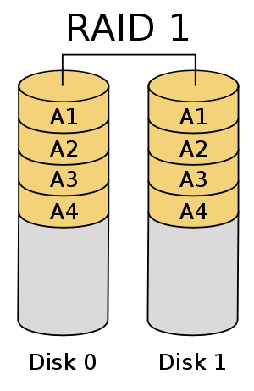
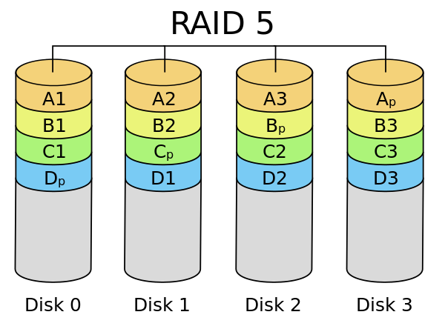
Durability
Durability is the ability of a system to recover data despite faults (i.e. fault tolerance)
Durability does not necessarily imply availability
Small defects (e.g. single disk failure) → use Reed-Solomon error correcting codes.
Short term data preservation (e.g. buffer cache, delayed writes) → use special, battery-backed RAM (NVRAM) for buffer cache.
Long term data preservation → use Redundant Array of Inexpensive disks (RAID)
Spread data redundantly across multiple disks to tolerate individual disk failures.
RAID 1 will mirror a disk onto another “shadow” disk.
RAID 5 stripes data across n multiple disks to allow for single disk failure.
  Each stripe unit consists of n-1 blocks and one parity block, which is created by XOR-ing the n-1 blocks.
  If a disk fails, simply XOR the remaining disks.

Slide 42
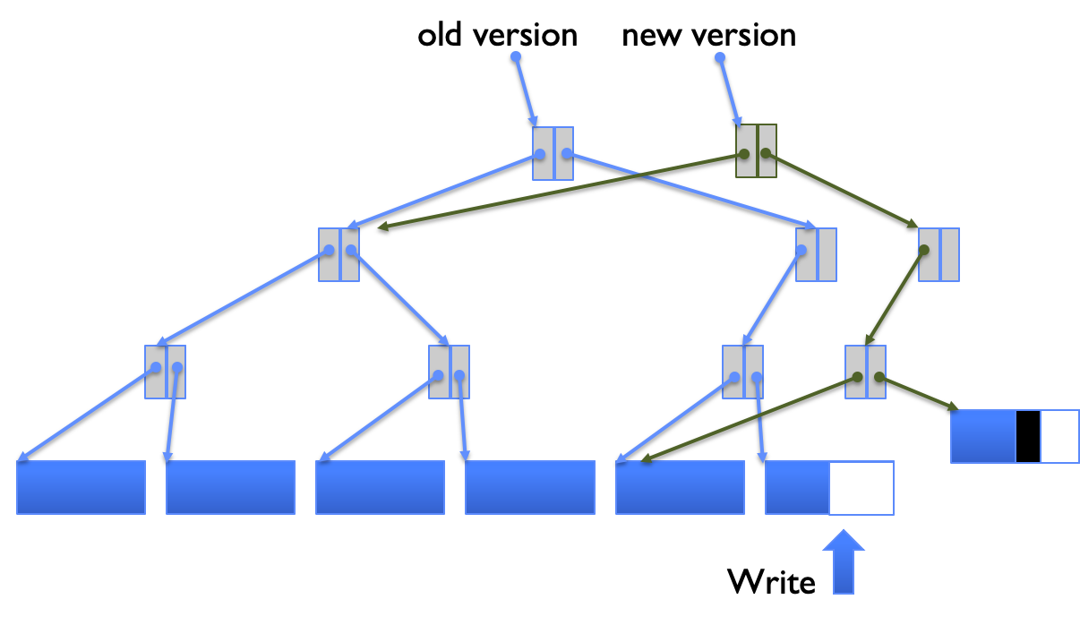
Reliability
Reliability the ability of a system or component to perform its required functions under stated conditions for a specified period of time.
Includes availability, durability, security.
Careful ordering and recovery
Break down an operation into smaller chunks.
Not a foolproof method but works most of the times.
Copy on write (COW)
Write new versions of data into a new place on disk instead of updating in place.
Update mappings and references to data last.
Easy recovery if system crashes in the middle of updating data since old data is fully intact.
Data is only being added, not modified → batch updates, parallel writes
Creating a File
Careful Ordering (FFS) | Recovery (fsck)
Allocate data block. Write data block. Allocate inode. Write inode block. Update free map. Update directory entry. Update modify time for directory entry. | Scan inode table. If any unliked files (not in any directory), delete or put in lost and found directory. Compare free block bitmap against inode trees. Scan directories for missing update/access times.

Slide 43
Concept Check
What benefit with regards to read bandwidth might you see from using RAID 1?
What is the minimum number of disks needed to use RAID 5?
RAID 4 had a dedicated disk with all the parity blocks. On the other hand, RAID 5 distributes the parity blocks across all disks in a round robin fashion. Why is this approach beneficial in terms of write bandwidth?
How can COW help with write speeds?

Slide 44
Concept Check
What benefit with regards to read bandwidth might you see from using RAID 1?
Two copies of same data → doubled read bandwidth
What is the minimum number of disks needed to use RAID 5?
RAID 4 had a dedicated disk with all the parity blocks. On the other hand, RAID 5 distributes the parity blocks across all disks in a round robin fashion. Why is this approach beneficial in terms of write bandwidth?
How can COW help with write speeds?

Slide 45
Concept Check
What benefit with regards to read bandwidth might you see from using RAID 1?
Two copies of same data → doubled read bandwidth
What is the minimum number of disks needed to use RAID 5?
3 since a failed disk is recovered by XOR-ing the remaining disks. RAID X ≠ X number of disks needed.
RAID 4 had a dedicated disk with all the parity blocks. On the other hand, RAID 5 distributes the parity blocks across all disks in a round robin fashion. Why is this approach beneficial in terms of write bandwidth?
How can COW help with write speeds?

Slide 46
Concept Check
What benefit with regards to read bandwidth might you see from using RAID 1?
Two copies of same data → doubled read bandwidth
What is the minimum number of disks needed to use RAID 5?
3 since a failed disk is recovered by XOR-ing the remaining disks. RAID X ≠ X number of disks needed.
RAID 4 had a dedicated disk with all the parity blocks. On the other hand, RAID 5 distributes the parity blocks across all disks in a round robin fashion. Why is this approach beneficial in terms of write bandwidth?
Parity block needs to be written to on very update.
All parity blocks on one disk → this disk becomes the bottleneck for all writes.
How can COW help with write speeds?

Slide 47
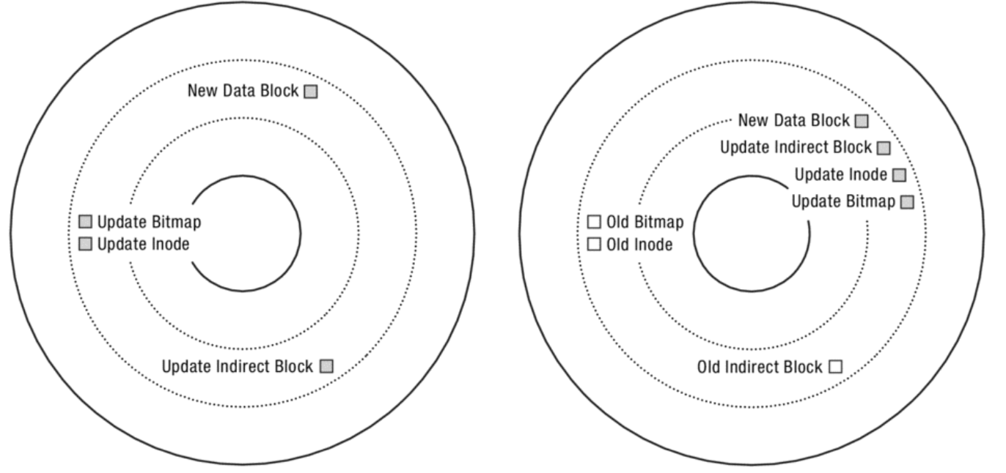
Concept Check
What benefit with regards to read bandwidth might you see from using RAID 1?
Two copies of same data → doubled read bandwidth
What is the minimum number of disks needed to use RAID 5?
3 since a failed disk is recovered by XOR-ing the remaining disks. RAID X ≠ X number of disks needed.
RAID 4 had a dedicated disk with all the parity blocks. On the other hand, RAID 5 distributes the parity blocks across all disks in a round robin fashion. Why is this approach beneficial in terms of write bandwidth?
Parity block needs to be written to on very update.
All parity blocks on one disk → this disk becomes the bottleneck for all writes.
How can COW help with write speeds?
Can transform random I/O into sequential I/O.

