Slide 1
CS162
Operating Systems and
Systems Programming
Lecture 23
Filesystems 3: Filesystem Case Studies (Con’t),
Buffer Cache, Reliability
April 16th, 2024
Prof. John Kubiatowicz
http://cs162.eecs.Berkeley.edu

Slide 2
Recall: FAT Properties
File is collection of disk blocks (Microsoft calls them “clusters”)
FAT is array of integers mapped 1-1 with disk blocks
  Each integer is either:
    Pointer to next block in file; or
    End of file flag; or
    Free block flag
File Number is index of root
of block list for the file
  Follow list to get block #
  Directory must map name to block number at start of file
But: Where is FAT stored?
  Beginning of disk, before the data blocks
  Usually 2 copies (to handle errors)
FAT
Disk Blocks
0:
0:
File number
31:
File 31, Block 0
File 31, Block 1
File 31, Block 3
free
File 31, Block 2
N-1:
N-1:
memory

Slide 3
Case Study:
Berkeley Fast File System (FFS)

Slide 4
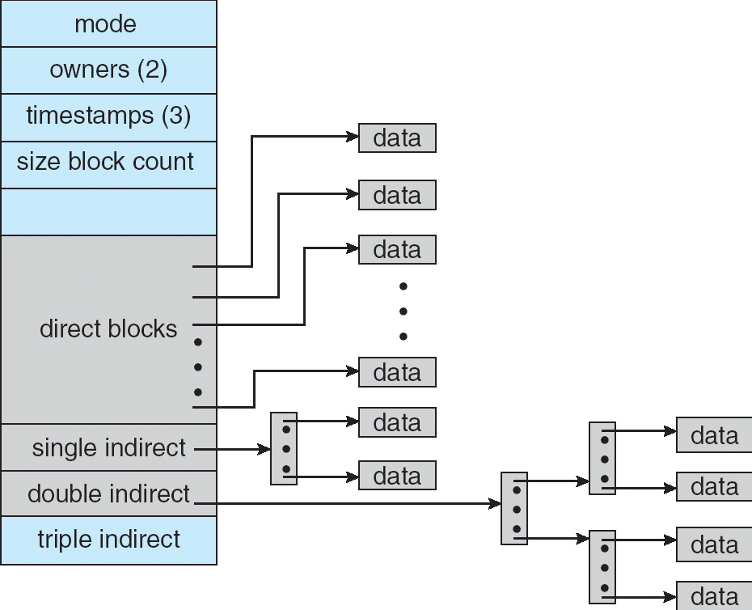
Recall: Multilevel Indexed Files (Original 4.1 BSD)
Sample file in multilevel indexed format:
  10 direct ptrs, 1K blocks
  How many accesses for block #23?
  (assume file header accessed on open)?
    Two: One for indirect block, one for data
  How about block #5?
    One: One for data
  Block #340?
    Three: double indirect block,
    indirect block, and data
UNIX 4.1 Pros and cons
  Pros: Simple (more or less)
  Files can easily expand (up to a point)
  Small files particularly cheap and easy
  Cons: Lots of seeks
  Very large files must read many indirect block (four I/Os per block!)

Slide 5
Recall: FFS Changes in Inode Placement: Motivation
In early UNIX and DOS/Windows’ FAT file system, headers stored in special array in outermost cylinders
  Fixed size, set when disk is formatted
    At formatting time, a fixed number of inodes are created
    Each is given a unique number, called an “inumber”
Problem #1: Inodes all in one place (outer tracks)
  Head crash potentially destroys all files by destroying inodes
  Inodes not close to the data that the point to
    To read a small file, seek to get header, seek back to data
Problem #2: When create a file, don’t know how big it will become (in UNIX, most writes are by appending)
  How much contiguous space do you allocate for a file?
  Makes it hard to optimize for performance

Slide 6
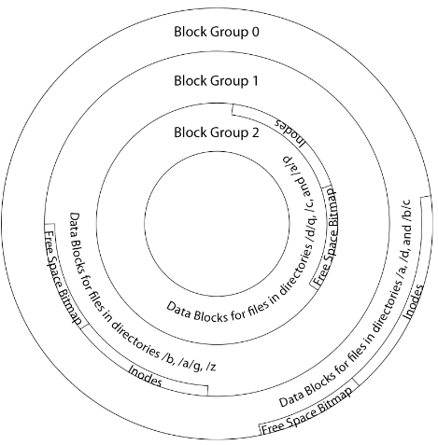
FFS Locality: Block Groups
The UNIX BSD 4.2 (FFS) distributed the header information (inodes) closer to the data blocks
  Often, inode for file stored in same “cylinder group”
  as parent directory of the file
  makes an “ls” of that directory run very fast
File system volume divided into set of block groups
  Close set of tracks
Data blocks, metadata, and free space
interleaved within block group
  Avoid huge seeks between user data and
  system structure
Put directory and its files in common block group

Slide 7
FFS Locality: Block Groups (Con’t)
First-Free allocation of new file blocks
  To expand file, first try successive blocks in bitmap, then
  choose new range of blocks
  Few little holes at start, big sequential runs at
  end of group
  Avoids fragmentation
  Sequential layout for big files
Important: keep 10% or more free!
  Reserve space in the Block Group
Summary: FFS Inode Layout Pros
  For small directories, can fit all data, file headers,
  etc. in same cylinder ⇒ no seeks!
  File headers much smaller than whole block
  (a few hundred bytes), so multiple headers fetched from disk at same time
  Reliability: whatever happens to the disk, you can find many of the files (even if directories disconnected)

Slide 8
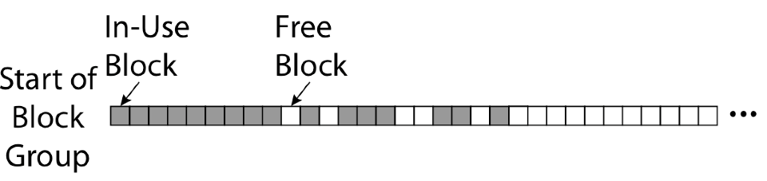
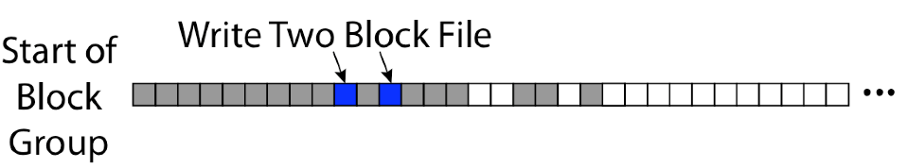
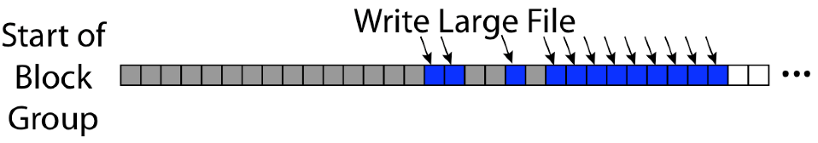
UNIX 4.2 BSD FFS First Fit Block Allocation
Fills in the small holes at the start of block group
Avoids fragmentation, leaves contiguous free space at end

Slide 9
Attack of the Rotational Delay
Problem 3: Missing blocks due to rotational delay
  Issue: Read one block, do processing, and read next block. In meantime, disk has continued turning: missed next block! Need 1 revolution/block!
  Solution1: Skip sector positioning (“interleaving”)
    Place the blocks from one file on every other block of a track: give time for processing to overlap rotation
    Can be done by OS or in modern drives by the disk controller
  Solution 2: Read ahead: read next block right after first, even if application hasn’t asked for it yet
    This can be done either by OS (read ahead)
    By disk itself (track buffers) - many disk controllers have internal RAM that allows them to read a complete track
Modern disks + controllers do many things “under the covers”
  Track buffers, elevator algorithms, bad block filtering
Skip Sector
Track Buffer
(Holds complete track)

Slide 10
UNIX 4.2 BSD FFS
Pros
  Efficient storage for both small and large files
  Locality for both small and large files
  Locality for metadata and data
  No defragmentation necessary!
Cons
  Inefficient for tiny files (a 1 byte file requires both an inode and a data block)
  Inefficient encoding when file is mostly contiguous on disk
  Need to reserve 10-20% of free space to prevent fragmentation

Slide 11
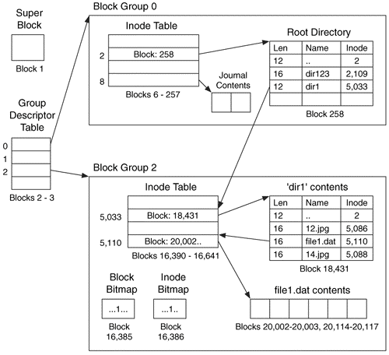
Linux Example: Ext2/3 Disk Layout
Disk divided into block groups
  Provides locality
  Each group has two block-sized bitmaps (free blocks/inodes)
  Block sizes settable at format time:
  1K, 2K, 4K, 8K…
Actual inode structure similar to 4.2 BSD
  with 12 direct pointers
Ext3: Ext2 with Journaling
  Several degrees of protection with comparable overhead
  We will talk about Journalling later
Example: create a file1.dat
under /dir1/ in Ext3

Slide 12
Recall: Directory Abstraction
Directories are specialized files
  Contents: List of pairs <file name, file number>
System calls to access directories
  open / creat traverse the structure
  mkdir /rmdir add/remove entries
  link / unlink (rm)
libc support
  DIR * opendir (const char *dirname)
  struct dirent * readdir (DIR *dirstream)
  int readdir_r (DIR *dirstream, struct dirent *entry,
  struct dirent **result)
/usr
/usr/lib
/usr/lib4.3
/usr/lib4.3/foo

Slide 13
Hard Links
Hard link
  Mapping from name to file number in the directory structure
  First hard link to a file is made when file created
  Create extra hard links to a file with the link() system call
  Remove links with unlink() system call
When can file contents be deleted?
  When there are no more hard links to the file
  Inode maintains reference count for this purpose
/usr
/usr/lib
/usr/lib4.3
/usr/lib4.3/foo

Slide 14
Soft Links (Symbolic Links)
Soft link or Symbolic Link or Shortcut
  Directory entry contains the path and name of the file
  Map one name to another name
Contrast these two different types of directory entries:
  Normal directory entry: <file name, file #>
  Symbolic link: <file name, dest. file name>
OS looks up destination file name each time program accesses
source file name
  Lookup can fail (error result from open)
Unix: Create soft links with symlink syscall

Slide 15
Directory Traversal
What happens when we open /home/cs162/stuff.txt?
“/” - inumber for root inode configured into kernel, say 2
  Read inode 2 from its position in inode array on disk
  Extract the direct and indirect block pointers
  Determine block that holds root directory (say block 49358)
  Read that block, scan it for “home” to get inumber for this directory (say 8086)
Read inode 8086 for /home, extract its blocks, read block (say 7756), scan it for “cs162” to get its inumber (say 732)
Read inode 732 for /home/cs162, extract its blocks, read block (say 12132), scan it for “stuff.txt” to get its inumber, say 9909
Read inode 9909 for /home/cs162/stuff.txt
Set up file description to refer to this inode so reads / write can access the data blocks referenced by its direct and indirect pointers
Check permissions on the final inode and each directory’s inode…
inode
block 49358
2
“home”:8086
732
block 12132
“stuff.txt”:9909
8086
block 7756
“cs162”:732
Blocks of stuff.txt
9909
2:
9099:
“home”:8086
732:
8086:
“cs162”:732
“stuff.txt”:9909
Memory

Slide 16
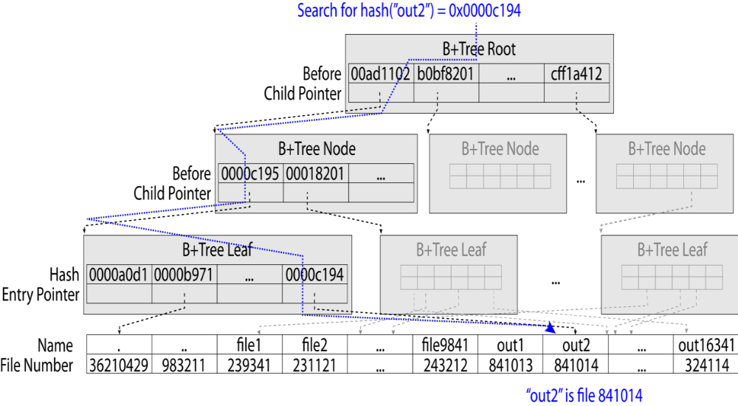
Large Directories: B-Trees (dirhash)
in FreeBSD, NetBSD, OpenBSD

Slide 17

Administrivia
Homework 5: Due April 23rd
Project 3: Design reviews this week
Midterm 3: April 25th
  Everything fair game with focus on last 1/3 of class
  Three hand-written cheat-sheets, double sided
Class attendance: No credit for people who use the same photo!
Last chance to suggest topics for final lecture!
https://tinyurl.com/25ep5ep3

Slide 18
Case Study:
Windows NTFS

Slide 19
New Technology File System (NTFS)
Default on modern Windows systems
Variable length extents
  Rather than fixed blocks
Instead of FAT or inode array: Master File Table
  Like a database, with max 1 KB size for each table entry
  Everything (almost) is a sequence of <attribute:value> pairs
    Meta-data and data
Each entry in MFT contains metadata and:
  File’s data directly (for small files)
  A list of extents (start block, size) for file’s data
  For big files: pointers to other MFT entries with more extent lists

Slide 20
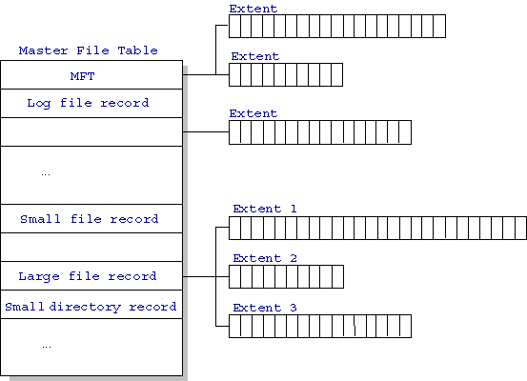
NTFS
Master File Table
  Database with Flexible 1KB entries for metadata/data
  Variable-sized attribute records (data or metadata)
  Extend with variable depth tree (non-resident)
Extents – variable length contiguous regions
  Block pointers cover runs of blocks
  Similar approach in Linux (ext4)
  File create can provide hint as to
  size of file
Journaling for reliability
  Discussed later
http://ntfs.com/ntfs-mft.htm

Slide 21
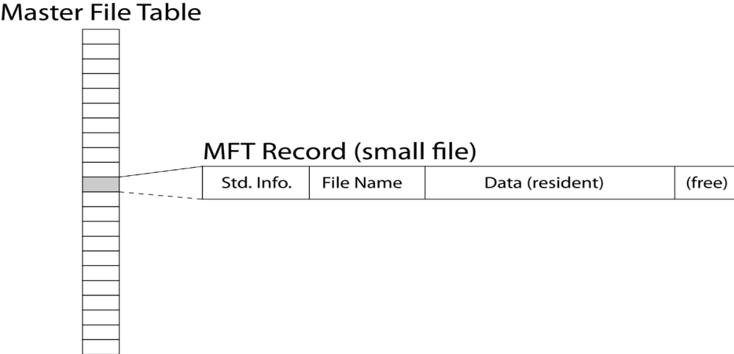
NTFS Small File: Data stored with Metadata
Create time, modify time, access time,
Owner id, security specifier, flags (RO, hidden, sys)
data attribute
Attribute list

Slide 22
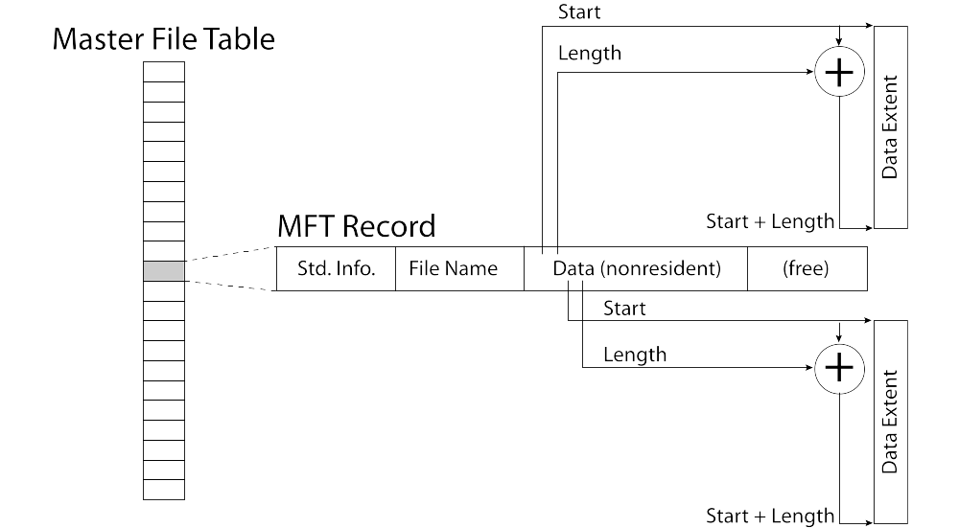
NTFS Medium File: Extents for File Data

Slide 23
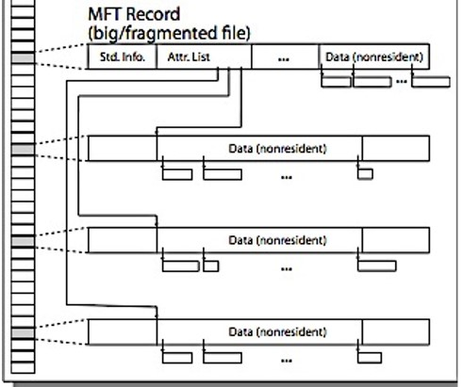
NTFS Large File: Pointers to Other MFT Records

Slide 24
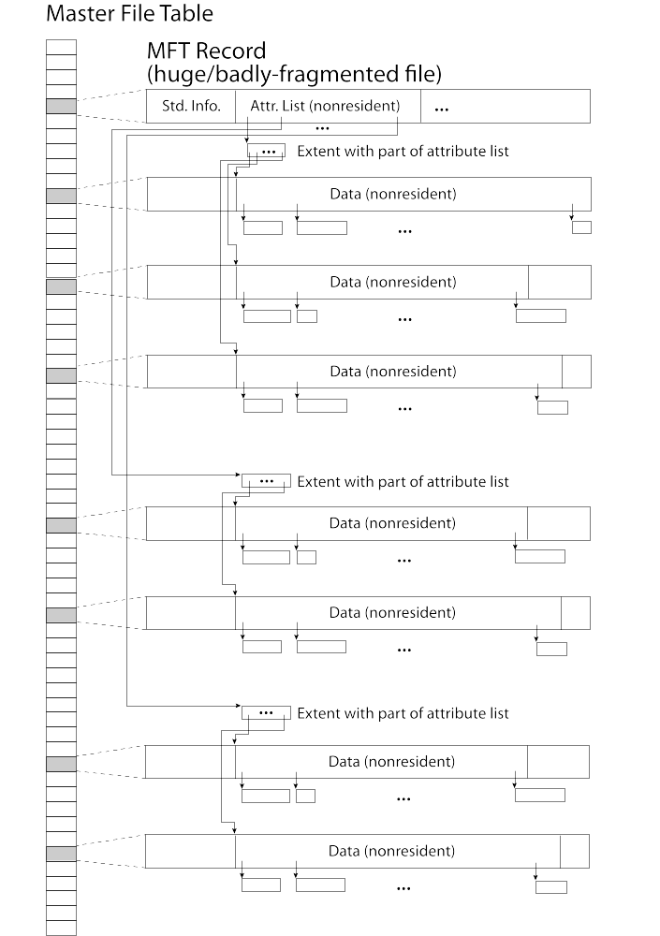
NTFS Huge, Fragmented File:
Many MFT Records

Slide 25
NTFS Directories
Directories implemented as B Trees
File's number identifies its entry in MFT
MFT entry always has a file name attribute
  Human readable name, file number of parent dir
Hard link? Multiple file name attributes in MFT entry

Slide 26
The buffer cache

Slide 27


Recall: From Storage to File Systems
I/O API and
syscalls
Variable-Size Buffer
Memory Address
Logical Index,
Typically 4 KB
File System
Block
Flash Trans. Layer
Hardware Devices
Sector(s)
Sector(s)
Sector(s)
Phys. Block
Phys Index., 4KB
Physical Index,
512B or 4KB
Erasure Page
HDD
SSD

Slide 28
Need for Cache Between FileSystem and Devices
I/O API and
syscalls
Variable-Size Buffer
Memory Address
Not block-sized
or block-aligned
access
File System
(Block Based)
Logical Index,
Typically 4 KB
Reuse of inodes,
indirect blocks,
data blocks
Speed up access
to file system
path and data
Slow access to
Data blocks of
fixed size!
Buffer Cache
(Block Based)
Flash Trans. Layer
Hardware Devices
free
free
Sector(s)
Sector(s)
Sector(s)
Phys. Block
Phys Index., 4KB
Flash Trans. Layer
Apparent speed
and flexibility is
greater because
of Buffer Cache
Physical Index,
512B or 4KB
Erasure Page
Hardware Devices
Sector(s)
Sector(s)
Sector(s)
Phys. Block
Phys Index., 4KB
HDD
SSD
Physical Index,
512B or 4KB
Erasure Page
HDD
SSD

Slide 29
Buffer Cache: Motivation
Buffer Cache
(Block Based)
Blocks
free
free
State
Kernel must copy disk blocks to memory (somewhere) to access their contents and write them back if modified
  Could be data blocks, inodes, directory contents, etc.
  Possibly dirty (modified and not yet written back)
Key Idea: Exploit locality by caching disk data in memory
  Name translations: Mapping from paths→inodes
  Disk blocks: Mapping from block address→disk content
Buffer Cache: Memory used to cache kernel resources, including disk blocks and name translations
  Can contain “dirty” blocks (with modifications not on disk)

Slide 30

File System Buffer Cache
Data blocks
Disk
Reading
OS implements a cache of disk blocks for efficient access to data, directories, inodes, freemap
PCB
iNodes
file desc
Writing
Dir Data blocks
Free bitmap
Memory
Blocks
State
free
free

Slide 31
File System Buffer Cache: open
Data blocks
Disk
Directory lookup repeat as needed:
  load block of directory
  search for map
Reading
PCB
iNodes
file desc
Writing
Dir Data blocks
Free bitmap
Memory
Blocks
State
free
free
rd
dir

Slide 32
File System Buffer Cache: open
Data blocks
Disk
Directory lookup repeat as needed:
  load block of directory
  search for map
Create reference via open file descriptor
Reading
PCB
iNodes
file desc
Writing
Dir Data blocks
<name>:inumber
Free bitmap
Memory
Blocks
State
free
dir
inode
rd

Slide 33
File System Buffer Cache: Read?
Data blocks
Disk
Read Process
  From inode, traverse index structure to find data block
  load data block
  copy all or part to read data buffer
Reading
PCB
iNodes
file desc
Writing
Dir Data blocks
<name>:inumber
Free bitmap
Memory
Blocks
State
free
dir
inode

Slide 34
File System Buffer Cache: Write?
Data blocks
Disk
Process similar to read, but may allocate new blocks (update free map), blocks need to be written back to disk; inode?
Reading
PCB
iNodes
file desc
Writing
Dir Data blocks
<name>:inumber
Free bitmap
Memory
Blocks
State
free
dir
inode

Slide 35
File System Buffer Cache: Eviction?
Data blocks
Disk
Blocks being written back to disc go through a transient state
Reading
PCB
iNodes
file desc
Writing
Dir Data blocks
<name>:inumber
Free bitmap
Memory
Blocks
State
free
dir
dirty
inode
dirty

Slide 36
Buffer Cache Discussion
Implemented entirely in OS software
  Unlike memory caches and TLB
Blocks go through transitional states between free and in-use
  Being read from disk, being written to disk
  Other processes can run, etc.
Blocks are used for a variety of purposes
  inodes, data for dirs and files, freemap
  OS maintains pointers into them
Termination – e.g., process exit – open, read, write
Replacement – what to do when it fills up?

Slide 37
File System Caching
Replacement policy? LRU
  Can afford overhead full LRU implementation
  Advantages:
    Works very well for name translation
    Works well in general as long as memory is big enough to accommodate a host’s working set of files.
  Disadvantages:
    Fails when some application scans through file system, thereby flushing the cache with data used only once
    Example: find . –exec grep foo {} \;
Other Replacement Policies?
  Some systems allow applications to request other policies
  Example, ‘Use Once’:
    File system can discard blocks as soon as they are used

Slide 38
File System Caching (con’t)
Cache Size: How much memory should the OS allocate to the buffer cache vs virtual memory?
  Too much memory to the file system cache ⇒ won’t be able to run many applications
  Too little memory to file system cache ⇒ many applications may run slowly (disk caching not effective)
  Solution: adjust boundary dynamically so that the disk access rates for paging and file access are balanced

Slide 39
File System Prefetching
Read Ahead Prefetching: fetch sequential blocks early
  Key Idea: exploit fact that most common file access is sequential by prefetching subsequent disk blocks ahead of current read request
  Elevator algorithm can efficiently interleave prefetches from concurrent applications
How much to prefetch?
  Too much prefetching imposes delays on requests by other applications
  Too little prefetching causes many seeks (and rotational delays) among concurrent file requests

Slide 40
Delayed Writes
Buffer cache is a writeback cache (writes are termed “Delayed Writes”)
write() copies data from user space to kernel buffer cache
  Quick return to user space
read() is fulfilled by the cache, so reads see the results of writes
  Even if the data has not reached disk
When does data from a write syscall finally reach disk?
  When the buffer cache is full (e.g., we need to evict something)
  When the buffer cache is flushed periodically (in case we crash)

Slide 41
Delayed Writes (Advantages)
Performance advantage: return to user quickly without writing to disk!
Disk scheduler can efficiently order lots of requests
  Elevator Algorithm can rearrange writes to avoid random seeks
Delay block allocation:
  May be able to allocate multiple blocks at same time for file, keep them contiguous
Some files never actually make it all the way to disk
  Many short-lived files!

Slide 42
Buffer Caching vs. Demand Paging
Replacement Policy?
  Demand Paging: LRU is infeasible; use approximation (like NRU/Clock)
  Buffer Cache: LRU is OK
Eviction Policy?
  Demand Paging: evict not-recently-used pages when memory is close to full
  Buffer Cache: write back dirty blocks periodically, even if used recently
    Why? To minimize data loss in case of a crash

Slide 43
Dealing with Persistent State
Buffer Cache: write back dirty blocks periodically, even if used recently
  Why? To minimize data loss in case of a crash
  Linux does periodic flush every 30 seconds
Not foolproof! Can still crash with dirty blocks in the cache
  What if the dirty block was for a directory?
    Lose pointer to file’s inode (leak space)
    File system now in inconsistent state ☹
Takeaway: File systems need
recovery mechanisms

Slide 44
Quick Aside: Memory Mapped files

Slide 45
Memory Mapped Files
Traditional I/O involves explicit transfers between buffers in process address space to/from regions of a file
  This involves multiple copies into caches in memory, plus system calls
What if we could “map” the file directly into an empty region of our address space
  Implicitly “page it in” when we read it
  Write it and “eventually” page it out
Data in Buffer Cache already!
Executable files are treated this way when we exec the process!!

Slide 46
Recall: Who Does What, When?
Process
virtual address
physical address
MMU
page#
PT
instruction
frame#
retry
page fault
offset
exception
frame#
Operating System
offset
update PT entry
Page Fault Handler
load page from disk
scheduler

Slide 47
Using Paging to mmap() Files
Process
virtual address
physical address
MMU
page#
PT
instruction
frame#
offset
retry
page fault
exception
Read File contents
from memory!
Operating System
Create PT entries
for mapped region
as “backed” by file
Page Fault Handler
File
scheduler
mmap() file to region of VAS

Slide 48
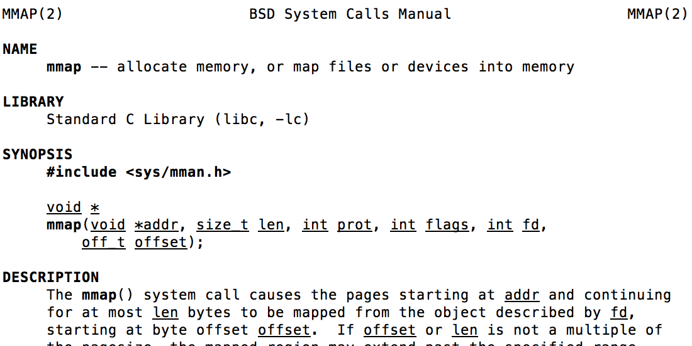
mmap() system call
May map a specific region or let the system find one for you
  Tricky to know where the holes are
Used both for manipulating files and for sharing between processes

Slide 49
An mmap() Example
#include <sys/mman.h> /* also stdio.h, stdlib.h, string.h, fcntl.h, unistd.h */
int something = 162;
int main (int argc, char *argv[]) {
int myfd;
char *mfile;
printf("Data at: %16lx\n", (long unsigned int) &something);
printf("Heap at : %16lx\n", (long unsigned int) malloc(1));
printf("Stack at: %16lx\n", (long unsigned int) &mfile);
/* Open the file */
myfd = open(argv[1], O_RDWR | O_CREAT);
if (myfd < 0) { perror("open failed!");exit(1); }
/* map the file */
mfile = mmap(0, 10000, PROT_READ|PROT_WRITE, MAP_FILE|MAP_SHARED, myfd, 0);
if (mfile == MAP_FAILED) {perror("mmap failed"); exit(1);}
printf("mmap at : %16lx\n", (long unsigned int) mfile);
puts(mfile);
strcpy(mfile+20,"Let's write over it");
close(myfd);
return 0;
}
$ ./mmap test
Data at: 105d63058
Heap at : 7f8a33c04b70
Stack at: 7fff59e9db10
mmap at : 105d97000
This is line one
This is line two
This is line three
This is line four
$ cat test
This is line one
ThiLet's write over its line three
This is line four

Slide 50
Sharing through Mapped Files
VAS 1
VAS 2
0x000…
0x000…
instructions
instructions
data
data
File
heap
heap
Memory
stack
stack
OS
OS
0xFFF…
0xFFF…
Also: anonymous memory between parents and children
  no file backing – just swap space

Slide 51
How to make File Systems more Durable?

Slide 52
Important “ilities”
Availability: the probability that the system can accept and process requests
  Measured in “nines” of probability: e.g. 99.9% probability is “3-nines of availability”
  Key idea here is independence of failures
Durability: the ability of a system to recover data despite faults
  This idea is fault tolerance applied to data
  Doesn’t necessarily imply availability: information on pyramids was very durable, but could not be accessed until discovery of Rosetta Stone
Reliability: the ability of a system or component to perform its required functions under stated conditions for a specified period of time (IEEE definition)
  Usually stronger than simply availability: means that the system is not only “up”, but also working correctly
  Includes availability, security, fault tolerance/durability
  Must make sure data survives system crashes, disk crashes, other problems

Slide 53
How to Make File Systems more Durable?
Disk blocks contain Reed-Solomon error correcting codes (ECC) to deal with small defects in disk drive
  Can allow recovery of data from small media defects
Make sure writes survive in short term
  Either abandon delayed writes or
  Use special, battery-backed RAM (called non-volatile RAM or NVRAM) for dirty blocks in buffer cache
Make sure that data survives in long term
  Need to replicate! More than one copy of data!
  Important element: independence of failure
    Could put copies on one disk, but if disk head fails…
    Could put copies on different disks, but if server fails…
    Could put copies on different servers, but if building is struck by lightning….
    Could put copies on servers in different continents…

Slide 54
RAID 1: Disk Mirroring/Shadowing
Redundant Array of Inexpensive Disks
(developed here at Berkeley!)
recovery
group
Each disk is fully duplicated onto its “shadow”
  For high I/O rate, high availability environments
  Most expensive solution: 100% capacity overhead
Bandwidth sacrificed on write:
  Logical write = two physical writes
  Highest bandwidth when disk heads and rotation synchronized (challenging)
Reads may be optimized
  Can have two independent reads to same data
Recovery:
  Disk failure ⇒ replace disk and copy data to new disk
  Hot Spare: idle disk attached to system for immediate replacement

Slide 55
RAID 5+: High I/O Rate Parity
Stripe Unit
Data stripped across multiple disks
  Successive blocks stored on successive
  (non-parity) disks
  Increased bandwidth over single disk
Parity block (in green) constructed
by XORing data blocks in stripe
  P0=D0⊕D1⊕D2⊕D3
  Can destroy any one disk and still
  reconstruct data
Suppose Disk 3 fails, then can reconstruct:
D2=D0⊕D1⊕D3⊕P0
Can spread information widely across internet for durability
  RAID algorithms work over geographic scale
D0
D1
D2
D3
P0
D4
D5
D6
P1
D7
Increasing
Logical
Disk
Addresses
D8
D9
P2
D10
D11
D12
P3
D13
D14
D15
P4
D16
D17
D18
D19
D20
D21
D22
D23
P5
Disk 1
Disk 2
Disk 3
Disk 4
Disk 5

Slide 56
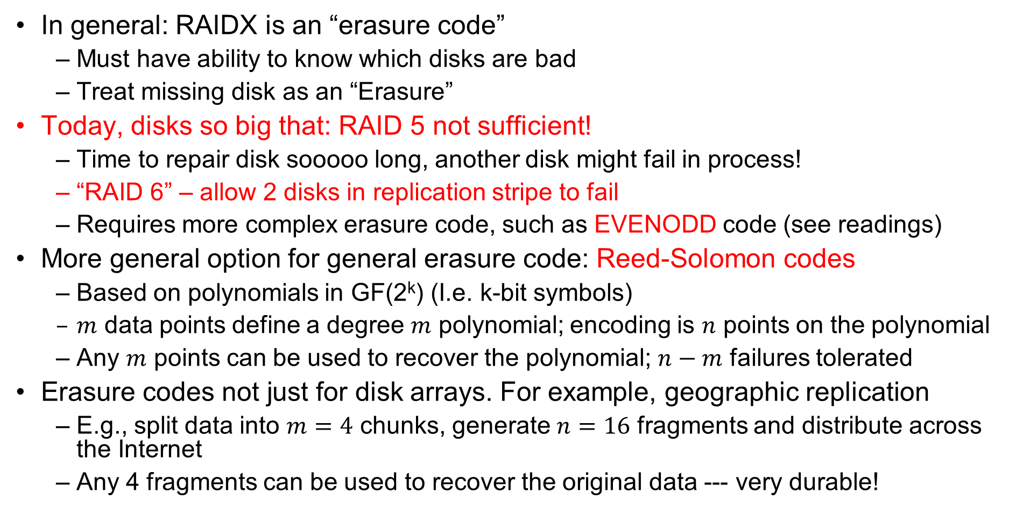
RAID 6 and other Erasure Codes
In general: RAIDX is an “erasure code”
  Must have ability to know which disks are bad
  Treat missing disk as an “Erasure”
Today, disks so big that: RAID 5 not sufficient!
  Time to repair disk sooooo long, another disk might fail in process!
  “RAID 6” – allow 2 disks in replication stripe to fail
  Requires more complex erasure code, such as EVENODD code (see readings)
More general option for general erasure code: Reed-Solomon codes
  Based on polynomials in GF(2^{k}) (I.e. k-bit symbols)
  $m$ data points define a degree $m$ polynomial; encoding is $n$ points on the polynomial
  Any $m$ points can be used to recover the polynomial; $n−m$ failures tolerated
Erasure codes not just for disk arrays. For example, geographic replication
  E.g., split data into $m=4$ chunks, generate $n=16$ fragments and distribute across the Internet
  Any 4 fragments can be used to recover the original data --- very durable!

Slide 57
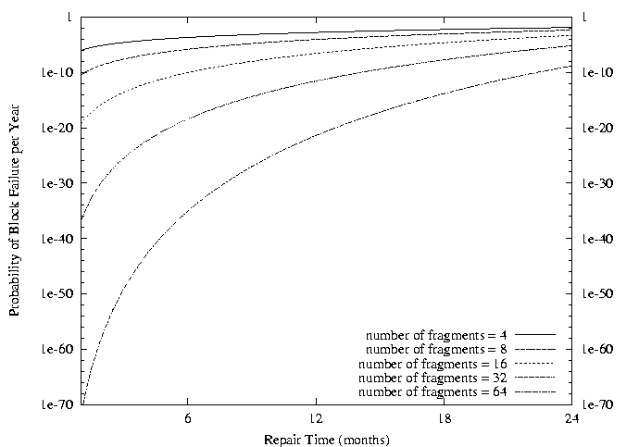
Use of Erasure Coding for High Durability/overhead ratio!
Fraction Blocks Lost
Per Year (FBLPY)
Exploit law of large numbers for durability!
6 month repair, FBLPY with 4x increase in total size of data:
  Replication (4 copies): 0.03
  Fragmentation (16 of 64 fragments needed): 10⁻³⁵

Slide 58
Higher Durability through Geographic Replication
Highly durable – hard to destroy all copies
Highly available for reads
  Simple replication: read any copy
  Erasure coded: read m of n
Low availability for writes
  Can’t write if any one replica is not up
  Or – need relaxed consistency model
Reliability? – availability, security, durability, fault-tolerance
Replica/Frag #1
Replica/Frag #2
Replica/Frag #n

Slide 59
File System Summary (1/2)
File System:
  Transforms blocks into Files and Directories
  Optimize for size, access and usage patterns
  Maximize sequential access, allow efficient random access
  Projects the OS protection and security regime (UGO vs ACL)
File defined by header, called “inode”
Naming: translating from user-visible names to actual sys resources
  Directories used for naming for local file systems
  Linked or tree structure stored in files
4.2 BSD Multilevel Indexed Scheme
  inode contains file info, direct pointers to blocks, indirect blocks, doubly indirect, etc..
  NTFS: variable extents not fixed blocks, tiny files data is in header

Slide 60
File System Summary (2/2)
File layout driven by freespace management
  Optimizations for sequential access: start new files in open ranges of free blocks, rotational optimization
  Integrate freespace, inode table, file blocks and dirs into block group
Deep interactions between mem management, file system, sharing
  mmap(): map file or anonymous segment to memory
Buffer Cache: Memory used to cache kernel resources, including disk blocks and name translations
  Can contain “dirty” blocks (blocks yet on disk)

