Slide 1
Discussion 10
Distributed Systems
04/19/24
Staff

Slide 2
Announcements
Sunday | Monday | Tuesday | Wednesday | Thursday | Friday | Saturday
 |  |  |  |  | HW5 Checkpoint Deadline
 |  | HW 5 Due |  | Midterm 3
 |  |  |  | Project 3 Due

Slide 3
Transactions

Slide 4
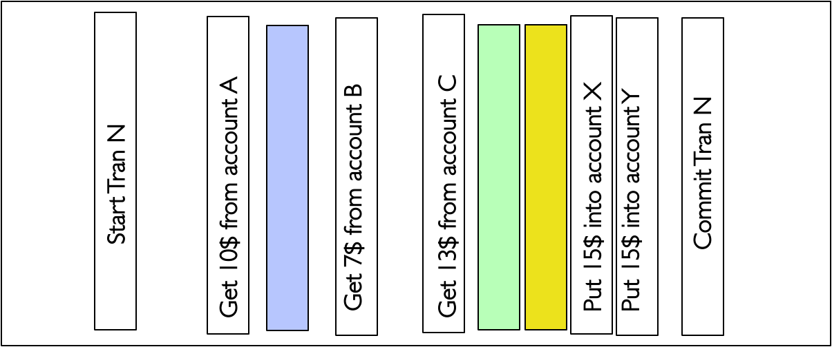
Transactions
Transactions are indivisible units.
Transactions follow ACID properties.
Atomicity: a transaction must occur in its entirety or not at all.
Consistency: a transaction takes system from one consistent state (i.e. meets all integrity and correctness constraints) to another.
Isolation: each transaction must appear to execute on its own.
Durability: a committed transaction’s changes must persist through crashes.
Each entry in a transaction must be idempotent, meaning it has the same effect when executed once or many times) (i.e. f(f(x)) = f(x)).
Transactions are stored on logs/journals (on disk).
Writes to a log are assumed to be atomic.
Logs will typically use a circular buffer (maintain head, tail pointer).

Slide 5
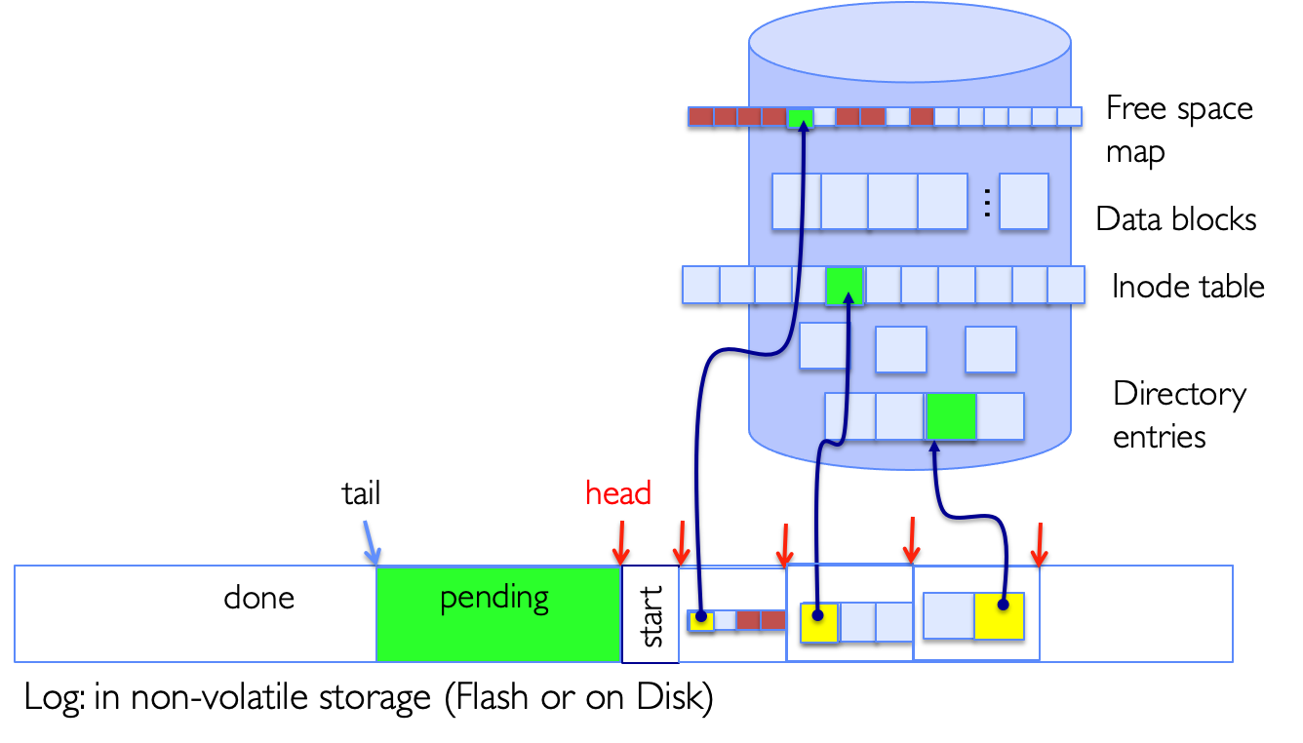
Transactions
Transactional file systems use transactions for reliability.
Journaling file systems use write-ahead logging (WAL) where log entries are written to disk before data gets modified.
  Preparation phase append all updates to the log.
  Commit phase logs a commit record, indicating the transaction must happen at some point.
  Write back will asynchronously apply committed transactions’ updates.
  Garbage collect any completed transaction in the background.
Log structured file system (LFS) use logs as storage.

Slide 6
Concept Check
Why does each entry in a transaction need to be idempotent?
Consider a file system with a buffer cache. Your program creates a file called pintos.bean. While the changes have been logged with a commit entry, the tail of the log still points to before the start of the log entry corresponding to creating pintos.bean. Assuming no further disk reads or writes have happened, if your program wants to read pintos.bean, will it need to scan through the logs?
What is the purpose of a commit entry in a log?

Slide 7
Concept Check
Why does each entry in a transaction need to be idempotent?
Entry might already have been applied prior to crash.
Consider a file system with a buffer cache. Your program creates a file called pintos.bean. While the changes have been logged with a commit entry, the tail of the log still points to before the start of the log entry corresponding to creating pintos.bean. Assuming no further disk reads or writes have happened, if your program wants to read pintos.bean, will it need to scan through the logs?
What is the purpose of a commit entry in a log?

Slide 8
Concept Check
Why does each entry in a transaction need to be idempotent?
Entry might already have been applied prior to crash.
Consider a file system with a buffer cache. Your program creates a file called pintos.bean. While the changes have been logged with a commit entry, the tail of the log still points to before the start of the log entry corresponding to creating pintos.bean. Assuming no further disk reads or writes have happened, if your program wants to read pintos.bean, will it need to scan through the logs?
No since buffer cache will hold blocks corresponding to pintos.bean.
What is the purpose of a commit entry in a log?

Slide 9
Concept Check
Why does each entry in a transaction need to be idempotent?
Entry might already have been applied prior to crash.
Consider a file system with a buffer cache. Your program creates a file called pintos.bean. While the changes have been logged with a commit entry, the tail of the log still points to before the start of the log entry corresponding to creating pintos.bean. Assuming no further disk reads or writes have happened, if your program wants to read pintos.bean, will it need to scan through the logs?
No since buffer cache will hold blocks corresponding to pintos.bean.
What is the purpose of a commit entry in a log?
Makes each transaction atomic.

Slide 10
Journaling

Slide 11
Journaling
You create two new files, F1 and F2, right before your laptop’s battery dies. You plug in and reboot your computer, and the operating system finds the following sequence of log entries in the file system’s journal.
[T1] Find free blocks, mark free map accordingly.
[T1] Allocate inode.
[T1] Add directory entry.
[T1] COMMIT
[T2] Find free blocks, mark free map accordingly.
[T2] Allocate inode.
What are the possible states of files F1 and F2 on disk at boot time?
  F1 has nothing applied.
  F1 is in an intermediate state.
  F1 has all its updates written to disk.
  F2 has nothing.
  F2 is in an intermediate state.
  F2 has all its updates written to disk.

Slide 12
Journaling
You create two new files, F1 and F2, right before your laptop’s battery dies. You plug in and reboot your computer, and the operating system finds the following sequence of log entries in the file system’s journal.
[T1] Find free blocks, mark free map accordingly.
[T1] Allocate inode.
[T1] Add directory entry.
[T1] COMMIT
[T2] Find free blocks, mark free map accordingly.
[T2] Allocate inode.
What are the possible states of files F1 and F2 on disk at boot time?
  F1 has nothing applied.
  F1 is in an intermediate state.
  F1 has all its updates written to disk.
  F2 has nothing.
  F2 is in an intermediate state.
  F2 has all its updates written to disk.

Slide 13
Journaling
You create two new files, F1 and F2, right before your laptop’s battery dies. You plug in and reboot your computer, and the operating system finds the following sequence of log entries in the file system’s journal.
[T1] Find free blocks, mark free map accordingly.
[T1] Allocate inode.
[T1] Add directory entry.
[T1] COMMIT
[T2] Find free blocks, mark free map accordingly.
[T2] Allocate inode.
Say the following entries are found at the end of the log.
  Add a directory.
  COMMIT
How does this change the possible states of file F2 on disk at boot time?
  F2 has nothing.
  F2 is in an intermediate state.
  F2 has all its updates written to disk.

Slide 14
Journaling
You create two new files, F1 and F2, right before your laptop’s battery dies. You plug in and reboot your computer, and the operating system finds the following sequence of log entries in the file system’s journal.
[T1] Find free blocks, mark free map accordingly.
[T1] Allocate inode.
[T1] Add directory entry.
[T1] COMMIT
[T2] Find free blocks, mark free map accordingly.
[T2] Allocate inode.
Say the following entries are found at the end of the log.
  Add a directory.
  COMMIT
How does this change the possible states of file F2 on disk at boot time?
  F2 has nothing.
  F2 is in an intermediate state.
  F2 has all its updates written to disk.

Slide 15
Journaling
You create two new files, F1 and F2, right before your laptop’s battery dies. You plug in and reboot your computer, and the operating system finds the following sequence of log entries in the file system’s journal.
[T1] Find free blocks, mark free map accordingly.
[T1] Allocate inode.
[T1] Add directory entry.
[T1] COMMIT
[T2] Find free blocks, mark free map accordingly.
[T2] Allocate inode.
[T2] Add a directory.
[T2] COMMIT
Say the log contained only entries (5) through (8) as shown. What are the possible states of file F1 on disk at the time of the reboot?
  F1 has nothing applied.
  F1 is in an intermediate state.
  F1 has all its updates written to disk.

Slide 16
Journaling
You create two new files, F1 and F2, right before your laptop’s battery dies. You plug in and reboot your computer, and the operating system finds the following sequence of log entries in the file system’s journal.
[T1] Find free blocks, mark free map accordingly.
[T1] Allocate inode.
[T1] Add directory entry.
[T1] COMMIT
[T2] Find free blocks, mark free map accordingly.
[T2] Allocate inode.
[T2] Add a directory.
[T2] COMMIT
Say the log contained only entries (5) through (8) as shown. What are the possible states of file F1 on disk at the time of the reboot?
  F1 has nothing applied.
  F1 is in an intermediate state.
  F1 has all its updates written to disk.

Slide 17
Journaling
You create two new files, F1 and F2, right before your laptop’s battery dies. You plug in and reboot your computer, and the operating system finds the following sequence of log entries in the file system’s journal.
[T1] Find free blocks, mark free map accordingly.
[T1] Allocate inode.
[T1] Add directory entry.
[T1] COMMIT
[T2] Find free blocks, mark free map accordingly.
[T2] Allocate inode.
[T2] Add a directory.
[T2] COMMIT
When recovering from a system crash and applying the updates recorded in the journal, does the OS need to check if these updates were partially applied before the failure?

Slide 18
Journaling
You create two new files, F1 and F2, right before your laptop’s battery dies. You plug in and reboot your computer, and the operating system finds the following sequence of log entries in the file system’s journal.
[T1] Find free blocks, mark free map accordingly.
[T1] Allocate inode.
[T1] Add directory entry.
[T1] COMMIT
[T2] Find free blocks, mark free map accordingly.
[T2] Allocate inode.
[T2] Add a directory.
[T2] COMMIT
When recovering from a system crash and applying the updates recorded in the journal, does the OS need to check if these updates were partially applied before the failure?
No. Each log entry is idempotent.

Slide 19
Distributed Systems

Slide 20
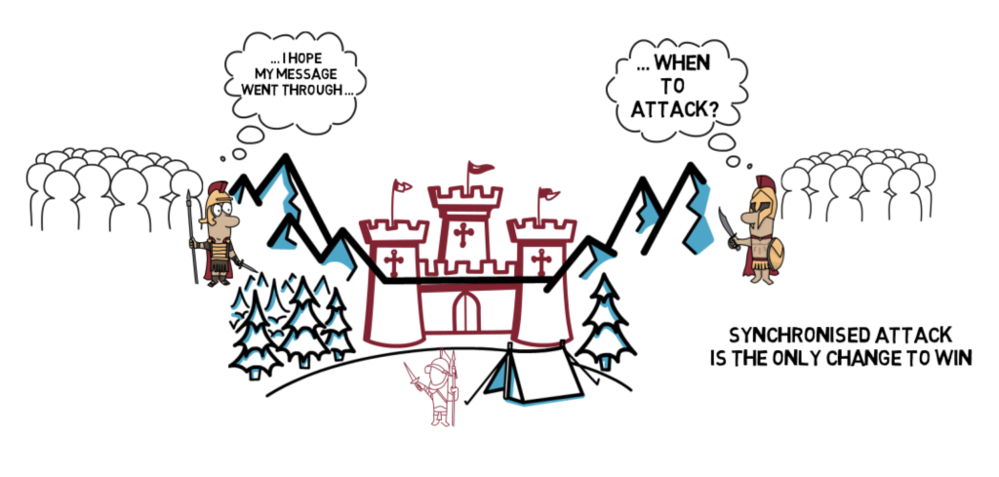
Distributed Transactions
General’s paradox demonstrates the impossibility of reaching consensus over an unreliable network.
Two generals on separate mountains who can only communicate via messengers that may be captured.
Need to attack at the same time for attack to succeed.
Distributed transaction involves multiple machines atomically agreeing to do something or not.
No constraints on time like the General’s paradox → easier problem and can be solved.

Slide 21
Atomic Commit
Two-phase commit (2PC) achieves distributed transaction as an atomic commit protocol (ACP).
Developed by Jim Gray (Berkeley Professor, Turing Award winner)!
Assumes one coordinator, N participants, and a persistent log for each machine.
Must come to a unanimous decision (i.e. commit requires all N workers to vote commit).
Prepare phase
  Coordinator sends VOTE-REQ to all participants.s
  Each participant decides to commit/abort and logs VOTE-COMMIT/VOTE-ABORT.
  Each participant sends VOTE-COMMIT/VOTE-ABORT to the coordinator.
  Coordinator logs GLOBAL-COMMIT/GLOBAL-ABORT based on participants’ decisions.
Commit/abort phase
  Coordinator sends GLOBAL-COMMIT/GLOBAL-ABORT to all participants.
  Each participant logs GLOBAL-COMMIT/GLOBAL-ABORT and commits/aborts.
  Each participant sends an ACK to the coordinator.
  Coordinator ends transaction once all N ACKs have been received.
Single node (participant or coordinator) failure leads to blocking.
Coordinator State Machine
INIT
Recv: START
Send: VOTE-REQ
WAIT
Recv: ≥ 1 VOTE-ABORT
Send: GLOBAL-ABORT
Recv: all VOTE-COMMIT
Send: GLOBAL-COMMIT
ABORT
COMMIT
Participant State Machine
INIT
Recv: VOTE-REQ
Send: VOTE-ABORT
Recv: VOTE-REQ
Send: VOTE-COMMIT
READY
Recv: GLOBAL-ABORT
Recv: GLOBAL-COMMIT
ABORT
COMMIT

Slide 22
Concept Check
The vanilla implementation of 2PC logs all decisions. How could 2PC be optimized to reduce logging?
2PC exhibits blocking behavior where a worker can be stalled until the coordinator recovers. Why is this undesirable?

Slide 23
Concept Check
The vanilla implementation of 2PC logs all decisions. How could 2PC be optimized to reduce logging?
Abort decisions can be ignored with the idea of presumed abort.
2PC exhibits blocking behavior where a worker can be stalled until the coordinator recovers. Why is this undesirable?

Slide 24
Concept Check
The vanilla implementation of 2PC logs all decisions. How could 2PC be optimized to reduce logging?
Abort decisions can be ignored with the idea of presumed abort.
2PC exhibits blocking behavior where a worker can be stalled until the coordinator recovers. Why is this undesirable?
Worker blocked → may be holding resources that other transactions may need.

Slide 25
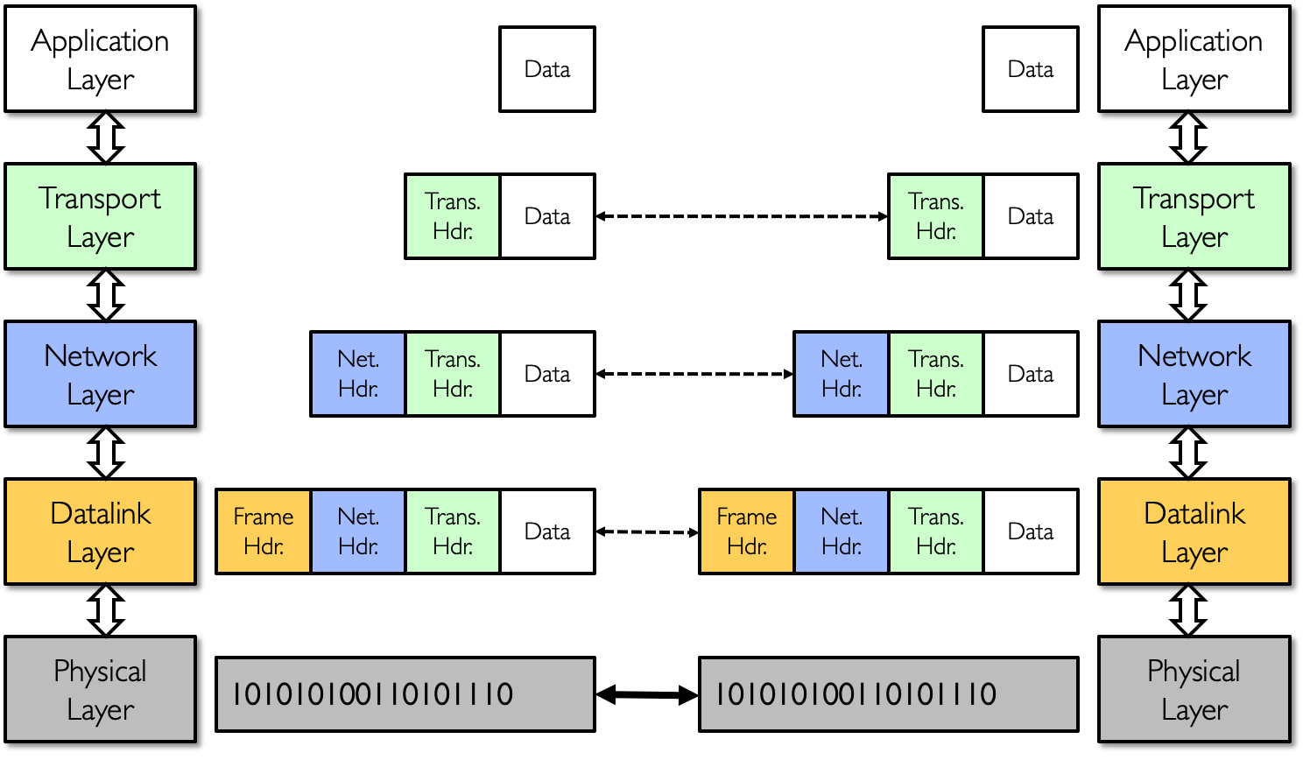
Networking
Network is a physical connection that allows two computers to communicate.
Layering means building complex services from simpler ones where each layer provides services needed by higher layers by utilizing services provided by lower layers.
Physical layer delivers the raw bits from endpoint to another (e.g. ethernet, fiber)
Datalink layer adds the packet abstraction and is responsible for local delivery of packets within the same network (e.g. switches, bridges, network interface cards).
Network layer is responsible for global delivery of packets across one or more networks.
Transport layer provides end to end communication, operating on streams of data (e.g. TCP, UDP).
Application layer provides network support for applications (e.g. HTTP, FTP, DNS, SSH).

Slide 26
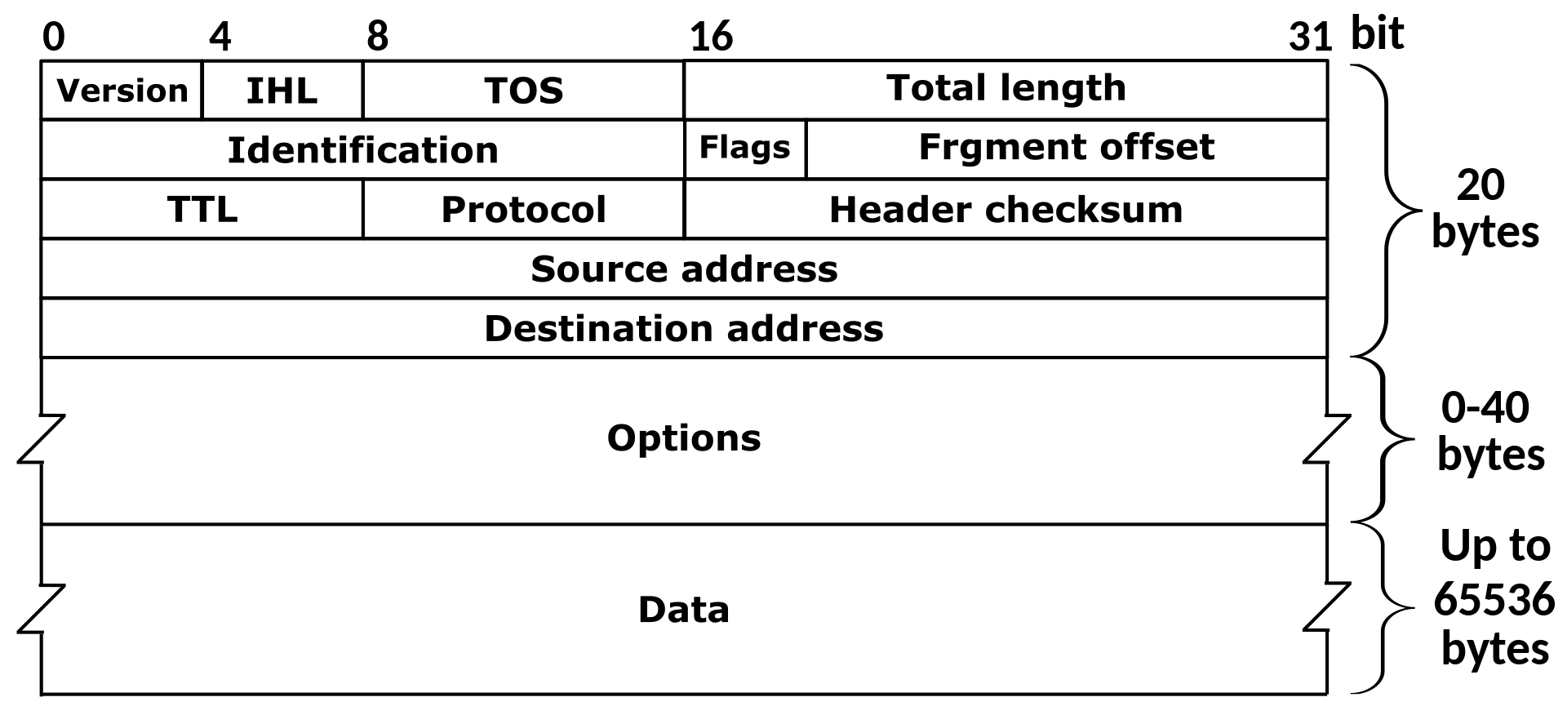
Networking
Network layer serves as the “narrow waist” to facilitate interoperability between applications and physical mediums.
Internet protocol (IP) facilitates the network layer as a “best-effort” packet delivery system.
Packets may be lost, corrupted, or delivered out of order.
IP Address is a 32-bit (IPv4) or 64-bit (IPv6) destination of packet (e.g. 192.168.162.162).

Slide 27

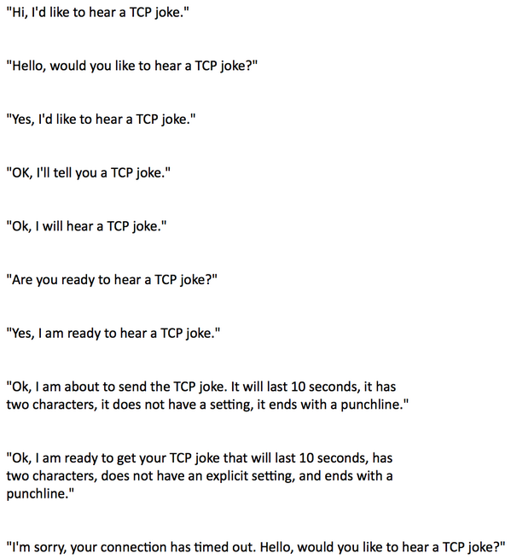
Networking
Achieved routing from machine to machine in network layer, but want routing from process to process (using ports).
User datagram protocol (UDP) provides best effort delivery.
No-frills extension of IP other than a checksum to detect some forms of packet corruption.
Low-overhead due to small packet size!
Transmission control protocol (TCP) provides reliable, in-order delivery.
Error-checked delivery, flow control, congestion control.
Much bigger overhead than UDP.
Both of these protocols are built on top of IP in the transport layer!

Slide 28
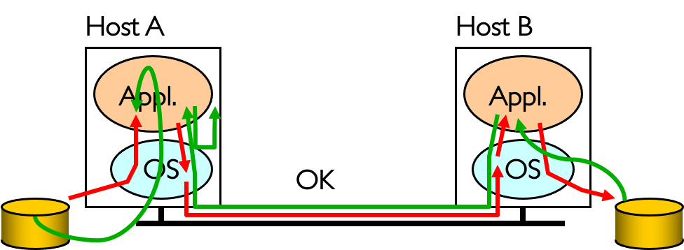
End-to-End Principle
“End-to-End Arguments in System Design” by Saltzer, Reed, Clark (1984)
Hugely influential paper, serves as basis for a lot of systems.
End-to-end (E2E) principle is the idea that some types of network functionality can only be correctly implemented end-to-end.
Conservative interpretation: don’t implement a function at lower levels unless it can be completely implemented at this level.
Moderate interpretation: if hosts can implement functionality correctly, implement it in a lower level only as a performance enhancement.
Many different interpretations!

Slide 29
Concept Check
An interpretation of the E2E Principle argues that functionality should only be placed in the network if certain conditions are met.
Only If Sufficient: Don’t implement a function in the network unless it can be completely implemented at this level.
Only If Necessary: Don’t implement anything in the network that can be implemented correctly by the hosts.
Only If Useful: If hosts can implement functionality correctly, implement it in the network only as a performance enhancement.
Consider the example of the reliable packet transfer: making all efforts to ensure that a packet sent is not lost or corrupted and is indeed received by the other end. Using each of the three criteria, argue if reliability should be implemented in the network.
Why would you ever want to use UDP over TCP?

Slide 30
Concept Check
An interpretation of the E2E Principle argues that functionality should only be placed in the network if certain conditions are met.
Only If Sufficient: Don’t implement a function in the network unless it can be completely implemented at this level.
Only If Necessary: Don’t implement anything in the network that can be implemented correctly by the hosts.
Only If Useful: If hosts can implement functionality correctly, implement it in the network only as a performance enhancement.
Consider the example of the reliable packet transfer: making all efforts to ensure that a packet sent is not lost or corrupted and is indeed received by the other end. Using each of the three criteria, argue if reliability should be implemented in the network.
Only If Sufficient: No. End hosts still need to check.
Only If Necessary: No. Reliability can be implemented fully in the end hosts.
Only If Useful: Sometimes. Lossy links may lead to sever performance decrease with only an E2E check.
Why would you ever want to use UDP over TCP?

Slide 31
Concept Check
An interpretation of the E2E Principle argues that functionality should only be placed in the network if certain conditions are met.
Only If Sufficient: Don’t implement a function in the network unless it can be completely implemented at this level.
Only If Necessary: Don’t implement anything in the network that can be implemented correctly by the hosts.
Only If Useful: If hosts can implement functionality correctly, implement it in the network only as a performance enhancement.
Consider the example of the reliable packet transfer: making all efforts to ensure that a packet sent is not lost or corrupted and is indeed received by the other end. Using each of the three criteria, argue if reliability should be implemented in the network.
Only If Sufficient: No. End hosts still need to check.
Only If Necessary: No. Reliability can be implemented fully in the end hosts.
Only If Useful: Sometimes. Lossy links may lead to sever performance decrease with only an E2E check.
Why would you ever want to use UDP over TCP?
UDP used in applications that prioritize speed and low overhead, don’t care about being lossy (e.g. streaming AV, real time data).

Slide 32
Two Phase Commit
Consider a system with one coordinator (C) and three workers (W₁, W₂, W₃). The following latencies are given for each worker.
You may assume all other latencies not given are negligible. C has a timeout of 3 s, log latency of 5 ms, and can communicate with all workers in parallel.
What is the minimum amount of time needed for 2PC to complete successfully?
Worker | Send/Receive (each direction) | Log
W₁ | 400 ms | 10 ms
W₂ | 300 ms | 20 ms
W₃ | 200 ms | 30 ms

Slide 33
Two Phase Commit
Consider a system with one coordinator (C) and three workers (W₁, W₂, W₃). The following latencies are given for each worker.
You may assume all other latencies not given are negligible. C has a timeout of 3 s, log latency of 5 ms, and can communicate with all workers in parallel.
What is the minimum amount of time needed for 2PC to complete successfully?
Prepare phase: worker receives message + log result + send back message + coordinator logs.
max(400 + 10 + 400, 300 + 20 + 300, 200 + 30 + 200) + 5 = 815 ms
Worker | Send/Receive (each direction) | Log
W₁ | 400 ms | 10 ms
W₂ | 300 ms | 20 ms
W₃ | 200 ms | 30 ms

Slide 34
Two Phase Commit
Consider a system with one coordinator (C) and three workers (W₁, W₂, W₃). The following latencies are given for each worker.
You may assume all other latencies not given are negligible. C has a timeout of 3 s, log latency of 5 ms, and can communicate with all workers in parallel.
What is the minimum amount of time needed for 2PC to complete successfully?
Prepare phase: worker receives message + log result + send back message + coordinator logs.
max(400 + 10 + 400, 300 + 20 + 300, 200 + 30 + 200) + 5 = 815 ms
Commit/abort phase: worker receives message + log result + send back message (no coordinator log)
max(400 + 10 + 400, 300 + 20 + 300, 200 + 30 + 200) = 810 ms
Total latency = 810 + 815 = 1625 ms
Worker | Send/Receive (each direction) | Log
W₁ | 400 ms | 10 ms
W₂ | 300 ms | 20 ms
W₃ | 200 ms | 30 ms

Slide 35
Two Phase Commit
Consider a system with one coordinator (C) and three workers (W₁, W₂, W₃). The following latencies are given for each worker.
You may assume all other latencies not given are negligible. C has a timeout of 3 s, log latency of 5 ms, and can communicate with all workers in parallel.
Consider that all three workers vote to commit during the preparation phase. The coordinator broad- casts a commit decision to all the workers. However, W₂ crashes and does not recover until immediately after the coordinator’s timeout phase. Does this transaction commit or abort? What is the latency of this transaction, assuming no further failures?
Worker | Send/Receive (each direction) | Log
W₁ | 400 ms | 10 ms
W₂ | 300 ms | 20 ms
W₃ | 200 ms | 30 ms

Slide 36
Two Phase Commit
Consider a system with one coordinator (C) and three workers (W₁, W₂, W₃). The following latencies are given for each worker.
You may assume all other latencies not given are negligible. C has a timeout of 3 s, log latency of 5 ms, and can communicate with all workers in parallel.
Consider that all three workers vote to commit during the preparation phase. The coordinator broad- casts a commit decision to all the workers. However, W₂ crashes and does not recover until immediately after the coordinator’s timeout phase. Does this transaction commit or abort? What is the latency of this transaction, assuming no further failures?
Transaction still commits since a commit decision was made.
Worker | Send/Receive (each direction) | Log
W₁ | 400 ms | 10 ms
W₂ | 300 ms | 20 ms
W₃ | 200 ms | 30 ms

Slide 37
Two Phase Commit
Consider a system with one coordinator (C) and three workers (W₁, W₂, W₃). The following latencies are given for each worker.
You may assume all other latencies not given are negligible. C has a timeout of 3 s, log latency of 5 ms, and can communicate with all workers in parallel.
Consider that all three workers vote to commit during the preparation phase. The coordinator broad- casts a commit decision to all the workers. However, W₂ crashes and does not recover until immediately after the coordinator’s timeout phase. Does this transaction commit or abort? What is the latency of this transaction, assuming no further failures?
Transaction still commits since a commit decision was made.
Preparation phase: 815 ms as before
Worker | Send/Receive (each direction) | Log
W₁ | 400 ms | 10 ms
W₂ | 300 ms | 20 ms
W₃ | 200 ms | 30 ms

Slide 38
Two Phase Commit
Consider a system with one coordinator (C) and three workers (W₁, W₂, W₃). The following latencies are given for each worker.
You may assume all other latencies not given are negligible. C has a timeout of 3 s, log latency of 5 ms, and can communicate with all workers in parallel.
Consider that all three workers vote to commit during the preparation phase. The coordinator broad- casts a commit decision to all the workers. However, W₂ crashes and does not recover until immediately after the coordinator’s timeout phase. Does this transaction commit or abort? What is the latency of this transaction, assuming no further failures?
Transaction still commits since a commit decision was made.
Preparation phase: 815 ms as before
Commit phase:
First try takes 3000 ms (timeout)
Second try only takes 300 + 20 + 300 = 620 ms (W₂)
Worker | Send/Receive (each direction) | Log
W₁ | 400 ms | 10 ms
W₂ | 300 ms | 20 ms
W₃ | 200 ms | 30 ms

Slide 39
Two Phase Commit
Consider a system with one coordinator (C) and three workers (W₁, W₂, W₃). The following latencies are given for each worker.
You may assume all other latencies not given are negligible. C has a timeout of 3 s, log latency of 5 ms, and can communicate with all workers in parallel.
Consider that all three workers vote to commit during the preparation phase. The coordinator broad- casts a commit decision to all the workers. However, W₂ crashes and does not recover until immediately after the coordinator’s timeout phase. Does this transaction commit or abort? What is the latency of this transaction, assuming no further failures?
Transaction still commits since a commit decision was made.
Preparation phase: 815 ms as before
Commit phase:
First try takes 3000 ms (timeout)
Second try only takes 300 + 20 + 300 = 620 ms (W₂)
Total latency = 815 + 3000 + 620 = 4435 ms
Worker | Send/Receive (each direction) | Log
W₁ | 400 ms | 10 ms
W₂ | 300 ms | 20 ms
W₃ | 200 ms | 30 ms

Slide 40
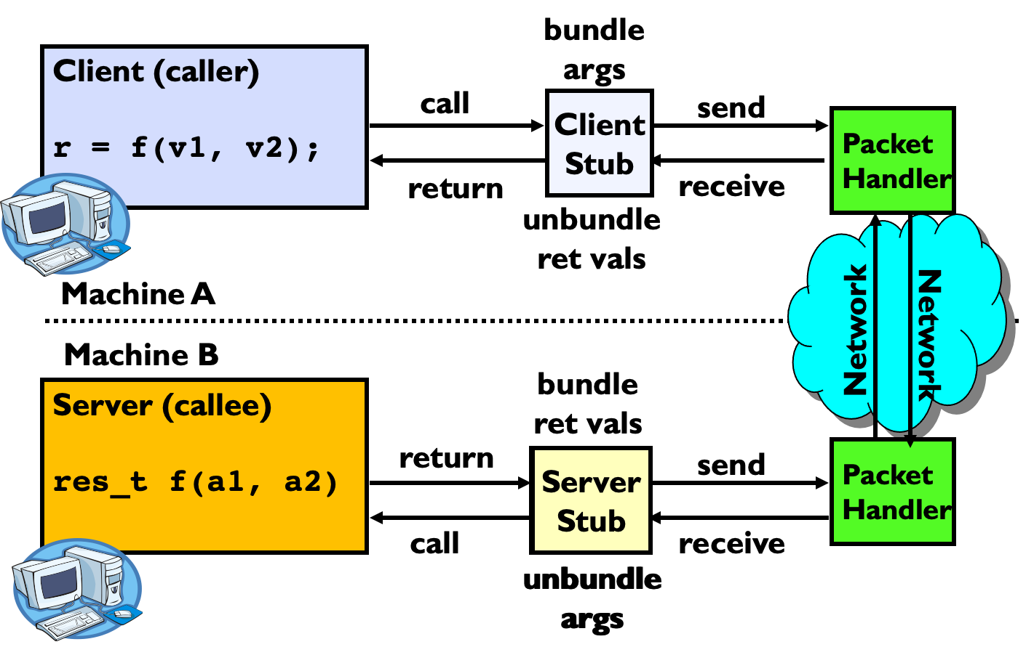
Remote Procedure Call (RPC)
Remote procedure call (RPC) makes executing code on a remote machine as simple and straightforward as calling a local function.
Automate all of the complexity of translating between representations.
Marshalling/serializing involves converting values into a canonical form (e.g. endianness), serializing objects, copying arguments passed by reference, etc.
Stub provides the glue on client/server.
  Client stub is responsible for marshalling/serializing arguments and unmarshalling/deserializing return values.
  Server stub is responsible for unmarshalling/deserializing arguments and marshalling/serializing return values.

Slide 41
Primes
Edward wants to build a RPC system for the following two procedures.
/* Returns the ith prime number (0-indexed). */
uint32_t ith_prime(uint32_t i);
/* Returns 1 if x and y are comprime, 0 otherwise. */
uint32_t is_coprime(uint32_t x, uint32_t y);
In particular, Edward is looking to setup the server side. You may assume the actual logic for both procedures have already been implemented.
/* Assume dest has enough space allocated. */
void read_args(int sock_fd, char *dest) {
int byte_len = 0;
int read_bytes = 0;
while ((read_bytes = read(sock_fd, dest, 8 - byte_len)) > 0) {
byte_len += read_bytes;
}
}
Edward notices that the arguments required are either 4 or 8 bytes. As a result, he believes he can handle either case by attempting to read 8 bytes with the code on the left.
However when Edward implements it, he notices that for some inputs the server appears to be stuck. Why might this be happening and for which inputs could this happen?

Slide 42
Primes
Edward wants to build a RPC system for the following two procedures.
/* Returns the ith prime number (0-indexed). */
uint32_t ith_prime(uint32_t i);
/* Returns 1 if x and y are comprime, 0 otherwise. */
uint32_t is_coprime(uint32_t x, uint32_t y);
In particular, Edward is looking to setup the server side. You may assume the actual logic for both procedures have already been implemented.
/* Assume dest has enough space allocated. */
void read_args(int sock_fd, char *dest) {
int byte_len = 0;
int read_bytes = 0;
while ((read_bytes = read(sock_fd, dest, 8 - byte_len)) > 0) {
byte_len += read_bytes;
}
}
Edward notices that the arguments required are either 4 or 8 bytes. As a result, he believes he can handle either case by attempting to read 8 bytes with the code on the left.
However when Edward implements it, he notices that for some inputs the server appears to be stuck. Why might this be happening and for which inputs could this happen?
read is trying to return 8 bytes from the socket or indicate there is no more data. However, the socket will not return 0 unless the socket is closed. As long as the connection stays open, the read will block instead.

Slide 43
Primes
Edward wants to build a RPC system for the following two procedures.
/* Returns the ith prime number (0-indexed). */
uint32_t ith_prime(uint32_t i);
/* Returns 1 if x and y are comprime, 0 otherwise. */
uint32_t is_coprime(uint32_t x, uint32_t y);
In particular, Edward is looking to setup the server side. You may assume the actual logic for both procedures have already been implemented.
Edward realizes his previous solution was insufficient, so he decides to implement a slightly more complicated protocol.
The client will perform the following.
Send an identifier for the function it wants as an integer (0 for ith_prime, 1 for is_coprime).
Send all bytes for all the arguments.
The server will then perform the following.
Read identifier.
Use identifier to allocate memory and set read size.
Read arguments.
void receive_rpc (int sock_fd) {
/* Read in procedure identifier. */
uint32_t id;
int bytes_read = 0, cur_read = 0;
while (_______________) {
bytes_read += cur_read;
}
id = _______________;
/* Get sizes and allocate space for arguments and return values. */
char *args, *rets;
size_t arg_bytes, ret_bytes;
get_sizes(id, &args, &arg_bytes, &rets, &ret_bytes);
/* Read in arguments. */
bytes_read = 0;
while (_______________) {
bytes_read += cur_read;
}
/* Call appropriate server stub stub function based on id. */
call_server_stub(id, args, arg_bytes, rets, ret_bytes);
/* Write return values. */
int bytes_written = 0, cur_written = 0;
while (_______________) {
bytes_written += cur_written;
}
/* Clean up socket. */
_______________;
}

Slide 44
Primes
Edward wants to build a RPC system for the following two procedures.
/* Returns the ith prime number (0-indexed). */
uint32_t ith_prime(uint32_t i);
/* Returns 1 if x and y are comprime, 0 otherwise. */
uint32_t is_coprime(uint32_t x, uint32_t y);
In particular, Edward is looking to setup the server side. You may assume the actual logic for both procedures have already been implemented.
Edward realizes his previous solution was insufficient, so he decides to implement a slightly more complicated protocol.
The client will perform the following.
Send an identifier for the function it wants as an integer (0 for ith_prime, 1 for is_coprime).
Send all bytes for all the arguments.
The server will then perform the following.
Read identifier.
Use identifier to allocate memory and set read size.
Read arguments.
void receive_rpc (int sock_fd) {
/* Read in procedure identifier. */
uint32_t id;
int bytes_read = 0, cur_read = 0;
while ((cur_read = read(sock_fd, ((char *) &id) + bytes_read,
sizeof(uint32_t) - bytes_read)) > 0) {
bytes_read += cur_read;
}
id = _______________;
/* Get sizes and allocate space for arguments and return values. */
char *args, *rets;
size_t arg_bytes, ret_bytes;
get_sizes(id, &args, &arg_bytes, &rets, &ret_bytes);
/* Read in arguments. */
bytes_read = 0;
while (_______________) {
bytes_read += cur_read;
}
/* Call appropriate server stub stub function based on id. */
call_server_stub(id, args, arg_bytes, rets, ret_bytes);
/* Write return values. */
int bytes_written = 0, cur_written = 0;
while (_______________) {
bytes_written += cur_written;
}
/* Clean up socket. */
_______________;
}

Slide 45
Primes
Edward wants to build a RPC system for the following two procedures.
/* Returns the ith prime number (0-indexed). */
uint32_t ith_prime(uint32_t i);
/* Returns 1 if x and y are comprime, 0 otherwise. */
uint32_t is_coprime(uint32_t x, uint32_t y);
In particular, Edward is looking to setup the server side. You may assume the actual logic for both procedures have already been implemented.
Edward realizes his previous solution was insufficient, so he decides to implement a slightly more complicated protocol.
The client will perform the following.
Send an identifier for the function it wants as an integer (0 for ith_prime, 1 for is_coprime).
Send all bytes for all the arguments.
The server will then perform the following.
Read identifier.
Use identifier to allocate memory and set read size.
Read arguments.
void receive_rpc (int sock_fd) {
/* Read in procedure identifier. */
uint32_t id;
int bytes_read = 0, cur_read = 0;
while ((cur_read = read(sock_fd, ((char *) &id) + bytes_read,
sizeof(uint32_t) - bytes_read)) > 0) {
bytes_read += cur_read;
}
id = ntohl(id);
/* Get sizes and allocate space for arguments and return values. */
char *args, *rets;
size_t arg_bytes, ret_bytes;
get_sizes(id, &args, &arg_bytes, &rets, &ret_bytes);
/* Read in arguments. */
bytes_read = 0;
while (_______________) {
bytes_read += cur_read;
}
/* Call appropriate server stub stub function based on id. */
call_server_stub(id, args, arg_bytes, rets, ret_bytes);
/* Write return values. */
int bytes_written = 0, cur_written = 0;
while (_______________) {
bytes_written += cur_written;
}
/* Clean up socket. */
_______________;
}

Slide 46
Primes
Edward wants to build a RPC system for the following two procedures.
/* Returns the ith prime number (0-indexed). */
uint32_t ith_prime(uint32_t i);
/* Returns 1 if x and y are comprime, 0 otherwise. */
uint32_t is_coprime(uint32_t x, uint32_t y);
In particular, Edward is looking to setup the server side. You may assume the actual logic for both procedures have already been implemented.
Edward realizes his previous solution was insufficient, so he decides to implement a slightly more complicated protocol.
The client will perform the following.
Send an identifier for the function it wants as an integer (0 for ith_prime, 1 for is_coprime).
Send all bytes for all the arguments.
The server will then perform the following.
Read identifier.
Use identifier to allocate memory and set read size.
Read arguments.
void receive_rpc (int sock_fd) {
/* Read in procedure identifier. */
uint32_t id;
int bytes_read = 0, cur_read = 0;
while ((cur_read = read(sock_fd, ((char *) &id) + bytes_read,
sizeof(uint32_t) - bytes_read)) > 0) {
bytes_read += cur_read;
}
id = ntohl(id);
/* Get sizes and allocate space for arguments and return values. */
char *args, *rets;
size_t arg_bytes, ret_bytes;
get_sizes(id, &args, &arg_bytes, &rets, &ret_bytes);
/* Read in arguments. */
bytes_read = 0;
while ((cur_read = read(sock_fd, &args[bytes_read],
arg_bytes - bytes_read)) > 0) {
bytes_read += cur_read;
}
/* Call appropriate server stub stub function based on id. */
call_server_stub(id, args, arg_bytes, rets, ret_bytes);
/* Write return values. */
int bytes_written = 0, cur_written = 0;
while (_______________) {
bytes_written += cur_written;
}
/* Clean up socket. */
_______________;
}

Slide 47
Primes
Edward wants to build a RPC system for the following two procedures.
/* Returns the ith prime number (0-indexed). */
uint32_t ith_prime(uint32_t i);
/* Returns 1 if x and y are comprime, 0 otherwise. */
uint32_t is_coprime(uint32_t x, uint32_t y);
In particular, Edward is looking to setup the server side. You may assume the actual logic for both procedures have already been implemented.
Edward realizes his previous solution was insufficient, so he decides to implement a slightly more complicated protocol.
The client will perform the following.
Send an identifier for the function it wants as an integer (0 for ith_prime, 1 for is_coprime).
Send all bytes for all the arguments.
The server will then perform the following.
Read identifier.
Use identifier to allocate memory and set read size.
Read arguments.
void receive_rpc (int sock_fd) {
/* Read in procedure identifier. */
uint32_t id;
int bytes_read = 0, cur_read = 0;
while ((cur_read = read(sock_fd, ((char *) &id) + bytes_read,
sizeof(uint32_t) - bytes_read)) > 0) {
bytes_read += cur_read;
}
id = ntohl(id);
/* Get sizes and allocate space for arguments and return values. */
char *args, *rets;
size_t arg_bytes, ret_bytes;
get_sizes(id, &args, &arg_bytes, &rets, &ret_bytes);
/* Read in arguments. */
bytes_read = 0;
while ((cur_read = read(sock_fd, &args[bytes_read],
arg_bytes - bytes_read)) > 0) {
bytes_read += cur_read;
}
/* Call appropriate server stub stub function based on id. */
call_server_stub(id, args, arg_bytes, rets, ret_bytes);
/* Write return values. */
int bytes_written = 0, cur_written = 0;
while ((cur_written = write(sock_fd, &rets[bytes_written],
ret_bytes - bytes_written)) > 0) {
bytes_written += cur_written;
}
/* Clean up socket. */
_______________;
}

Slide 48
Primes
Edward wants to build a RPC system for the following two procedures.
/* Returns the ith prime number (0-indexed). */
uint32_t ith_prime(uint32_t i);
/* Returns 1 if x and y are comprime, 0 otherwise. */
uint32_t is_coprime(uint32_t x, uint32_t y);
In particular, Edward is looking to setup the server side. You may assume the actual logic for both procedures have already been implemented.
Edward realizes his previous solution was insufficient, so he decides to implement a slightly more complicated protocol.
The client will perform the following.
Send an identifier for the function it wants as an integer (0 for ith_prime, 1 for is_coprime).
Send all bytes for all the arguments.
The server will then perform the following.
Read identifier.
Use identifier to allocate memory and set read size.
Read arguments.
void receive_rpc (int sock_fd) {
/* Read in procedure identifier. */
uint32_t id;
int bytes_read = 0, cur_read = 0;
while ((cur_read = read(sock_fd, ((char *) &id) + bytes_read,
sizeof(uint32_t) - bytes_read)) > 0) {
bytes_read += cur_read;
}
id = ntohl(id);
/* Get sizes and allocate space for arguments and return values. */
char *args, *rets;
size_t arg_bytes, ret_bytes;
get_sizes(id, &args, &arg_bytes, &rets, &ret_bytes);
/* Read in arguments. */
bytes_read = 0;
while ((cur_read = read(sock_fd, &args[bytes_read],
arg_bytes - bytes_read)) > 0) {
bytes_read += cur_read;
}
/* Call appropriate server stub stub function based on id. */
call_server_stub(id, args, arg_bytes, rets, ret_bytes);
/* Write return values. */
int bytes_written = 0, cur_written = 0;
while ((cur_written = write(sock_fd, &rets[bytes_written],
ret_bytes - bytes_written)) > 0) {
bytes_written += cur_written;
}
/* Clean up socket. */
close(sock_fd);
}

Slide 49
Primes
Edward wants to build a RPC system for the following two procedures.
/* Returns the ith prime number (0-indexed). */
uint32_t ith_prime(uint32_t i);
/* Returns 1 if x and y are comprime, 0 otherwise. */
uint32_t is_coprime(uint32_t x, uint32_t y);
In particular, Edward is looking to setup the server side. You may assume the actual logic for both procedures have already been implemented.
Finally, Edward want to implement the call stubs, which are function wrappers between each individual function we support and the generic RPC library.
uint32_t ith_prime_cstub(struct addrinfo *addrs, uint32_t i) {
uint32_t prime_val;
i = htonl(i);
call_rpc(addrs, RPC_PRIME, (char *)&i, 1, (char *) &prime_val, 1);
return ntohl(prime_val);
}
uint32_t is_coprime_cstub(struct addrinfo *addrs, uint32_t x,
uint32_t y) {
uint32_t coprime_val;
uint32_t args[2] = {htonl(x), htonl(y)};
call_rpc(addrs, RPC_COPRIME, (char *) args, 2,
(char *) &coprime_val, 1);
return ntohl(coprime_val);
}
void ith_prime_sstub (char *args, char *rets) {
______________________________;
______________________________;
______________________________;
______________________________;
}
void is_coprime_sstub (char *args, char *rets) {
______________________________;
______________________________;
______________________________;
______________________________;
______________________________;
}

Slide 50
Primes
Edward wants to build a RPC system for the following two procedures.
/* Returns the ith prime number (0-indexed). */
uint32_t ith_prime(uint32_t i);
/* Returns 1 if x and y are comprime, 0 otherwise. */
uint32_t is_coprime(uint32_t x, uint32_t y);
In particular, Edward is looking to setup the server side. You may assume the actual logic for both procedures have already been implemented.
Finally, Edward want to implement the call stubs, which are function wrappers between each individual function we support and the generic RPC library.
uint32_t ith_prime_cstub(struct addrinfo *addrs, uint32_t i) {
uint32_t prime_val;
i = htonl(i);
call_rpc(addrs, RPC_PRIME, (char *)&i, 1, (char *) &prime_val, 1);
return ntohl(prime_val);
}
uint32_t is_coprime_cstub(struct addrinfo *addrs, uint32_t x,
uint32_t y) {
uint32_t coprime_val;
uint32_t args[2] = {htonl(x), htonl(y)};
call_rpc(addrs, RPC_COPRIME, (char *) args, 2,
(char *) &coprime_val, 1);
return ntohl(coprime_val);
}
void ith_prime_sstub (char *args, char *rets) {
uint32_t* arg_ptr = (uint32_t *) args;
______________________________;
______________________________;
______________________________;
}
void is_coprime_sstub (char *args, char *rets) {
______________________________;
______________________________;
______________________________;
______________________________;
______________________________;
}

Slide 51
Primes
Edward wants to build a RPC system for the following two procedures.
/* Returns the ith prime number (0-indexed). */
uint32_t ith_prime(uint32_t i);
/* Returns 1 if x and y are comprime, 0 otherwise. */
uint32_t is_coprime(uint32_t x, uint32_t y);
In particular, Edward is looking to setup the server side. You may assume the actual logic for both procedures have already been implemented.
Finally, Edward want to implement the call stubs, which are function wrappers between each individual function we support and the generic RPC library.
uint32_t ith_prime_cstub(struct addrinfo *addrs, uint32_t i) {
uint32_t prime_val;
i = htonl(i);
call_rpc(addrs, RPC_PRIME, (char *)&i, 1, (char *) &prime_val, 1);
return ntohl(prime_val);
}
uint32_t is_coprime_cstub(struct addrinfo *addrs, uint32_t x,
uint32_t y) {
uint32_t coprime_val;
uint32_t args[2] = {htonl(x), htonl(y)};
call_rpc(addrs, RPC_COPRIME, (char *) args, 2,
(char *) &coprime_val, 1);
return ntohl(coprime_val);
}
void ith_prime_sstub (char *args, char *rets) {
uint32_t* arg_ptr = (uint32_t *) args;
uint32_t i = ntohl(args_ptr[0]);
______________________________;
______________________________;
}
void is_coprime_sstub (char *args, char *rets) {
______________________________;
______________________________;
______________________________;
______________________________;
______________________________;
}

Slide 52
Primes
Edward wants to build a RPC system for the following two procedures.
/* Returns the ith prime number (0-indexed). */
uint32_t ith_prime(uint32_t i);
/* Returns 1 if x and y are comprime, 0 otherwise. */
uint32_t is_coprime(uint32_t x, uint32_t y);
In particular, Edward is looking to setup the server side. You may assume the actual logic for both procedures have already been implemented.
Finally, Edward want to implement the call stubs, which are function wrappers between each individual function we support and the generic RPC library.
uint32_t ith_prime_cstub(struct addrinfo *addrs, uint32_t i) {
uint32_t prime_val;
i = htonl(i);
call_rpc(addrs, RPC_PRIME, (char *)&i, 1, (char *) &prime_val, 1);
return ntohl(prime_val);
}
uint32_t is_coprime_cstub(struct addrinfo *addrs, uint32_t x,
uint32_t y) {
uint32_t coprime_val;
uint32_t args[2] = {htonl(x), htonl(y)};
call_rpc(addrs, RPC_COPRIME, (char *) args, 2,
(char *) &coprime_val, 1);
return ntohl(coprime_val);
}
void ith_prime_sstub (char *args, char *rets) {
uint32_t* arg_ptr = (uint32_t *) args;
uint32_t i = ntohl(args_ptr[0]);
uint32_t result = htonl(ith_prime(i));
______________________________;
}
void is_coprime_sstub (char *args, char *rets) {
______________________________;
______________________________;
______________________________;
______________________________;
______________________________;
}

Slide 53
Primes
Edward wants to build a RPC system for the following two procedures.
/* Returns the ith prime number (0-indexed). */
uint32_t ith_prime(uint32_t i);
/* Returns 1 if x and y are comprime, 0 otherwise. */
uint32_t is_coprime(uint32_t x, uint32_t y);
In particular, Edward is looking to setup the server side. You may assume the actual logic for both procedures have already been implemented.
Finally, Edward want to implement the call stubs, which are function wrappers between each individual function we support and the generic RPC library.
uint32_t ith_prime_cstub(struct addrinfo *addrs, uint32_t i) {
uint32_t prime_val;
i = htonl(i);
call_rpc(addrs, RPC_PRIME, (char *)&i, 1, (char *) &prime_val, 1);
return ntohl(prime_val);
}
uint32_t is_coprime_cstub(struct addrinfo *addrs, uint32_t x,
uint32_t y) {
uint32_t coprime_val;
uint32_t args[2] = {htonl(x), htonl(y)};
call_rpc(addrs, RPC_COPRIME, (char *) args, 2,
(char *) &coprime_val, 1);
return ntohl(coprime_val);
}
void ith_prime_sstub (char *args, char *rets) {
uint32_t* arg_ptr = (uint32_t *) args;
uint32_t i = ntohl(args_ptr[0]);
uint32_t result = htonl(ith_prime(i));
memcpy(rets, &result, sizeof(uint32_t));
}
void is_coprime_sstub (char *args, char *rets) {
______________________________;
______________________________;
______________________________;
______________________________;
______________________________;
}

Slide 54
Primes
Edward wants to build a RPC system for the following two procedures.
/* Returns the ith prime number (0-indexed). */
uint32_t ith_prime(uint32_t i);
/* Returns 1 if x and y are comprime, 0 otherwise. */
uint32_t is_coprime(uint32_t x, uint32_t y);
In particular, Edward is looking to setup the server side. You may assume the actual logic for both procedures have already been implemented.
Finally, Edward want to implement the call stubs, which are function wrappers between each individual function we support and the generic RPC library.
uint32_t ith_prime_cstub(struct addrinfo *addrs, uint32_t i) {
uint32_t prime_val;
i = htonl(i);
call_rpc(addrs, RPC_PRIME, (char *)&i, 1, (char *) &prime_val, 1);
return ntohl(prime_val);
}
uint32_t is_coprime_cstub(struct addrinfo *addrs, uint32_t x,
uint32_t y) {
uint32_t coprime_val;
uint32_t args[2] = {htonl(x), htonl(y)};
call_rpc(addrs, RPC_COPRIME, (char *) args, 2,
(char *) &coprime_val, 1);
return ntohl(coprime_val);
}
void ith_prime_sstub (char *args, char *rets) {
uint32_t* arg_ptr = (uint32_t *) args;
uint32_t i = ntohl(args_ptr[0]);
uint32_t result = htonl(ith_prime(i));
memcpy(rets, &result, sizeof(uint32_t));
}
void is_coprime_sstub (char *args, char *rets) {
uint32_t* arg_ptr = (uint32_t *) args;
______________________________;
______________________________;
______________________________;
______________________________;
}

Slide 55
Primes
Edward wants to build a RPC system for the following two procedures.
/* Returns the ith prime number (0-indexed). */
uint32_t ith_prime(uint32_t i);
/* Returns 1 if x and y are comprime, 0 otherwise. */
uint32_t is_coprime(uint32_t x, uint32_t y);
In particular, Edward is looking to setup the server side. You may assume the actual logic for both procedures have already been implemented.
Finally, Edward want to implement the call stubs, which are function wrappers between each individual function we support and the generic RPC library.
uint32_t ith_prime_cstub(struct addrinfo *addrs, uint32_t i) {
uint32_t prime_val;
i = htonl(i);
call_rpc(addrs, RPC_PRIME, (char *)&i, 1, (char *) &prime_val, 1);
return ntohl(prime_val);
}
uint32_t is_coprime_cstub(struct addrinfo *addrs, uint32_t x,
uint32_t y) {
uint32_t coprime_val;
uint32_t args[2] = {htonl(x), htonl(y)};
call_rpc(addrs, RPC_COPRIME, (char *) args, 2,
(char *) &coprime_val, 1);
return ntohl(coprime_val);
}
void ith_prime_sstub (char *args, char *rets) {
uint32_t* arg_ptr = (uint32_t *) args;
uint32_t i = ntohl(args_ptr[0]);
uint32_t result = htonl(ith_prime(i));
memcpy(rets, &result, sizeof(uint32_t));
}
void is_coprime_sstub (char *args, char *rets) {
uint32_t* arg_ptr = (uint32_t *) args;
uint32_t x = ntohl(args_ptr[0]);
uint32_t y = ntohl(args_ptr[1]);
______________________________;
______________________________;
}

Slide 56
Primes
Edward wants to build a RPC system for the following two procedures.
/* Returns the ith prime number (0-indexed). */
uint32_t ith_prime(uint32_t i);
/* Returns 1 if x and y are comprime, 0 otherwise. */
uint32_t is_coprime(uint32_t x, uint32_t y);
In particular, Edward is looking to setup the server side. You may assume the actual logic for both procedures have already been implemented.
Finally, Edward want to implement the call stubs, which are function wrappers between each individual function we support and the generic RPC library.
uint32_t ith_prime_cstub(struct addrinfo *addrs, uint32_t i) {
uint32_t prime_val;
i = htonl(i);
call_rpc(addrs, RPC_PRIME, (char *)&i, 1, (char *) &prime_val, 1);
return ntohl(prime_val);
}
uint32_t is_coprime_cstub(struct addrinfo *addrs, uint32_t x,
uint32_t y) {
uint32_t coprime_val;
uint32_t args[2] = {htonl(x), htonl(y)};
call_rpc(addrs, RPC_COPRIME, (char *) args, 2,
(char *) &coprime_val, 1);
return ntohl(coprime_val);
}
void ith_prime_sstub (char *args, char *rets) {
uint32_t* arg_ptr = (uint32_t *) args;
uint32_t i = ntohl(args_ptr[0]);
uint32_t result = htonl(ith_prime(i));
memcpy(rets, &result, sizeof(uint32_t));
}
void is_coprime_sstub (char *args, char *rets) {
uint32_t* arg_ptr = (uint32_t *) args;
uint32_t x = ntohl(args_ptr[0]);
uint32_t y = ntohl(args_ptr[1]);
uint32_t result = htonl(is_coprime(x, y));
______________________________;
}

Slide 57
Primes
Edward wants to build a RPC system for the following two procedures.
/* Returns the ith prime number (0-indexed). */
uint32_t ith_prime(uint32_t i);
/* Returns 1 if x and y are comprime, 0 otherwise. */
uint32_t is_coprime(uint32_t x, uint32_t y);
In particular, Edward is looking to setup the server side. You may assume the actual logic for both procedures have already been implemented.
Finally, Edward want to implement the call stubs, which are function wrappers between each individual function we support and the generic RPC library.
uint32_t ith_prime_cstub(struct addrinfo *addrs, uint32_t i) {
uint32_t prime_val;
i = htonl(i);
call_rpc(addrs, RPC_PRIME, (char *)&i, 1, (char *) &prime_val, 1);
return ntohl(prime_val);
}
uint32_t is_coprime_cstub(struct addrinfo *addrs, uint32_t x,
uint32_t y) {
uint32_t coprime_val;
uint32_t args[2] = {htonl(x), htonl(y)};
call_rpc(addrs, RPC_COPRIME, (char *) args, 2,
(char *) &coprime_val, 1);
return ntohl(coprime_val);
}
void ith_prime_sstub (char *args, char *rets) {
uint32_t* arg_ptr = (uint32_t *) args;
uint32_t i = ntohl(args_ptr[0]);
uint32_t result = htonl(ith_prime(i));
memcpy(rets, &result, sizeof(uint32_t));
}
void is_coprime_sstub (char *args, char *rets) {
uint32_t* arg_ptr = (uint32_t *) args;
uint32_t x = ntohl(args_ptr[0]);
uint32_t y = ntohl(args_ptr[1]);
uint32_t result = htonl(is_coprime(x, y));
memcpy(rets, &result, sizeof(uint32_t));
}

