Slide 1
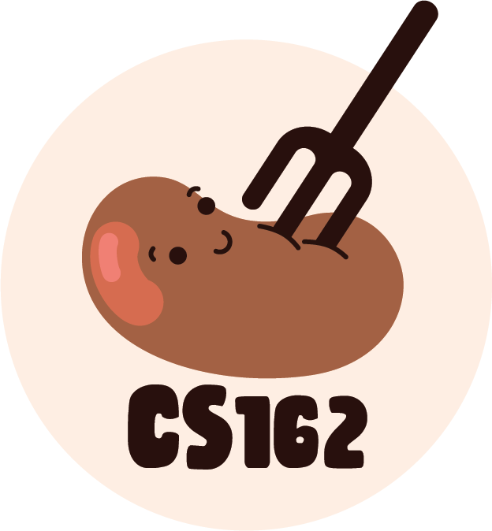
C Review Session
Notes:
A

Slide 2
Zoom Logistics
This presentation will be recorded, so please have your videos off
If you have any questions, please post them in chat!
We’ll also try to leave some time for Q&A after the presentation for any other questions
Notes:
A

Slide 3
Disclaimer
These slides are not a comprehensive overview of everything you need from 61C to succeed in 162
  Other concepts not mentioned will likely be brought up when relevant
This class has A LOT of C coding
  If you choose to take this class you are committing to that workload
  Almost everyone taking this class is rusty in C but this review alone will not make you comfortable enough for this class
Notes:
A

Slide 4
Other Resources
CS 162 Ladder
  Overview of C and 61C topics
CS 61C Resources Page
  C staff notes, GDB reference card
Python Tutor C
  Just like CS 61A’s Python Tutor, but for C
Notes:
A

Slide 5
Outline
We’ll do brief conceptual review on topics and then do a review section. We’ll close with notes on Git and other tips.
Topics List:
  C Basic Syntax
  C Pointers and Arrays
  C Structs
  C Memory Layout
  Review
  Git
Notes:
A

Slide 6
C Basics

Slide 7
Types in C
C is a statically typed language
  Type is known at compile-time (instead of at run-time)
All types are numerical or a composition of other types:
  Ex. int, char, struct, union, typedef, pointer
Every variable in C has a type:
  int i; // Declares i to be an integer.
  int j = 5; // Defines j to be an integer initialized to 5.
All variables in C are just bytes under the hood with some length
  Ex: int32_t is a 4 byte integer interpreted as a signed 2’s complement number
There is no built-in bool
  Must import stdbool.h with #include <stdbool.h>

Slide 8
Basic Operations
Adding (+), subtracting (-), dividing (/), multiplying (*).
Pre-increment and post-increment for numeric types:
  Ex: int, long, char, size_t
int i = 0;
printf("%d\n", ++i); // Increments and then returns the value of i.
printf("%d\n", i++); // Increments i but returns the value before increment.
printf("%d\n", i);
-------------------
1
1
2

Slide 9
Multiple Declarations
You can declare/define multiple variables in the same line.
int x, y;
char c = 'a', d;
float f, g = 3.0, h = 162.0;

Slide 10
Conditionals and Loops
Change control flow/iterate. Basic syntax:
if-else if-else blocks:
int i = 5;
if (i == 5) {
i = 6;
printf("This is executed.\n");
} else if (i == 6) {
printf("This is not executed.\n");
} else {
printf("Not executed either.\n");
}
if (i == 6) {
printf("This will be executed, however.\n");
}
For loops:
for (int i = 0; i <= 162; i++) {
printf("%d\n", i);
}
// Not limited to integers!
for (char c = fgetc(infile); c != EOF; c = fgetc(infile)) {
putchar(c);
}
While loops:
int i = 0;
while (i <= 162) {
printf("%d\n", i);
++i;
}
Do-while loops:
int i = 0;
do {
printf("%d\n", i);
++i;
} while (i <= 162);
Notes:
Everything between if statement to the else statement forms a block. Subsequent else ifs and elses will not execute if an earlier statement in the block was true.
If we replaced all of the else ifs and elses with ifs, then all of the loop conditions would be evaluated and checked to see if they are true.
Do-while guarantees at least one iteration.

Slide 11
Switch Statements
Switch statements are a nice way to do conditional logic based on the value of an expression:
char c = 'c';
printf("Make sure to break out of your cases!\n");
switch (c) {
case 'a':
printf("Why?\n");
break;
case 'c':
printf("Otherwise you will ");
case 'b':
printf("fall through!\n");
break;
default:
break;
}

Slide 12
Type Casting
We can convert between types with casting either implicitly or explicitly
  Ex: unsigned int i = -1;
  Ex: long s = (unsigned int) -1;
C does not have the concept of generics the way other languages do
Instead C uses void * and char * to generalize pointer types. Can use char * to modify data at the byte level.
It’s easy to cast to fix compilation errors but break your program as a result.

Slide 13
Truthiness in C
In C, the only false values are things that evaluate to 0
  0, NULL, false (w/ #include <stdbool.h>)
All other values are truthy.
It’s not uncommon in C to see while (1) { ... }
  This is an infinite loop in C. (Can also do for(;;) {})

Slide 14
Pointers
Memory Manipulation

Slide 15
Pointer Syntax
Denote variables as pointers with *
  int* my_pointer means a pointer to an integer
  char** my_db_pointer means a pointer to a pointer to a character
& – Address operator: get the memory address of a variable
  int x = 5;
  int* my_pointer = &x;
* – Dereference operator: get the value of the variable that is pointed to
  int my_int = *my_pointer; // Gets the value of integer pointed to by my_pointer.
  *my_pointer = 7; // Changes the value of the integer pointed to by my_pointer.
Pitfall with Multiple Pointer Declarations in one line:
  int *x, y; declares x to be a pointer to int but y to be an int . Use int *x, *y instead.

Slide 16
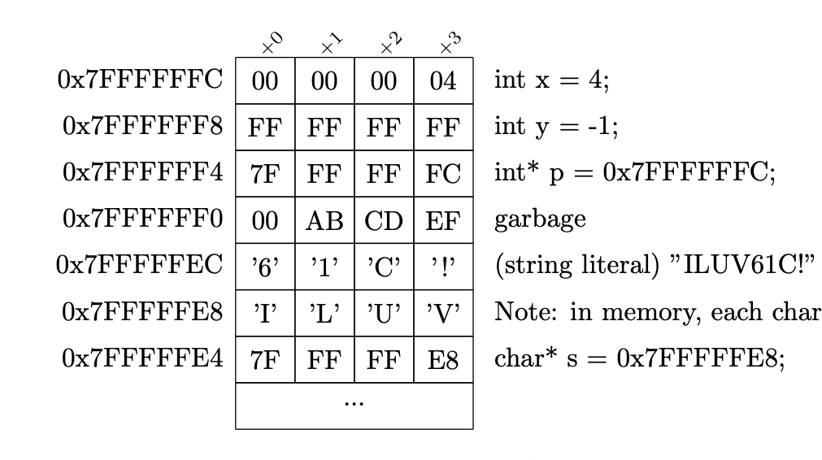
Pointers in C and Memory
Can think of memory as one big array
A memory address is just the index of the memory array
Each memory address holds one byte of data (byte addressing)
Q: Is this a 32-bit or 64-bit system?
A: 32-bit (memory addresses)
61C Fa17 Notes

Slide 17
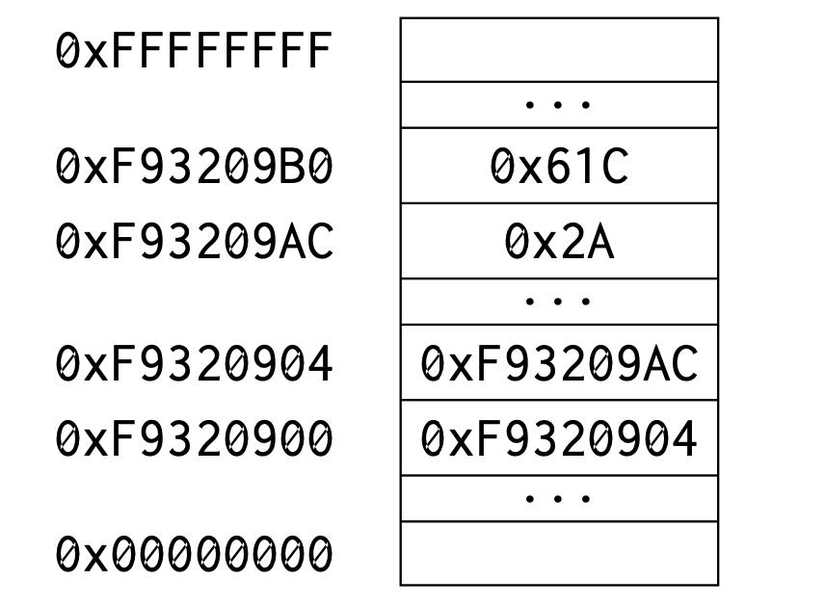
Pointers in C
The value of a pointer is the memory address of what it’s pointing to
*The stack grows down.
Task: Make p point to y, and make db_p be pointer that points to p.
int x = 1564;
int y = 42;
...
int* p = ______;
int** db_p = ______;
61C Fa19 Discussion 2

Slide 18
Pointers in C
The value of a pointer is the memory address of what it’s pointing to
*The stack grows down.
int x = 1564;
int y = 42;
...
int* p = &y;
int** db_p = &p;

Slide 19
Pointers in C
The value of a pointer is the memory address of what it’s pointing to
What do the following evaluate to?
&db_p
db_p
*db_p
**db_p
int x = 1564;
int y = 42;
...
int* p = &y;
int** db_p = &p;

Slide 20
Pointers in C
The value of a pointer is the memory address of what it’s pointing to
What do the following evaluate to?
&db_p — 0xF9320900
db_p — 0xF9320904
*db_p — 0xF93209AC
**db_p — 0x2A
int x = 1564;
int y = 42;
...
int* p = &y;
int** db_p = &p;

Slide 21
Pointers in C
Think of “*” as the inverse of “&” and vice versa.
NULL is used as the value for an invalid/uninitialized pointer
Just passing an address doesn’t make it valid
  Using memory that is not legal/in scope can lead to program crashes (segfaults)

Slide 22
sizeof
In C, the sizes of types may depend on the system you’re targeting:
  Ex: Size of a pointer. Could be 4 bytes (32-bit) or 8 bytes (64-bit).
In C, we use sizeof to determine the size
  Ex: sizeof(int) == # bytes in an integer
  sizeof(int*) == sizeof(char*) == # bytes in a pointer
sizeof is important to use for memory allocation
  Malloc calls should include sizeof somewhere
  Ex: int* x = malloc(sizeof(int))

Slide 23
Writeable Function Parameters
When a function is called, its parameters are copied onto its stack
  C is a pass by value language, like Java
Changes to these values will be lost when the function returns
Solution:
  pass in a pointer as a parameter
  function receives copy of pointer
  function uses this pointer to access/edit the contents it points to
  the changes will persist after the function returns

Slide 24
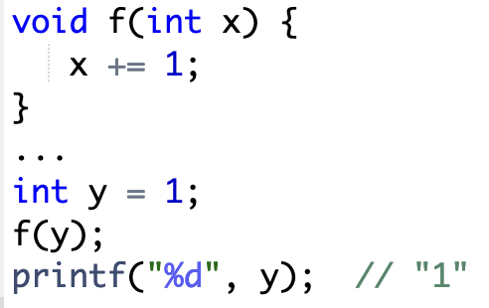
Writeable Function Parameters Example

Slide 25
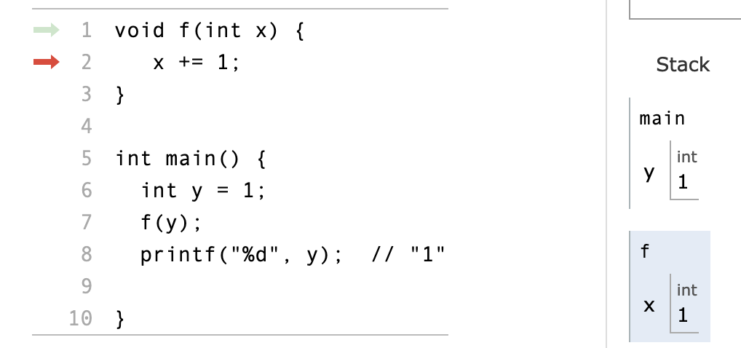
Writeable Function Parameters Example

Slide 26
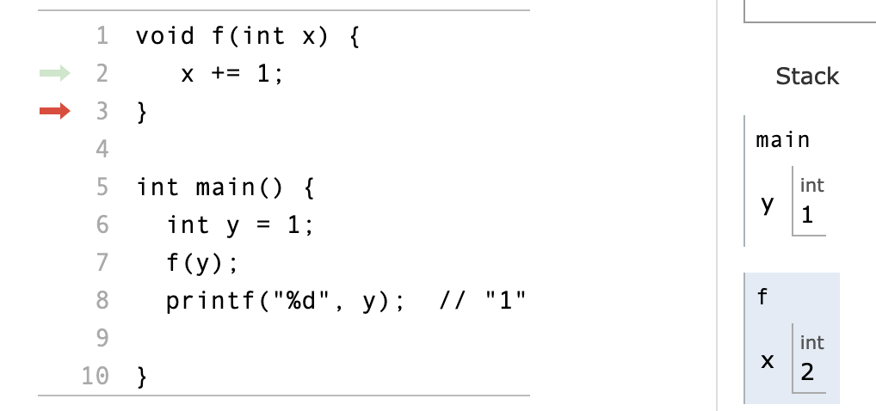
Writeable Function Parameters Example

Slide 27
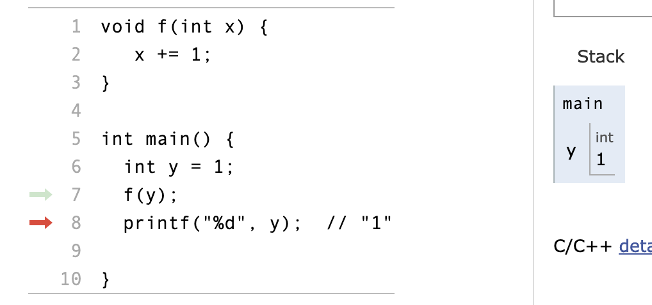
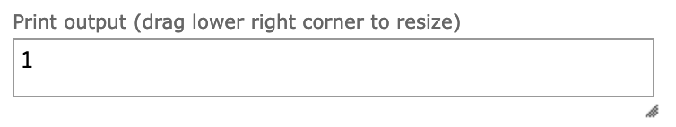
Writeable Function Parameters Example

Slide 28
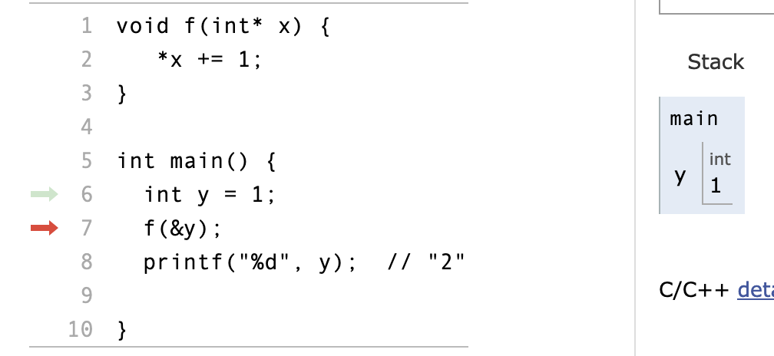
Writeable Function Parameters Example

Slide 29
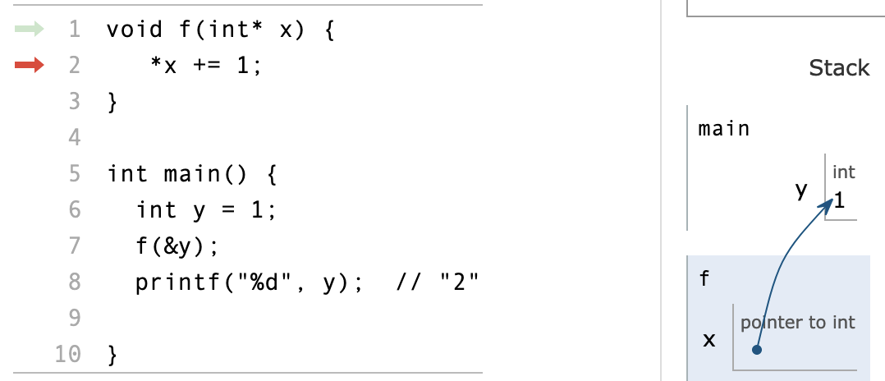
Writeable Function Parameters Example

Slide 30
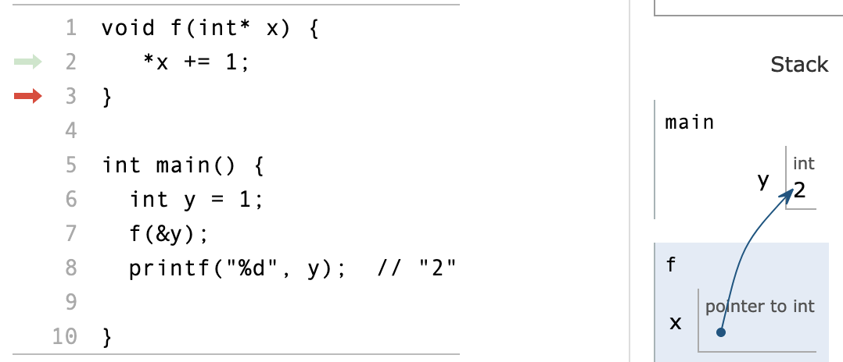
Writeable Function Parameters Example

Slide 31
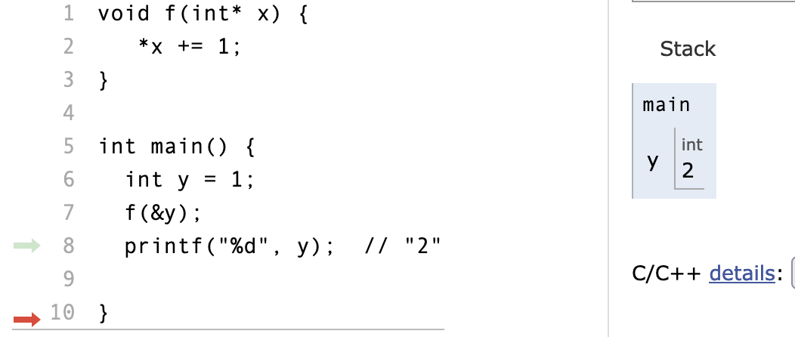
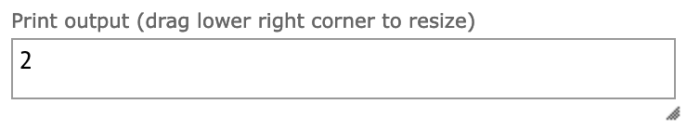
Writeable Function Parameters Example

Slide 32
Arrays in C
An array is a contiguous region of memory of fixed size
  int array[3];
Either static or allocated on the stack.
Referenced by an address to their first element
  array == &array[0]
Access elements via pointer arithmetic
  array[i] == *(array + i)
Arrays don’t have an end marker
  programmer’s responsibility to keep track of the size of an array

Slide 33
Pointer Arithmetic
int lottery_numbers[3] = {62, 55, 30};
lottery_numbers[0] == *lottery_numbers == 62
Q: *(lottery_numbers + 2) or *(lottery_numbers + 2*sizeof(int))?
A: *(lottery_numbers + 2)
The compiler knows to multiply by 2*sizeof(int), and does it for you.
This is valid for any type-defined pointer, the compiler will automatically advance the correct number of bytes based on the pointer’s type

Slide 34
Arrays are not Pointers!
Arrays and pointers share a few characteristics, but they are not the same.
Pointers can point to anything. Even invalid memory. Arrays are either static or on on the stack (valid by definition).
Arrays are not reassignable. Ex: int arr[10]; arr = arr + 1; will error. Similar to const pointers in that regard. Non const pointers can be reassigned.
Arrays include size in their type. An int array of 9 elements is a different type than an int array of 10 elements, for example.
Arrays that have their size determined at compile time can have their size queried using sizeof.

Slide 35
Arrays Carry Size Information
int arr[10];
int *p = arr;
printf("%lu\t%lu\n", sizeof(arr), sizeof(p));
-------------
40 8

Slide 36
Pointers to Arrays
int lottery_numbers[3] = {62, 55, 30}; (pointer w/ space for 3 integers)
Q: Which of the following gives a pointer to the lottery_numbers array?
void* ptr_one = lottery_numbers;
void* ptr_two = &lottery_numbers;
void* ptr_tre = &lottery_numbers[0];

Slide 37
Pointers to Arrays
int lottery_numbers[3] = {62, 55, 30}; (pointer w/ space for 3 integers)
Q: Which of the following gives a pointer to the lottery_numbers array?
void* ptr_one = lottery_numbers;
void* ptr_two = &lottery_numbers;
void* ptr_tre = &lottery_numbers[0];
A: All of them are correct and equivalent to each other!
For more information read here.

Slide 38
Pointers to Arrays
int lottery_numbers[3] = {62, 55, 30};
How can lottery_numbers == &lottery_numbers?
  lottery_numbers -> gives you the address of lottery_numbers[0]
  &lottery_numbers -> gives you the address of the entire array, which is the same thing
&lottery_numbers and lottery_numbers evaluate to pointers to different things
  lottery_numbers decays to an int *
  &lottery_numbers points to an int array of size 3
  Try adding 1 to each pointer!

Slide 39
Data Structures in C
structs, typedefs.

Slide 40
Typedef
typedef creates a new type that has the exact same structure as a data type
Syntax for typedef
  typedef <data type name> <new data type name>;
  typedef int my_int;
  typedef long long LL;
Commonly used to create new types from structs

Slide 41
Structs
structs allow us to create groups of different types (arrays, int, char)
struct syntax
  struct my_struct { int x; char* y; };
Usually used in conjunction with typedef
  typedef struct { int x; char* y; } my_struct;
  my_struct instance;
structs DO NOT have methods, constructors, or destructors
Alternate notation when accessing fields of structs via pointers:
  my_struct* instance_ptr = &instance;
  (*instance_ptr).x == instance_ptr->x
  (*struct_instance).field == struct_insance->field

Slide 42
Initializing a struct
typedef struct my_struct {
int my_int;
char my_char;
} my_struct_t;
// typedef means “my_struct_t” is equivalent to “struct my_struct”
// Method 2: malloc and initialize manually
// (most common, especially if struct
// ptr is being returned)
// Note the use of -> instead of .
my_struct_t* s2 = malloc(sizeof(my_struct_t));
s2->my_int = 3;
s2->my_char = ‘c’;
// The following is incorrect
my_struct s3;
// The following is correct
struct my_struct s4;
// Method 1: declare struct on stack
// initialize fields manually
void main() {
my_struct_t s1;
s1.my_int = 1;
s1.my_char = ‘a’;
}

Slide 43
Ex: Using typedef
(1)
struct ListNode {
char* value;
struct ListNode* next;
};
typedef struct ListNode LinkNode;
(2)
typedef struct ListNode {
char* value;
struct ListNode* next;
} LinkNode;

Slide 44
types.h
off_t: signed integer, used for file offsets
pid_t: signed integer, used for process IDs
pthread_t: unsigned integer, used to identify a thread
size_t: unsigned integer, used for sizes of objects
Why so many types? Can’t we have int instead of pid_t?
This is for accommodating different types of devices. Some devices may be 32-bit machines vs 64-bits.

Slide 45
Pointers and Structs
Alternate notation when dealing with pointers to structs.
  (*struct_pointer).value == struct_pointer->value

Slide 46
Working with C Data Structures + Pointers!
Complete the example function that adds a new node to the back of the list.
void add_node_to_back (LinkNode* head, char* str) {
while (head->next != NULL) { // Iterate through list to find end
_____________________;
}
_______________________;
_______________________;
_______________________;
_______________________;
}
typedef struct ListNode {
char* value;
struct ListNode* next;
} LinkNode;

Slide 47
Working with C Data Structures + Pointers!
void add_node_to_back (LinkNode* head, char* str) {
while (head->next != NULL) { // Iterate through list to find end
head = head->next;
}
LinkNode* new_node = (LinkNode*) malloc(sizeof(LinkNode));
// +1 copies over null terminator
new_node->value = (char*) malloc(sizeof(char)*(strlen(str)+1));
strncpy(new_node->value, str, strlen(str)+1);
new_node->next = NULL;
head->next = new_node;
}

Slide 48
C Basics
The following code has undefined behavior. Identify all of the following bugs in the code.

Slide 49
Pointer Basics
basics.c
// Print out all array elements, // each element on a newline void print_array (int* arr) { while (*arr != NULL) { printf ("%d\n", *arr); arr += sizeof (int); } } | int main () { // Array intended to consist of // 1, 2, 0, 5 int a[] = {1, 2, 0, 5, NULL}; // Should print: // 1 // 2 // 0 // 5 print_array (a); }
Notes:
Just prints 1

Slide 50
Pointer Basics
basics.c
// Print out all array elements, // each element on a newline void print_array (int* arr, size_t size) { int* endpoint = arr + size; while (arr < endpoint) { printf ("%d\n", *arr); arr += 1; } } | int main () { // Array intended to consist of // 1, 2, 0, 5 // No need for NULL int a[] = {1, 2, 0, 5}; // Should print: // 1 // 2 // 0 // 5 print_array (a, 4); }
Notes:
Even if NULL was kept in a[], it wouldn’t print everything. 0 == NULL

Slide 51
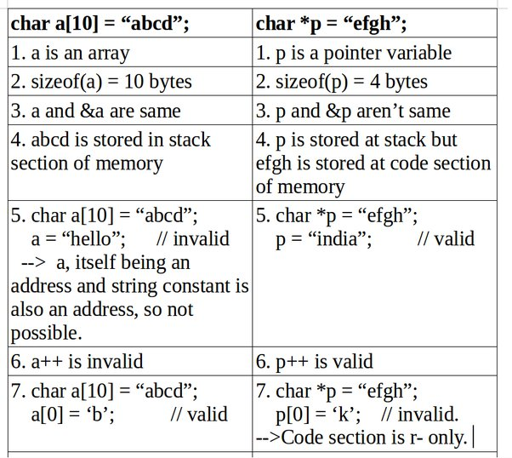
Strings in C
A string in C is just an array of characters (type is char*)
  A proper string always ends with a null terminator ‘\0’
C Library functions assume proper strings (e.g. strlen, strcpy, strcmp)
  very unsafe assumption, errors can occur
Functions that have length as a parameter are safer (still not good though)
  ex) strncpy, strncat, etc.

Slide 52
C Memory Layout

Slide 53
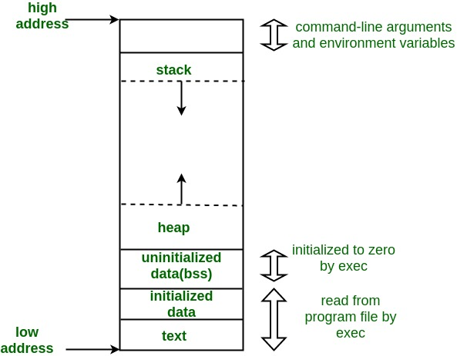
Memory Layout

Slide 54
Memory Layout (explained)
Text: Actual instructions of the Program
Data (+ BSS): Statically allocated data (global and static variables, Strings, constants)
Stack: Local variables for each function call
Heap: Dynamic memory that persists beyond function calls (malloc)

Slide 55
C Memory (Global)
Global variables can be accessed by all functions and exist throughout the duration of a program’s lifetime
Convenient, but dangerous
  no access control, namespace pollution, testing/confinement issues (hard to unit test), concurrency issues, etc.
  bad practice in large-scale software engineering projects

Slide 56
C Memory (Stack)
Stores local arguments and function parameters in a stack frame
When a function is invoked, a stack frame is pushed to the stack
When a function returns, its stack frame is removed from the stack
Do not return a pointer to the stack.
Instead, store and return data on the heap (with malloc/calloc) or make them global if it’s appropriate.

Slide 57
C Memory (Heap)
Memory on the heap is requested with the alloc series of functions
void* malloc (size_t nbytes)
  Return a pointer to n bytes of data
void* calloc (size_t nelems, size_t elemsize)
  Return a pointer to elemsize * nelems bytes of data (recommended for arrays, strings)
  Data is zeroed-out
void* realloc (void* ptr, size_t nbytes)
  Resizes a block of memory that was previously allocated (without losing old data)
  Realloc can return a NEW pointer–be sure to update any references to the old pointer after
Release heap-allocated memory with free (void* ptr)
Helpful Tip: Use malloc(sizeof(<insert type>)) instead of malloc(<number>)
Avoid padding issues!

Slide 58
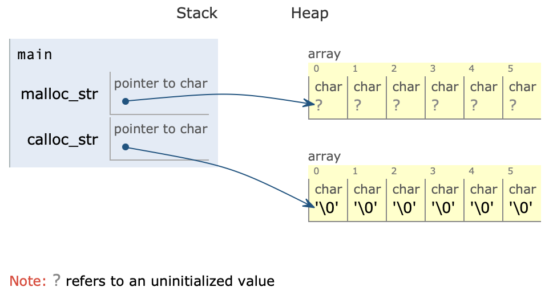
C Memory (Heap) String Example
malloc((5+1)*sizeof(char))
calloc(5+1, sizeof(char))
Note how calloc zeroes out the memory.
The +1 represents the null terminator.

Slide 59
C Memory (Heap)
Heap data is requested with the alloc series of functions
  You saw malloc, calloc, and realloc
void* malloc (size_t nbytes)
  Return a pointer to n bytes of data
void* calloc (size_t elemsize, size_t nelems)
  Return a pointer to elemsize * nelems bytes of data
void* calloc (void *ptr, size_t nbytes)
  Return a pointer to n bytes of data resizing the existing ptr (possibly moving it)
Memory is returned with free (void* ptr)
WARNING: For strings:
calloc “provides” null-terminators (because it zeros out all allocated memory); however, malloc does not provide null-terminators. You will need to set the null terminator appropriately. Good practice to put null terminator manually anyway.
For both malloc and calloc, be sure to request one additional byte for the null-terminator. For malloc, be sure to actually set that byte to the null-terminator.

Slide 60
About Free
Every time you add a malloc/calloc, think about where you will free that data so it happens every time.
  But of course, don’t free memory that will be used in other places :)
We will explicitly check for memory leaks (Unfreed, unused heap allocations) in projects
  Run valgrind!

Slide 61
Let’s take a break!

Slide 62
Review/Examples

Slide 63
C Memory
In the following program we have provided 5 print statements. State which print statements will not always succeed and why. Assume all necessary includes.

Slide 64
C Memory
char global[] = {'h', 'e', 'l', 'l', 'o'}; int main () { printf ("%s\n", f1()); printf ("%s\n", f2()); printf ("%s\n", f3()); printf ("%s\n", f4()); printf ("%s\n", f5()); } | char* f3 () { char hello[] = "hello"; return hello; }
char* f1 () { return "hello"; } | char* f4 () { return malloc (strlen ("hello") + 1); }
char* f2 () { return global; } | char* f5 () { char* arr = calloc(strlen("hello") + 1, sizeof (char)); for (int i = 0; i < 5; i++) { arr[i] = "hello"[i]; } return arr; }

Slide 65
C Memory
char global[] = {'h', 'e', 'l', 'l', 'o'}; int main () { printf ("%s\n", f1()); printf ("%s\n", f2()); printf ("%s\n", f3()); printf ("%s\n", f4()); printf ("%s\n", f5()); } | char* f5 () { char* arr = calloc(strlen("hello") + 1, sizeof (char)); for (int i = 0; i < 5; i++) { arr[i] = "hello"[i]; } return arr; }
char* f1 () { // string literals stored in data segment // (null termination is done by compiler) return "hello"; } | char* f3 () { char hello[] = "hello"; return hello; }
char* f2 () { return global; } | char* f4 () { return malloc (strlen ("hello") + 1); }

Slide 66
C Memory
char global[] = {'h', 'e', 'l', 'l', 'o'}; int main () { printf ("%s\n", f1()); printf ("%s\n", f2()); printf ("%s\n", f3()); printf ("%s\n", f4()); printf ("%s\n", f5()); } | char* f5 () { char* arr = calloc(strlen("hello") + 1, sizeof (char)); for (int i = 0; i < 5; i++) { arr[i] = "hello"[i]; } return arr; }
char* f1 () { // string literals stored in data segment // (null termination is done by compiler) return "hello"; } | char* f3 () { char hello[] = "hello"; return hello; }
char* f2 () { return global; // no null terminator // would work if global had a null terminator } | char* f4 () { return malloc (strlen ("hello") + 1); }

Slide 67
C Memory
char global[] = {'h', 'e', 'l', 'l', 'o'}; int main () { printf ("%s\n", f1()); printf ("%s\n", f2()); printf ("%s\n", f3()); printf ("%s\n", f4()); printf ("%s\n", f5()); } | char* f5 () { char* arr = calloc(strlen("hello") + 1, sizeof (char)); for (int i = 0; i < 5; i++) { arr[i] = "hello"[i]; } return arr; }
char* f1 () { // string literals stored in data segment // (null termination is done by compiler) return "hello"; } | char* f3 () { char hello[] = "hello"; return hello; // cannot return stack array }
char* f2 () { return global; // no null terminator // would work if global had a null terminator } | char* f4 () { return malloc (strlen ("hello") + 1); }

Slide 68
C Memory
char global[] = {'h', 'e', 'l', 'l', 'o'}; int main () { printf ("%s\n", f1()); printf ("%s\n", f2()); printf ("%s\n", f3()); printf ("%s\n", f4()); printf ("%s\n", f5()); } | char* f5 () { char* arr = calloc(strlen("hello") + 1, sizeof (char)); for (int i = 0; i < 5; i++) { arr[i] = "hello"[i]; } return arr; }
char* f1 () { // string literals stored in data segment // (null termination is done by compiler) return "hello"; } | char* f3 () { char hello[] = "hello"; return hello; // cannot return stack array }
char* f2 () { return global; // no null terminator // would work if global had a null terminator } | char* f4 () { return malloc (strlen ("hello") + 1); // no null terminator }

Slide 69
C Memory
char global[] = {'h', 'e', 'l', 'l', 'o'}; int main () { printf ("%s\n", f1()); printf ("%s\n", f2()); printf ("%s\n", f3()); printf ("%s\n", f4()); printf ("%s\n", f5()); } | char* f5 () { char* arr = calloc(strlen("hello") + 1, sizeof (char)); for (int i = 0; i < 5; i++) { arr[i] = "hello"[i]; } return arr; // calloc adds null terminator }
char* f1 () { // string literals stored in data segment // (null termination is done by compiler) return "hello"; } | char* f3 () { char hello[] = "hello"; return hello; // cannot return stack array }
char* f2 () { return global; // no null terminator // would work if global had a null terminator } | char* f4 () { return malloc (strlen ("hello") + 1); // no null terminator }

Slide 70
libc
string manipulation, file i/o

Slide 71
Useful Functions to Know
strlen - returns the length of a string (not including the null terminator)
strcpy - copies the characters from src string to dest string
strcmp - compares two strings lexicographically; returns an integer
fprintf - print formatted strings to a specified file
fopen - opens a FILE*
fclose - close a FILE*
fread - read contents from a FILE*
fwrite - write contents to a FILE*

Slide 72
File I/O Example
(void* ptr, size_t size, size_t nmemb, FILE* stream)
int write_char(char* filename, char c) {
FILE* file = fopen(filename, "w");
if (file == NULL) return 0;
if (fwrite(&char, 1, 1, file) != 1) {
fclose(file);
return 0;
}
fclose(file);
return 1;
}

Slide 73
strcpy Implementation
char* strcpy(char* dest, const char* src) {
if (dest == NULL) {
return NULL;
}
while (*src != '\0') {
*dest = *src;
dest++;
src++;
}
return dest;
}
strcpy() copies the string pointed to by src into the buffer pointed to by dest, and returns the pointer to dest.
What’s the issue with this solution?

Slide 74
strcpy Implementation
char* strcpy(char* dest, const char* src) {
if (dest == NULL) {
return NULL;
}
char* ptr = dest;
while (*src != '\0') {
*dest = *src;
dest++;
src++;
}
*dest = '\0';
return ptr;
}
strcpy() copies the string pointed to by src into the buffer pointed to by dest, and returns the pointer to dest.

Slide 75
strlen Implementation
long int strlen_staff(const char* src) {
/* INSERT CODE HERE */
}
strlen() returns how many characters are in the string pointed to by *src.

Slide 76
strlen Implementation (sol'n)
long int strlen_staff(const char* src) {
long int count = 0;
while(*src != '\0') {
count++;
src += 1;
}
return count;
}
strlen() returns how many characters are in the string pointed to by *src.

Slide 77
fprintf formatting
Prints a formatted string to the specified FILE*
For each conversion specification (%[char]), provide an argument to be printed
  fprintf(file1, “Line %d: %s”, 1, “Segmentation Fault”)
Some common specifications: %d [decimal], %u [unsigned decimal], %c [character], %s [string], %f [double], %p [address]
printf(...) = fprintf(stdout, ...)

Slide 78
Swap
void swap(int *a, int *b) {
int* temp;
temp = a;
a = b;
b = temp;
}
int main () {
int a = 1;
int b = 2;
swap(&a, &b);
printf("%d %d\n", a, b);
}
What does the following print?
Notes:
Should be unswitched

Slide 79
Swap
void swap(int *a, int *b) {
int* temp;
temp = a;
a = b;
b = temp;
}
int main () {
int a = 1;
int b = 2;
swap(&a, &b);
printf("%d %d\n", a, b);
}
What does the following print?
1 2
While we are swapping the pointers, these changes are only applicable inside the swap function. To persist them to main, we can swap the values instead.
int temp;
temp = *a;
*a = *b;
*b = temp;
Notes:
Should be unswitched

Slide 80
Strings
char* create_reversed_string(char* str) {
int length = _________;
char* new_str = malloc(____);
for (int i = ____; i < ____; ____) {
new_str[i] = str[____];
}
________;
return new_str;
}
Fill in the blanks to create a reversed string.
Do not reverse the string in-place, use malloc to create a new string instead.

Slide 81
Strings
char* create_reversed_string(char* str) {
int length = strlen(str);
char* new_str = malloc(length+1);
for (int i = 0; i < length; i++) {
new_str[i] = str[length-i-1];
}
new_str[length] = '\0';
return new_str;
}
Important Notes
Allocate space for null-terminator
Set null-terminator after reversing string
Followup: Do we need to set the null terminator if we use calloc?

Slide 82
Git
Everyone’s Favorite Version Control

Slide 83
git checkout
I want to go back (temporarily) to a previous commit!
  Git checkout <commit hash> or HEAD
You can also checkout to remotes
  Git checkout staff main
    Checkout staff skeleton codes!

Slide 84
git reset
What if I mess up? Git reset to the rescue!
Go back to a specific commit and preserve changes as unstaged edits
  $ git reset <commit>
Different from git checkout
  Git checkout: Go back to the commit but keep the entire history intact
  Git reset: unstage the edits and remove the commits before
Please do not use –hard with git reset, if possible!

Slide 85
git log
Sometimes we need to look at the project's history
The commit history, or git log, shows us all of the commits that preceded the most recent commit
To view it, use the git log command (depending on your terminal, you may need to press "q" to return to the command line)
To show an abbreviated version, add the --oneline option:
  git log --oneline
Notice our new commit appearing in the log!

Slide 86
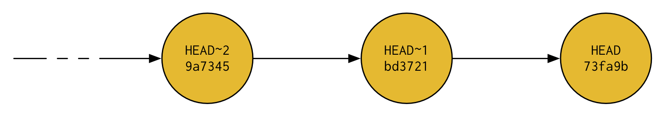
git diff <commit1> <commit2>
We've used the log to confirm that a new commit was made, but how do we know that the new commit contains the changes that we want?
Use the git diff <commit1> <commit2> command! ("diff" = difference)
It shows us the difference between the two provided commits
Usually, we are comparing the latest commit to some other commit
  The latest commit is always called HEAD
  The commit immediately prior to HEAD is HEAD~1
  The commit immediately prior to HEAD~1 is HEAD~2 (two commits before HEAD)
To compare the latest commit and the one prior to that:
  git diff HEAD~1 HEAD

Slide 87
A Few Pieces of Advice
Make sure to git pull before working on any files
Let people know what and what files you are working on to avoid merge conflicts
  Make new branches for portions of your project
  Pair programming and VSCode Liveshare!
  If encountered merge conflicts, resolve them carefully
Be careful when working off of previous commits (ie. git checkout)
  Can result in diverges in history and messy git stuff

Slide 88
More Advice
Use 'git checkout staff/main -- file_name' to replace your version with the staff version.
  Particularly useful when you accidentally modify a test file in projects!
Avoid using 'git push -f'

