Slide 1
CS162
Operating Systems and
Systems Programming
Lecture 3
Abstractions 1: Threads and Processes
A quick, programmer’s viewpoint
January 23rd, 2024
Prof. John Kubiatowicz
http://cs162.eecs.Berkeley.edu

Slide 2
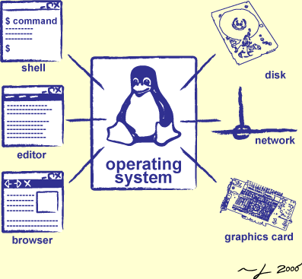
Goals for Today: The Thread Abstraction
What threads are
  And what they are not
Why threads are useful (motivation)
How to write a program using threads
Alternatives to using threads

Slide 3
Recall: Four Fundamental OS Concepts
Thread: Execution Context
  Fully describes program state
  Program Counter, Registers, Execution Flags, Stack
Address space (with or w/o translation)
  Set of memory addresses accessible to program (for read or write)
  May be distinct from memory space of the physical machine
  (in which case programs operate in a virtual address space)
Process: an instance of a running program
  Protected Address Space + One or more Threads
Dual mode operation / Protection
  Only the “system” has the ability to access certain resources
  Combined with translation, isolates programs from each other and the OS from programs

Slide 4
Recall: Illusion of Multiple Processors
Programmer’s View:
Threads are virtual cores
Multiple threads: Multiplex hardware in time
A Thread is executing on a processor when it is resident in that processor’s registers
Each virtual core (thread) has:
  Program counter (PC), stack pointer (SP)
  Registers – both integer and floating point
Where is “it” (the thread)?
  On the real (physical) core, or
  Saved in chunk of memory – called the Thread Control Block (TCB)
vCPU1
vCPU2
vCPU3
Shared Memory
On a single physical CPU
vCPU1
vCPU2
vCPU3
vCPU1
vCPU2
Time

Slide 5
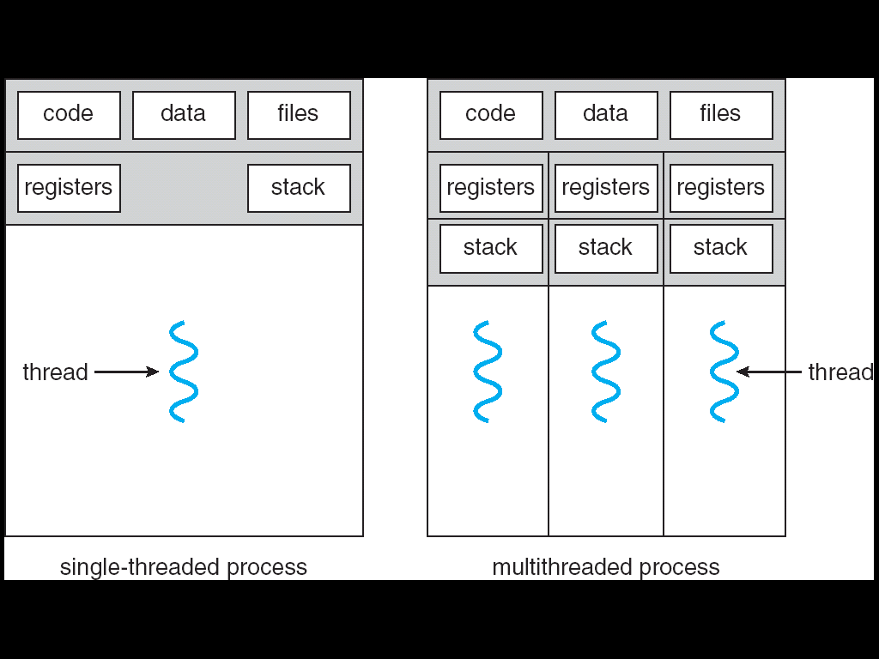
Recall: Process
Definition: execution environment with Restricted Rights
  One or more threads in a (protected) Address Space
  Owns memory (address space), file descriptors, network connections, …
Instance of a running program
  When you run an executable, it runs in its own process
  Application: one or more processes working together
Why processes?
  Protected from each other!
  OS Protected from them
In modern OS, anything that runs outside of the kernel runs in a process
Multi-Threaded Process

Slide 6
Recall: Simple address translation with Base and Bound
0000…
code
0000…
code
Static Data
heap
Addresses translated
on-the-fly
Static Data
heap
stack
0100…
stack
Base Address
1000…
code
1000…
0010…
Program
address
0010…
Static Data
1010…
heap
Bound
<
stack
1100…
0100…
Can the program touch OS?
Can it touch other programs?
FFFF…

Slide 7
Simple B&B: User => Kernel
0000…
Proc 1
Proc 2
Proc n
code
…
Static Data
OS
heap
stack
sysmode
0
1000…
code
Base
1000 …
0000…
Static Data
Bound
0100…
FFFF…
heap
uPC
xxxx…
stack
1100…
PC
0000 1234
code
3000…
regs
00FF…
Static Data
How to return to system?
…
heap
stack
3080…
FFFF…

Slide 8
Simple B&B: Interrupt
0000…
Proc 1
Proc 2
Proc n
code
…
Static Data
OS
heap
stack
sysmode
1
1000…
code
Base
1000 …
0000…
Static Data
Bound
0100 …
FFFF…
heap
uPC
0000 1234
stack
1100…
PC
IntrpVector[i]
code
3000…
regs
00FF…
Static Data
How to save registers and set up system stack?
…
heap
stack
3080…
FFFF…

Slide 9
Simple B&B: Switch User Process
0000…
Proc 1
Proc 2
Proc n
code
RTU
…
Static Data
OS
heap
stack
sysmode
1
1000…
1000 …
code
Base
3000 …
0000…
Static Data
0100 …
Bound
0080 …
FFFF…
heap
0000 1234
uPC
0000 0248
regs
stack
1100…
PC
0001 0124
00FF…
code
3000…
regs
00D0…
Static Data
How to save registers and set up system stack?
…
heap
stack
3080…
FFFF…

Slide 10
Simple B&B: “resume”
0000…
Proc 1
Proc 2
Proc n
code
RTU
…
Static Data
OS
heap
stack
sysmode
0
1000…
1000 …
code
Base
3000 …
0000…
Static Data
0100 …
Bound
0080 …
FFFF…
heap
0000 1234
uPC
xxxx xxxx
regs
stack
1100…
PC
000 0248
00FF…
code
3000…
regs
00D0…
Static Data
How to save registers and set up system stack?
…
heap
stack
3080…
FFFF…

Slide 11
Is Simple Base and Bound Enough for General Systems?
NO: Too simplistic for real systems
Inflexible/Wasteful:
  Must dedicate physical memory for potential future use
  (Think stack and heap!)
Fragmentation:
  Kernel has to somehow fit whole processes into contiguous block of memory
  After a while, memory becomes fragmented!
Sharing:
  Very hard to share any data between Processes or between Process and Kernel
  Need to communicate indirectly through the kernel…

Slide 12
Better: Translation through Page Table (More soon!)
Code
Data
Heap
Stack
Data 2
Code
Data
Heap
Stack
Stack 1
Heap 1
Code 1
Stack 2
Prog 1
Virtual
Address
Space 1
Prog 2
Virtual
Address
Space 2
Data 1
Heap 2
Code 2
OS code
Translation Map 1
OS data
Translation Map 2
OS heap &
Stacks
Physical Address Space

Slide 13
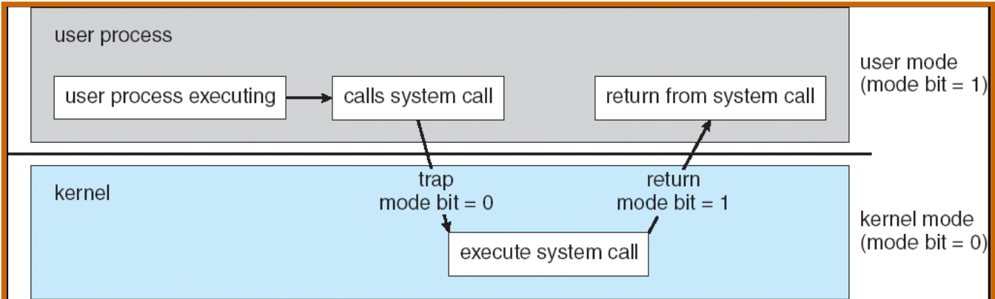
Recall: Dual Mode Operation
Processes (i.e., programs you run) execute in user mode
  To perform privileged actions, processes request services from the OS kernel
  Carefully controlled transition from user to kernel mode
Kernel executes in kernel mode
  Performs privileged actions to support running processes
  … and configures hardware to properly protect them (e.g., address translation)
Carefully controlled transitions between user mode and kernel mode
  System calls, interrupts, exceptions

Slide 14
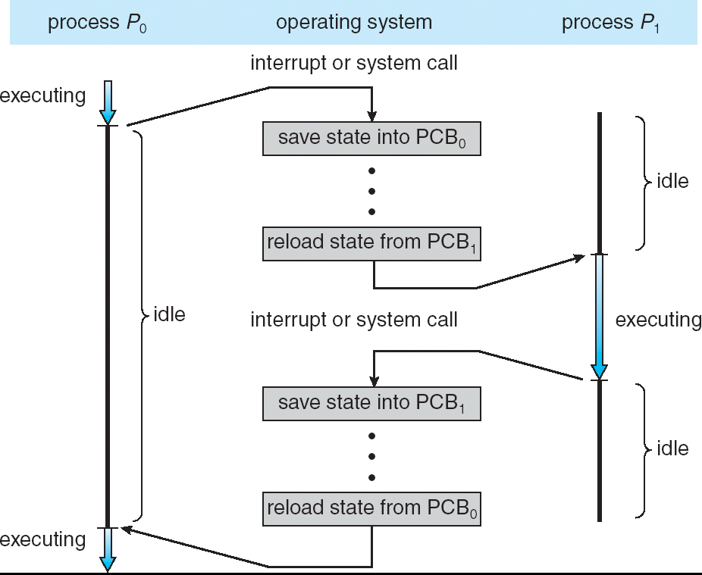
Adding Protection: CPU Switch From Process A to Process B
User Mode
Kernel/System Mode
User Mode

Slide 15
Running Many Programs
We have the basic mechanism to:
  switch between user processes and the kernel,
  the kernel can switch among user processes,
  Protect OS from user processes and processes from each other
Questions:
  How do we represent user processes in the OS?
  How do we decide which user process to run?
  How do we pack up the process and set it aside?
  How do we get a stack and heap for the kernel?
  Aren’t we wasting are lot of memory?

Slide 16
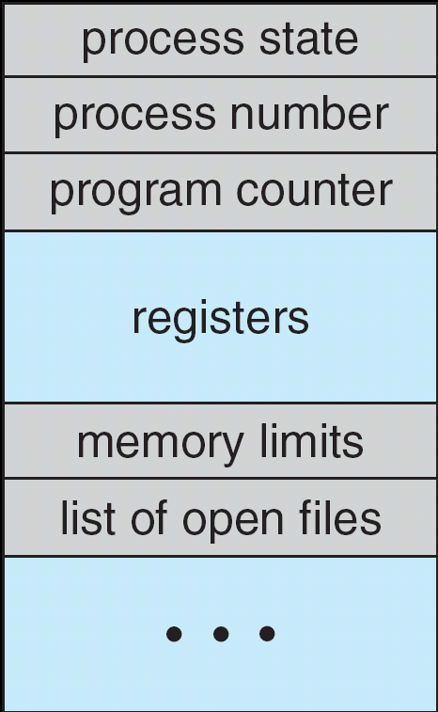
Multiplexing Processes: The Process Control Block
Kernel represents each process with a process control block (PCB)
  Status (running, ready, blocked, …)
  Register state (when not ready)
  Process ID (PID), User, Executable, Priority, …
  Execution time, …
  Memory space, translation, …
Kernel Scheduler maintains a data structure containing the PCBs
  Give out CPU to different processes
  This is a Policy Decision
Give out non-CPU resources
  Memory/IO
  Another policy decision
Process
Control
Block

Slide 17
Scheduler
if ( readyProcesses(PCBs) ) {
nextPCB = selectProcess(PCBs);
run( nextPCB );
} else {
run_idle_process();
}
Scheduling: Mechanism for deciding which processes/threads receive hardware CPU time, when, and for how long
Lots of different scheduling policies provide …
  Fairness or
  Realtime guarantees or
  Latency optimization or ..

Slide 18
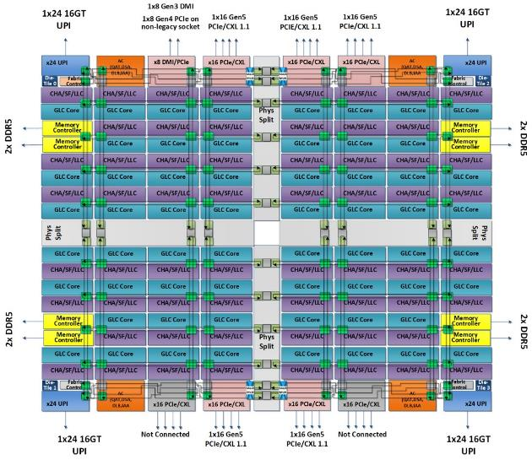
Also Recall: The World Is Parallel: Saphire Rapids (2023)
Up to 60 cores, 120 threads/package (socket)
  Up to 4 “chiplets” bonded together
Network:
  On-chip Mesh Interconnect
  Fast off-chip network (UPI):
  directly connects 8-chips
  480 cores/shared memory domain!
Each Core Has:
  80 KB L1 Cache
  2 MB L2 Cache
  Fraction of up to 112.5 MB L3 Cache
DRAM/chips
  Up to 4 TiB of DDR5 memory
Many Accellerators of different types
  Graphics, Encryption, AI, Security
Saphire Rapids 4-chiplet single package

Slide 19
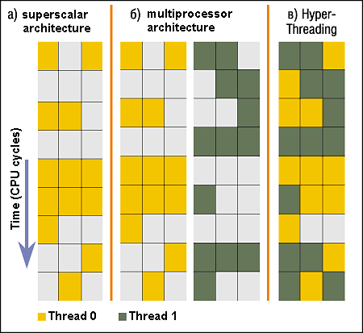
Simultaneous MultiThreading/Hyperthreading
Hardware scheduling technique
  Avoids software overhead of multiplexing
  Superscalar processors can execute
  multiple instructions that are independent.
  Hyperthreading duplicates register state
  to make a second “thread,” allowing
  more instructions to run.
Can schedule each thread as if were
separate CPU
  But, sub-linear speedup!
Original technique called “Simultaneous Multithreading”
  http://www.cs.washington.edu/research/smt/index.html
  SPARC, Pentium 4/Xeon (“Hyperthreading”), Power 5
Colored blocks show instructions executed
Notes:
Intel seems to be discarding SMT in Silvermont because of power problems

Slide 20
Administrivia: Getting started!
Kubiatowicz Office Hours:
  Tuesday/Thursday 3-4pm, in 673 Soda Hall
Homework 0: Due Tomorrow!
  Get familiar with the cs162 tools
  configure your VM, submit via git
  Practice finding out information:
    How to use GDB? How to understand output of unix tools?
    We don’t assume that you already know everything!
    Learn to use “man” (command line), “help” (in gdb, etc), google
Project 0: Started Yesterday!
  Learn about Pintos and how to modify and debug kernel
  Important for getting started on projects!
Should be going to sections now – Important information there
  Any section will do until groups assigned

Slide 21
Administrivia (Con’t)
THIS Friday is Drop Deadline! HARD TO DROP LATER!
  If you know you are going to drop, do so now to leave room for others on waitlist!
  Why do we do this? So that groups aren’t left without members!
Group sign up via autograder form next week
  Get finding groups of 4 people ASAP
  Priority for same section; if cannot make this work, keep same TA
  Remember: Your TA needs to see you in section!
Midterm 1: 2/15
  8-10PM in person
  We will say more about material when we get closer…
Midterm 1 conflicts
  We will handle these conflicts after have final class roster
  Watch for queries by HeadTA to collect information

Slide 22


CS 162 Collaboration Policy
Explaining a concept to someone in another group
Discussing algorithms/testing strategies with other groups
Discussing debugging approaches with other groups
Searching online for generic algorithms (e.g., hash table)
Sharing code or test cases with another group or individual (including HW!)
Copying OR reading another group’s code or test cases
Copying OR reading online code or test cases from prior years
Helping someone in another group to debug their code
We compare all project and HW submissions against prior year submissions and online solutions and will take actions (described on the course overview page) against offenders
Don’t put a friend in a bad position by asking for help that they shouldn’t give!

Slide 23
More About Threads: What are they?
Definition from before: A single unique execution context
  Describes its representation
It provides the abstraction of: A single execution sequence that represents a separately schedulable task
  Also a valid definition!
Threads are a mechanism for concurrency (overlapping execution)
  However, they can also run in parallel (simultaneous execution)
Protection is an orthogonal concept
  A protection domain can contain one thread or many

Slide 24
Motivation for Threads
Operating systems must handle multiple things at once (MTAO)
  Processes, interrupts, background system maintenance
Networked servers must handle MTAO
  Multiple connections handled simultaneously
Parallel programs must handle MTAO
  To achieve better performance
Programs with user interface often must handle MTAO
  To achieve user responsiveness while doing computation
Network and disk bound programs must handle MTAO
  To hide network/disk latency
  Sequence steps in access or communicatoin
I made this term up!

Slide 25
Threads Allow Handling MTAO
Threads are a unit of concurrency provided by the OS
Each thread can represent one thing or one task

Slide 26
Multiprocessing vs. Multiprogramming
Some Definitions:
  Multiprocessing: Multiple CPUs(cores)
  Multiprogramming: Multiple jobs/processes
  Multithreading: Multiple threads/processes
What does it mean to run two threads concurrently?
  Scheduler is free to run threads in any order and interleaving
  Thread may run to completion or time-slice in big chunks or small chunks
A
Multiprocessing
B
C
A
B
C
Multiprogramming
A
B
C
A
B
C
B

Slide 27
Concurrency is not Parallelism
Concurrency is about handling multiple things at once (MTAO)
Parallelism is about doing multiple things simultaneously
Example: Two threads on a single-core system...
  … execute concurrently …
  … but not in parallel
Each thread handles or manages a separate thing or task…
But those tasks are not necessarily executing simultaneously!

Slide 28
Silly Example for Threads
Imagine the following program:
  main() {
  ComputePI(“pi.txt”);
  PrintClassList(“classlist.txt”);
  }
What is the behavior here?
Program would never print out class list
Why? ComputePI would never finish

Slide 29
Adding Threads
Version of program with threads (loose syntax):
  main() {
  create_thread(ComputePI, “pi.txt”);
  create_thread(PrintClassList, “classlist.txt”);
  }
create_thread: Spawns a new thread running the given procedure
  Should behave as if another CPU is running the given procedure
Now, you would actually see the
class list
CPU1
CPU2
CPU1
CPU2
CPU1
CPU2
Time

Slide 30
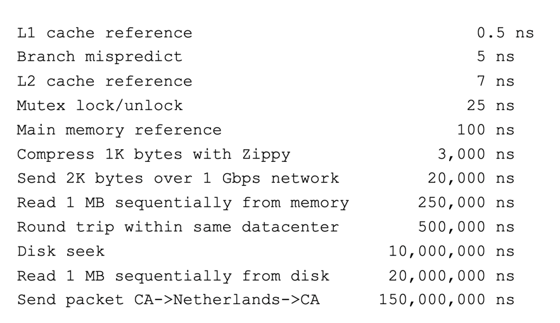
More Practical Motivation: Compute/IO overlap
Back to Jeff Dean’s “Numbers Everyone Should Know”
Handle I/O in separate thread, avoid blocking other progress

Slide 31
Threads Mask I/O Latency
A thread is in one of the following three states:
  RUNNING – running
  READY – eligible to run, but not currently running
  BLOCKED – ineligible to run
If a thread is waiting for an I/O to finish, the OS marks it as BLOCKED
Once the I/O finally finishes, the OS marks it as READY
vCPU1
vCPU2
vCPU1
vCPU2
vCPU1
vCPU2
Time

Slide 32
Threads Mask I/O Latency
If no thread performs I/O:
If thread 1 performs a blocking I/O operation:
vCPU1
vCPU2
vCPU1
vCPU2
vCPU1
vCPU2
Time
vCPU1 starts I/O operation
I/O operation completes
vCPU1
vCPU2
vCPU1
vCPU2
Time

Slide 33
A Better Example for Threads
Version of program with threads (loose syntax):
  main() {
  create_thread(ReadLargeFile, “pi.txt”);
  create_thread(RenderUserInterface);
  }
What is the behavior here?
  Still respond to user input
  While reading file in the background

Slide 34
Multithreaded Programs
You know how to compile a C program and run the executable
  This creates a process that is executing that program
Initially, this new process has one thread in its own address space
  With code, globals, etc. as specified in the executable
Q: How can we make a multithreaded process?
A: Once the process starts, it issues system calls to create new threads
  These new threads are part of the process: they share its address space

Slide 35
System Calls (“Syscalls”)
Word Processing
Compilers
Web Browsers
“But, I’ve never seen a syscall!”
OS library issues system call
Language runtime uses OS library…
Email
Databases
Web Servers
Application / Service
Portable OS Library
OS
User
System Call
Interface
System
Portable OS Kernel
Software
Platform support, Device Drivers
Hardware
x86
PowerPC
ARM
PCI
Ethernet (1Gbs/10Gbs)
802.11 a/g/n/ac
SCSI
Graphics
Thunderbolt

Slide 36
OS Library Issues Syscalls
Proc 1
Proc 2
Proc n
…
OS
Appln
login
Window Manager
…
libc
OS library
OS library
OS library
OS

Slide 37
OS Library API for Threads: pthreads
Here: the “p” is for “POSIX” which is a part of a standardized API
int pthread_create(pthread_t *thread, const pthread_attr_t *attr,
void *(*start_routine)(void*), void *arg);
  thread is created executing start_routine with arg as its sole argument.
  return is implicit call to pthread_exit
void pthread_exit(void *value_ptr);
  terminates the thread and makes value_ptr available to any successful join
int pthread_join(pthread_t thread, void **value_ptr);
  suspends execution of the calling thread until the target thread terminates.
  On return with a non-NULL value_ptr the value passed to pthread_exit() by the terminating thread is made available in the location referenced by value_ptr.
prompt% man pthread
https://pubs.opengroup.org/onlinepubs/7908799/xsh/pthread.h.html

Slide 38
Peeking Ahead: System Call Example
What happens when pthread_create(…) is called in a process?
Library:
int pthread_create(…) {
Do some work like a normal fn…
asm code … syscall # into %eax
put args into registers %ebx, …
special trap instruction
Kernel:
get args from regs
dispatch to system func
Do the work to spawn the new thread
Store return value in %eax
get return values from regs
Do some more work like a normal fn…
};

Slide 39
New Idea: Fork-Join Pattern
create
exit
join
Main thread creates (forks) collection of sub-threads passing them args to work on…
… and then joins with them, collecting results.

Slide 40
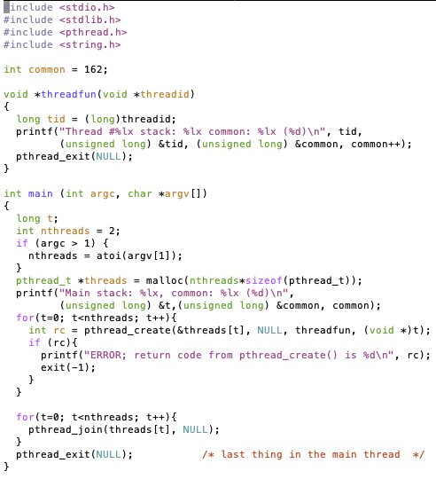

pThreads Example
How many threads are in this program?
What function does each thread run?
One possible result:
Does the main thread join with the threads in the same order that they were created?
  Yes: Loop calls Join in thread order
Do the threads exit in the same order they were created?
  No: Depends on scheduling order!
Would the result change if run again?
  Yes: Depends on scheduling order!
Is this code safe/correct???
  No – threads share are variable that is used without locking and there is a race condition!

Slide 41
Thread State
State shared by all threads in process/address space
  Content of memory (global variables, heap)
  I/O state (file descriptors, network connections, etc)
State “private” to each thread
  Kept in TCB ≡ Thread Control Block
  CPU registers (including, program counter)
  Execution stack – what is this?
Execution Stack
  Parameters, temporary variables
  Return PCs are kept while called procedures are executing

Slide 42
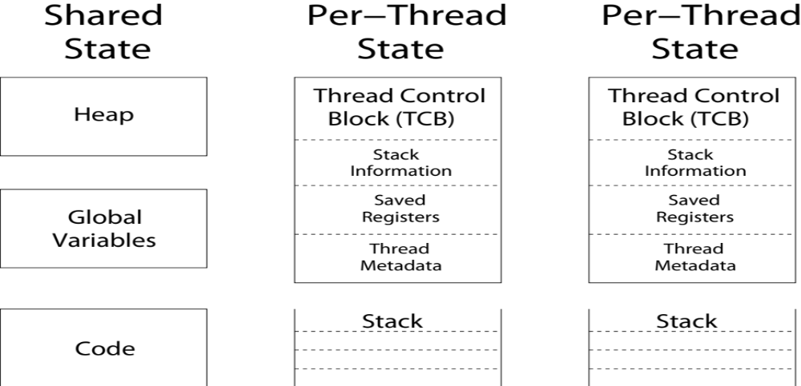
Shared vs. Per-Thread State

Slide 43
Execution Stack Example
A(int tmp) {
if (tmp<2)
B();
printf(tmp);
}
B() {
C();
}
C() {
A(2);
}
A(1);
A:
A+1:
A+2:
B:
B+1:
C:
C+1:
exit:
Stack holds temporary results
Permits recursive execution
Crucial to modern languages

Slide 44
Execution Stack Example
A: tmp=1
ret=exit
A(int tmp) {
if (tmp<2)
B();
printf(tmp);
}
B() {
C();
}
C() {
A(2);
}
A(1);
Stack
Pointer
A:
A+1:
A+2:
B:
B+1:
C:
C+1:
exit:
Stack holds temporary results
Permits recursive execution
Crucial to modern languages

Slide 45
Execution Stack Example
A: tmp=1
ret=exit
A(int tmp) {
if (tmp<2)
B();
printf(tmp);
}
B() {
C();
}
C() {
A(2);
}
A(1);
Stack
Pointer
A:
A+1:
A+2:
B:
B+1:
C:
C+1:
exit:
Stack holds temporary results
Permits recursive execution
Crucial to modern languages

Slide 46
Execution Stack Example
A: tmp=1
ret=exit
A(int tmp) {
if (tmp<2)
B();
printf(tmp);
}
B() {
C();
}
C() {
A(2);
}
A(1);
Stack
Pointer
A:
A+1:
A+2:
B:
B+1:
C:
C+1:
exit:
Stack holds temporary results
Permits recursive execution
Crucial to modern languages

Slide 47
Execution Stack Example
A: tmp=1
ret=exit
A(int tmp) {
if (tmp<2)
B();
printf(tmp);
}
B() {
C();
}
C() {
A(2);
}
A(1);
A:
A+1:
A+2:
B:
B+1:
C:
C+1:
exit:
B: ret=A+2
Stack
Pointer
Stack holds temporary results
Permits recursive execution
Crucial to modern languages

Slide 48
Execution Stack Example
A: tmp=1
ret=exit
A(int tmp) {
if (tmp<2)
B();
printf(tmp);
}
B() {
C();
}
C() {
A(2);
}
A(1);
A:
A+1:
A+2:
B:
B+1:
C:
C+1:
exit:
B: ret=A+2
Stack
Pointer
Stack holds temporary results
Permits recursive execution
Crucial to modern languages

Slide 49
Execution Stack Example
A: tmp=1
ret=exit
A(int tmp) {
if (tmp<2)
B();
printf(tmp);
}
B() {
C();
}
C() {
A(2);
}
A(1);
A:
A+1:
A+2:
B:
B+1:
C:
C+1:
exit:
B: ret=A+2
C: ret=B+1
Stack
Pointer
Stack holds temporary results
Permits recursive execution
Crucial to modern languages

Slide 50
Execution Stack Example
A: tmp=1
ret=exit
A(int tmp) {
if (tmp<2)
B();
printf(tmp);
}
B() {
C();
}
C() {
A(2);
}
A(1);
A:
A+1:
A+2:
B:
B+1:
C:
C+1:
exit:
B: ret=A+2
C: ret=B+1
A: tmp=2
ret=C+1
Stack
Pointer
Stack Growth
Stack holds temporary results
Permits recursive execution
Crucial to modern languages

Slide 51
Execution Stack Example
A: tmp=1
ret=exit
A(int tmp) {
if (tmp<2)
B();
printf(tmp);
}
B() {
C();
}
C() {
A(2);
}
A(1);
A:
A+1:
A+2:
B:
B+1:
C:
C+1:
exit:
B: ret=A+2
C: ret=B+1
A: tmp=2
ret=C+1
Stack
Pointer
Stack Growth
Output:
>2
Stack holds temporary results
Permits recursive execution
Crucial to modern languages

Slide 52
Execution Stack Example
A: tmp=1
ret=exit
A(int tmp) {
if (tmp<2)
B();
printf(tmp);
}
B() {
C();
}
C() {
A(2);
}
A(1);
A:
A+1:
A+2:
B:
B+1:
C:
C+1:
exit:
B: ret=A+2
C: ret=B+1
A: tmp=2
ret=C+1
Stack
Pointer
Stack Growth
Output:
>2
Stack holds temporary results
Permits recursive execution
Crucial to modern languages

Slide 53
Execution Stack Example
A: tmp=1
ret=exit
A(int tmp) {
if (tmp<2)
B();
printf(tmp);
}
B() {
C();
}
C() {
A(2);
}
A(1);
A:
A+1:
A+2:
B:
B+1:
C:
C+1:
exit:
B: ret=A+2
C: ret=B+1
Stack
Pointer
Output:
>2
Stack holds temporary results
Permits recursive execution
Crucial to modern languages

Slide 54
Execution Stack Example
A: tmp=1
ret=exit
A(int tmp) {
if (tmp<2)
B();
printf(tmp);
}
B() {
C();
}
C() {
A(2);
}
A(1);
A:
A+1:
A+2:
B:
B+1:
C:
C+1:
exit:
B: ret=A+2
Stack
Pointer
Output:
>2
Stack holds temporary results
Permits recursive execution
Crucial to modern languages

Slide 55
Execution Stack Example
A: tmp=1
ret=exit
A(int tmp) {
if (tmp<2)
B();
printf(tmp);
}
B() {
C();
}
C() {
A(2);
}
A(1);
Stack
Pointer
A:
A+1:
A+2:
B:
B+1:
C:
C+1:
exit:
Output:
>2 1
Stack holds temporary results
Permits recursive execution
Crucial to modern languages

Slide 56
Execution Stack Example
A: tmp=1
ret=exit
A(int tmp) {
if (tmp<2)
B();
printf(tmp);
}
B() {
C();
}
C() {
A(2);
}
A(1);
Stack
Pointer
A:
A+1:
A+2:
B:
B+1:
C:
C+1:
exit:
Output:
>2 1
Stack holds temporary results
Permits recursive execution
Crucial to modern languages

Slide 57
Execution Stack Example
A(int tmp) {
if (tmp<2)
B();
printf(tmp);
}
B() {
C();
}
C() {
A(2);
}
A(1);
Output:
>2 1
Stack holds temporary results
Permits recursive execution
Crucial to modern languages

Slide 58
Execution Stack Example
A: tmp=1
ret=exit
A(int tmp) {
if (tmp<2)
B();
printf(tmp);
}
B() {
C();
}
C() {
A(2);
}
A(1);
Stack
Pointer
B: ret=A+2
C: ret=b+1
A: tmp=2
ret=C+1
Stack Growth
Stack holds temporary results
Permits recursive execution
Crucial to modern languages

Slide 59
Memory Layout with Two Threads
0xFFF…
Two sets of CPU registers
Two sets of Stacks
Issues:
  How do we position stacks relative to
  each other?
  What maximum size should we choose
  for the stacks?
  What happens if threads violate this?
  How might you catch violations?
Stack 1
Stack 2
Address Space
Heap
Global Data
Code
0x000…

Slide 60
INTERLEAVING AND NONDETERMINISM
(The beginning of a long discussion!)

Slide 61
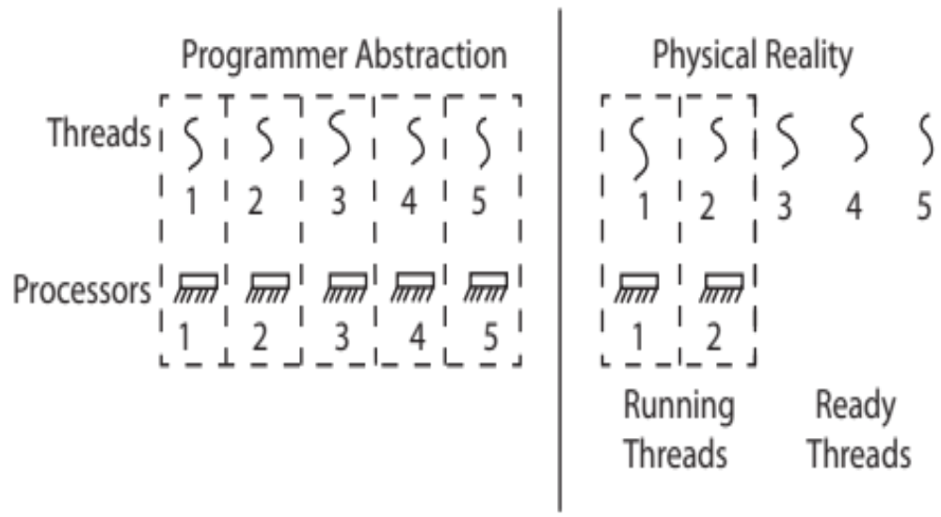
Thread Abstraction
Illusion: Infinite number of processors
Reality: Threads execute with variable “speed”
  Programs must be designed to work with any schedule

Slide 62
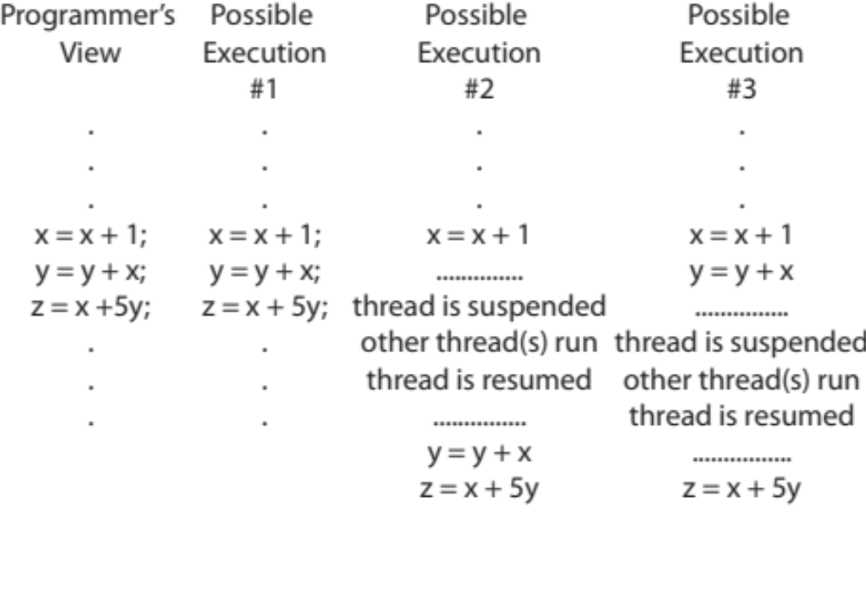
Programmer vs. Processor View

Slide 63
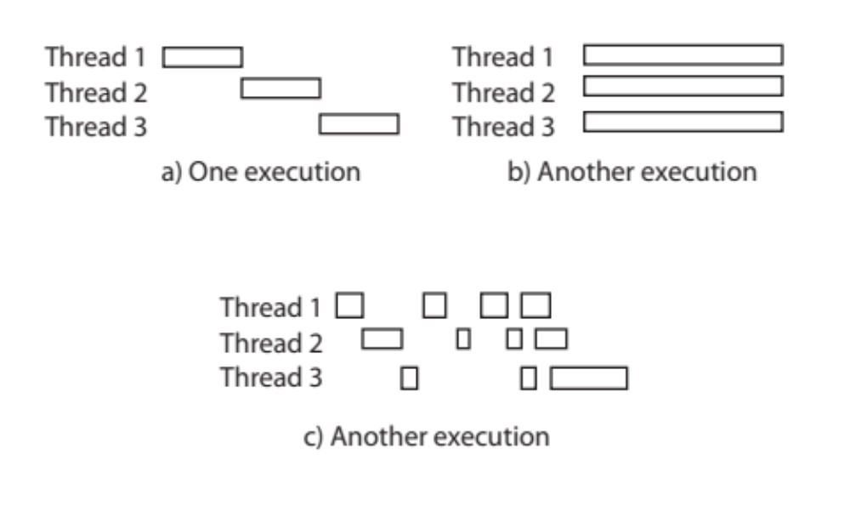
Possible Executions

Slide 64
Correctness with Concurrent Threads
Non-determinism:
  Scheduler can run threads in any order
  Scheduler can switch threads at any time
  This can make testing very difficult
Independent Threads
  No state shared with other threads
  Deterministic, reproducible conditions
Cooperating Threads
  Shared state between multiple threads
Goal: Correctness by Design

Slide 65
Race Conditions: Example 1
Initially x == 0 and y == 0
What are the possible values of x below after all threads finish?
Must be 1. Thread B does not interfere
Thread A
x = 1;
Thread B
y = 2;

Slide 66
Race Conditions: Example 2
Initially x == 0 and y == 0
What are the possible values of x below?
1 or 3 or 5 (non-deterministically)
Race Condition: Thread A races against Thread B!
Thread A
x = y + 1;
Thread B
y = 2;
y = y * 2;

Slide 67
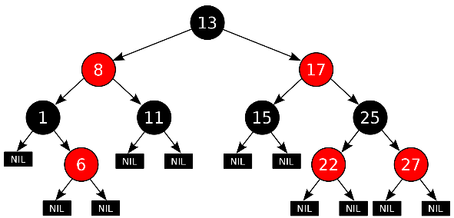
Example: Shared Data Structure
Thread A
Insert(3)
Thread B
Insert(4)
Get(6)
Tree-Based Set Data Structure

Slide 68
Relevant Definitions
Synchronization: Coordination among threads, usually regarding shared data
Mutual Exclusion: Ensuring only one thread does a particular thing at a time (one thread excludes the others)
  Type of synchronization
Critical Section: Code exactly one thread can execute at once
  Result of mutual exclusion
Lock: An object only one thread can hold at a time
  Provides mutual exclusion

Slide 69
Locks
Locks provide two atomic operations:
  Lock.acquire() – wait until lock is free; then mark it as busy
    After this returns, we say the calling thread holds the lock
  Lock.release() – mark lock as free
    Should only be called by a thread that currently holds the lock
    After this returns, the calling thread no longer holds the lock
For now, don’t worry about how to implement locks!
  We’ll cover that in substantial depth later on in the class

Slide 70
Thread A
Insert(3)
Lock.acquire()
Insert 3 into the data structure
Lock.release()
Thread B
Insert(4)
Lock.acquire()
Insert 4 into the data structure
Lock.release()
Get(6)
Lock.acquire()
Check for membership
Lock.release()
Tree-Based Set Data Structure

Slide 71
OS Library Locks: pthreads
int pthread_mutex_init(pthread_mutex_t *mutex,
const pthread_mutexattr_t *attr)
int pthread_mutex_lock(pthread_mutex_t *mutex);
int pthread_mutex_unlock(pthread_mutex_t *mutex);
You’ll get a chance to use these in Homework 1

Slide 72
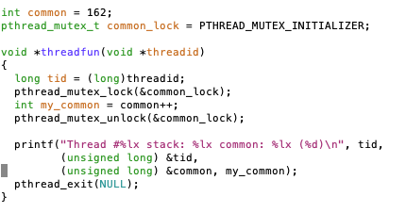
Our Example
Critical section

Slide 73
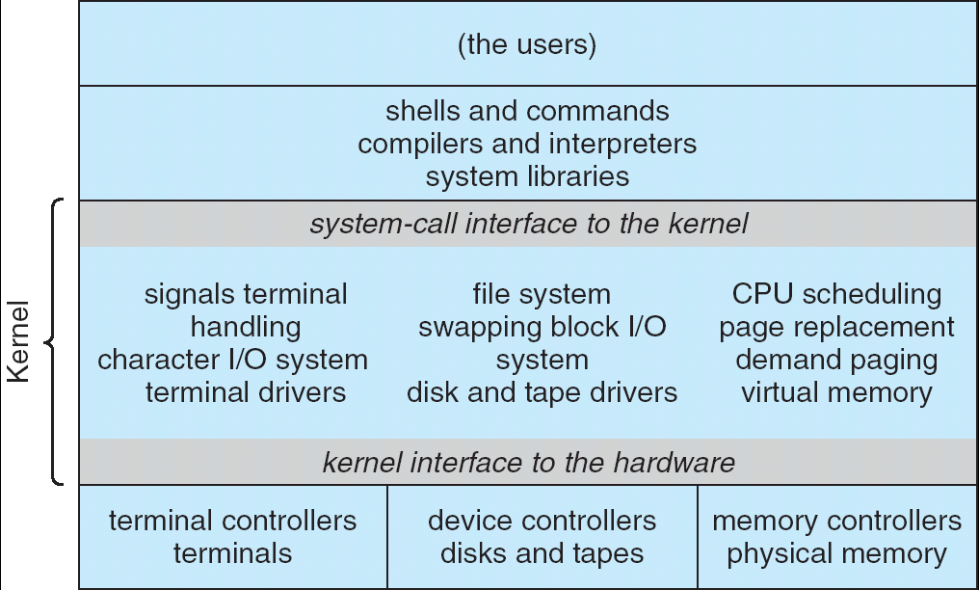
Recall: UNIX System Structure
Applications
User Mode
Standard Libs
Kernel Mode
Hardware

Slide 74
Recall: Life of a Process
User Mode
interrupt
exception
syscall
rtn
rfi
Kernel Mode
exit
exec
Limited HW access
Full HW access

Slide 75
3 types of Kernel Mode Transfer
Syscall
  Process requests a system service, e.g., exit
  Like a function call, but “outside” the process
  Does not have the address of the system function to call
  Like a Remote Procedure Call (RPC) – for later
  Marshall the syscall id and args in registers and exec syscall
Interrupt
  External asynchronous event triggers context switch
  eg. Timer, I/O device
  Independent of user process
Trap or Exception
  Internal synchronous event in process triggers context switch
  e.g., Protection violation (segmentation fault), Divide by zero, …

Slide 76
Implementing Safe Kernel Mode Transfers
Important aspects:
  Controlled transfer into kernel (e.g., syscall table)
  Separate kernel stack!
Carefully constructed kernel code packs up the user process state and sets it aside
  Details depend on the machine architecture
  More on this next time
Should be impossible for buggy or malicious user program to cause the kernel to corrupt itself!

Slide 77
Recall: System Call Interface: A Narrow Waist
Word Processing
Compilers
Web Browsers
Email
Databases
Web Servers
Application / Service
Portable OS Library
OS
User Mode
System Call
Interface
System Mode
Portable OS Kernel
Software
Platform support, Device Drivers
Hardware
x86
PowerPC
ARM
PCI
Ethernet (1Gbs/10Gbs)
802.11 a/g/n/ac/ax
SCSI
Graphics
Thunderbolt

Slide 78
Kernel System Call Handler
Vector through well-defined syscall entry points!
  Table mapping system call number to handler
Locate arguments
  In registers or on user (!) stack
Copy arguments
  From user memory into kernel memory
  Protect kernel from malicious code evading checks
Validate arguments
  Protect kernel from errors in user code
Copy results back
  Into user memory

Slide 79
Hardware support: Interrupt Control
Interrupt processing not visible to the user process:
  Occurs between instructions, restarted transparently
  No change to process state
  What can be observed even with perfect interrupt processing?
Interrupt Handler invoked with interrupts ‘disabled’
  Re-enabled upon completion
  Non-blocking (run to completion, no waits)
  Pack up in a queue and pass off to an OS thread for hard work
    wake up an existing OS thread

Slide 80
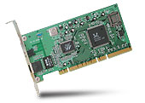
Interrupt Controller
Interrupt Mask
Priority Encoder
IntID
CPU
Interrupt
Int Disable
Timer
Software
Interrupt
Control
NMI
Network
Interrupts invoked with interrupt lines from devices
Interrupt controller chooses interrupt request to honor
  Interrupt identity specified with ID line
  Mask enables/disables interrupts
  Priority encoder picks highest enabled interrupt
  Software Interrupt Set/Cleared by Software
CPU can disable all interrupts with internal flag
Non-Maskable Interrupt line (NMI) can’t be disabled

Slide 81
How do we take interrupts safely?
Interrupt vector
  Limited number of entry points into kernel
Kernel interrupt stack
  Handler works regardless of state of user code
Interrupt masking
  Handler is non-blocking
Atomic transfer of control
  “Single instruction”-like to change:
    Program counter
    Stack pointer
    Memory protection
    Kernel/user mode
Transparent restartable execution
  User program does not know interrupt occurred

Slide 82
Interrupt Vector
Address and properties of each interrupt handler
interrupt number (i)
intrpHandler_i () {
….
}
Where else do you see this dispatch pattern?
  System Call
  Exceptions

Slide 83
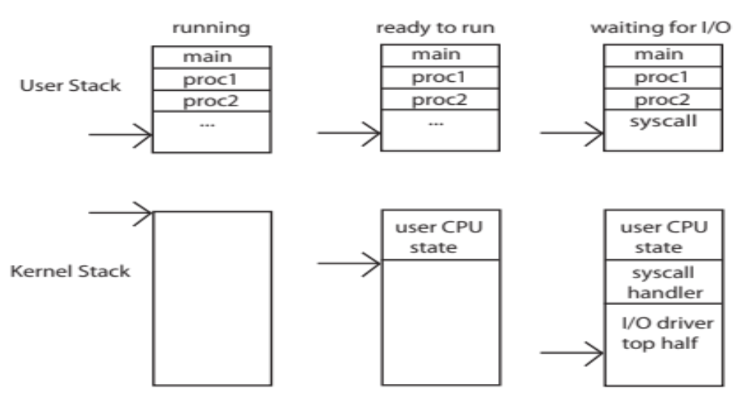
Need for Separate Kernel Stacks
Kernel needs space to work
Cannot put anything on the user stack (Why?)
Two-stack model
  OS thread has interrupt stack (located in kernel memory) plus User stack (located in user memory)
  Syscall handler copies user args to kernel space before invoking specific function (e.g., open)
  Interrupts (???)

Slide 84
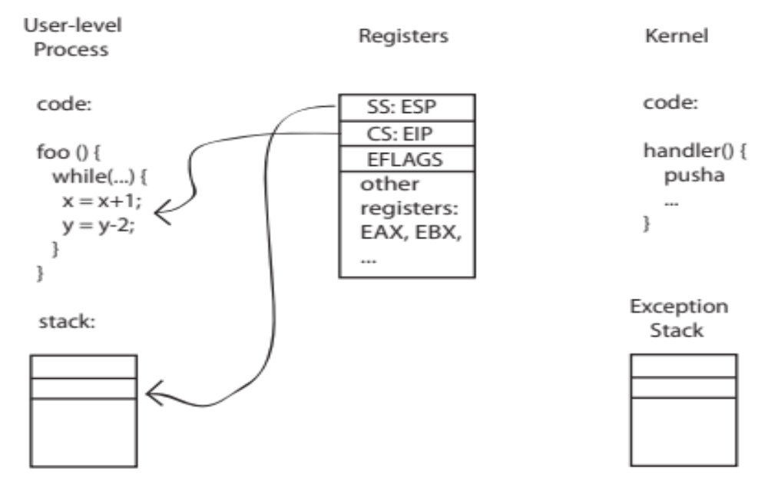
Before

Slide 85
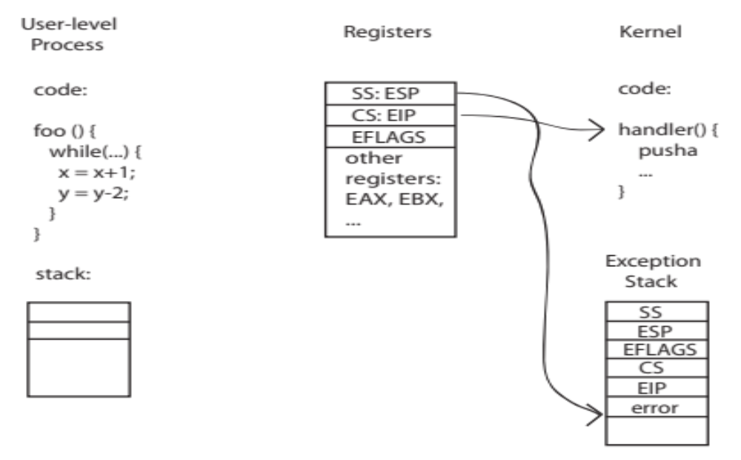
During Interrupt/System Call

Slide 86
Managing Processes
How to manage process state?
  How to create a process?
  How to exit from a process?
Remember: Everything outside of the kernel is running in a process!
  Including the shell! (Homework 2)
Processes are created and managed… by processes!

Slide 87
Bootstrapping
If processes are created by other processes, how does the first process start?
First process is started by the kernel
  Often configured as an argument to the kernel before the kernel boots
  Often called the “init” process
After this, all processes on the system are created by other processes

Slide 88
Next time: Process Management API
exit – terminate a process
fork – copy the current process
exec – change the program being run by the current process
wait – wait for a process to finish
kill – send a signal (interrupt-like notification) to another process
sigaction – set handlers for signals

Slide 89
Conclusion
Threads are the OS unit of concurrency
  Abstraction of a virtual CPU core
  Can use pthread_create, etc., to manage threads within a process
  They share data → need synchronization to avoid data races
Processes consist of one or more threads in an address space
  Abstraction of the machine: execution environment for a program
  Can use fork, exec, etc. to manage threads within a process
We saw the role of the OS library
  Provide API to programs
  Interface with the OS to request services

