Slide 1
Discussion 1
Fundamentals, Processes, Pintos Lists
01/26/24

Slide 2
Announcements
Sunday | Monday | Tuesday | Wednesday | Thursday | Friday | Saturday
 | Project 0 Release |  | Homework 0 Due | Homework 1 Release | Early Drop Deadline | Group Formation Deadline
 |  | Project 0 Due | Project 1 Release
 |  |  | Homework 1 Due

Slide 3
Fundamentals

Slide 4



Operating systems
Operating systems (OS) provide hardware abstractions (e.g. file systems, processes) to software applications and manage hardware resources (e.g. memory, CPU).
Not a well-defined term!
Special layer of software that provides application software access to hardware resources.
Plays three roles.
Referee: manage protection, isolation, and sharing of resources.
Illusionist: provide clean, easy-to-use abstractions of physical resources.
Glue: provide common services.

Slide 5
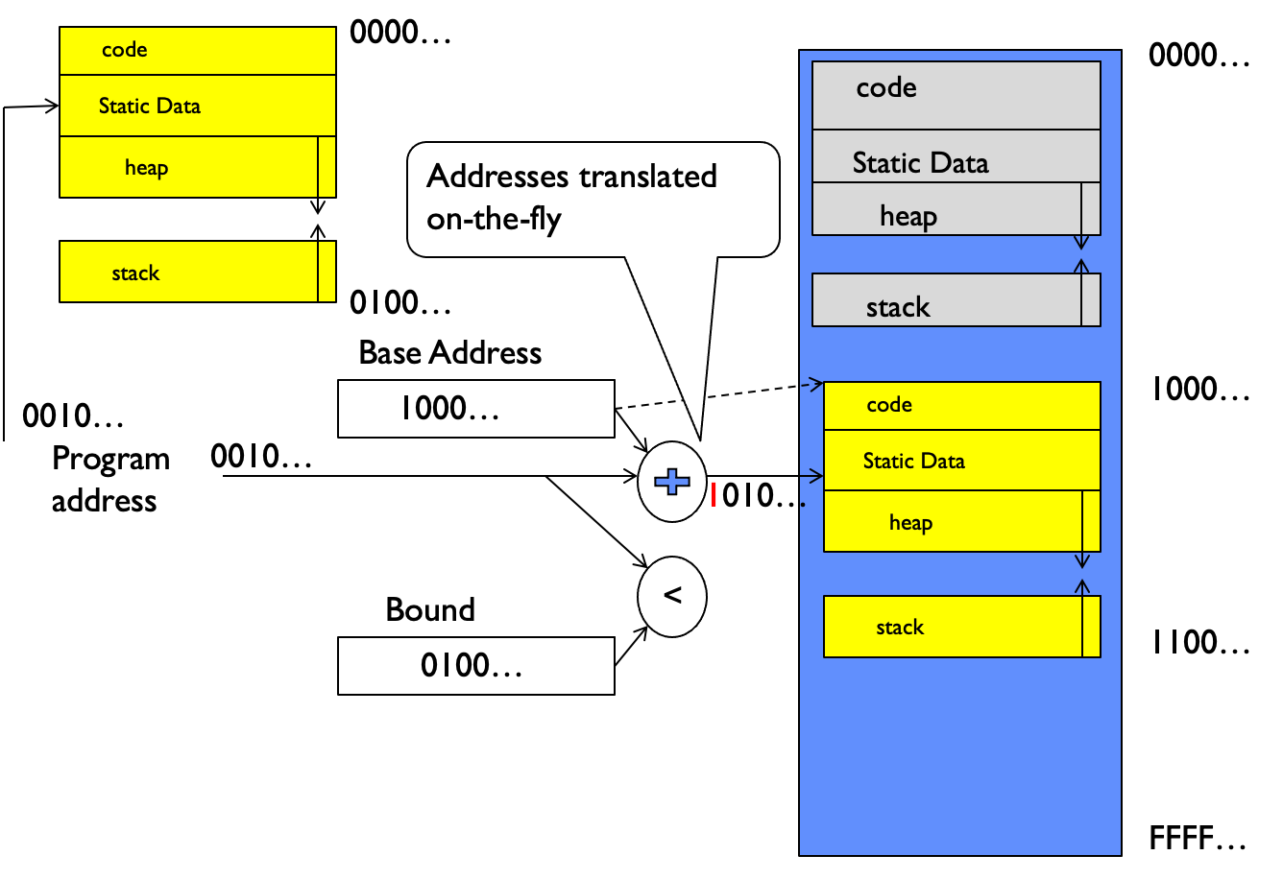
Address Space
Address space is the set of accessible addresses and associated states.
32-bit processor has 2³² ≈ 4 billion addresses.
Entire address space isn’t real locations but potential spaces.
Exception/fault (e.g. segfault) if trying to access restricted memory.
Programs operate with virtual memory.
Instead of accessing physical memory directly, programs request a virtual address which is translated into a physical address.
Examples include base and bound (shown on right), segmentation, page tables

Slide 6
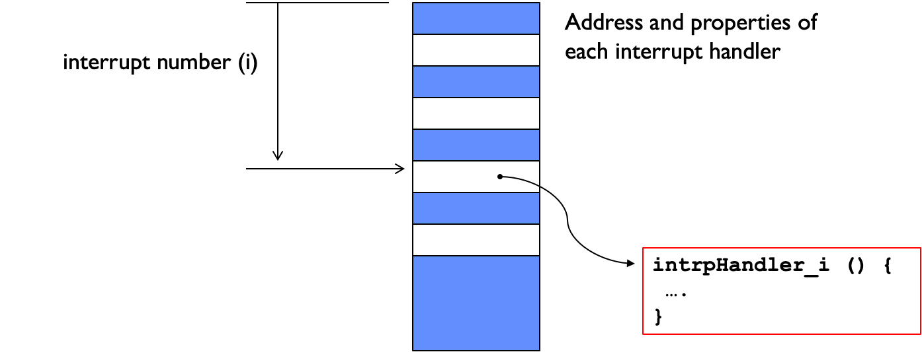
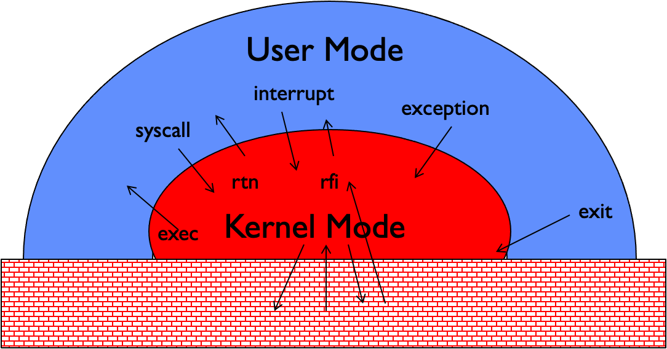
Dual Mode Operation
Hardware provides two modes.
Kernel/supervisor/privileged mode has the most privileges (i.e. kernel and other parts of OS operate in this mode).
User mode prohibits certain operations (i.e. user programs execute)
Restricted user mode is important to make sure user process cannot maliciously corrupt the system.
Three main ways of mode transfers (switch from user to kernel mode).
Processes request a system service through a system call (syscall) which encompass functionality that require kernel mode privileges.
Interrupts (hardware interrupts) are external asynchronous events (e.g. timer, I/O) that trigger a mode switch.
Traps (software interrupts or exceptions) are internal synchronous events (e.g. segfault, divide by zero) that trigger a mode switch.
All three modes known as unprogrammed control transfer.
Process doesn’t identify the specific address but rather an index into the interrupt vector table (IVT) which contains the address and properties of each interrupt handler.

Slide 7
Concept Check
What is the importance of address translation?
Similar to what’s done in the prologue at calling convention, what needs to happen before a mode transfer occurs?

Slide 8
Concept Check
What is the importance of address translation?
Necessary for idea of virtual memory
  Isolation/protection between different processes’ address spaces
  Illusion to processor as sole user of address space
Similar to what’s done in the prologue at calling convention, what needs to happen before a mode transfer occurs?

Slide 9
Concept Check
What is the importance of address translation?
Necessary for idea of virtual memory
  Isolation/protection between different processes’ address spaces
  Illusion to processor as sole user of address space
Similar to what’s done in the prologue at calling convention, what needs to happen before a mode transfer occurs?
Need to save processor state (e.g. registers) in the thread control block (TCB) since kernel may overwrite it.

Slide 10
Concept Check
How does the syscall handler protect the kernel from corrupt or malicious user code?
Trivia: Contrary to the answer above, in Linux the /dev/kmem file, which contains the entirety of kernel virtual memory, can be read. Why do we let a user program read kernel memory?

Slide 11
Concept Check
How does the syscall handler protect the kernel from corrupt or malicious user code?
User program specifies an index instead of direct address of the handler.
Arguments are validated and copied over to kernel stack to prevent time-of-check to time-of-use (TOCTTOU) attacks.
After the syscall finishes, the results are copied back in to user memory.
The user process is not allowed to access the results stored in kernel memory for security reasons.
Trivia: Contrary to the answer above, in Linux the /dev/kmem file, which contains the entirety of kernel virtual memory, can be read. Why do we let a user program read kernel memory?

Slide 12
Concept Check
How does the syscall handler protect the kernel from corrupt or malicious user code?
User program specifies an index instead of direct address of the handler.
Arguments are validated and copied over to kernel stack to prevent time-of-check to time-of-use (TOCTTOU) attacks.
After the syscall finishes, the results are copied back in to user memory.
The user process is not allowed to access the results stored in kernel memory for security reasons.
Trivia: Contrary to the answer above, in Linux the /dev/kmem file, which contains the entirety of kernel virtual memory, can be read. Why do we let a user program read kernel memory?
This isn't violating any of the OS principles of memory protection. Opening and reading files is a privileged operation, and you need to be running as a user with root privileges in the first place (`sudo` or superuser) that can make a syscall to read /dev/kmem.

Slide 13
Processes

Slide 14
Process Control Block
OS needs to run many programs, meaning it needs mechanisms such as
Switching between user processes and the kernel.
Switching among user processes through the kernel.
Protecting the OS from user processes and protecting processes from each other.
Kernel represents each process with a process control block (PCB).

Slide 15
Syscall
OS provides library/API that implements process management syscalls.
Unix puts it as part of C standard library (libc).
Use man pages for full documentation.
void exit(int status) terminates calling process with exit code status.
Exit code 0 = no errors, nonzero means otherwise.
Usually not explicitly called by main since OS implicitly calls it once main returns.
pid_t fork(void) creates a new process by copying the current process.
Process created from fork is child process, process calling fork is parent process.
Parent and child are identical (e.g. same address space) except for PID and a few other things.
Return type is pid_t (signed integer).
  > 0 means current process is parent.
  = 0 means current process is child.
  -1 means error has occurred
int main() {
pid_t fork_ret = fork();
if (fork_ret > 0) {
/* parent process logic */
} else if (fork_ret == 0) {
/* child process logic */
} else {
/* error handling */
}
}
Typical fork workflow

Slide 16
Syscall
exec changes the program being run by the current process.
Does not create a new process like fork.
exec is a family of functions with different signatures.
pid_t wait(int *wstatus) waits for a child process to finish.
Returns PID of terminated child process if successful, -1 on error.
Store status information in wstatus if not NULL.
int kill(pid_t pid, int sig) sends a signal (interrupt-like notification) to another process.
SIGINT (Ctrl - C), SIGKILL (kill on command line), SIGSTOP (Ctrl - Z).
Signal handler defines the behavior when a process receives a signal.
Custom signal handler can be written for most signals except SIGKILL and SIGSTOP using sigaction.

Slide 17
Concept Check
int main(void) {
int a = 1;
pid_t fork_ret = fork();
if (fork_ret) > 0 {
a++;
fprintf(stdout, "Parent: int a is %d at %p\n", a, &a);
} else if (fork_ret == 0) {
a++;
fprintf(stdout, "Child: int a is %d at %p\n", a, &a);
} else {
printf("Oedipus");
}
return 0;
}
Will the parent and child print the same value for a?
Will they print the same address for a?
Will they even write to the same STDOUT?

Slide 18
Concept Check
int main(void) {
int a = 1;
pid_t fork_ret = fork();
if (fork_ret) > 0 {
a++;
fprintf(stdout, "Parent: int a is %d at %p\n", a, &a);
} else if (fork_ret == 0) {
a++;
fprintf(stdout, "Child: int a is %d at %p\n", a, &a);
} else {
printf("Oedipus");
}
return 0;
}
Will the parent and child print the same value for a?
Yes. Processes do not share the same memory space, so a is 2 for both.
Will they print the same address for a?
Will they even write to the same STDOUT?

Slide 19
Concept Check
int main(void) {
int a = 1;
pid_t fork_ret = fork();
if (fork_ret) > 0 {
a++;
fprintf(stdout, "Parent: int a is %d at %p\n", a, &a);
} else if (fork_ret == 0) {
a++;
fprintf(stdout, "Child: int a is %d at %p\n", a, &a);
} else {
printf("Oedipus");
}
return 0;
}
Will the parent and child print the same value for a?
Yes. Processes do not share the same memory space, so a is 2 for both.
Will they print the same address for a?
Yes. Fork copies the address space of the parent to the child.
Will they even write to the same STDOUT?

Slide 20
Concept Check
int main(void) {
int a = 1;
pid_t fork_ret = fork();
if (fork_ret) > 0 {
a++;
fprintf(stdout, "Parent: int a is %d at %p\n", a, &a);
} else if (fork_ret == 0) {
a++;
fprintf(stdout, "Child: int a is %d at %p\n", a, &a);
} else {
printf("Oedipus");
}
return 0;
}
Will the parent and child print the same value for a?
Yes. Processes do not share the same memory space, so a is 2 for both.
Will they print the same address for a?
Yes. Fork copies the address space of the parent to the child.
Will they even write to the same STDOUT?
Yes. File descriptors are copied over to the new process, so both STDOUTs will reference the same "file".

Slide 21
Fork and Friends
int main(void) {
for (int i = 0; i < 3; i++)
pid_t fork_ret = fork();
return 0;
}
How many new processes (not including the original process) are created when the following program is run? Assume all fork calls succeed.

Slide 22
Fork and Friends
int main(void) {
for (int i = 0; i < 3; i++)
pid_t fork_ret = fork();
return 0;
}
How many new processes (not including the original process) are created when the following program is run? Assume all fork calls succeed.
Original Process
i | 0
fork_ret

Slide 23
Fork and Friends
int main(void) {
for (int i = 0; i < 3; i++)
pid_t fork_ret = fork();
return 0;
}
How many new processes (not including the original process) are created when the following program is run? Assume all fork calls succeed.
Process 8
i | 0
fork_ret | 0
Original Process
i | 0
fork_ret | 8

Slide 24
Fork and Friends
int main(void) {
for (int i = 0; i < 3; i++)
pid_t fork_ret = fork();
return 0;
}
How many new processes (not including the original process) are created when the following program is run? Assume all fork calls succeed.
Process 8
i | 1
fork_ret | 0
Original Process
i | 0
fork_ret | 8

Slide 25
Fork and Friends
int main(void) {
for (int i = 0; i < 3; i++)
pid_t fork_ret = fork();
return 0;
}
How many new processes (not including the original process) are created when the following program is run? Assume all fork calls succeed.
Process 23
i | 1
fork_ret | 0
Process 8
i | 1
fork_ret | 23
Original Process
i | 0
fork_ret | 8

Slide 26
Fork and Friends
int main(void) {
for (int i = 0; i < 3; i++)
pid_t fork_ret = fork();
return 0;
}
How many new processes (not including the original process) are created when the following program is run? Assume all fork calls succeed.
Process 23
i | 2
fork_ret | 0
Process 8
i | 1
fork_ret | 23
Original Process
i | 0
fork_ret | 8

Slide 27
Fork and Friends
int main(void) {
for (int i = 0; i < 3; i++)
pid_t fork_ret = fork();
return 0;
}
How many new processes (not including the original process) are created when the following program is run? Assume all fork calls succeed.
Process 23
i | 2
fork_ret | 25
Process 25
i | 2
fork_ret | 0
Process 8
i | 1
fork_ret | 23
Original Process
i | 0
fork_ret | 8

Slide 28
Fork and Friends
int main(void) {
for (int i = 0; i < 3; i++)
pid_t fork_ret = fork();
return 0;
}
How many new processes (not including the original process) are created when the following program is run? Assume all fork calls succeed.
Process 23
i | 2
fork_ret | 25
Process 25
i | 3
fork_ret | 0
Process 8
i | 1
fork_ret | 23
Original Process
i | 0
fork_ret | 8

Slide 29
Fork and Friends
int main(void) {
for (int i = 0; i < 3; i++)
pid_t fork_ret = fork();
return 0;
}
How many new processes (not including the original process) are created when the following program is run? Assume all fork calls succeed.
Process 23
i | 2
fork_ret | 25
Process 25
i | 3
fork_ret | 0
Process 8
i | 1
fork_ret | 23
Original Process
i | 0
fork_ret | 8

Slide 30
Fork and Friends
int main(void) {
for (int i = 0; i < 3; i++)
pid_t fork_ret = fork();
return 0;
}
How many new processes (not including the original process) are created when the following program is run? Assume all fork calls succeed.
Process 23
i | 3
fork_ret | 25
Process 25
i | 3
fork_ret | 0
Process 8
i | 1
fork_ret | 23
Original Process
i | 0
fork_ret | 8

Slide 31
Fork and Friends
int main(void) {
for (int i = 0; i < 3; i++)
pid_t fork_ret = fork();
return 0;
}
How many new processes (not including the original process) are created when the following program is run? Assume all fork calls succeed.
Process 23
i | 3
fork_ret | 25
Process 25
i | 3
fork_ret | 0
Process 8
i | 1
fork_ret | 23
Original Process
i | 0
fork_ret | 8

Slide 32
Fork and Friends
int main(void) {
for (int i = 0; i < 3; i++)
pid_t fork_ret = fork();
return 0;
}
How many new processes (not including the original process) are created when the following program is run? Assume all fork calls succeed.
Process 23
i | 3
fork_ret | 25
Process 25
i | 3
fork_ret | 0
Process 8
i | 2
fork_ret | 23
Original Process
i | 0
fork_ret | 8

Slide 33
Fork and Friends
int main(void) {
for (int i = 0; i < 3; i++)
pid_t fork_ret = fork();
return 0;
}
How many new processes (not including the original process) are created when the following program is run? Assume all fork calls succeed.
Process 23
i | 3
fork_ret | 25
Process 25
i | 3
fork_ret | 0
Process 8
i | 2
fork_ret | 5
Process 5
i | 2
fork_ret | 0
Original Process
i | 0
fork_ret | 8

Slide 34
Fork and Friends
int main(void) {
for (int i = 0; i < 3; i++)
pid_t fork_ret = fork();
return 0;
}
How many new processes (not including the original process) are created when the following program is run? Assume all fork calls succeed.
Process 23
i | 3
fork_ret | 25
Process 25
i | 3
fork_ret | 0
Process 8
i | 2
fork_ret | 5
Process 5
i | 3
fork_ret | 0
Original Process
i | 0
fork_ret | 8

Slide 35
Fork and Friends
int main(void) {
for (int i = 0; i < 3; i++)
pid_t fork_ret = fork();
return 0;
}
How many new processes (not including the original process) are created when the following program is run? Assume all fork calls succeed.
Process 23
i | 3
fork_ret | 25
Process 25
i | 3
fork_ret | 0
Process 8
i | 2
fork_ret | 5
Process 5
i | 3
fork_ret | 0
Original Process
i | 0
fork_ret | 8

Slide 36
Fork and Friends
int main(void) {
for (int i = 0; i < 3; i++)
pid_t fork_ret = fork();
return 0;
}
How many new processes (not including the original process) are created when the following program is run? Assume all fork calls succeed.
Process 23
i | 3
fork_ret | 25
Process 25
i | 3
fork_ret | 0
Process 8
i | 3
fork_ret | 5
Process 5
i | 3
fork_ret | 0
Original Process
i | 0
fork_ret | 8

Slide 37
Fork and Friends
int main(void) {
for (int i = 0; i < 3; i++)
pid_t fork_ret = fork();
return 0;
}
How many new processes (not including the original process) are created when the following program is run? Assume all fork calls succeed.
Process 23
i | 3
fork_ret | 25
Process 25
i | 3
fork_ret | 0
Process 8
i | 3
fork_ret | 5
Process 5
i | 3
fork_ret | 0
Original Process
i | 0
fork_ret | 8

Slide 38
Fork and Friends
int main(void) {
for (int i = 0; i < 3; i++)
pid_t fork_ret = fork();
return 0;
}
How many new processes (not including the original process) are created when the following program is run? Assume all fork calls succeed.
Process 23
i | 3
fork_ret | 25
Process 25
i | 3
fork_ret | 0
Process 8
i | 3
fork_ret | 5
Process 5
i | 3
fork_ret | 0
Original Process
i | 1
fork_ret | 8

Slide 39
Fork and Friends
int main(void) {
for (int i = 0; i < 3; i++)
pid_t fork_ret = fork();
return 0;
}
How many new processes (not including the original process) are created when the following program is run? Assume all fork calls succeed.
Process 23
i | 3
fork_ret | 25
Process 25
i | 3
fork_ret | 0
Process 8
i | 3
fork_ret | 5
Process 5
i | 3
fork_ret | 0
Original Process
i | 1
fork_ret | 16
Process 16
i | 1
fork_ret | 0

Slide 40
Fork and Friends
int main(void) {
for (int i = 0; i < 3; i++)
pid_t fork_ret = fork();
return 0;
}
How many new processes (not including the original process) are created when the following program is run? Assume all fork calls succeed.
Process 23
i | 3
fork_ret | 25
Process 25
i | 3
fork_ret | 0
Process 8
i | 3
fork_ret | 5
Process 5
i | 3
fork_ret | 0
Original Process
i | 1
fork_ret | 16
Process 16
i | 2
fork_ret | 0

Slide 41
Fork and Friends
int main(void) {
for (int i = 0; i < 3; i++)
pid_t fork_ret = fork();
return 0;
}
How many new processes (not including the original process) are created when the following program is run? Assume all fork calls succeed.
Process 23
i | 3
fork_ret | 25
Process 25
i | 3
fork_ret | 0
Process 8
i | 3
fork_ret | 5
Process 5
i | 3
fork_ret | 0
Original Process
i | 1
fork_ret | 16
Process 16
i | 2
fork_ret | 19
Process 19
i | 2
fork_ret | 0

Slide 42
Fork and Friends
int main(void) {
for (int i = 0; i < 3; i++)
pid_t fork_ret = fork();
return 0;
}
How many new processes (not including the original process) are created when the following program is run? Assume all fork calls succeed.
Process 23
i | 3
fork_ret | 25
Process 25
i | 3
fork_ret | 0
Process 8
i | 3
fork_ret | 5
Process 5
i | 3
fork_ret | 0
Original Process
i | 1
fork_ret | 16
Process 16
i | 2
fork_ret | 19
Process 19
i | 3
fork_ret | 0

Slide 43
Fork and Friends
int main(void) {
for (int i = 0; i < 3; i++)
pid_t fork_ret = fork();
return 0;
}
How many new processes (not including the original process) are created when the following program is run? Assume all fork calls succeed.
Process 23
i | 3
fork_ret | 25
Process 25
i | 3
fork_ret | 0
Process 8
i | 3
fork_ret | 5
Process 5
i | 3
fork_ret | 0
Original Process
i | 1
fork_ret | 16
Process 16
i | 2
fork_ret | 19
Process 19
i | 3
fork_ret | 0

Slide 44
Fork and Friends
int main(void) {
for (int i = 0; i < 3; i++)
pid_t fork_ret = fork();
return 0;
}
How many new processes (not including the original process) are created when the following program is run? Assume all fork calls succeed.
Process 23
i | 3
fork_ret | 25
Process 25
i | 3
fork_ret | 0
Process 8
i | 3
fork_ret | 5
Process 5
i | 3
fork_ret | 0
Original Process
i | 1
fork_ret | 16
Process 16
i | 3
fork_ret | 19
Process 19
i | 3
fork_ret | 0

Slide 45
Fork and Friends
int main(void) {
for (int i = 0; i < 3; i++)
pid_t fork_ret = fork();
return 0;
}
How many new processes (not including the original process) are created when the following program is run? Assume all fork calls succeed.
Process 23
i | 3
fork_ret | 25
Process 25
i | 3
fork_ret | 0
Process 8
i | 3
fork_ret | 5
Process 5
i | 3
fork_ret | 0
Original Process
i | 1
fork_ret | 16
Process 16
i | 3
fork_ret | 19
Process 19
i | 3
fork_ret | 0

Slide 46
Fork and Friends
int main(void) {
for (int i = 0; i < 3; i++)
pid_t fork_ret = fork();
return 0;
}
How many new processes (not including the original process) are created when the following program is run? Assume all fork calls succeed.
Process 23
i | 3
fork_ret | 25
Process 25
i | 3
fork_ret | 0
Process 8
i | 3
fork_ret | 5
Process 5
i | 3
fork_ret | 0
Original Process
i | 2
fork_ret | 16
Process 16
i | 3
fork_ret | 19
Process 19
i | 3
fork_ret | 0

Slide 47
Fork and Friends
int main(void) {
for (int i = 0; i < 3; i++)
pid_t fork_ret = fork();
return 0;
}
How many new processes (not including the original process) are created when the following program is run? Assume all fork calls succeed.
Process 23
i | 3
fork_ret | 25
Process 25
i | 3
fork_ret | 0
Process 8
i | 3
fork_ret | 5
Process 5
i | 3
fork_ret | 0
Original Process
i | 2
fork_ret | 98
Process 16
i | 3
fork_ret | 19
Process 19
i | 3
fork_ret | 0
Process 98
i | 2
fork_ret | 0

Slide 48
Fork and Friends
int main(void) {
for (int i = 0; i < 3; i++)
pid_t fork_ret = fork();
return 0;
}
How many new processes (not including the original process) are created when the following program is run? Assume all fork calls succeed.
Process 23
i | 3
fork_ret | 25
Process 25
i | 3
fork_ret | 0
Process 8
i | 3
fork_ret | 5
Process 5
i | 3
fork_ret | 0
Original Process
i | 2
fork_ret | 98
Process 16
i | 3
fork_ret | 19
Process 19
i | 3
fork_ret | 0
Process 98
i | 3
fork_ret | 0

Slide 49
Fork and Friends
int main(void) {
for (int i = 0; i < 3; i++)
pid_t fork_ret = fork();
return 0;
}
How many new processes (not including the original process) are created when the following program is run? Assume all fork calls succeed.
Process 23
i | 3
fork_ret | 25
Process 25
i | 3
fork_ret | 0
Process 8
i | 3
fork_ret | 5
Process 5
i | 3
fork_ret | 0
Original Process
i | 2
fork_ret | 98
Process 16
i | 3
fork_ret | 19
Process 19
i | 3
fork_ret | 0
Process 98
i | 3
fork_ret | 0

Slide 50
Fork and Friends
int main(void) {
for (int i = 0; i < 3; i++)
pid_t fork_ret = fork();
return 0;
}
How many new processes (not including the original process) are created when the following program is run? Assume all fork calls succeed.
Process 23
i | 3
fork_ret | 25
Process 25
i | 3
fork_ret | 0
Process 8
i | 3
fork_ret | 5
Process 5
i | 3
fork_ret | 0
Original Process
i | 2
fork_ret | 98
Process 16
i | 3
fork_ret | 19
Process 19
i | 3
fork_ret | 0
Process 98
i | 3
fork_ret | 0

Slide 51
Fork and Friends
int main(void) {
for (int i = 0; i < 3; i++)
pid_t fork_ret = fork();
return 0;
}
How many new processes (not including the original process) are created when the following program is run? Assume all fork calls succeed.
Process 23
i | 3
fork_ret | 25
Process 25
i | 3
fork_ret | 0
Process 8
i | 3
fork_ret | 5
Process 5
i | 3
fork_ret | 0
Original Process
i | 3
fork_ret | 98
Process 16
i | 3
fork_ret | 19
Process 19
i | 3
fork_ret | 0
Process 98
i | 3
fork_ret | 0

Slide 52
Fork and Friends
int main(void) {
for (int i = 0; i < 3; i++)
pid_t fork_ret = fork();
return 0;
}
How many new processes (not including the original process) are created when the following program is run? Assume all fork calls succeed.
Process 23
i | 3
fork_ret | 25
Process 25
i | 3
fork_ret | 0
Process 8
i | 3
fork_ret | 5
Process 5
i | 3
fork_ret | 0
Original Process
i | 3
fork_ret | 98
Process 16
i | 3
fork_ret | 19
Process 19
i | 3
fork_ret | 0
Process 98
i | 3
fork_ret | 0

Slide 53
Fork and Friends
int main(void) {
for (int i = 0; i < 3; i++)
pid_t fork_ret = fork();
return 0;
}
How many new processes (not including the original process) are created when the following program is run? Assume all fork calls succeed.
7 process in addition to the original process.
Process 23
i | 3
fork_ret | 25
Process 25
i | 3
fork_ret | 0
Process 8
i | 3
fork_ret | 5
Process 5
i | 3
fork_ret | 0
Original Process
i | 3
fork_ret | 98
Process 16
i | 3
fork_ret | 19
Process 19
i | 3
fork_ret | 0
Process 98
i | 3
fork_ret | 0

Slide 54
Fork and Friends
int main(void) {
int* stuff = malloc(sizeof(int));
*stuff = 5;
pid_t fork_ret = fork();
printf("The last digit of pi is %d\n", *stuff);
if (fork_ret == 0)
*stuff = 6;
return 0;
}
What are the possible outputs when the following program is run?

Slide 55
Fork and Friends
int main(void) {
int* stuff = malloc(sizeof(int));
*stuff = 5;
pid_t fork_ret = fork();
printf("The last digit of pi is %d\n", *stuff);
if (fork_ret == 0)
*stuff = 6;
return 0;
}
What are the possible outputs when the following program is run?
Heap is part of the address space like the stack, so output is the same as previous question.
If fork succeeds, then
The last digit of pi is 5.
The last digit of pi is 5.
Otherwise, only one line is printed.

Slide 56
Fork and Friends
int main(void) {
pid_t fork_ret = fork();
int exit;
if (fork_ret != 0)
wait(&exit);
printf("Hello World: %d\n", fork_ret);
return 0;
}
What are the possible outputs when the following program is run? Assume the child process has PID 162162.

Slide 57
Fork and Friends
int main(void) {
pid_t fork_ret = fork();
int exit;
if (fork_ret != 0)
wait(&exit);
printf("Hello World: %d\n", fork_ret);
return 0;
}
What are the possible outputs when the following program is run? Assume the child process has PID 162162.
Parent process will wait until child process completes, so it won’t print before child prints.
Hello World: 0
Hello World: 162162
If fork fails, then program will print
Hello World: -1
since fork will return -1. Note that wait(&exit) when fork() fails will return immediately.

Slide 58
Fork and Friends
int main(void) {
char** argv = (char**)malloc(3 * sizeof(char*));
argv[0] = "/bin/ls";
argv[1] = ".";
argv[2] = NULL;
for (int i = 0; i < 10; i++) {
printf("%d\n", i);
if (i == 3) {
execv("/bin/ls", argv);
}
}
return 0;
}
Does the following program print all numbers from 0 to 9 as well as the output of running ls? If not, what is the minimal code change to accomplish this? Assume all syscalls succeed.

Slide 59
Fork and Friends
int main(void) {
char** argv = (char**)malloc(3 * sizeof(char*));
argv[0] = "/bin/ls";
argv[1] = ".";
argv[2] = NULL;
for (int i = 0; i < 10; i++) {
printf("%d\n", i);
if (i == 3) {
execv("/bin/ls", argv);
}
}
return 0;
}
Does the following program print all numbers from 0 to 9 as well as the output of running ls? If not, what is the minimal code change to accomplish this? Assume all syscalls succeed.
Currently, program stops after printing 3, giving an output of
0
1
2
3
<output of ls>
since execv overwrites the entire process image (i.e. rest of loop will not execute).

Slide 60
Fork and Friends
int main(void) {
char** argv = (char**)malloc(3 * sizeof(char*));
argv[0] = "/bin/ls";
argv[1] = ".";
argv[2] = NULL;
for (int i = 0; i < 10; i++) {
printf("%d\n", i);
if (i == 3) {
pid_t fork_ret = fork();
if (fork_ret == 0)
execv("/bin/ls", argv);
}
}
return 0;
}
Does the following program print all numbers from 0 to 9 as well as the output of running ls? If not, what is the minimal code change to accomplish this? Assume all syscalls succeed.
Currently, program stops after printing 3, giving an output of
0
1
2
3
<output of ls>
since execv overwrites the entire process image (i.e. rest of loop will not execute).
Fork and exec in child to make sure parent process continues the loop.

Slide 61
Signal Handling
Signal Value Action Comment
----------------------------------------------------------------------
SIGHUP 1 Terminate Hangup detected on controlling terminal
or death of controlling process
SIGINT 2 Terminate Interrupt from keyboard (Ctrl - c)
SIGQUIT 3 Core Dump Quit from keyboard (Ctrl - \)
SIGILL 4 Core Dump Illegal Instruction
SIGABRT 6 Core Dump Abort signal from abort(3)
SIGFPE 8 Core Dump Floating point exception
SIGKILL 9 Terminate Kill signal
SIGSEGV 11 Core Dump Invalid memory reference
SIGPIPE 13 Terminate Broken pipe: write to pipe with no
readers
SIGALRM 14 Terminate Timer signal from alarm(2)
SIGTERM 15 Terminate Termination signal
SIGUSR1 30,10,16 Terminate User-defined signal 1
SIGUSR2 31,12,17 Terminate User-defined signal 2
SIGCHLD 20,17,18 Ignore Child stopped or terminated
SIGCONT 19,18,25 Continue Continue if stopped
SIGSTOP 17,19,23 Stop Stop process
SIGTSTP 18,20,24 Stop Stop typed at tty
SIGTTIN 21,21,26 Stop tty input for background process
SIGTTOU 22,22,27 Stop tty output for background process

Slide 62
Signal Handling
Overriding SIGSTOP and SIGKILL is disabled. Why?

Slide 63
Signal Handling
Overriding SIGSTOP and SIGKILL is disabled. Why?
If a process were to override their signal handlers to ignore SIGSTOP and SIGKILL, it can run a malicious process forever.

Slide 64
Signal Handling
void sigquit_handler(int sig) {
if (sig == SIGINT || sig == SIGQUIT)
exit(1);
}
void sigint_handler(int sig) {
if (sig == SIGINT)
signal(SIGINT, sigquit_handler);
}
int main() {
signal(SIGQUIT, sigquit_handler);
signal(SIGINT, sigint_handler);
while (1) {
printf("Sleeping for a second ...\n");
sleep(1);
}
}
What are the different ways you can use the keyboard to cause the program to exit? Assume program is run in a bash cell.

Slide 65
Signal Handling
void sigquit_handler(int sig) {
if (sig == SIGINT || sig == SIGQUIT)
exit(1);
}
void sigint_handler(int sig) {
if (sig == SIGINT)
signal(SIGINT, sigquit_handler);
}
int main() {
signal(SIGQUIT, sigquit_handler);
signal(SIGINT, sigint_handler);
while (1) {
printf("Sleeping for a second ...\n");
sleep(1);
}
}
What are the different ways you can use the keyboard to cause the program to exit? Assume program is run in a bash cell.
main initialized SIGINT and SIGQUIT to custom handlers
Ctrl - \ will be routed to sigquit_handler which exits program upon SIGQUIT.
Ctrl - C will be routed to sigint_handler which redefines SIGINT handler to sigquit_handler.
Pressing Ctrl - C or Ctrl - \ after Ctrl-C will exit program.
SIGSTOP handler is not redefined → Ctrl-Z will exit program.

Slide 66
Pintos Lists

Slide 67
Regular Linked Lists
struct ll_node {
int value;
struct ll_node* next;
};
/* Returns the sum of a linked list. */
int ll_sum(ll_node* start) {
ll_node* iter;
int total = 0;
for (iter = start; iter != NULL; iter = iter->next)
total += iter->value;
return total;
}

Slide 68
Pintos (Doubly) Linked Lists
/* List element. */
struct list_elem {
struct list_elem* prev; /* Previous list element. */
struct list_elem* next; /* Next list element. */
};
/* List. */
struct list {
struct list_elem head; /* List head. */
struct list_elem tail; /* List tail. */
};
/* Given a struct list, returns a reference to the
first list_elem in the list. */
struct list_elem* list_begin(struct list* lst);
/* Given a struct list, returns a reference to the
last list_elem in the list. */
struct list_elem* list_end(struct list* lst);
/* Given a liter = list_begin(lst)ist_elem, finds the next
list_elem in the list. */
struct list_elem* list_next(struct list_elem* elem);
/* Converts pointer to list element LIST_ELEM into
a pointer to the structure that LIST_ELEM is
embedded inside. You must also provide the name
of the outer structure STRUCT and the member
name MEMBER of the list element. */
STRUCT* list_entry(LIST_ELEM, STRUCT, MEMBER);

Slide 69
Pintos (Doubly) Linked Lists
Empty Pintos list:
prev
next
prev
next
head
tail

Slide 70
Pintos (Doubly) Linked Lists
prev
next
prev
next
prev
next
prev
next
head
list_begin
tail
list_end
Technically, both `list_begin` and `list_end` will give you the tail for the empty Pintos list

Slide 71
Pintos (Doubly) Linked Lists
prev
next
prev
next
prev
next
prev
next
head
list_begin
tail
list_end
Technically, both `list_begin` and `list_end` will give you the tail for the empty Pintos list
Anyway, how is this useful?

Slide 72
Pintos (Doubly) Linked Lists
struct node
int data_int;
char* data_str;
struct list_elem elem;
prev
next
prev
next
prev
next
prev
next
head
tail

Slide 73
Pintos (Doubly) Linked Lists
struct node
int data_int;
char* data_str;
struct list_elem elem;
list_entry
prev
next
prev
next
prev
next
prev
next
head
tail
Avoid having to allocate memory for a separate data structure
Generic, easy-to-use interface (we’ll demonstrate this in the problem)

Slide 74
Pintos Lists
struct list_data {
char* name;
struct list pl_list;
};
struct pl_node {
int value;
struct list_elem elem;
};
/* Returns the sum of a pintos-style list of pl_nodes. */
int pl_sum(struct list_data* data) {
struct list_elem* iter;
struct pl_node* temp;
struct list* lst = ____________;
int total = 0;
for (______________________; _____________________; ______________________) {
temp = list_entry(__________________________);
____________________;
}
return total;
}
Fill in the blanks to sum up the elements of a Pintos list.
/* Given a struct list, returns a reference to the
first list_elem in the list. */
struct list_elem* list_begin(struct list* lst);
/* Given a struct list, returns a reference to the
last list_elem in the list. */
struct list_elem* list_end(struct list* lst);
/* Given a list_elem, finds the next list_elem in
the list. */
struct list_elem* list_next(struct list_elem* elem);
/* Converts pointer to list element LIST_ELEM into
a pointer to the structure that LIST_ELEM is
embedded inside. You must also provide the name
of the outer structure STRUCT and the member
name MEMBER of the list element. */
STRUCT* list_entry(LIST_ELEM, STRUCT, MEMBER);

Slide 75
Pintos Lists
struct list_data {
char* name;
struct list pl_list;
};
struct pl_node {
int value;
struct list_elem elem;
};
/* Returns the sum of a pintos-style list of pl_nodes. */
int pl_sum(struct list_data* data) {
struct list_elem* iter;
struct pl_node* temp;
struct list* lst = &data->pl_list;
int total = 0;
for (______________________; _____________________; ______________________) {
temp = list_entry(__________________________);
____________________;
}
return total;
}
Fill in the blanks to sum up the elements of a Pintos list.
/* Given a struct list, returns a reference to the
first list_elem in the list. */
struct list_elem* list_begin(struct list* lst);
/* Given a struct list, returns a reference to the
last list_elem in the list. */
struct list_elem* list_end(struct list* lst);
/* Given a list_elem, finds the next list_elem in
the list. */
struct list_elem* list_next(struct list_elem* elem);
/* Converts pointer to list element LIST_ELEM into
a pointer to the structure that LIST_ELEM is
embedded inside. You must also provide the name
of the outer structure STRUCT and the member
name MEMBER of the list element. */
STRUCT* list_entry(LIST_ELEM, STRUCT, MEMBER);

Slide 76
Pintos Lists
struct list_data {
char* name;
struct list pl_list;
};
struct pl_node {
int value;
struct list_elem elem;
};
/* Returns the sum of a pintos-style list of pl_nodes. */
int pl_sum(struct list_data* data) {
struct list_elem* iter;
struct pl_node* temp;
struct list* lst = &data->pl_list;
int total = 0;
for (iter = list_begin(lst); _____________________; ______________________) {
temp = list_entry(__________________________);
____________________;
}
return total;
}
Fill in the blanks to sum up the elements of a Pintos list.
/* Given a struct list, returns a reference to the
first list_elem in the list. */
struct list_elem* list_begin(struct list* lst);
/* Given a struct list, returns a reference to the
last list_elem in the list. */
struct list_elem* list_end(struct list* lst);
/* Given a liter = list_begin(lst)ist_elem, finds the next list_elem in
the list. */
struct list_elem* list_next(struct list_elem* elem);
/* Converts pointer to list element LIST_ELEM into
a pointer to the structure that LIST_ELEM is
embedded inside. You must also provide the name
of the outer structure STRUCT and the member
name MEMBER of the list element. */
STRUCT* list_entry(LIST_ELEM, STRUCT, MEMBER);

Slide 77
Pintos Lists
struct list_data {
char* name;
struct list pl_list;
};
struct pl_node {
int value;
struct list_elem elem;
};
/* Returns the sum of a pintos-style list of pl_nodes. */
int pl_sum(struct list_data* data) {
struct list_elem* iter;
struct pl_node* temp;
struct list* lst = &data->pl_list;
int total = 0;
for (iter = list_begin(lst); _____________________; ______________________) {
temp = list_entry(__________________________);
____________________;
}
return total;
}
Fill in the blanks to sum up the elements of a Pintos list.
/* Given a struct list, returns a reference to the
first list_elem in the list. */
struct list_elem* list_begin(struct list* lst);
/* Given a struct list, returns a reference to the
last list_elem in the list. */
struct list_elem* list_end(struct list* lst);
/* Given a liter = list_begin(lst)ist_elem, finds the next list_elem in
the list. */
struct list_elem* list_next(struct list_elem* elem);
/* Converts pointer to list element LIST_ELEM into
a pointer to the structure that LIST_ELEM is
embedded inside. You must also provide the name
of the outer structure STRUCT and the member
name MEMBER of the list element. */
STRUCT* list_entry(LIST_ELEM, STRUCT, MEMBER);

Slide 78
Pintos Lists
struct list_data {
char* name;
struct list pl_list;
};
struct pl_node {
int value;
struct list_elem elem;
};
/* Returns the sum of a pintos-style list of pl_nodes. */
int pl_sum(struct list_data* data) {
struct list_elem* iter;
struct pl_node* temp;
struct list* lst = &data->pl_list;
int total = 0;
for (iter = list_begin(lst); iter != list_end(lst); ______________________) {
temp = list_entry(__________________________);
____________________;
}
return total;
}
Fill in the blanks to sum up the elements of a Pintos list.
/* Given a struct list, returns a reference to the
first list_elem in the list. */
struct list_elem* list_begin(struct list* lst);
/* Given a struct list, returns a reference to the
last list_elem in the list. */
struct list_elem* list_end(struct list* lst);
/* Given a liter = list_begin(lst)ist_elem, finds the next list_elem in
the list. */
struct list_elem* list_next(struct list_elem* elem);
/* Converts pointer to list element LIST_ELEM into
a pointer to the structure that LIST_ELEM is
embedded inside. You must also provide the name
of the outer structure STRUCT and the member
name MEMBER of the list element. */
STRUCT* list_entry(LIST_ELEM, STRUCT, MEMBER);

Slide 79
Pintos Lists
struct list_data {
char* name;
struct list pl_list;
};
struct pl_node {
int value;
struct list_elem elem;
};
/* Returns the sum of a pintos-style list of pl_nodes. */
int pl_sum(struct list_data* data) {
struct list_elem* iter;
struct pl_node* temp;
struct list* lst = &data->pl_list;
int total = 0;
for (iter = list_begin(lst); iter != list_end(lst); iter = list_next(iter)) {
temp = list_entry(__________________________);
____________________;
}
return total;
}
Fill in the blanks to sum up the elements of a Pintos list.
/* Given a struct list, returns a reference to the
first list_elem in the list. */
struct list_elem* list_begin(struct list* lst);
/* Given a struct list, returns a reference to the
last list_elem in the list. */
struct list_elem* list_end(struct list* lst);
/* Given a liter = list_begin(lst)ist_elem, finds the next list_elem in
the list. */
struct list_elem* list_next(struct list_elem* elem);
/* Converts pointer to list element LIST_ELEM into
a pointer to the structure that LIST_ELEM is
embedded inside. You must also provide the name
of the outer structure STRUCT and the member
name MEMBER of the list element. */
STRUCT* list_entry(LIST_ELEM, STRUCT, MEMBER);

Slide 80
Pintos Lists
struct list_data {
char* name;
struct list pl_list;
};
struct pl_node {
int value;
struct list_elem elem;
};
/* Returns the sum of a pintos-style list of pl_nodes. */
int pl_sum(struct list_data* data) {
struct list_elem* iter;
struct pl_node* temp;
struct list* lst = &data->pl_list;
int total = 0;
for (iter = list_begin(lst); iter != list_end(lst); iter = list_next(iter)) {
temp = list_entry(iter, struct pl_node, elem);
____________________;
}
return total;
}
Fill in the blanks to sum up the elements of a Pintos list.
/* Given a struct list, returns a reference to the
first list_elem in the list. */
struct list_elem* list_begin(struct list* lst);
/* Given a struct list, returns a reference to the
last list_elem in the list. */
struct list_elem* list_end(struct list* lst);
/* Given a liter = list_begin(lst)ist_elem, finds the next list_elem in
the list. */
struct list_elem* list_next(struct list_elem* elem);
/* Converts pointer to list element LIST_ELEM into
a pointer to the structure that LIST_ELEM is
embedded inside. You must also provide the name
of the outer structure STRUCT and the member
name MEMBER of the list element. */
STRUCT* list_entry(LIST_ELEM, STRUCT, MEMBER);

Slide 81
Pintos Lists
struct list_data {
char* name;
struct list pl_list;
};
struct pl_node {
int value;
struct list_elem elem;
};
/* Returns the sum of a pintos-style list of pl_nodes. */
int pl_sum(struct list_data* data) {
struct list_elem* iter;
struct pl_node* temp;
struct list* lst = &data->pl_list;
int total = 0;
for (iter = list_begin(lst); iter != list_end(lst); iter = list_next(iter)) {
temp = list_entry(iter, struct pl_node, elem);
total += temp->value;
}
return total;
}
Fill in the blanks to sum up the elements of a Pintos list.
/* Given a struct list, returns a reference to the
first list_elem in the list. */
struct list_elem* list_begin(struct list* lst);
/* Given a struct list, returns a reference to the
last list_elem in the list. */
struct list_elem* list_end(struct list* lst);
/* Given a liter = list_begin(lst)ist_elem, finds the next list_elem in
the list. */
struct list_elem* list_next(struct list_elem* elem);
/* Converts pointer to list element LIST_ELEM into
a pointer to the structure that LIST_ELEM is
embedded inside. You must also provide the name
of the outer structure STRUCT and the member
name MEMBER of the list element. */
STRUCT* list_entry(LIST_ELEM, STRUCT, MEMBER);

