Slide 1
CS162
Operating Systems and
Systems Programming
Lecture 6
Abstractions 4: Sockets, I/O, IPC (finished)
February 1st, 2024
Prof. John Kubiatowicz
http://cs162.eecs.Berkeley.edu

Slide 2
Recall: Connection Setup over TCP/IP
Client Side
Server Side
Server
Socket
Server Listening:
Server IP addr
well-known port,
Protocol (TCP/IP)
Connection request:
Client IP addr
Client Port
Protocol (TCP/IP)
Request Connection
new
socket
socket
socket
connection
5-Tuple identifies each connection:
  Source IP Address
  Destination IP Address
  Source Port Number
  Destination Port Number
  Protocol (always TCP here)
Often, Client Port “randomly” assigned
  Done by OS during client socket setup
Server Port often “well known”
  80 (web), 443 (secure web), 25 (sendmail), etc
  Well-known ports from 0—1023

Slide 3
Recall: Simple Web Server
Client
Server
Create Server Socket
Create Client Socket
Bind it to an Address
(host:port)
Connect it to server (host:port)
Listen for Connection
Accept syscall()
Connection Socket
Connection Socket
write request
read request
read response
write response
Close Client Socket
Close Connection Socket
Close Server Socket

Slide 4
Client Code
char *host_name, *port_name;
// Create a socket
struct addrinfo *server = lookup_host(host_name, port_name);
int sock_fd = socket(server->ai_family, server->ai_socktype,
server->ai_protocol);
// Connect to specified host and port
connect(sock_fd, server->ai_addr, server->ai_addrlen);
// Carry out Client-Server protocol
run_client(sock_fd);
/* Clean up on termination */
close(sock_fd);
char *host_name, *port_name;
// Create a socket
struct addrinfo *server = lookup_host(host_name, port_name);
int sock_fd = socket(server->ai_family, server->ai_socktype,
server->ai_protocol);
// Connect to specified host and port
connect(sock_fd, server->ai_addr, server->ai_addrlen);
// Carry out Client-Server protocol
run_client(sock_fd);
/* Clean up on termination */
close(sock_fd);

Slide 5
Client-Side: Getting the Server Address
struct addrinfo *lookup_host(char *host_name, char *port) {
struct addrinfo *server;
struct addrinfo hints;
memset(&hints, 0, sizeof(hints));
hints.ai_family = AF_UNSPEC; /* Includes AF_INET and AF_INET6 */
hints.ai_socktype = SOCK_STREAM; /* Essentially TCP/IP */
int rv = getaddrinfo(host_name, port_name, &hints, &server);
if (rv != 0) {
printf("getaddrinfo failed: %s\n", gai_strerror(rv));
return NULL;
}
return server;
}

Slide 6
Server Code (v1)
// Create socket to listen for client connections
char *port_name;
struct addrinfo *server = setup_address(port_name);
int server_socket = socket(server->ai_family,
server->ai_socktype, server->ai_protocol);
// Bind socket to specific port
bind(server_socket, server->ai_addr, server->ai_addrlen);
// Start listening for new client connections
listen(server_socket, MAX_QUEUE);
while (1) {
// Accept a new client connection, obtaining a new socket
int conn_socket = accept(server_socket, NULL, NULL);
serve_client(conn_socket);
close(conn_socket);
}
close(server_socket);
// Create socket to listen for client connections
char *port_name;
struct addrinfo *server = setup_address(port_name);
int server_socket = socket(server->ai_family,
server->ai_socktype, server->ai_protocol);
// Bind socket to specific port
bind(server_socket, server->ai_addr, server->ai_addrlen);
// Start listening for new client connections
listen(server_socket, MAX_QUEUE);
while (1) {
// Accept a new client connection, obtaining a new socket
int conn_socket = accept(server_socket, NULL, NULL);
serve_client(conn_socket);
close(conn_socket);
}
close(server_socket);

Slide 7
Server Address: Itself (wildcard IP), Passive
struct addrinfo *setup_address(char *port) {
struct addrinfo *server;
struct addrinfo hints;
memset(&hints, 0, sizeof(hints));
hints.ai_family = AF_UNSPEC; /* Includes AF_INET and AF_INET6 */
hints.ai_socktype = SOCK_STREAM; /* Essentially TCP/IP */
hints.ai_flags = AI_PASSIVE; /* Set up for server socket */
int rv = getaddrinfo(NULL, port, &hints, &server); /* No address! (any local IP) */
if (rv != 0) {
printf("getaddrinfo failed: %s\n", gai_strerror(rv));
return NULL;
}
return server;
}
Accepts any connections on the specified port

Slide 8
How Could the Server Protect Itself?
Handle each connection in a separate process
  This will mean that the logic serving each request will be “sandboxed” away from the main server process
In the following code, keep in mind:
  fork() will duplicate all of the parent’s file descriptors (i.e. pointers to sockets!)
  We keep control over accepting new connections in the parent
  New child connection for each remote client

Slide 9
Server With Protection (each connection has own process)
Client
Server
Create Server Socket
Create Client Socket
Bind it to an Address
(host:port)
Connect it to server (host:port)
Listen for Connection
Accept syscall()
Connection Socket
Connection Socket
Child
Parent
Close Listen Socket
Close Connection Socket
write request
read request
read response
write response
Wait for child
Close Client Socket
Close Connection Socket
Close Server Socket

Slide 10
Server Code (v2)
// Socket setup code elided…
listen(server_socket, MAX_QUEUE);
while (1) {
// Accept a new client connection, obtaining a new socket
int conn_socket = accept(server_socket, NULL, NULL);
pid_t pid = fork();
if (pid == 0) {
close(server_socket);
serve_client(conn_socket);
close(conn_socket);
exit(0);
} else {
close(conn_socket);
wait(NULL);
}
}
close(server_socket);
// Socket setup code elided…
listen(server_socket, MAX_QUEUE);
while (1) {
// Accept a new client connection, obtaining a new socket
int conn_socket = accept(server_socket, NULL, NULL);
pid_t pid = fork();
if (pid == 0) {
close(server_socket);
serve_client(conn_socket);
close(conn_socket);
exit(0);
} else {
close(conn_socket);
wait(NULL);
}
}
close(server_socket);

Slide 11
How to make a Concurrent Server
So far, in the server:
  Listen will queue requests
  Buffering present elsewhere
  But server waits for each connection to terminate before servicing the next
    This is the standard shell pattern
A concurrent server can handle and service a new connection before the previous client disconnects
  Simple – just don’t wait in parent!
  Perhaps not so simple – multiple child processes better not have data races with one another through file system/etc!

Slide 12
Server With Protection and Concurrency
Client
Server
Create Server Socket
Create Client Socket
Bind it to an Address
(host:port)
Connect it to server (host:port)
Listen for Connection
Accept syscall()
Connection Socket
Connection Socket
Child
Parent
Close Listen Socket
Close Connection Socket
write request
read request
read response
write response
Close Client Socket
Close Connection Socket
Close Server Socket

Slide 13
Server Code (v3)
// Socket setup code elided…
listen(server_socket, MAX_QUEUE);
while (1) {
// Accept a new client connection, obtaining a new socket
int conn_socket = accept(server_socket, NULL, NULL);
pid_t pid = fork();
if (pid == 0) {
close(server_socket);
serve_client(conn_socket);
close(conn_socket);
exit(0);
} else {
close(conn_socket);
//wait(NULL);
}
}
close(server_socket);
// Socket setup code elided…
listen(server_socket, MAX_QUEUE);
while (1) {
// Accept a new client connection, obtaining a new socket
int conn_socket = accept(server_socket, NULL, NULL);
pid_t pid = fork();
if (pid == 0) {
close(server_socket);
serve_client(conn_socket);
close(conn_socket);
exit(0);
} else {
close(conn_socket);
//wait(NULL);
}
}
close(server_socket);

Slide 14
Faster Concurrent Server (without Protection)
Spawn a new thread to handle each connection
  Lower overhead spawning process (less to do)
Main thread initiates new client connections without waiting for previously spawned threads
Why give up the protection of separate processes?
  More efficient to create new threads
  More efficient to switch between threads
Even more potential for data races (need synchronization?)
  Through shared memory structures
  Through file system

Slide 15
Server with Concurrency, without Protection
Client
Server
Create Server Socket
Create Client Socket
Bind it to an Address
(host:port)
Connect it to server (host:port)
Listen for Connection
Accept syscall()
Connection Socket
Connection Socket
pthread_create
Spawned Thread
write request
read request
Main Thread
read response
write response
Close Client Socket
Close Connection Socket
Close Server Socket

Slide 16
Thread Pools: More Later!
Problem with previous version: Unbounded Threads
  When web-site becomes too popular – throughput sinks
Instead, allocate a bounded “pool” of worker threads, representing the maximum level of multiprogramming
Master
Thread
queue
Thread Pool
master() {
allocThreads(worker,queue);
while(TRUE) {
con=AcceptCon();
Enqueue(queue,con);
wakeUp(queue);
}
}
worker(queue) {
while(TRUE) {
con=Dequeue(queue);
if (con==null)
sleepOn(queue);
else
ServiceWebPage(con);
}
}

Slide 17
Administrivia
Project 1 in full swing! Released Yesterday!
  We expect that your design document will give intuitions behind your designs, not just a dump of pseudo-code
  Think of this you are in a company and your TA is you manager
Paradox: need code for design document?
  Not full code, just enough prove you have thought through complexities of design
Should be attending your permanent discussion section!
  Discussion section attendance is mandatory, but don’t come if sick!!
    We have given a mechanism to make up for missed sections—see EdStem
Midterm 1: February 15th, 8-10PM (Two weeks from today!)
  Fill out conflict request form!

Slide 18
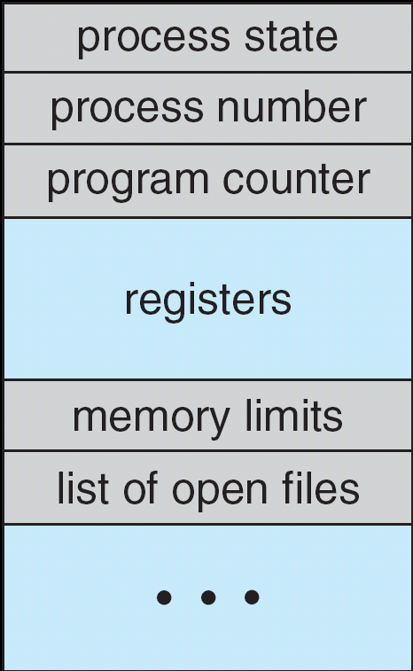
Recall: The Process Control Block
Kernel represents each process as a process control block (PCB)
  Status (running, ready, blocked, …)
  Register state (when not ready)
  Process ID (PID), User, Executable, Priority, …
  Execution time, …
  Memory space, translation, …
Kernel Scheduler maintains a data structure containing the PCBs
  Give out CPU to different processes
  This is a Policy Decision
Give out non-CPU resources
  Memory/IO
  Another policy decision
Process
Control
Block

Slide 19
Process-Specific File Descriptor Table inside Kernel
Process
Suppose that we execute
open(“foo.txt”)
and that the result is 3
Thread’s Regs
Address Space (Memory)
…
User Space
Kernel Space
File Descriptors
Open File Description
3
Not shown: Initially contains 0, 1, and 2 (stdin, stdout, stderr)
File: foo.txt
Position: 0

Slide 20
Process-Specific File Descriptor Table inside Kernel
Process
Suppose that we execute
open(“foo.txt”)
and that the result is 3
Next, suppose that we execute
read(3, buf, 100)
and that the result is 100
Thread’s Regs
Address Space (Memory)
…
User Space
Kernel Space
File Descriptors
Open File Description
3
Not shown: Initially contains 0, 1, and 2 (stdin, stdout, stderr)
File: foo.txt
Position: 0

Slide 21
Process-Specific File Descriptor Table inside Kernel
Process
Suppose that we execute
open(“foo.txt”)
and that the result is 3
Next, suppose that we execute
read(3, buf, 100)
and that the result is 100
Thread’s Regs
Address Space (Memory)
…
User Space
Kernel Space
File Descriptors
Open File Description
3
Not shown: Initially contains 0, 1, and 2 (stdin, stdout, stderr)
File: foo.txt
Position: 100

Slide 22
Process-Specific File Descriptor Table inside Kernel
Process
Suppose that we execute
open(“foo.txt”)
and that the result is 3
Next, suppose that we execute
read(3, buf, 100)
and that the result is 100
Finally, suppose that we execute
close(3)
Thread’s Regs
Address Space (Memory)
…
User Space
Kernel Space
File Descriptors
Open File Description
3
Not shown: Initially contains 0, 1, and 2 (stdin, stdout, stderr)
File: foo.txt
Position: 100

Slide 23
Instead of Closing, let’s fork()!
Process 1
Process 2
Thread’s Regs
Address Space (Memory)
File descriptor is copied
Open file description is aliased
Thread’s Regs
Address Space (Memory)
…
…
User Space
Kernel Space
File Descriptors
File Descriptors
Open File Description
3
3
Not shown: Initially contains 0, 1, and 2 (stdin, stdout, stderr)
File: foo.txt
Position: 100

Slide 24
Open File Description is Aliased
Process 1
Process 2
read(3, buf, 100)
Thread’s Regs
Address Space (Memory)
Thread’s Regs
Address Space (Memory)
…
…
User Space
Kernel Space
File Descriptors
File Descriptors
Open File Description
3
3
Not shown: Initially contains 0, 1, and 2 (stdin, stdout, stderr)
File: foo.txt
Position: 100

Slide 25
Open File Description is Aliased
Process 1
Process 2
read(3, buf, 100)
Thread’s Regs
Address Space (Memory)
Thread’s Regs
Address Space (Memory)
…
…
User Space
Kernel Space
File Descriptors
File Descriptors
Open File Description
3
3
Not shown: Initially contains 0, 1, and 2 (stdin, stdout, stderr)
File: foo.txt
Position: 200

Slide 26
Open File Description is Aliased
Process 1
Process 2
read(3, buf, 100)
read(3, buf, 100)
Thread’s Regs
Address Space (Memory)
Thread’s Regs
Address Space (Memory)
…
…
User Space
Kernel Space
File Descriptors
File Descriptors
Open File Description
3
3
Not shown: Initially contains 0, 1, and 2 (stdin, stdout, stderr)
File: foo.txt
Position: 200

Slide 27
Open File Description is Aliased
Process 1
Process 2
read(3, buf, 100)
read(3, buf, 100)
Thread’s Regs
Address Space (Memory)
Thread’s Regs
Address Space (Memory)
…
…
User Space
Kernel Space
File Descriptors
File Descriptors
Open File Description
3
3
Not shown: Initially contains 0, 1, and 2 (stdin, stdout, stderr)
File: foo.txt
Position: 300

Slide 28
File Descriptor is Copied
Process 1
Process 2
read(3, buf, 100)
close(3)
read(3, buf, 100)
Thread’s Regs
Address Space (Memory)
Thread’s Regs
Address Space (Memory)
…
…
User Space
Kernel Space
File Descriptors
File Descriptors
Open File Description
3
3
Not shown: Initially contains 0, 1, and 2 (stdin, stdout, stderr)
File: foo.txt
Position: 300

Slide 29
File Descriptor is Copied
Process 1
Process 2
read(3, buf, 100)
close(3)
read(3, buf, 100)
Thread’s Regs
Address Space (Memory)
Thread’s Regs
Address Space (Memory)
Open file description remains alive until no file descriptors in any process refer to it
…
…
User Space
Kernel Space
File Descriptors
File Descriptors
Open File Description
3
Not shown: Initially contains 0, 1, and 2 (stdin, stdout, stderr)
File: foo.txt
Position: 300

Slide 30
Why is Aliasing the Open File Description a Good Idea?
It allows for shared resources between processes

Slide 31
Example: Shared Terminal Emulator
When you fork() a process, the parent’s and child’s printf outputs go to the same terminal

Slide 32
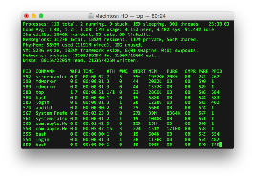
Example: Shared Terminal Emulator
Process 1
Process 2
Thread’s Regs
Address Space (Memory)
Thread’s Regs
Address Space (Memory)
…
…
User Space
Kernel Space
Terminal Emulator
File Descriptors
File Descriptors
0
1
2
0
1
2

Slide 33
Example: Shared Terminal Emulator
Process 1
Process 2
close(0)
Thread’s Regs
Address Space (Memory)
Thread’s Regs
Address Space (Memory)
…
…
User Space
Kernel Space
Terminal Emulator
File Descriptors
File Descriptors
0
1
2
0
1
2

Slide 34
Example: Shared Terminal Emulator
Process 1
Process 2
close(0)
Thread’s Regs
Address Space (Memory)
Thread’s Regs
Address Space (Memory)
If one process closes stdin (0), it remains open in other processes
…
…
User Space
Kernel Space
Terminal Emulator
File Descriptors
File Descriptors
0
1
2
0
1
2

Slide 35
Single-Process Pipe Example (not that interesting yet!)
#include <unistd.h>
int main(int argc, char *argv[])
{
char *msg = "Message in a pipe.\n";
char buf[BUFSIZE];
int pipe_fd[2];
if (pipe(pipe_fd) == -1) {
fprintf (stderr, "Pipe failed.\n"); return EXIT_FAILURE;
}
ssize_t writelen = write(pipe_fd[1], msg, strlen(msg)+1);
printf("Sent: %s [%ld, %ld]\n", msg, strlen(msg)+1, writelen);
ssize_t readlen = read(pipe_fd[0], buf, BUFSIZE);
printf("Rcvd: %s [%ld]\n", msg, readlen);
close(pipe_fd[0]);
close(pipe_fd[1]);
}
Could be useful for multithreaded processes…

Slide 36
Example: Pipes Between Processes
Parent Process
Child Process
pipe(…)
fork()
Thread’s Regs
Address Space (Memory)
Thread’s Regs
Address Space (Memory)
…
…
User Space
Kernel Space
File Descriptors
File Descriptors
3
4
3
4
In
Out
Pipe

Slide 37
Example: Channel from Parent ⇒ Child
Child Process
Parent Process
Child Process
Parent Process
pipe(…)
fork()
close(3)
pipe(…)
fork()
close(3)
close(4)
close(4)
Thread’s Regs
Thread’s Regs
Address Space (Memory)
Thread’s Regs
Address Space (Memory)
Thread’s Regs
Address Space (Memory)
Address Space (Memory)
…
…
…
…
User Space
User Space
Kernel Space
Kernel Space
File Descriptors
File Descriptors
File Descriptors
File Descriptors
3
4
3
4
3
4
In
Out
In
Out
Pipe
Pipe

Slide 38
Inter-Process Communication (IPC): Parent ⇒ Child
// continuing from earlier
pid_t pid = fork();
if (pid < 0) {
fprintf (stderr, "Fork failed.\n");
return EXIT_FAILURE;
}
if (pid != 0) {
close(pipe_fd[0]); // Not using this descriptor!
ssize_t writelen = write(pipe_fd[1], msg, msglen);
printf("Parent: %s [%ld, %ld]\n", msg, msglen, writelen);
} else {
close(pipe_fd[1]); // Not using this descriptor!
ssize_t readlen = read(pipe_fd[0], buf, BUFSIZE);
printf("Child Rcvd: %s [%ld]\n", msg, readlen);
}

Slide 39
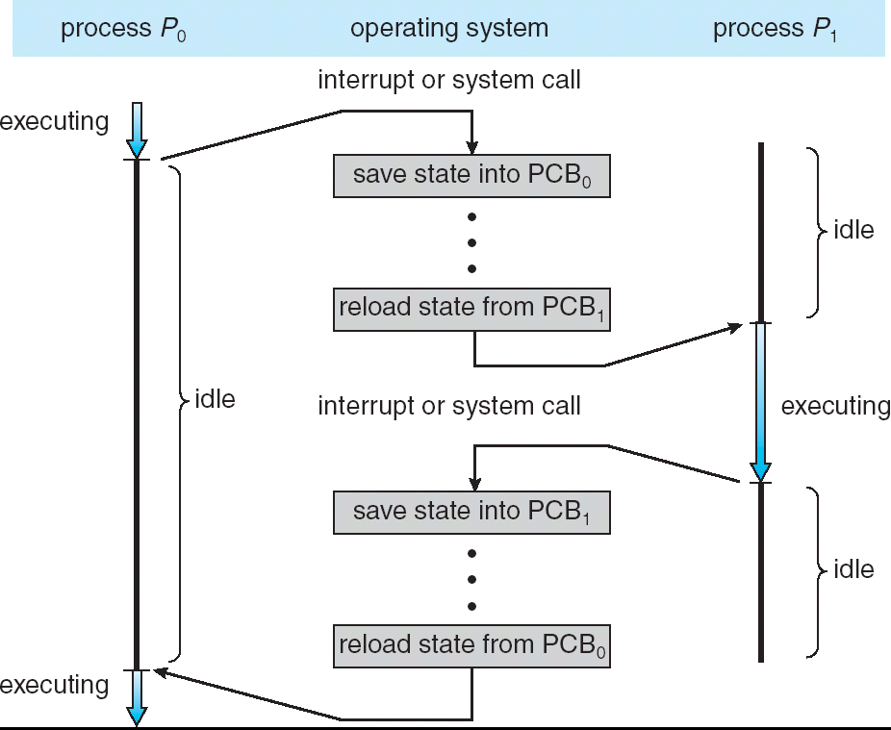
Recall: CPU Switch From Process A to Process B
User Mode
Kernel/System Mode
User Mode

Slide 40
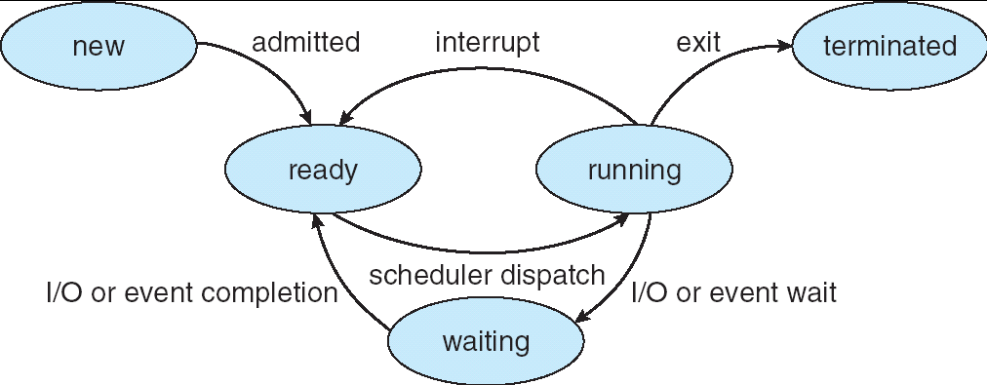
Lifecycle of a Process
As a process executes, it changes state:
  new: The process is being created
  ready: The process is waiting to run
  running: Instructions are being executed
  waiting: Process waiting for some event to occur
  terminated: The process has finished execution

Slide 41
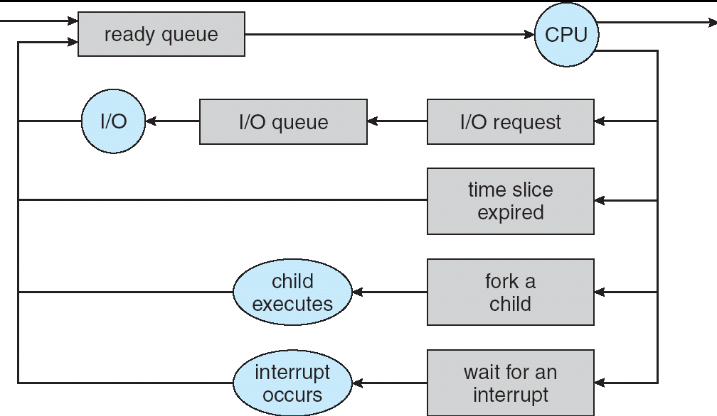
Process Scheduling
PCBs move from queue to queue as they change state
  Decisions about which order to remove from queues are Scheduling decisions
  Many algorithms possible (few weeks from now)

Slide 42
Ready Queue And Various I/O Device Queues
Process not running ⇒ PCB is in some scheduler queue
  Separate queue for each device/signal/condition
  Each queue can have a different scheduler policy
Ready
Queue
Head
Other
State
PCB₉
Link
Other
State
PCB₆
Link
Other
State
PCB₁₆
Link
Tail
Registers
Registers
Registers
USB
Unit 0
Head
Tail
Disk
Unit 0
Head
Other
State
PCB₂
Link
Other
State
PCB₃
Link
Tail
Registers
Registers
Disk
Unit 2
Head
Tail
Other
State
PCB₈
Ether
Netwk 0
Link
Head
Tail
Registers

Slide 43
Recall: Modern Process with Threads
Thread: a sequential execution stream within process
(Sometimes called a “Lightweight process”)
  Process still contains a single Address Space
  No protection between threads
Multithreading: a single program made up of a number of different concurrent activities
  Sometimes called multitasking, as in Ada …
Why separate the concept of a thread from that of a process?
  Discuss the “thread” part of a process (concurrency)
  Separate from the “address space” (protection)
  Heavyweight Process ≡ Process with one thread

Slide 44
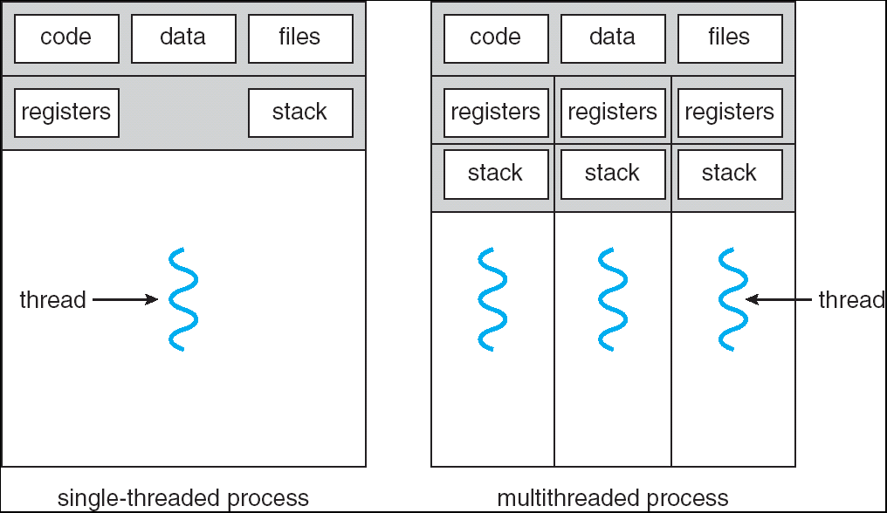
Recall: Single and Multithreaded Processes
Threads encapsulate concurrency: “Active” component
Address spaces encapsulate protection: “Passive” part
  Keeps buggy program from trashing the system
Why have multiple threads per address space?
Notes:
Sometimes need parallelism for a single job, and processes are very expensive – to start, switch between, and to communicate between

Slide 45
Recall: Thread State
State shared by all threads in process/address space
  Content of memory (global variables, heap)
  I/O state (file descriptors, network connections, etc)
State “private” to each thread
  Kept in TCB ≡ Thread Control Block
  CPU registers (including, program counter)
  Execution stack – what is this?
Execution Stack
  Parameters, temporary variables
  Return PCs are kept while called procedures are executing

Slide 46
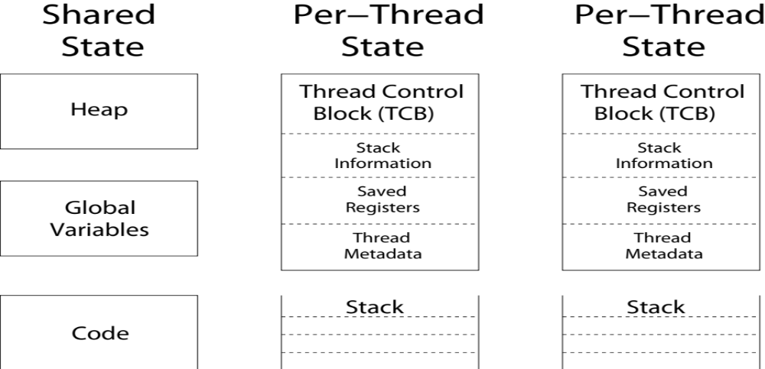
Shared vs. Per-Thread State

Slide 47
Memory Footprint: Two-Threads
If we stopped this program and examined it with a debugger, we would see
  Two sets of CPU registers
  Two sets of Stacks
Questions:
  How do we position stacks relative to
  each other?
  What maximum size should we choose
  for the stacks?
  What happens if threads violate this?
  How might you catch violations?
Stack 1
Stack 2
Address Space
Heap
Global Data
Code

Slide 48
Recall: Use of Threads
Version of program with Threads (loose syntax):
main() {
ThreadFork(ComputePI, “pi.txt” ));
ThreadFork(PrintClassList, “classlist.txt”));
}
What does ThreadFork() do?
  Start independent thread running given procedure
What is the behavior here?
  Now, you would actually see the class list
  This should behave as if there are two separate CPUs
CPU1
CPU2
CPU1
CPU2
CPU1
CPU2
Time

Slide 49
The Core of Concurrency: the Dispatch Loop
Conceptually, the scheduling loop of the operating system looks as follows:
Loop {
RunThread();
ChooseNextThread();
SaveStateOfCPU(curTCB);
LoadStateOfCPU(newTCB);
}
This is an infinite loop
  One could argue that this is all that the OS does
Should we ever exit this loop???
  When would that be?
Notes:
Emergency crash of operating system called “panic()”

Slide 50
Conclusion
Recall: Everything is a file!
  open(), read(), write(), and close() used for wide variety of I/O:
  Devices (terminals, printers, etc.)
  Regular files on disk
  Networking (sockets)
  Local interprocess communication (pipes, sockets)
Processes have two parts
  Threads (Concurrency)
  Address Spaces (Protection)
Various textbooks talk about processes
  When this concerns concurrency, really talking about thread portion of a process
  When this concerns protection, talking about address space portion of a process
Stack is essential part of computation
  Every thread has two stacks: user-level (in address space) and kernel
  The kernel stack + support often called the “kernel thread”

