Slide 1
CS162
Operating Systems and
Systems Programming
Lecture 10
Synchronization 4: Readers/Writers
Scheduling Intro: Pintos Concurrency, FCFS
February 20st, 2024
Prof. John Kubiatowicz
http://cs162.eecs.Berkeley.edu

Slide 2

Recall: Bounded Buffer, 3rd cut (coke machine)
Semaphore fullSlots = 0; // Initially, no coke
Semaphore emptySlots = bufSize;
// Initially, num empty slots
Semaphore mutex = 1; // No one using machine
Producer(item) {
semaP(&emptySlots); // Wait until space
semaP(&mutex); // Wait until machine free
Enqueue(item);
semaV(&mutex);
semaV(&fullSlots); // Tell consumers there is
// more coke
}
Consumer() {
semaP(&fullSlots); // Check if there’s a coke
semaP(&mutex); // Wait until machine free
item = Dequeue();
semaV(&mutex);
semaV(&emptySlots); // tell producer need more
return item;
}
Critical sections using mutex protect integrity of the queue
fullSlots signals coke
emptySlots
signals space

Slide 3
Recall: Monitors and Condition Variables
Monitor: a lock and zero or more condition variables for managing concurrent access to shared data
  Use of Monitors is a programming paradigm
  Some languages like Java provide monitors in the language
Condition Variable: a queue of threads waiting for something inside a critical section
  Key idea: allow sleeping inside critical section by atomically releasing lock at time we go to sleep
  Contrast to semaphores: Can’t wait inside critical section
Operations:
  Wait(&lock): Atomically release lock and go to sleep. Re-acquire lock later, before returning.
  Signal(): Wake up one waiter, if any
  Broadcast(): Wake up all waiters
Rule: Must hold lock when doing condition variable ops!

Slide 4
Recall: Bounded Buffer – 4rd cut (Monitors, pthread-like)
lock buf_lock = <initially unlocked>
condition producer_CV = <initially empty>
condition consumer_CV = <initially empty>
Producer(item) {
acquire(&buf_lock);
while (buffer full) { cond_wait(&producer_CV, &buf_lock); }
enqueue(item);
cond_signal(&consumer_CV);
release(&buf_lock);
}
What does thread do when it is waiting?
- Sleep, not busywait!
Consumer() {
acquire(buf_lock);
while (buffer empty) { cond_wait(&consumer_CV, &buf_lock); }
item = dequeue();
cond_signal(&producer_CV);
release(buf_lock);
return item
}

Slide 5

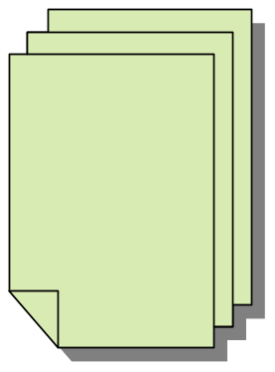



Readers/Writers Problem
W
R
R
R
Motivation: Consider a shared database
  Two classes of users:
    Readers – never modify database
    Writers – read and modify database
  Is using a single lock on the whole database sufficient?
    Like to have many readers at the same time
    Only one writer at a time

Slide 6
Basic Structure of Mesa Monitor Program
Monitors represent the synchronization logic of the program
  Wait if necessary
  Signal when change something so any waiting threads can proceed
Basic structure of mesa monitor-based program:
  lock
  while (need to wait) {
  condvar.wait();
  }
  unlock
  do something so no need to wait
  lock
  condvar.signal();
  unlock
Check and/or update
state variables
Wait if necessary
Check and/or update
state variables

Slide 7
Basic Readers/Writers Solution
Correctness Constraints:
  Readers can access database when no writers
  Writers can access database when no readers or writers
  Only one thread manipulates state variables at a time
Basic structure of a solution:
  Reader()
  Wait until no writers
  Access data base
  Check out – wake up a waiting writer
  Writer()
  Wait until no active readers or writers
  Access database
  Check out – wake up waiting readers or writer
  State variables (Protected by a lock called “lock”):
    int AR: Number of active readers; initially = 0
    int WR: Number of waiting readers; initially = 0
    int AW: Number of active writers; initially = 0
    int WW: Number of waiting writers; initially = 0
    Condition okToRead = NIL
    Condition okToWrite = NIL

Slide 8
Code for a Reader
Reader() {
// First check self into system
acquire(&lock);
while ((AW + WW) > 0) { // Is it safe to read?
WR++; // No. Writers exist
cond_wait(&okToRead,&lock);// Sleep on cond var
WR--; // No longer waiting
}
AR++; // Now we are active!
release(&lock);
// Perform actual read-only access
AccessDatabase(ReadOnly);
// Now, check out of system
acquire(&lock);
AR--; // No longer active
if (AR == 0 && WW > 0) // No other active readers
cond_signal(&okToWrite);// Wake up one writer
release(&lock);
}
Why Release the Lock here?

Slide 9
Code for a Writer
Writer() {
// First check self into system
acquire(&lock);
while ((AW + AR) > 0) { // Is it safe to write?
WW++; // No. Active users exist
cond_wait(&okToWrite,&lock); // Sleep on cond var
WW--; // No longer waiting
}
AW++; // Now we are active!
release(&lock);
// Perform actual read/write access
AccessDatabase(ReadWrite);
// Now, check out of system
acquire(&lock);
AW--; // No longer active
if (WW > 0){ // Give priority to writers
cond_signal(&okToWrite);// Wake up one writer
} else if (WR > 0) { // Otherwise, wake reader
cond_broadcast(&okToRead); // Wake all readers
}
release(&lock);
}
Why broadcast() here instead of signal()?
Why Give priority to writers?

Slide 10
Simulation of Readers/Writers Solution
Use an example to simulate the solution
Consider the following sequence of operators:
  R1, R2, W1, R3
Initially: AR = 0, WR = 0, AW = 0, WW = 0

Slide 11
Simulation of Readers/Writers Solution
R1 comes along (no waiting threads)
AR = 0, WR = 0, AW = 0, WW = 0
Reader() {
acquire(&lock)
while ((AW + WW) > 0) { // Is it safe to read?
WR++; // No. Writers exist
cond_wait(&okToRead,&lock);// Sleep on cond var
WR--; // No longer waiting
}
AR++; // Now we are active!
release(&lock);
AccessDBase(ReadOnly);
acquire(&lock);
AR--;
if (AR == 0 && WW > 0)
cond_signal(&okToWrite);
release(&lock);
}

Slide 12
Simulation of Readers/Writers Solution
R1 comes along (no waiting threads)
AR = 0, WR = 0, AW = 0, WW = 0
Reader() {
acquire(&lock);
while ((AW + WW) > 0) { // Is it safe to read?
WR++; // No. Writers exist
cond_wait(&okToRead,&lock);// Sleep on cond var
WR--; // No longer waiting
}
AR++; // Now we are active!
release(&lock);
AccessDBase(ReadOnly);
acquire(&lock);
AR--;
if (AR == 0 && WW > 0)
cond_signal(&okToWrite);
release(&lock);
}

Slide 13
Simulation of Readers/Writers Solution
R1 comes along (no waiting threads)
AR = 1, WR = 0, AW = 0, WW = 0
Reader() {
acquire(&lock);
while ((AW + WW) > 0) { // Is it safe to read?
WR++; // No. Writers exist
cond_wait(&okToRead,&lock);// Sleep on cond var
WR--; // No longer waiting
}
AR++; // Now we are active!
release(&lock);
AccessDBase(ReadOnly);
acquire(&lock);
AR--;
if (AR == 0 && WW > 0)
cond_signal(&okToWrite);
release(&lock);
}

Slide 14
Simulation of Readers/Writers Solution
R1 comes along (no waiting threads)
AR = 1, WR = 0, AW = 0, WW = 0
Reader() {
acquire(&lock);
while ((AW + WW) > 0) { // Is it safe to read?
WR++; // No. Writers exist
cond_wait(&okToRead,&lock);// Sleep on cond var
WR--; // No longer waiting
}
AR++; // Now we are active!
release(&lock);
AccessDBase(ReadOnly);
acquire(&lock);
AR--;
if (AR == 0 && WW > 0)
cond_signal(&okToWrite);
release(&lock);
}
Why release the
lock here???

Slide 15
Simulation of Readers/Writers Solution
R1 accessing dbase (no other threads)
AR = 1, WR = 0, AW = 0, WW = 0
Reader() {
acquire(&lock);
while ((AW + WW) > 0) { // Is it safe to read?
WR++; // No. Writers exist
cond_wait(&okToRead,&lock);// Sleep on cond var
WR--; // No longer waiting
}
AR++; // Now we are active!
release(&lock);
AccessDBase(ReadOnly);
acquire(&lock);
AR--;
if (AR == 0 && WW > 0)
cond_signal(&okToWrite);
release(&lock);
}

Slide 16
Simulation of Readers/Writers Solution
R2 comes along (R1 accessing dbase)
AR = 1, WR = 0, AW = 0, WW = 0
Reader() {
acquire(&lock);
while ((AW + WW) > 0) { // Is it safe to read?
WR++; // No. Writers exist
cond_wait(&okToRead,&lock);// Sleep on cond var
WR--; // No longer waiting
}
AR++; // Now we are active!
release(&lock);
AccessDBase(ReadOnly);
acquire(&lock);
AR--;
if (AR == 0 && WW > 0)
cond_signal(&okToWrite);
release(&lock);
}

Slide 17
Simulation of Readers/Writers Solution
R2 comes along (R1 accessing dbase)
AR = 1, WR = 0, AW = 0, WW = 0
Reader() {
acquire(&lock);
while ((AW + WW) > 0) { // Is it safe to read?
WR++; // No. Writers exist
cond_wait(&okToRead,&lock);// Sleep on cond var
WR--; // No longer waiting
}
AR++; // Now we are active!
release(&lock);
AccessDBase(ReadOnly);
acquire(&lock);
AR--;
if (AR == 0 && WW > 0)
cond_signal(&okToWrite);
release(&lock);
}

Slide 18
Simulation of Readers/Writers Solution
R2 comes along (R1 accessing dbase)
AR = 2, WR = 0, AW = 0, WW = 0
Reader() {
acquire(&lock);
while ((AW + WW) > 0) { // Is it safe to read?
WR++; // No. Writers exist
cond_wait(&okToRead,&lock);// Sleep on cond var
WR--; // No longer waiting
}
AR++; // Now we are active!
release(&lock);
AccessDBase(ReadOnly);
acquire(&lock);
AR--;
if (AR == 0 && WW > 0)
cond_signal(&okToWrite);
release(&lock);
}

Slide 19
Simulation of Readers/Writers Solution
R2 comes along (R1 accessing dbase)
AR = 2, WR = 0, AW = 0, WW = 0
Reader() {
acquire(&lock);
while ((AW + WW) > 0) { // Is it safe to read?
WR++; // No. Writers exist
cond_wait(&okToRead,&lock);// Sleep on cond var
WR--; // No longer waiting
}
AR++; // Now we are active!
release(&lock);
AccessDBase(ReadOnly);
acquire(&lock);
AR--;
if (AR == 0 && WW > 0)
cond_signal(&okToWrite);
release(&lock);
}

Slide 20
Simulation of Readers/Writers Solution
R1 and R2 accessing dbase
AR = 2, WR = 0, AW = 0, WW = 0
Reader() {
acquire(&lock);
while ((AW + WW) > 0) { // Is it safe to read?
WR++; // No. Writers exist
cond_wait(&okToRead,&lock);// Sleep on cond var
WR--; // No longer waiting
}
AR++; // Now we are active!
release(&lock);
AccessDBase(ReadOnly);
acquire(&lock);
AR--;
if (AR == 0 && WW > 0)
cond_signal(&okToWrite);
release(&lock);
}
Assume readers take a while to access database
  Situation: Locks released, only AR is non-zero

Slide 21
Simulation of Readers/Writers Solution
W1 comes along (R1 and R2 are still accessing dbase)
AR = 2, WR = 0, AW = 0, WW = 0
Writer() {
acquire(&lock);
while ((AW + AR) > 0) { // Is it safe to write?
WW++; // No. Active users exist
cond_wait(&okToWrite,&lock);// Sleep on cond var
WW--; // No longer waiting
}
AW++;
release(&lock);
AccessDBase(ReadWrite);
acquire(&lock);
AW--;
if (WW > 0){
cond_signal(&okToWrite);
} else if (WR > 0) {
cond_broadcast(&okToRead);
}
release(&lock);
}

Slide 22
Simulation of Readers/Writers Solution
W1 comes along (R1 and R2 are still accessing dbase)
AR = 2, WR = 0, AW = 0, WW = 0
Writer() {
acquire(&lock);
while ((AW + AR) > 0) { // Is it safe to write?
WW++; // No. Active users exist
cond_wait(&okToWrite,&lock);// Sleep on cond var
WW--; // No longer waiting
}
AW++;
release(&lock);
AccessDBase(ReadWrite);
acquire(&lock);
AW--;
if (WW > 0){
cond_signal(&okToWrite);
} else if (WR > 0) {
cond_broadcast(&okToRead);
}
release(&lock);
}

Slide 23
Simulation of Readers/Writers Solution
W1 comes along (R1 and R2 are still accessing dbase)
AR = 2, WR = 0, AW = 0, WW = 1
Writer() {
acquire(&lock);
while ((AW + AR) > 0) { // Is it safe to write?
WW++; // No. Active users exist
cond_wait(&okToWrite,&lock);// Sleep on cond var
WW--; // No longer waiting
}
AW++;
release(&lock);
AccessDBase(ReadWrite);
acquire(&lock);
AW--;
if (WW > 0){
cond_signal(&okToWrite);
} else if (WR > 0) {
cond_broadcast(&okToRead);
}
release(&lock);
}
W1 cannot start because of readers

Slide 24
Simulation of Readers/Writers Solution
R3 comes along (R1 and R2 accessing dbase, W1 waiting)
AR = 2, WR = 0, AW = 0, WW = 1
Reader() {
acquire(&lock);
while ((AW + WW) > 0) { // Is it safe to read?
WR++; // No. Writers exist
cond_wait(&okToRead,&lock);// Sleep on cond var
WR--; // No longer waiting
}
AR++; // Now we are active!
release(&lock);
AccessDBase(ReadOnly);
acquire(&lock);
AR--;
if (AR == 0 && WW > 0)
cond_signal(&okToWrite);
release(&lock);
}

Slide 25
Simulation of Readers/Writers Solution
R3 comes along (R1 and R2 accessing dbase, W1 waiting)
AR = 2, WR = 0, AW = 0, WW = 1
Reader() {
acquire(&lock);
while ((AW + WW) > 0) { // Is it safe to read?
WR++; // No. Writers exist
cond_wait(&okToRead,&lock);// Sleep on cond var
WR--; // No longer waiting
}
AR++; // Now we are active!
release(&lock);
AccessDBase(ReadOnly);
acquire(&lock);
AR--;
if (AR == 0 && WW > 0)
cond_signal(&okToWrite);
release(&lock);
}

Slide 26
Simulation of Readers/Writers Solution
R3 comes along (R1 and R2 accessing dbase, W1 waiting)
AR = 2, WR = 1, AW = 0, WW = 1
Reader() {
acquire(&lock);
while ((AW + WW) > 0) { // Is it safe to read?
WR++; // No. Writers exist
cond_wait(&okToRead,&lock);// Sleep on cond var
WR--; // No longer waiting
}
AR++; // Now we are active!
lock.release();
AccessDBase(ReadOnly);
acquire(&lock);
AR--;
if (AR == 0 && WW > 0)
cond_signal(&okToWrite);
release(&lock);
}

Slide 27
Simulation of Readers/Writers Solution
R3 comes along (R1, R2 accessing dbase, W1 waiting)
AR = 2, WR = 1, AW = 0, WW = 1
Reader() {
acquire(&lock);
while ((AW + WW) > 0) { // Is it safe to read?
WR++; // No. Writers exist
cond_wait(&okToRead,&lock);// Sleep on cond var
WR--; // No longer waiting
}
AR++; // Now we are active!
release(&lock);
AccessDBase(ReadOnly);
acquire(&lock);
AR--;
if (AR == 0 && WW > 0)
cond_signal(&okToWrite);
release(&lock);
}
R3 cannot start because of writers (both AW & WW)

Slide 28
Simulation of Readers/Writers Solution
R1 and R2 accessing dbase, W1 and R3 waiting
AR = 2, WR = 1, AW = 0, WW = 1
Reader() {
acquire(&lock);
while ((AW + WW) > 0) { // Is it safe to read?
WR++; // No. Writers exist
cond_wait(&okToRead,&lock);// Sleep on cond var
WR--; // No longer waiting
}
AR++; // Now we are active!
release(&lock);
AccessDBase(ReadOnly);
acquire(&lock);
AR--;
if (AR == 0 && WW > 0)
cond_signal(&okToWrite);
release(&lock);
}
Status:
R1 and R2 still reading
W1 and R3 waiting on okToWrite and okToRead, respectively

Slide 29
Simulation of Readers/Writers Solution
R2 finishes (R1 accessing dbase, W1 and R3 waiting)
AR = 2, WR = 1, AW = 0, WW = 1
Reader() {
acquire(&lock);
while ((AW + WW) > 0) { // Is it safe to read?
WR++; // No. Writers exist
cond_wait(&okToRead,&lock);// Sleep on cond var
WR--; // No longer waiting
}
AR++; // Now we are active!
release(&lock);
AccessDBase(ReadOnly);
acquire(&lock);
AR--;
if (AR == 0 && WW > 0)
cond_signal(&okToWrite);
release(&lock);
}

Slide 30
Simulation of Readers/Writers Solution
R2 finishes (R1 accessing dbase, W1 and R3 waiting)
AR = 1, WR = 1, AW = 0, WW = 1
Reader() {
acquire(&lock);
while ((AW + WW) > 0) { // Is it safe to read?
WR++; // No. Writers exist
cond_wait(&okToRead,&lock);// Sleep on cond var
WR--; // No longer waiting
}
AR++; // Now we are active!
release(&lock);
AccessDBase(ReadOnly);
acquire(&lock);
AR--;
if (AR == 0 && WW > 0)
cond_signal(&okToWrite);
release(&lock);
}

Slide 31
Simulation of Readers/Writers Solution
R2 finishes (R1 accessing dbase, W1 and R3 waiting)
AR = 1, WR = 1, AW = 0, WW = 1
Reader() {
acquire(&lock);
while ((AW + WW) > 0) { // Is it safe to read?
WR++; // No. Writers exist
cond_wait(&okToRead,&lock);// Sleep on cond var
WR--; // No longer waiting
}
AR++; // Now we are active!
release(&lock);
AccessDBase(ReadOnly);
acquire(&lock);
AR--;
if (AR == 0 && WW > 0)
cond_signal(&okToWrite);
release(&lock);
}

Slide 32
Simulation of Readers/Writers Solution
R2 finishes (R1 accessing dbase, W1 and R3 waiting)
AR = 1, WR = 1, AW = 0, WW = 1
Reader() {
acquire(&lock);
while ((AW + WW) > 0) { // Is it safe to read?
WR++; // No. Writers exist
cond_wait(&okToRead,&lock);// Sleep on cond var
WR--; // No longer waiting
}
AR++; // Now we are active!
release(&lock);
AccessDBase(ReadOnly);
acquire(&lock);
AR--;
if (AR == 0 && WW > 0)
cond_signal(&okToWrite);
release(&lock);
}

Slide 33
Simulation of Readers/Writers Solution
R1 finishes (W1 and R3 waiting)
AR = 1, WR = 1, AW = 0, WW = 1
Reader() {
acquire(&lock);
while ((AW + WW) > 0) { // Is it safe to read?
WR++; // No. Writers exist
cond_wait(&okToRead,&lock);// Sleep on cond var
WR--; // No longer waiting
}
AR++; // Now we are active!
release(&lock);
AccessDBase(ReadOnly);
acquire(&lock);
AR--;
if (AR == 0 && WW > 0)
cond_signal(&okToWrite);
release(&lock);
}

Slide 34
Simulation of Readers/Writers Solution
R1 finishes (W1, R3 waiting)
AR = 0, WR = 1, AW = 0, WW = 1
Reader() {
acquire(&lock);
while ((AW + WW) > 0) { // Is it safe to read?
WR++; // No. Writers exist
cond_wait(&okToRead,&lock);// Sleep on cond var
WR--; // No longer waiting
}
AR++; // Now we are active!
release(&lock);
AccessDBase(ReadOnly);
acquire(&lock);
AR--;
if (AR == 0 && WW > 0)
cond_signal(&okToWrite);
release(&lock);
}

Slide 35
Simulation of Readers/Writers Solution
R1 finishes (W1, R3 waiting)
AR = 0, WR = 1, AW = 0, WW = 1
Reader() {
acquire(&lock);
while ((AW + WW) > 0) { // Is it safe to read?
WR++; // No. Writers exist
cond_wait(&okToRead,&lock);// Sleep on cond var
WR--; // No longer waiting
}
AR++; // Now we are active!
release(&lock);
AccessDBase(ReadOnly);
acquire(&lock);
AR--;
if (AR == 0 && WW > 0)
cond_signal(&okToWrite);
release(&lock);
}

Slide 36
Simulation of Readers/Writers Solution
R1 signals a writer (W1 and R3 waiting)
AR = 0, WR = 1, AW = 0, WW = 1
Reader() {
acquire(&lock);
while ((AW + WW) > 0) { // Is it safe to read?
WR++; // No. Writers exist
cond_wait(&okToRead,&lock);// Sleep on cond var
WR--; // No longer waiting
}
AR++; // Now we are active!
release(&lock);
AccessDBase(ReadOnly);
acquire(&lock);
AR--;
if (AR == 0 && WW > 0)
cond_signal(&okToWrite);
release(&lock);
}
All readers done,
Signal writer W1

Slide 37
Simulation of Readers/Writers Solution
W1 gets signal (R3 still waiting)
AR = 0, WR = 1, AW = 0, WW = 1
Writer() {
acquire(&lock);
while ((AW + AR) > 0) { // Is it safe to write?
WW++; // No. Active users exist
cond_wait(&okToWrite,&lock);// Sleep on cond var
WW--; // No longer waiting
}
AW++;
release(&lock);
AccessDBase(ReadWrite);
acquire(&lock);
AW--;
if (WW > 0){
cond_signal(&okToWrite);
} else if (WR > 0) {
cond_broadcast(&okToRead);
}
release(&lock);
}
Receive signal from R1

Slide 38
Simulation of Readers/Writers Solution
W1 gets signal (R3 still waiting)
AR = 0, WR = 1, AW = 0, WW = 0
Writer() {
acquire(&lock);
while ((AW + AR) > 0) { // Is it safe to write?
WW++; // No. Active users exist
cond_wait(&okToWrite,&lock);// Sleep on cond var
WW--; // No longer waiting
}
AW++;
release(&lock);
AccessDBase(ReadWrite);
acquire(&lock);
AW--;
if (WW > 0){
cond_signal(&okToWrite);
} else if (WR > 0) {
cond_broadcast(&okToRead);
}
release(&lock);
}

Slide 39
Simulation of Readers/Writers Solution
W1 gets signal (R3 still waiting)
AR = 0, WR = 1, AW = 1, WW = 0
Writer() {
acquire(&lock);
while ((AW + AR) > 0) { // Is it safe to write?
WW++; // No. Active users exist
cond_wait(&okToWrite,&lock);// Sleep on cond var
WW--; // No longer waiting
}
AW++;
release(&lock);
AccessDBase(ReadWrite);
acquire(&lock);
AW--;
if (WW > 0){
cond_signal(&okToWrite);
} else if (WR > 0) {
cond_broadcast(&okToRead);
}
release(&lock);
}

Slide 40
Simulation of Readers/Writers Solution
W1 accessing dbase (R3 still waiting)
AR = 0, WR = 1, AW = 1, WW = 0
Writer() {
acquire(&lock);
while ((AW + AR) > 0) { // Is it safe to write?
WW++; // No. Active users exist
cond_wait(&okToWrite,&lock);// Sleep on cond var
WW--; // No longer waiting
}
AW++;
release(&lock);
AccessDBase(ReadWrite);
acquire(&lock);
AW--;
if (WW > 0){
cond_signal(&okToWrite);
} else if (WR > 0) {
cond_broadcast(&okToRead);
}
release(&lock);
}

Slide 41
Simulation of Readers/Writers Solution
W1 finishes (R3 still waiting)
AR = 0, WR = 1, AW = 1, WW = 0
Writer() {
acquire(&lock);
while ((AW + AR) > 0) { // Is it safe to write?
WW++; // No. Active users exist
cond_wait(&okToWrite,&lock);// Sleep on cond var
WW--; // No longer waiting
}
AW++;
release(&lock);
AccessDBase(ReadWrite);
acquire(&lock);
AW--;
if (WW > 0){
cond_signal(&okToWrite);
} else if (WR > 0) {
cond_broadcast(&okToRead);
}
release(&lock);
}

Slide 42
Simulation of Readers/Writers Solution
W1 finishes (R3 still waiting)
AR = 0, WR = 1, AW = 0, WW = 0
Writer() {
acquire(&lock);
while ((AW + AR) > 0) { // Is it safe to write?
WW++; // No. Active users exist
cond_wait(&okToWrite,&lock);// Sleep on cond var
WW--; // No longer waiting
}
AW++;
release(&lock);
AccessDBase(ReadWrite);
acquire(&lock);
AW--;
if (WW > 0){
cond_signal(&okToWrite);
} else if (WR > 0) {
cond_broadcast(&okToRead);
}
release(&lock);
}

Slide 43
Simulation of Readers/Writers Solution
W1 finishes (R3 still waiting)
AR = 0, WR = 1, AW = 0, WW = 0
Writer() {
acquire(&lock);
while ((AW + AR) > 0) { // Is it safe to write?
WW++; // No. Active users exist
cond_wait(&okToWrite,&lock);// Sleep on cond var
WW--; // No longer waiting
}
AW++;
release(&lock);
AccessDBase(ReadWrite);
acquire(&lock);
AW--;
if (WW > 0){
cond_signal(&okToWrite);
} else if (WR > 0) {
cond_broadcast(&okToRead);
}
release(&lock);
}

Slide 44
Simulation of Readers/Writers Solution
W1 signaling readers (R3 still waiting)
AR = 0, WR = 1, AW = 0, WW = 0
Writer() {
acquire(&lock);
while ((AW + AR) > 0) { // Is it safe to write?
WW++; // No. Active users exist
cond_wait(&okToWrite,&lock);// Sleep on cond var
WW--; // No longer waiting
}
AW++;
release(&lock);
AccessDBase(ReadWrite);
acquire(&lock);
AW--;
if (WW > 0){
cond_signal(&okToWrite);
} else if (WR > 0) {
cond_broadcast(&okToRead);
}
release(&lock);
}
No waiting writers,
Signal reader R3

Slide 45
Simulation of Readers/Writers Solution
R3 gets signal (no waiting threads)
AR = 0, WR = 1, AW = 0, WW = 0
Reader() {
acquire(&lock);
while ((AW + WW) > 0) { // Is it safe to read?
WR++; // No. Writers exist
cond_wait(&okToRead,&lock);// Sleep on cond var
WR--; // No longer waiting
}
AR++; // Now we are active!
release(&lock);
AccessDBase(ReadOnly);
acquire(&lock);
AR--;
if (AR == 0 && WW > 0)
cond_signal(&okToWrite);
release(&lock);
}
Receive signal from W1

Slide 46
Simulation of Readers/Writers Solution
R3 gets signal (no waiting threads)
AR = 0, WR = 0, AW = 0, WW = 0
Reader() {
acquire(&lock);
while ((AW + WW) > 0) { // Is it safe to read?
WR++; // No. Writers exist
cond_wait(&okToRead,&lock);// Sleep on cond var
WR--; // No longer waiting
}
AR++; // Now we are active!
release(&lock);
AccessDBase(ReadOnly);
acquire(&lock);
AR--;
if (AR == 0 && WW > 0)
cond_signal(&okToWrite);
release(&lock);
}

Slide 47
Simulation of Readers/Writers Solution
R3 accessing dbase (no waiting threads)
AR = 1, WR = 0, AW = 0, WW = 0
Reader() {
acquire(&lock);
while ((AW + WW) > 0) { // Is it safe to read?
WR++; // No. Writers exist
cond_wait(&okToRead,&lock);// Sleep on cond var
WR--; // No longer waiting
}
AR++; // Now we are active!
release(&lock);
AccessDBase(ReadOnly);
acquire(&lock);
AR--;
if (AR == 0 && WW > 0)
cond_signal(&okToWrite);
release(&lock);
}

Slide 48
Simulation of Readers/Writers Solution
R3 finishes (no waiting threads)
AR = 1, WR = 0, AW = 0, WW = 0
Reader() {
acquire(&lock);
while ((AW + WW) > 0) { // Is it safe to read?
WR++; // No. Writers exist
cond_wait(&okToRead,&lock);// Sleep on cond var
WR--; // No longer waiting
}
AR++; // Now we are active!
release(&lock);
AccessDBase(ReadOnly);
acquire(&lock);
AR--;
if (AR == 0 && WW > 0)
cond_signal(&okToWrite);
release(&lock);
}

Slide 49
Simulation of Readers/Writers Solution
R3 finishes (no waiting threads)
AR = 0, WR = 0, AW = 0, WW = 0
Reader() {
acquire(&lock);
while ((AW + WW) > 0) { // Is it safe to read?
WR++; // No. Writers exist
cond_wait(&okToRead,&lock);// Sleep on cond var
WR--; // No longer waiting
}
AR++; // Now we are active!
release(&lock);
AccessDBase(ReadOnly);
acquire(&lock);
AR--;
if (AR == 0 && WW > 0)
cond_signal(&okToWrite);
release(&lock);
}
All DONE!
DBase is Idle

Slide 50
Administrivia
Still grading Midterm 1 (Sorry)
  Finishing soon!
  Solutions also will be up soon.
Homework #2 due Thursday, 2/22
Homework #3: Released on Friday 2/23
  Option to do this in Rust!
  Rust crash course on Monday 2/26
Professor Kubi’s office hours changed:
  Monday (1:00-2:00PM), Thursday (3:00-4:00PM)
  673 Soda Hall
FYI: Next Midterm on 3/14
  PI Day!

Slide 51
Questions
Can readers starve? Consider Reader() entry code:
  while ((AW + WW) > 0) { // Is it safe to read?
  WR++; // No. Writers exist
  cond_wait(&okToRead,&lock);// Sleep on cond var
  WR--; // No longer waiting
  }
AR++; // Now we are active!
What if we erase the condition check in Reader exit?
AR--; // No longer active
if (AR == 0 && WW > 0) // No other active readers
cond_signal(&okToWrite);// Wake up one writer
Further, what if we turn the signal() into broadcast()
AR--; // No longer active
cond_broadcast(&okToWrite); // Wake up sleepers
Finally, what if we use only one condition variable (call it “okContinue”) instead of two separate ones?
  Both readers and writers sleep on this variable
  Must use broadcast() instead of signal()

Slide 52
Use of Single CV: okContinue
Reader() {
// check into system
acquire(&lock);
while ((AW + WW) > 0) {
WR++;
cond_wait(&okContinue,&lock);
WR--;
}
AR++;
release(&lock);
// read-only access
AccessDbase(ReadOnly);
// check out of system
acquire(&lock);
AR--;
if (AR == 0 && WW > 0)
cond_signal(&okContinue);
release(&lock);
}
Writer() {
// check into system
acquire(&lock);
while ((AW + AR) > 0) {
WW++;
cond_wait(&okContinue,&lock);
WW--;
}
AW++;
release(&lock);
// read/write access
AccessDbase(ReadWrite);
// check out of system
acquire(&lock);
AW--;
if (WW > 0){
cond_signal(&okContinue);
} else if (WR > 0) {
cond_broadcast(&okContinue);
}
release(&lock);
}
What if we turn okToWrite and okToRead into okContinue
(i.e. use only one condition variable instead of two)?

Slide 53
Use of Single CV: okContinue
Reader() {
// check into system
acquire(&lock);
while ((AW + WW) > 0) {
WR++;
cond_wait(&okContinue,&lock);
WR--;
}
AR++;
release(&lock);
// read-only access
AccessDbase(ReadOnly);
// check out of system
acquire(&lock);
AR--;
if (AR == 0 && WW > 0)
cond_signal(&okContinue);
release(&lock);
}
Writer() {
// check into system
acquire(&lock);
while ((AW + AR) > 0) {
WW++;
cond_wait(&okContinue,&lock);
WW--;
}
AW++;
release(&lock);
// read/write access
AccessDbase(ReadWrite);
// check out of system
acquire(&lock);
AW--;
if (WW > 0){
cond_signal(&okContinue);
} else if (WR > 0) {
cond_broadcast(&okContinue);
}
release(&lock);
}
Consider this scenario:
R1 arrives
W1, R2 arrive while R1 still reading → W1 and R2 wait for R1 to finish
Assume R1’s signal is delivered to R2 (not W1)

Slide 54
Use of Single CV: okContinue
Reader() {
// check into system
acquire(&lock);
while ((AW + WW) > 0) {
WR++;
cond_wait(&okContinue,&lock);
WR--;
}
AR++;
release(&lock);
// read-only access
AccessDbase(ReadOnly);
// check out of system
acquire(&lock);
AR--;
if (AR == 0 && WW > 0)
cond_broadcast(&okContinue);
release(&lock);
}
Writer() {
// check into system
acquire(&lock);
while ((AW + AR) > 0) {
WW++;
cond_wait(&okContinue,&lock); WW--;
}
AW++;
release(&lock);
// read/write access
AccessDbase(ReadWrite);
// check out of system
acquire(&lock);
AW--;
if (WW > 0 || WR > 0){
cond_broadcast(&okContinue); }
release(&lock);
}
Need to change to broadcast()!
Must broadcast() to sort things out!

Slide 55
Can we construct Monitors from Semaphores?
Locking aspect is easy: Just use a mutex
Can we implement condition variables this way?
  Wait(Semaphore *thesema) { semaP(thesema); }
  Signal(Semaphore *thesema) { semaV(thesema); }
  Doesn’t work: Wait() may sleep with lock held
Does this work better?
  Wait(Lock *thelock, Semaphore *thesema) {
  release(thelock);
  semaP(thesema);
  acquire(thelock);
  }
  Signal(Semaphore *thesema) {
  semaV(thesema);
  }
  No: Condition vars have no history, semaphores have history:
    What if thread signals and no one is waiting? NO-OP
    What if thread later waits? Thread Waits
    What if thread V’s and noone is waiting? Increment
    What if thread later does P? Decrement and continue

Slide 56
Construction of Monitors from Semaphores (con’t)
Problem with previous try:
  P and V are commutative – result is the same no matter what order they occur
  Condition variables are NOT commutative
Does this fix the problem?
  Wait(Lock *thelock, Semaphore *thesema) {
  release(thelock);
  semaP(thesema);
  acquire(thelock);
  }
  Signal(Semaphore *thesema) {
  if semaphore queue is not empty
  semaV(thesema);
  }
  Not legal to look at contents of semaphore queue
  There is a race condition – signaler can slip in after lock release and before waiter executes semaphore.P()
It is actually possible to do this correctly
  Complex solution for Hoare scheduling in book
  Can you come up with simpler Mesa-scheduled solution?

Slide 57
C-Language Support for Synchronization
C language: Pretty straightforward synchronization
  Just make sure you know all the code paths out of a critical section
  int Rtn() {
  acquire(&lock);
  …
  if (exception) {
  release(&lock);
  return errReturnCode;
  }
  …
  release(&lock);
  return OK;
  }
  Watch out for setjmp/longjmp!
    Can cause a non-local jump out of procedure
    In example, procedure E calls longjmp, poping stack back to procedure B
    If Procedure C had lock.acquire, problem!
Proc A
Proc B
Calls setjmp
Stack growth
Proc C
acquire(&lock)
Proc D
Proc E
Calls longjmp

Slide 58
Concurrency and Synchronization in C
Harder with more locks
void Rtn() {
lock1.acquire();
…
if (error) {
lock1.release();
return;
}
…
lock2.acquire();
…
if (error) {
lock2.release()
lock1.release();
return;
}
…
lock2.release();
lock1.release();
}
Is goto a solution???
void Rtn() {
lock1.acquire();
…
if (error) {
goto release_lock1_and_return;
}
…
lock2.acquire();
…
if (error) {
goto release_both_and_return;
}
…
release_both_and_return:
lock2.release();
release_lock1_and_return:
lock1.release();
}

Slide 59
C++ Language Support for Synchronization
Languages with exceptions like C++
  Languages that support exceptions are problematic (easy to make a non-local exit without releasing lock)
  Consider:
  void Rtn() {
  lock.acquire();
  …
  DoFoo();
  …
  lock.release();
  }
  void DoFoo() {
  …
  if (exception) throw errException;
  …
  }
  Notice that an exception in DoFoo() will exit without releasing the lock!

Slide 60
C++ Language Support for Synchronization (con’t)
Must catch all exceptions in critical sections
  Catch exceptions, release lock, and re-throw exception:
  void Rtn() {
  lock.acquire();
  try {
  …
  DoFoo();
  …
  } catch (…) { // catch exception
  lock.release(); // release lock
  throw; // re-throw the exception
  }
  lock.release();
  }
  void DoFoo() {
  …
  if (exception) throw errException;
  …
  }

Slide 61
Much better: C++ Lock Guards
#include <mutex>
int global_i = 0;
std::mutex global_mutex;
void safe_increment() {
std::lock_guard<std::mutex> lock(global_mutex);
…
global_i++;
// Mutex released when ‘lock’ goes out of scope
}

Slide 62
Python with Keyword
More versatile than we show here (can be used to close files, database connections, etc.)
lock = threading.Lock()
…
with lock: # Automatically calls acquire()
some_var += 1
…
# release() called however we leave block

Slide 63
Java synchronized Keyword
Every Java object has an associated lock:
  Lock is acquired on entry and released on exit from a synchronized method
  Lock is properly released if exception occurs inside a synchronized method
  Mutex execution of synchronized methods (beware deadlock)
class Account {
private int balance;
// object constructor
public Account (int initialBalance) {
balance = initialBalance;
}
public synchronized int getBalance() {
return balance;
}
public synchronized void deposit(int amount) {
balance += amount;
}
}

Slide 64
Java Support for Monitors
Along with a lock, every object has a single condition variable associated with it
To wait inside a synchronized method:
  void wait();
  void wait(long timeout);
To signal while in a synchronized method:
  void notify();
  void notifyAll();

Slide 65
Goal for Today
if ( readyThreads(TCBs) ) {
nextTCB = selectThread(TCBs);
run( nextTCB );
} else {
run_idle_thread();
}
Discussion of Scheduling:
  Which thread should run on the CPU next?
Scheduling goals, policies
Look at a number of different schedulers

Slide 66
Recall: Stacks for Yield with Multiple Threads
Consider the following code blocks:
proc A() {
B();
}
proc B() {
while(TRUE) {
yield();
}
}
Suppose we have 2 threads:
  Threads S and T
  Assume that both have been running for a while
Thread S
Thread T
A
A
B(while)
B(while)
Stack growth
yield
yield
kernel_yield
kernel_yield
run_new_thread
run_new_thread
switch
switch
Thread S's switch
returns to Thread T
Thread T's switch
returns to Thread S

Slide 67
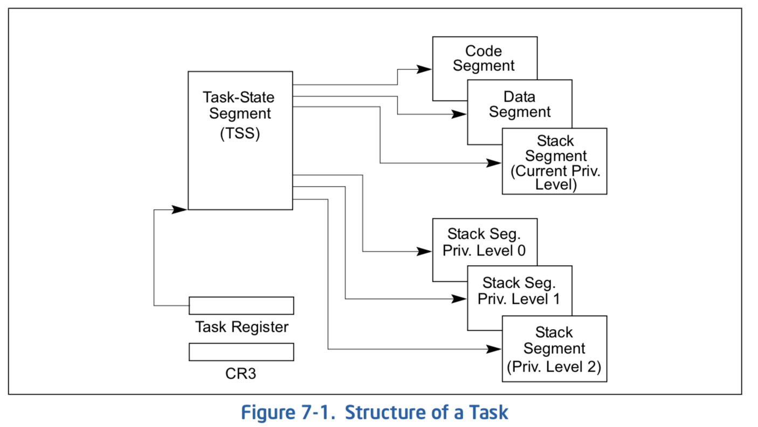
Hardware context switch support in x86
Syscall/Intr (U → K)
  PL 3 → 0;
  TSS ← EFLAGS, CS:EIP;
  SS:ESP ← k-thread stack (TSS PL 0);
  push (old) SS:ESP onto (new) k-stack
  push (old) EFLAGS, CS:EIP, <err>
  CS:EIP ← <k target handler>
Then
  Handler saves other regs, etc
  Does all its works, possibly choosing other threads, changing PTBR (CR3)
  kernel thread has set up user GPRs
iret (K → U)
  PL 0 → 3;
  EFLAGS, CS:EIP ← popped off k-stack
  SS:ESP ← popped off k-stack
pg 2,942 of 4,922 of x86 reference manual
Pintos: tss.c, intr-stubs.S

Slide 68
Pintos: Kernel Crossing on Syscall or Interrupt
Time
user
stack
user
code
cs:eip
cs:eip
cs:eip
cs:eip
cs:eip
ss:esp
ss:esp
ss:esp
ss:esp
ss:esp
PTBR
PTBR
PTBR
PTBR
PTBR
cs:eip
cs:eip
cs:eip
ss:esp
ss:esp
ss:esp
ready to resume
kernel
code
processing
saves
…
iret
syscall / interrupt
TCB
TCB
TCB
TCB
TCB
kernel
thread
stack

Slide 69
Pintos: Context Switch – Scheduling
Time
user
stack
user’
stack
user
code
cs:eip
cs:eip
cs:eip
Schedule
cs:eip’
cs:eip’
ss:esp
ss:esp
ss:esp
ss:esp’
ss:esp’
PTBR
PTBR
PTBR
PTBR’
PTBR’
cs:eip
cs:eip
cs:eip’
ss:esp
ss:esp
ss:esp’
ready to resume
kernel
code
processing
saves
…
iret
syscall / interrupt
TCB
TCB
TCB
TCB
TCB
kernel
thread
stack
switch kernel threads
Pintos: switch.S

Slide 70
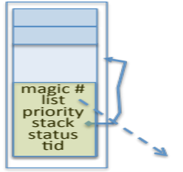
MT Kernel single Thread Process ala Pintos/x86
code
data
Kernel stack and
TCB stored in one
4K page
magic #
magic #
list
list
priority
priority
stack
Kernel
status
tid
stack
User
status
tid
code
code
data
data
heap
***
heap
PC
IP
User
stack
User
stack
SP
K SP
Proc Regs
PL: #
Each user process/thread associated with a kernel thread, described by a 4KB page object containing TCB and kernel stack for the kernel thread
Notes:
See https://web.stanford.edu/class/cs140/projects/pintos/pintos_6.html
Always set to THREAD_MAGIC, which is just an arbitrary number defined in threads/thread.c, and used to detect stack overflow. thread_current() checks that the magic member of the running thread's struct thread is set to THREAD_MAGIC. Stack overflow tends to change this value, triggering the assertion. For greatest benefit, as you add members to struct thread, leave magic at the end. (see

Slide 71
Running User Code with Kernel stack waiting
code
data
magic #
magic #
list
list
priority
priority
stack
Kernel
status
tid
stack
User
status
tid
code
code
data
data
heap
***
heap
IP
User
stack
User
stack
SP
K SP
Proc Regs
PL: 3
x86 CPU holds interrupt SP in register
During user thread execution, associated kernel thread is “standing by”

Slide 72
In Kernel Thread: No User Component
code
data
magic #
list
priority
Kernel
stack
User
status
tid
code
code
data
data
heap
***
heap
IP
User
stack
User
stack
SP
K SP
Proc Regs
PL: 0
Kernel threads execute with small stack in thread structure
Pure kernel threads have no corresponding user-mode thread

Slide 73
User → Kernel (interrupts, syscalls)
code
data
magic #
list
priority
Kernel
stack
User
status
tid
code
code
data
data
heap
***
heap
IP
User
stack
User
stack
SP
K SP
Proc Regs
PL: 0
Mechanism vectors through “interrupt vector”

Slide 74
Kernel → User
code
data
magic #
magic #
list
list
priority
priority
stack
Kernel
status
tid
stack
User
status
tid
code
code
data
data
heap
***
heap
IP
User
stack
User
stack
SP
K SP
Proc Regs
PL: 3
Interrupt return (iret) restores user stack, IP, and PL

Slide 75
User → Kernel via “interrupt vector” (interrupts & traps)
0
This is called the
“interrupt vector” but
should be called the
“exception vector”
magic #
list
priority
stack
Kernel
status
tid
User
code
code
255
intr vector
data
data
heap
***
heap
IP
User
stack
User
stack
SP
K SP
Proc Regs
PL: 3
Interrupts (timer) or trap (syscall, page fault) transfers through interrupt vector (IDT)
  Each slot for different exception type

Slide 76
Pintos Interrupt Processing for Timer (0x20)
intrNN_stub()
Wrapper for generic handler
***
0
intr_entry:
save regs as frame
set up kernel env.
call intr_handler
intr_exit:
restore regs
iret
push 0x20 (int #)
jmp intr_entry
0x20
push 0x21 (int #)
jmp intr_entry
***
255
Hardware interrupt vector
stubs.S

Slide 77
Switch to Kernel Stack for Thread
code
User state stored
on stack for later
restart (restoring of
stack, SP, IP, etc)
data
magic #
list
priority
Kernel
stack
User
status
tid
code
code
data
data
heap
***
heap
IP
User
stack
User
stack
SP
K SP
Proc Regs
PL: 0
Information required to restart thread stored on kernel stack
  Switching becomes simple to different kernel stack and restoring

Slide 78
Pintos Interrupt Processing for Timer (0x20)
interrupt.c
Wrapper for generic handler
Intr_handler(*frame)
- classify
- dispatch
- ack IRQ
- maybe thread yield
intrNN_stub()
0
***
intr_entry:
save regs as frame
set up kernel env.
call intr_handler
intr_exit:
restore regs
iret
push 0x20 (int #)
jmp intr_entry
0x20
push 0x21 (int #)
jmp intr_entry
timer_intr(*frame)
tick++
thread_tick()
0
***
255
0x20
timer.c
Hardware interrupt vector
stubs.S
Pintos intr_handlers

Slide 79
Pintos Interrupt Processing for Timer (0x20)
interrupt.c
Wrapper for generic handler
Intr_handler(*frame)
- classify
- dispatch
- ack IRQ
- maybe thread yield
intrNN_stub()
0
***
intr_entry:
save regs as frame
set up kernel env.
call intr_handler
intr_exit:
restore regs
iret
push 0x20 (int #)
jmp intr_entry
0x20
push 0x21 (int #)
jmp intr_entry
timer_intr(*frame)
tick++
thread_tick()
0
***
255
0x20
timer.c
Hardware interrupt vector
stubs.S
Pintos intr_handlers

Slide 80
Timer may trigger thread switch
thread_tick
  Updates thread counters
  If quanta exhausted, sets yield flag
thread_yield
  On path to rtn from interrupt
  Sets current thread back to READY
  Pushes it back on ready_list
  Calls schedule to select next thread to run upon iret
Schedule
  Selects next thread to run
  Calls switch_threads to change regs to point to stack for thread to resume
  Sets its status to RUNNING
  If user thread, activates the process
  Returns back to intr_handler

Slide 81
Thread Switch (switch.S)
code
data
magic #
list
priority
Kernel
stack
User
status
tid
code
code
data
data
heap
***
heap
IP
User
stack
User
stack
SP
K SP
Proc Regs
PL: 0
switch_threads: save regs on current small stack, change SP, return from destination threads call to switch_threads

Slide 82
Pintos Return from Processing for Timer (0x20)
interrupt.c
Wrapper for generic handler
Intr_handler(*frame)
- classify
- dispatch
- ack IRQ
- maybe thread yield
intrNN_stub()
0
***
intr_entry:
save regs as frame
set up kernel env.
call intr_handler
intr_exit:
restore regs
iret
push 0x20 (int #)
jmp intr_entry
0x20
push 0x20 (int #)
jmp intr_entry
timer_intr(*frame)
tick++
thread_tick()
0
***
255
0x20
timer.c
Hardware interrupt vector
Hardware interrupt vector
stubs.S
thread_yield()
- schedule
Resume Some Thread
Pintos intr_handlers
schedule()
- switch

Slide 83
Kernel → Different User Thread
code
data
magic #
magic #
list
list
priority
priority
stack
Kernel
status
stack
tid
status
User
tid
code
code
data
data
heap
***
heap
IP
User
stack
User
stack
SP
K SP
Proc Regs
PL: 3
iret restores user stack and priority level (PL)

Slide 84
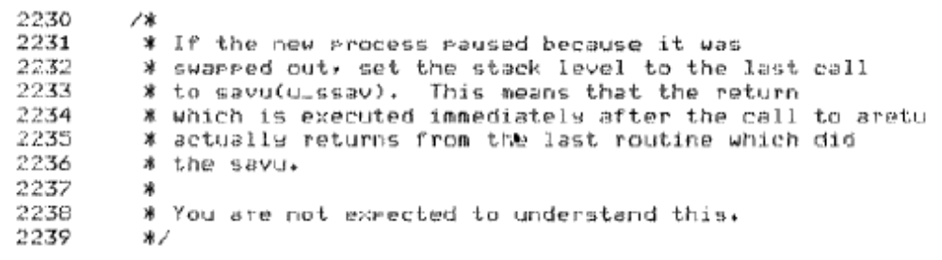
Famous Quote WRT Scheduling: Dennis Richie
Dennis Richie,
Unix V6, slp.c:
“If the new process paused because it was swapped out, set the stack level to the last call to savu(u_ssav). This means that the return which is executed immediately after the call to aretu actually returns from the last routine which did the savu.”
“You are not expected to understand this.”
Source: Dennis Ritchie, Unix V6 slp.c (context-switching code) as per The Unix Heritage Society(tuhs.org); gif by Eddie Koehler.
Included by Ali R. Butt in CS3204 from Virginia Tech

Slide 85
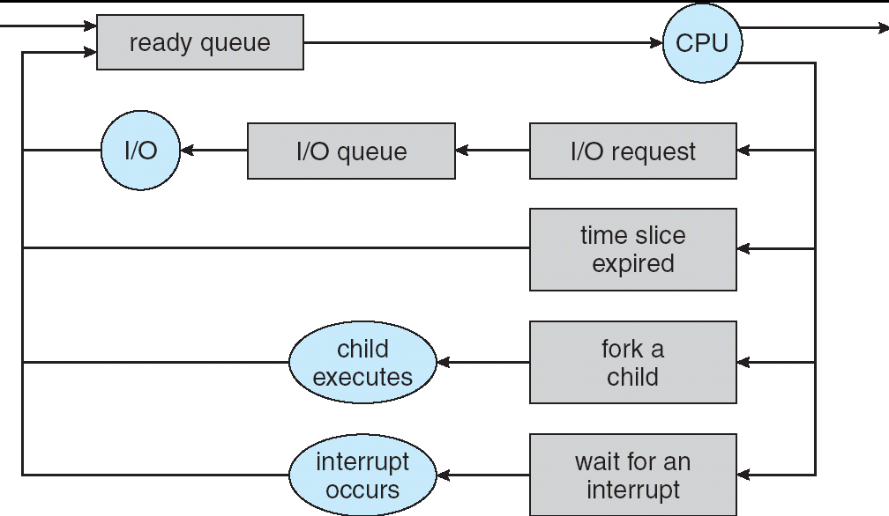
Recall: Scheduling
Question: How is the OS to decide which of several tasks to take off a queue?
Scheduling: deciding which threads are given access to resources from moment to moment
  Often, we think in terms of CPU time, but could also think about access to resources like network BW or disk access

Slide 86
Scheduling: All About Queues

Slide 87
Scheduling Assumptions
CPU scheduling big area of research in early 70’s
Many implicit assumptions for CPU scheduling:
  One program per user
  One thread per program
  Programs are independent
Clearly, these are unrealistic but they simplify the problem so it can be solved
  For instance: is “fair” about fairness among users or programs?
    If I run one compilation job and you run five, you get five times as much CPU on many operating systems
The high-level goal: Dole out CPU time to optimize some desired parameters of system
USER1
USER2
USER3
USER1
USER2
Time

Slide 88
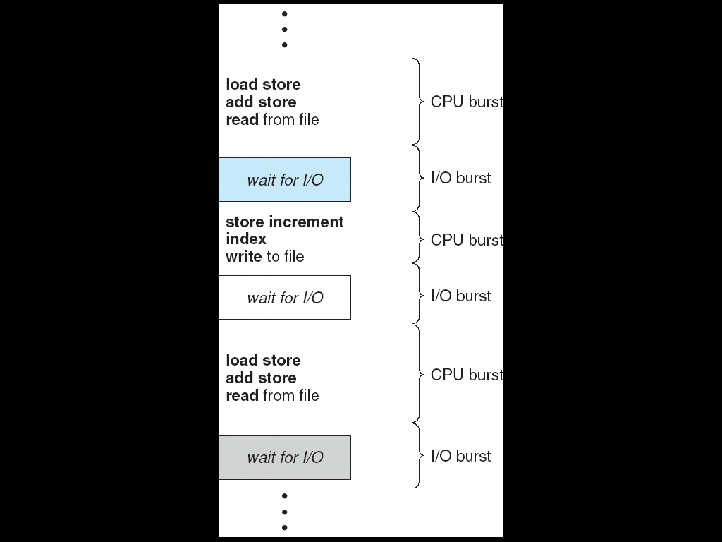
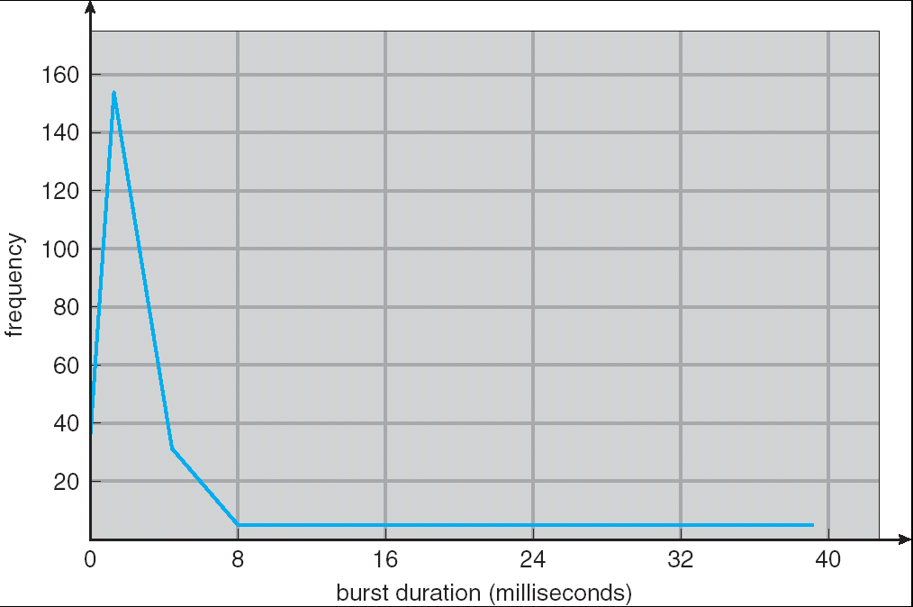
Assumption: CPU Bursts
Weighted toward small bursts
Execution model: programs alternate between bursts of CPU and I/O
  Program typically uses the CPU for some period of time, then does I/O, then uses CPU again
  Each scheduling decision is about which job to give to the CPU for use by its next CPU burst
  With timeslicing, thread may be forced to give up CPU before finishing current CPU burst

Slide 89
Scheduling Policy Goals/Criteria
Minimize Response Time
  Minimize elapsed time to do an operation (or job)
  Response time is what the user sees:
    Time to echo a keystroke in editor
    Time to compile a program
    Real-time Tasks: Must meet deadlines imposed by World
Maximize Throughput
  Maximize operations (or jobs) per second
  Throughput related to response time, but not identical:
    Minimizing response time will lead to more context switching than if you only maximized throughput
  Two parts to maximizing throughput
    Minimize overhead (for example, context-switching)
    Efficient use of resources (CPU, disk, memory, etc)
Fairness
  Share CPU among users in some equitable way
  Fairness is not minimizing average response time:
    Better average response time by making system less fair
Notes:
What does CPU scheduling have to do with efficient use of the disk?
A lot! Have to have the CPU to make a disk request
Fairness: Minimize # of angry phone calls? Minimize my response time?

Slide 90

First-Come, First-Served (FCFS) Scheduling
First-Come, First-Served (FCFS)
  Also “First In, First Out” (FIFO) or “Run until done”
    In early systems, FCFS meant one program
    scheduled until done (including I/O)
    Now, means keep CPU until thread blocks
Example: Process Burst Time
P₁ 24
P₂ 3
P₃ 3
  Suppose processes arrive in the order: P₁ , P₂ , P₃
  The Gantt Chart for the schedule is:
  Waiting time for P₁ = 0; P₂ = 24; P₃ = 27
  Average waiting time: (0 + 24 + 27)/3 = 17
  Average Completion time: (24 + 27 + 30)/3 = 27
Convoy effect: short process stuck behind long process
P₁
P₂
P₃
0
24
27
30

Slide 91
Convoy effect
Scheduled Task (process, thread)
time
Scheduling queue
arrivals
With FCFS non-preemptive scheduling, convoys of small tasks tend to build up when a large one is running.

Slide 92
FCFS Scheduling (Cont.)
Example continued:
  Suppose that processes arrive in order: P2 , P3 , P1
  Now, the Gantt chart for the schedule is:
  Waiting time for P1 = 6; P2 = 0; P3 = 3
  Average waiting time: (6 + 0 + 3)/3 = 3
  Average Completion time: (3 + 6 + 30)/3 = 13
In second case:
  Average waiting time is much better (before it was 17)
  Average completion time is better (before it was 27)
FIFO Pros and Cons:
  Simple (+)
  Short jobs get stuck behind long ones (-)
    Safeway: Getting milk, always stuck behind cart full of items!
    Upside: get to read about Space Aliens!
P₂
P₃
P₁
0
3
6
30

Slide 93
Conclusion
Monitors: A lock plus one or more condition variables
  Always acquire lock before accessing shared data
  Use condition variables to wait inside critical section
    Three Operations: Wait(), Signal(), and Broadcast()
Monitors represent the logic of the program
  Wait if necessary
  Signal when change something so any waiting threads can proceed
Readers/Writers Monitor example
  Shows how monitors allow sophisticated controlled entry to protected code
  Mesa scheduling allows a more relaxed checking of wait conditions
Monitors supported natively in a number of languages
Scheduling Goals:
  Minimize Response Time (e.g. for human interaction)
  Maximize Throughput (e.g. for large computations)
  Fairness (e.g. Proper Sharing of Resources)
  Predictability (e.g. Hard/Soft Realtime)
Round-Robin Scheduling:
  Give each thread a small amount of CPU time when it executes; cycle between all ready threads
  Pros: Better for short jobs

