Slide 1
CS162
Operating Systems and
Systems Programming
Lecture 11
Scheduling 1:
Concepts and Classic Policies
February 22nd, 2024
Prof. John Kubiatowicz
http://cs162.eecs.Berkeley.edu

Slide 2
Recall: Basic Structure of Mesa Monitor Program
Monitors represent the synchronization logic of the program
  Wait if necessary
  Signal when change something so any waiting threads can proceed
Basic structure of mesa monitor-based program:
  lock
  while (need to wait) {
  condvar.wait();
  }
  unlock
  do something so no need to wait
  lock
  condvar.signal();
  unlock
Check and/or update
state variables
Wait if necessary
Check and/or update
state variables

Slide 3
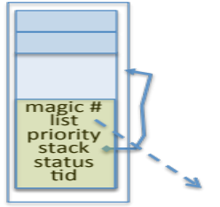
Recall: MT Kernel single Thread Process ala Pintos/x86
code
data
Kernel stack and
TCB stored in one
4K page
magic #
magic #
list
list
priority
priority
stack
Kernel
status
tid
stack
User
status
tid
code
code
data
data
heap
***
heap
PC
IP
User
stack
User
stack
SP
K SP
Proc Regs
PL: #
Each user process/thread associated with a kernel thread, described by a 4KB page object containing TCB and kernel stack for the kernel thread
Notes:
See https://web.stanford.edu/class/cs140/projects/pintos/pintos_6.html
Always set to THREAD_MAGIC, which is just an arbitrary number defined in threads/thread.c, and used to detect stack overflow. thread_current() checks that the magic member of the running thread's struct thread is set to THREAD_MAGIC. Stack overflow tends to change this value, triggering the assertion. For greatest benefit, as you add members to struct thread, leave magic at the end. (see

Slide 4
Recall: User → Kernel via “interrupt vector” (interrupts & traps)
0
This is called the
“interrupt vector” but
should be called the
“exception vector”
magic #
list
priority
stack
Kernel
status
tid
User
code
code
255
intr vector
data
data
heap
***
heap
IP
User
stack
User
stack
SP
K SP
Proc Regs
PL: 3
Interrupts (timer) or trap (syscall, page fault) transfers through interrupt vector (IDT)
  Each slot for different exception type

Slide 5
Pintos Interrupt Processing for Timer (0x20)
intrNN_stub()
Wrapper for generic handler
***
0
intr_entry:
save regs as frame
set up kernel env.
call intr_handler
intr_exit:
restore regs
iret
push 0x20 (int #)
jmp intr_entry
0x20
push 0x21 (int #)
jmp intr_entry
***
255
Hardware interrupt vector
stubs.S

Slide 6
Switch to Kernel Stack for Thread
code
User state stored
on stack for later
restart (restoring of
stack, SP, IP, etc)
data
magic #
list
priority
Kernel
stack
User
status
tid
code
code
data
data
heap
***
heap
IP
User
stack
User
stack
SP
K SP
Proc Regs
PL: 0
Information required to restart thread stored on kernel stack
  Switching becomes simple to different kernel stack and restoring

Slide 7
Pintos Interrupt Processing for Timer (0x20)
interrupt.c
Wrapper for generic handler
Intr_handler(*frame)
- classify
- dispatch
- ack IRQ
- maybe thread yield
intrNN_stub()
0
***
intr_entry:
save regs as frame
set up kernel env.
call intr_handler
intr_exit:
restore regs
iret
push 0x20 (int #)
jmp intr_entry
0x20
push 0x21 (int #)
jmp intr_entry
timer_intr(*frame)
tick++
thread_tick()
0
***
255
0x20
timer.c
Hardware interrupt vector
stubs.S
Pintos intr_handlers

Slide 8
Timer may trigger thread switch
thread_tick
  Updates thread counters
  If quanta exhausted, sets yield flag
thread_yield
  On path to rtn from interrupt
  Sets current thread back to READY
  Pushes it back on ready_list
  Calls schedule to select next thread to run upon iret
Schedule
  Selects next thread to run
  Calls switch_threads to change regs to point to stack for thread to resume
  Sets its status to RUNNING
  If user thread, activates the process
  Returns back to intr_handler

Slide 9
Thread Switch (switch.S)
code
data
magic #
list
priority
Kernel
stack
User
status
tid
code
code
data
data
heap
***
heap
IP
User
stack
User
stack
SP
K SP
Proc Regs
PL: 0
switch_threads: save regs on current kernel stack, change SP,
return from destination thread’s call to switch_threads

Slide 10
Pintos Return from Processing for Timer (0x20)
interrupt.c
Wrapper for generic handler
Intr_handler(*frame)
- classify
- dispatch
- ack IRQ
- maybe thread yield
intrNN_stub()
0
***
intr_entry:
save regs as frame
set up kernel env.
call intr_handler
intr_exit:
restore regs
iret
push 0x20 (int #)
jmp intr_entry
0x20
push 0x20 (int #)
jmp intr_entry
timer_intr(*frame)
tick++
thread_tick()
0
***
255
0x20
timer.c
Hardware interrupt vector
Hardware interrupt vector
stubs.S
thread_yield()
- schedule
Resume Some Thread
Pintos intr_handlers
schedule()
- switch

Slide 11
Kernel → Different User Thread
code
data
magic #
magic #
list
list
priority
priority
stack
Kernel
status
stack
tid
status
User
tid
code
code
data
data
heap
***
heap
IP
User
stack
User
stack
SP
K SP
Proc Regs
PL: 3
iret restores user stack and priority level (PL)

Slide 12
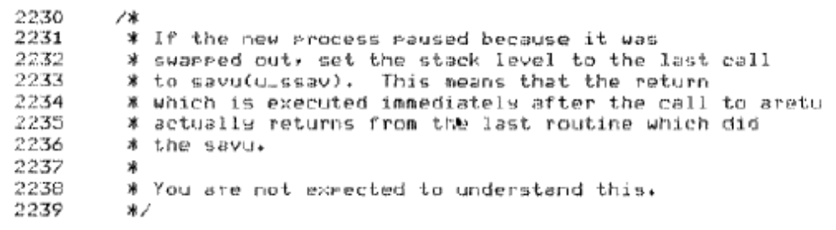
Famous Quote WRT Scheduling: Dennis Richie
Dennis Richie,
Unix V6, slp.c:
“If the new process paused because it was swapped out, set the stack level to the last call to savu(u_ssav). This means that the return which is executed immediately after the call to aretu actually returns from the last routine which did the savu.”
“You are not expected to understand this.”
Source: Dennis Ritchie, Unix V6 slp.c (context-switching code) as per The Unix Heritage Society(tuhs.org); gif by Eddie Koehler.
Included by Ali R. Butt in CS3204 from Virginia Tech

Slide 13
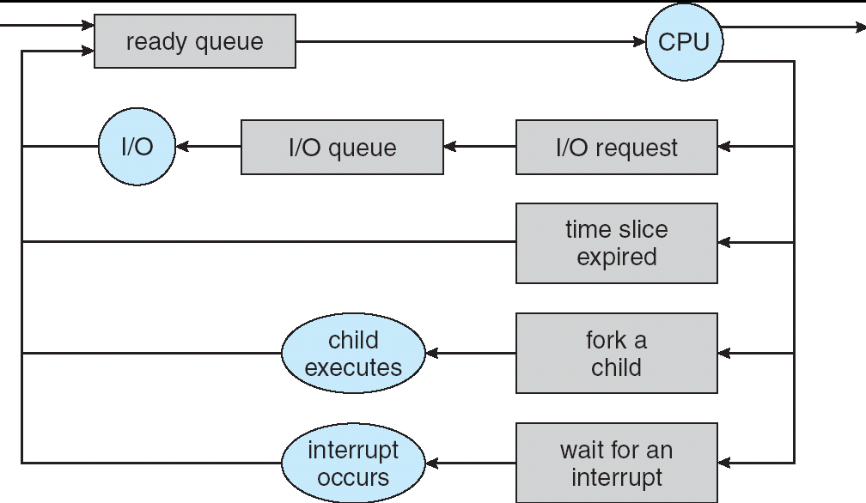
Recall: Scheduling
Question: How is the OS to decide which of several tasks to take off a queue?
Scheduling: deciding which threads are given access to resources from moment to moment
  Often, we think in terms of CPU time, but could also think about access to resources like network BW or disk access

Slide 14
Scheduling: All About Queues

Slide 15
Scheduling Assumptions
CPU scheduling big area of research in early 70’s
Many implicit assumptions for CPU scheduling:
  One program per user
  One thread per program
  Programs are independent
Clearly, these are unrealistic but they simplify the problem so it can be solved
  For instance: is “fair” about fairness among users or programs?
    If I run one compilation job and you run five, you get five times as much CPU on many operating systems
The high-level goal: Dole out CPU time to optimize some desired parameters of system
USER1
USER2
USER3
USER1
USER2
Time

Slide 16
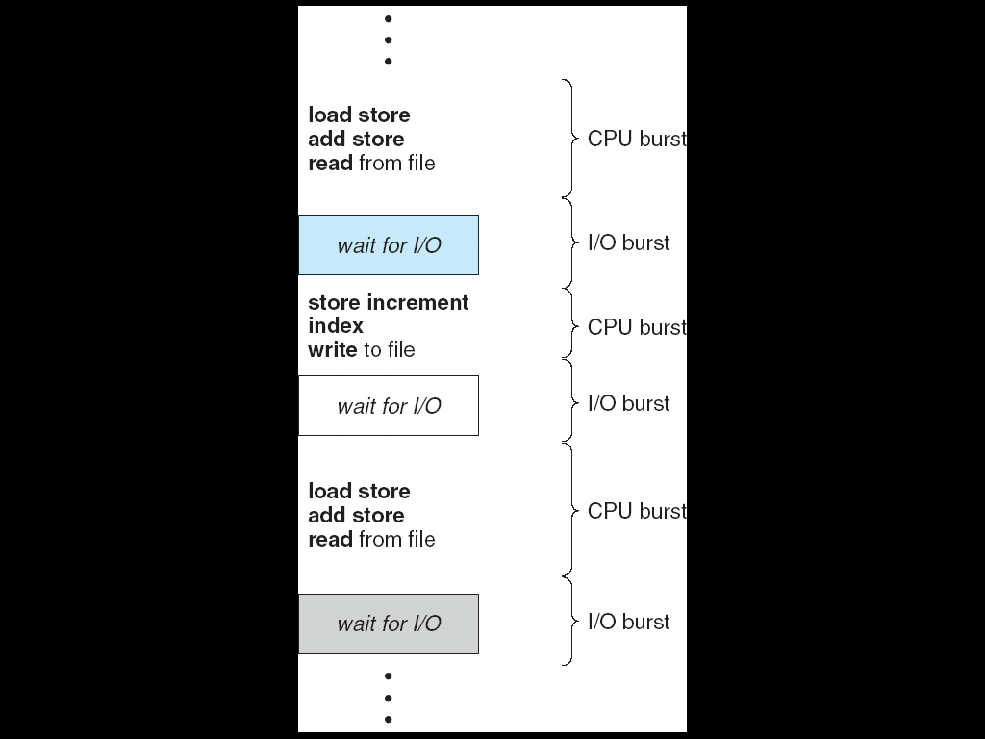
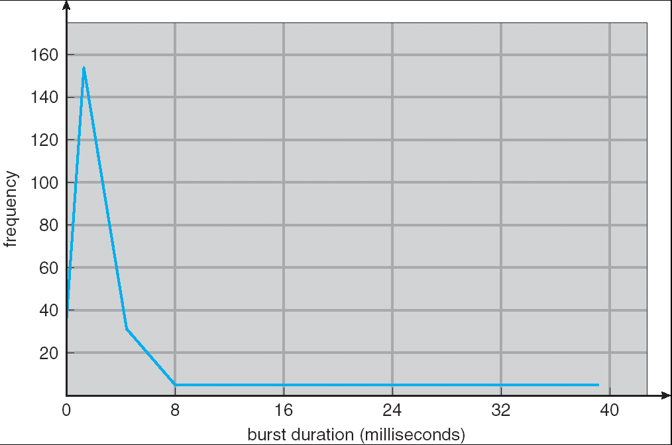
Assumption: CPU Bursts
Weighted toward small bursts
Execution model: programs alternate between bursts of CPU and I/O
  Program typically uses the CPU for some period of time, then does I/O, then uses CPU again
  Each scheduling decision is about which job to give to the CPU for use by its next CPU burst
  With timeslicing, thread may be forced to give up CPU before finishing current CPU burst

Slide 17
Scheduling Policy Goals/Criteria
Minimize Response Time
  Minimize elapsed time to do an operation (or job)
  Response time is what the user sees:
    Time to echo a keystroke in editor
    Time to compile a program
    Real-time Tasks: Must meet deadlines imposed by World
Maximize Throughput
  Maximize operations (or jobs) per second
  Throughput related to response time, but not identical:
    Minimizing response time will lead to more context switching than if you only maximized throughput
  Two parts to maximizing throughput
    Minimize overhead (for example, context-switching)
    Efficient use of resources (CPU, disk, memory, etc)
Fairness
  Share CPU among users in some equitable way
  Fairness is not minimizing average response time:
    Better average response time by making system less fair
Notes:
What does CPU scheduling have to do with efficient use of the disk?
A lot! Have to have the CPU to make a disk request
Fairness: Minimize # of angry phone calls? Minimize my response time?

Slide 18

First-Come, First-Served (FCFS) Scheduling
First-Come, First-Served (FCFS)
  Also “First In, First Out” (FIFO) or “Run until done”
    In early systems, FCFS meant one program
    scheduled until done (including I/O)
    Now, means keep CPU until thread blocks
Example: Process Burst Time
P₁ 24
P₂ 3
P₃ 3
  Suppose processes arrive in the order: P₁ , P₂ , P₃
  The Gantt Chart for the schedule is:
  Waiting time for P₁ = 0; P₂ = 24; P₃ = 27
  Average waiting time: (0 + 24 + 27)/3 = 17
  Average Completion time: (24 + 27 + 30)/3 = 27
Convoy effect: short process stuck behind long process
P₁
P₂
P₃
0
24
27
30

Slide 19
Convoy effect
Scheduled Task (process, thread)
time
Scheduling queue
arrivals
With FCFS non-preemptive scheduling, convoys of small tasks tend to build up when a large one is running.

Slide 20
FCFS Scheduling (Cont.)
Example continued:
  Suppose that processes arrive in order: P2 , P3 , P1
  Now, the Gantt chart for the schedule is:
  Waiting time for P1 = 6; P2 = 0; P3 = 3
  Average waiting time: (6 + 0 + 3)/3 = 3
  Average Completion time: (3 + 6 + 30)/3 = 13
In second case:
  Average waiting time is much better (before it was 17)
  Average completion time is better (before it was 27)
FIFO Pros and Cons:
  Simple (+)
  Short jobs get stuck behind long ones (-)
    Safeway: Getting milk, always stuck behind cart full of items!
    Upside: get to read about Space Aliens!
P₂
P₃
P₁
0
3
6
30

Slide 21
Administrivia
Midterm I:
  Grading done today by Tomorrow morning. Sorry for the delay!
  Solutions will be up off the Resources page
Project 1 final report is due Wednesday, February 28th
Also due Wednesday: Peer evaluations
  These are a required mechanism for evaluating group dynamics
  Project scores are a zero-sum game
    In the normal/best case, all partners get the same grade
    In groups with issues, we may take points from non-participating group members and give them to participating group members!
How does this work?
  You get 20 points/partner to distribute as you want:
  Example—4 person group, you get 3 x 20 = 60 points
    If all your partners contributed equally, give the 20 points each
    Or, you could do something like:
      22 points partner 1
      22 points partner 2
      16 points partner 3
  DO NOT GIVE YOURSELF POINTS!
    You are NOT an unbiased evaluator of your group behavior

Slide 22

Round Robin (RR) Scheduling
FCFS Scheme: Potentially bad for short jobs!
  Depends on submit order
  If you are first in line at supermarket with milk, you don’t care who is behind you, on the other hand…
Round Robin Scheme: Preemption!
  Each process gets a small unit of CPU time
  (time quantum), usually 10-100 milliseconds
  After quantum expires, the process is preempted
  and added to the end of the ready queue.
  n processes in ready queue and time quantum is q ⇒
    Each process gets 1/n of the CPU time
    In chunks of at most q time units
    No process waits more than (n-1)q time units

Slide 23
RR Scheduling (Cont.)
Performance
  q large ⇒ FCFS
  q small ⇒ Interleaved (really small ⇒ hyperthreading?)
  q must be large with respect to context switch, otherwise overhead is too high (all overhead)

Slide 24
Example of RR with Time Quantum = 20
Example: Process Burst Time
P₁ 53
P₂ 8
P₃ 68
P₄ 24
  The Gantt chart is:
  Waiting time for P₁=(68-20)+(112-88)=72 P₂=(20-0)=20
  P₃=(28-0)+(88-48)+(125-108)=85
  P₄=(48-0)+(108-68)=88
  Average waiting time = (72+20+85+88)/4=66¼
  Average completion time = (125+28+153+112)/4 = 104½
Thus, Round-Robin Pros and Cons:
  Better for short jobs, Fair (+)
  Context-switching time adds up for long jobs (-)
P₁
P₂
P₃
P₄
P₁
P₃
P₄
P₁
P₃
P₃
0
20
28
48
68
88
108
112
125
145
153

Slide 25
How to Implement RR in the Kernel?
FIFO Queue, as in FCFS
But preempt job after quantum expires, and send it to the back of the queue
  How? Timer interrupt!
  And, of course, careful synchronization
Project 2: Scheduling

Slide 26

Round-Robin Discussion
How do you choose time slice?
  What if too big?
    Response time suffers
  What if infinite (∞)?
    Get back FIFO
  What if time slice too small?
    Throughput suffers!
Actual choices of timeslice:
  Initially, UNIX timeslice one second:
    Worked ok when UNIX was used by one or two people.
    What if three compilations going on? 3 seconds to echo each keystroke!
  Need to balance short-job performance and long-job throughput:
    Typical time slice today is between 10ms – 100ms
    Typical context-switching overhead is 0.1ms – 1ms
    Roughly 1% overhead due to context-switching

Slide 27
Comparisons between FCFS and Round Robin
Assuming zero-cost context-switching time, is RR always better than FCFS?
Simple example: 10 jobs, each take 100s of CPU time
RR scheduler quantum of 1s
All jobs start at the same time
Completion Times:
  Both RR and FCFS finish at the same time
  Average completion time is much worse under RR!
    Bad when all jobs same length
Also: Cache state must be shared between all jobs with RR but can be devoted to each job with FIFO
  Total time for RR longer even for zero-cost switch!
Job # | FIFO | RR
1 | 100 | 991
2 | 200 | 992
… | … | …
9 | 900 | 999
10 | 1000 | 1000

Slide 28
Earlier Example with Different Time Quantum
P₂
[8]
P₄
[24]
P₁
[53]
P₃
[68]
Best FCFS:
0
8
32
85
153
Quantum
P₁
P₂
P₃
P₄
Average
Wait
Time
Best FCFS
32
0
85
8
31¼
Q = 1
84
22
85
57
62
Q = 5
82
20
85
58
61¼
Q = 8
80
8
85
56
57¼
Q = 10
82
10
85
68
61¼
Q = 20
72
20
85
88
66¼
Worst FCFS
68
145
0
121
83½
Completion
Time
Best FCFS
85
8
153
32
69½
Q = 1
137
30
153
81
100½
Q = 5
135
28
153
82
99½
Q = 8
133
16
153
80
95½
Q = 10
135
18
153
92
99½
Q = 20
125
28
153
112
104½
Worst FCFS
121
153
68
145
121¾

Slide 29
Handling Differences in Importance: Strict Priority Scheduling
Priority 3
Job 1
Job 2
Job 3
Priority 2
Job 4
Priority 1
Priority 0
Job 5
Job 6
Job 7
Execution Plan
  Always execute highest-priority runable jobs to completion
  Each queue can be processed in RR with some time-quantum
Problems:
  Starvation:
    Lower priority jobs don’t get to run because higher priority jobs
  Deadlock: Priority Inversion
    Happens when low priority task has lock needed by high-priority task
    Usually involves third, intermediate priority task preventing high-priority task from running
How to fix problems?
  Dynamic priorities – adjust base-level priority up or down based on heuristics about interactivity, locking, burst behavior, etc…

Slide 30
Scheduling Fairness
What about fairness?
  Strict fixed-priority scheduling between queues is unfair (run highest, then next, etc):
    long running jobs may never get CPU
    Urban legend: In Multics, shut down machine, found 10-year-old job ⇒
    Ok, probably not…
  Must give long-running jobs a fraction of the CPU even when there are shorter jobs to run
  Tradeoff: fairness gained by hurting avg response time!

Slide 31
Scheduling Fairness
How to implement fairness?
  Could give each queue some fraction of the CPU
    What if one long-running job and 100 short-running ones?
    Like express lanes in a supermarket—sometimes express lanes get so long, get better service by going into one of the other lines
  Could increase priority of jobs that don’t get service
    What is done in some variants of UNIX
    This is ad hoc—what rate should you increase priorities?
    And, as system gets overloaded, no job gets CPU time, so everyone increases in priority⇒Interactive jobs suffer

Slide 32

What if we Knew the Future?
Could we always mirror best FCFS?
Shortest Job First (SJF):
  Run whatever job has least amount of
  computation to do
  Sometimes called “Shortest Time to Completion First” (STCF)
Shortest Remaining Time First (SRTF):
  Preemptive version of SJF: if job arrives and has a shorter time to completion than the remaining time on the current job, immediately preempt CPU
  Sometimes called “Shortest Remaining Time to Completion First” (SRTCF)
These can be applied to whole program or current CPU burst
  Idea is to get short jobs out of the system
  Big effect on short jobs, only small effect on long ones
  Result is better average response time
Notes:
Rich get richer, and poor get poorer = short jobs get through the system faster, long jobs take even longer

Slide 33
Discussion
SJF/SRTF are the best you can do at minimizing average response time
  Provably optimal (SJF among non-preemptive, SRTF among preemptive)
  Since SRTF is always at least as good as SJF, focus on SRTF
Comparison of SRTF with FCFS
  What if all jobs the same length?
    SRTF becomes the same as FCFS (i.e. FCFS is best can do if all jobs the same length)
  What if jobs have varying length?
    SRTF: short jobs not stuck behind long ones

Slide 34
Example to illustrate benefits of SRTF
A or B
C
C’s
I/O
C’s
I/O
C’s
I/O
Three jobs:
  A, B: both CPU bound, run for week
  C: I/O bound, loop 1ms CPU, 9ms disk I/O
  If only one at a time, C uses 90% of the disk, A or B could use 100% of the CPU
With FCFS:
  Once A or B get in, keep CPU for two weeks
What about RR or SRTF?
  Easier to see with a timeline

Slide 35
SRTF Example continued:
Disk Utilization:
9/201 ~ 4.5%
C
A
B
C
RR 100ms time slice
Disk Utilization:
~90% but lots of wakeups!
C’s
I/O
C’s
I/O
CABAB…
C
RR 1ms time slice
C’s
I/O
C’s
I/O
Disk Utilization:
90%
C
A
A
A
SRTF
C’s
I/O
C’s
I/O

Slide 36

SRTF Further discussion
Starvation
  SRTF can lead to starvation if many small jobs!
  Large jobs never get to run
Somehow need to predict future
  How can we do this?
  Some systems ask the user
    When you submit a job, have to say how long it will take
    To stop cheating, system kills job if takes too long
  But: hard to predict job’s runtime even for non-malicious users
Bottom line, can’t really know how long job will take
  However, can use SRTF as a yardstick
  for measuring other policies
  Optimal, so can’t do any better
SRTF Pros & Cons
  Optimal (average response time) (+)
  Hard to predict future (-)
  Unfair (-)

Slide 37
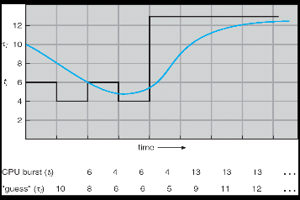
Predicting the Length of the Next CPU Burst
Adaptive: Changing policy based on past behavior
  CPU scheduling, in virtual memory, in file systems, etc
  Works because programs have predictable behavior
    If program was I/O bound in past, likely in future
    If computer behavior were random, wouldn’t help
Example: SRTF with estimated burst length
  Use an estimator function on previous bursts:
  Let t_{n-1}, t_{n-2}, t_{n-3}, etc. be previous CPU burst lengths.
  Estimate next burst τ_{n} = f(t_{n-1}, t_{n-2}, t_{n-3}, …)
  Function f could be one of many different time series estimation schemes
  (Kalman filters, etc)
  For instance, exponential averaging
  τn = αt_{n-1}+(1-α)τ_{n-1}
  with (0<α≤1)

Slide 38

Lottery Scheduling
Yet another alternative: Lottery Scheduling
  Give each job some number of lottery tickets
  On each time slice, randomly pick a winning ticket
  On average, CPU time is proportional to number of tickets
  given to each job
How to assign tickets?
  To approximate SRTF, short running jobs get more, long running jobs get fewer
  To avoid starvation, every job gets at least one ticket (everyone makes progress)
Advantage over strict priority scheduling: behaves gracefully as load changes
  Adding or deleting a job affects all jobs proportionally, independent of how many tickets each job possesses

Slide 39
Lottery Scheduling Example (Cont.)
Lottery Scheduling Example
  Assume short jobs get 10 tickets, long jobs get 1 ticket
  What if too many short jobs to give reasonable response time?
    If load average is 100, hard to make progress
    One approach: log some user out
# short jobs/ # long jobs | % of CPU each short jobs gets | % of CPU each long jobs gets
1/1 | 91% | 9%
0/2 | N/A | 50%
2/0 | 50% | N/A
10/1 | 9.9% | 0.99%
1/10 | 50% | 5%

Slide 40
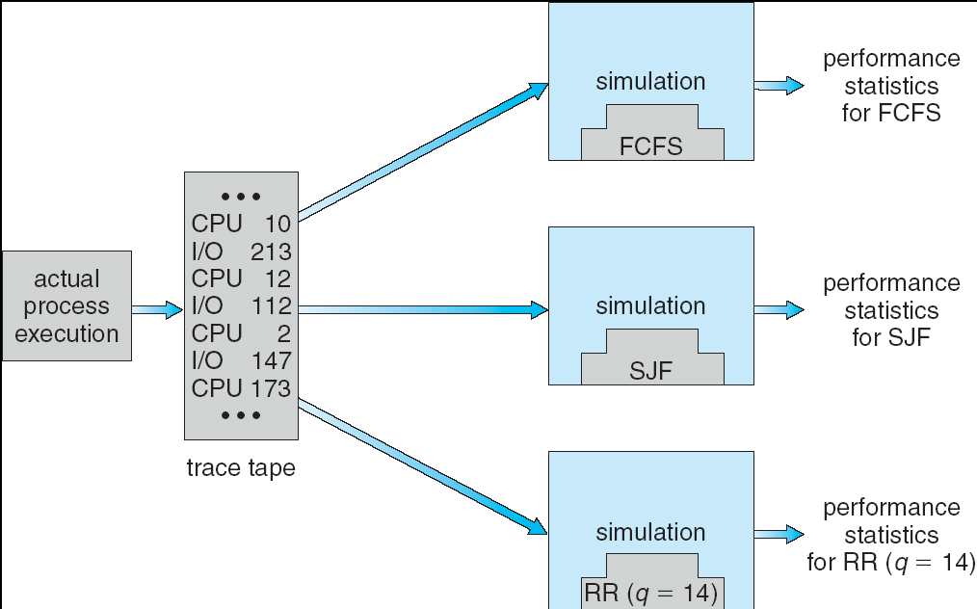
How to Evaluate a Scheduling algorithm?
Deterministic modeling
  takes a predetermined workload and compute the performance of each algorithm
  for that workload
Queueing models
  Mathematical approach for handling stochastic workloads
Implementation/Simulation:
  Build system which allows actual algorithms
  to be run against actual data
  Most flexible/general

Slide 41
How to Handle Simultaneous Mix of Diff Types of Apps?
Consider mix of interactive and high throughput apps:
  How to best schedule them?
  How to recognize one from the other?
    Do you trust app to say that it is “interactive”?
  Should you schedule the set of apps identically on
  servers, workstations, pads, and cellphones?
For instance, is Burst Time (observed) useful to
decide which application gets CPU time?
  Short Bursts ⇒ Interactivity ⇒ High Priority?
Assumptions encoded into many schedulers:
  Apps that sleep a lot and have short bursts must
  be interactive apps – they should get high priority
  Apps that compute a lot should get low(er?) priority, since they won’t notice intermittent bursts from interactive apps
Hard to characterize apps:
  What about apps that sleep for a long time, but then compute for a long time?
  Or, what about apps that must run under all circumstances (say periodically)
Weighted toward small bursts

Slide 42
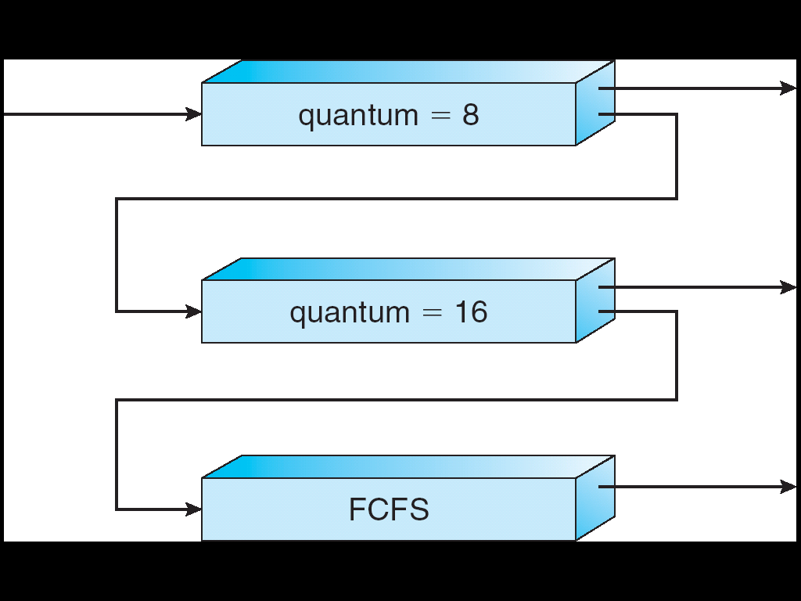
Multi-Level Feedback Scheduling
Another method for exploiting past behavior (first use in CTSS)
  Multiple queues, each with different priority
    Higher priority queues often considered “foreground” tasks
  Each queue has its own scheduling algorithm
    e.g. foreground – RR, background – FCFS
    Sometimes multiple RR priorities with quantum increasing exponentially
    (highest:1ms, next: 2ms, next: 4ms, etc)
Adjust each job’s priority as follows (details vary)
  Job starts in highest priority queue
  If timeout expires, drop one level
  If timeout doesn’t expire, push up one level (or to top)
Long-Running Compute
Tasks Demoted to
Low Priority

Slide 43
Scheduling Details
Long-Running Compute
Tasks Demoted to
Low Priority
Result approximates SRTF:
  CPU bound jobs drop like a rock
  Short-running I/O bound jobs stay near top
Scheduling must be done between the queues
  Fixed priority scheduling:
    serve all from highest priority, then next priority, etc.
  Time slice:
    each queue gets a certain amount of CPU time
    e.g., 70% to highest, 20% next, 10% lowest

Slide 44
Scheduling Details
Long-Running Compute
Tasks Demoted to
Low Priority
Countermeasure: user action that can foil intent of the OS designers
  For multilevel feedback, put in a bunch of meaningless I/O to keep job’s priority high
  Of course, if everyone did this, wouldn’t work!
Example of Othello program:
  Playing against competitor, so key was to do computing at higher priority the competitors.
    Put in printf’s, ran much faster!

Slide 45
Case Study: Linux O(1) Scheduler
Kernel/Realtime Tasks
User Tasks
0
100
139
Priority-based scheduler: 140 priorities
  40 for “user tasks” (set by “nice”), 100 for “Realtime/Kernel”
  Lower priority value ⇒ higher priority (for realtime values)
  Highest priority value ⇒ Lower priority (for nice values)
  All algorithms O(1)
    Timeslices/priorities/interactivity credits all computed when job finishes time slice
    140-bit bit mask indicates presence or absence of job at given priority level
Two separate priority queues: “active” and “expired”
  All tasks in the active queue use up their timeslices and get placed on the expired queue, after which queues swapped
Timeslice depends on priority – linearly mapped onto timeslice range
  Like a multi-level queue (one queue per priority) with different timeslice at each level
  Execution split into “Timeslice Granularity” chunks – round robin through priority

Slide 46
O(1) Scheduler Continued
Heuristics
  User-task priority adjusted ±5 based on heuristics
    p->sleep_avg = sleep_time – run_time
    Higher sleep_avg ⇒ more I/O bound the task, more reward (and vice versa)
  Interactive Credit
    Earned when a task sleeps for a “long” time
    Spend when a task runs for a “long” time
    IC is used to provide hysteresis to avoid changing interactivity for temporary changes in behavior
  However, “interactive tasks” get special dispensation
    To try to maintain interactivity
    Placed back into active queue, unless some other task has been starved for too long…
Real-Time Tasks
  Always preempt non-RT tasks
  No dynamic adjustment of priorities
  Scheduling schemes:
    SCHED_FIFO: preempts other tasks, no timeslice limit
    SCHED_RR: preempts normal tasks, RR scheduling amongst tasks of same priority

Slide 47
So, Does the OS Schedule Processes or Threads?
Many textbooks use the “old model”—one thread per process
Usually it's really: threads (e.g., in Linux)
One point to notice: switching threads vs. switching processes incurs different costs:
  Switch threads: Save/restore registers
  Switch processes: Change active address space too!
    Expensive
    Disrupts caching
Recall, However: Simultaneous Multithreading (or “Hyperthreading”)
  Different threads interleaved on a cycle-by-cycle basis and can be in different processes (have different address spaces)

Slide 48
Multi-Core Scheduling
Algorithmically, not a huge difference from single-core scheduling
Implementation-wise, helpful to have per-core scheduling data structures
  Cache coherence
Affinity scheduling: once a thread is scheduled on a CPU, OS tries to reschedule it on the same CPU
  Cache reuse

Slide 49
Recall: Spinlocks for multiprocessing
Spinlock implementation:
int value = 0; // Free
Acquire() {
while (test&set(&value)) {}; // spin while busy
}
Release() {
value = 0; // atomic store
}
Spinlock doesn’t put the calling thread to sleep—it just busy waits
  When might this be preferable?
    Waiting for limited number of threads at a barrier in a multiprocessing (multicore) program
    Wait time at barrier would be greatly increased if threads must be woken inside kernel
Every test&set() is a write, which makes value ping-pong around between core-local caches (using lots of memory!)
  So – really want to use test&test&set() !
As we discussed in Lecture 8, the extra read eliminates the ping-ponging issues:
  // Implementation of test&test&set():
  Acquire() {
  do {
  while(value); // wait until might be free
  } while (test&set(&value)); // exit if acquire lock
  }

Slide 50
Gang Scheduling and Parallel Applications
When multiple threads work together on a multi-core system, try to schedule them together
  Makes spin-waiting more efficient (inefficient to spin-wait for a thread that’s suspended)
Alternative: OS informs a parallel program how many processors its threads are scheduled on (Scheduler Activations)
  Application adapts to number of cores that it has scheduled
  “Space sharing” with other parallel programs can be more efficient, because parallel speedup is often sublinear with the number of cores

Slide 51
Conclusion
Scheduling Goals:
  Minimize Response Time (e.g. for human interaction)
  Maximize Throughput (e.g. for large computations)
  Fairness (e.g. Proper Sharing of Resources)
  Predictability (e.g. Hard/Soft Realtime)
Round-Robin Scheduling:
  Give each thread a small amount of CPU time when it executes; cycle between all ready threads
  Pros: Better for short jobs
Shortest Job First (SJF)/Shortest Remaining Time First (SRTF):
  Run whatever job has the least amount of computation to do/least remaining amount of computation to do
Multi-Level Feedback Scheduling:
  Multiple queues of different priorities and scheduling algorithms
  Automatic promotion/demotion of process priority in order to approximate SJF/SRTF

