Slide 1
CS162
Operating Systems and
Systems Programming
Lecture 13
Scheduling 3: Proportional Share Scheduling, Deadlock
February 29th, 2024
Prof. John Kubiatowicz
http://cs162.eecs.Berkeley.edu

Slide 2
Recall: Real-Time Scheduling
Goal: Predictability of Performance!
  We need to predict with confidence worst case response times for systems!
  In RTS, performance guarantees are:
    Task- and/or class centric and often ensured a priori
  In conventional systems, performance is:
    System/throughput oriented with post-processing (… wait and see …)
  Real-time is about enforcing predictability, and does not equal fast computing!!!
Hard real-time: for time-critical safety-oriented systems
  Meet all deadlines (if at all possible)
  Ideally: determine in advance if this is possible
  Earliest Deadline First (EDF), Least Laxity First (LLF),
  Rate-Monitonic Scheduling (RMS), Deadline Monotonic Scheduling (DM)
Soft real-time: for multimedia
  Attempt to meet deadlines with high probability
  Constant Bandwidth Server (CBS)

Slide 3
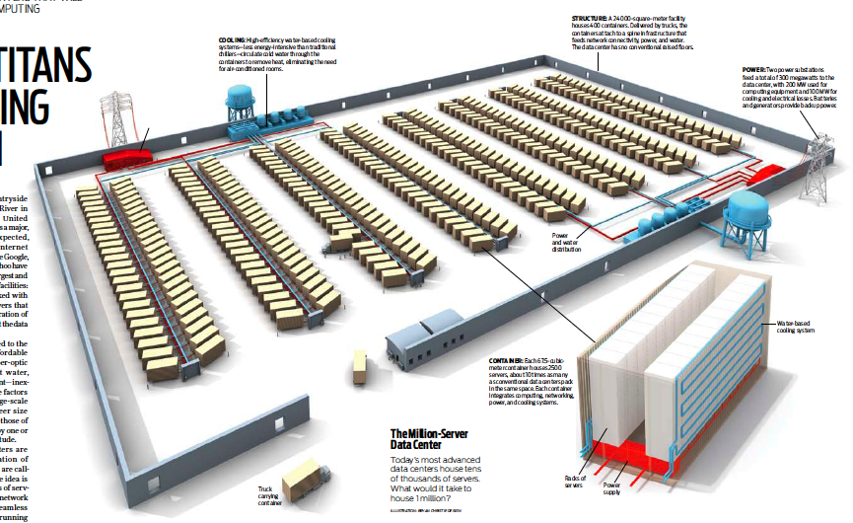
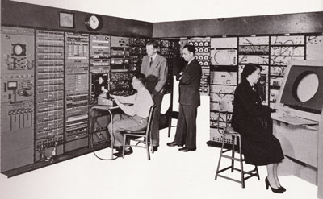
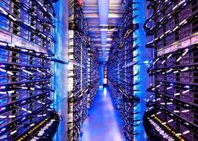
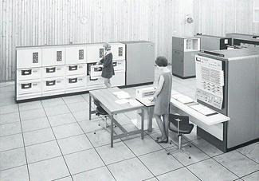
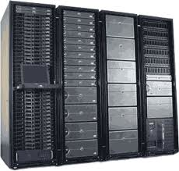
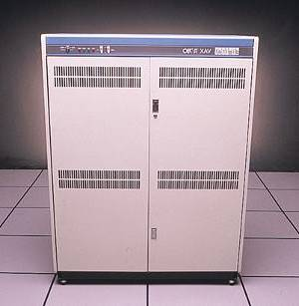








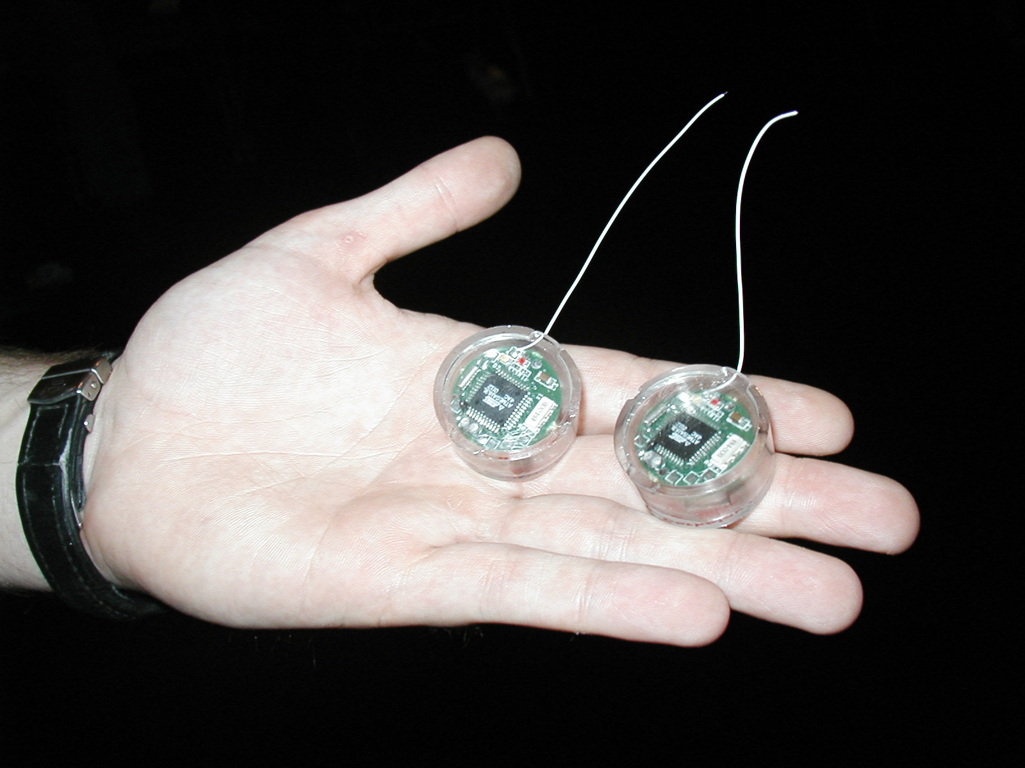
Recall: Changing Landscape…
Computers
Per Person
Number crunching, Data Storage, Massive Inet Services,
ML, …
1:10⁶
Mainframe
Bell’s Law: New computer class every 10 years
Mini
1:10³
Workstation
Productivity,
Interactive
PC
Laptop
1:1
PDA
Cell
Streaming from/to the physical world
10³:1
years
Mote!
The Internet of Things!

Slide 4
Changing Landscape of Scheduling
Priority-based scheduling rooted in “time-sharing”
  Allocating precious, limited resources across a diverse workload
    CPU bound, vs interactive, vs I/O bound
80’s brought about personal computers, workstations, and servers on networks
  Different machines of different types for different purposes
  Shift to fairness and avoiding extremes (starvation)
90’s emergence of the web, rise of internet-based services, the data-center-is-the-computer
  Server consolidation, massive clustered services, huge flashcrowds
  It’s about predictability, 95th percentile performance guarantees

Slide 5
Key Idea: Proportional-Share Scheduling
The policies we’ve studied so far:
  Always prefer to give the CPU to a prioritized job
  Non-prioritized jobs may never get to run
But priorities were a means, not an end:
  Give priority to interactive tasks or I/O tasks for responsiveness
  Lower priority given to long running tasks
Instead, we can share the CPU proportionally
  Give each job a share of the CPU according to its priority
  Low-priority jobs get smaller share of CPU
  But all jobs can at least make progress (no starvation)
This idea is closely related to fair queueing

Slide 6

Lottery Scheduling
Simple Idea:
  Give each job some number of lottery tickets
  On each time slice, randomly pick a winning ticket
  On average, CPU time is proportional to number of tickets
  given to each job
How to assign tickets?
  To approximate SRTF, short running jobs get more, long running jobs get fewer
  To avoid starvation, every job gets at least one ticket (everyone makes progress)
Advantage over strict priority scheduling: behaves gracefully as load changes
  Adding or deleting a job affects all jobs proportionally, independent of how many tickets each job possesses

Slide 7
Lottery Scheduling Example (Cont.)
Lottery Scheduling Example
  Assume short jobs get 10 tickets, long jobs get 1 ticket
  What if too many short jobs to give reasonable response time?
    If load average is 100, hard to make progress
    One approach: log some user out
# short jobs/ # long jobs | % of CPU each short jobs gets | % of CPU each long jobs gets
1/1 | 91% | 9%
0/2 | N/A | 50%
2/0 | 50% | N/A
10/1 | 9.9% | 0.99%
1/10 | 50% | 5%

Slide 8
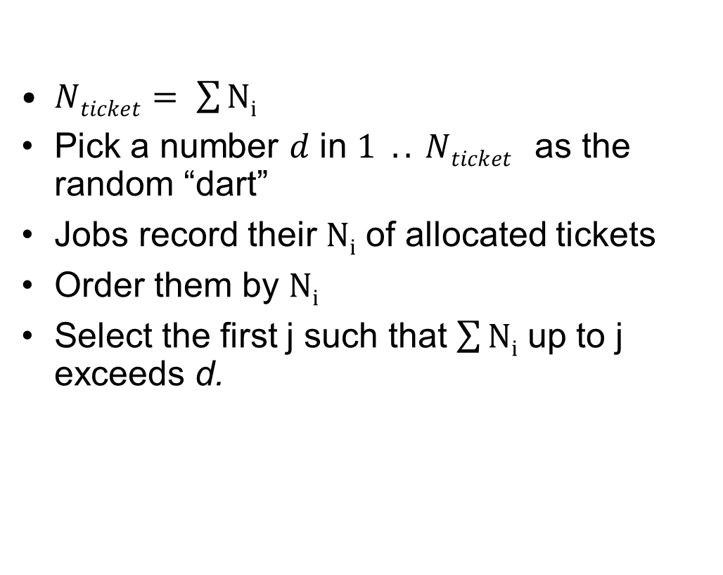
Lottery Scheduling: Simple Mechanism
10
$Nticket= \sum{Ni}$
Pick a number $d$ in $1 .. Nticket$ as the random “dart”
Jobs record their $Ni$ of allocated tickets
Order them by $Ni$
Select the first j such that $\sum{Ni}$ up to j exceeds d.
1

Slide 9
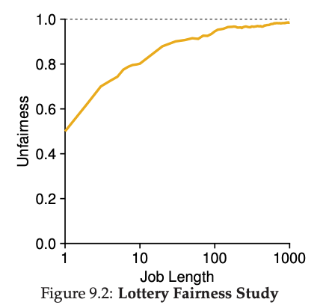
Unfairness
E.g., Given two jobs A and B of same run time (# Qs) that are each supposed to receive 50%,
U = finish time of first / finish time of last
As a function of run time

Slide 10
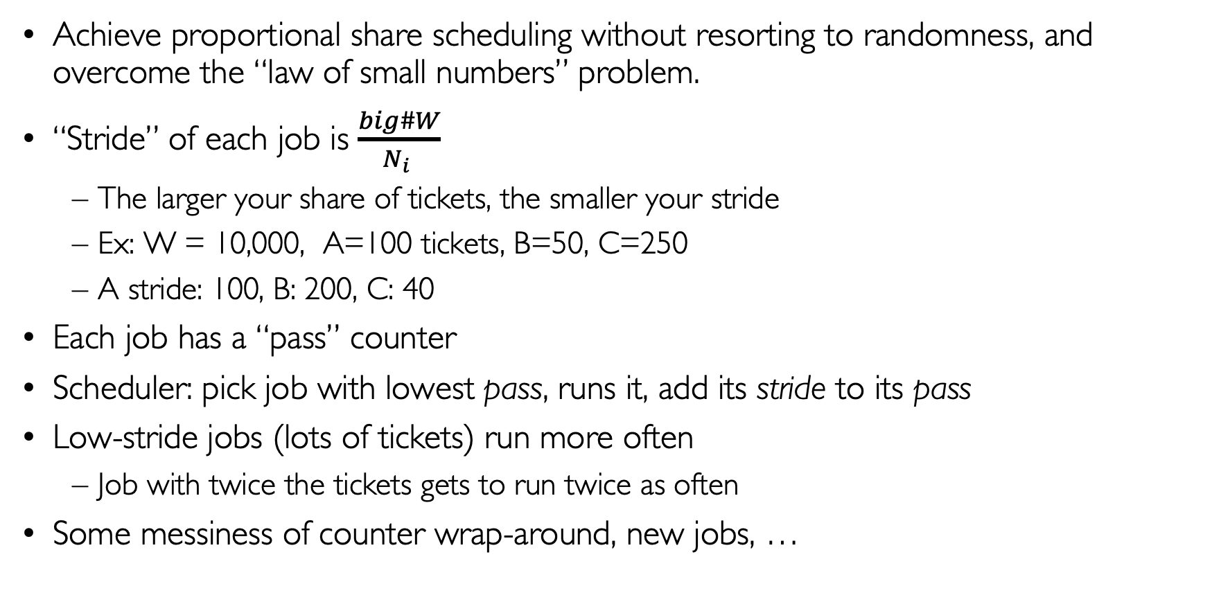
Stride Scheduling
Achieve proportional share scheduling without resorting to randomness, and overcome the “law of small numbers” problem.
“Stride” of each job is $\frac{big\#W}{N_{i} }$
  The larger your share of tickets, the smaller your stride
  Ex: W = 10,000, A=100 tickets, B=50, C=250
  A stride: 100, B: 200, C: 40
Each job has a “pass” counter
Scheduler: pick job with lowest pass, runs it, add its stride to its pass
Low-stride jobs (lots of tickets) run more often
  Job with twice the tickets gets to run twice as often
Some messiness of counter wrap-around, new jobs, …

Slide 11

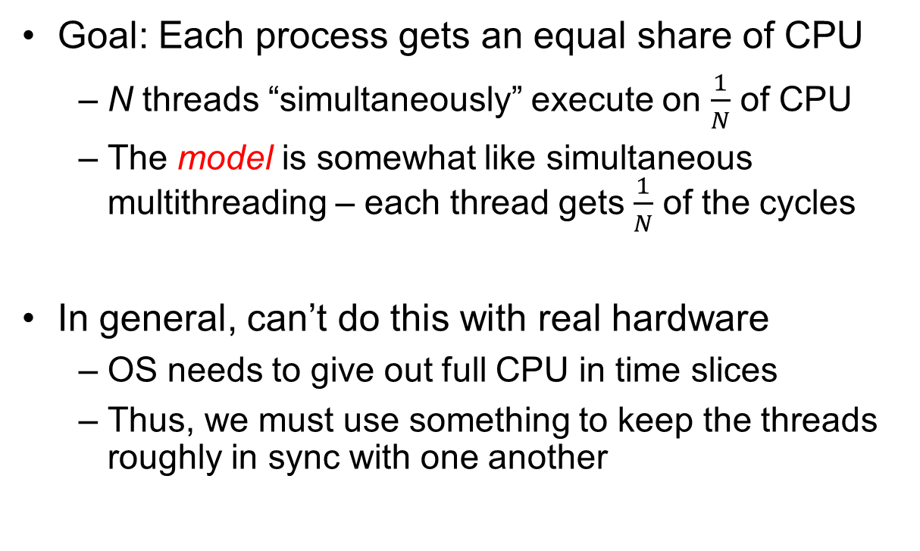
Linux Completely Fair Scheduler (CFS)
Goal: Each process gets an equal share of CPU
  N threads “simultaneously” execute on $\frac{1}{N}$ of CPU
  The model is somewhat like simultaneous multithreading – each thread gets $\frac{1}{N}$ of the cycles
In general, can’t do this with real hardware
  OS needs to give out full CPU in time slices
  Thus, we must use something to keep the threads roughly in sync with one another
Model: “Perfectly” subdivided CPU:
$$\frac{1}{N}$$
T₁
T₂
T₃
CPU Time

Slide 12
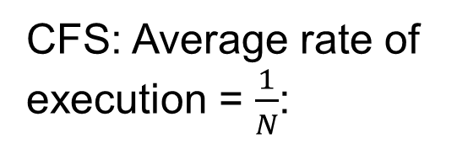

Linux Completely Fair Scheduler (CFS)
Basic Idea: track CPU time per thread and schedule threads to match up average rate of execution
Scheduling Decision:
  “Repair” illusion of complete fairness
  Choose thread with minimum CPU time
  Closely related to Fair Queueing
Use a heap-like scheduling queue for this…
  O(log N) to add/remove threads, where N is number of threads
Sleeping threads don’t advance their CPU time, so they get a boost when they wake up again…
  Get interactivity automatically!
CFS: Average rate of execution = $\frac{1}{N}$:
T₁
$$\frac{1}{N}$$
T₃
CPU Time
T₂

Slide 13
Linux CFS: Responsiveness/Starvation Freedom
In addition to fairness, we want low response time and starvation freedom
  Make sure that everyone gets to run at least a bit!
Constraint 1: Target Latency
  Period of time over which every process gets service
  Quanta = Target_Latency / n
Target Latency: 20 ms, 4 Processes
  Each process gets 5ms time slice
Target Latency: 20 ms, 200 Processes
  Each process gets 0.1ms time slice (!!!)
  Recall Round-Robin: large context switching overhead if slice gets to small

Slide 14
Linux CFS: Throughput
Goal: Throughput
  Avoid excessive overhead
Constraint 2: Minimum Granularity
  Minimum length of any time slice
Target Latency 20 ms, Minimum Granularity 1 ms, 200 processes
  Each process gets 1 ms time slice

Slide 15
Aside: Priority in Unix – Being Nice
The industrial operating systems of the 60s and 70’s provided priority to enforced desired usage policies.
  When it was being developed at Berkeley, instead it provided ways to “be nice”.
nice values range from -20 to 19
  Negative values are “not nice”
  If you wanted to let your friends get more time, you would nice up your job
Scheduler puts higher nice-value tasks (lower priority) to sleep more …
  In O(1) scheduler, this translated fairly directly to priority (and time slice)
How does this idea translate to CFS?
  Change the rate of CPU cycles given to threads to change relative priority

Slide 16
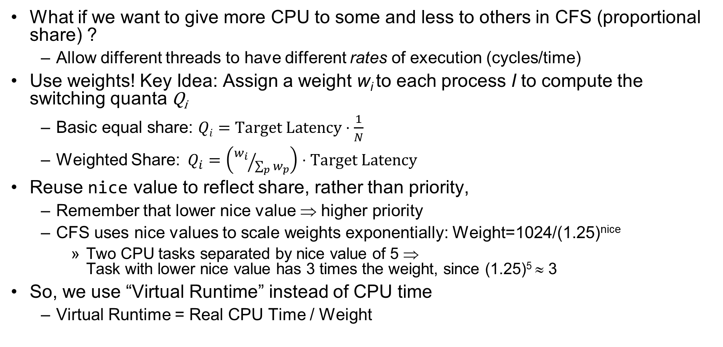
Linux CFS: Proportional Shares
What if we want to give more CPU to some and less to others in CFS (proportional share) ?
  Allow different threads to have different rates of execution (cycles/time)
Use weights! Key Idea: Assign a weight w_{i} to each process I to compute the switching quanta Q_{i}
  Basic equal share: $Qi=Target Latency⋅\frac{1}{N}$
  Weighted Share:$Q_{i}=\left({w_{i}}/{\sum_{p}{w_{p}}}\right)⋅Target Latency$
Reuse nice value to reflect share, rather than priority,
  Remember that lower nice value ⇒ higher priority
  CFS uses nice values to scale weights exponentially: Weight=1024/(1.25)^{nice}
    Two CPU tasks separated by nice value of 5 ⇒
    Task with lower nice value has 3 times the weight, since (1.25)⁵ ≈ 3
So, we use “Virtual Runtime” instead of CPU time
  Virtual Runtime = Real CPU Time / Weight

Slide 17
Example: Linux CFS: Proportional Shares
Target Latency = 20ms
Minimum Granularity = 1ms
Example: Two CPU-Bound Threads
  Thread A has weight 1
  Thread B has weight 4
Time slice for A? 4 ms
Time slice for B? 16 ms

Slide 18
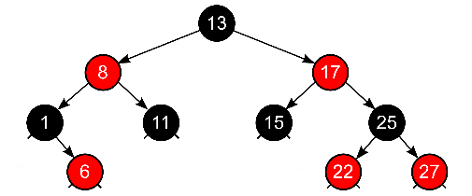
Linux CFS: Proportional Shares
16 (w_{B}=4)
B
Physical
CPU Time
Virtual
CPU Time
B
A
4 (w_{A}=1)
A
Track a thread's virtual runtime rather than its true physical runtime
  Higher weight: Virtual runtime increases more slowly
  Lower weight: Virtual runtime increases more quickly
Scheduler’s Decisions are based on Virtual CPU Time
Use of Red-Black tree to hold all runnable processes as
sorted on vruntime variable
  O(log N) time to perform insertions/deletions
    Cache the item at far left (item with earliest vruntime)
  When ready to schedule, grab version with smallest vruntime (which will be item at the far left).

Slide 19
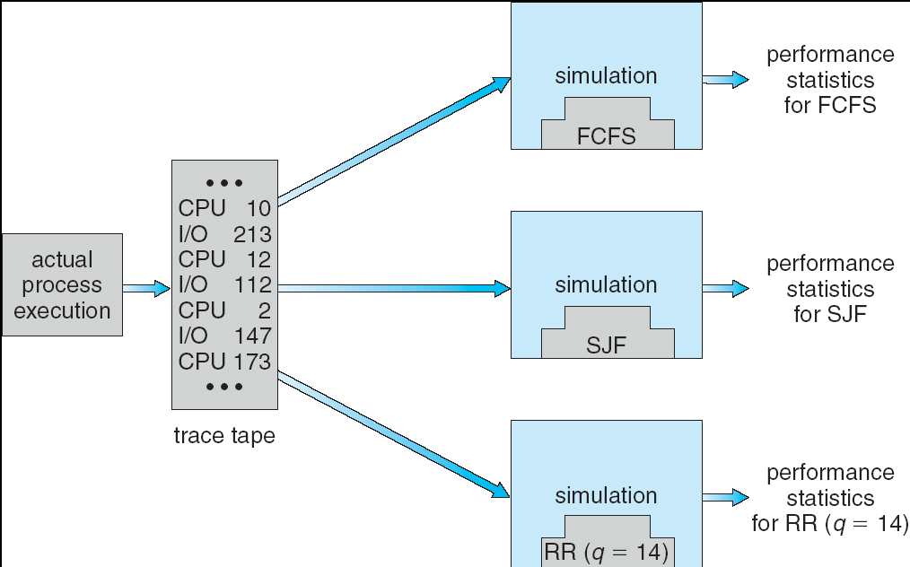
How to Evaluate a Scheduling algorithm?
Deterministic modeling
  takes a predetermined workload and compute the performance of each algorithm
  for that workload
Queueing models
  Mathematical approach for handling stochastic workloads
Implementation/Simulation:
  Build system which allows actual algorithms
  to be run against actual data
  Most flexible/general

Slide 20
Choosing the Right Scheduler
I Care About: | Then Choose:
CPU Throughput | FCFS
Avg. Response Time | SRTF Approximation
I/O Throughput | SRTF Approximation
Fairness (CPU Time) | Linux CFS
Fairness – Wait Time to Get CPU | Round Robin
Meeting Deadlines | EDF
Favoring Important Tasks | Priority

Slide 21
A Final Word On Scheduling
When do the details of the scheduling policy and fairness really matter?
  When there aren’t enough resources to go around
When should you simply buy a faster computer?
  (Or network link, or expanded highway, or …)
  One approach: Buy it when it will pay for itself in improved response time
    Perhaps you’re paying for worse response time in reduced
    productivity, customer angst, etc…
    Might think that you should buy a faster X when X is utilized 100%,
    but usually, response time goes to infinity as utilization⇒100%
An interesting implication of this curve:
  Most scheduling algorithms work fine in the “linear” portion of
  the load curve, fail otherwise
  Argues for buying a faster X when hit “knee” of curve
Response
time
100%
Utilization

Slide 22
Administrivia
Welcome to Project 2
  Please get started earlier than last time!
Midterm 2
  Coming up in 2 weeks! (3/14)
  Everything up to the midterm is fair game (perhaps deemphasizing the lecture on the day before….)

Slide 23
Deadlock: A Deadly type of Starvation
Starvation: thread waits indefinitely
  Example, low-priority thread waiting for resources constantly in use by high-priority threads
Deadlock: circular waiting for resources
  Thread A owns Res 1 and is waiting for Res 2
  Thread B owns Res 2 and is waiting for Res 1
Deadlock ⇒ Starvation but not vice versa
  Starvation can end (but doesn’t have to)
  Deadlock can’t end without external intervention
Thread
A
Wait
For
Owned
By
Res 1
Res 2
Owned
By
Wait
For
Thread
B
Notes:
Now let's look at some key problems we face when synchronizing or scheduling concurrent tasks.

Slide 24
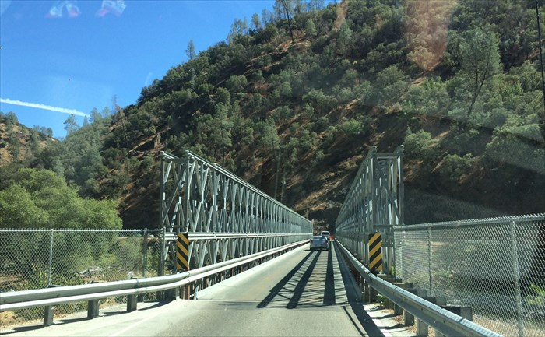
Example: Single-Lane Bridge Crossing
CA 140 to Yosemite National Park

Slide 25



Bridge Crossing Example
Each segment of road can be viewed as a resource
  Car must own the segment under them
  Must acquire segment that they are moving into
For bridge: must acquire both halves
  Traffic only in one direction at a time
Deadlock: Shown above when two cars in opposite directions meet in middle
  Each acquires one segment and needs next
  Deadlock resolved if one car backs up (preempt resources and rollback)
    Several cars may have to be backed up
Starvation (not Deadlock):
  East-going traffic really fast ⇒ no one gets to go west
Owned
By
Wait
For
West
Half
East
Half
Honk!
Owned
By
Wait
For

Slide 26
Deadlock with Locks
Thread A:
x.Acquire();
y.Acquire();
…
y.Release();
x.Release();
Thread B:
y.Acquire();
x.Acquire();
…
x.Release();
y.Release();
Thread
A
Owned
By
Wait
For
Lock x
Lock y
Wait
For
Thread
B
Owned
By
This lock pattern exhibits non-deterministic deadlock
  Sometimes it happens, sometimes it doesn’t!
This is really hard to debug!

Slide 27
Deadlock with Locks: “Unlucky” Case
Thread A:
x.Acquire();
y.Acquire(); <stalled>
<unreachable>
…
y.Release();
x.Release();
Thread B:
y.Acquire();
x.Acquire(); <stalled>
<unreachable>
…
x.Release();
y.Release();
Thread
A
Owned
By
Wait
For
Lock x
Lock y
Wait
For
Thread
B
Owned
By
Neither thread will get to run ⇒ Deadlock

Slide 28
Deadlock with Locks: “Lucky” Case
Thread A:
x.Acquire();
y.Acquire();
…
y.Release();
x.Release();
Thread B:
y.Acquire();
x.Acquire();
…
x.Release();
y.Release();
Sometimes, schedule won’t trigger deadlock!

Slide 29
Other Types of Deadlock
Threads often block waiting for resources
  Locks
  Terminals
  Printers
  CD drives
  Memory
Threads often block waiting for other threads
  Pipes
  Sockets
You can deadlock on any of these!

Slide 30
Deadlock with Space
Thread A:
AllocateOrWait(1 MB)
AllocateOrWait(1 MB)
Free(1 MB)
Free(1 MB)
Thread B
AllocateOrWait(1 MB)
AllocateOrWait(1 MB)
Free(1 MB)
Free(1 MB)
If only 2 MB of space, we get same deadlock situation

Slide 31

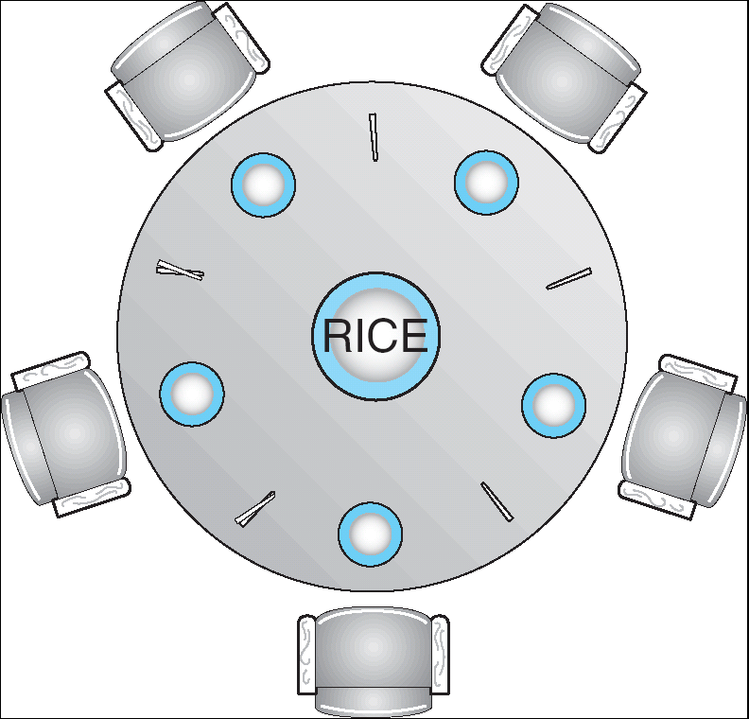

Dining Lawyers Problem
Five chopsticks/Five lawyers (really cheap restaurant)
  Free-for all: Lawyer will grab any one they can
  Need two chopsticks to eat
What if all grab at same time?
  Deadlock!
How to fix deadlock?
  Make one of them give up a chopstick (Hah!)
  Eventually everyone will get chance to eat
How to prevent deadlock?
  Never let lawyer take last chopstick if no hungry lawyer has two chopsticks afterwards
  Can we formalize this requirement somehow?

Slide 32
Four requirements for occurrence of Deadlock
Mutual exclusion
  Only one thread at a time can use a resource.
Hold and wait
  Thread holding at least one resource is waiting to acquire additional resources held by other threads
No preemption
  Resources are released only voluntarily by the thread holding the resource, after thread is finished with it
Circular wait
  There exists a set {T₁, …, T_{n}} of waiting threads
    T₁ is waiting for a resource that is held by T₂
    T₂ is waiting for a resource that is held by T₃
    …
    T_{n} is waiting for a resource that is held by T₁

Slide 33
Detecting Deadlock: Resource-Allocation Graph
System Model
  A set of Threads T₁, T₂, . . ., T_{n}
  Resource types R₁, R₂, . . ., R_{m}
    CPU cycles, memory space, I/O devices
  Each resource type R_{i} has W_{i} instances
  Each thread utilizes a resource as follows:
    Request() / Use() / Release()
Resource-Allocation Graph:
  V is partitioned into two types:
    T = {T₁, T₂, …, T_{n}}, the set threads in the system.
    R = {R₁, R₂, …, R_{m}}, the set of resource types in system
  request edge – directed edge T₁ → R_{j}
  assignment edge – directed edge R_{j} → T_{i}
Symbols
T₁
T₂
R₁
R₂

Slide 34
Resource-Allocation Graph Examples
Model:
  request edge – directed edge T₁ → R_{j}
  assignment edge – directed edge R_{j} → T_{i}
R₁
R₂
R₁
R₂
R₁
T₂
T₁
T₂
T₃
T₁
T₂
T₃
T₁
T₃
R₃
T₄
R₄
R₃
R₂
R₄
Simple Resource
Allocation Graph
Allocation Graph
With Deadlock
Allocation Graph
With Cycle, but
No Deadlock

Slide 35
Deadlock Detection Algorithm
Let [X] represent an m-ary vector of non-negative integers
(quantities of resources of each type):
  [FreeResources]: Current free resources each type
  [Request_{X}]: Current requests from thread X
  [Alloc_{X}]: Current resources held by thread X
See if tasks can eventually terminate on their own
[Avail] = [FreeResources]
Add all nodes to UNFINISHED
do {
done = true
Foreach node in UNFINISHED {
if ([Request_{node}] <= [Avail]) {
remove node from UNFINISHED
[Avail] = [Avail] + [Alloc_{node}]
done = false
}
}
} until(done)
Nodes left in UNFINISHED ⇒ deadlocked
R₁
T₂
T₁
T₃
T₄
R₂

Slide 36
How should a system deal with deadlock?
Four different approaches:
Deadlock prevention: write your code in a way that it isn’t prone to deadlock
Deadlock recovery: let deadlock happen, and then figure out how to recover from it
Deadlock avoidance: dynamically delay resource requests so deadlock doesn’t happen
Deadlock denial: ignore the possibility of deadlock
Modern operating systems:
  Make sure the system isn’t involved in any deadlock
  Ignore deadlock in applications
    “Ostrich Algorithm”

Slide 37
Techniques for Preventing Deadlock
Infinite resources
  Include enough resources so that no one ever runs out of resources.
  Doesn’t actually have to be infinite, just large…
  Give illusion of infinite resources (e.g. virtual memory)
  Examples:
    Bay bridge with 12,000 lanes. Never wait!
    Infinite disk space (not realistic yet?)
No Sharing of resources (totally independent threads)
  Not very realistic
Don’t allow waiting
  How the phone company avoids deadlock
    Call Mom in Toledo, works way through phone network, but if blocked get busy signal.
  Technique used in Ethernet/some multiprocessor nets
    Everyone speaks at once. On collision, back off and retry
  Inefficient, since have to keep retrying
    Consider: driving to San Francisco; when hit traffic jam, suddenly you’re transported back home and told to retry!

Slide 38
(Virtually) Infinite Resources
Thread A
AllocateOrWait(1 MB)
AllocateOrWait(1 MB)
Free(1 MB)
Free(1 MB)
Thread B
AllocateOrWait(1 MB)
AllocateOrWait(1 MB)
Free(1 MB)
Free(1 MB)
With virtual memory we have “infinite” space so everything will just succeed, thus above example won’t deadlock
  Of course, it isn’t actually infinite, but certainly larger than 2MB!

Slide 39
Techniques for Preventing Deadlock
Make all threads request everything they’ll need at the beginning.
  Problem: Predicting future is hard, tend to over-estimate resources
  Example:
    If need 2 chopsticks, request both at same time
    Don’t leave home until we know no one is using any intersection between here and where you want to go; only one car on the Bay Bridge at a time
Force all threads to request resources in a particular order preventing any cyclic use of resources
  Thus, preventing deadlock
  Example (x.Acquire(), y.Acquire(), z.Acquire(),…)
    Make tasks request disk, then memory, then…
    Keep from deadlock on freeways around SF by requiring everyone to go clockwise

Slide 40
Request Resources Atomically (1)
Rather than:
Thread A:
x.Acquire();
y.Acquire();
…
y.Release();
x.Release();
Thread B:
y.Acquire();
x.Acquire();
…
x.Release();
y.Release();
Consider instead:
Thread A:
Acquire_both(x, y);
…
y.Release();
x.Release();
Thread B:
Acquire_both(y, x);
…
x.Release();
y.Release();

Slide 41
Request Resources Atomically (2)
Or consider this:
Thread A
z.Acquire();
x.Acquire();
y.Acquire();
z.Release();
…
y.Release();
x.Release();
Thread B
z.Acquire();
y.Acquire();
x.Acquire();
z.Release();
…
x.Release();
y.Release();

Slide 42
Acquire Resources in Consistent Order
Rather than:
Thread A:
x.Acquire();
y.Acquire();
…
y.Release();
x.Release();
Thread B:
y.Acquire();
x.Acquire();
…
x.Release();
y.Release();
Consider instead:
Thread A:
x.Acquire();
y.Acquire();
…
y.Release();
x.Release();
Thread B:
x.Acquire();
y.Acquire();
…
x.Release();
y.Release();
Does it matter in which order the locks are released?

Slide 43


Train Example (Wormhole-Routed Network)
Circular dependency (Deadlock!)
  Each train wants to turn right, but is blocked by other trains
Similar problem to multiprocessor networks
  Wormhole-Routed Network: Messages trail through network like a “worm”
Fix? Imagine grid extends in all four directions
  Force ordering of channels (tracks)
    Protocol: Always go east-west first, then north-south
  Called “dimension ordering” (X then Y)
Disallowed
By Rule

Slide 44
Techniques for Recovering from Deadlock
Terminate thread, force it to give up resources
  In Bridge example, Godzilla picks up a car, hurls it into the river. Deadlock solved!
  Hold dining lawyer in contempt and take away in handcuffs
  But, not always possible – killing a thread holding a mutex leaves world inconsistent
Preempt resources without killing off thread
  Take away resources from thread temporarily
  Doesn’t always fit with semantics of computation
Roll back actions of deadlocked threads
  Hit the rewind button on TiVo, pretend last few minutes never happened
  For bridge example, make one car roll backwards (may require others behind him)
  Common technique in databases (transactions)
  Of course, if you restart in exactly the same way, may reenter deadlock once again
Many operating systems use other options

Slide 45
Another view of virtual memory: Pre-empting Resources
Thread A:
AllocateOrWait(1 MB)
AllocateOrWait(1 MB)
Free(1 MB)
Free(1 MB)
Thread B:
AllocateOrWait(1 MB)
AllocateOrWait(1 MB)
Free(1 MB)
Free(1 MB)
Before: With virtual memory we have “infinite” space so everything will just succeed, thus above example won’t deadlock
  Of course, it isn’t actually infinite, but certainly larger than 2MB!
Alternative view: we are “pre-empting” memory when paging out to disk, and giving it back when paging back in
  This works because thread can’t use memory when paged out

Slide 46
Techniques for Deadlock Avoidance
Idea: When a thread requests a resource, OS checks if it would result in deadlock
  If not, it grants the resource right away
  If so, it waits for other threads to release resources
  THIS DOES NOT WORK!!!!
Example:
Thread A:
x.Acquire();
y.Acquire();
…
y.Release();
x.Release();
Thread B:
y.Acquire();
x.Acquire();
…
x.Release();
y.Release();
Blocks…
Wait?
But it’s already too late…

Slide 47
Deadlock Avoidance: Three States
Safe state
  System can delay resource acquisition to prevent deadlock
Unsafe state
  No deadlock yet…
  But threads can request resources in a pattern that unavoidably leads to deadlock
Deadlocked state
  There exists a deadlock in the system
  Also considered “unsafe”
Deadlock avoidance: prevent system from reaching an unsafe state

Slide 48
Deadlock Avoidance
Idea: When a thread requests a resource, OS checks if it would result in deadlock an unsafe state
  If not, it grants the resource right away
  If so, it waits for other threads to release resources
Example:
Thread A:
x.Acquire();
y.Acquire();
…
y.Release();
x.Release();
Thread B:
y.Acquire();
x.Acquire();
…
x.Release();
y.Release();
Wait until Thread A releases mutex X

Slide 49
Banker’s Algorithm for Avoiding Deadlock
Toward right idea:
  State maximum (max) resource needs in advance
  Allow particular thread to proceed if:
    (available resources - #requested) ≥ max
    remaining that might be needed by any thread
Banker’s algorithm (less conservative):
  Allocate resources dynamically
    Evaluate each request and grant if some
    ordering of threads is still deadlock free afterward
    Technique: pretend each request is granted, then run deadlock detection
    algorithm, substituting:
    ([Max_{node}]-[Alloc_{node}] <= [Avail]) for ([Request_{node}] <= [Avail])
    Grant request if result is deadlock free (conservative!)

Slide 50
Banker’s Algorithm for Avoiding Deadlock
[Avail] = [FreeResources]
Add all nodes to UNFINISHED
do {
done = true
Foreach node in UNFINISHED {
if ([Request_{node}] <= [Avail]) {
remove node from UNFINISHED
[Avail] = [Avail] + [Alloc_{node}]
done = false
}
}
} until(done)
Toward right idea:
  State maximum (max) resource needs in advance
  Allow particular thread to proceed if:
    (available resources - #requested) ≥ max
    remaining that might be needed by any thread
Banker’s algorithm (less conservative):
  Allocate resources dynamically
    Evaluate each request and grant if some
    ordering of threads is still deadlock free afterward
    Technique: pretend each request is granted, then run deadlock detection
    algorithm, substituting:
    ([Max_{node}]-[Alloc_{node}] <= [Avail]) for ([Request_{node}] <= [Avail])
    Grant request if result is deadlock free (conservative!)

Slide 51
Banker’s Algorithm for Avoiding Deadlock
[Avail] = [FreeResources]
Add all nodes to UNFINISHED
do {
done = true
Foreach node in UNFINISHED {
if ([Max_{node}]-[Alloc_{node}] <= [Avail]) {
remove node from UNFINISHED
[Avail] = [Avail] + [Alloc_{node}]
done = false
}
}
} until(done)
Toward right idea:
  State maximum (max) resource needs in advance
  Allow particular thread to proceed if:
    (available resources - #requested) ≥ max
    remaining that might be needed by any thread
Banker’s algorithm (less conservative):
  Allocate resources dynamically
    Evaluate each request and grant if some
    ordering of threads is still deadlock free afterward
    Technique: pretend each request is granted, then run deadlock detection
    algorithm, substituting:
    ([Max_{node}]-[Alloc_{node}] <= [Avail]) for ([Request_{node}] <= [Avail])
    Grant request if result is deadlock free (conservative!)

Slide 52
Banker’s Algorithm for Avoiding Deadlock
Toward right idea:
  State maximum (max) resource needs in advance
  Allow particular thread to proceed if:
    (available resources - #requested) ≥ max
    remaining that might be needed by any thread
Banker’s algorithm (less conservative):
  Allocate resources dynamically
    Evaluate each request and grant if some
    ordering of threads is still deadlock free afterward
    Technique: pretend each request is granted, then run deadlock detection
    algorithm, substituting:
    ([Max_{node}]-[Alloc_{node}] <= [Avail]) for ([Request_{node}] <= [Avail])
    Grant request if result is deadlock free (conservative!)
  Keeps system in a “SAFE” state: there exists a sequence {T₁, T₂, … T_{n}} with T₁ requesting all remaining resources, finishing, then T₂ requesting all remaining resources, etc..

Slide 53

Banker’s Algorithm Example
Banker’s algorithm with dining lawyers
  “Safe” (won’t cause deadlock) if when try to
  grab chopstick either:
    Not last chopstick
    Is last chopstick but someone will have
    two afterwards
  What if k-handed lawyers? Don’t allow if:
    It’s the last one, no one would have k
    It’s 2nd to last, and no one would have k-1
    It’s 3rd to last, and no one would have k-2
    …

Slide 54
Conclusion
Proportional Share Scheduling (Lottery Scheduling, Stride Scheduling CFS)
  Give each job a share of the CPU according to its priority
  Low-priority jobs get to run less often
  But all jobs can at least make progress (no starvation)
Four conditions for deadlocks
  Mutual exclusion
  Hold and wait
  No preemption
  Circular wait
Techniques for addressing Deadlock
  Deadlock prevention:
    write your code in a way that it isn’t prone to deadlock
  Deadlock recovery:
    let deadlock happen, and then figure out how to recover from it
  Deadlock avoidance:
    dynamically delay resource requests so deadlock doesn’t happen
    Banker’s Algorithm provides on algorithmic way to do this
  Deadlock denial:
    ignore the possibility of deadlock

