Slide 1
CS162
Operating Systems and
Systems Programming
Lecture 14
Memory 1: Virtual Memory,
Segments and Page Tables
March 5th, 2024
Prof. John Kubiatowicz
http://cs162.eecs.Berkeley.edu

Slide 2
Recall: Four requirements for occurrence of Deadlock
Mutual exclusion
  Only one thread at a time can use a resource.
Hold and wait
  Thread holding at least one resource is waiting to acquire additional resources held by other threads
No preemption
  Resources are released only voluntarily by the thread holding the resource, after thread is finished with it
Circular wait
  There exists a set {T₁, …, T_{n}} of waiting threads
    T₁ is waiting for a resource that is held by T₂
    T₂ is waiting for a resource that is held by T₃
    …
    T_{n} is waiting for a resource that is held by T₁

Slide 3
Recall: Banker’s Algorithm for Avoiding Deadlock
Toward right idea:
  State maximum (max) resource needs in advance
  Allow particular thread to proceed if:
    (available resources - #requested) ≥ max remaining that might be needed by any thread
Banker’s algorithm (less conservative):
  Allocate resources dynamically
    Evaluate each request and grant if some
    ordering of threads is still deadlock free afterward
    Technique: pretend each request is granted, then run deadlock
    detection algorithm, substituting:
    ([Max_{node}]-[Alloc_{node}] <= [Avail]) for ([Request_{node}] <= [Avail])
  Grant request if won’t prevent some thread from allocating its maximum and finshing
Keeps system in a “SAFE” state:
  There exists a sequence {T₁, T₂, … T_{n}} with T₁ requesting all remaining resources, finishing, then T₂ requesting all remaining resources, etc..

Slide 4

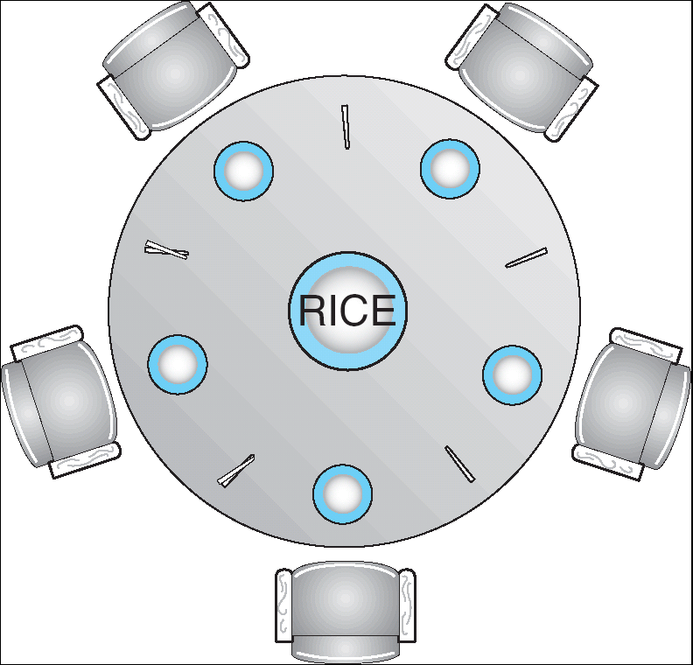


Recall: Banker’s Algorithm Example
Banker’s algorithm with dining lawyers
  “Safe” (won’t cause deadlock) if when try to
  grab chopstick either:
    Not last chopstick
    Is last chopstick but someone will have
    two afterwards
  What if k-handed lawyers? Don’t allow if:
    It’s the last one, no one would have k
    It’s 2nd to last, and no one would have k-1
    It’s 3rd to last, and no one would have k-2
    …

Slide 5
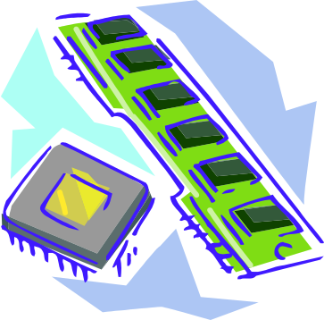
Virtualizing Resources
Physical Reality:
Different Processes/Threads share the same hardware
  Need to multiplex CPU (Just finished: scheduling)
  Need to multiplex use of Memory (starting today)
  Need to multiplex disk and devices (later in term)
Why worry about memory sharing?
  The complete working state of a process and/or kernel is defined by its data in memory (and registers)
  Consequently, cannot just let different threads of control use the same memory
    Physics: two different pieces of data cannot occupy the same locations in memory
  Probably don’t want different threads to even have access to each other’s memory if in different processes (protection)
Notes:
Now we're going to talk about other ways we can virtualize resources.
Seen: virtualizing CPU by multiplexing many processes and threads onto it (scheduling)
Now: memory

Slide 6
Important Aspects of Memory Multiplexing
Protection:
  Prevent access to private memory of other processes
    Different pages of memory can be given special behavior (Read Only, Invisible to user programs, etc).
    Kernel data protected from User programs
    Programs protected from themselves
Translation:
  Ability to translate accesses from one address space (virtual) to a different one (physical)
  When translation exists, processor uses virtual addresses, physical memory uses physical addresses
  Side effects:
    Can be used to avoid overlap
    Can be used to give uniform view of memory to programs
Controlled overlap:
  Separate state of threads should not collide in physical memory. Obviously, unexpected overlap causes chaos!
  Conversely, would like the ability to overlap when desired (for communication)

Slide 7
Alternative View: Interposing on Process Behavior
OS interposes on process’ I/O operations
  How? All I/O happens via syscalls.
OS interposes on process’ CPU usage
  How? Interrupt lets OS preempt current thread
Question: How can the OS interpose on process’ memory accesses?
  Too slow for the OS to interpose every memory access
  Translation: hardware support to accelerate the common case
  Page fault: uncommon cases trap to the OS to handle

Slide 8
Recall: Four Fundamental OS Concepts
Thread: Execution Context
  Fully describes program state
  Program Counter, Registers, Execution Flags, Stack
Address space (with or w/o translation)
  Set of memory addresses accessible to program (for read or write)
  May be distinct from memory space of the physical machine
  (in which case programs operate in a virtual address space)
Process: an instance of a running program
  Protected Address Space + One or more Threads
Dual mode operation / Protection
  Only the “system” has the ability to access certain resources
  Combined with translation, isolates programs from each other and the OS from programs

Slide 9
THE BASICS: Address/Address Space
Address Space:
2^{k} “things”
Address:
“Things” here usually
means “bytes” (8 bits)
k bits
What is 2¹⁰ bytes (where a byte is appreviated as “B”)?
  2¹⁰ B = 1024B = 1 KB (for memory, 1K = 1024, not 1000)
How many bits to address each byte of 4KB page?
  4KB = 4×1KB = 4× 2¹⁰= 2¹²⇒ 12 bits
How much memory can be addressed with 20 bits? 32 bits? 64 bits?
  Use 2^{k}

Slide 10
Address Space, Process Virtual Address Space
Definition: Set of accessible addresses and the state associated with them
  2³² = ~4 billion bytes on a 32-bit machine
How many 32-bit numbers fit in this address space?
  32-bits = 4 bytes, so 2³²/4 = 2³⁰=~1billion
What happens when processor reads or writes to an address?
  Perhaps acts like regular memory
  Perhaps causes I/O operation
    (Memory-mapped I/O)
  Causes program to abort (segfault)?
  Communicate with another program
  …
0x000…
code
Static Data
heap
stack
0xFFF…

Slide 11
Recall: Process Address Space: typical structure
0x000…
Code Segment
PC:
SP:
Static Data
heap
Processor
registers
sbrk syscall
Stack Segment
0xFFF…

Slide 12

Recall: Uniprogramming
Uniprogramming (no Translation or Protection)
  Application always runs at same place in physical memory since only one application at a time
  Application can access any physical address
  Application given illusion of dedicated machine by giving it reality of a dedicated machine
0xFFFFFFFF
Operating
System
Valid 32-bit
Addresses
Application
0x00000000

Slide 13
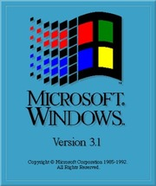
Primitive Multiprogramming
Multiprogramming without Translation or Protection
  Must somehow prevent address overlap between threads
  Use Loader/Linker: Adjust addresses while program loaded into memory (loads, stores, jumps)
    Everything adjusted to memory location of program
    Translation done by a linker-loader (relocation)
    Common in early days (… till Windows 3.x, 95?)
With this solution, no protection: bugs in any program can cause other programs to crash or even the OS
0xFFFFFFFF
Operating
System
Application2
0x00020000
Application1
0x00000000

Slide 14
Binding of Instructions and Data to Memory
Assume 4byte words
0x300 = 4 * 0x0C0
0x0C0 = 0000 1100 0000
0x300 = 0011 0000 0000
Process view of memory
Physical addresses
  data1: dw 32
  …
  start: lw r1,0(data1)
  jal checkit
  loop: addi r1, r1, -1
  bnz r1, loop …
  checkit: …
  0x0300 00000020
  … …
  0x0900 8C2000C0
  0x0904 0C000280
  0x0908 2021FFFF
  0x090C 14200242
  …
  0x0A00

Slide 15
Binding of Instructions and Data to Memory
Physical
Memory
0x0000
0x0300
  00000020
Process view of memory
Physical addresses
  data1: dw 32
  …
  start: lw r1,0(data1)
  jal checkit
  loop: addi r1, r1, -1
  bnz r1, loop …
  checkit: …
  0x0300 00000020
  … …
  0x0900 8C2000C0
  0x0904 0C000280
  0x0908 2021FFFF
  0x090C 14200242
  …
  0x0A00
0x0900
  8C2000C0
  0C000340
  2021FFFF
  14200242
0xFFFF

Slide 16
Second copy of program from previous example
Physical
Memory
0x0000
0x0300
App X
Process view of memory
Physical addresses
  data1: dw 32
  …
  start: lw r1,0(data1)
  jal checkit
  loop: addi r1, r1, -1
  bnz r1, loop …
  checkit: …
  0x0300 00000020
  … …
  0x0900 8C2000C0
  0x0904 0C000280
  0x0908 2021FFFF
  0x090C 14200242
  …
  0x0A00
0x0900
?
0xFFFF
Need address translation!

Slide 17
Second copy of program from previous example
Physical
Memory
0x0000
0x0300
App X
Process view of memory
Physical addresses
  data1: dw 32
  …
  start: lw r1,0(data1)
  jal checkit
  loop: addi r1, r1, -1
  bnz r1, loop …
  checkit: …
  0x1300 00000020
  … …
  0x1900 8C2004C0
  0x1904 0C000680
  0x1908 2021FFFF
  0x190C 14200642
  …
  0x1A00
0x0900
0x1300
  00000020
0x1900
  8C2004C0
  0C000680
  2021FFFF
  14200642
One of many possible translations!
Where does translation take place?
    Compile time, Link/Load time, or Execution time?
0xFFFF

Slide 18
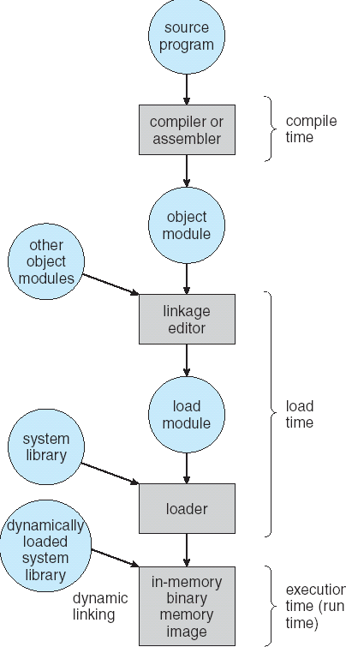
From Program to Process
Preparation of a program for execution involves components at:
  Compile time (i.e., “gcc”)
  Link/Load time (UNIX “ld” does link)
  Execution time (e.g., dynamic libs)
Addresses can be bound to final values anywhere in this path
  Depends on hardware support
  Also depends on operating system
Dynamic Libraries
  Linking postponed until execution
  Small piece of code (i.e. the stub), locates appropriate memory-resident library routine
  Stub replaces itself with the address of the routine, and executes routine

Slide 19
Administrivia
Midterm 2: Thursday 3/14 from 8-10PM
  A week from tomorrow!!!
  All material up to Lecture 16 technically in bounds
  Closed book: with two double-sided handwritten sheets of notes
Homework 4 coming out
  Released tomorrow, Wednesday 3/6
Project 2 design document due this Friday!
Starting next week – will have an opportunity to get extra credit participation points by attending lecture
  Details to follow

Slide 20
Administrivia (Con’t)
You need to know your units as CS/Engineering students!
Units of Time: “s”: Second, “min”: 60s, “h”: 3600s, (of course)
  Millisecond: 1ms ⇒ 10⁻³ s
  Microsecond: 1μs ⇒ 10⁻⁶ s
  Nanosecond: 1ns: ⇒ 10⁻⁹ s
  Picosecond: 1ps ⇒ 10⁻¹² s
Integer Sizes: “b” ⇒ ”bit”, “B” ⇒ “byte” == 8 bits, “W”⇒”word”==? (depends. Could be 16b, 32b, 64b)
Units of Space (memory), sometimes called the “binary system”
  Kilo: 1KB ≡ 1KiB ⇒ 1024 bytes == 2¹⁰ bytes == 1024 ≈ 1.0×10³
  Mega: 1MB ≡ 1MiB ⇒ (1024)² bytes == 2²⁰ bytes == 1,048,576 ≈ 1.0×10⁶
  Giga: 1GB ≡ 1GiB ⇒ (1024)³ bytes == 2³⁰ bytes == 1,073,741,824 ≈ 1.1×10⁹
  Tera: 1TB ≡ 1TiB ⇒ (1024)⁴ bytes == 2⁴⁰ bytes == 1,099,511,627,776 ≈ 1.1×10¹²
  Peta: 1PB ≡ 1PiB ⇒ (1024)⁵ bytes == 2⁵⁰ bytes == 1,125,899,906,842,624 ≈ 1.1 × 10¹⁵
  Exa: 1EB ≡ 1EiB ⇒ (1024)⁶ bytes == 2⁶⁰ bytes == 1,152,921,504,606,846,976 ≈ 1.2 × 10¹⁸
Units of Bandwidth, Space on disk/etc, Everything else…, sometimes called the “decimal system”
  Kilo: 1KB/s ⇒ 10³ bytes/s, 1KB ⇒ 10³ bytes
  Mega: 1MB/s ⇒ 10⁶ bytes/s, 1MB ⇒ 10⁶ bytes
  Giga: 1GB/s ⇒ 10⁹ bytes/s, 1GB ⇒ 10⁹ bytes
  Tera: 1TB/s ⇒ 10¹² bytes/s, 1TB ⇒ 10¹² bytes
  Peta: 1PB/s ⇒ 10¹⁵ bytes/s, 1PB ⇒ 10¹⁵ bytes
  Exa: 1EB/s ⇒ 10¹⁸ bytes/s, 1EB ⇒ 10¹⁸ bytes

Slide 21

Multiprogramming with Protection
Can we protect programs from each other without translation?
  Yes: Base and Bound!
  Used by, e.g., Cray-1 supercomputer
0xFFFFFFFF
Operating
System
Bound= 0x30000
Base = 0x20000
Application2
0x00020000
Application1
0x00000000

Slide 22
Recall: Base and Bound (No Translation)
0000…
code
Still protects OS and isolates program
Requires relocating loader
No addition on address path
Static Data
heap
stack
Base
Original Program
1000…
1000…
0000…
code
code
>=
Program
address
1010…
Static Data
Static Data
heap
heap
Bound
<
1100…
stack
1100…
stack
0100…
FFFF…

Slide 23
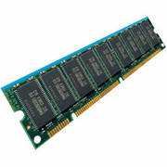
Recall: General Address translation
Virtual
Addresses
Physical
Addresses
CPU
MMU
Untranslated read or write
Consequently, two views of memory:
  View from the CPU (what program sees, virtual memory)
  View from memory (physical memory)
  Translation box (Memory Management Unit or MMU) converts between two views
Translation ⇒ much easier to implement protection!
  If task A cannot even gain access to task B’s data, no way for A to adversely affect B
With translation, every program can be linked/loaded into same region of user address space

Slide 24
Recall: Base and Bound (with Translation)
0000…
code
Addresses translated
on-the-fly
Static Data
heap
stack
Base Address
1000…
Original Program
1000…
code
Program
address
0010…
0000…
Static Data
code
1010…
heap
Static Data
<
heap
Bound
stack
1100…
0100…
stack
0100…
Hardware relocation
Can the program touch OS?
Can it touch other programs?
FFFF…

Slide 25
Issues with Simple B&B Method
process 6
process 6
process 6
process 6
process 5
process 5
process 5
process 9
process 9
process 11
process 2
process 10
OS
OS
OS
OS
Fragmentation problem over time
  Not every process is same size ⇒ memory becomes fragmented over time
  Fragmentation: wasted space both external (between blocks) and internal (inside blocks)
Missing support for sparse address space
  Would like to have multiple chunks/program (Code, Data, Stack, Heap, etc)
Hard to do inter-process sharing
  Want to share code segments when possible
  Want to share memory between processes
  Helped by providing multiple segments per process

Slide 26
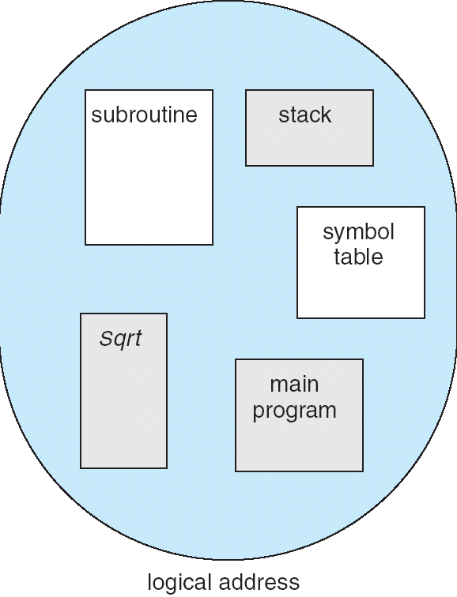
More Flexible Segmentation
1
1
1
4
2
3
2
2
4
3
user view of
memory space
physical
memory space
Logical View: multiple separate segments
  Typical: Code, Data, Stack
  Others: memory sharing, etc
Each segment is given region of contiguous memory
  Has a base and limit
  Can reside anywhere in physical memory

Slide 27
Implementation of Multi-Segment Model
Virtual
Address
offset
>
Error
Seg #
Offset
Base0
Limit0
V
Base1
Limit1
V
Base2
Limit2
V
Base2
Limit2
V
Physical
Address
Base3
Limit3
N
+
Base4
Limit4
V
Base5
Limit5
N
Base6
Limit6
N
Base7
Limit7
V
Check Valid
Segment map resides in processor
  Segment number mapped into base/limit pair
  Base added to offset to generate physical address
  Error check catches offset out of range
As many chunks of physical memory as entries
  Segment addressed by portion of virtual address
  However, could be included in instruction instead:
    x86 Example: mov [es:bx],ax.
What is “V/N” (valid / not valid)?
  Can mark segments as invalid; requires check as well
Access
Error

Slide 28
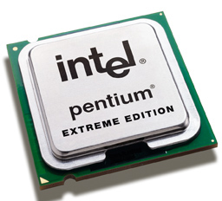
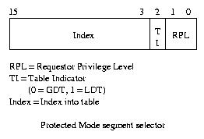
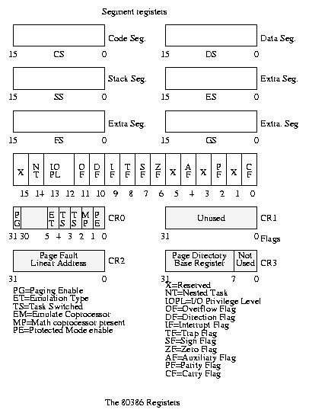
Intel x86 Special Registers
80386 Special Registers
Typical Segment Register
  Current Priority is RPL of Code Segment (CS)
Segmentation can’t be just “turned off”
  What if we just want to use paging?
  Set base and bound to all of memory, in all segments

Slide 29
Example: Four Segments (16 bit addresses)
Seg ID # | Base | Limit
0 (code) | 0x4000 | 0x0800
1 (data) | 0x4800 | 0x1400
2 (shared) | 0xF000 | 0x1000
3 (stack) | 0x0000 | 0x3000
Seg
Offset
15
14
13
0
Virtual Address Format
0x0000
0x0000
0x4000
0x8000
0xC000
Virtual
Address Space
Physical
Address Space

Slide 30
Example: Four Segments (16 bit addresses)
Seg ID # | Base | Limit
0 (code) | 0x4000 | 0x0800
1 (data) | 0x4800 | 0x1400
2 (shared) | 0xF000 | 0x1000
3 (stack) | 0x0000 | 0x3000
Seg
Offset
15
14
13
0
Virtual Address Format
SegID = 0
0x0000
0x0000
0x4000
0x4000
0x4800
0x8000
0xC000
Virtual
Address Space
Physical
Address Space

Slide 31
Example: Four Segments (16 bit addresses)
Seg ID # | Base | Limit
0 (code) | 0x4000 | 0x0800
1 (data) | 0x4800 | 0x1400
2 (shared) | 0xF000 | 0x1000
3 (stack) | 0x0000 | 0x3000
Seg
Offset
15
14
13
0
Virtual Address Format
SegID = 0
0x0000
0x0000
SegID = 1
0x4000
0x4000
0x4800
0x5C00
0x8000
0xC000
Virtual
Address Space
Physical
Address Space

Slide 32
Example: Four Segments (16 bit addresses)
Seg ID # | Base | Limit
0 (code) | 0x4000 | 0x0800
1 (data) | 0x4800 | 0x1400
2 (shared) | 0xF000 | 0x1000
3 (stack) | 0x0000 | 0x3000
Seg
Offset
15
14
13
0
Virtual Address Format
SegID = 0
0x0000
0x0000
SegID = 1
0x4000
Might
be shared
0x4000
0x4800
0x5C00
0x8000
Space for
Other Apps
0xC000
0xF000
Shared with
Other Apps
Virtual
Address Space
Physical
Address Space

Slide 33
Example of Segment Translation (16bit address)
0x0240 main: la $a0, varx
0x0244 jal strlen
… …
0x0360 strlen: li $v0, 0 ;count
0x0364 loop: lb $t0, ($a0)
0x0368 beq $r0,$t0, done
… …
0x4050 varx dw 0x314159
Seg ID # | Base | Limit
0 (code) | 0x4000 | 0x0800
1 (data) | 0x4800 | 0x1400
2 (shared) | 0xF000 | 0x1000
3 (stack) | 0x0000 | 0x3000
Let’s simulate a bit of this code to see what happens (PC=0x240):
Fetch 0x0240 (0000 0010 0100 0000). Virtual segment #? 0; Offset? 0x240
Physical address? Base=0x4000, so physical addr=0x4240
Fetch instruction at 0x4240. Get “la $a0, varx”
Move 0x4050 → $a0, Move PC+4→PC

Slide 34
Example of Segment Translation (16bit address)
0x0240 main: la $a0, varx
0x0244 jal strlen
… …
0x0360 strlen: li $v0, 0 ;count
0x0364 loop: lb $t0, ($a0)
0x0368 beq $r0,$t0, done
… …
0x4050 varx dw 0x314159
Seg ID # | Base | Limit
0 (code) | 0x4000 | 0x0800
1 (data) | 0x4800 | 0x1400
2 (shared) | 0xF000 | 0x1000
3 (stack) | 0x0000 | 0x3000
Let’s simulate a bit of this code to see what happens (PC=0x240):
Fetch 0x0240 (0000 0010 0100 0000). Virtual segment #? 0; Offset? 0x240
Physical address? Base=0x4000, so physical addr=0x4240
Fetch instruction at 0x4240. Get “la $a0, varx”
Move 0x4050 → $a0, Move PC+4→PC
Fetch 0x0244. Translated to Physical=0x4244. Get “jal strlen”
Move 0x0248 → $ra (return address!), Move 0x0360 → PC

Slide 35
Example of Segment Translation (16bit address)
0x0240 main: la $a0, varx
0x0244 jal strlen
… …
0x0360 strlen: li $v0, 0 ;count
0x0364 loop: lb $t0, ($a0)
0x0368 beq $r0,$t0, done
… …
0x4050 varx dw 0x314159
Seg ID # | Base | Limit
0 (code) | 0x4000 | 0x0800
1 (data) | 0x4800 | 0x1400
2 (shared) | 0xF000 | 0x1000
3 (stack) | 0x0000 | 0x3000
Let’s simulate a bit of this code to see what happens (PC=0x240):
Fetch 0x0240 (0000 0010 0100 0000). Virtual segment #? 0; Offset? 0x240
Physical address? Base=0x4000, so physical addr=0x4240
Fetch instruction at 0x4240. Get “la $a0, varx”
Move 0x4050 → $a0, Move PC+4→PC
Fetch 0x0244. Translated to Physical=0x4244. Get “jal strlen”
Move 0x0248 → $ra (return address!), Move 0x0360 → PC
Fetch 0x0360. Translated to Physical=0x4360. Get “li $v0, 0”
Move 0x0000 → $v0, Move PC+4→PC

Slide 36
Example of Segment Translation (16bit address)
0x0240 main: la $a0, varx
0x0244 jal strlen
… …
0x0360 strlen: li $v0, 0 ;count
0x0364 loop: lb $t0, ($a0)
0x0368 beq $r0,$t0, done
… …
0x4050 varx dw 0x314159
Seg ID # | Base | Limit
0 (code) | 0x4000 | 0x0800
1 (data) | 0x4800 | 0x1400
2 (shared) | 0xF000 | 0x1000
3 (stack) | 0x0000 | 0x3000
Let’s simulate a bit of this code to see what happens (PC=0x0240):
Fetch 0x0240 (0000 0010 0100 0000). Virtual segment #? 0; Offset? 0x240
Physical address? Base=0x4000, so physical addr=0x4240
Fetch instruction at 0x4240. Get “la $a0, varx”
Move 0x4050 → $a0, Move PC+4→PC
Fetch 0x0244. Translated to Physical=0x4244. Get “jal strlen”
Move 0x0248 → $ra (return address!), Move 0x0360 → PC
Fetch 0x0360. Translated to Physical=0x4360. Get “li $v0, 0”
Move 0x0000 → $v0, Move PC+4→PC
Fetch 0x0364. Translated to Physical=0x4364. Get “lb $t0, ($a0)”
Since $a0 is 0x4050, try to load byte from 0x4050
Translate 0x4050 (0100 0000 0101 0000). Virtual segment #? 1; Offset? 0x50
Physical address? Base=0x4800, Physical addr = 0x4850,
Load Byte from 0x4850→$t0, Move PC+4→PC

Slide 37
Observations about Segmentation
Translation on every instruction fetch, load or store
Virtual address space has holes
  Segmentation efficient for sparse address spaces
When it is OK to address outside valid range?
  This is how the stack (and heap?) allowed to grow
  For instance, stack takes fault, system automatically increases size of stack
Need protection mode in segment table
  For example, code segment would be read-only
  Data and stack would be read-write (stores allowed)
What must be saved/restored on context switch?
  Segment table stored in CPU, not in memory (small)
  Might store all of processes memory onto disk when switched (called “swapping”)

Slide 38
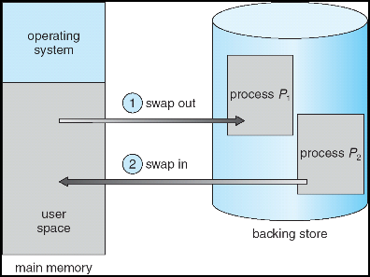
What if not all segments fit in memory?
Extreme form of Context Switch: Swapping
  To make room for next process, some or all of the previous process is moved to disk
    Likely need to send out complete segments
  This greatly increases the cost of context-switching
What might be a desirable alternative?
  Some way to keep only active portions of a process in memory at any one time
  Need finer granularity control over physical memory

Slide 39
Problems with Segmentation
Must fit variable-sized chunks into physical memory
May move processes multiple times to fit everything
Limited options for swapping to disk
Fragmentation: wasted space
  External: free gaps between allocated chunks
  Internal: don’t need all memory within allocated chunks

Slide 40
Recall: General Address Translation
Code
Data
Heap
Stack
Data 2
Code
Data
Heap
Stack
Stack 1
Heap 1
Code 1
Stack 2
Prog 1
Virtual
Address
Space 1
Data 1
Prog 2
Virtual
Address
Space 2
Heap 2
Code 2
OS code
Translation Map 1
OS data
Translation Map 2
OS heap &
Stacks
Physical Address Space

Slide 41
Paging: Physical Memory in Fixed Size Chunks
Solution to fragmentation from segments?
  Allocate physical memory in fixed size chunks (“pages”)
  Every chunk of physical memory is equivalent
    Can use simple vector of bits to handle allocation:
    00110001110001101 … 110010
    Each bit represents page of physical memory
    1 ⇒ allocated, 0 ⇒ free
Should pages be as big as our previous segments?
  No: Can lead to lots of internal fragmentation
    Typically have small pages (1K-16K)
  Consequently: need multiple pages/segment

Slide 42
How to Implement Simple Paging?
Virtual Address:
Virtual
Page #
Offset
PageTablePtr
page #0
V,R
Physical
Page #
Offset
page #1
V,R
page #1
V,R
page #2
V,R,W
Physical Address
PageTableSize
>
page #3
V,R,W
Check Perm
Access Error
page #4
N
page #5
V,R,W
Access
Error
Page Table (One per process)
  Resides in physical memory
  Contains physical page and permission for each virtual page (e.g. Valid bits, Read, Write, etc)
Virtual address mapping
  Offset from Virtual address copied to Physical Address
    Example: 10 bit offset ⇒ 1024-byte pages
  Virtual page # is all remaining bits
    Example for 32-bits: 32-10 = 22 bits, i.e. 4 million entries
    Physical page # copied from table into physical address
  Check Page Table bounds and permissions

Slide 43
Simple Page Table Example
Example (4 byte pages)
0x00
0000 0000
0x00
a
b
c
d
0001 0000
0x04
0
4
i
j
k
l
0x04
0000 0100
1
0000 1100
0x05!
e
f
g
h
3
2
1
0000 0100
0x08
0x06?
0x08
0000 1000
Page
Table
0x0C
i
j
k
l
e
f
g
h
0x09?
0x0E!
0x10
Virtual
Memory
0000 0110
0000 1110
a
b
c
d
0000 1001
0000 0101
Physical
Memory
Notes:
What is virtual address 0x6? 1|10 = 3|2 = 0xE
What is virtual address 0x9? 10|01 = 1|1 = 0x5

Slide 44
What about Sharing?
Virtual Address
(Process A):
Virtual
Page #
Offset
PageTablePtrA
page #0
V,R
page #1
V,R
page #2
V,R,W
page #2
V,R,W
page #3
V,R,W
Shared
Page
page #4
N
page #5
V,R,W
PageTablePtrB
page #0
V,R
page #1
N
This physical page
appears in address
space of both processes
page #2
V,R,W
page #3
N
page #4
V,R
page #4
V,R
page #5
V,R,W
Virtual Address
(Process B):
Virtual
Page #
Offset

Slide 45
Where is page sharing used ?
The “kernel region” of every process has the same page table entries
  The process cannot access it at user level
  But on U->K switch, kernel code can access it AS WELL AS the region for THIS user
    What does the kernel need to do to access other user processes?
Different processes running same binary!
  Execute-only, but do not need to duplicate code segments
User-level system libraries (execute only)
Shared-memory segments between different processes
  Can actually share objects directly between processes
    Must map page into same place in address space!
  This is a limited form of the sharing that threads have within a single process

Slide 46
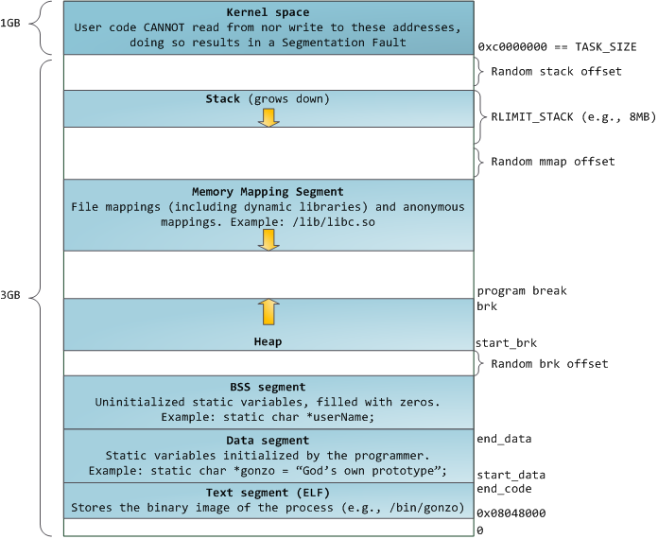
Memory Layout for Linux 32-bit (Pre-Meltdown patch!)
http://static.duartes.org/img/blogPosts/linuxFlexibleAddressSpaceLayout.png

Slide 47
Some simple security measures
Address Space Randomization
  Position-Independent Code ⇒ can place user code anywhere in address space
    Random start address makes much harder for attacker to cause jump to code that it seeks to take over
  Stack & Heap can start anywhere, so randomize placement
Kernel address space isolation
  Don’t map whole kernel space into each process, switch to kernel page table
  Meltdown⇒map none of
  kernel into user mode!

Slide 48
Summary: Paging
Virtual memory view
Page Table
11111 11101
11110 11100
11101 null
11100 null
11011 null
11010 null
11001 null
11000 null
10111 null
10110 null
10101 null
10100 null
10011 null
10010 10000
10001 01111
10000 01110
01111 null
01110 null
01101 null
01100 null
01011 01101
01010 01100
01001 01011
01000 01010
00111 null
00110 null
00101 null
00100 null
00011 00101
00010 00100
00001 00011
00000 00010
Physical memory view
1111 1111
1110 1111
1111 0000
stack
stack
1110 0000
1100 0000
heap
1000 0000
heap
0111 000
data
data
0101 000
0100 0000
code
code
0001 0000
0000 0000
0000 0000
page #
offset

Slide 49
Summary: Paging
Virtual memory view
Page Table
11111 11101
11110 11100
11101 null
11100 null
11011 null
11010 null
11001 null
11000 null
10111 null
10110 null
10101 null
10100 null
10011 null
10010 10000
10001 01111
10000 01110
01111 null
01110 null
01101 null
01100 null
01011 01101
01010 01100
01001 01011
01000 01010
00111 null
00110 null
00101 null
00100 null
00011 00101
00010 00100
00001 00011
00000 00010
Physical memory view
1111 1111
stack
1110 0000
stack
1110 0000
1100 0000
What happens if stack grows to 1110 0000?
heap
1000 0000
heap
0111 000
data
data
0101 000
0100 0000
code
code
0001 0000
0000 0000
0000 0000
page #
offset

Slide 50
Summary: Paging
Virtual memory view
Page Table
11111 11101
11110 11100
11101 10111
11100 10110
11011 null
11010 null
11001 null
11000 null
10111 null
10110 null
10101 null
10100 null
10011 null
10010 10000
10001 01111
10000 01110
01111 null
01110 null
01101 null
01100 null
01011 01101
01010 01100
01001 01011
01000 01010
00111 null
00110 null
00101 null
00100 null
00011 00101
00010 00100
00001 00011
00000 00010
Physical memory view
1111 1111
stack
1110 0000
stack
1110 0000
1100 0000
stack
Allocate new pages where room!
heap
1000 0000
heap
0111 000
data
data
0101 000
Challenge: Table size equal to # of pages in virtual memory!
0100 0000
code
code
0001 0000
0000 0000
0000 0000
page #
offset

Slide 51
Conclusion
Segment Mapping
  Segment registers within processor
  Segment ID associated with each access
    Often comes from portion of virtual address
    Can come from bits in instruction instead (x86)
  Each segment contains base and limit information
    Offset (rest of address) adjusted by adding base
Page Tables
  Memory divided into fixed-sized chunks of memory
  Virtual page number from virtual address mapped through page table to physical page number
  Offset of virtual address same as physical address
  Large page tables can be placed into virtual memory
Next Time: Multi-Level Tables
  Virtual address mapped to series of tables
  Permit sparse population of address space

