Slide 1
CS 189
Discussion 1
1/25/2023
Arvind Rajaraman
arvind.rajaraman@berkeley.edu

Slide 2
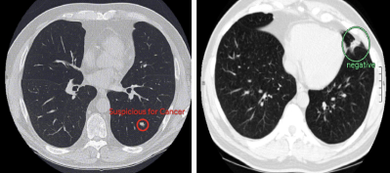

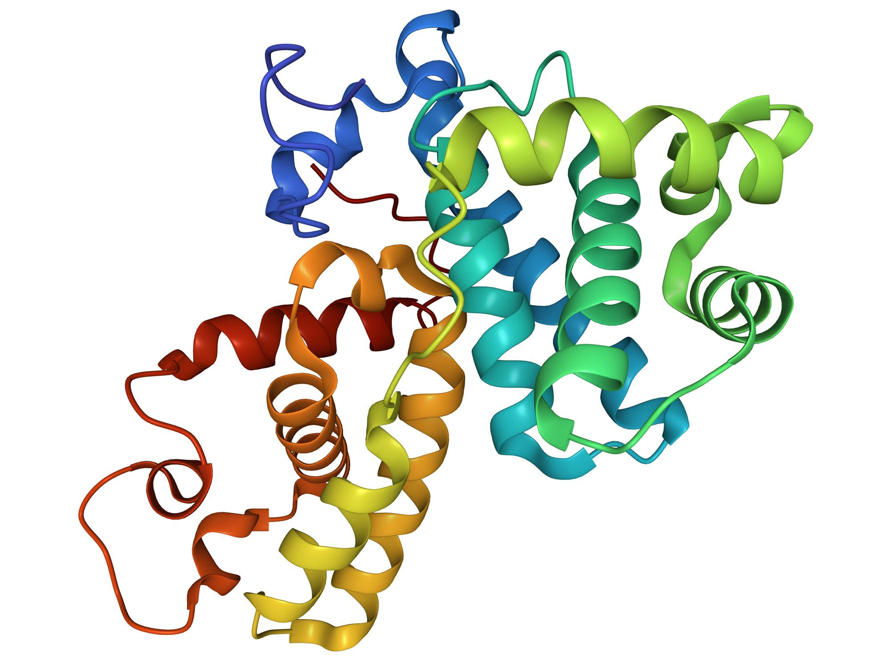
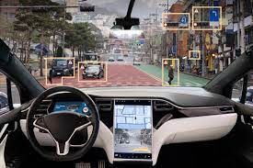
Why machine learning?
ChatGPT

Slide 3

A little bit about me…
Arvind Rajaraman
Junior, EECS + Business major
Head TA for CS 189
  2x TA for CS 189, 2x TA for CS 188
Working with Prof. Anca Dragan on robotic modeling of human learning
  To learn human intent/preferences, for robots to be as aligned and assistive to human goals as possible!
ML interests: RL, LLMs, autonomous driving
I like Thai & Indian food, hip-hop & Bollywood music, hiking, traveling, and reading!
Feel free to reach out for anything, ML or not!

Slide 4

Introductions!
Introduce yourself!
Name
Year
Major
Where you’re from
Fun fact or favorite hobby!
9

Slide 5
Format of Discussion
Start off with a mini-lecture covering the current week’s Monday lecture and previous week’s Wednesday lecture
Go over the discussion worksheet
  Spend time alone working on the problem
  Discuss answers with people around you
  We will go over it together!
Note: we may not always have time to go over the entire worksheet!

Slide 6
Typical ML Workflow
Gather data
Pre-process data
  Shuffling
  Partitioning
  Data augmentation
  Feature selection
Train model
Validate model
  Set hyperparameters, like model size, learning rate, and momentum
Test model

Slide 7
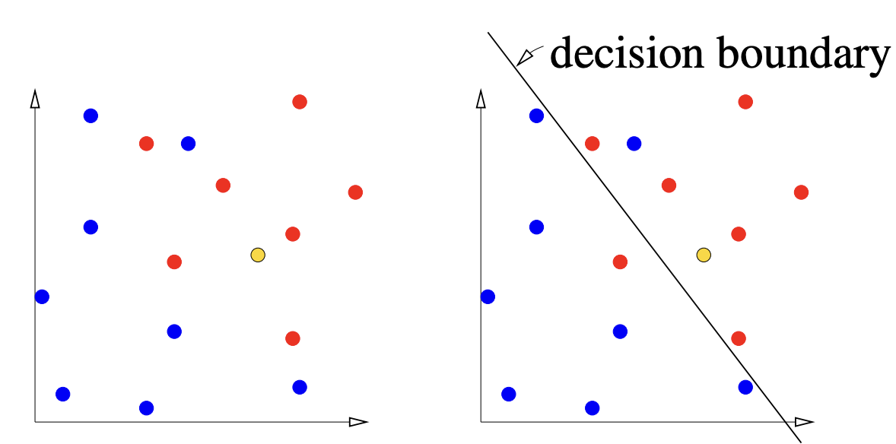
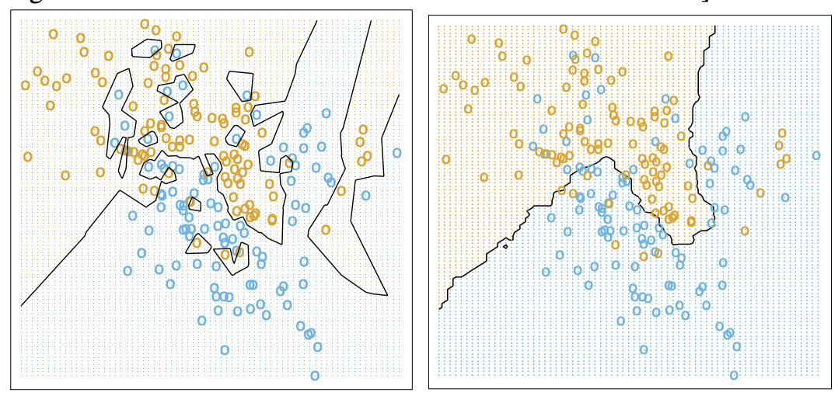
Classification
Linear classifier
Slower train time
Faster test time
y = mx + b but abstracted for N dimensions
k-Nearest neighbor classifier
Faster train time
Slower test time
k “regularizes” the classifier - helps with overfitting

Slide 8

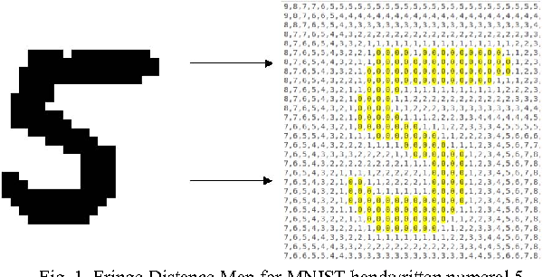
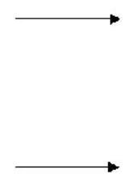
Images as Features

Slide 9
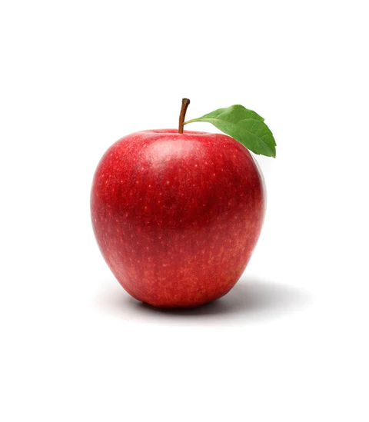
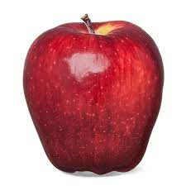
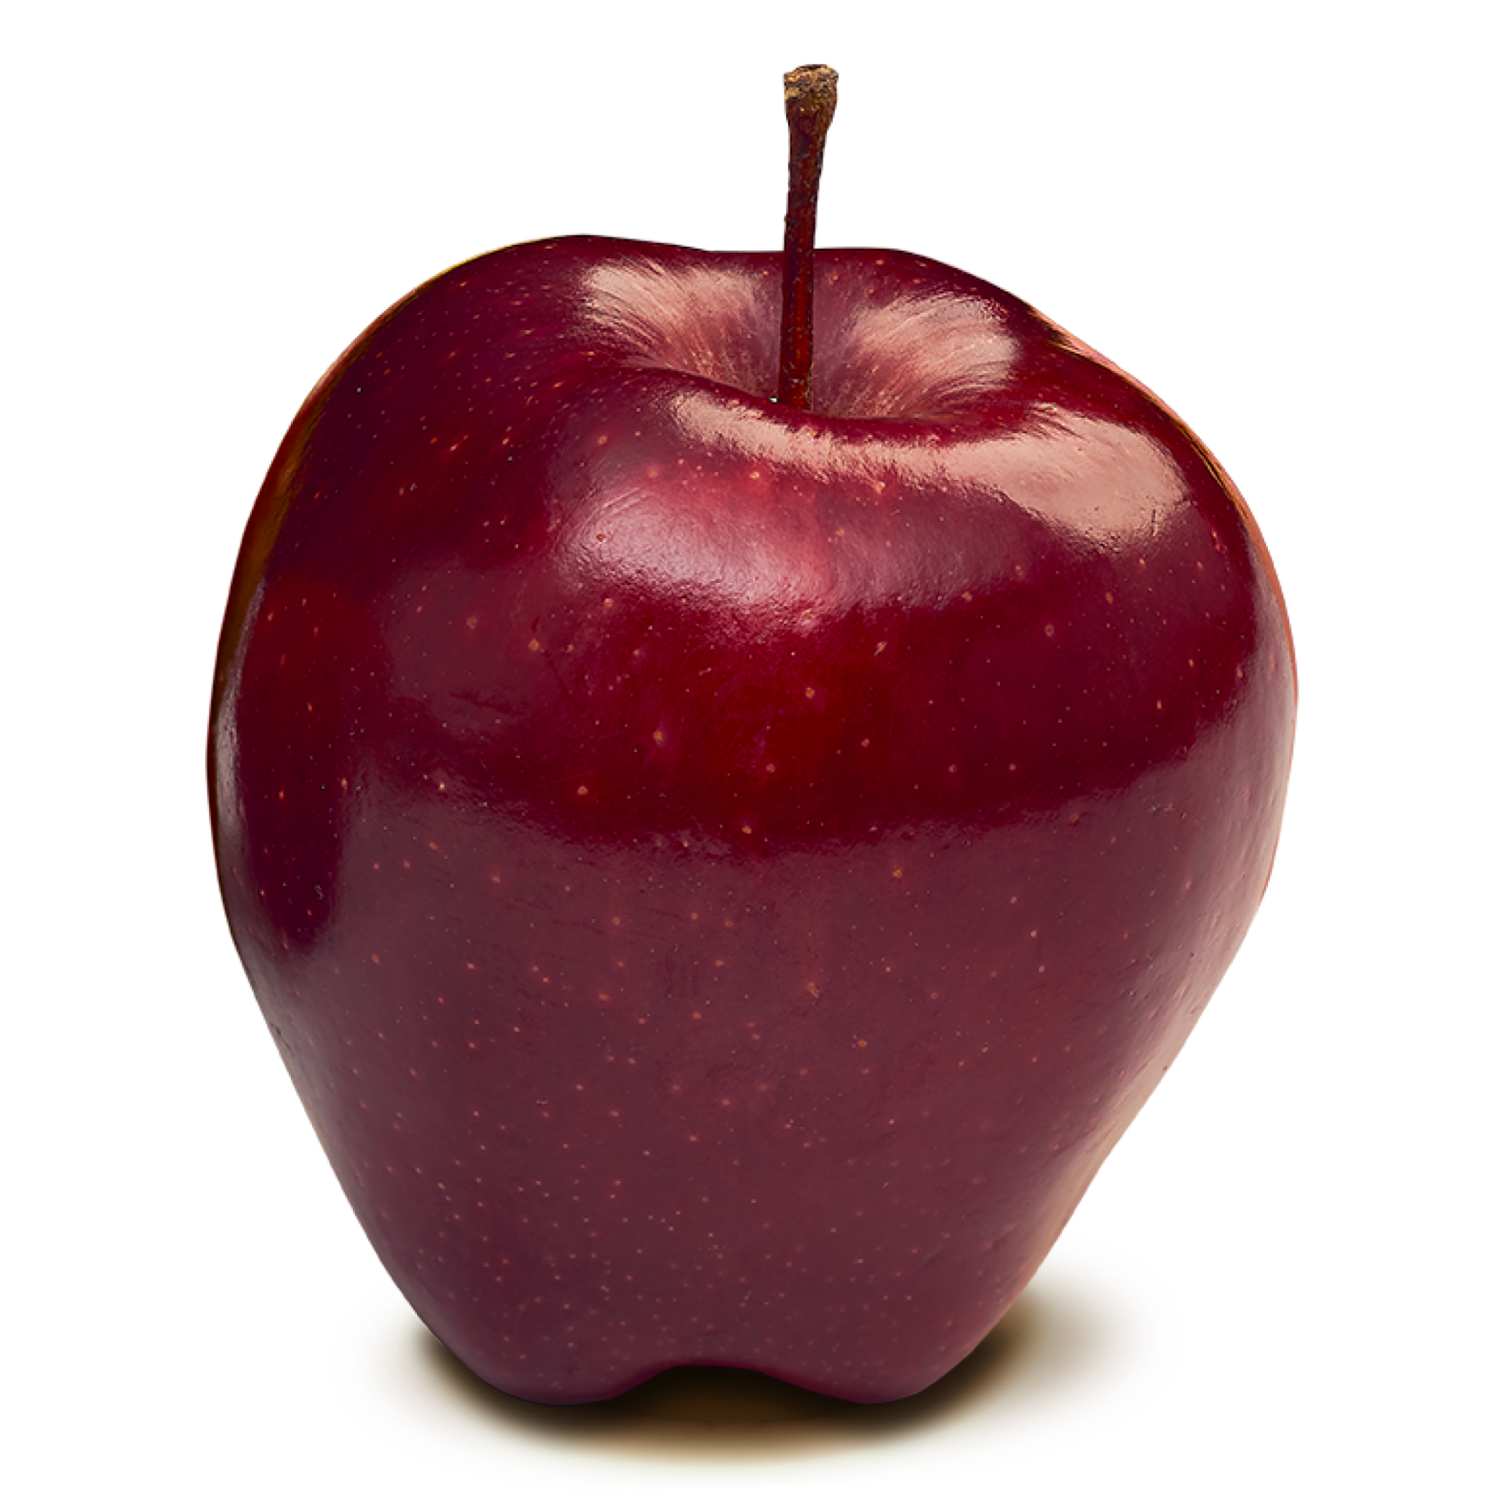
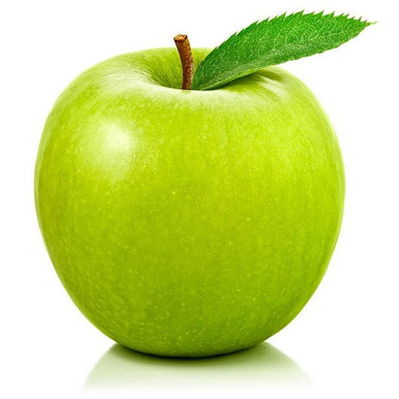
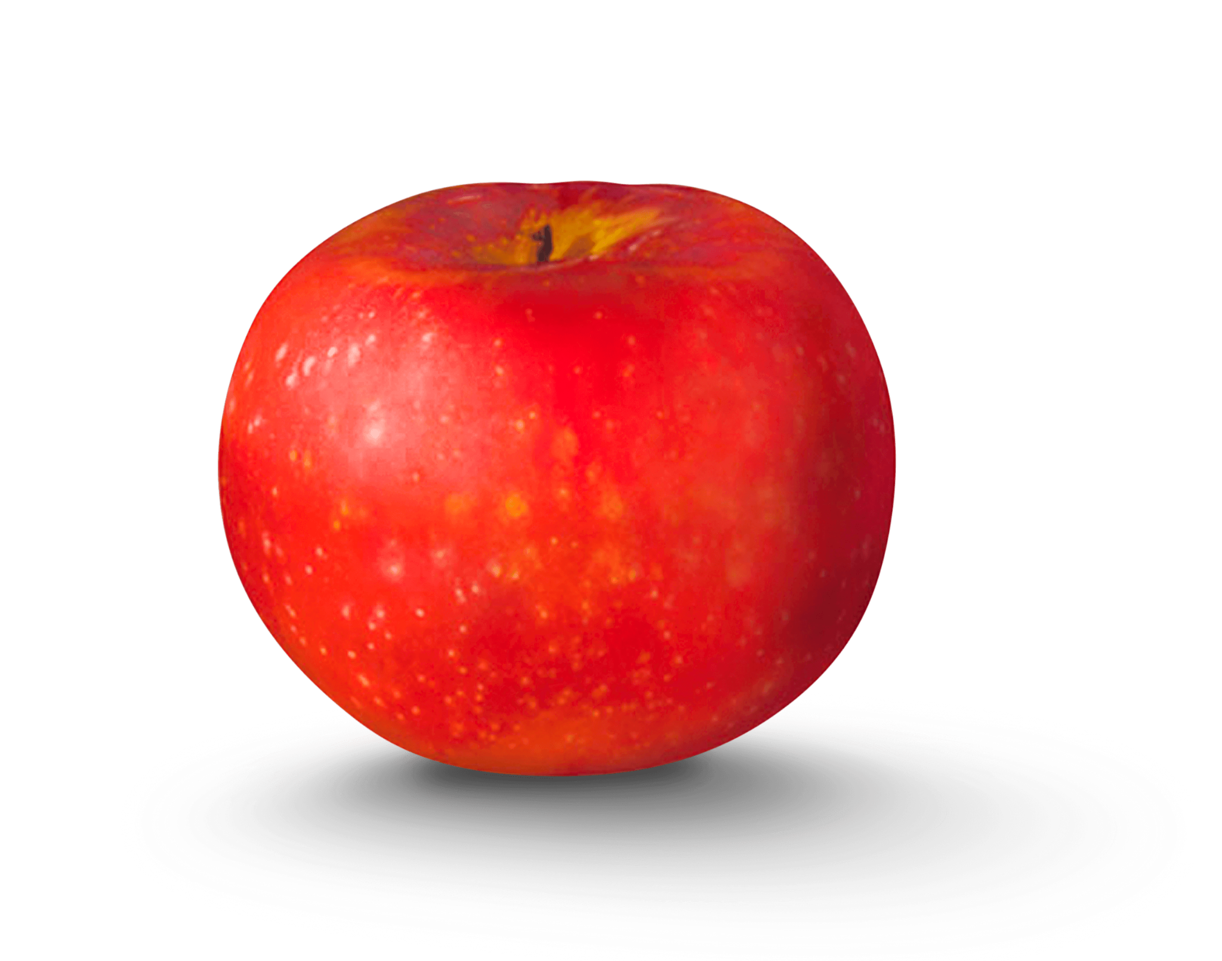
Train vs. Test Time
???
Train time
Data used to train the model
Training error going down means the model is learning
Want training set to be as diverse as possible
Test time
Data used to test model on examples not seen before
Testing error going down means the model is learning robustly
  I.e. It learns to look for different image features in apples like texture, stem, shape; not just memorizing the examples it sees

Slide 10
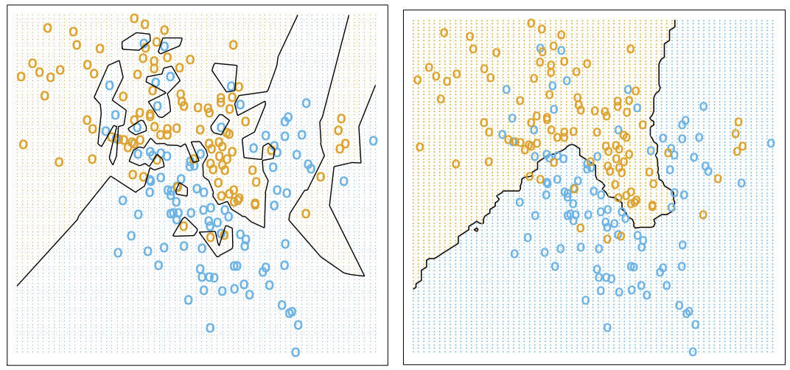
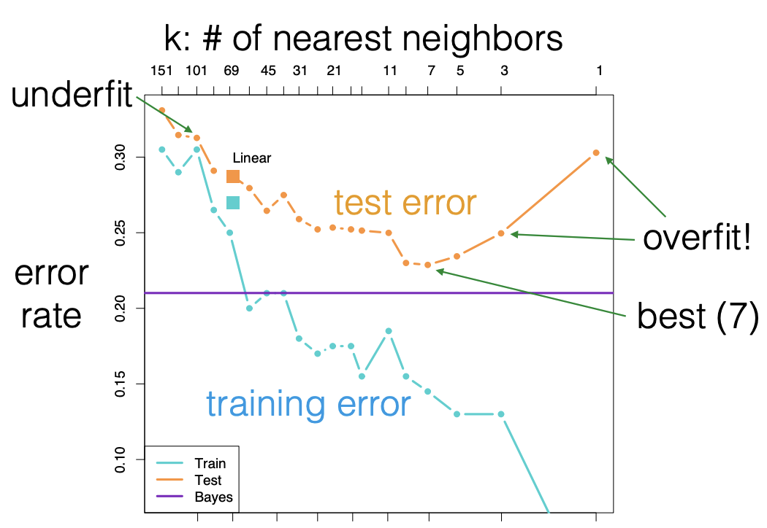
Validation
In between training and testing, there is a validation step! How do we choose k in kNN?
Why not make the validation and test set the same?
Otherwise, we would overfit k to the test distribution!
The effect of overfitting is much smaller in validation than training, but it is still possible, and generally a good practice to use a separate dataset.

Slide 11
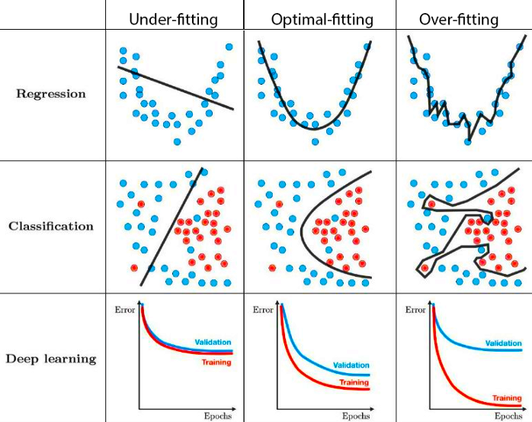
Overfitting vs. Underfitting
Increase in bias
= Decrease in variance
= More underfitting

Slide 12
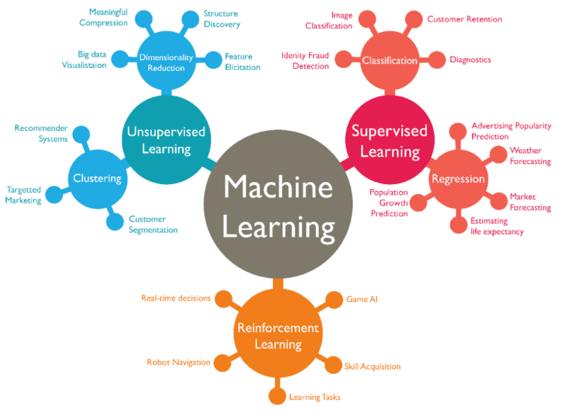
Taxonomy of Machine Learning

Slide 13
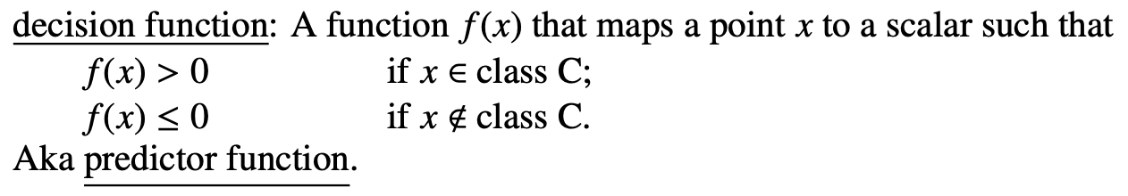
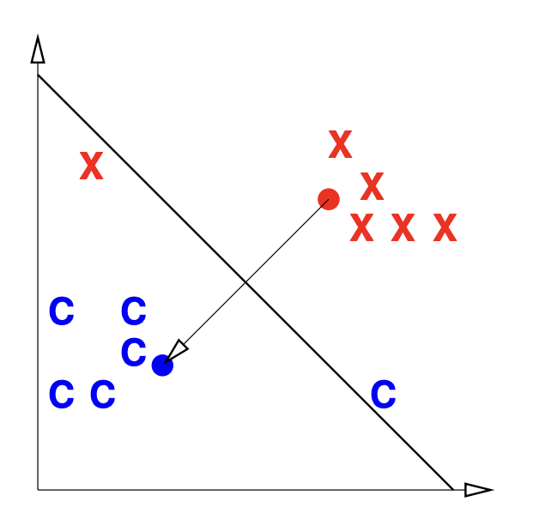
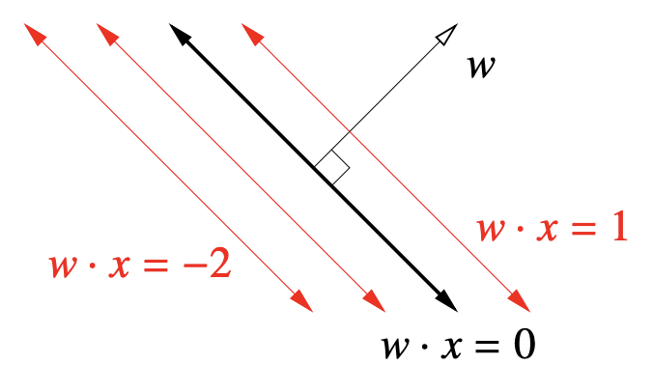
Decision Functions
> 0
< 0
= 0

Slide 14
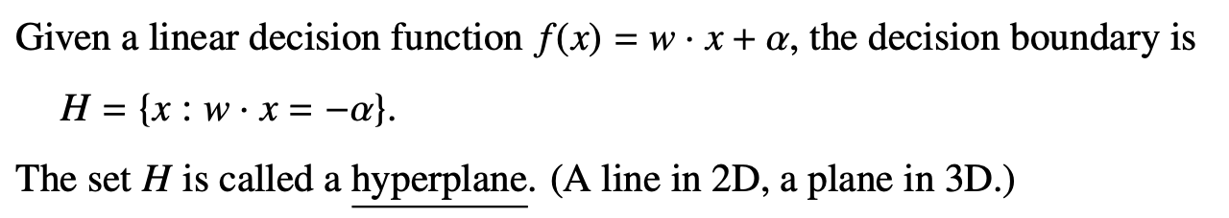
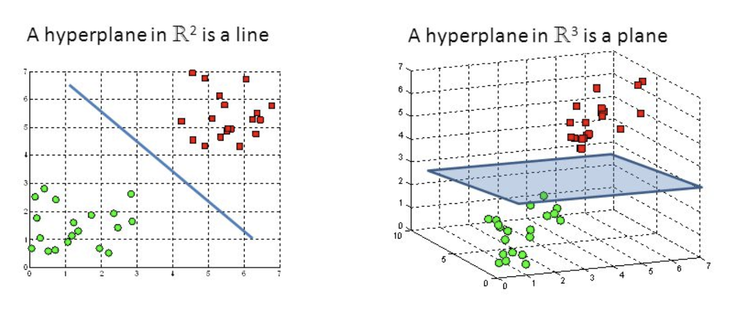
Hyperplanes

Slide 15
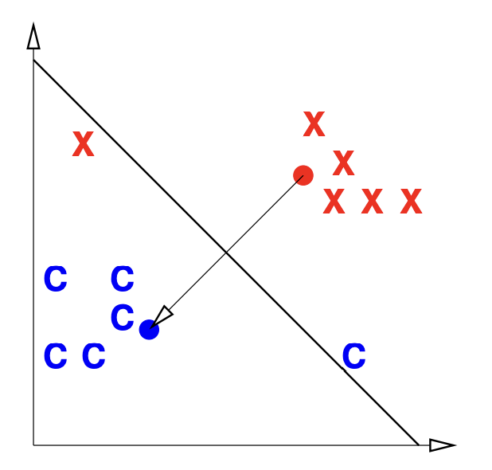
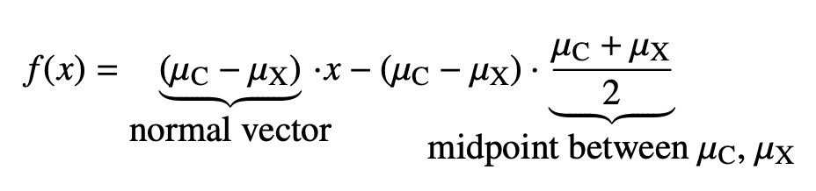
Centroid Method (ew)
We can easily find a linear classifier that gives 100% training accuracy, and it’s not the centroid-based classifier in this case!

Slide 16
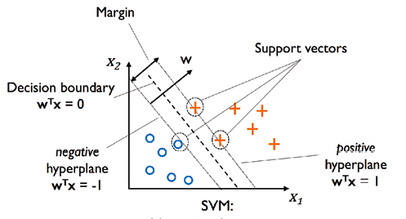
Maximum-Margin Classifier / Hard-Margin SVM (wow!)

Slide 17
Concept Check
What is outputted for a classification model versus a regression model?
  Classification: an element from a fixed-size set, e.g. apple ∈ {apple, orange, banana}
  Regression: a scalar in R, e.g. predicted house price of $403,392
Intuitively, what does a very low k and very high k mean in a nearest-neighbor model?
  Very low k: We rely on a specific point way too much
  Very high k: We make very unsure classifications and don’t learn
What metric do we minimize when training a model?
  Validation error
Why is a maximum-margin classifier/hard-margin SVM volatile?
  A new datapoint added between margins can drastically change the shape of the classifier and margins.

Slide 18
Discussion
Worksheet

Slide 19
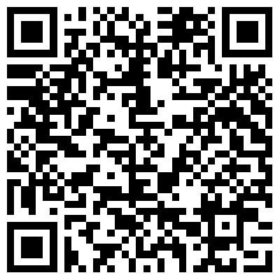
Thank you for coming!
⇐ My discussion slides for each week will be visible here!

