Slide 1
CS 189
Discussion 5
2/22/2023
Arvind Rajaraman
arvind.rajaraman@berkeley.edu

Slide 2
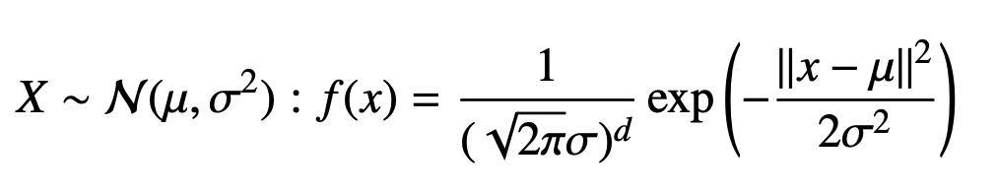
Recall: Gaussian Distribution
For a new test point, the optimal Bayes rule is:

Slide 3
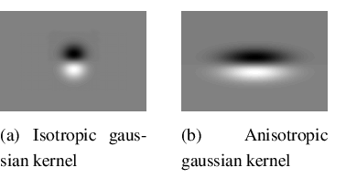
Isotropic vs. Anisotropic Gaussians
Isotropic Gaussian has covariance matrix Σ = 𝜎²I, i.e. no covariance between features. This can be thought of as a “symmetric Gaussian”. If not, it’s anisotropic.

Slide 4
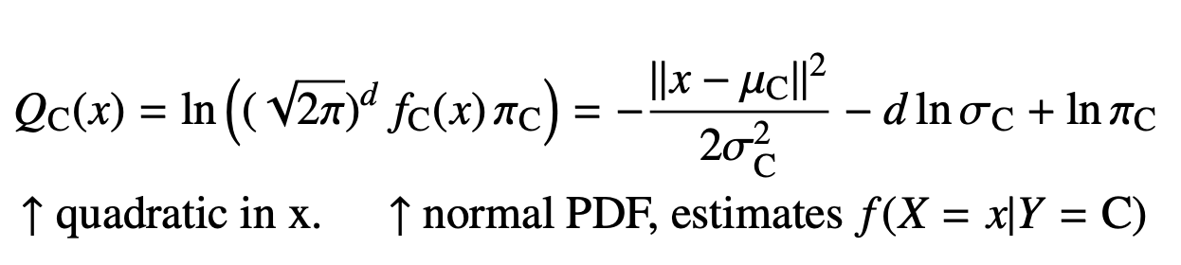
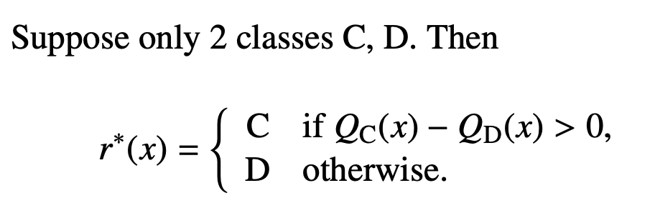
Recall: QDA for Isotropic Gaussians
To ease calculations, take the log of the Gaussian PDF:

Slide 5
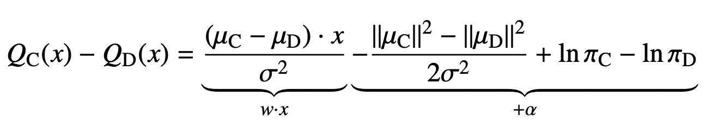
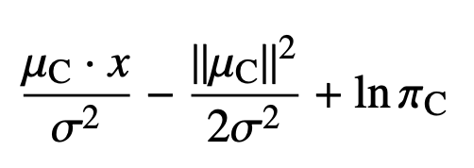
Recall: LDA for Isotropic Gaussians
What if we constrain each class’s Gaussian to be the same variance? We get a simpler PDF!
The decision rule becomes - Choose C that maximizes:
pooled within-class variance

Slide 6
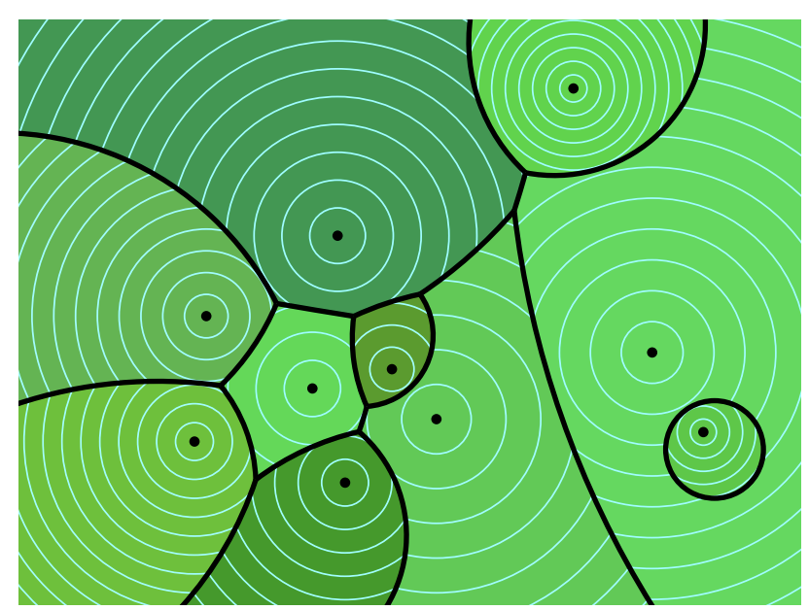
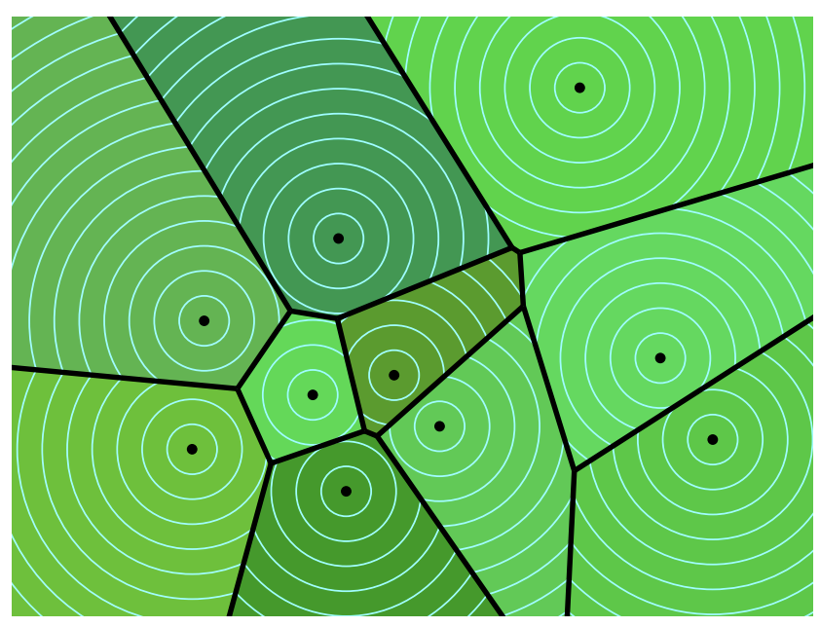
Recall: QDA & LDA Visually
Iso-QDA
LDA

Slide 7
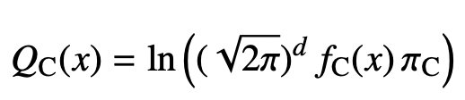
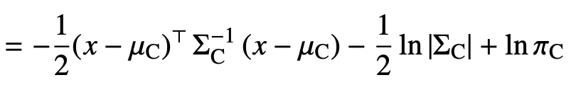
QDA for Anisotropic Gaussians
Maximize:
If isotropic Gaussian, formula is the same, but we know Σ = 𝜎²I, so the formula simplifies.

Slide 8
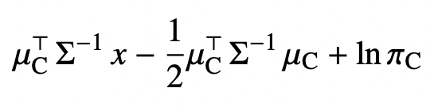
LDA for Anisotropic Gaussians
Maximize:
If isotropic Gaussian, formula is the same, but we know Σ = 𝜎²I, so the formula simplifies.

Slide 9
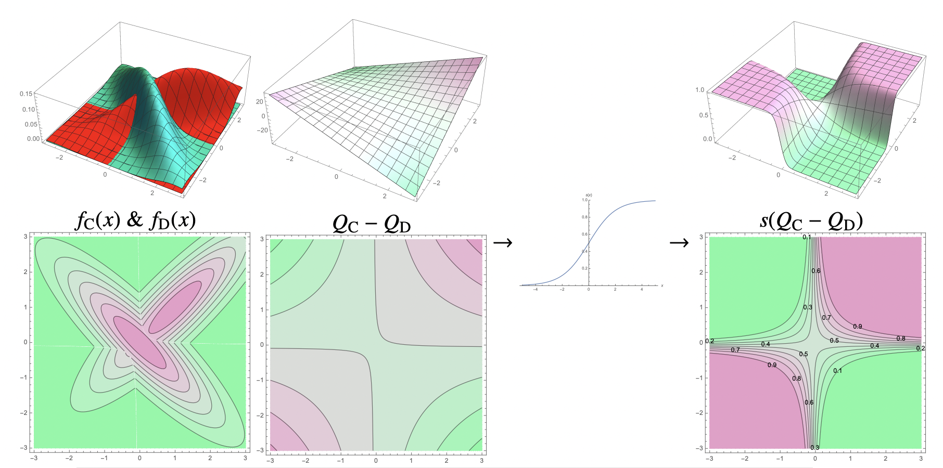
Anisotropic QDA Decision Boundary Formation

Slide 10
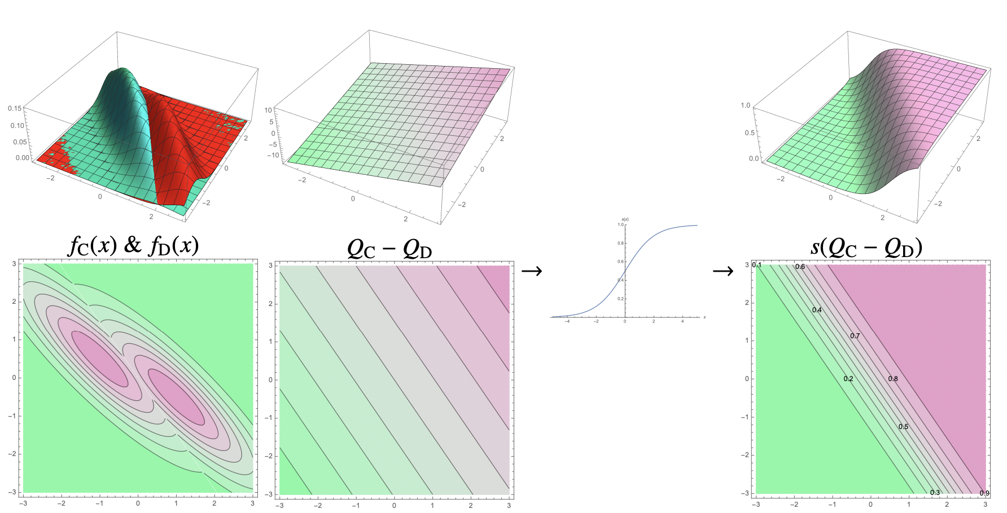
Anisotropic LDA Decision Boundary Formation

Slide 11
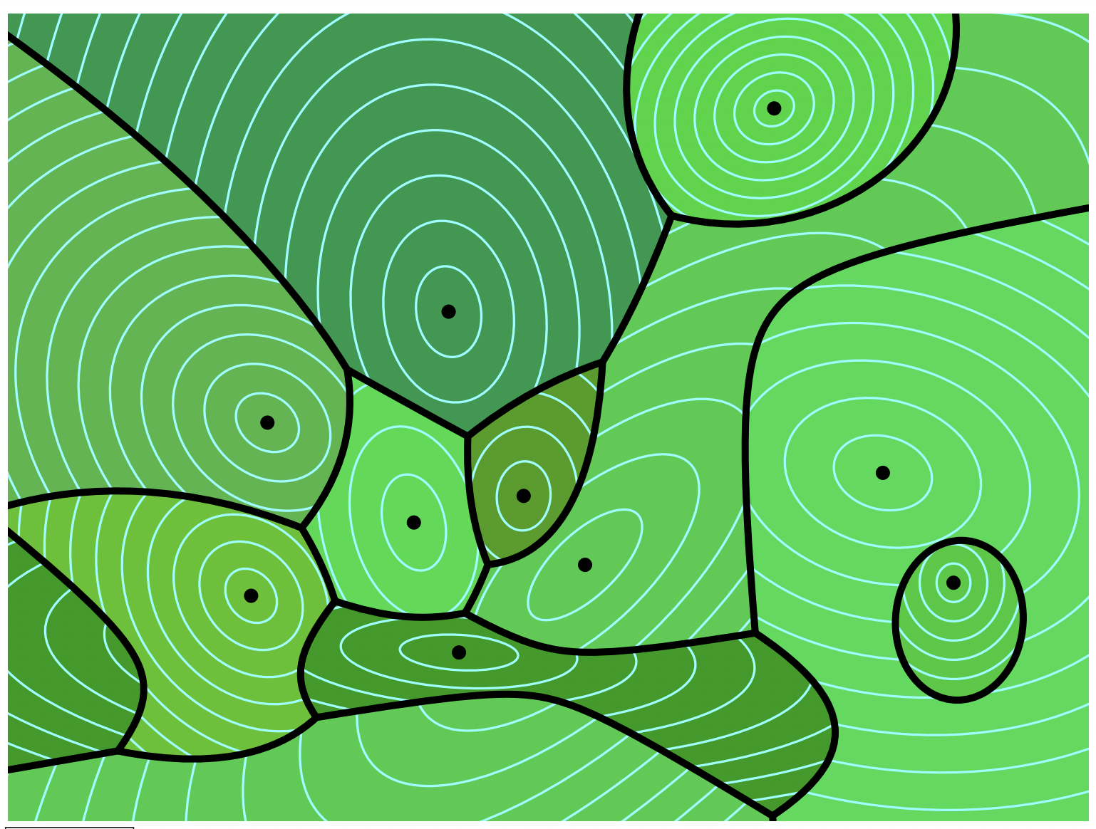
Isotropic vs. Anisotropic QDA Visually
Iso-QDA
Aniso-QDA

Slide 12
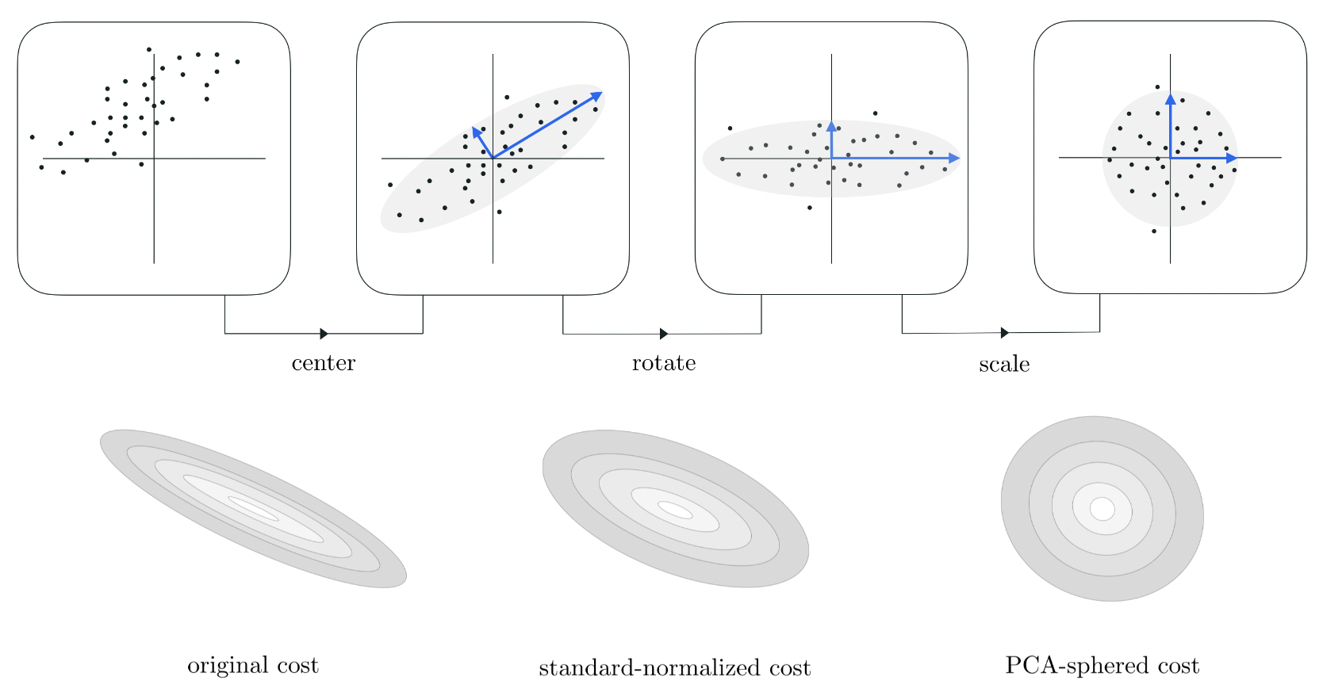
Data Transformations, Visually
centering
+
decorrelating
+
sphering
= whitening

Slide 13
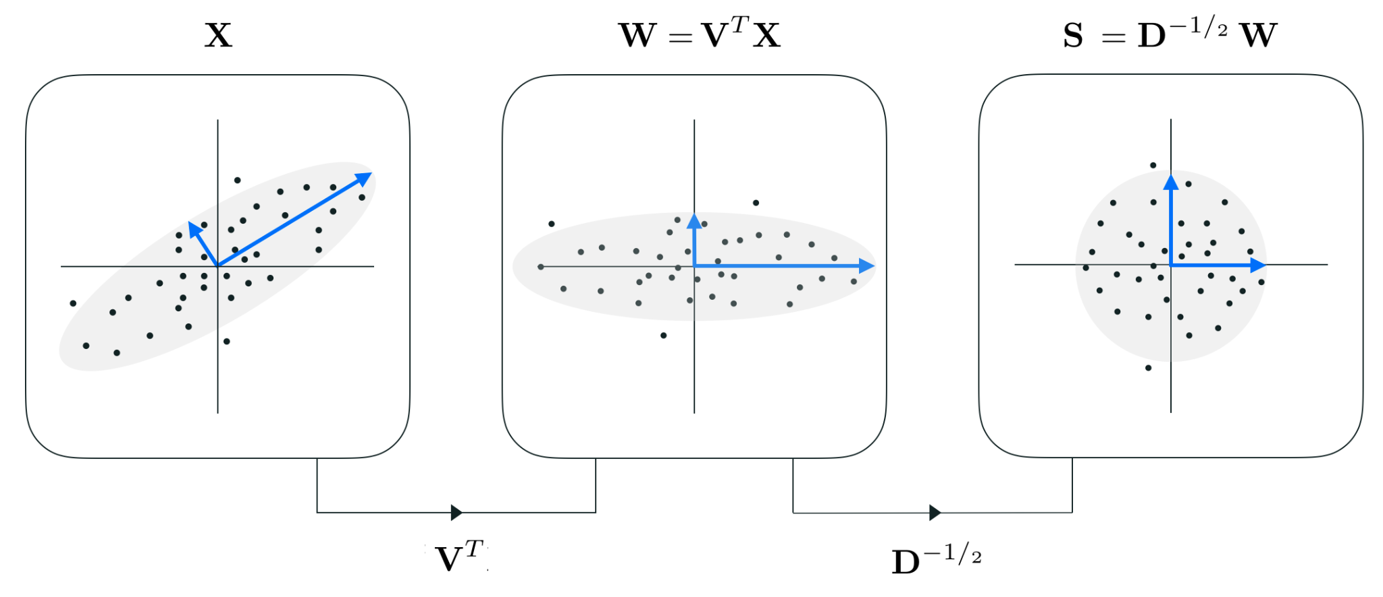

Data Transformations, Mathematically
Note: Here we are taking the eigendecomposition of the covariance matrix, not the data matrix!!!
=

Slide 14
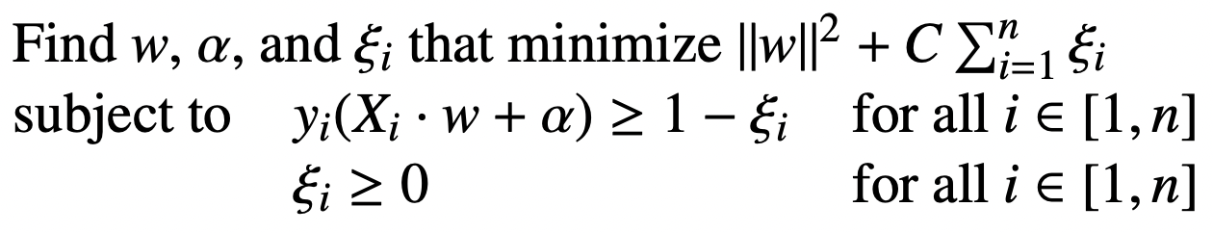
Why do we whiten data for SVMs?
Hint: Think about the loss for a soft-margin SVM:
Hint 2: Let’s say your classifying a house as an apartment or a single-family home, and your two input features are square footage and number of bedrooms. What happens to misclassified points?
Square footage range = [500, 10000] and Number of bedrooms range = [0, 4].
In the weight vector, a square footage of 500 is penalized 125² = 15,625x more than 4 bedrooms!! Whitening helps to make all the data around the same range.

Slide 15
Concept Check
What is the simplifying assumption about isotropic Gaussians?
  It’s that Σ = 𝜎²I, so all the Σ’s become scalars in the LDA/QDA discriminant functions!
Is QDA or LDA more likely to overfit?
  QDA has O(d²) weights while O(d) weights, so the former is more likely to have a sinuous decision boundary that may overfit the data.
QDA/LDA may not always yield the optimal Bayes classifier. What assumption about QDA/LDA on the data makes it suboptimal?
  The assumption that all data is drawn from Gaussian distributions. Not everything is actually Gaussian, even if we want it to be :)
You forgot to add your priors for QDA! Instead of recalculating Q(x), what easy trick can you do to Q(x)?
  Incorporating a prior π_{C} involves adding ln(π_{C}) to Q(x). So, we are basically using a different isocontour of Q(x).

Slide 16
Discussion
Worksheet

Slide 17
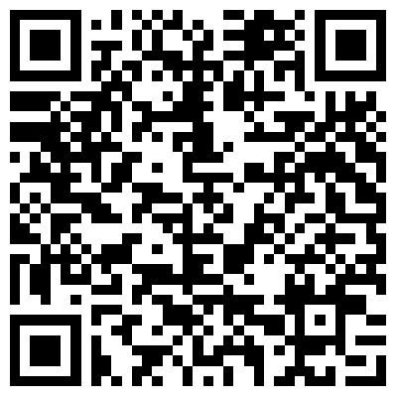
Thank you for coming!
⇐ My discussion slides for each week will be visible here!

