Slide 1
CS 189
Discussion 6
3/1/2023
Arvind Rajaraman
arvind.rajaraman@berkeley.edu

Slide 2

Recall: Taxonomy of Machine Learning

Slide 3
Classification vs. Regression
Classification:
Learn a model f : X → Y where Y is in {A, B, C, D, E}.
Predict a class.
Sample tasks: cat/dog image classification, predicting if debtors default or not, etc.
Regression:
Learn a model f : X → Y where Y is a real number.
Predict a real-valued number.
Can reformat regression into classification through logistic regression!
Sample tasks: predicting price of a house, predicting inflation, etc.

Slide 4
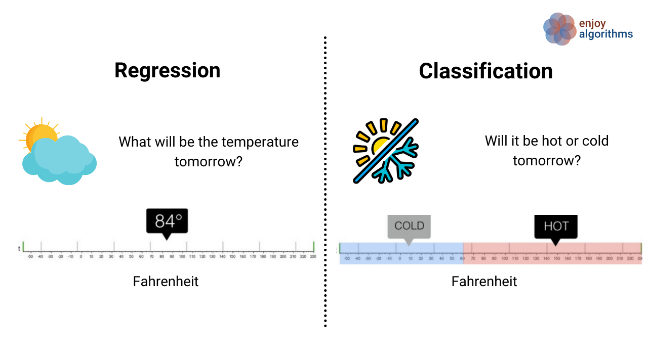
Same Problem Formatted as Classification vs. Regression

Slide 5
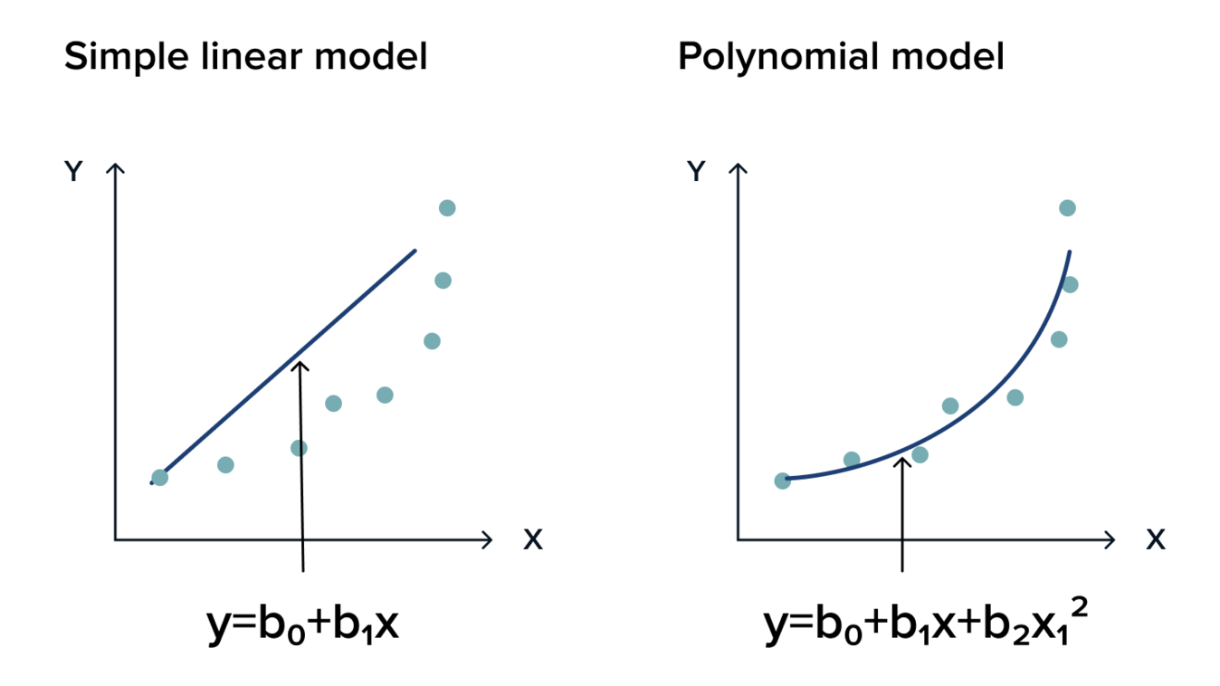
Regression Functions
Most common example is a linear function (i.e. line of best fit).
Other examples include:
Polynomial function
Logistic function
Circle/conic of best fit
Etc.

Slide 6
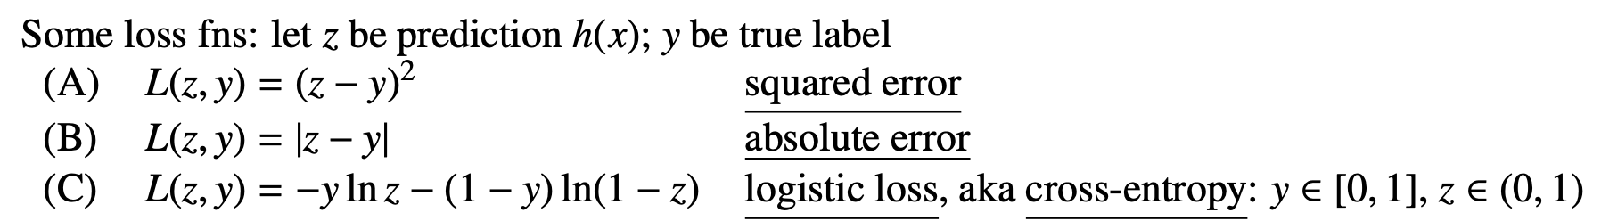
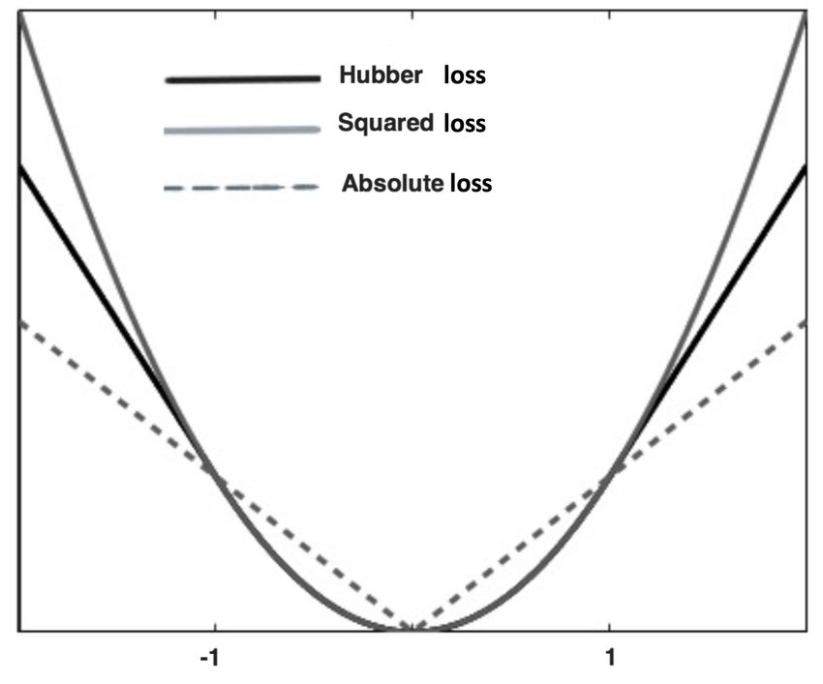
Loss Functions
A loss function tells the model how much it should penalize 1 wrong output.

Slide 7
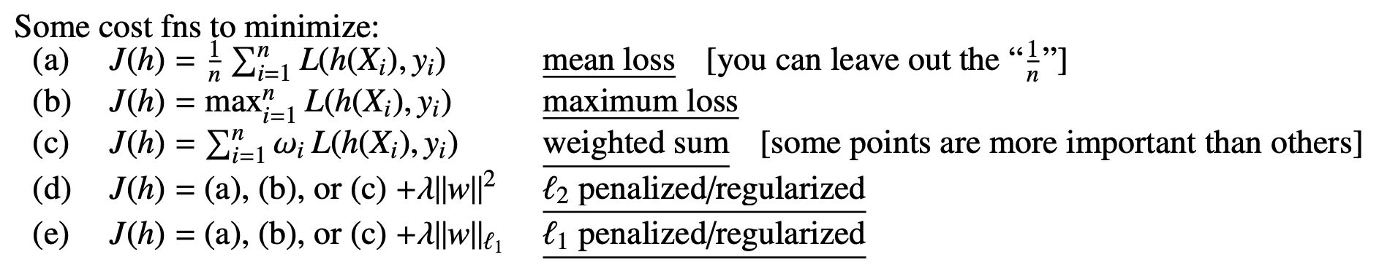
Cost Functions
A cost function tells the model how much it should penalize all outputs.

Slide 8
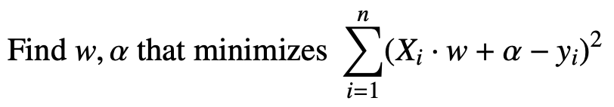
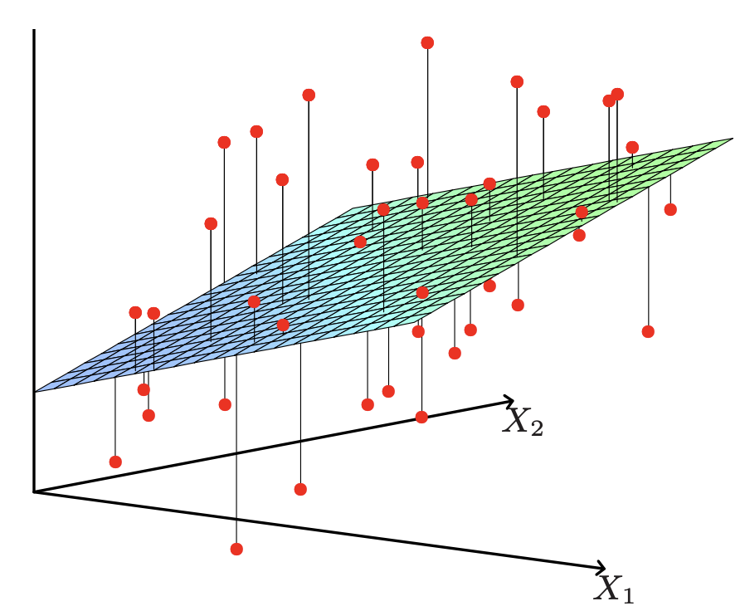
OLS (Ordinary Least Squares) Regression
y_{i, pred}

Slide 9
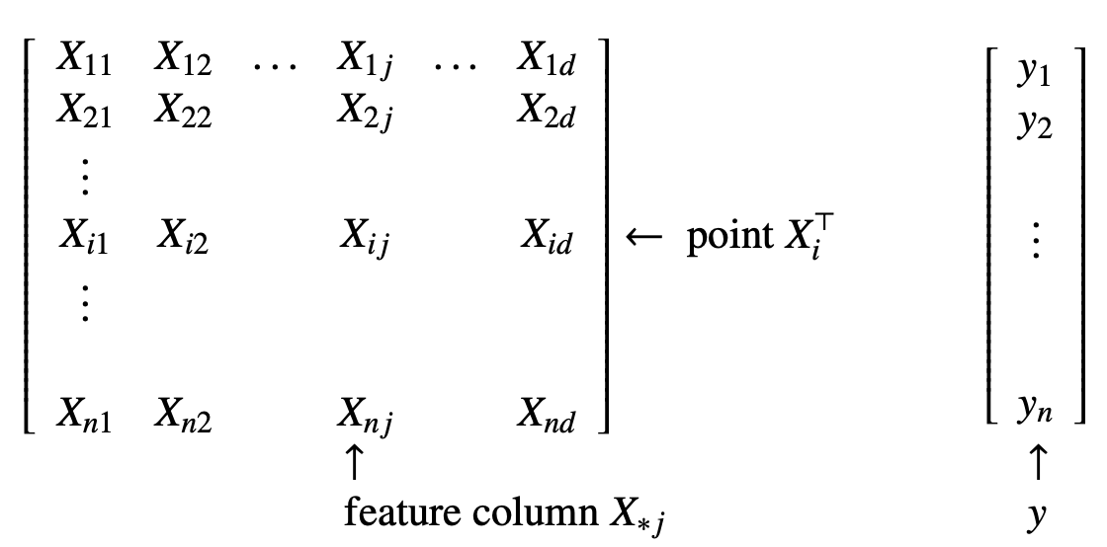
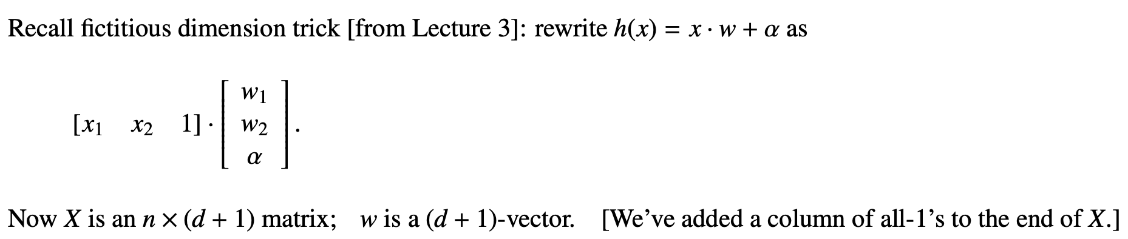
Convert α into a “feature”

Slide 10
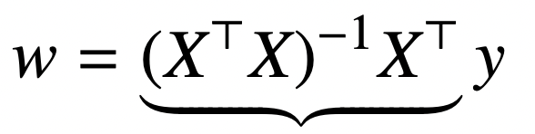

OLS Closed-Form Solution

Slide 11
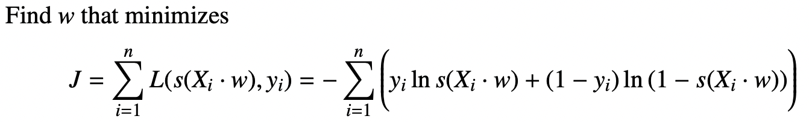
Logistic Regression
Instead of predicting the line of best fit, predict the “logistic function of best fit”.
Cross-Entropy Loss

Slide 12
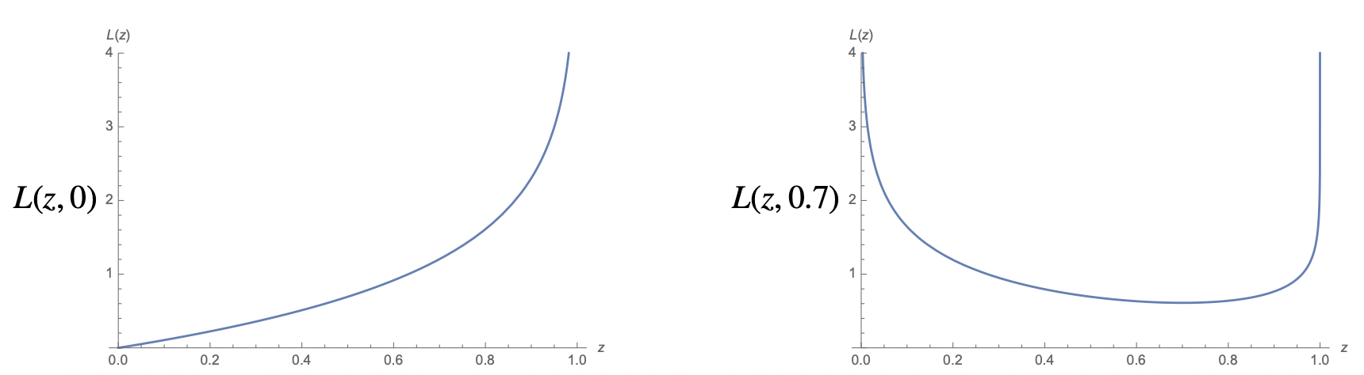
Cross-Entropy Loss Examples

Slide 13
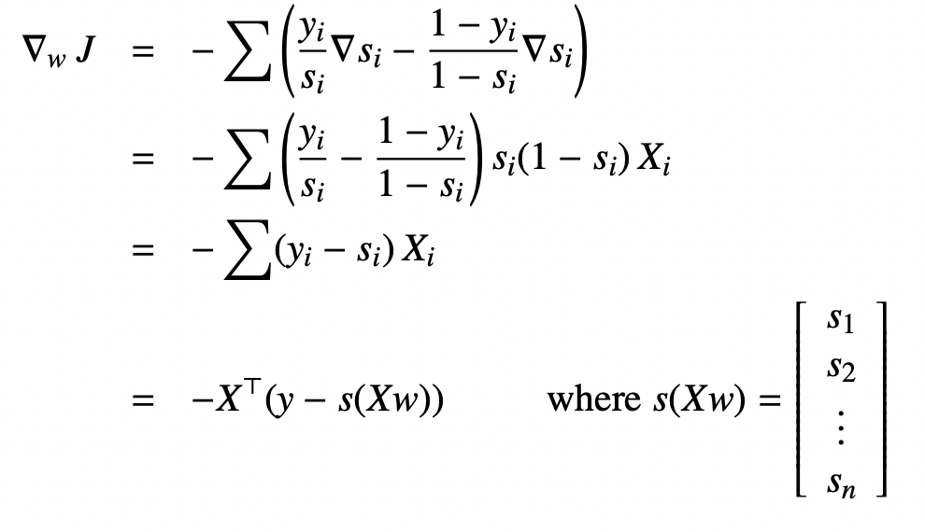
Logistic Regression does not have a closed-form solution!
Notice how the gradient is self-referential!

Slide 14
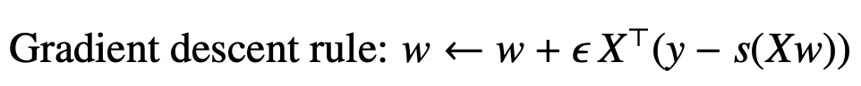
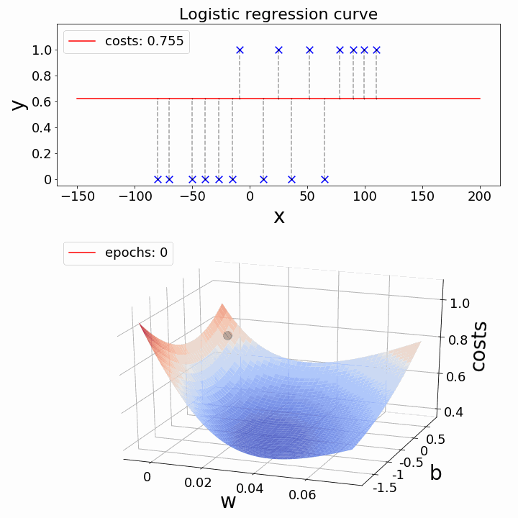
Gradient Descent converges to optimal solution

Slide 15
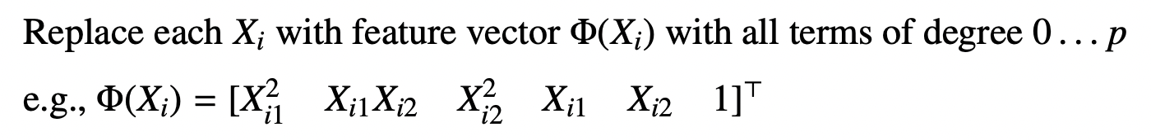
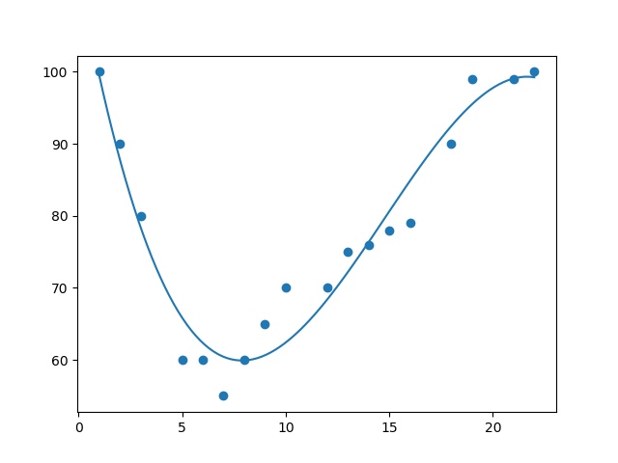
Polynomial Regression (as Linear Regression)

Slide 16
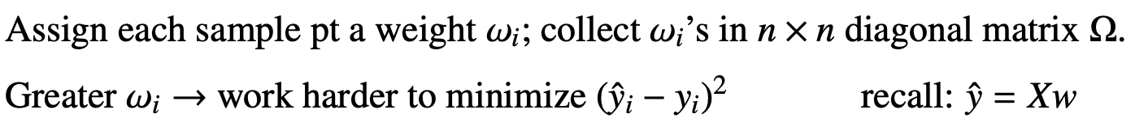
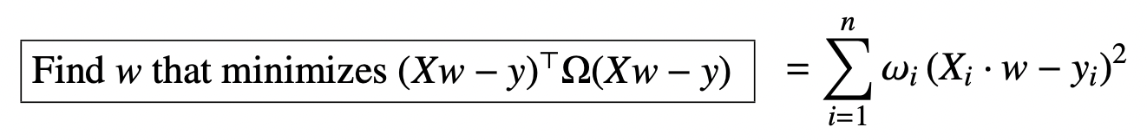

Weighted Linear Regression
*

Slide 17
GDA vs. Logistic Regression
Logistic regression splits data points into 2 classes, just like GDA. What are the advantages of each?
GDA:
LDA is very stable for well-separated classes
LDA easily extends to > 2 classes. Logistic regression requires more modifications (using softmax regression).
LDA is more accurate when data exhibits Gaussian behavior.
Logistic regression:
Correctly classified points at extremes of dataset have small effect on decision boundary (GDA weights each point equally).
Naturally fits labels between 0 and 1.
Logistic regression more robust on non-Gaussian distributions.

Slide 18
Concept Check
Why would one want to use squared loss (L₂) over absolute loss (L₁)?
  Absolute loss is not differentiable at the origin, whereas squared loss is.
Is there always a guaranteed solution by OLS?
  Yes, every matrix has a pseudoinverse, so for Xw = y, there always exists X⁺, so you can always solve w = X⁺y.
  It’s possible to have infinite solutions though.
If we use OLS, will centering data ever decrease the loss?
  No, centering is a linear transformation on the data (subtracting the mean, which is a fixed constant), so the line of best fit will also be translated to keep the same loss.
What is true of a local minimum in OLS? Hint: think about OLS’s convexity.
  A local minimum is also a global minimum, because OLS is convex.

Slide 19
Discussion
Worksheet

Slide 20

Thank you for coming!
⇐ My discussion slides for each week will be visible here!

