Slide 1
Lecture 2: Functions
Raymond Tan
CS 61A - Summer 2024

Slide 2


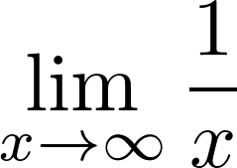


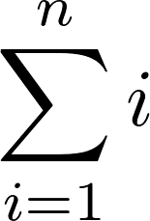

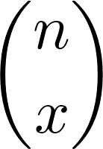
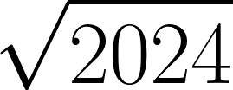

20 + 24
An expression describes a computation and evaluates to a value.
Notes:
Laryn

Slide 3
Types of Expressions
Primitive Expressions:
2 3.5
'hello!'
True
numbers
strings
booleans
add ( 2 , 3 )
Call Expressions:
Operator
Operand
Operand

Slide 4
Call Expressions
Evaluation procedure for call expressions
Evaluate the operator
Evaluate the operands from left to right
Apply the operator (a function) to the
evaluated operands (arguments)
add ( 2 , 3 )
Operator
Operand
Operand
Apply!
Operators and operands are also expressions
So they also evaluate to values
Notes:
Laryn

Slide 5
add(add(6, mul(4, 6)), mul(3, 5))
Operator
Operand
Operand
Notes:
Laryn

Slide 6
Nested Call Expressions
Evaluate operator Evaluate operands Apply!
1
2
3
45
add(add(6, mul(4, 6)), mul(3, 5))
add
30
15
add(6, mul(4, 6))
mul(3, 5)
24
add
6
mul(4, 6)
mul
3
5
mul
4
6
Expression Tree
Notes:
Laryn

Slide 7
Assignment Statements
In Python, we can bind expressions to variables.

Slide 8
Assignment Statements
In Python, we can bind expressions to variables.
Assignment Statement
x = 1 + 2

Slide 9
Assignment Statements
In Python, we can bind expressions to variables.
Assignment Statement
x = 1 + 2
Expression on the right
Bound to the variable on the left

Slide 10
Assignment Statements
In Python, we can bind expressions to variables.
Incorrect!
1 + 2 = x
Assignment Statement
x = 1 + 2
Expression on the right
Bound to the variable on the left

Slide 11
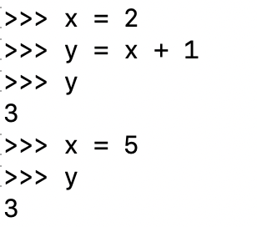
Assignment Statements – Example

Slide 12
Assignment Statements – Example
y still retains its original value after x has been reassigned!

Slide 13
Demo: Assignment of Python builtin functions

Slide 14
User Defined Functions
We can define our own functions using def statements!

Slide 15
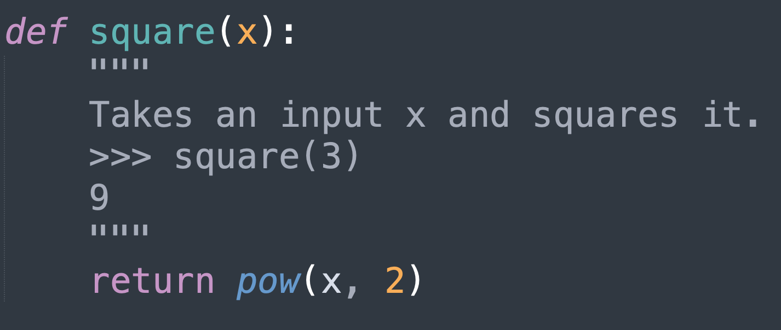
User Defined Functions
We can define our own functions using def statements!

Slide 16
User Defined Functions
We can define our own functions using def statements!
def tells Python we’re defining a function

Slide 17
User Defined Functions
We can define our own functions using def statements!
def tells Python we’re defining a function
Doctests provide a description of our function and the expected behavior

Slide 18
User Defined Functions
We can define our own functions using def statements!
def tells Python we’re defining a function
Doctests provide a description of our function and the expected behavior
return statement denotes what the function is outputting

Slide 19
User Defined Functions
We can define our own functions using def statements!
def tells Python we’re defining a function
Doctests provide a description of our function and the expected behavior
return statement denotes what the function is outputting
A function’s signature is denoted as the name of the function and the arguments it takes in.

Slide 20
Environment Diagrams

Slide 21
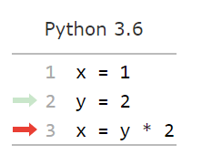
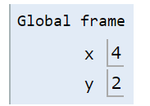
Visualizing Assignment
Demo
Names are bound to values in an environment
Final Value
Name
Bindings

Slide 22
Visualizing Assignment
Demo
Names are bound to values in an environment
Final Value
Name
Bindings
To execute an assignment statement:
Evaluate the expression to the right of =.
Bind the value of the expression to the name to the left of = in the current environment.

Slide 23
Calling User Defined Functions
Procedure for calling/applying user-defined functions:

Slide 24
Calling User Defined Functions
Procedure for calling/applying user-defined functions:
Add a local frame, forming a new environment

Slide 25
Calling User Defined Functions
Procedure for calling/applying user-defined functions:
Add a local frame, forming a new environment
Bind the function’s formal parameters to its arguments in that frame

Slide 26
Calling User Defined Functions
Procedure for calling/applying user-defined functions:
Add a local frame, forming a new environment
Bind the function’s formal parameters to its arguments in that frame
Execute the body of the function in that new environment

Slide 27
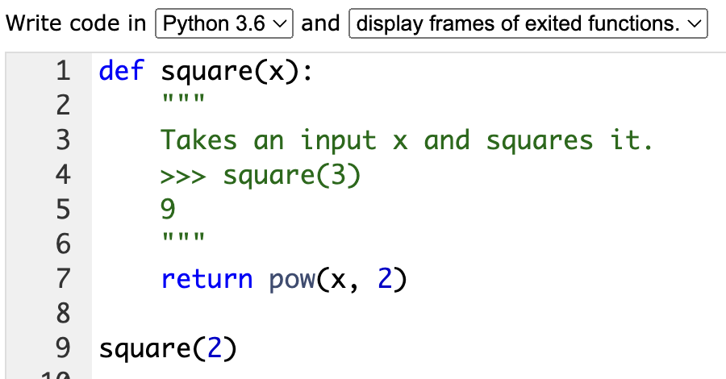
Calling User Defined Functions
Procedure for calling/applying user-defined functions:
Add a local frame, forming a new environment
Bind the function’s formal parameters to its arguments in that frame
Execute the body of the function in that new environment
tutor.cs61a.org

Slide 28
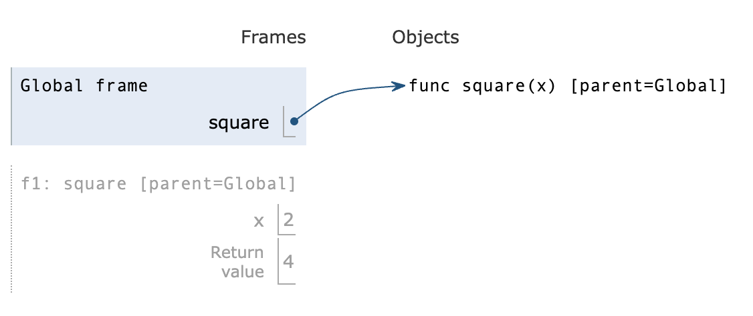
Calling User Defined Functions
Procedure for calling/applying user-defined functions:
Add a local frame, forming a new environment
Bind the function’s formal parameters to its arguments in that frame
Execute the body of the function in that new environment
tutor.cs61a.org

Slide 29
Calling User Defined Functions
Procedure for calling/applying user-defined functions:
Add a local frame, forming a new environment
Bind the function’s formal parameters to its arguments in that frame
Execute the body of the function in that new environment
The parent of a function is the frame in which we define the function
tutor.cs61a.org

Slide 30
Calling User Defined Functions
Procedure for calling/applying user-defined functions:
Add a local frame, forming a new environment
Bind the function’s formal parameters to its arguments in that frame
Execute the body of the function in that new environment
The parent of a function is the frame in which we define the function
*A function’s signature has all the information needed to create a local frame
tutor.cs61a.org
*Except argument values

Slide 31
Break time!

Slide 32
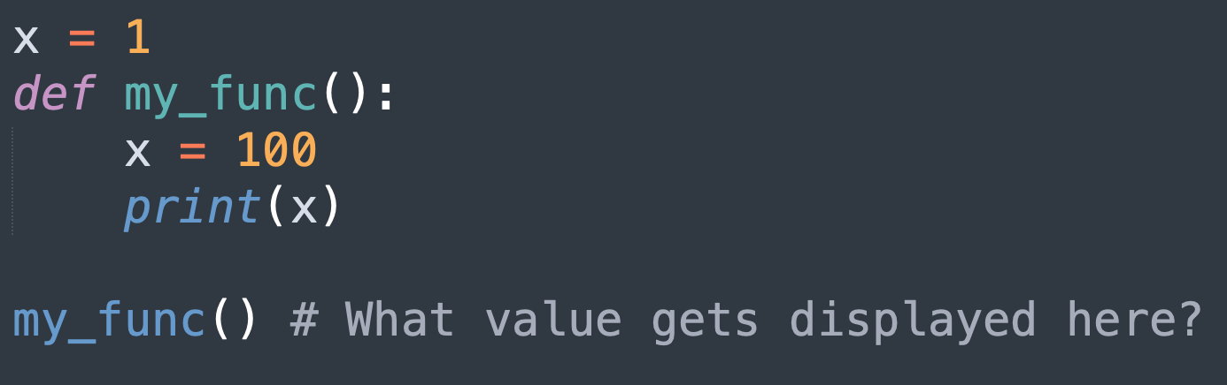
What if we have variables with the same name in different parts of our program?

Slide 33
What if we have variables with the same name in different parts of our program?
Answer: 100

Slide 34
Looking Up Names in Environments
Every expression is evaluated in the context of an environment.

Slide 35
Looking Up Names in Environments
Every expression is evaluated in the context of an environment.
Our programs always begin with a global frame, and then new local frames are created when we make a function call.

Slide 36
Looking Up Names in Environments
Every expression is evaluated in the context of an environment.
Our programs always begin with a global frame, and then new local frames are created when we make a function call.
Most important rules for environment diagrams:

Slide 37
Looking Up Names in Environments
Every expression is evaluated in the context of an environment.
Our programs always begin with a global frame, and then new local frames are created when we make a function call.
Most important rules for environment diagrams:
An environment is a sequence of frames.

Slide 38
Looking Up Names in Environments
Every expression is evaluated in the context of an environment.
Our programs always begin with a global frame, and then new local frames are created when we make a function call.
Most important rules for environment diagrams:
An environment is a sequence of frames.
A name evaluates to the value bound to that name in the earliest frame of the current environment in which that name is found

Slide 39
A sequence of frames
Latest
Global
f1
f2
..
Earliest

Slide 40
A sequence of frames
Latest
A sequence is a first frame, and then the rest of the sequence
Global
f1
f2
..
Earliest

Slide 41
A sequence of frames
Latest
A sequence is a first frame, and then the rest of the sequence
Global
Not every frame is part of the same environment, though each frame on the left is part of the environment diagram
f1
f2
..
Earliest

Slide 42
A sequence of frames
Latest
A sequence is a first frame, and then the rest of the sequence
Global
Not every frame is part of the same environment, though each frame on the left is part of the environment diagram
f1
f2
f2 has a parent frame of Global, and f1 has a parent frame of Global
..
Earliest

Slide 43
A sequence of frames
Latest
A sequence is a first frame, and then the rest of the sequence
Global
Not every frame is part of the same environment, though each frame on the left is part of the environment diagram
f1
f2 and f1 are not part of the same environment
f2
f2 has a parent frame of Global, and f1 has a parent frame of Global
..
Earliest

Slide 44
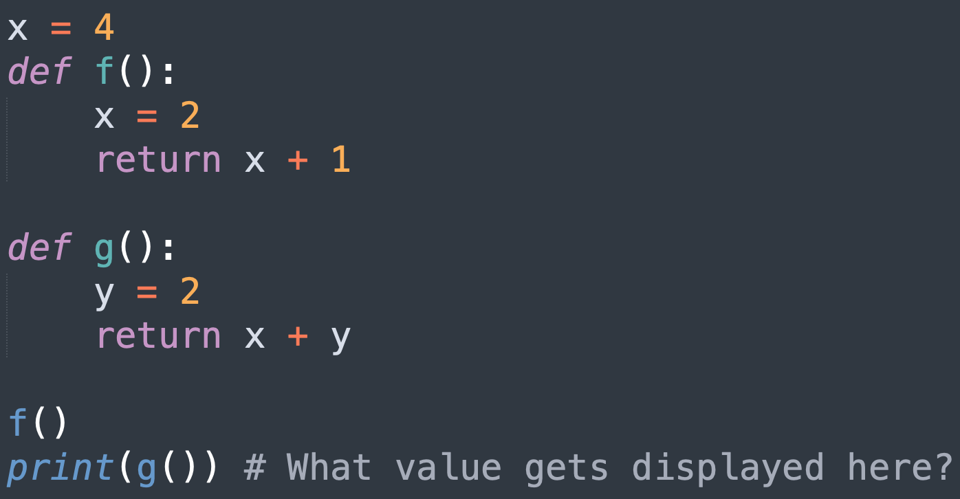
Example #1

Slide 45
Example #1
Answer: 6

Slide 46
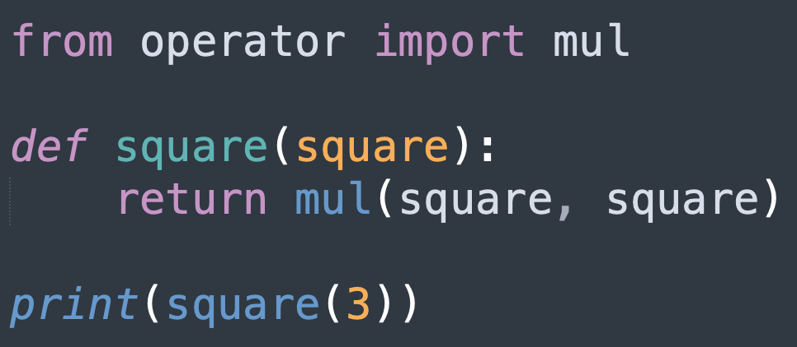
Example #2

Slide 47
Reminder: Rules for evaluating call expressions
Evaluation procedure for call expressions
Evaluate the operator
Evaluate the operands from left to right
Apply the operator (a function) to the
evaluated operands (arguments)
It is not until we finish the first two steps and get to the third step that a new frame is opened, and operand values are bound to the argument names!
Notes:
Laryn

Slide 48
Example #2
Answer: 9

Slide 49
Summary
An expression is anything that evaluates to a value in Python
  Primitive and call expressions
Assignment statements bind names to values
Call expression evaluation follows a distinct set of rules
  Evaluate the operator, evaluate the operand, and apply the operator onto the operands
Environment diagrams allow us to visualize assignment
  Use tutor.cs61a.org to try this out on your own programs!
Each environment is a sequence of frames, and all frames in a program make up an environment diagram
Notes:
Laryn

