Slide 1
Lab 09
Conway’s Game of Life (BYOW Intro)
Notes:
Credits to these slides for inspiration and examples: https://docs.google.com/presentation/d/1PcGNOfoL4aKPVV63uUl_wCEB4D-b5UuT1GUIczI40F4/edit#slide=id.p

Slide 2
Announcements
Project 3A World Generation is due Monday, 4/15.

Slide 3
Build Your Own World (Intro)
Notes:
This would be a good place to pause and maybe poll the lab section on who has read the spec for Project 3 or started on the lab to gauge their current status in the course.

Slide 4
Introduction
Build Your Own World or BYOW is Project 3, where our goal is to build a game that generates random, explorable worlds.
Throughout this project, there are several criterias that you must meet (as detailed in the spec). Lab 09 serves as an introduction to some of the tools you’ll want to familiarize yourself with as well as other useful concepts to help you get started on the project.

Slide 5
World Generation

Slide 6
World Generation
Before we get started, let’s consider what it looks like to build a world.

Slide 7
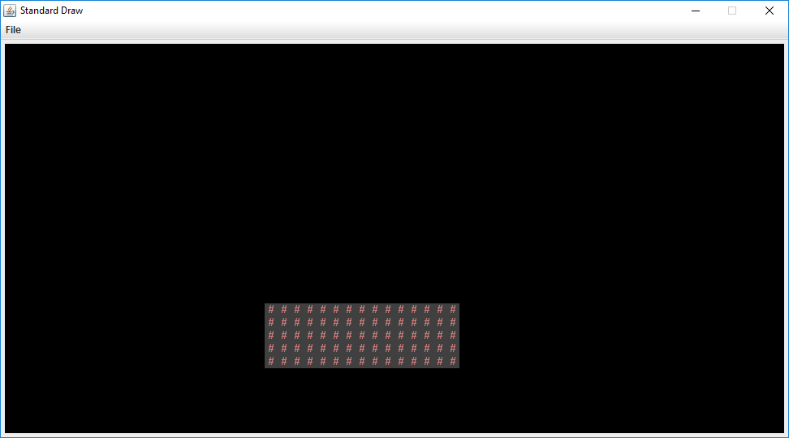
Maybe Something Like This (BoringWorldDemo)

Slide 8
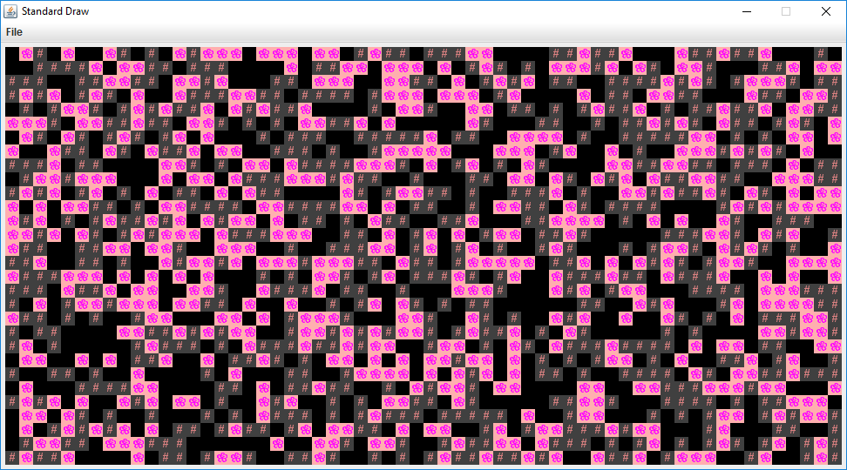
Or This (RandomWorldDemo)

Slide 9
World Generation
For this lab and Project 3, we’ve provided several classes to help build your world:
A tile rendering engine (TERenderer)
A representation of a 2-D tile array (TETile)
Some pre-generated tiles (Tileset)
All of this can be found in the package tileengine. If you haven’t already, go ahead and open up the lab assignment to view these files/classes.

Slide 10
Project 3
Here are some topics we’ll cover briefly to help you get started on Project 3:
Pseudorandomness
Persistence

Slide 11
Pseudorandomness
In project 3, each of the worlds that are generated should be noticeably distinct from each other. To ensure that they are random (more criteria in Project 3 spec), you’ll want to use a random number generator.
More specifically, it’ll be a pseudorandom. We can do this by creating a Random object. If given a seed, the sequence of numbers generated will be deterministic (hence it being pseudorandom).

Slide 12
Pseudorandomness
An example using the Random object is provided in the lab spec that we recommend checking out.
The main question to consider is how might you also use it to make your worlds noticeably random and distinct from each other?
What qualities for each world would you want to randomize? Hallways? Rooms? Location of the rooms?

Slide 13
Persistence
Another part of the project will involve persistence - effectively, how are you going to save the state of your world, so it continues to persist after the program ends?
This involves a later part of the project (not in world generation), but it might help to start thinking about this early.

Slide 14
Persistence - Scenario
Let’s set up a hypothetical scenario: Say your game allows players to collect coins that spawn randomly on the map. Collecting these coins adds to a score.
The players makes a few movements around the map and collects the coins.
Then, the player saves and quits. When the player loads the world back in, they should expect it to be the same as when they left off and allow them to continue their progress.

Slide 15
Persistence - Questions
Some questions:
How do you make sure the world is the same (specifically, the rooms and hallways)?
How do you ensure that the coins they haven’t collected are still in the same location? Or what about the coins they already collected? Those shouldn’t appear anymore.
What about their score? The player’s location?

Slide 16
Persistence - FileUtils
For this lab, you’ll learn about storing information in a text file and loading it back into the program. From there, start thinking about what information you might want to actually end up saving and loading back into the game.

Slide 17
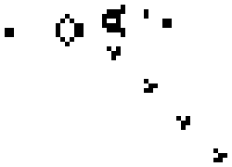
Conway’s Game of Life
Notes:
GIF is from Conway’s Game of Life Wikipedia: https://en.wikipedia.org/wiki/Conway%27s_Game_of_Life (Bill Gosper's Glider Gun in action—a variation of Conway's Game of Life. This image was made by using Life32 v2.15 beta, by Johan G. Bontes.)
This would be a good place to pause and maybe poll the lab section on who has read the spec for Project 3 or started on the lab to gauge their current status in the course.

Slide 18
Background
The lab spec goes into a little more detail, but Conway's Game of Life is an example of how cells change over time. It is a zero-player game and each cell is either alive or dead.
The status of a cell can change depending on its 8 neighbors - right, left, bottom, top, and diagonal (example to the right).

Slide 19
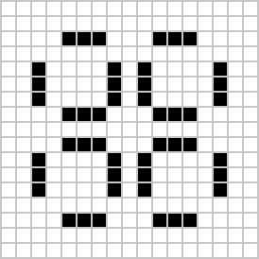
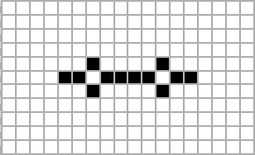
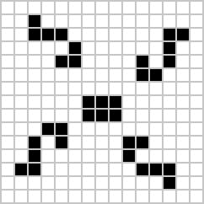
Some Examples
Here are a couple examples of how cells can change over time

Slide 20
Neighbors and Generations
Earlier, we mentioned how the status of a cell can change based on its 8 neighbors. At each time step, we check if the status of a cell changes, based on the 4 rules:
Any live cell with fewer than two live neighbors dies, as if by underpopulation.
Any live cell with two or three neighbors lives on to the next generation.
Any live cell with more than three neighbors dies, as if by overpopulation.
Any dead cell with exactly three live neighbors becomes a live cell, as if by reproduction.

Slide 21
Example
Any live cell with fewer than two live neighbors dies, as if by underpopulation.
Any live cell with two or three neighbors lives on to the next generation.
Any live cell with more than three neighbors dies, as if by overpopulation.
Any dead cell with exactly three live neighbors becomes a live cell, as if by reproduction.
If we’re looking at that cell, how should we expect it to change next time step?

Slide 22
Example
Any live cell with fewer than two live neighbors dies, as if by underpopulation.
Any live cell with two or three neighbors lives on to the next generation.
Any live cell with more than three neighbors dies, as if by overpopulation.
Any dead cell with exactly three live neighbors becomes a live cell, as if by reproduction.
It would cease to exist!

Slide 23
Example
Any live cell with fewer than two live neighbors dies, as if by underpopulation.
Any live cell with two or three neighbors lives on to the next generation.
Any live cell with more than three neighbors dies, as if by overpopulation.
Any dead cell with exactly three live neighbors becomes a live cell, as if by reproduction.
It would cease to exist!

Slide 24
Example
An important thing to note is that you’ll have to check this for all cells, since it is possible for a dead cell to become a live cell.

Slide 25
Next Generation
The rules we previously defined is how we create the next generation of cells. For this lab, you’ll be be implementing the following method to produce the generation of cells:
public TETile[][] nextGeneration(TETile[][] tiles) {
TETile[][] nextGen = new TETile[width][height];
// More code below
}
The passed in tiles will be the current generation/state. The next generation/state should be saved in nextGen.

Slide 26
Saving and Loading
We’ll also be implementing two methods to help use save and load the board. Read up on the spec and make sure you understand the requirements and specific format that we’ll be looking for!

Slide 27
Lab Overview

Slide 28
An Overview
Lab 09 is due Friday, 4/05 at 11:59 pm.
Deliverables:
Complete the following methods in lab09: nextGeneration, saveBoard, loadBoard
The local tests are not comprehensive - passing them all does not guarantee full score on Gradescope.
Do not modify the files in patterns. The provided local tests will not run if they are changed, and they should remain unmodified for testing purposes.

