Slide 1
Lab 3
Debugging Part 2

Slide 2
Announcements
Project 1A due Monday, 2/05 at 11:59 pm

Slide 3
Stack Trace

Slide 4
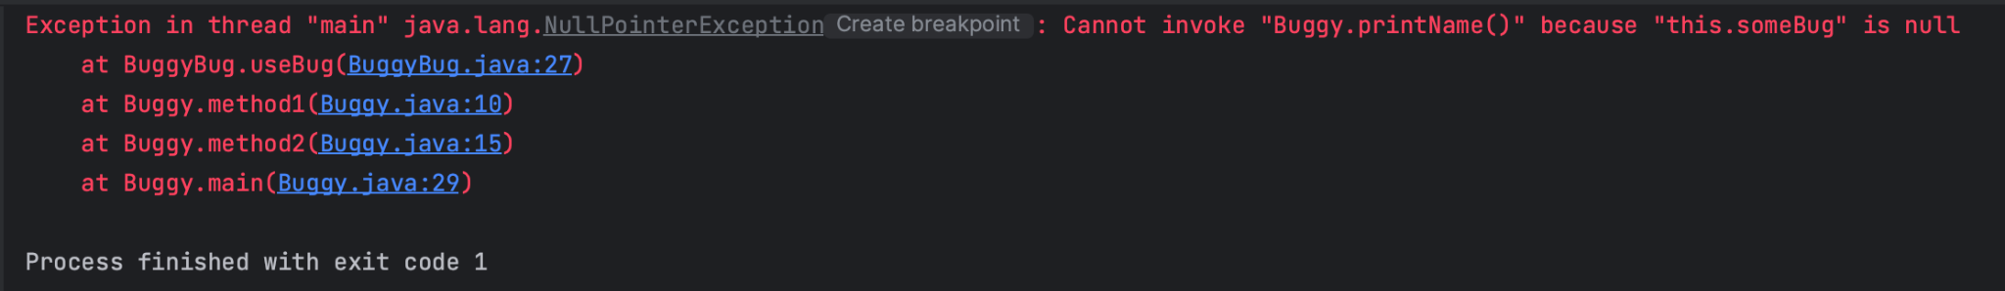
Stack Trace
When you’re running your program, sometimes, you’ll get something like this:

Slide 5
This is the stack trace and it shows up when an error or exception occurs. The stack trace contains a collection of stack records (which store application movements during its execution).
This is another way of saying that it tracks the method calls a program makes, up until the point of the error or exception.

Slide 6
This is the stack trace and it shows up when an error or exception occurs. The stack trace contains a collection of stack records (which store application movements during its execution).
This is another way of saying that it tracks the method calls a program makes, up until the point of the error or exception.
The stack trace is a useful tool that helps us debug and troubleshoot, as it can be used to isolate the location of the bug as well as the nature of bug.

Slide 7
Exceptions

Slide 8
What are Exceptions?
The stack trace shows up when an exception is thrown, so let’s talk about what an exception is.

Slide 9
What are Exceptions?
The stack trace shows up when an exception is thrown, so let’s talk about what an exception is.
An exception is an unwanted or unexpected event that occurs during the execution of a program and disrupts the normal flow of the program.
Exceptions can be caught and handled by the program (try-catch blocks for example, won’t be covered in today’s lab).

Slide 10
What are Exceptions?
The stack trace shows up when an exception is thrown, so let’s talk about what an exception is.
An exception is an unwanted or unexpected event that occurs during the execution of a program and disrupts the normal flow of the program.
Exceptions can be caught and handled by the program (try-catch blocks for example, won’t be covered in today’s lab).
When an exception does occur, an exception object is created - this object contains information about the exception, such as the name and description of the exception.

Slide 11
Common Types of Exceptions
Here are some common exceptions that you might run into:
NullPointerException: Thrown when an application attempts to use null in the case where an object is required (Ex. accessing or modifying field of a null object)
ArrayIndexOutOfBoundsException: When an array tries to access an illegal index (Ex. trying to access an element at index -1)
ClassNotFoundException: When an application tries to load in a class through its string name, but no definition for the class with the specified name could be found

Slide 12
Common Types of Exceptions Continued
ClassCastException: Improperly try to cast a class from one type to another
ArithmeticException: When an exceptional arithmetic condition has occurred (Ex. dividing an integer by 0)
IllegalArgumentException: Indicates that method has been passed/given an illegal or inappropriate argument

Slide 13
Errors

Slide 14
Errors
Errors are not the same as exceptions - they’re much harder to handle so we usually don’t try to handle errors.

Slide 15
Errors
Errors are not the same as exceptions - they’re much harder to handle so we usually don’t try to handle errors.
Errors represent irrecoverable conditions such as the Java virtual machine (JVM) running out of memory, stack overflow errors, infinite recursion etc.
A common one you might see is OutOfMemoryError - this indicates that the JVM runs out of memory and this can sometimes originate from how a program is structured.

Slide 16
Lab Overview

Slide 17
An Overview
Lab 3 is due Friday, 2/02 at 11:59 pm.
As a reminder, to get the lab assignment, run git pull skeleton main in your personal repository.
Deliverables:
Completion of Adventure, which consists of four stages:
  BeeCountingStage
  SpeciesListStage
  PalindromeStage
  MachineStage
For help, use the Lab queue: [INSERT]
Notes:
Make sure to insert what you want to use for OH/Lab queue. Debugging Part 2 :)

