Slide 1

Memory (Mis)Management
Register: https://citris-uc.org/event/citris-and-berkeley-space-center-present-woody-hoburg-on-his-journey-from-uc-berkeley-student-to-nasa-astronaut/
February 6, 2024
4:00-5:00pm
Banatao Auditorium
Sutardja Dai Hall

Slide 2
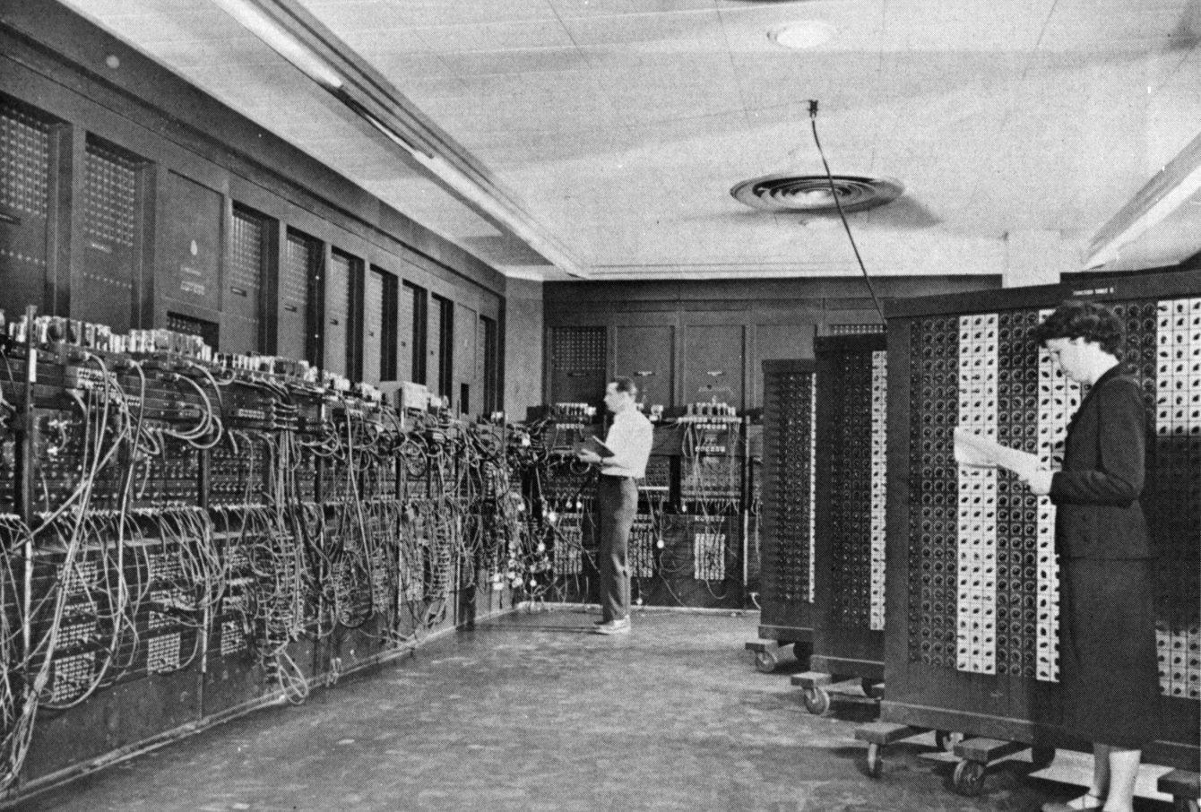
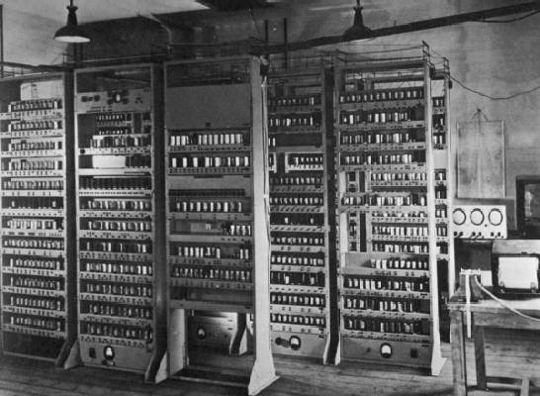
From ENIAC (1946) to EDSAC (1949)
ENIAC: First Electronic General-Purpose Computer
Needed 2-3 days to setup new program
Programmed with patch cords and switches
  At that time & before, "computer" mostly referred to people who did calculations
  Mostly women! (See Hidden Figures, 2016)
EDSAC: First General Stored-Program Computer
Programs held as numbers in memory
  Revolution! Program is also data!
35-bit binary two’s complement words

Slide 3
What gets printed?
[Concept Check]
sizeof(): compile-time operator; gives size in bytes (of type or variable).
// for this exercise, assume
// shorts are 16b on a 64-bit architecture
void mystery(short arr[], int len) {
printf("%d ", len);
printf("%d\n", sizeof(arr));
}
int main() {
short nums[] = {1, 2, 3, 99, 100};
printf("%d ", sizeof(nums));
mystery(nums, sizeof(nums)/sizeof(short));
return 0;
}
10 5 10
10 5 8
80 5 80
80 5 40
Other

Slide 4
What gets printed?
[Concept Check]
sizeof(): compile-time operator; gives size in bytes (of type or variable).
// for this exercise, assume
// shorts are 16b on a 64-bit architecture
void mystery(short arr[], int len) {
printf("%d ", len);
printf("%d\n", sizeof(arr));
}
int main() {
short nums[] = {1, 2, 3, 99, 100};
printf("%d ", sizeof(nums));
mystery(nums, sizeof(nums)/sizeof(short));
return 0;
}
10 5 10
10 5 8
80 5 80
80 5 40
Other
Array has decayed to a pointer
In array’s declared scope, total array size.
In array’s declared scope,
# elements in array.

Slide 5
Memory Locations
Memory Locations
The Stack
The Heap
Linked List Example
When Memory Goes Bad
Implementing Memory Management

Slide 6
C Program Address Space
A program’s address space contains 4 regions:
  Stack: local variables inside functions, grows downward
  Heap: space requested via malloc();
  resizes dynamically, grows upward
  Data (Static Data): variables declared outside main,
  does not grow or shrink
  Text (aka code): program executable loaded when program starts, does not change
  0x00000000 chunk is unwriteable/unreadable
  so you that crash on NULL pointer access
Programming in C requires knowing where objects are in memory, otherwise things don’t work as expected.
  By contrast, Java hides location of objects.
0xFFFF FFFF
stack
heap
data
text
0x0000 0000
For now, OS somehow
prevents accesses between
stack and heap.
(more later w/virtual memory)
Notes:
How does the C compiler determine where to put all the variables in a machine’s memory?
How to create dynamically sized objects?
To simplify discussion, we assume
one program runs at a time,
with access to all of memory.
Later, we’ll discuss virtual memory, which lets multiple programs all run at same time, each thinking they own all of memory.
(The only real addition is the C runtime has to say, "Hey operating system, gimme a big block of memory" when it needs more memory.)

Slide 7
Where are variables allocated?
Global: If declared outside a function,
allocated in data (static) storage.
Local: If declared inside function,
allocated on the stack and
freed when function returns.
  NB: main() is also a function.
For both these memory types,
the management is automatic.
  You don’t need to worry about deallocating
  when you are no longer using them.
  But a variable does not exist anymore once a function ends!
0xFFFF FFFF
stack
int myGlobal;
… main() {
int myTemp;
…
}
heap
data
text
0x0000 0000

Slide 8
The Stack
Memory Locations
The Stack
The Heap
Linked List Example
When Memory Goes Bad
Implementing Memory Management

Slide 9
The Stack
Every time a function is called,
a new stack frame is allocated on the stack.
A stack frame includes:
  Return “instruction” address (who called me?)
  Arguments*
  Space for other local variables
Stack frames contiguous blocks of memory;
the stack pointer indicates the start of stack frames.
When function ends, stack frame is tossed off the stack; frees memory for future stack frames.
(more later when we cover details for a RISC-V processor architecture)
fooA() { fooB(); }
fooB() { fooC(); }
fooC() { … }
fooA frame
fooB frame
SP
fooC frame
*see slide notes in pptx for technical elaboration
Notes:
*for performance reasons, this is actually a subset of arguments that don’t fit in a separate location called registers (more later when we discuss RISC-V)

Slide 10
The Stack is Last In, First Out (LIFO)
stack
int main ()
{ a(0); …
}
Stack Pointer
Stack grows down
Stack Pointer
void a (int m)
{ b(1);
}
Stack Pointer
void b (int n)
{ c(2);
}
void c (int o)
{ d(3);
}
Stack Pointer
Stack Pointer
The stack grows downward; a()’s local variables have lower byte addresses than main()’s, and so on.
void d (int p)
{
}
Stack Pointer

Slide 11

Recall: Array Are Very Primitive
[From last time]
Array bounds are not checked during element access.
  Consequence: We can accidentally access off the end of an array!
An array is passed to a function as a pointer.
  Consequence: The array size is lost! Be careful with sizeof()!
Declared arrays are only allocated while the scope is valid.
    char *foo() {
    char string[32]; ...;
    return string;
    } is incorrect
Solution:
Dynamic memory allocation! (more late now)

Slide 12
Passing Pointers into the Stack
It is fine to pass a pointer to stack space further down.
  I.e., pointers to addresses higher in the stack point to data in currently allocated stack frames.
void load_buf() { … };
int main() {
…
char buf[...];
load_buf(buf, BUFLEN);
…
}
stack
buf char array
persistent through load_buf’s execution
However, it is catastrophically bad to return a pointer to something in the stack!
  Memory will be overwritten when other functions are called!
  So your data would no longer exist…and writes can overwrite key pointers, causing crashes!
However,
char *make_buf() {
char buf[50];
return buf;
}
void foo() {…}
int main(){
char *stackAddr = \
make_buf();
foo(stackAddr);
…
}
stack
stackAddr points
to overwritten
memory
stackAddr
buf
buf???

Slide 13
The Heap
Memory Locations
The Stack
The Heap
Linked List Example
When Memory Goes Bad
Implementing Memory Management

Slide 14
What is the Heap?
The heap is dynamic memory – memory that can be
allocated, resized, and freed during program runtime.
  Useful for persistent memory across function calls.
  But biggest source of pointer bugs, memory leaks, …
  Similar to Java new command allocates memory….but with key differences below.
Huge pool of memory (usually >> stack), but not allocated in contiguous order.
  Back-to-back requests for heap memory could result in blocks very far apart
In C, specify number of bytes of memory explicitly to allocate/deallocate item.
  malloc(): Allocates raw, uninitialized memory from heap
  free(): Frees memory on heap
  realloc(): Resizes previously allocated heap blocks to new size
  Unlike the stack, memory gets reused only when programmer explicitly cleans up

Slide 15
void *malloc(size_t n)
Allocates a block of uninitialized memory:
  size_t n is an unsigned integer type big enough to “count” memory bytes.
  Returns void * pointer to block of memory on heap.
  A return of NULL indicates no more memory (always check for it!!!)
To allocate a struct:
typedef struct { ... } TreeNode;
TreeNode *tp = (TreeNode *) malloc(sizeof(TreeNode));
To allocate an array of 20 ints:
int *ptr = (int *) malloc(20*sizeof(int));
  Many years ago ints used to be 16b. Now, 32b or 64b…
Typecast casts return value
from type (void *) to (TreeNode *)
sizeof(type) gives size in bytes.
Assuming size of objects can lead to misleading, unportable code. Use sizeof()!

Slide 16
void free(void *ptr)
Dynamically frees heap memory
  ptr is a pointer containing an address originally returned by malloc()/realloc().
int *ptr = (int *) malloc (sizeof(int)*20);
...
free(ptr); // implicit typecast to (void *)
When you free memory, be sure to pass the original address returned from malloc(). Otherwise, crash (or worse!)
Notes:
$ man malloc
Linux Programmer’s Manual
The free() function frees the memory space pointed to by ptr, which must have been returned by a previous call to malloc(), calloc(), or realloc(). Otherwise, or if free(ptr) has already been called before, undefined behavior occurs. If ptr is NULL, no operation is performed.”

Slide 17
void *realloc(void *ptr, size_t size)
Resize a previously allocated block at ptr to a new size.
  Returns new address of the memory block.
    In doing so, it may need to copy all data to a new location.
  realloc(NULL, size); // behaves like malloc
  realloc(ptr, 0); // behaves like free, deallocates heap block
Remember: Always check for return NULL,
which would mean you’ve run out of memory!
int *ip; ip = (int *) malloc(10*sizeof(int));
… … … /* check for NULL */
ip = (int *) realloc(ip, 20*sizeof(int));
/* contents of first 10 elements retained */
… … … /* check for NULL */
realloc(ip,0); /* equivalent to free(ip); */

Slide 18
Linked List Example
Memory Locations
The Stack
The Heap
Linked List Example
When Memory Goes Bad
Implementing Memory Management

Slide 19
Linked List Example
1
2
3
4
5
6
7
# include <string.h>
int main() {
struct Node *head = NULL;
add_to_front(&head, "abc");
… // free nodes, strings here…
}
void add_to_front(struct Node **head_ptr, char *data) {
struct Node *node = (struct Node *) malloc(sizeof(struct Node));
node->data = (char *) malloc(strlen(data) + 1); // extra byte!
strcpy(node->data, data); // strcpy also copies null terminator
node->next = *head_ptr;
*head_ptr = node;
}
struct Node {
char *data;
struct Node *next;
};

Slide 20
Linked List Example
1
2
3
4
5
6
7
# include <string.h>
int main() {
struct Node *head = NULL;
add_to_front(&head, "abc");
… // free nodes, strings here…
}
void add_to_front(struct Node **head_ptr, char *data) {
struct Node *node = (struct Node *) malloc(sizeof(struct Node));
node->data = (char *) malloc(strlen(data) + 1); // extra byte!
strcpy(node->data, data); // strcpy also copies null terminator
node->next = *head_ptr;
*head_ptr = node;
}
struct Node {
char *data;
struct Node *next;
};
head_ptr
head
NULL
data
'a' | 'b' | 'c'
'\0'
Notes:
String literals in data (static)

Slide 21
Linked List Example
1
2
3
4
5
6
7
# include <string.h>
int main() {
struct Node *head = NULL;
add_to_front(&head, "abc");
… // free nodes, strings here…
}
void add_to_front(struct Node **head_ptr, char *data) {
struct Node *node = (struct Node *) malloc(sizeof(struct Node));
node->data = (char *) malloc(strlen(data) + 1); // extra byte!
strcpy(node->data, data); // strcpy also copies null terminator
node->next = *head_ptr;
*head_ptr = node;
}
struct Node {
char *data;
struct Node *next;
};
0x300
node
0x300
???
???
head_ptr
NULL
pointer stored on stack
malloc’ed sizeof(struct Node) bytes starting at heap address 0x300
data
'a' | 'b' | 'c'
'\0'

Slide 22
Linked List Example
1
2
3
4
5
6
7
# include <string.h>
int main() {
struct Node *head = NULL;
add_to_front(&head, "abc");
… // free nodes, strings here…
}
void add_to_front(struct Node **head_ptr, char *data) {
struct Node *node = (struct Node *) malloc(sizeof(struct Node));
node->data = (char *) malloc(strlen(data) + 1); // extra byte!
strcpy(node->data, data); // strcpy also copies null terminator
node->next = *head_ptr;
*head_ptr = node;
}
struct Node {
char *data;
struct Node *next;
};
0x300
node
0x300
0x350
???
head_ptr
NULL
malloc’ed 4 bytes starting at heap address 0x350
data
'a' | 'b' | 'c'
0x350
'\0'
? | ? | ? | ?

Slide 23
Linked List Example
1
2
3
4
5
6
7
# include <string.h>
int main() {
struct Node *head = NULL;
add_to_front(&head, "abc");
… // free nodes, strings here…
}
void add_to_front(struct Node **head_ptr, char *data) {
struct Node *node = (struct Node *) malloc(sizeof(struct Node));
node->data = (char *) malloc(strlen(data) + 1); // extra byte!
strcpy(node->data, data); // strcpy also copies null terminator
node->next = *head_ptr;
*head_ptr = node;
}
struct Node {
char *data;
struct Node *next;
};
0x300
node
0x300
0x350
???
head_ptr
NULL
data
'a' | 'b' | 'c'
0x350
'\0'
'\0'
'a' | 'b' | 'c'

Slide 24
Linked List Example
1
2
3
4
5
6
7
# include <string.h>
int main() {
struct Node *head = NULL;
add_to_front(&head, "abc");
… // free nodes, strings here…
}
void add_to_front(struct Node **head_ptr, char *data) {
struct Node *node = (struct Node *) malloc(sizeof(struct Node));
node->data = (char *) malloc(strlen(data) + 1); // extra byte!
strcpy(node->data, data); // strcpy also copies null terminator
node->next = *head_ptr;
*head_ptr = node;
}
struct Node {
char *data;
struct Node *next;
};
0x300
node
0x300
0x350
NULL
head_ptr
NULL
data
'a' | 'b' | 'c'
0x350
'\0'
'a' | 'b' | 'c'
'\0'

Slide 25
Linked List Example
1
2
3
4
5
6
7
# include <string.h>
int main() {
struct Node *head = NULL;
add_to_front(&head, "abc");
… // free nodes, strings here…
}
void add_to_front(struct Node **head_ptr, char *data) {
struct Node *node = (struct Node *) malloc(sizeof(struct Node));
node->data = (char *) malloc(strlen(data) + 1); // extra byte!
strcpy(node->data, data); // strcpy also copies null terminator
node->next = *head_ptr;
*head_ptr = node;
}
struct Node {
char *data;
struct Node *next;
};
0x300
node
0x300
0x350
NULL
head_ptr
0x300
data
'a' | 'b' | 'c'
0x350
'\0'
'a' | 'b' | 'c'
'\0'

Slide 26
Linked List Example
1
2
3
4
5
6
7
# include <string.h>
int main() {
struct Node *head = NULL;
add_to_front(&head, "abc");
… // free nodes, strings here…
}
void add_to_front(struct Node **head_ptr, char *data) {
struct Node *node = (struct Node *) malloc(sizeof(struct Node));
node->data = (char *) malloc(strlen(data) + 1); // extra byte!
strcpy(node->data, data); // strcpy also copies null terminator
node->next = *head_ptr;
*head_ptr = node;
}
struct Node {
char *data;
struct Node *next;
};
0x300
Check out the lecture code in Drive!
0x350
NULL
head
0x300
'a' | 'b' | 'c'
0x350
'\0'
'a' | 'b' | 'c'
'\0'

Slide 27
When Memory Goes Bad
Memory Locations
The Stack
The Heap
Linked List Example
When Memory Goes Bad
Implementing Memory Management

Slide 28
Working with Memory
Code, Static storage are easy:
  They never grow or shrink.
Stack space is also easy:
  Stack frames are created and destroyed in LIFO order.
  Just avoid “dangling references”: pointers to deallocated variables (e.g., from old stack frames).
Working with the heap is tricky:
  Memory can be allocated / deallocated at any time!
  “Memory leak”: If you forget to
  deallocate memory
  “Use after free”: If you use data after calling free
  “Double free”: If you call free 2x on same memory
0xFFFF FFFF
stack
heap
data
    Your program will eventually run out of memory
text
0x0000 0000
    Possible crash or exploitable vulnerability

Slide 29
Failure to free()
The runtime does not check for the programmer’s failure to manage memory.
  Memory is so performance-critical that there just isn’t time to do this.
  Usual result: you corrupt the memory allocator’s internal structure, and you find out much later in a totally unrelated part of your code!
Memory leak: Failure to free() allocated memory
  Initial symptoms. Nothing…
    Until you hit a critical point, memory leaks aren’t actually a problem
  …Later symptoms: performance drops off a cliff…
    Memory hierarchy behavior tends to be great just up until it isn’t, then it hits several cliffs
  …and then your program is killed off!
    Because the operating system (OS) says “no” when you ask for more memory

Slide 30
Use after Free
“Dangling reference”
When you keep using a pointer, even after it has been deallocated
Reads after the free may be corrupted!
  If something else takes over that memory, your program will probably read the wrong information!
Writes corrupt other data!
  Uh oh... Your program crashes later!
struct foo *f;
…
f = malloc(sizeof(struct foo));
…
free(f);
…
bar(f->a); // !!!

Slide 31
Double-Free...
  struct foo *f = (struct foo *) malloc(10*sizeof(struct foo));
  ...
  free(f);
  ...
  free(f); // !!!
May cause either a use-after-free (because something else called malloc() and got that data) or corrupt heap data (because you are no longer freeing a pointer tracked by malloc)

Slide 32
Forgetting realloc() Can Move Data
”Dangling reference”
Remember, when you realloc it can copy data to a different part of the heap.
  Reads may be corrupted, and writes may corrupt other pieces of memory.
int *nums;
nums = malloc(10*sizeof(int));
…
// forget to update nums
// on realloc call
realloc(nums, 20*sizeof(int));
// nums could now point
// to invalid memory,
// and we could have potentially
lost a pointer to a new block
int *nums;
nums = malloc(10*sizeof(int));
…
int *g = nums;
…
nums = realloc(nums,
20*sizeof(int));
// g could now point
// to invalid memory

Slide 33

Faulty Heap Management
[Concept Check]
How many memory management errors are in this code?
void free_mem_x() {
int fnh[3];
...
free(fnh);
}
void free_mem_y() {
int *fum = malloc(4*sizeof(int));
free(fum+1);
...
free(fum);
...
free(fum);
}
[for next time]
1
2
3
0
Other

Slide 34
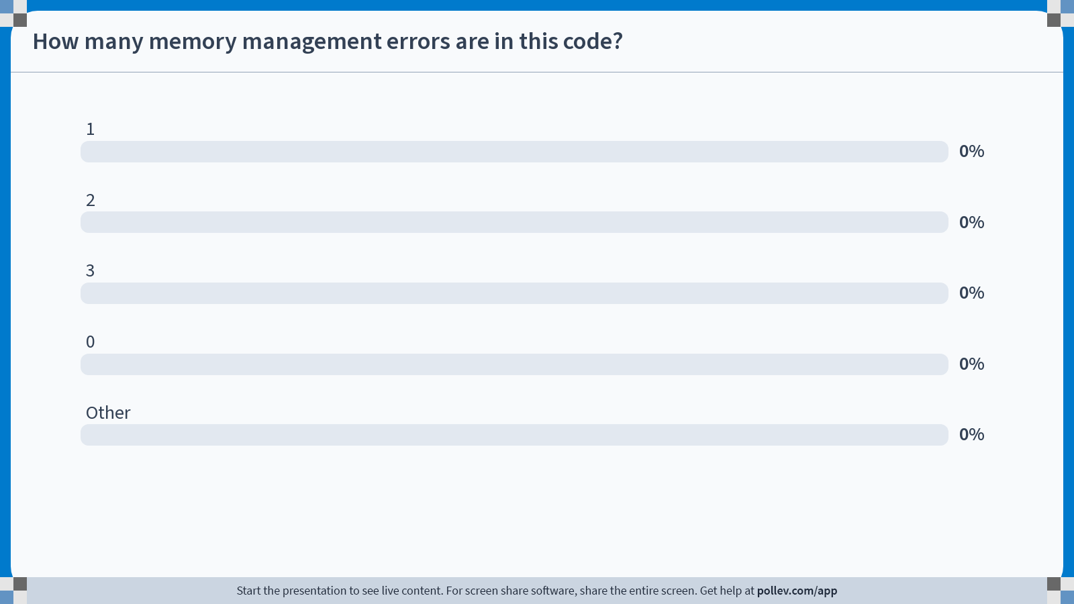
Notes:
Do not modify the notes in this section to avoid tampering with the Poll Everywhere activity.
More info at polleverywhere.com/support
How many memory management errors are in this code?
https://www.polleverywhere.com/multiple_choice_polls/lwAQZsP5QdbmQwoLJYsV6?state=opened&flow=Default&onscreen=persist

Slide 35
Faulty Heap Management
[Concept Check]
How many memory management errors are in this code?
void free_mem_x() {
int fnh[3];
...
free(fnh);
}
void free_mem_y() {
int *fum = malloc(4*sizeof(int));
free(fum+1);
...
free(fum);
...
free(fum);
}
[for next time]
1
2
3
0
Other
    free() on stack-allocated memory
    free() on memory that isn’t the pointer from malloc
    Double free()

Slide 36
Valgrind to the rescue!!!
Valgrind slows down your program by an order of magnitude, but...
  It adds a tons of checks designed to catch most (but not all) memory errors
    Memory leaks
    Misuse of free
    Writing over the end of arrays
Tools like Valgrind are absolutely essential for debugging C code.
Check out Lab 02!

Slide 37
And in Conclusion…
C has 3 pools of memory for variables:
  Data: global/static variable storage, basically permanent
  Stack: local variable storage, parameters, return address
  Heap (dynamic storage): malloc() grabs space from here, free() returns it.
  (4th memory pool: text, for the program executable itself)
Heap data is biggest source of bugs in C code!
🗹

Slide 38
Implementing Memory Management
Memory Locations
The Stack
The Heap
Linked List Example
When Memory Goes Bad
Implementing Memory Management
Material not tested. Recording:
https://www.youtube.com/watch?v=Sq5tSeWfnGY

Slide 39
Heap Management Requirements
Want malloc() and free() to run quickly
Want minimal memory overhead
Want to avoid fragmentation*,
when most of our free memory is in many small chunks
  In this case, we might have many free bytes but not be able to satisfy a large request since the free bytes are not contiguous in memory.
* This is technically external fragmentation
Notes:
Next time: rename section Implementing a Heap Allocator
Memory can be allocated / deallocated at any time!

Slide 40
Heap Management Example
R3?
R2 (10 bytes)
R2 (10 bytes)
R2 (10 bytes)
R1 (100 bytes)
R1 (100 bytes)
R3?
Heap grows up
  Request R1,
  100 bytes
  Request R2,
  10 bytes
  Memory from R1 is freed
  Request R3,
  50 bytes?

Slide 41
K&R Malloc/Free Implementation
From Section 8.7 of K&R
  Code in the book uses some C language features we haven’t discussed and is written in a very terse style; don’t worry if you can’t decipher the code
Each block of memory is preceded by a header that has two fields:
  size of the block, and
  a pointer to the next block
All free blocks are kept in a circular linked list.
In an allocated block, the header’s pointer field is unused.

Slide 42
K&R Malloc/Free Implementation
malloc() searches the free list for a block that is big enough. If none is found, more memory is requested from the operating system. If what it gets can’t satisfy the request, it fails.
free() checks if the blocks adjacent to the freed block are also free.
  If so, adjacent free blocks are merged (coalesced) into a single, larger free block.
  Otherwise, freed block is just added to the free list.

Slide 43
Choosing a block in malloc()
If there are multiple free blocks of memory that are big enough for some request, how do we choose which one to use?
  best-fit: choose the smallest block that is big enough for the request.
  first-fit: choose the first block we see that is big enough.
  next-fit: like first-fit, but remember where we finished searching and resume searching from there.

