Slide 1
Floating Point

Slide 2

Faulty Heap Management
[from last time]
How many memory management errors are in this code?
void free_mem_x() {
int fnh[3];
...
free(fnh);
}
void free_mem_y() {
int *fum = malloc(4*sizeof(int));
free(fum+1);
...
free(fum);
...
free(fum);
}
1
2
3
0
Other

Slide 3
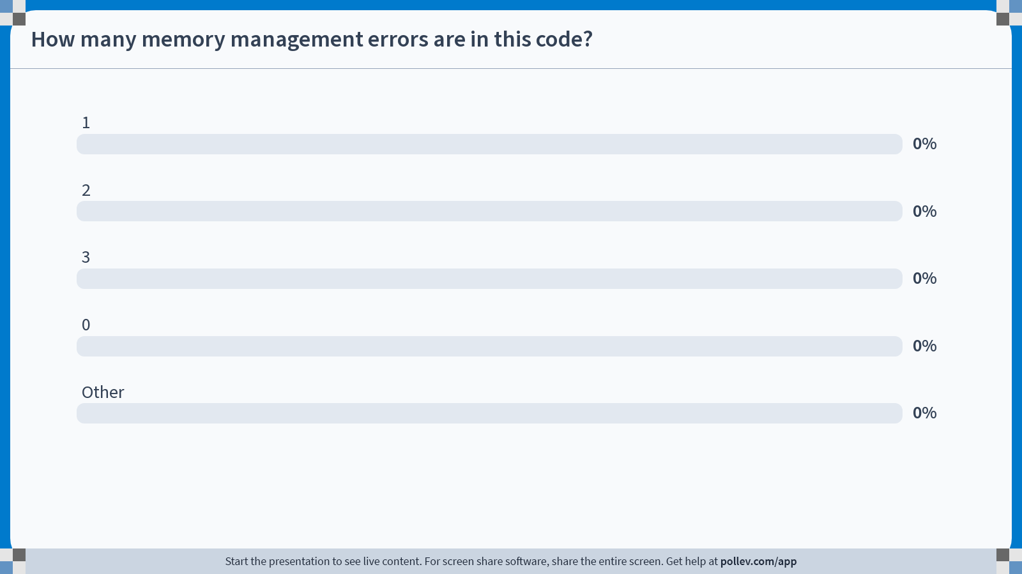
Notes:
Do not modify the notes in this section to avoid tampering with the Poll Everywhere activity.
More info at polleverywhere.com/support
How many memory management errors are in this code?
https://www.polleverywhere.com/multiple_choice_polls/lwAQZsP5QdbmQwoLJYsV6?state=opened&flow=Default&onscreen=persist

Slide 4
Faulty Heap Management
[Concept Check]
How many memory management errors are in this code?
void free_mem_x() {
int fnh[3];
...
free(fnh);
}
void free_mem_y() {
int *fum = malloc(4*sizeof(int));
free(fum+1);
...
free(fum);
...
free(fum);
}
1
2
3
0
Other
    free() on stack-allocated memory
    free() on memory that isn’t the pointer from malloc
    Double free()

Slide 5
Great Idea #1: Abstraction (Levels of Representation/Interpretation)
Week 1 | – | Welcome | C 1: Intro
Week 2 | C 2: Pointers, Arrays, and Strings | Number 1: Bit ops, Integer num rep | C 3: Memory (Stack, Heap)
Week 3 | Number 2: Floating Point | C 4: Generics, Function Pointers | RISC-V 1: Intro to Assembly
Learning C means learning the binary abstraction! Our first “unit” of CS61C interleaves bit representation with C.

Slide 6
Basics, Fixed Point
Basics, Fixed Point
Floating Point
Special Numbers
Other Floating Point Representations
(Bonus) More Examples

Slide 7

Quote of the Day
“95% of the folks out there are completely clueless about floating-point.”
– James Gosling, 1998-02-28
  Sun Fellow
  Java Inventor

Slide 8
Review of Integer Number Representations
Computers made to process numbers,
represented as bits.
What can we represent in N bits?
  2^{N} things, and no more! We’ve covered a few conventions…
  Unsigned integers:
    Range: 0 to 2^{N} - 1
    N=32: 2^{N} - 1 = 4,294,967,295)
  Signed Integers (Two’s Complement)
    Range: -2^{(N-1)} to 2^{(N-1)} - 1
    N=32: 2^{(N-1)} - 1 = 2,147,483,647)

Slide 9
What about other numbers?
Very large numbers (sec/millennium)
  31,556,926,010 (3.155692610 x 10¹⁰)
Very small numbers? (Bohr radius)
  0.000000000052917710 (5.2917710 x 10⁻¹¹)
#s with both integer & fractional parts?
  2.625
Scientific Notation
Let’s start with representing
this number…

Slide 10
“Fixed Point” Binary Representation
“Binary Point,” like decimal point, signifies the boundary between integer and fractional parts.
Example 6-bit representation, positive numbers only:
With the above 6-bit ”fixed binary point” representation:
  Range: 0 to 3.9375
x | x | . | y | y | y | y
2¹ | 2⁰ |  | 2⁻¹ | 2⁻² | 2⁻³ | 2⁻⁴
1x2¹ + 1x2⁻¹ + 1x2⁻³
= 2 + 0.5 + 0.125
= 2.625_{ten}
1 | 0 | . | 1 | 0 | 1 | 0
2¹ | 2⁰ |  | 2⁻¹ | 2⁻² | 2⁻³ | 2⁻⁴
xxyyyy
101010
11.1111_{two} = 4 – 1x2⁻⁴

Slide 11
Arithmetic with Fixed Point
Addition is straightforward:
Multiplication is a bit more complex:
01.1000 1.5₁₀
+ 00.1000 0.5₁₀
10.0000 2.0₁₀
01.1000 1.5₁₀
x 00.1000 0.5₁₀
00 0000
000 000
0000 00
01100 0
000000
000000
0001100 0000 → 00.1100
Need to remember where point is…

Slide 12
What about other numbers?
Very large numbers (sec/millennium)
  31,556,926,010 (3.155692610 x 10¹⁰)
Very small numbers? (Bohr radius)
  0.000000000052917710 (5.2917710 x 10⁻¹¹)
#s with both integer & fractional parts?
  2.625
Very large numbers (sec/millennium)
  31,556,926,010 (3.155692610 x 10¹⁰)
Very small numbers? (Bohr radius)
  0.000000000052917710 (5.2917710 x 10⁻¹¹)
#s with both integer & fractional parts?
  2.625
11....0.0
Scientific Notation
34 bits
0.0....11
58 bits
To store all these numbers, we’d need a fixed-point rep with at least 92 bits. There must be a better way!
✅
Notes:
log(31556926010)/log(2) = 34.8
log(0.000000000052917710)/log(2) = -34.1
2^-35+2^-36+2^-37+2^-39+2^-43+2^-45+2^-46+2^-47+2^-48+2^-55+2^-57+2^-58

Slide 13
Floating Point
Basics, Fixed Point
Floating Point
Special Numbers
Other Floating Point Representations
(Bonus) More Examples

Slide 14
Floating Point
A “floating binary point” most effectively uses of our limited bits (and thus more accuracy in our number representation).
Example:
  Suppose we wanted to represent 0.1640625_{ten}.
  Binary representation: … 000000.001010100000…
The binary point is stored separately from the significant bits, so very large and small numbers can be represented.
1. Store these ”significant bits.”
2. Keep track of the binary point 2 places to the left of the MSB (“exponent field”).

Slide 15
Enter Scientific Notation (in Decimal)
“Normalized form”: no leadings 0s (exactly one nonzero digit to left of point).
  To represent 3/1,000,000,000:
    Normalized: 3.0 x 10⁻⁹
    Not normalized: 0.3 x 10⁻⁸, 30.0 x 10⁻¹⁰
decimal point
radix (base 10)
1.640625_{ten} x 10 ⁻¹
significand
exponent

Slide 16
Enter Scientific Notation (in Binary)
“Normalized form”: no leadings 0s (exactly one nonzero digit to left of point).
  To represent 3/1,000,000,000:
    Normalized: 3.0 x 10⁻⁹
    Not normalized: 0.3 x 10⁻⁸, 30.0 x 10⁻¹⁰
“Floating point”: Computer arithmetic that supports this binary representation.
  Represents numbers where the binary point is not fixed (as opposed to integers).
  C variable types: float, double
decimal point
radix (base 10)
1.640625_{ten} x 10 ⁻¹
significand
exponent
1.0101_{two} x 2 ⁻³
“binary point”
radix (base 2)
Note: Normalized binary representation always leads with a 1! (why?)

Slide 17
IEEE 754 Floating Point Standard (1/3)
Single precision standard for 32-bit word. In C, float.
Normalized format:
±1.xxx…x_{two} x 2^{yyy…ytwo}
31 | 30 |  | 23 | 22 |  |  |  |  | 0
s | exponent |  |  | significand
1 bit | 8 bits |  |  | 23 bits
Notes:
IEEE standard 754-1985 (also an inter- national standard, IEC 559)
https://stackoverflow.com/questions/31967040/is-it-safe-to-assume-floating-point-is-represented-using-ieee754-floats-in-c

Slide 18
IEEE 754 Floating Point Standard (1/3)
Single precision standard for 32-bit word. In C, float.
Normalized format:
±1.xxx…x_{two} x 2^{yyy…ytwo}
31 | 30 |  | 23 | 22 |  |  |  |  | 0
s | exponent |  |  | significand
1 bit | 8 bits |  |  | 23 bits
Sign bit:
  1 is negative
  0 is positive
Significand field (i.e., mantissa):
  Normalized convention: significand leads w/1
  To pack more bits, treat leading 1 as implicit; represent other bits explicitly in significand.
    significand = 1 + 23-bit significand field
    0 < significand field < 1
Notes:
IEEE standard 754-1985 (also an inter- national standard, IEC 559)
https://stackoverflow.com/questions/31967040/is-it-safe-to-assume-floating-point-is-represented-using-ieee754-floats-in-c

Slide 19
IEEE 754 Floating Point Standard (2/3)
Single precision standard for 32-bit word. In C, float.
Normalized format:
±1.xxx…x_{two} x 2^{yyy…ytwo}
31 | 30 |  | 23 | 22 |  |  |  |  | 0
s | exponent |  |  | significand
1 bit | 8 bits |  |  | 23 bits
Exponent field uses “bias notation”:
  Bias of 127: Subtract 127 from exponent field to get exponent value.
  Designers wanted FP numbers to be used even without specialized FP hardware, e.g., sort records with FP numbers using integer compares.
  Idea: for the same sign, bigger exponent field should represent bigger numbers.
    2’s complement poses a problem (because negative numbers look bigger)
  We’ll see numbers ordered EXACTLY as in sign-magnitude
00…00 → 11…11
0 to +MAX → -0 to -MAX
Notes:
J-16 The primary reason why the IEEE standard, like most other floating-point formats, uses biased exponents is that it means nonnegative numbers are ordered in the same way as integers. That is, the magnitude of floating-point numbers can be compared using an integer comparator. Another (related) advantage is that 0 is represented by a word of all 0s. The downside of biased exponents is that adding them is slightly awkward, because it requires that the bias be subtracted from their sum
Bias for N bits chosen as –(2^{N-1}-1)

Slide 20
IEEE 754 Floating Point Standard (3/3)
[Summary]
Single precision standard for 32-bit word. In C, float.
Normalized format:
31 | 30 |  | 23 | 22 |  |  |  |  | 0
s | exponent |  |  | significand
1 bit | 8 bits |  |  | 23 bits
Sign bit
  1 is negative
  0 is positive
Exponent field
  Bias of 127
  Subtract 127 from exponent field to get exponent value
Significand field (i.e., mantissa)
  To pack more bits, numerical significand leads w/implicit 1
    significand = 1 + 23-bit significand field
  How to represent zero?
  More later…
(-1)^{S} x (1 + significand) x 2^{(exponent-127)}

Slide 21

“Father” of the Floating Point Standard
IEEE Standard 754 for Binary Floating-Point Arithmetic.
1989
ACM Turing
Award Winner!
Prof. William Kahan
☑
www.cs.berkeley.edu/~wkahan/ieee754status/754story.html
Notes:
1:30 in
IEEE standard 754-1985 (also an inter- national standard, IEC 559)
https://amturing.acm.org/award_winners/kahan_1023746.cfm

Slide 22
Normalized Example
What is the decimal equivalent of the following IEEE 754 single-precision binary floating point number?
31 | 30 |  | 23 | 22 |  |  |  |  | 0
1 | 1000 0001 |  |  | 111 0000 0000 0000 0000 0000
-7 * 2^129
-3.5
-3.75
-7
-7.5
Something else
(-1)^{S} x (1 + significand) x 2^{(exponent-127)}

Slide 23
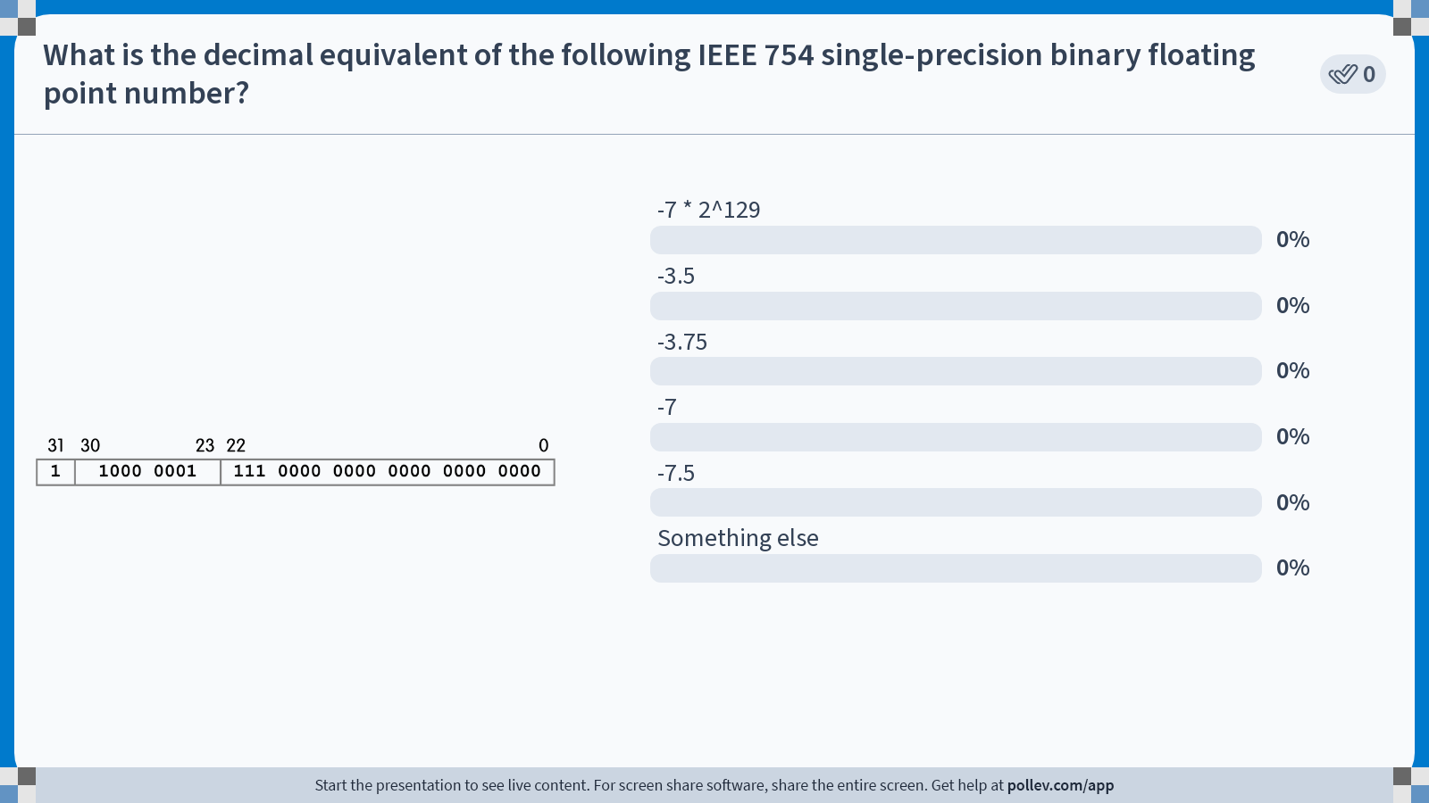
Notes:
Do not modify the notes in this section to avoid tampering with the Poll Everywhere activity.
More info at polleverywhere.com/support
What is the decimal equivalent of the following IEEE 754 single-precision binary floating point number?
https://www.polleverywhere.com/multiple_choice_polls/CUSIiCfWhh7jbnrSbDhcd?state=opened&flow=Default&onscreen=persist

Slide 24
Normalized Example
What is the decimal equivalent of the following IEEE 754 single-precision binary floating point number?
31 | 30 |  | 23 | 22 |  |  |  |  | 0
1 | 1000 0001 |  |  | 111 0000 0000 0000 0000 0000
s | exponent |  |  | significand
-7 * 2^129
-3.5
-3.75
-7
-7.5
Something else
(-1)^{S} x (1 + significand) x 2^{(exponent-127)}
(-1)¹ x (1 + .111)_{two} x 2⁽¹²⁹⁻¹²⁷⁾
-1 x (1.111)_{two} x 2⁽²⁾
-111.1_{two}
-7.5_{ten}

Slide 25
Step Size
What is the next representable number after y? Before y?
31 | 30 |  | 23 | 22 |  |  |  |  | 0
0 | 1000 0001 |  |  | 111 0000 0000 0000 0000 0000
s | exponent |  |  | significand
y
+1
0 | 1000 0001 | 111 0000 0000 0000 0000 0001
next float after y
y + ((.0…01)_{two} x 2⁽¹²⁹⁻¹²⁷⁾)
y + ( 2⁻²³ x 2⁽²⁾)
Because we have a fixed # of bits, we cannot represent all numbers in a range.
Step size is the spacing between consecutive floats with a given exponent.
  Bigger exponents → bigger step size.
  Smaller exponents → smaller step size!
y + 2⁻²¹
“step size”

Slide 26
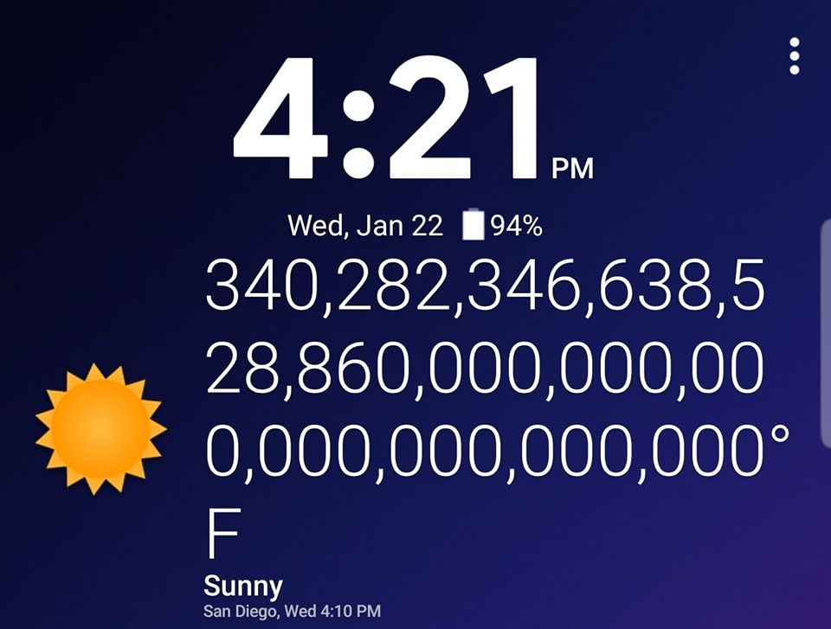
Computing in the News(?) Climate Change
INT_MAX: 2147483647
UINT_MAX: 4294967295
FLOAT_MAX: 3.40282e+38
s | 1111 1110 | 1…1 (23 bits)
(1.1…1) x 2^{(254-127) ≈} 3.4 x 10³⁸
This is the maximum normalized float rep in IEEE 754, where biased exponents are restricted to the range 1 to 254 (2⁻¹²⁶ to 2¹²⁷).
Exponent fields 0, 255 are reserved for special numbers. More now!
Notes:
From 2020

Slide 27
Special Numbers
Basics, Fixed Point
Floating Point
Special Numbers
Other Floating Point Representations
(Bonus) More Examples

Slide 28
Representing Zero
Note: Zero has no normalized representation (i.e., no leading 1).
IEEE 754 represents ±0:
  Reserve exponent value 0000 0000;
  signals to hardware to not implicitly add 1.
  Keep significand all zeroes.
  What about sign? Both cases valid! Why?
+0:
0 | 0000 0000 | 000…000
–0:
1 | 0000 0000 | 000…000

Slide 29
Special Numbers
Normalized numbers are only a fraction (heh) of floating point representations. For single-precision (32-bit):
Professor Kahan had clever ideas;
“Waste not, want not.”
Biased Exponent | Significand field | Object
0 | all zeros | ±0
0 | nonzero | ???
1 – 254 | anything | Normalized floating point
255 | all zeros | ???
255 | nonzero | ???
1 – 254 | anything | Normalized floating point
The fields 0 and 255 accommodate overflow, underflow, and arithmetic errors.

Slide 30
Overflow and Underflow
Because 0 and 255 are reserved exponent fields,
the range of normalized single-precision floating point is:
  Largest magnitude:
  Smallest magnitude:
s | 1111 1110 | 1…1 (23 bits)
s | 0000 0001 | 0…0 (23 bits)
(1.1…1) x 2^{(254-127) ≈} 3.4 x 10³⁸
(1.0) x 2^{(1-127) ≈} 1.2 x 10⁻³⁸
-3.4x10³⁸
-1
-1.2x10⁻³⁸
1.2x10⁻³⁸
1
3.4x10³⁸
0

Slide 31
Overflow and Underflow
Because 0 and 255 are reserved exponent fields,
the range of normalized single-precision floating point is:
  Largest magnitude:
What if a number falls outside this range?
  Too large: overflow. Magnitude of value is too large to represent!
  Too small: underflow. Magnitude of value is too small to represent!
  Smallest magnitude:
s | 1111 1110 | 1…1 (23 bits)
s | 0000 0001 | 0…0 (23 bits)
(1.1…1) x 2^{(254-127) ≈} 3.4 x 10³⁸
(1.0) x 2^{(1-127) ≈} 1.2 x 10⁻³⁸
overflow
underflow
overflow
-3.4x10³⁸
-1
-1.2x10⁻³⁸
1.2x10⁻³⁸
1
3.4x10³⁸
0

Slide 32
Representation for ± ∞
In FP, divide by ±0 should produce ±∞, not overflow.
Why?
  OK to do further computations with ∞
  E.g., X/0 > Y may be a valid comparison.
  Ask math majors
IEEE 754 represents ±∞:
  Reserve exponent value 1111 1111.
  And keep significand all zeroes.
+∞:
0 | 1111 1111 | 000…000
–∞:
1 | 1111 1111 | 000…000

Slide 33
Representation for Not a Number
What do I get if I calculate sqrt(-4.0) or 0/0?
  If ∞ is not an error, these shouldn’t be either!
  Called Not a Number (NaN).
  Exponent = 255, Significand nonzero.
Why is this useful?
  They contaminate: op(NaN, X) = NaN
  Hope NaNs help with debugging?
  Can use the significand to encode/identify where errors occurred! (proprietary; not defined in standard)
s | 1111 1111 | xxx…xxxx

Slide 34
Denorms: Gradual Underflow (1/2)
[for next time]
Problem:
  There’s a gap among representable FP numbers around zero!
  Smallest normalized number:
  2nd smallest normalized number:
31 | 30 |  | 23 | 22 | 1 0
0 | 0000 0001 |  |  | 00000…00001
0 | 0000 0001 | 000…000
(1.0) x 2⁽¹⁻¹²⁷⁾ ⁼ 2⁻¹²⁶
(1.000……1₂) x 2⁽¹⁻¹²⁷⁾
= (1 + 2⁻²³) x 2⁻¹²⁶ = 2⁻¹²⁶ + 2⁻¹⁴⁹
2⁻¹²⁶
2⁻¹⁴⁹
–∞
0
+∞
Huge difference between 0 and smallest vs. smallest and 2nd smallest! Occurs b/c of normalization and implicit leading 1.

Slide 35
Denorms: Gradual Underflow (2/2)
[for next time]
Solution:
  We still haven’t used Exponent = 0, Significand nonzero.
  DEnormalized number:
    no (implied) leading 1
    implicit exponent for all denorms = -126.
31 | 30 23 | 22 0
s | 0000 0000 | xxx…xxxx
(-1)^{s} x (0.x……x₂) x 2⁻¹²⁶
Smallest denormalized number
Smallest normalized number
0 | 0000 0000 | 000…001
0 | 0000 0001 | 000…000
2⁻¹⁴⁹
2⁻¹²⁶
🥳
–∞
0
+∞
2⁻¹⁴⁸
2nd smallest denorm
Largest denorm
0 | 0000 0000 | 000…010
0 | 0000 0000 | 111…111

Slide 36
Special Numbers, Summary
[for next time]
Biased Exponent | Significand field | Object
0 | all zeros | ±0
0 | nonzero | Denormalized numbers
1 – 254 | anything | Normalized floating point
255 | all zeros | ±∞
255 | nonzero | NaNs
The fields 0 and 255 accommodate overflow, underflow, and arithmetic errors.

Slide 37
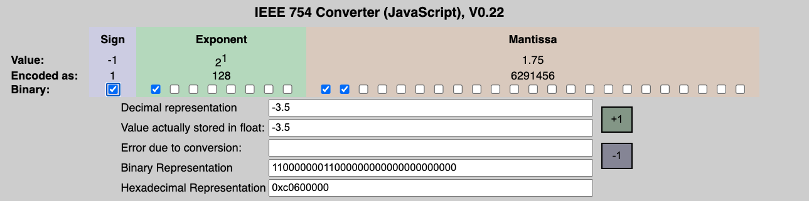
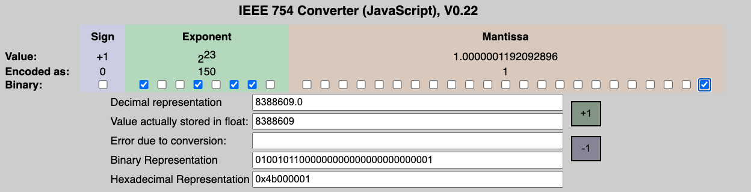
For you: IEEE-754 Floating Point Converter
[for next time]
https://www.h-schmidt.net/FloatConverter/IEEE754.html

Slide 38
[for next time]
Other Floating Point Representations
Basics, Fixed Point
Floating Point
Special Numbers
Other Floating Point Representations
(Bonus) More Examples

Slide 39
Precision and Accuracy
Don’t confuse these two terms!
[for next time]
Precision is a count of the number of bits used to represent a value.
Accuracy is the difference between the actual value of a number and its computer representation.
High precision permits high accuracy but doesn’t guarantee it.
It is possible to have high precision but low accuracy.
  Example: float pi = 3.14;
  pi will be represented using all 23 bits of the significand (highly precise),
  but it is only an approximation (not accurate).

Slide 40
Double Precision Floating Point
binary64: Next Multiple of Word Size (64 bits)
Double Precision (vs. Single Precision)
  C variable declared as double
  Exponent bias now 1023.
  Represent numbers from ~2.0 x 10⁻³⁰⁸ to ~2.0 x 10³⁰⁸.
  The primary advantage is greater accuracy due to larger significand.
31
30
20
19
0
S
Exponent
Significand
1 bit
11 bits
20 bits
Significand (cont’d)
32 bits

Slide 41
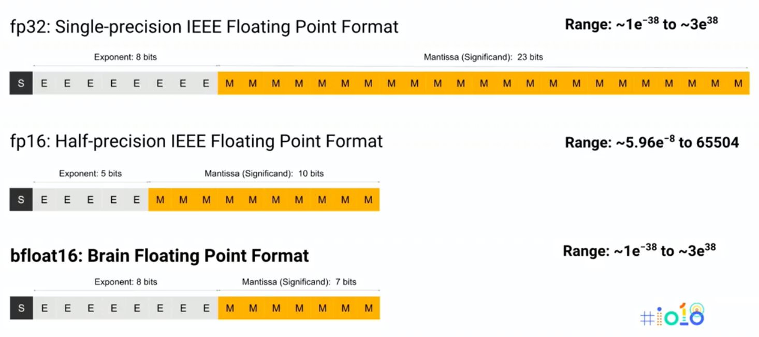
Other Floating Point Representations
[extra]
Quad-Precision? Yep! (128 bits) “binary128”
  Unbelievable range, precision (accuracy)
  15 exponent bits, 112 significand bits
Oct-Precision? Yep! “binary256”
  19 exponent bits, 236 significant bits
Half-Precision? Yep! “binary16” or “fp16”
  1/5/10 bits
Half-Precision? Yep! “bfloat16”
  Competing with fp16
  Same range as fp32!
  Used for faster ML
https://cloud.google.com/tpu/docs/bfloat16
https://en.wikipedia.org/wiki/Floating-point_arithmetic

Slide 42
Floating Point Soup
31
30
23
22
0
FP32
S
Exponent
Significand
1 bit
8 bits
23 bits
15
14
10
9
0
FP16
S
Exponent
Significand
1 bit
5 bits
10 bits
15
14
7
6
0
BFLOAT16
S
Exponent
Significand
1 bit
8 bits
7 bits
18
17
10
9
0
TF32
S
Exponent
Significand
1 bit
8 bits
10 bits

Slide 43
Who Uses What in Domain Accelerators?
Accelerator | int4 | int8 | int16 | fp16 | bf16 | fp32 | tf32
Google TPU v1 |  | x
Google TPU v2 |  |  |  |  | x
Google TPU v3 |  |  |  |  | x
Nvidia Volta TensorCore | x | x |  | x
Nvidia Ampere TensorCore | x | x | x | x | x | x | x
Nvidia DLA |  | x | x | x
Intel AMX |  | x |  |  | x
Amazon AWS Inferentia |  | x |  | x | x
Qualcomm Hexagon |  | x
Huawei Da Vinci |  | x |  | x
MediaTek APU 3.0 |  | x | x | x
Samsung NPU |  | x
Tesla NPU |  | x
Notes:
https://www.mathworks.com/company/newsletters/articles/what-is-int8-quantization-and-why-is-it-popular-for-deep-neural-networks.html

Slide 44
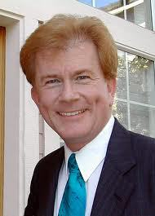
Unum
[extra]
Everything so far has had a fixed set of bits for Exponent and Significand.
  What if the field widths were variable?
  Also, add a “u-bit” to tell whether number is exact or in-between unums.
  “Promises to be to floating point what floating point is to fixed point.”
Claims to save power!
https://en.wikipedia.org/wiki/Unum_(number_format)
Dr. John Gustafson

Slide 45
Conclusion
www.h-schmidt.net/FloatConverter/IEEE754.html
Floating Point lets us…
  Represent numbers with both integer and fractional parts making efficient use of available bits.
  Store approximate values for very large and very small #s.
IEEE 754 Floating Point Standard is the most widely accepted attempt to standardize interpretation of such numbers.
  Every computer since ~1997 follows these conventions!
Summary (single precision, or fp32):
31 | 30 |  | 23 | 22 |  |  |  |  | 0
s | exponent |  |  | significand
1 bit | 8 bits |  |  | 23 bits
Can store NaN, ± ∞
(-1)^{S} x (1 + significand) x 2^{(exponent-127)}
☑
Exponent tells Significand how much (2^{i}) to count by (…, 1/4, 1/2, 1, 2, …)

Slide 46
(Bonus) More Examples
Basics, Fixed Point
Floating Point
Special Numbers
Other Floating Point Representations
(Bonus) More Examples

Slide 47
Ex 1: Convert Binary Floating Point to Decimal
31 | 30 |  | 23 | 22 |  |  |  |  | 0
0 | 0110 1000 |  |  | 101 0101 0100 0011 0100 0010
s | exponent |  |  | significand
0 → positive
1 + 1x2⁻¹+ 0x2⁻² + 1x2⁻³ + 0x2⁻⁴ + 1x2⁻⁵ + …
= 1+2⁻¹+2⁻³ +2⁻⁵ +2⁻⁷ +2⁻⁹ +2⁻¹⁴ +2⁻¹⁵ +2⁻¹⁷ +2⁻²²
= 1.0 + 0.666115
0110 1000_{two} = 104_{ten}
Bias adjustment:
104 - 127 = -23
1.666115_{ten}*2⁻²³ ≈ 1.986*10⁻⁷
(about 2/10,000,000)

Slide 48
Ex 2: Convert Decimal to Binary Floating Point
-2.340625 x 10¹
Denormalize. -23.40625
Convert integer part.
  23 = 16 + ( 7 = 4 + ( 3 = 2 + ( 1 ) ) ) = 10111₂
Convert fraction part.
  .40625 = .25 + ( .15625 = .125 + ( .03125 ) )
  = .01101₂
Put parts together + normalize.
  10111.01101 = 1.011101101 x 2⁴
Convert exponent. 127 + 4 = 10000011₂
0 | 1000 0011 | 011 1011 0100 0000 0000 0000

Slide 49
Ex 3: Represent 1/3
1/3
  = 0.33333…₁₀
  = 0.25 + 0.0625 + 0.015625 + 0.00390625 + …
  = 1/4 + 1/16 + 1/64 + 1/256 + …
  = 2⁻² + 2⁻⁴ + 2⁻⁶ + 2⁻⁸ + …
  = 0.0101010101… ₂ * 2⁰
  = 1.0101010101… ₂ * 2⁻²
  Sign: 0
  Exponent = -2 + 127 = 125 = 01111101
  Significand = 0101010101…
0 | 0111 1101 | 010 1010 1010 1010 1010 1010

Slide 50
Understanding the Significand (1/2)
Method 1 (Fractions):
  In decimal: 0.340₁₀ ⇒ 340₁₀/1000₁₀ ⇒ 34₁₀/100₁₀
  In binary: 0.110₂ ⇒ 110₂/1000₂ = 6₁₀/8₁₀ ⇒ 11₂/100₂ = 3₁₀/4₁₀
  Advantage: less purely numerical, more thought oriented; this method usually helps people understand the meaning of the significand better

Slide 51
Understanding the Significand (2/2)
Method 2 (Place Values):
  Convert from scientific notation
  In decimal:
  1.6732 = (1x10⁰) + (6x10⁻¹) + (7x10⁻²) + (3x10⁻³) + (2x10⁻⁴)
  In binary:
  1.1001 = (1x2⁰) + (1x2⁻¹) + (0x2⁻²) + (0x2⁻³) + (1x2⁻⁴)
  Interpretation of value in each position extends beyond the decimal/binary point
  Advantage: good for quickly calculating significand value; use this method for translating FP numbers
☑

Slide 52

Fractional Powers of 2
Mark Lu’s “Binary Float Displayer”
i 2^{-i}
0 1.0 1
0.5 1/2
0.25 1/4
0.125 1/8
0.0625 1/16
0.03125 1/32
0.015625
0.0078125
0.00390625
0.001953125
0.0009765625
0.00048828125
0.000244140625
0.0001220703125
0.00006103515625
0.000030517578125

