Slide 1
CS 70 Su23: Lecture 0
Introduction and course overview

Slide 2
Welcome to CS 70!
This is a discrete math and probability class
  for clarity, it’s (discrete math) and (probability)
Discrete math
  There will be a lot of proofs
Probability
  There will be a lot of sets and counting
  There will also be calculus (it’s ok if you’ve forgotten it)
“Math without numbers”

Slide 3
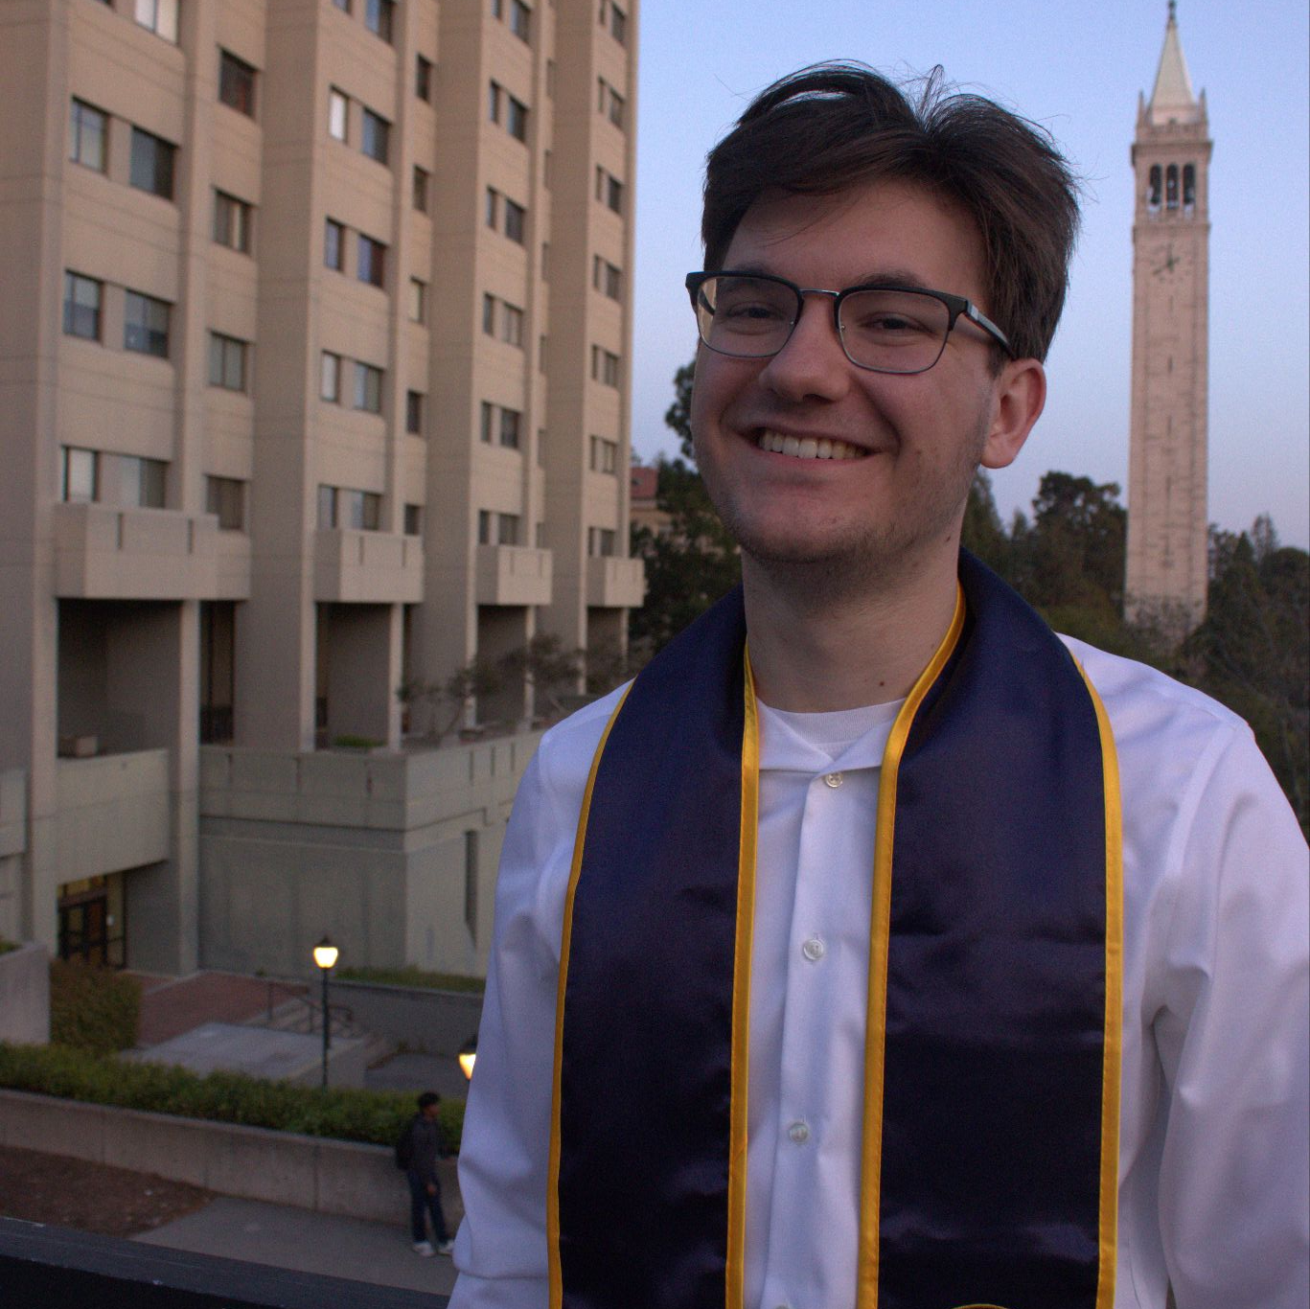
Who are we?
Nate (he/him)
Just finished BA in Math, CS, Physics
(Incoming) Grad student in Pure Math
  Not here :’(, in UK
TAed CS 70 for five semesters (including one summer; also took in summer)

Slide 4
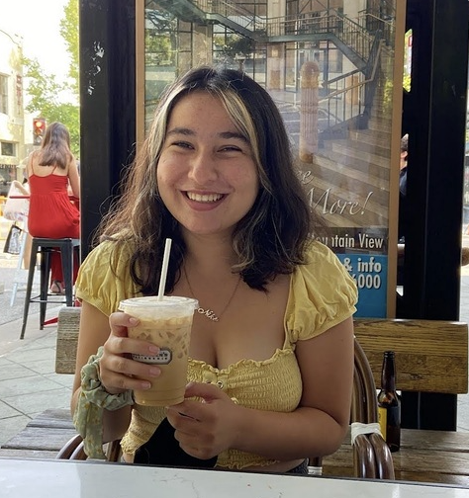
Who are we?
Nikki (she/her)
Studying CS/DS/Math :))
CS70 Head TA for 2 semesters, Data140 (Probability for Data Science) for 1 semester
Teaching probability section of the class!

Slide 5

Who are we?
Victor (he/him)
Grad student
  BS in EECS in 2012
Working full-time as an Engineering Manager at Everlaw
TAed CS 70 for three summers
Tenth(!) summer teaching CS 375!

Slide 6
Course expectations
We assume you have taken 61A (or equivalent)
  There’s no coding in this class, but we will reference programming (python) a fair amount
This is a 4-unit course
  Campus guidelines says 3 hours a week per unit
  but in the summer, everything is doubled because we have 8 weeks instead of 15
You should expect to spend 24 hours a week on CS 70
  We do not recommend taking any other technical courses over the summer
  6 hours will be spent in lecture, and 4 hours will be spent in discussion
  You should plan to spend 3 hours a day (weekdays only) on the problem sets
If you have other commitments that require more than 16 hours a week, please talk to us!

Slide 7
Course expectations
This course is intended to be taken synchronously, in-person
If you have a choice, we highly recommend doing things in-person
For those who must be remote, we will do our best
  but the experience will be worse
Remote exams will be proctored, and you will need to submit a recording of you taking the exam
Remote discussion and office hours will have limited coverage
Some discussions happen before lecture
You are expected to read the notes beforehand

Slide 8
Elephant in the room: grades
Discussion Attendance: 5%
  need to attend 13 throughout the summer
  sign up for a discussion section if you haven’t already!
Vitamins: 5%
  lowest two vitamins dropped
Homework: 20%
  lowest two homeworks dropped
Quizzes: 30% (instead of a midterm)
  lowest quiz dropped
Final: 40%

Slide 9
Assignments
Homework
  Released Monday, due Thursday at 11:59pm
  Grace period until Friday
Vitamins
  Released Monday, due Thursday at 11:59pm
  Grace period until Friday
Quizzes
  Every other week (week 2, week 4, week 6)
Final
  Last week

Slide 10
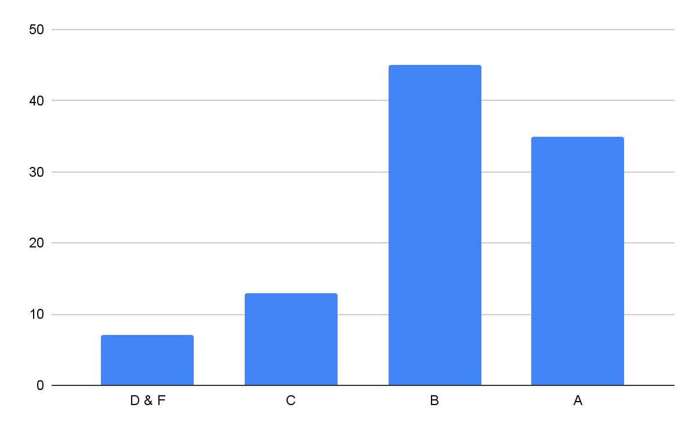
Grading
This class is not curved
  …is what we’d like to say
“A typical GPA for a lower division course will fall in the range 2.8 - 3.3, depending on the course and the students who enroll.
For example, a GPA of 3.0 would result from:
35% A's
45% B's
13% C's
7% D's and F's”

Slide 11
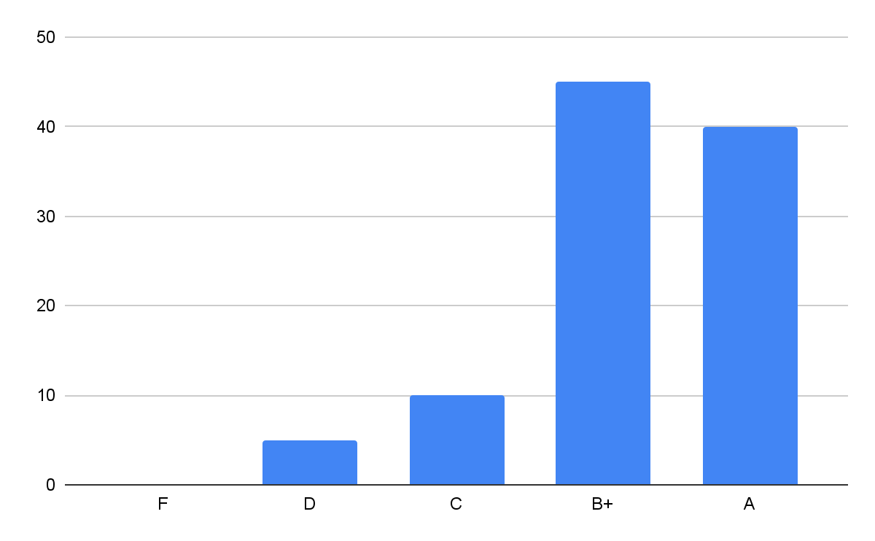
Grading
This class is not curved
  …is what we’d like to say
“A typical GPA for a lower division course will fall in the range 2.8 - 3.3, depending on the course and the students who enroll.
… but what about a GPA of 3.3?
40% A's
45% B+'s
10% C's
5% D's and F's”

Slide 12
Grading
This class is not curved
  …is what we’d like to say
But we’re also not doing a traditional curve
  instead of fitting your scores, we fit our exams to the curve
So concretely, what does this mean?
  exams have been written with an expected average (mean) of 50%
  this allows for better differentiation
  if the mean is too high, there’s no need to curve down
  getting 50% on an exam is not a failing grade!
tldr: if your total score is around 50%, you’re getting some flavor of B
please see clarification on this

Slide 13
Code of conduct
On everything except for exams, you are allowed infinite collaboration
  cite your sources: denote who you worked with, and what resources you consulted outside of the lecture notes
  no collaboration on quizzes or the final
You must always write up your own solutions
If you break the rules:
  1st offense: 0 on the assignment or exam
  2nd offense: 0 on the category (homework, quiz, final, etc)

Slide 14
Why CS 70?
Programs are just math
  This class hopes to provide the foundation upon which CS is built
  But we don’t teach this class first in the same way you want to learn the present before you learn the past (and future)
Thinking rigorously and reasoning logically is a good way to live life
  Hopefully, after this class, you will more tools to convince yourself if something is true

Slide 15
Some tips
MAKE FRIENDS
  Proofs is all about convincing others
  Be the “dumb” person in the room
  We will help here as much as we can
This class takes time (sometimes, a lot of time)
  Repetition and practice is the only way to learn the material
  Read the notes in addition to lecture slides
Reading math requires multiple tries
  If you read a paragraph and it doesn’t make sense, read it again!
  Just like code, break things down line by line, sentence by sentence, to follow it
  Abstract as necessary

Slide 16
Some terminology
“Formally"
  Framing something in precise mathematical terms
  Think of this as using “proofy” syntax, much like any programming language’s syntax
“Intuitively”
  A fancy way of saying “not mathy”
  Think of this as “opposite of formally” (or a way to get partial credit if you’re stuck)
Divides (“|”)
  formally, if a | b, there exists some q such that aq = b (and vice versa)
Parity (even/odd)
  if n is even, there exists some k such that n = 2k (and vice versa)
  if n is odd, there exists some k such that n = 2k + 1 (and vice versa)
  a number cannot be both even and odd

