Slide 1
CS 70 Su23: Lecture 1
Propositional logic

Slide 2
Propositions
A proposition is a statement that is either true or false
Examples of propositions
  2 + 2 = 4
  2 + 2 = 5
  Victor took BART to get to class
Examples that are not propositions
  2 + 2
  x + 2 = 5
  This statement is false
  Victor is the best thing that has ever happened to CS 70

Slide 3
P, Q, R, and friends
We bind propositions to variables to make them easier to work with
Some common operations on propositions:
  Conjunction: P ∧ Q
    “P and Q”
    True only when both P and Q are true
  Disjunction: P ∨ Q
    “P or Q”
    True when at least one of P and Q is true
  Negation: ¬P
    “not P”
    True when P is false
  These are called propositional forms (the result is itself a proposition)
If this sounds similar to booleans, that’s no coincidence
  They’re not exactly the same, but we won’t go into details in this class

Slide 4
Truth tables
Enumeration of all possible values for propositions
P | Q | P ∧ Q | P ∨ Q | ¬P | ¬P ∧ ¬Q | ¬P ∨ Q
T | T | T | T | F | F | T
T | F | F | T | F | F | F
F | T | F | T | T | F | T
F | F | F | F | T | T | T

Slide 5
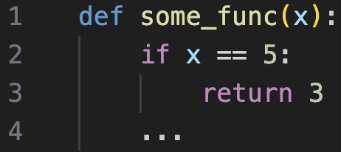
A quick detour
Consider the following code snippet:
Now consider the following input/output:
>>> some_func(5)
3
>>> some_func(5)
12
>>> some_func(1)
3
>>> some_func(1)
14
Take note of the ellipses! More can happen afterwards
Which of these would convince us there was an error executing this code?

Slide 6
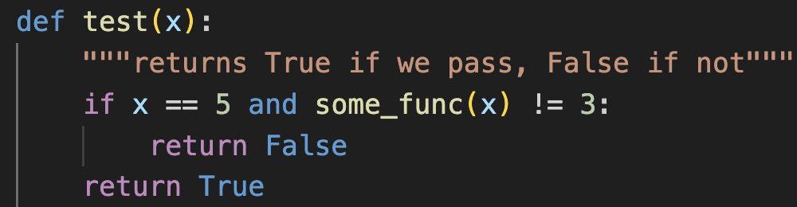
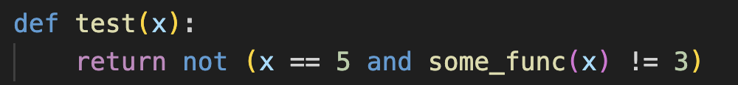
A quick detour
Let’s write this test up:
Simplifying:

Slide 7
A quick detour
Now let’s draw out the truth table for this:
Let P = x == 5
Q = some_func(x) == 3
R = test(x)
P | Q | R
T | T | T
T | F | F
F | T | T
F | F | T
¬P ∨ Q
T
F
T
T

Slide 8
Implication
This logical construction is so useful that it has its own name (and notation):
Implication: P ⇒ Q (read as “P implies Q” or “if P, then Q”)
  P ⇒ Q itself is either true or false, meaning that it is also a proposition!
Some terminology:
P is the antecedent (or hypothesis/premise)
Q is the consequent (or conclusion/outcome)
Two propositional forms are logically equivalent if their truth tables are identical (for example, P ⇒ Q ≡ ¬P ∨ Q)

Slide 9
Implication
Some example implications:
If you stand in the rain, you will get wet
If your total score is around 50%, you will receive some flavor of B
If pigs can fly, cats can talk
  implications for which P is always false are called “vacuously true”
If you ask Victor if he likes boba, he will say yes
Implication is the basis for much of mathematics

Slide 10
Implication
We can define some other terms from an implication:
The converse of P ⇒ Q is Q ⇒ P
The contrapositive of P ⇒ Q is ¬Q ⇒ ¬P
  sanity check: implication and contrapositive are logically equivalent
If an implication and its converse are both true, we write this as P ⇔ Q
read as “P if and only if Q” (iff)
Question: (P ⇒ Q) ⇒ (Q ⇒ P)?
This is true iff P ⇔ Q (does your head hurt yet?)

Slide 11
Quantifiers
Let’s revisit our “not a proposition” from earlier: x + 2 = 5
How do we turn this into a proposition?
  Let P(x) = “x + 2 = 5” (this is still not a proposition)
  We need to quantify it over some “universe”
Some examples:
  P(3): For x = 3, x + 2 = 5
  P(1): For x = 1, x + 2 = 5
  P(1) ∨ P(3): For x = 1 or x = 3, x + 2 = 5
  For all integers x, x + 2 = 5 (universal quantifier)
  There exists an integer x such that x + 2 = 5 (existential quantifier)

Slide 12
Quantifiers
Translating from english to math
For every integer x, x + 2 = 5
  ∀ x ∈ ℤ, x + 2 = 5
There exists some integer x such that x + 2 = 5
  ∃ x ∈ ℤ, x + 2 = 5
For any integer x, there is some larger integer y
  ∀ x ∈ ℤ, ∃ y ∈ ℤ st y > x
  (∀x ∈ ℤ)( ∃y ∈ ℤ)(y > x)
There is a largest integer
  ∃ y ∈ ℤ st ∀ x ∈ ℤ, y > x
  (∃y ∈ ℤ) (∀x ∈ ℤ)(y > x)

Slide 13
DeMorgan’s Laws
Naming something after yourself is the old way of commenting “first!”
¬(P∧Q) ≡ ¬P ∨ ¬Q
¬(P∨Q) ≡ ¬P ∧ ¬Q
A similar property holds for quantifiers:
¬(∀xP(x)) ≡ ∃x¬P(x)
¬(∃xP(x)) ≡ ∀x¬P(x)
Example from earlier: not (x == 5 and some_func(x) != 3)
¬(x == 5 ∧ some_func(x) != 3) ≡ x != 5 ∨ some_func(x) == 3
Or, with P and Q, ¬(P ∧ ¬Q) ≡ ¬P ∨ Q

Slide 14
Next class: proofs
Let’s put all of this together so we can start proving things are true or false!

