Slide 1
CS 70 Su23: Lecture 3
Induction

Slide 2
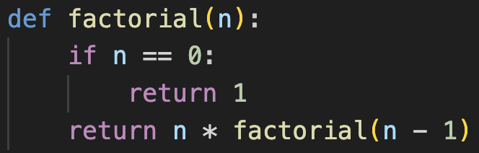
A quick detour
Consider the following recursive function:
What is going on here?
base case
setting up recursive call
“leap of faith”

Slide 3
A quick detour
How do we know this function is correct?
That is, we want to prove: ∀ n ∈ ℕ, factorial(n) = n!
Let’s try a direct proof:
Without loss of generality, let n ∈ ℕ (arbitrary natural number).
Consider factorial(n).
We know factorial(0) = 1.
factorial(1) = 1 * factorial(0) = 1!.
factorial(2) = 2 * factorial(1) = 2 * 1! = 2!.
…
factorial(n) = n * factorial(n - 1) = n * (n - 1)! = n!.
This is not rigorous!
(what if this breaks somewhere along the path?)

Slide 4
A quick detour
We made an implicit assumption in this “proof”:
factorial(n - 1) = (n - 1)!
which allowed us to show:
[ factorial(n - 1) = (n - 1)! ] ⇒ [ factorial(n) = n! ]
(or, with P(n) = factorial(n) = n!, P(n - 1) ⇒ P(n).
How do we know P(n - 1)?
“trust the recursion”

Slide 5
Induction
We need the mathematical equivalent of recursion:
P(0) ∧ [P(n) ⇒ P(n + 1)] ≡ ∀ n ∈ ℕ, P(n)
In other words, if you give me:
a base case
how to do the previous thing
I can show you how to do the next thing

Slide 6
Induction
Structured as follows:
  Want to show ∀ n ∈ ℕ, P(n)
  Base case: P(0)
  Inductive hypothesis: suppose P(k) for some k > 0
  Inductive step: consider P(k + 1)
  ???
  P(k) ⇒ P(k + 1)
  Profit Therefore, ∀ n ∈ ℕ, P(n)
  Q.E.D.

Slide 7
Induction
Structured as follows:
  Want to show ∀ n ∈ ℕ, P(n)
  Base case: P(0)
  Inductive hypothesis: suppose P(k) for some k > 0
  Inductive step: consider P(k + 1)
  ???
  P(k) ⇒ P(k + 1)
  Profit Therefore, ∀ n ∈ ℕ, P(n)
  Q.E.D.
base case
“leap of faith”
setting up recursive call

Slide 8
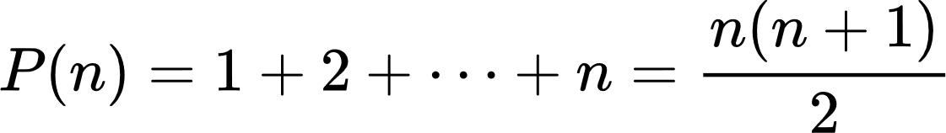
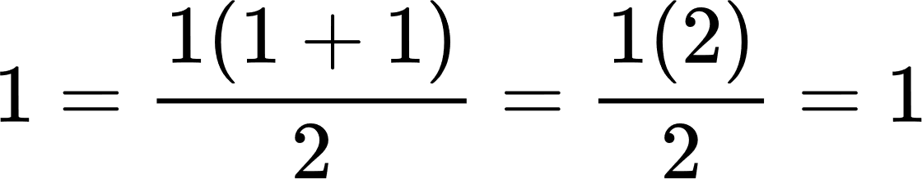
Example 1
Inductive hypothesis: suppose for some n > 1, P(n).
✓
Theorem:
Proof: induction on n. Let
Base case: n = 1.

Slide 9
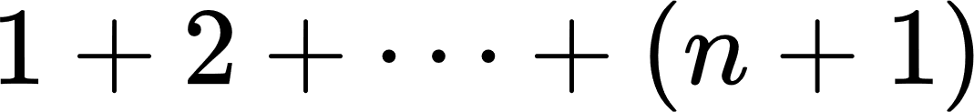
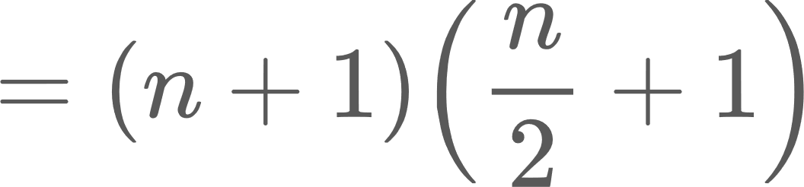
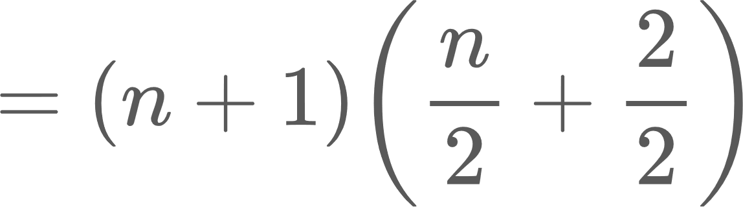
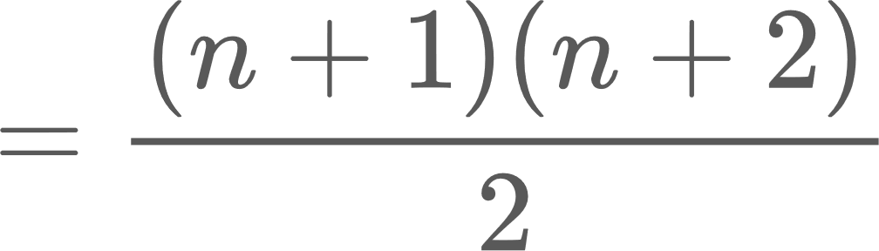
Example 1
Inductive step: consider
[inductive hypothesis]
Therefore, P(n) ⇒ P(n + 1), and we have proven our claim. QED

Slide 10
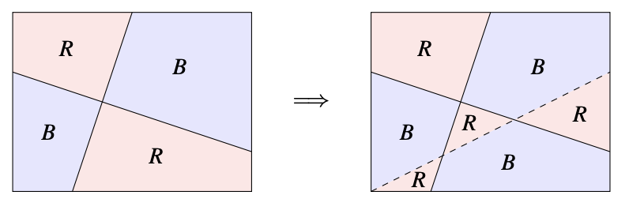
Example 2
Two-color theorem (refer to notes for more details)

Slide 11
Example 3
Consider a party with some number of guests. Someone is a celebrity if every other guest knows them, but they know nobody else. Prove that if the following conditions are met:
For any pair of guests A and B, either A knows B, or B knows A, but not both
There do not exist guests A, B, and C such that A knows B, B knows C, and C knows A
that the party must have a celebrity.

Slide 12
Example 3
Claim: for a party where the conditions hold, there must be a celebrity.
Proof: induction on n, the number of guests.
Base case: n = 1.
Trivially, we have found a celebrity. ✓
Inductive hypothesis: suppose for some n > 1, if the conditions hold, there must be a celebrity.

Slide 13
Example 3
Inductive step: consider a party of n + 1 people where the conditions hold.
Arbitrarily pick one person p to “hold out”.
From the remaining n people, from our inductive hypothesis, we know there must be a celebrity C.
If p knows C, we are done, since C knows no one else, and everyone else knows them.
Lemma: If p does not know C, p must be a celebrity.

Slide 14
Example 3
Lemma: if p does not know C, p must be a celebrity.
Proof by contradiction. Assume p is not a celebrity.
This means p must know someone else at the party, call them A.
From before, we know that A knows C.
However, C knows p, which violates the second condition of our party. →←
Therefore, p must be a celebrity.

Slide 15
Example 3
Inductive step: consider a party of n + 1 people where the conditions hold.
Arbitrarily pick one person p to “hold out”.
From the remaining n people, from our inductive hypothesis, we know there must be a celebrity C.
If p knows C, we are done, since C knows no one else, and everyone else knows them.
If p does not know C, p must be the celebrity.
Therefore, by induction on n, we have proven our claim. QED

Slide 16
Proving something stronger
Claim: the sum of the first n odd numbers is a perfect square.
Proof by induction on n.
Base case: n = 1.
The first odd number is 1, which is a perfect square. ✓
Inductive hypothesis: for some n > 1, the sum of the first n odd numbers is a perfect square.
Inductive step: consider the n + 1st odd number = 2n + 1.
From our inductive hypothesis, we know the sum of the first n + 1 odd numbers is m² + 2n + 1, for some m ∈ ℕ.

Slide 17
Proving something stronger
Claim: the sum of the first n odd numbers is n².
* same base case *
Inductive hypothesis: for some n > 1, the sum of the first n odd numbers is n².
Inductive step: consider the n + 1st odd number = 2n + 1.
From our inductive hypothesis, we know the sum of the first n + 1 odd numbers is n² + 2n + 1
= (n + 1)². ✓
Therefore, by induction on n, we have proven our claim. QED

Slide 18
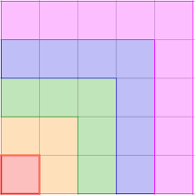
What just happened?
We made the problem “harder” by making a stronger claim, but made the proof easier
Specifically, we exploited a guess about the underlying structure
This made our inductive hypothesis yield more information
(Aside) a visual representation of sum of odd numbers:

Slide 19
Strong induction
Structured as follows:
  Want to show ∀ n ∈ ℕ, P(n)
  Base case: P(0)
  Inductive hypothesis: suppose P(1) ∧ P(2) ∧ … ∧ P(k) for some k > 0
    this is different from P(k) for all k > 0! (this assumes what we’re trying to prove)
  Inductive step: consider P(k + 1)
  ???
  P(k) ⇒ P(k + 1)
  Profit Therefore, ∀ n ∈ ℕ, P(n)
  Q.E.D.
So why ever use simple induction?
they’re actually the same!

Slide 20
Proof?
Claim: all horses are the same color.
Proof by induction on n = the number of horses.
Base case: n = 1.
If there’s only one horse, all horses are the same color. ✓
Inductive hypothesis: for some n > 1, all n horses are the same color.

Slide 21
Proof?
Inductive step: consider n + 1 horses.
Consider the first n horses. Our IH states they are all the same color.
Now consider the last n horses. Our IH states they are all the same color.
Because the middle horses are in both sets of horses, both the first n and last n horses must be the same color.
Therefore, all horses are the same color! QED

Slide 22
Help I broke something
“Middle horses”
  What about n = 2?
  This set is empty!
You may need multiple base cases in order for your proof to hold

Slide 23
Well-ordering principle
For any non-empty subset of ℕ, there will be a least element.
Earlier claim: ∀ n ∈ ℕ, 1 + 2 + … + n = n(n + 1) / 2.
Let S be the set of numbers for which this equation does not hold. Claim: S is the empty set.
Proof by contradiction: assume S is non-empty.

Slide 24
Well-ordering principle
By WOP, there is some smallest number c in this set.
By inspection, this equation holds for 0.
This means c > 0, and the equation must hold for c - 1.
1 + 2 + … + c - 1 = (c - 1) * c / 2
1 + 2 + … + c - 1 + c = (c - 1) * c / 2 + c (add c to both sides)
= c[(c - 1)/2 + 1]
= c(c + 1) / 2
However, the equation does not hold for c. →←
Therefore, S must be empty, and our claim is proven. QED
this looks kind of like induction…

Slide 25
Next class: stable matching
Putting everything together

