Slide 1
CS 70 Su23: Lecture 16
Conditional probability

Slide 2
Conditional probability
How do we “add knowledge” to our calculations?
Some examples. What’s the probability of:
  finding someone who is taking CS 70?
    in Dwinelle?
  finding your keys in your room?
    if you know they’re in your closet?
  getting the card you want?
    if a bunch of cards have already been drawn?
Given some information, how does that affect the probability of an event?

Slide 3
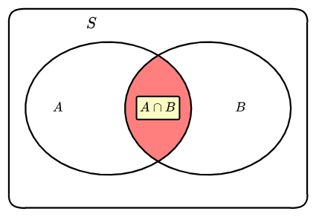
It’s like probability, but… conditional
Ω = our universe
A, B = events
Ω
Pr[A] = | |A|
 | |Ω|
Pr[B] = | |B|
 | |Ω|
Pr[A∩B] = | |A∩B|
 | |Ω|
What is the probability of A if we know B is going to happen?

Slide 4
It’s like probability, but… conditional
Notation:
Pr[A|B]. “The probability of A given B”
Ω
Pr[A|B] = | |A∩B|
 | |B|
Pr[A|B] = | Pr[A∩B]
 | Pr[B]

Slide 5
Conditional probability
[link to visualization]

Slide 6
Bayes’s Theorem
It’s just rearranging the conditional probability formula:
Pr[A|B] = | Pr[A∩B]
 | Pr[B]
Pr[B|A] = | Pr[A∩B]
 | Pr[A]
Pr[A∩B] = Pr[A|B] x Pr[B] = Pr[B|A] x Pr[A]
Pr[A|B] = | Pr[B|A] x Pr[A]
 | Pr[B]
If you know Pr[B|A], Pr[A], and Pr[B], you can compute Pr[A|B]
this may not be immediately obvious!
lets us do some interesting things

Slide 7
Inference
Structured as follows:
  We have a prior distribution Pr[A]
  We have a likelihood estimation Pr[B|A]
  We observe some event in B
  Use Bayes’s Theorem to update our posterior distribution Pr[A|B]
Bayes theorem and Bayes rule are the same thing (also note sometimes the apostrophe gets omitted for no real good reason)
Pr[A|B] = | Pr[B|A] x Pr[A]
 | Pr[B]

Slide 8
Example 1: Counterfeits
We want to detect counterfeit bills.
We have a test to see if a bill is fake (result is “fake” or “not fake”):
  When used on a fake bill, 90% of the time, it says “fake”
    10% of the time, it says “not fake”
  When used on a real bill, 80% of the time, it says “not fake”
    20% of the time, it says “fake”
We know 5% of the bills out there are fake
If we test a random bill and our test says “fake”, what is the probability the bill is fake?

Slide 9
Example 1: Counterfeits
Let’s define some events:
A = a bill is fake
  Ā = a bill is real (this is the complement of A)
B = the test results in “fake”
We are trying to find Pr[A|B].
What we know:
Pr[A] = 0.05
Pr[B|A] = 0.9
Pr[B|Ā] = 0.2

Slide 10
Example 1: Counterfeits
Time for Bayes’s rule!
Pr[A|B] = | Pr[B|A] x Pr[A]
 | Pr[B]
… but what is Pr[B]?

Slide 11
Example 1: Counterfeits
Observation:
Pr[B] = Pr[A∩B] + Pr[Ā∩B]
  Ā is the same as Ω\A
Can we take advantage of this?
More Bayes rule:
Pr[A∩B] = Pr[B|A] x Pr[A]
Pr[Ā∩B] = Pr[B|Ā] x Pr[Ā]
Ω

Slide 12
Example 1: Counterfeits
Time for Bayes’s rule!
Pr[A|B] = | Pr[B|A] x Pr[A]
 | Pr[B]
= | Pr[B|A] x Pr[A] | = | 0.9 x 0.05
 | Pr[B|A] x Pr[A] + Pr[B|Ā] x Pr[Ā] |  | 0.9 x 0.05 + 0.2 x 0.95
≈ 0.19
If a random bill tests as fake, there’s less than a 1 in 5 chance it’s actually fake!

Slide 13
Example 2: Biased coins
Your friend has two indistinguishable coins. One comes up heads 80% of the time, while the other comes up heads 30% of the time.
You pick a coin at random and flip it, and it comes up heads. Which coin did you (probably) pick?

Slide 14
Example 2: Biased coins
Let’s define some events:
A = you picked the 80% coin
  Ā = you picked the 30% coin (this is the complement of A)
B = the coin you flipped came up heads
We are trying to find Pr[A|B].
What we know:
Pr[A] = 0.5
Pr[B|A] = 0.8
Pr[B|Ā] = 0.3

Slide 15
Example 2: Biased coins
Time for Bayes’s rule!
Pr[A|B] = | Pr[B|A] x Pr[A]
 | Pr[B]
… but what is Pr[B]?

Slide 16
Example 2: Biased coins
Time for Bayes’s rule!
Pr[A|B] = | Pr[B|A] x Pr[A]
 | Pr[B]
= | Pr[B|A] x Pr[A] | = | 0.8 x 0.5
 | Pr[B|A] x Pr[A] + Pr[B|Ā] x Pr[Ā] |  | 0.8 x 0.5 + 0.3 x 0.5
= | 8
 | 11
Roughly a 73% chance you picked the 80% coin, 27% chance you picked the 30% coin

Slide 17
Aside: meta point
Manipulating the equations is not the hard part, setting up the events is!
When you see complicated word problems, always define your events carefully, and define their probabilities.

Slide 18
Total Probability Rule
Pr[B] = Pr[A∩B] + Pr[Ā∩B]
= Pr[B|A] x Pr[A] + Pr[B|Ā] x Pr[Ā]
Let’s generalize this!
Let A₁, A₂, … , A_{n} partition the sample space Ω:
A₁∪ A₂ ∪ … ∪ A_{n} = Ω
∀ i ≠ j, A_{i} ∩ A_{j} = ∅ (they are mutually exclusive; the sets are disjoint)
Pr[B] = ∑_{i} Pr[B|A_{i}] x Pr[A_{i}]

Slide 19
Inference
Structured as follows:
  We have a prior distribution Pr[A]
  We have a likelihood estimation Pr[B|A]
  We observe some event in B
  Use Bayes’s Theorem and Total Probability Rule to compute
  our posterior distribution Pr[A|B]
Pr[A|B] = | Pr[B|A] x Pr[A]
 | ∑_{i} Pr[B|A_{i}] x Pr[A_{i}]

Slide 20
Example 3: Rock paper scissors
You are playing against one of three opponents. There is a 20% chance you’ll face the first one, a 50% you’ll face the second one, and a 30% chance you’ll face the third one. The first opponent throws Rock 60% of the time, the second throws Rock 40% of the time, and the third throws Rock 33% of the time.
In the first round, your opponent throws Rock. What’s the likelihood that you will win the next round if you throw Paper?

Slide 21
Example 3: Rock paper scissors
Defining events:
Prior distribution
  Likelihood of opponent
Likelihood estimation
  How likely each opponent is to throw Rock
Observation
  they threw Rock
Posterior distribution
  how likely it is we’re facing each opponent

Slide 22
Example 3: Rock paper scissors
Let’s define some events:
A_{i} = you’re against opponent i
B = your opponent threw Rock
We are trying to find Pr[A|B].
What we know:
Pr[A₁] = 0.2, Pr[A₂] = 0.5, Pr[A₃] = 0.3,
Pr[B|A₁] = 0.6
Pr[B|A₂] = 0.4
Pr[B|A₃] = 0.33

Slide 23
Example 3: Rock paper scissors
Time for Bayes’s rule!
Pr[A₁|B] = | Pr[B|A₁] x Pr[A₁]
 | Pr[B]
= | Pr[B|A₁] x Pr[A₁] | = | 0.6 x 0.2
 | ∑_{i} Pr[B|A_{i}] x Pr[A_{i}] |  | 0.6 x 0.2 + 0.4 x 0.5 + 0.33 x 0.3
= | 6
 | 21
Pr[A₂|B] = 10/21
Pr[A₃|B] = 5/21

Slide 24
Example 3: Rock paper scissors
What’s the likelihood that you’ll win the next round if you throw Paper?
C = your opponent throws Rock on round 2
We are trying to find Pr[C|B].
New “priors”:
Pr[A₁|B] = 6/21, Pr[A₂|B] = 10/21, Pr[A₃|B] = 5/21
Likelihood estimates remain the same (opponents don’t switch it up):
Pr[C|A₁, B] = 0.6
Pr[C|A₂, B] = 0.4
Pr[C|A₃, B] = 0.33

Slide 25
Example 3: Rock paper scissors
Pr[C|B] = | ∑_{i}Pr[C|A_{i}, B] x Pr[A_{i}|B]
= | 0.6 x 6/21 + 0.4 x 10/21 + 0.33 x 5/21
= | 6/35 + 4/21 + 5/63
= | 139/315
There is roughly a 44% chance you’ll win the second round by throwing Paper

Slide 26
Example 4: Nikki likes chess
You’re about to play chess against a randomly-chosen instructor. If Victor is chosen, your chances of winning are 90%. If Nate is chosen, your chances of winning are 50%. If Nikki is chosen, your chances of winning are 10%.
What is your overall likelihood of winning?
A = you win
B₁ = you face Victor, B₂ = you face Nate, B₃ = you face Nikki
Total probability:
Pr[A] = ∑_{i} Pr[A|B_{i}] x Pr[B_{i}] = ⅓ (0.9 + 0.5 + 0.1) = 0.5

Slide 27
Example 5: Biased coins again
You have two coins, one that flips heads 80% of the time, and one that flips heads 30% of the time. You randomly pick one of the coins and flip it, then you flip the other coin.
What is the probability that the first flip is heads?
Let A_{i} = the i^{th} flip is heads, B_{i} = you picked the i^{th} coin
Pr[A₁] = Pr[A₁|B₁] x Pr[B₁] + Pr[A₁|B₂] x Pr[B₂]
= 0.8 x 0.5 + 0.3 x 0.5
= 0.55

Slide 28
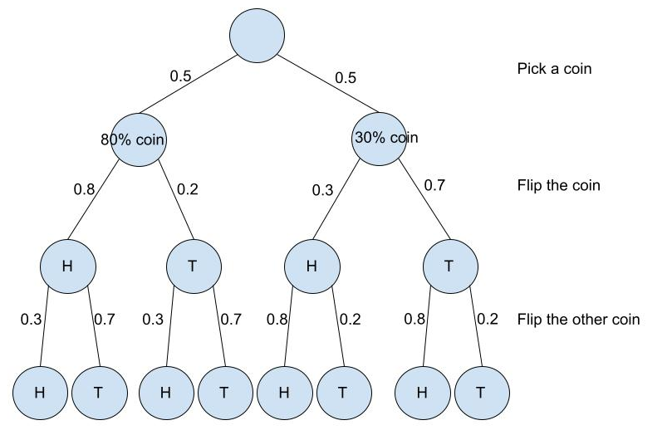
Example 5: Biased coins again
What is the probability that the second flip is heads?
Pr[A₂] = Pr[A₁∩A₂] + Pr[Ā₁∩A₂]
Pr[A₁∩A₂] = 0.5 x 0.8 x 0.3 + 0.5 x 0.3 x 0.8
= 0.24
Pr[Ā₁∩A₂] = 0.5 x 0.2 x 0.3 + 0.5 x 0.7 x 0.8
= 0.31
Pr[A₂] = 0.55

Slide 29
Example 5: Biased coins again
Pr[A₁] = Pr[A₂]. Why?
Knowing whether the first flip is heads affects our guess about the second flip.
That is, Pr[A₂|A₁] ≠ Pr[A₂].
But if we’re looking only at Pr[A₂], it’s unconditional. In other words, here, we don’t have knowledge of the previous flip.
In fact, it ends up being a symmetric argument for why the unconditional probabilities are equal.
Think about the question rephrased: “You flip both coins at the same time. What’s the probability that the second coin is heads?”
If you don’t get to observe the result of the first flip, the order in which you flip them doesn’t really matter!

Slide 30
Next class: more conditional probability
There’s a special name for when Pr[A₂|A₁] ≠ Pr[A₂]. We’ll talk about this in more depth (independence).
Nikki will be back!

