Slide 1
Lecture 4C:
Conditional Probability (II)
UC Berkeley CS70
Summer 2023
Nikki Suzani

Slide 2
Combinations of Events
As we’ve learned, we can look at intersections of events together, and find the probability.
On Monday, I said for a coin where P(heads) = ⅓:
P(HHHT) =
Why are we allowed to do this?

Slide 3
Independence
Two events are independent if P(A | B) = P(A)
That is, because A doesn’t depend on B, the probability that A happens given B happened is the same as the probability that A happens.

Slide 4
Expand Independence via Bayes’ Rule
P(A | B) = P(A)

Slide 5
Some Independence Practice
You have two weighted coins. Coin 1 has probability 0.6 of coming up heads, and Coin 2 has probability 0.7 of coming up heads. The two coins are independent.

Slide 6
Some Independence Practice
Are the events “your dice roll is even” and “your dice roll is odd” independent events?

Slide 7
Some Independence Practice
Are the events “your dice roll is 1” and “your dice roll is odd” independent events?

Slide 8
Some Independence Practice
Are the events “your dice roll is a 1 or 2”, and “your dice roll is odd” independent events?

Slide 9
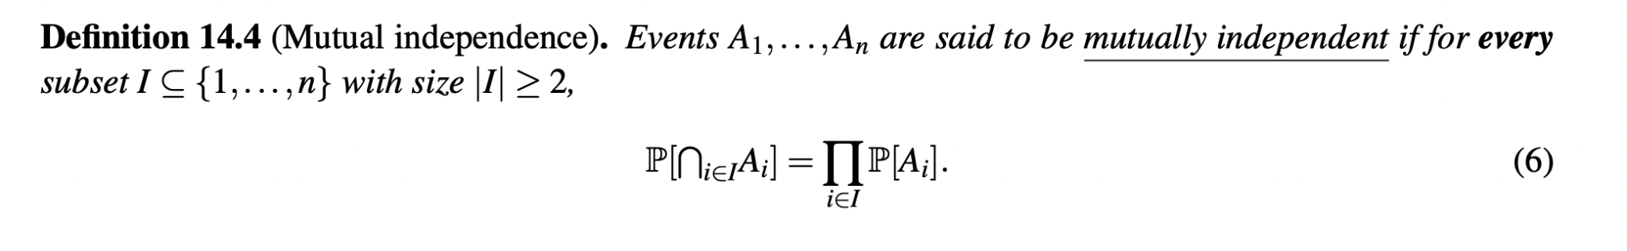
Mutual Independence
We can expand beyond just two events.
Back to coin tosses! How do we find P(HHHT) using the above definition?

Slide 10
Pairwise Independent but not Mutually Independent?
We flip a fair coin twice. Let A be the event that the first flip is H, B be the event that the second flip is H, and C be the event that both flips are the same.

Slide 11
Product Rule
What if they’re not independent? We can use Bayes’ Rule to get an equation for P(A ∩ B).

Slide 12
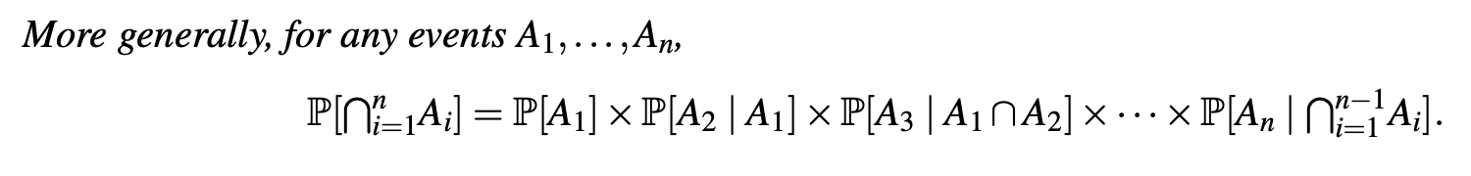
Product Rule (cont.)
Proof of the general product rule!

Slide 13
Product Rule (cont.)
Proof of the general product rule!

Slide 14
Probability of a Flush
Product Rule :)

Slide 15
Monty Hall Revisited (with Product Rule)
Let C_{i} be the event that the contestant chooses door i, let P_{i} be the event that the prize is behind door i, and let H_{i} be the event that the host chooses door i.

Slide 16
Monty Hall Revisited
Let C_{i} be the event that the contestant chooses door i, let P_{i} be the event that the prize is behind door i, and let H_{i} be the event that the host chooses door i.

Slide 17
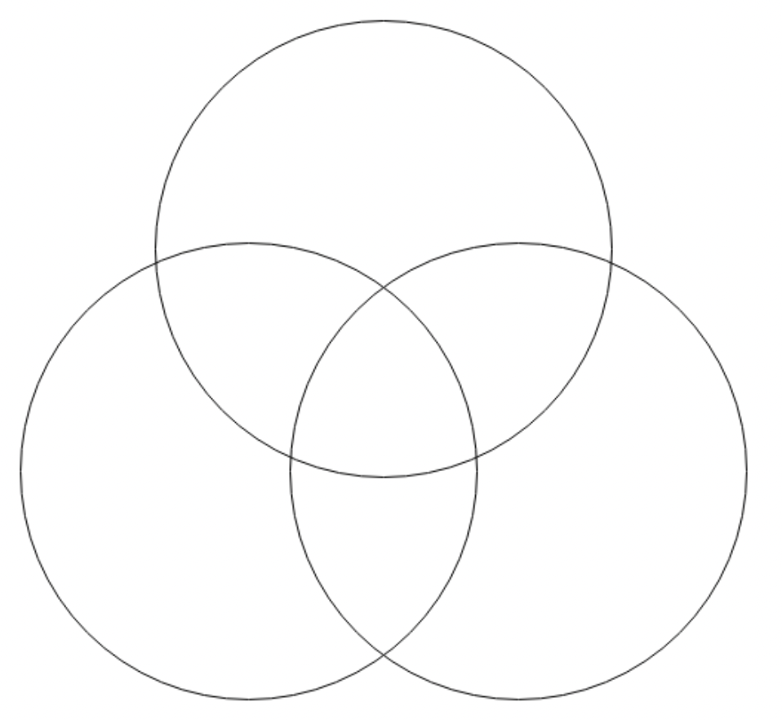
Unions of Events
Principle of Inclusion-Exclusion (but in probability!)
P(A U B) = P(A) + P(B) - P(A ∩ B)
What if you have three events?

Slide 18
Unions of Events
Three events?

Slide 19
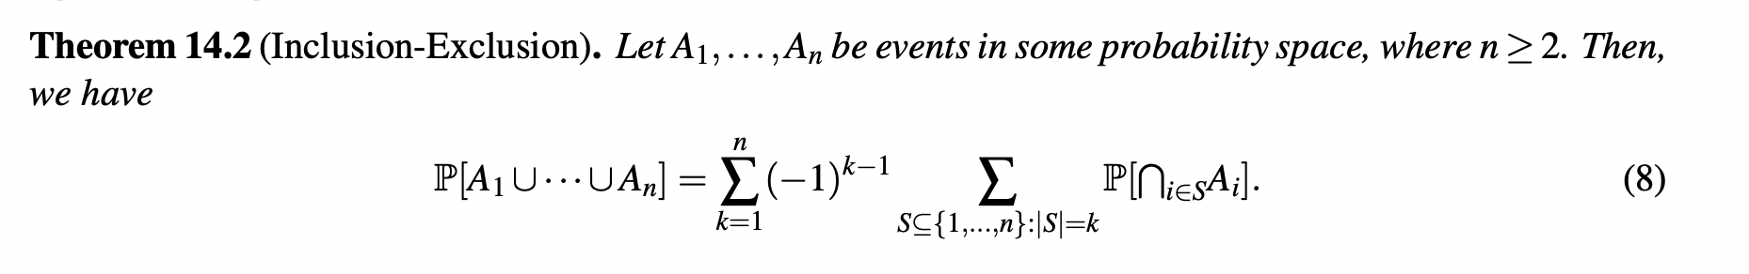
General Formula for Inclusion-Exclusion
A

Slide 20
PIE Matching Problem
The matching problem

Slide 21
PIE Matching Problem
P(matches at k locations):

Slide 22
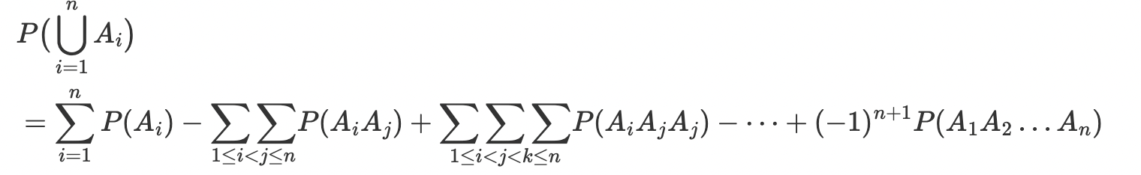
Probability of No Matches
P(no match) =

Slide 23
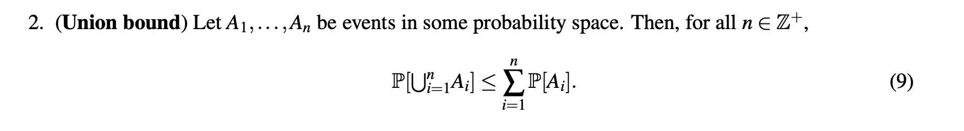
Union Bound
This is also known as Boole’s inequality! (Equal when mutually exclusive)

Slide 24
Proof of Union Bound
t

Slide 25
More bounds
We can also lower bound the chance of a union:

Slide 26
Bounding KPop Stans
We know 30% of the class likes Blackpink, 20% of the class likes New Jeans, and 10% of the class likes Twice. Let’s bound the probability that a randomly picked student likes at least one of the three KPop groups:
Lower bound:
Upper bound:

Slide 27
Bounding KPop Stans
We know 30% of the class likes Blackpink, 20% of the class likes New Jeans, and 10% of the class likes Twice. Let’s bound the probability that a randomly picked student likes at least one of the three KPop groups.
Lower bound:

Slide 28
Bounding KPop Stans
We know 30% of the class likes Blackpink, 20% of the class likes New Jeans, and 10% of the class likes Twice. Let’s bound the probability that a randomly picked student likes at least one of the three KPop groups.
Upper Bound:

Slide 29
Recap
We learned about independence and intersections of events
Concepts of mutual independence and the product rule
We also learned about bounding and unions
The principle of inclusion-exclusion (in probability)
How to upper and lower bound the value of a union

Slide 30
Notes
For Lecture 4D, for Note 15 & 19 we’re only going to be going over the definition of a random variable & different types of random variables. So feel free to ignore all the parts that talk about expectation until next week :)

