Slide 1
Lecture 5A:
Expectation I
UC Berkeley CS70
Summer 2023
Nikki Suzani

Slide 2
What is expectation?
The “expected” value of an experiment. When you look at a discrete distribution, you can think of it like the “balance point”.

Slide 3
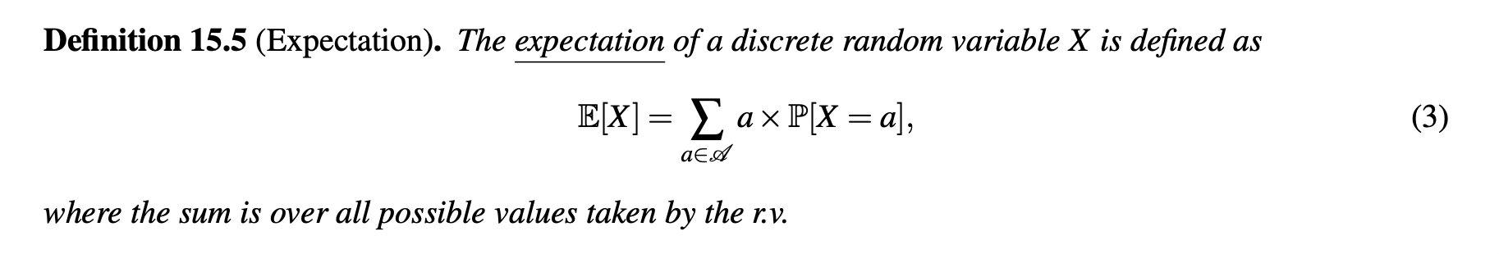
What is expectation? (formally)
.

Slide 4
Example: Dice Roll
Roll a fair six-sided dice and let X be the value that the dice rolled. What is E[X]?

Slide 5
Example: Two Dice Rolls
Roll a fair six-sided dice. Let X be the value of your first roll, and Y be the value of your second roll. What is E[X + Y]?

Slide 6
Example: Fixed Points of a Permutation
Let’s say we have three items X, Y, Z that we randomly permute. Let a “fixed point” be a point in the permutation that matches with the initial orientation. For example, Y, X, Z has one fixed point at Z, and X, Y, Z has three fixed points. Let F be the number of fixed points in my permutation. What is E[F]?

Slide 7
Example: Betting on League Champions
A Hextech Chest costs 400 RP to buy. When you open the chest, ⅓ of the time you get nothing, ⅓ of the time you get a champion worth 300 RP, and ⅓ of the time you get a champion worth 1200 RP. What is your expected net gain from buying a chest?

Slide 8
Expectation of Distributions: Bernoulli
Let X ~ Bernoulli(p). What is E[X]?

Slide 9
Example: Coin Flip
We flip a coin that flips heads with probability ⅓. If I flip the coin once, what is the expected number of heads that I see?

Slide 10
Example: Dice Roll
We flip a fair six-sided die. If I flip the dice once, what is the expected number of 6s that I see?

Slide 11
Linearity of Expectation
E[X + Y] = E[X] + E[Y]

Slide 12
Linearity of Expectation
E[aX + b] = aE[X] + b

Slide 13
Example: Two Dice Rolls
Roll a fair six-sided dice. Let X be the value of your first roll, and Y be the value of your second roll. What is E[X + Y]?

Slide 14
Expectation of Distributions: Binomial
Let X ~ Binomial(n, p). What is E(X)?

Slide 15
Example: 10 Coin Flips
Let C be a coin that flips heads with probability ⅓. If I flip the coin 10 times, what is the expected number of heads that I see?

Slide 16
Example: 10 Dice Rolls
Roll a fair six-sided dice 10 times. What is the expected number of even numbers that I see?

Slide 17
Expectation of Distributions: Hypergeometric
Let X ~ Hypergeometric(N, G, n). What is E[X]?

Slide 18
Example: Aces
We draw 20 cards from a 52-card deck. What is the expected number of aces that we draw?

Slide 19
Example: Survey Collection
We know that out of 300 people in the class, 60 of them play League of Legends. If I ask all 75 people from the lecture room if they play League, what is the expected number of League players I will get?

Slide 20
Tail Sum Formula for Expectation
For non-negative integer valued X:
We know that E(X) = 0*P(X=0) + 1*P(X=1) + 2P(X=2) + … nP(X=n)

Slide 21
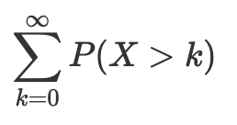
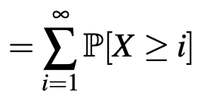
Tail Sum Formula (cont.)

Slide 22
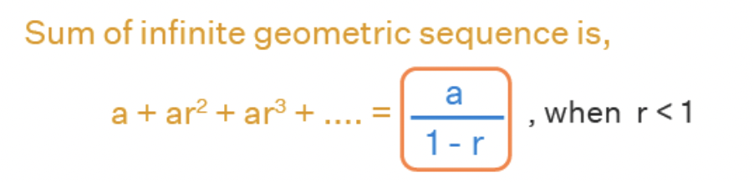
Expectation of Distributions: Geometric
Let X ~ Geometric(p). What is E[X]?
P(X > k) =

Slide 23
Example: Coin Flips
We keep flipping a coin (with probability ⅓ of being heads) until we get a heads. What is the expected number of coin flips we make?

Slide 24
Example: Favorite Champion
You are opening Champion Capsules: when opened, capsules give you one of the 200 League champions at random. You keep opening capsules until you get one of your three favorite champions. How many capsules should you expect to have to open?

Slide 25
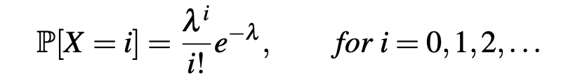
Expectation of Distributions: Poisson
Remember from Thursday, that for a Poisson R.V.:

Slide 26
Expectation of Distributions: Poisson
Let X ~ Poisson(λ). What is E[X]?

Slide 27
Example: Taylor Swift Albums
Taylor Swift releases an average of 1 album a year. How many albums do we expect her to release in 2023?

Slide 28
Example: Taylor Swift Albums
Taylor Swift releases an average of 1 album a year. Blackpink releases an average of 1 album every two years. In the year 2023, how many albums do we expect to see from either Taylor Swift or Blackpink?

Slide 29
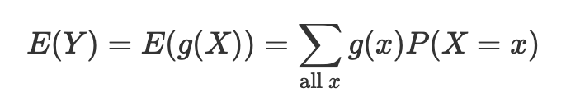
Expectation for Nonlinear Functions (LOTUS)
Let Y = g(X) be a nonlinear function of X. (For example: Y = X²).

Slide 30
Example: Square of a Dice Roll
Roll a fair six-sided dice. Let X be the value shown on the dice roll. What is E[X²]?

Slide 31
Example: Cube of a Dice Roll
Roll a fair six-sided dice. Let X be the value shown on the dice roll. What is E[X³]?

Slide 32
Expectation of Independent Random Variables
Let X and Y be two independent random variables. What is E[XY]?

Slide 33
Example: Dice Rolls
Roll a fair six-sided dice twice. What is the expectation of the product of the two dice rolls?

Slide 34
Example: Coin Tosses
We flip 10 fair coins and record the number of heads. Then, we do it again. What is the expectation of the product of the number of heads across both trials?

Slide 35
(If time, for fun) Method of Gaps
Deal out 52 cards from a deck one at a time. What are the expected number of cards between the 2nd and 3rd ace?

Slide 36
Recap
Learned about the definition of Expectation
Lots of methods to solve for expectation!
  Expectation of specific distributions
  Linearity of Expectation
  Tail Sum Formula
  Expectation for Nonlinear Functions
  Expectation for Independent Random Variables

