Slide 1
Lecture 5C:
Variance, Covariance
& Correlation
UC Berkeley CS70
Summer 2023
Nikki Suzani

Slide 2
What is variance?
How much does a random variable deviate from its mean?

Slide 3
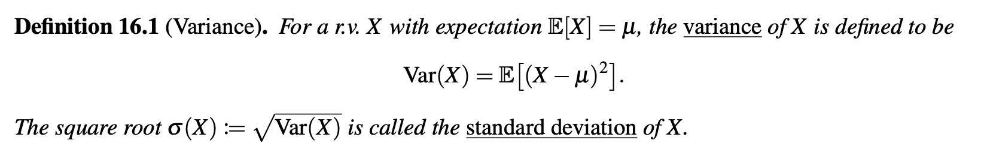
Variance (formally)

Slide 4
Variance of a Coin Toss
I flip a fair coin. What is the variance of my coin toss?

Slide 5
Variance of a Dice Roll
I roll a single six-sided dice. What is the variance of my dice roll?

Slide 6
Variance of a Uniform Random Variable
Let X be a random variable that takes on the values 1, … , n with the same probability (1/n). What is Var(X)?

Slide 7
Variance of a Uniform Random Variable (cont.)

Slide 8
Example: Variance of a Dice Roll (again)
Roll a fair six-sided dice. What is the variance?

Slide 9
Properties of Variance
Var(cX)

Slide 10
Properties of Variance
Var(X + b)

Slide 11
Properties of Variance
Var(X+b)

Slide 12
Variance of the Bernoulli Distribution
Let X ~ Bernoulli(p). What is Var(X)?

Slide 13
Making Serves
Nikki plays tennis (badly). Her serve ends up in the “legal zone” 20% of the time. What is the variance of the number of times her serve is legal?

Slide 14
Variance of Independent Random Variables
If X and Y are independent random variables, Var(X + Y) = Var(X) + Var(Y)

Slide 15
Variance of the Binomial Distribution
Let X ~ Binomial(n, p). What is Var(X)?

Slide 16
Example: Variance of 10 coin tosses
You toss a coin ten times that flips heads with probability ⅔. What is the variance of the number of heads?

Slide 17

Example: More tennis
Carlos Alcaraz wins matches against Novak Djokovic 1/3 of the time. If they play five times next year, what is the variance of the number of matches Alcaraz wins?

Slide 18
What is covariance?
Cov(X, Y) gives us information about how related X and Y are to each other.

Slide 19
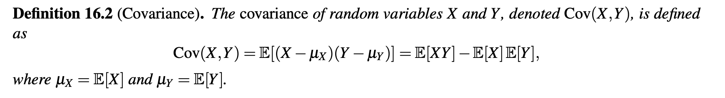
Covariance (Formally)
“Mean of the product minus the product of the means”

Slide 20
Covariance is Bilinear
Cov(aX + bY, aX + bY)

Slide 21
If X & Y are independent, they are uncorrelated
E[XY] = E[X]E[Y] if X and Y are independent
NOTE: If two events are uncorrelated, this doesn’t mean they’re independent.

Slide 22
Covariance Relation to Variance
Cov(X, X) = Var(X)

Slide 23
Covariance is Symmetric
Cov(X, Y) = Cov(Y, X)
What does this mean about Var(X+Y)?

Slide 24
Covariance of Two indicator variables
Let X and Y be two not-necessarily-independent Bernoulli random variables. What is E[XY]?

Slide 25
Covariance Method with Identically Distributed Variables
Find Var(X₁ + X₂ + … X_{n}) where all the X_{i} are identically distributed variables.

Slide 26
Example: Envelopes Problem
You have n envelopes and n letters. What is the variance of the number of letters that end up in the correct envelope?

Slide 27
Example: Envelopes Problem (cont.)

Slide 28
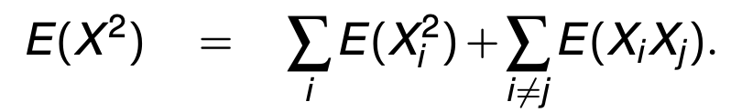
Envelopes Problem (another approach)
Let X = X₁ + X₂ + … + X_{n}

Slide 29
Variance of the Hypergeometric Distribution
Suppose you have a box with 10 red balls and 10 blue balls. You draw 10 times randomly without replacement. What is the variance of the number of red balls you pick?

Slide 30
Variance of the Hypergeometric Distribution (cont.)

Slide 31
Variance of the Hypergeometric (cont.)
What would the variance be if it was with replacement?

Slide 32
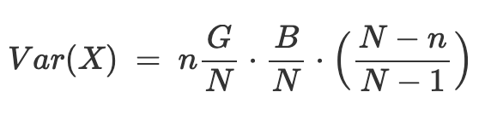
(Formally) Variance of Hypergeometric

Slide 33
Example of Hypergeometric: Tennis Balls
There are three blue tennis balls, four red tennis balls, and five green tennis balls in a box. If you draw three times randomly without replacement, what is the variance of the number of red tennis balls that you draw?

Slide 34
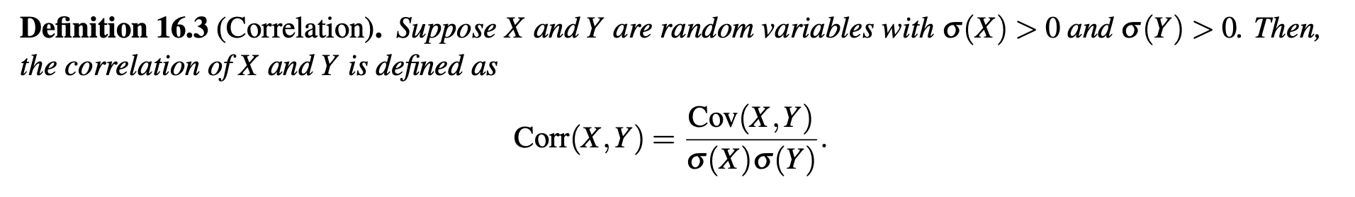
Correlation (Formally)
It’s hard to compare Cov(X, Y) and Cov(A, B) if A & B have different units than X & Y – numbers can vary pretty heavily based on units. Correlation helps us standardize units, in order to cross-compare covariances.

Slide 35
(If time, derivation) Variance of the Poisson Distribution
Let X ~ Poisson(λ). What is Var(X)?

Slide 36
(If time, derivation) Variance of the Geometric Distribution
Let X ~ Geometric(p). What is Var(X)?

Slide 37
Recap
Discussed the topics of variance, covariance, and correlation
  Properties of Variance
  Properties of Covariance
  Properties of Correlation
Discussed the variance of popular distributions and their derivations

