Slide 1
Lecture 6A:
Markov Chains
UC Berkeley CS70
Summer 2023
Nikki Suzani

Slide 2
Finite Markov Chains
Markov Chains help us to visualize transitions between different states.
0.7
0.3
0.5
Sitting
Standing
0.5

Slide 3
Finite Markov Chains (Formally)
Markov Chains are defined by two key components:
State Space – set of all possible states that your experiment can exist in (all possible values of the random variable in the Markov Chain). i.e. {sitting, standing}.

Slide 4
Finite Markov Chains (Formally)
Markov Chains are defined by two key components:
Transition Probability Matrix – the probability of moving from any one state to any other state

Slide 5
Key Information!
The most important thing about Markov chains, is that the chain is amnesic (memoryless) meaning each step should only depend on the previous state.

Slide 6
Can the following be modeled as a Markov Chain?
You have a coin that you flip continuously until you get two consecutive heads.

Slide 7
Modeled as a Markov Chain?
You’re drawing without replacement from a bag with a purple, red, and green ball. Model the outcomes of your draws.

Slide 8
More Vocab!
Often for Markov Chain questions you’re given an initial distribution. This tells you the probability of being in each state when you start. Each probability should be >= 0, and they should sum to 1.

Slide 9
Using the initial distribution
For some Markov Chain, let π = [0.3 0.4 0.2 0.1] for states A, B, and C respectively.
0.2
0.6
0.2
0.7
0.4
0.3
A
B
C
0.6

Slide 10
Using the initial distribution
Let π = [0.3 0.4 0.2 0.1]. After one step, what is the probability of being in state A?

Slide 11
Generalize!
Let’s look at the new matrix that we make. Now, what’s the probability of being in State A after two steps?

Slide 12
Generalize
How do we find the probability of being in a certain state after n steps?

Slide 13
More Vocab!
An invariant (or stationary) distribution π is a starting distribution such that:
π = πP

Slide 14
More Vocab!
A Markov chain is said to be irreducible if you can go from any starting space to any other ending space.
Specifically, there is a path of nonzero (positive) probability that goes from state i to state j for all i & j.

Slide 15
Irreducible or Not?
0.7
0.3
0.5
Sitting
Standing
0.5

Slide 16
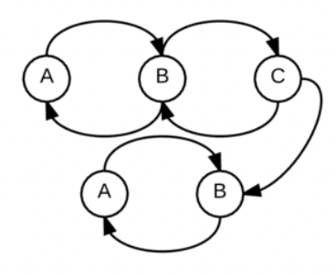
Irreducible or Not?

Slide 17
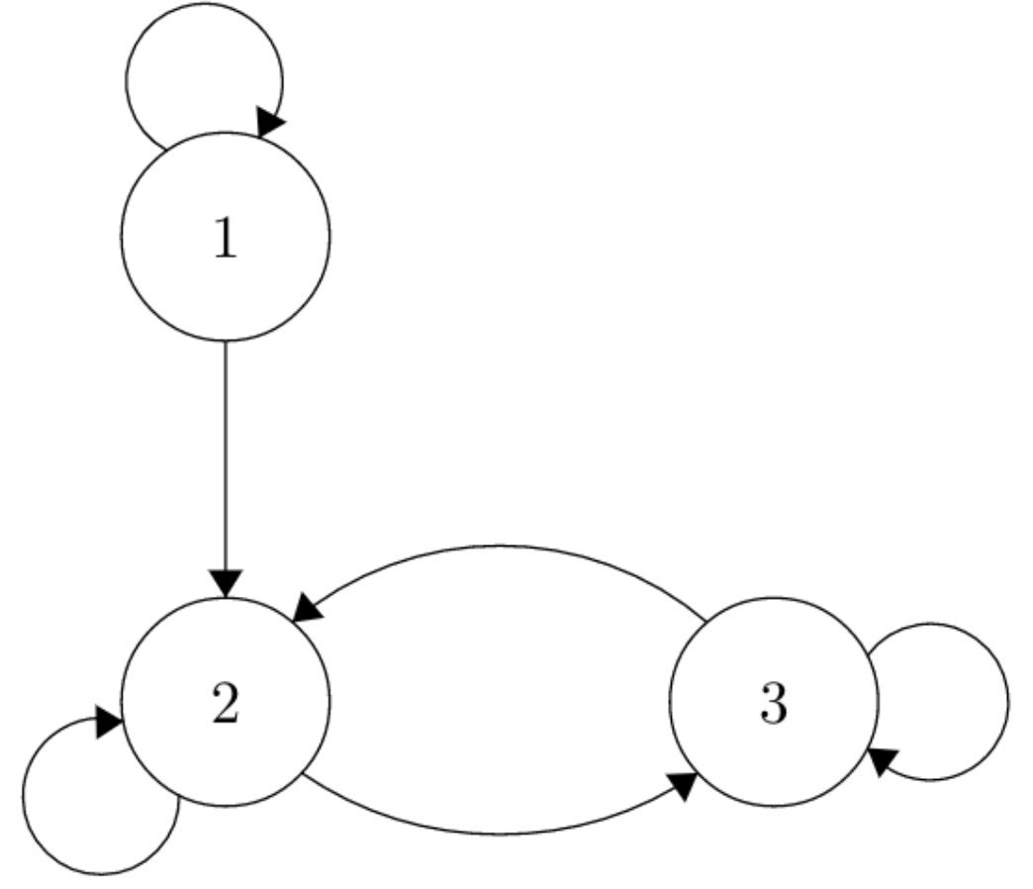
Irreducible or Not?

Slide 18
Irreducible or Not?
0.2
0.6
0.2
0.7
0.4
0.3
A
B
C
0.6

Slide 19
More Vocab!
A state i has period d if the Markov Chain can only come back to i in multiples of d.
A Markov Chain is said to be aperiodic if the period of the chain is 1 – meaning at any step, you have nonzero probability of being in any state.

Slide 20
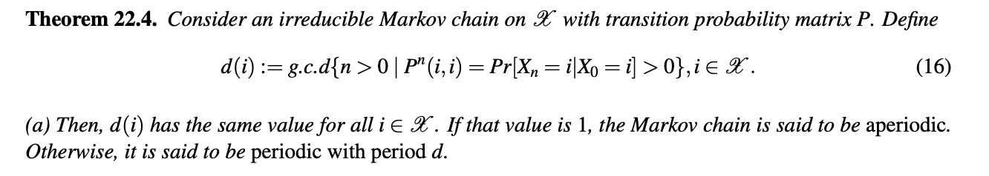
Aperiodic (Formally)

Slide 21
Aperiodic Quick Tip!
If any state in an irreducible Markov Chain has a self-loop with nonzero probability, then it is aperiodic.

Slide 22
Aperiodic or Not?
0.7
0.3
0.5
Sitting
Standing
0.5

Slide 23
Aperiodic or Not?
0.2
0.6
0.2
0.7
0.4
0.3
A
B
C
0.6

Slide 24
Aperiodic or Not?
A
1
1
B
C
1

Slide 25
Aperiodic or Not?
0.5
A
0.5
1
B
C
1

Slide 26
More Vocab!
If a Markov Chain is finite and irreducible, then its invariant distribution both exists and is unique. If it is aperiodic as well, it converges to the invariant distribution.

Slide 27
Solving for Invariant
Write out transition probability matrix
Write out detailed balance equations – using π = πP and the fact that the starting probabilities have to add to 1.
Solve :)

Slide 28
Solving for Invariant
1/2
3/4
1/2
A
B
1/4

Slide 29
Solving for Invariant

Slide 30
Special Case: Doubly Stochastic Matrices
A matrix is doubly stochastic if all the rows and all the columns sum to 1.

Slide 31
Doubly Stochastic Invariant
Suppose you have an irreducible, aperiodic finite Markov Chain. Prove that the uniform distribution is the invariant distribution.

Slide 32
Doubly Stochastic Example!
You roll a dice n times for some large n. What’s the probability that the sum of all the dice rolls is a multiple of 7?
Notes:
Problem taken from prob140.org :))

Slide 33
Doubly Stochastic Example!

Slide 34
Recap
Learned about Markov Chains:
Represent states and transitions where the next state only depends on the previous state
Learned about invariant (or stationary) distributions, and how irreducible/aperiodic relates to them
Learned how to solve for stationary distributions in general, and especially in doubly stochastic matrices

