Slide 1
CS 70 Su23: Lecture 24 (6B)
Markov Chains II: hitting time, probability of state A before state B

Slide 2
A quick recap
Markov chain (it’s a directed graph), defined by:
States (nodes)
Transition probabilities (edges)
  self-edges are allowed
  it’s probability, so all the outgoing edges have to add to 1
    do all incoming edges have to add to 1?¹
Initial probabilities (how likely you are to start at each state)
Markov chains are amnesic: the transition probabilities only depend on the current state
Notes:
¹ No. The shortest counterexample is to have two nodes A and B, with A having a self-edge with probability 1, and an edge from B to A with probability 1.

Slide 3
Hitting time
Given a starting state in a Markov Chain, what is the expected number of steps (transitions) until we reach some other state?
Suppose that:
Pr[A→B] = 1
Pr[B→C] = 1
If we start at A, how many steps, on average, will it take to get to C?
2 steps
A
B
C

Slide 4
First-step equations
Random variables are our friend. Let’s define:
T_{AB} = the number of steps it takes to go from state A to state B
If you only care about one of the states, you can simplify this (for example):
T_{A} = the number of steps it takes to go from A to C
  this is useful shorthand if your markov chain has a clear “end state”
We are interested in computing E[T_{A}], for some state A (to reach C).
You will also see this as a function (the notes uses β):
T(A) = the expected number of steps to reach state C from state A
  Note: this is an expectation! Be careful when reading to double check what the variable represents

Slide 5
First-step equations
What is T(C)?
E[T_{CC}] = 0 (you’re already there!)
A
B
C

Slide 6
Example 1: first-step equations (with numbers)
What is T(A)?
T(A) = 1 + ⅕T(A) + ⅘T(B)
What is T(B)?
T(B) = 1 + ½T(A) + ½T(C)
⅘
½
⅕
7/10
A
B
C
½
3/10

Slide 7
Example 1: first-step equations (with numbers)
T(A) = 1 + ⅕T(A) + ⅘T(B)
T(B) = 1 + ½T(A) + ½T(C)
= 1+ ½T(A)
T(A) = 1 + ⅕T(A) + ⅘(1 + ½T(A))
= 1 + ⅕T(A) + ⅘ + ⅖T(A)
= 9/5 + ⅗T(A)
⅖T(A) = 9/5
T(A) = 9/2
7/10
⅘
½
⅕
A
B
C
½
3/10

Slide 8
First-step equations
In general, the expected number of steps to state Y from state X is:
T_{Y}(X) = 1 + ∑_{Z} Pr[X→Z] · T_{Y}(Z)
T_{Y}(Y) = 0
In other words, we have to go somewhere, and with some probability, we end up at a different state, which takes some expected number of steps to get to state Y (if you start when you want to go, it takes 0 steps to get there).
(again, if Y is implied, you can omit it)

Slide 9
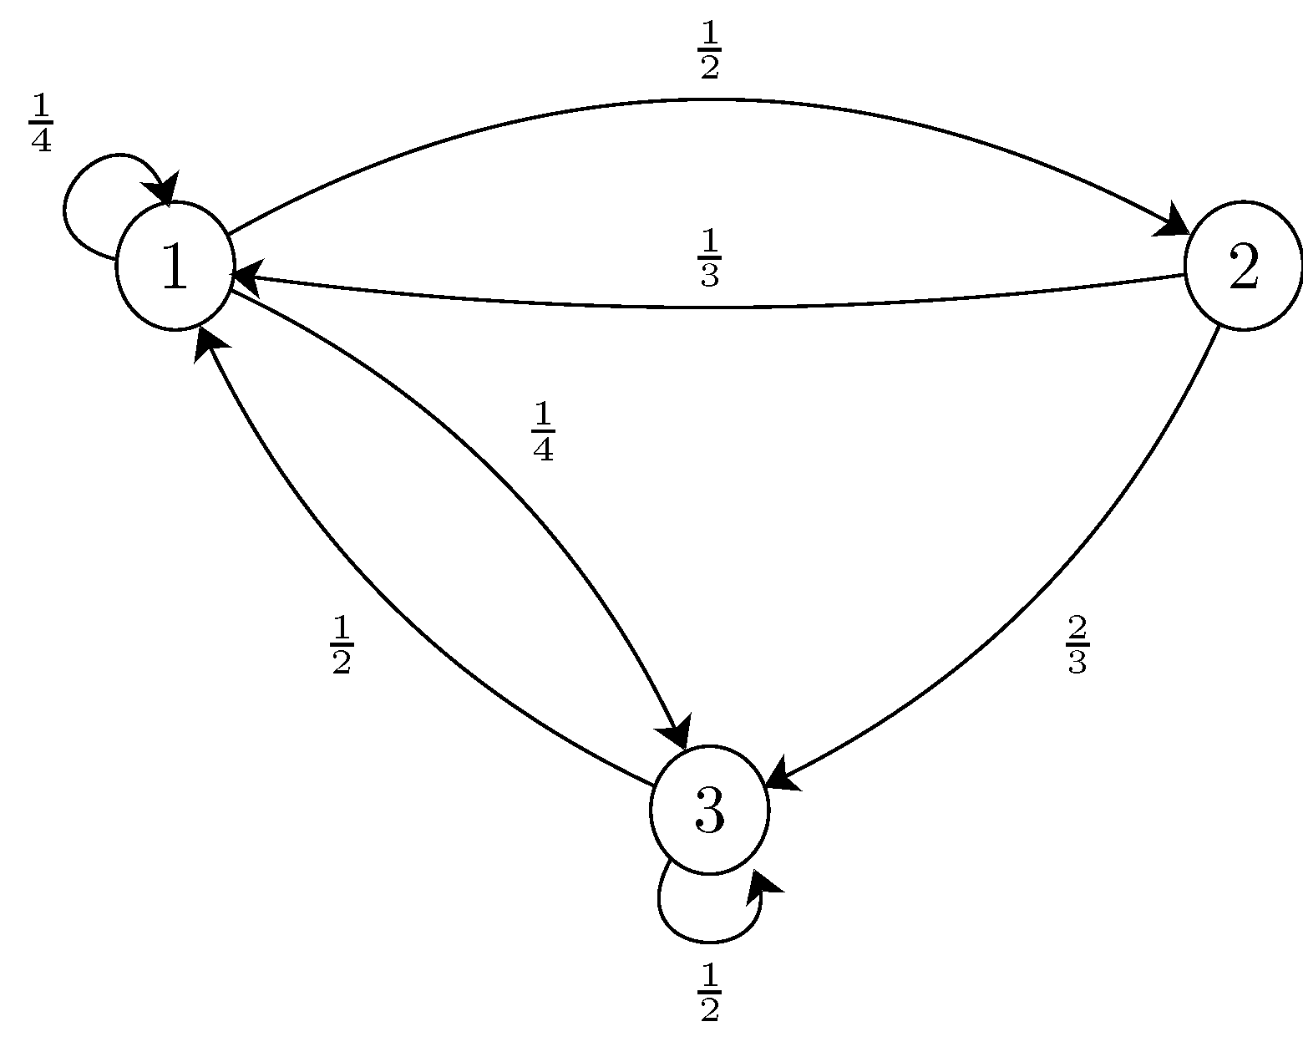
Example 2: more numbers
We want to reach state 1. What is T₁(2)?
T(2) = 1 + ⅓T(1) + ⅔T(3)
= 1 + ⅔T(3)
T(3) = 1 + ½T(1) + ½T(3)
= 1 + ½T(3)
T(3) = 2
T(2) = 7/3
Notes:
This example is taken from https://www.probabilitycourse.com/chapter11/11_2_7_solved_probs.php, if you’d like to look there for more examples

Slide 10
Example 3: Geometric… again
How can we represent a geometric distribution as a Markov Chain?
T(0) = 1 + pT(1) + (1 - p)T(0)
= 1 + T(0) - pT(0)
pT(0) = 1
T(0) = 1/p
1 - p
0H
p
1H

Slide 11
Example 4: Geometric… again (again)
Now what if we want to flip until we get 2 heads in a row?
1 - p
0H
p
1H
p
2H
1 - p

Slide 12
Example 4: Geometric… again (again)
T(0) = 1+ pT(1) + (1 - p)T(0)
T(1) = 1+ pT(2) + (1 - p)T(0)
= 1 + T(0) - pT(0)
1 - p
0H
p
1H
p
2H
1 - p
T(0) = 1 + p(1 + T(0) - pT(0)) + (1 - p)T(0)
T(0) = 1 + p + pT(0) - p²T(0) + T(0) - pT(0)
T(0) = (1 + p)/p²

Slide 13
Return time
We start at state X. What is the expected number of steps until we return to state X?
R_{X} = 1 + ∑_{Z} Pr[X→Z] · T_{X}(Z)
In other words, we have to go somewhere, and with some probability, we end up at a different state, which takes some expected number of steps to get to state 1.

Slide 14
Example 5: the numbers from before
We start in state 1. What is R₁?
R₁ = 1 + ¼ T(1) + ½T(2) + ¼T(3)
= 1 + 0 + ½ · 7/3 + ¼ · 2
= 6/6 + 7/6 + 3/6
= 16/6
= 8/3
Notes:
This example is taken from https://www.probabilitycourse.com/chapter11/11_2_7_solved_probs.php, if you’d like to look there for more examples

Slide 15
Probability of state A before state B
Given a starting state, what is the probability we reach some state before some other state?
Suppose that:
Pr[A→B] = 1
Pr[B→C] = 1
If we start at A, what is the probability of reaching C before B?
0
A
B
C

Slide 16
Probability of state A before state B
Let P(X) = the probability that you reach state A before state B from state X (for some specified states A and B).
This is, again, a function (the notes uses α)
If you want to be very precise, you can use subscripts for clarity
  Example: P_{CB}(X) = probability if reaching C before B, starting from X

Slide 17
Example 6: probability of C before B
Returning to our example:
Let’s say we are interested in whether we visit C before B.
What is P(C)?
1
What is P(B)?
0
A
B
C

Slide 18
Example 6: probability of C before B
Returning to our example:
What is P(A)?
P(A) = Pr[A→A] · P(A)
+ Pr[A→B] · P(B)
+ Pr[A→C] · P(C)
= Pr[A→A] · P(A)
+ Pr[A→C] · P(C)
A
B
C

Slide 19
Probability of state A before state B
In general, the probability of reaching state A before state B, starting from state X, is:
P_{AB}(X) = ∑_{Y} Pr[X→Y] · P_{AB}(Y)
P_{AB}(A) = 1
P_{AB}(B) = 0
(again, if A and B are implied, you can omit them)

Slide 20
Example 7: gamble responsibly
You are playing a game where you flip a coin with probability p. If it lands heads, you win $1. Otherwise, you lose $1. The game ends when you have $0. What is the probability that you earn $N before you run out of money?
Let’s write out the equations:
P(0) = 0
P(N) = 1
P(n) = p · P(n + 1) + (1 - p) · P(n - 1), for 0 < n < N
With the magic of algebra, we have P(n) = (1 - ((1 - p)/p)^{n}) / (1 - ((1 - p)/p)^{N})

