Slide 1
Lecture 6D:
Continuous Probability II
UC Berkeley CS70
Summer 2023
Nikki Suzani

Slide 2
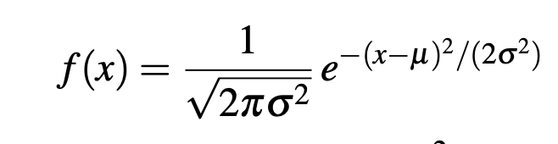
Gaussian (Normal) Random Variables
A normal (or Gaussian) distribution is a distribution with two parameters, μ – its expectation – and σ² – its variance.

Slide 3
Some Cool Properties of the Normal Distribution

Slide 4
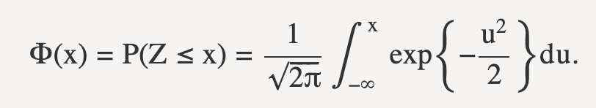
Gaussian (Normal) Random Variables (cont.)
CDF of the Normal(0, 1) distribution is referred to as 𝛷(x).

Slide 5
“Scaling” Normal Random Variables

Slide 6
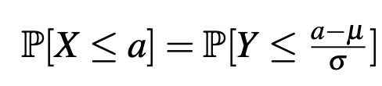
“Scaling” Normal Random Variables (cont.)
where Y is standard normal.
This allows us to use the CDF!

Slide 7
Sum of Independent Normal RVs

Slide 8
Central Limit Theorem
Let X₁, X₂, … X_{n} be a sequence of n i.i.d. random variables with E(X_{i}) = μ and Var(X_{i}) = σ². When n is large, both the sample sum and the sample mean can be approximated as normal random variables.

Slide 9
Sample Sum Expectation & Variance
Let X₁, X₂, … X_{n} be a sequence of n i.i.d. random variables with E(X_{i}) = μ and Var(X_{i}) = σ². Find the distribution of S_{n} = X₁ + … + X_{n} for large n.

Slide 10
Scaling to Standard Normal

Slide 11
Sample Mean Expectation and Variance
Let X₁, X₂, … X_{n} be a sequence of n i.i.d. random variables with E(X_{i}) = μ and Var(X_{i}) = σ². Find the distribution of X-bar = S_{n}/n = X₁ + … + X_{n} for large n.

Slide 12
Scaling to Standard Normal

Slide 13
How to Solve CLT Questions
Identify that you can use CLT – sample mean/sum of i.i.d. random variables for large n.
Calculate the Mean and Variance of the sample mean/sum
Convert your value into the standard normal value (subtract mean, divide by standard deviation)
Use 𝛷(standard normal value)

Slide 14
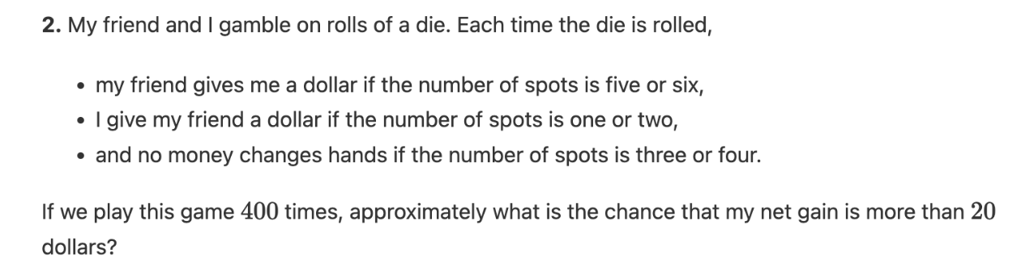
Dice Example

Slide 15
Dice Example (cont.)

Slide 16
Exam Example
N students take an exam where the average is 50, and the variance is 5. Let S_{n} be the sum of their n scores, and assume all of their scores are independent. What is the probability that their average score is greater than 72.5?

Slide 17
Exam Example

Slide 18
Polling Example
We want to estimate the true proportion p of students who like Olivia Rodrigo more than Joshua Bassett. We poll n people, for large n. How many people do we have to poll to get an estimate with accuracy 0.1 with 95% probability?

Slide 19
Polling Example

Slide 20
Poisson Example
The number of times I listen to Olivia Rodrigo’s Vampire is modeled by a Poisson(λ) distribution per day, but I don’t know λ. All I know about λ is that it is at most 20. If I track the number of times I listen to Vampire each day, for a large number of days, how many days do I need to track to get a 95% confidence interval for λ of width 3.

Slide 21
Poisson Example (cont.)

Slide 22
Poisson Example (cont.)

Slide 23
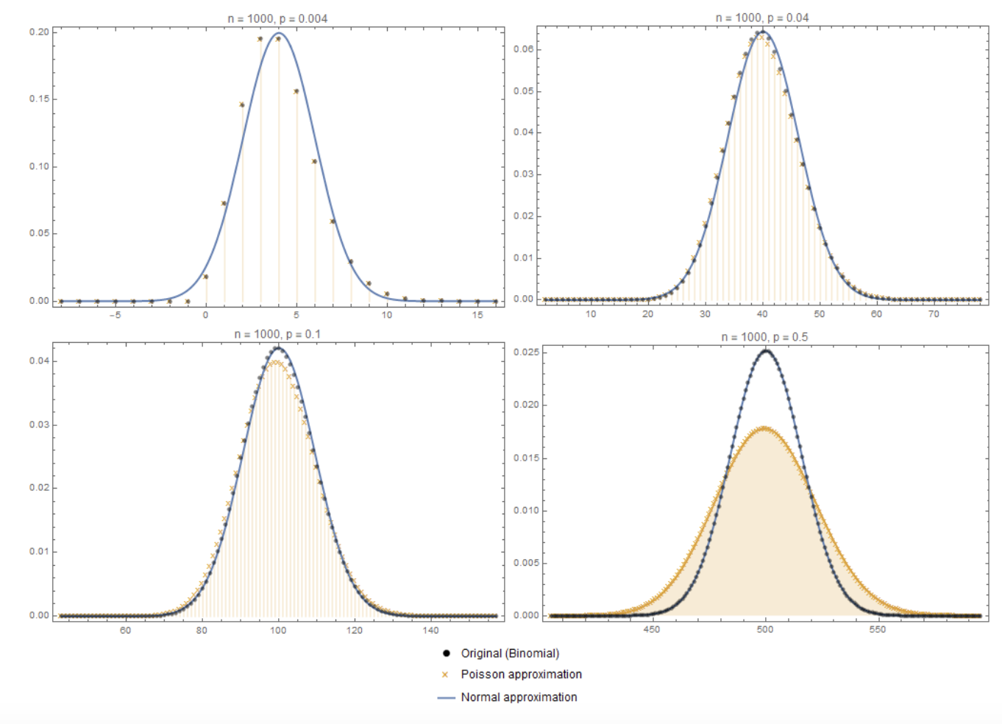
Normal as a Limiting Distribution of Binomial
When n is large, and p is not small, the normal distribution is a good approximation to the binomial. Source: https://math.stackexchange.com/questions/3278070/approximation-of-binomial-distribution-poisson-vs-normal-distribution.

Slide 24
(If time)
The following are slides that didn’t make it into recording for 6C so I will redo them if there is time, so that they can be in a recording.

Slide 25
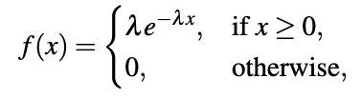
Exponential Distribution
Def: For some λ > 0, a continuous random variable X is an exponential random variable with parameter λ if it has the following PDF,
We can write X ~ Exp(λ) if is an exponential random variable.
Let’s check that f(x) satisfies the two PDF properties
Notes:
Lambda and e^{-lambda*x} is always positive
Integral gives λ(-1/λ)e^{-λx} x from 0 to inf → (0-1) for the e^{-λx} term

Slide 26

Expectation & Variance of Exponential
For a random variable X ~ Exp(λ),

Slide 27
Example Exponential
Going back to our terrible alarm clock, we know the behavior is:
Once plugged in, the alarm will randomly ring once after some amount of time, however we know it goes off at a rate of 1 time every 10 minutes.
Let X be the amount of time it takes the alarm to sound. X ~ Exp(1/10), because our rate of rings is 1/10 per minute.
How many minutes should we expect to wait before the alarm rings?
Notes:
10 mins, 1/(1/10)

Slide 28

An important property to note
Proof:

Slide 29


Exponential Relation to Geometric
Let’s try to draw a more rigorous connection between Exponential and Geometric distributions. Take our Geometric r.v. and consider running trials after every d seconds. The probability of a success is p = λ𝛅.
Then, let Y denote the amount of time/seconds before a successful trial:
To translate our trials to a continuum, consider taking the limit of d → 0. Then, for any time t,

Slide 30
Recap
Discussed Gaussian (Normal) Random Variables
Properties of Normal Distributions
Scaling Normal Distributions
Summing Independent Random Normal Variables
The CDF of a Normal Distribution
Solving Problems using the Central Limit Theorem (CLT)

