Slide 1
Lecture 7B:
Probability Review
UC Berkeley CS70
Summer 2023
Nikki Suzani

Slide 2

Discrete Probability
Define Probability Spaces:
Sample Space (Ω)
Probability of each sample point, P(ω)
Combine omega, ω, into events
For uniform probability, P(A) = |A| / |Ω|

Slide 3
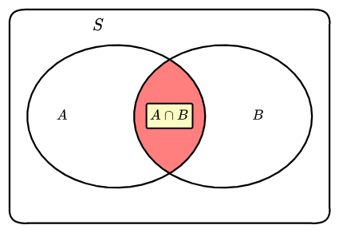
Conditional Probability
Bayes’ Rule
Pr[A|B] = | P(A∩B)
 | P(B)
Pr[A|B] = | Pr[B|A] x Pr[A]
 | Pr[B]

Slide 4
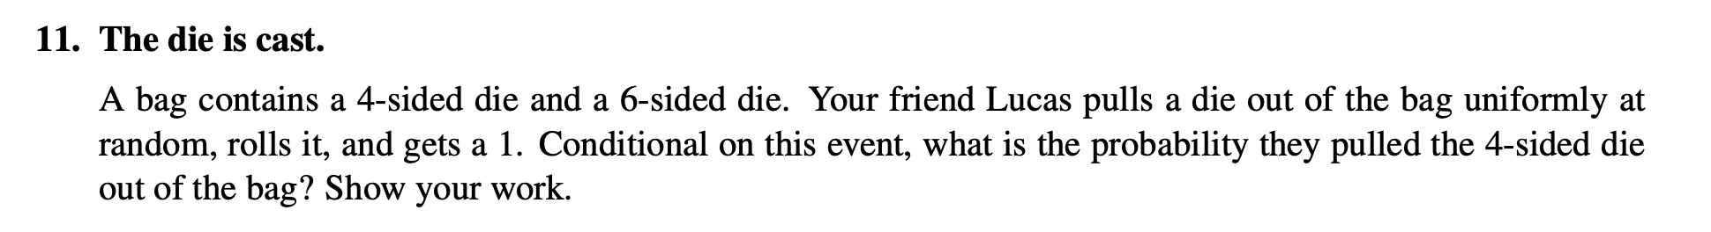
Bayes’ Rule Exam Question
Notes:
Fall 2021 Q11

Slide 5
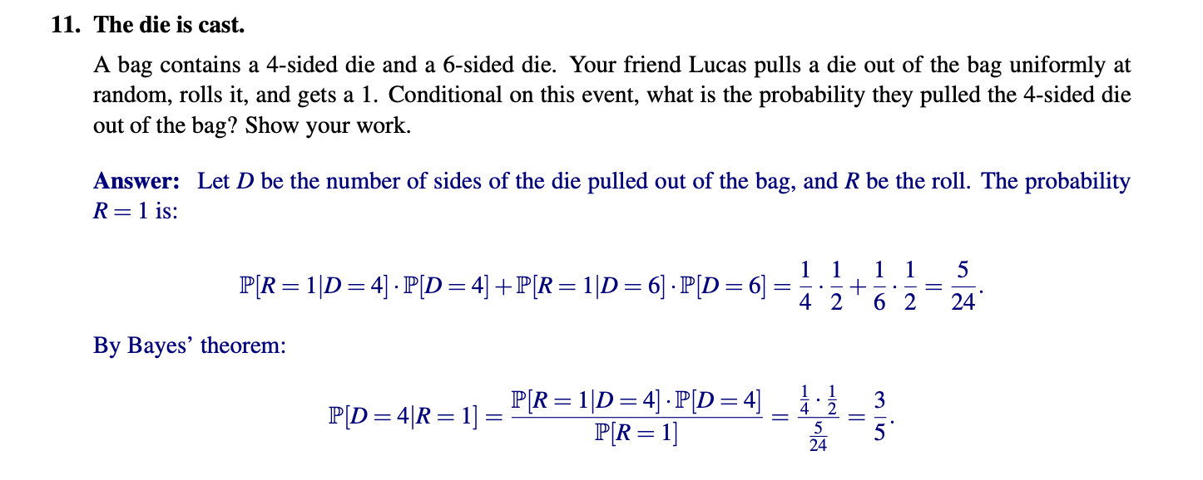

Slide 6
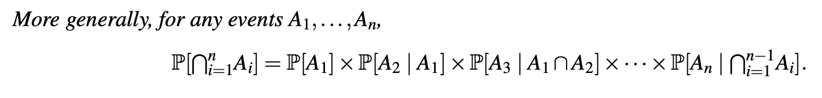
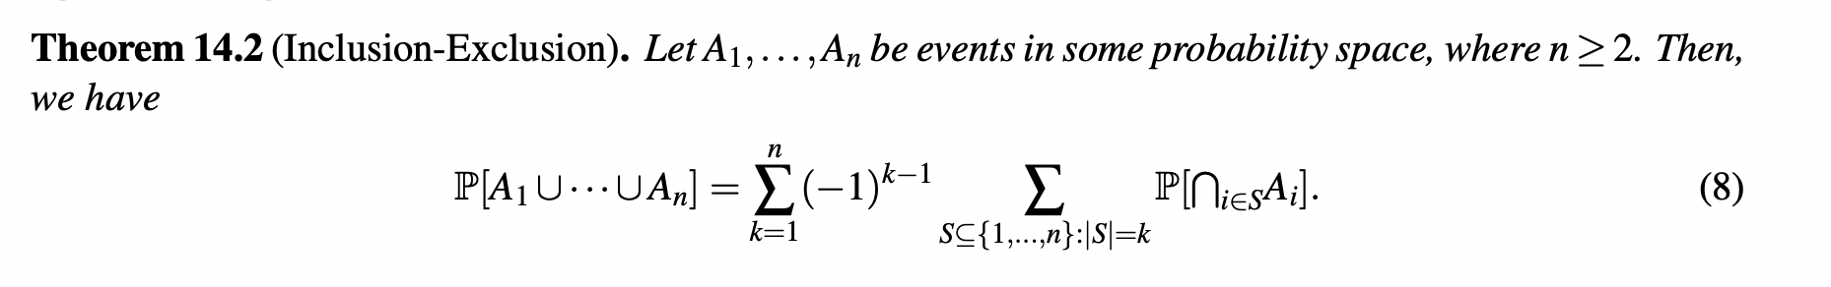
Intersections and Unions
Independent: P(A | B) = P(A), P(A ∩ B) = P(A)P(B)
Product Rule:
Principle of Inclusion-Exclusion:
Union Bound: P(A U B) ≤ P(A) + P(B)

Slide 7
Independence Exam Question
Notes:
Fall 2020, 8e

Slide 8
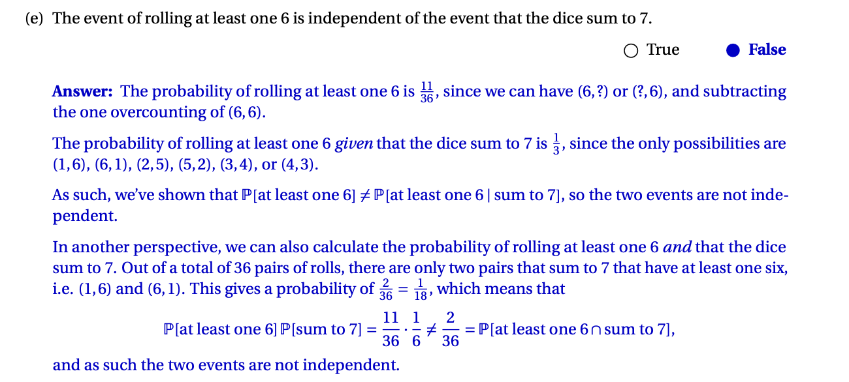

Slide 9
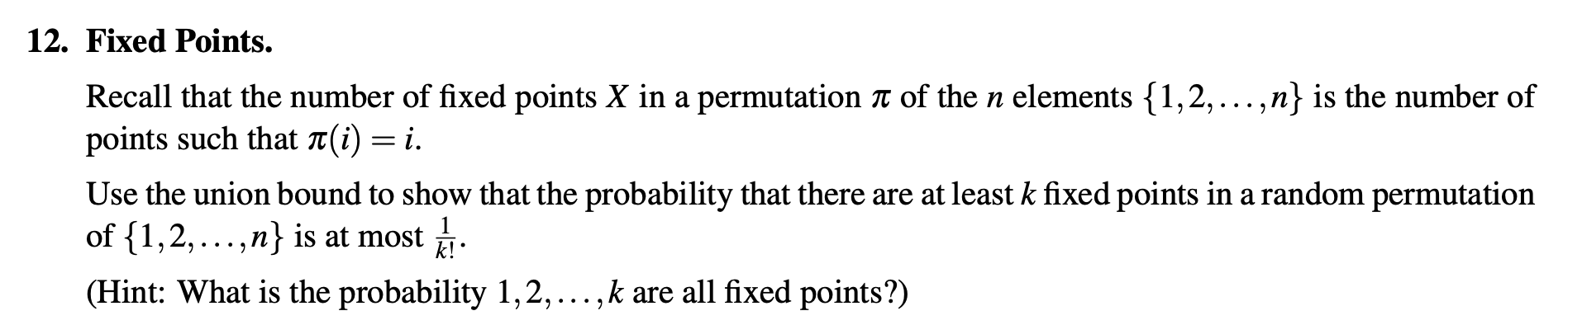
Union Bound Exam Question
Notes:
Fall 2021 Q12

Slide 10
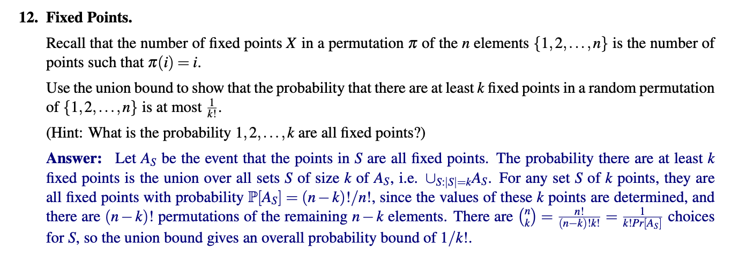

Slide 11
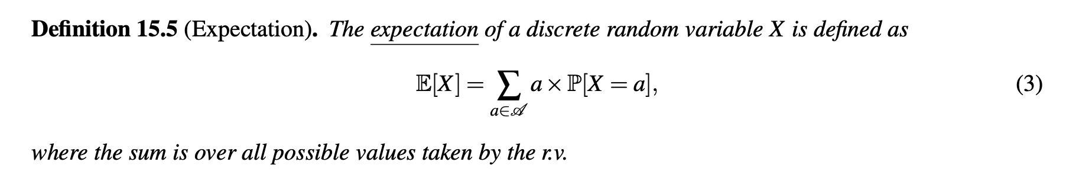
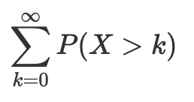
Expectation
Tail Sum:

Slide 12
Linearity of Expectation
E[aX + b] = aE[X] + b
E[X + Y] = E[X] + E[Y]

Slide 13
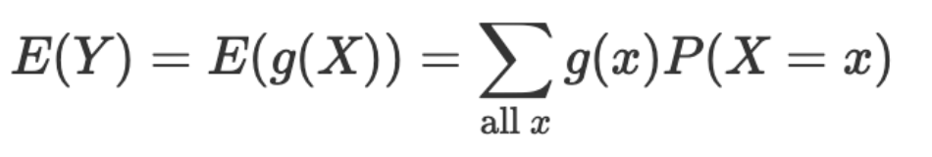
More Expectation
E[X] = E[E[X | Y]]

Slide 14
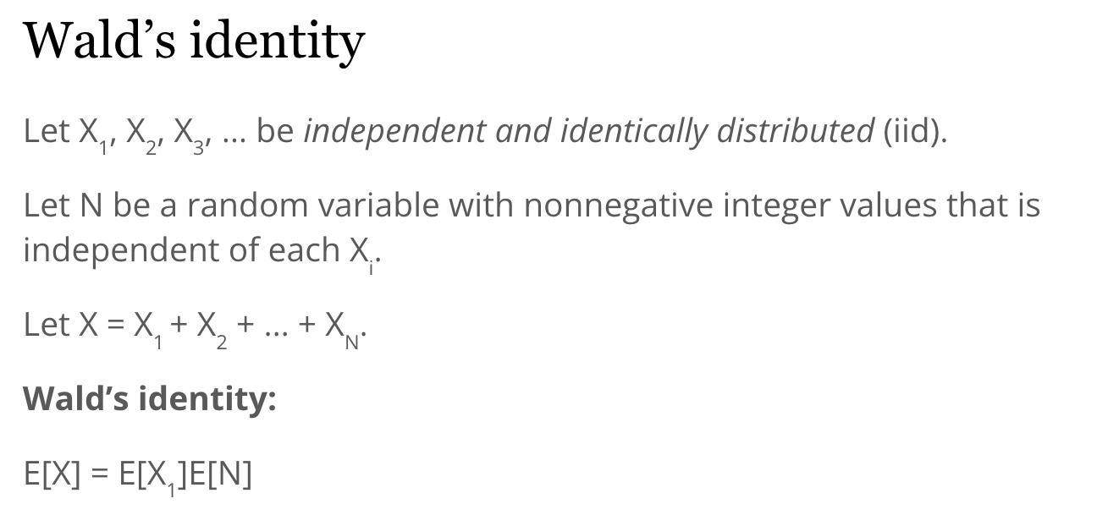
Wald’s Identity

Slide 15
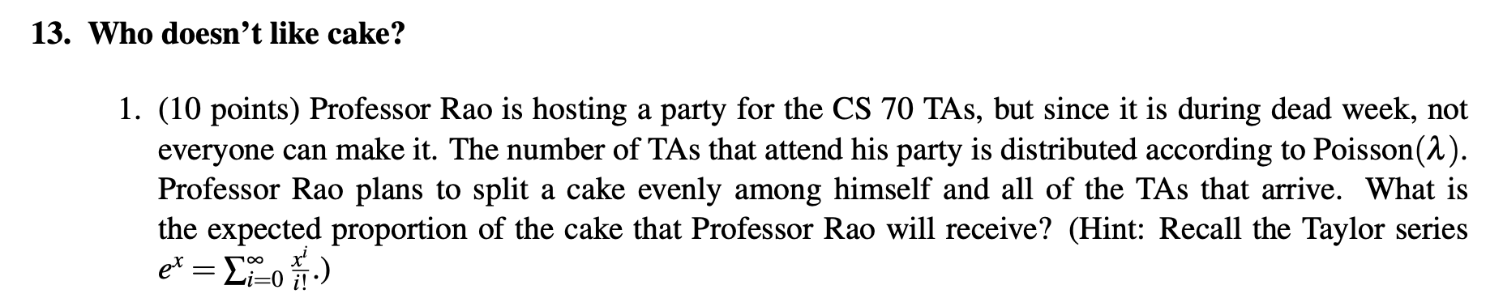
Expectation Exam Question
Notes:
Sp22 Q13

Slide 16
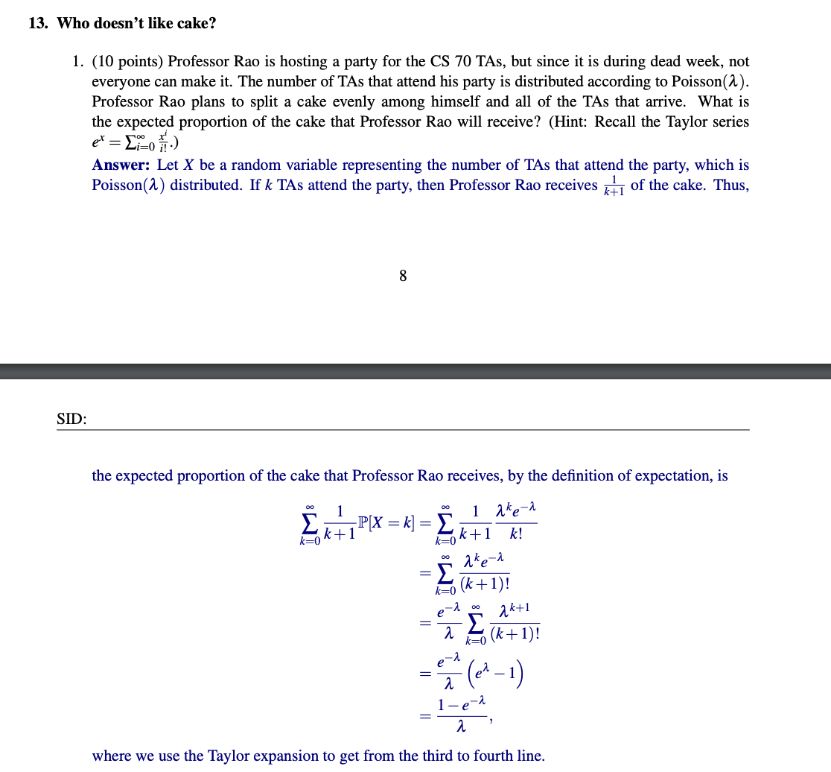

Slide 17
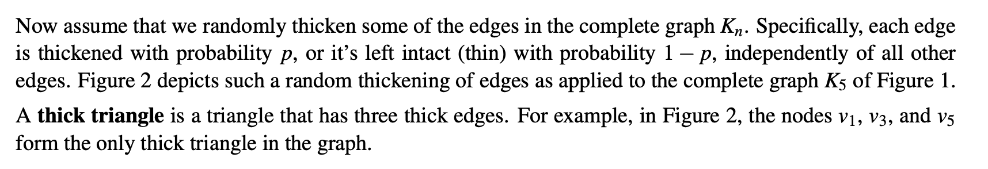
Indicator Expectation Exam Question
Notes:
Fa21 Q18

Slide 18
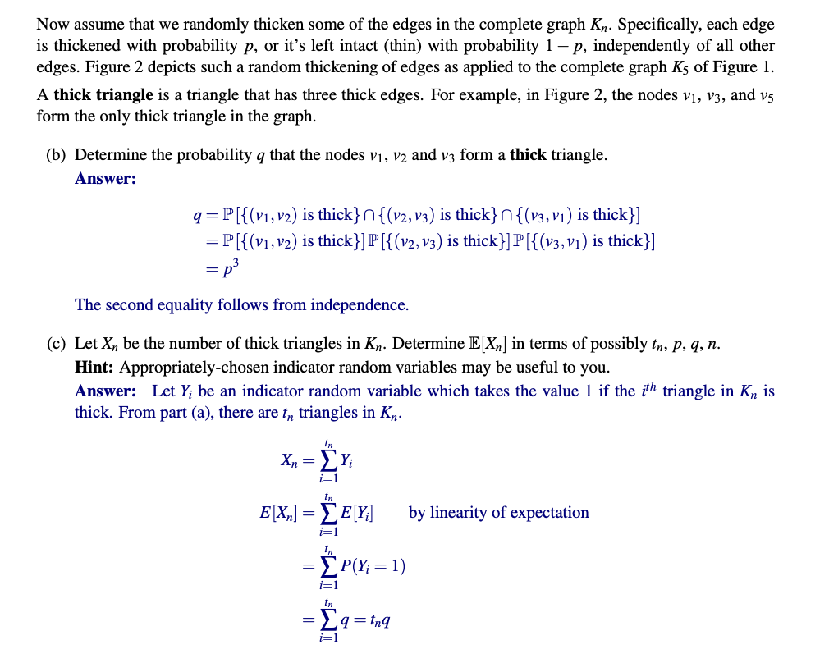

Slide 19
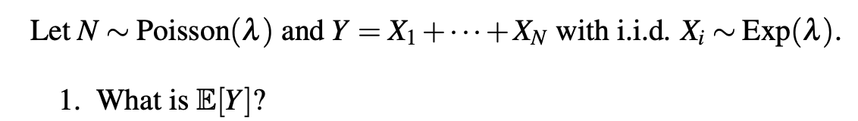
Conditional Expectation Exam Question
Notes:
Sp22

Slide 20
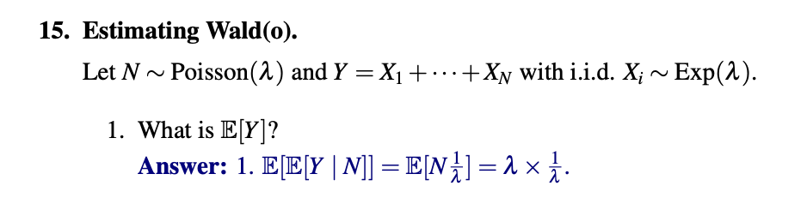

Slide 21
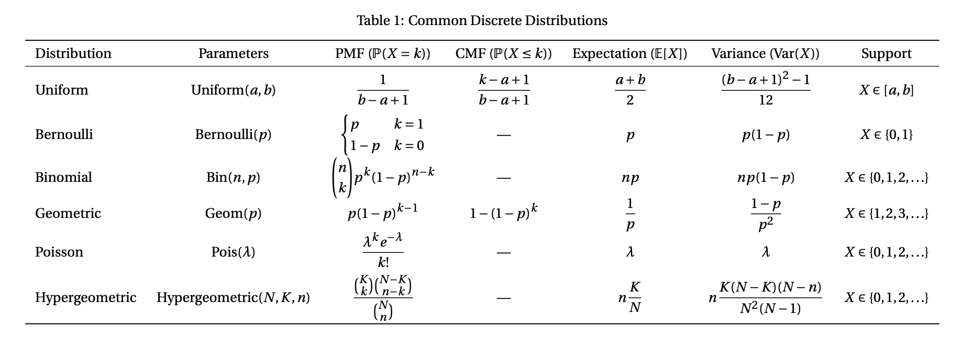
Discrete Random Variables, Expectation, Variance
Notes:
Credit: Alec Li, https://smartspot2.github.io/assets/pdf/CS70_Cheatsheet.pdf

Slide 22
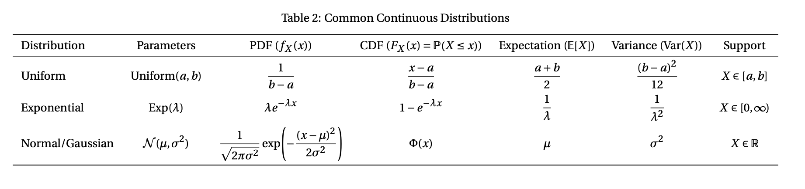
Continuous Random Variables, Expectation, Variance
Notes:
Credit: Alec Li, https://smartspot2.github.io/assets/pdf/CS70_Cheatsheet.pdf

Slide 23
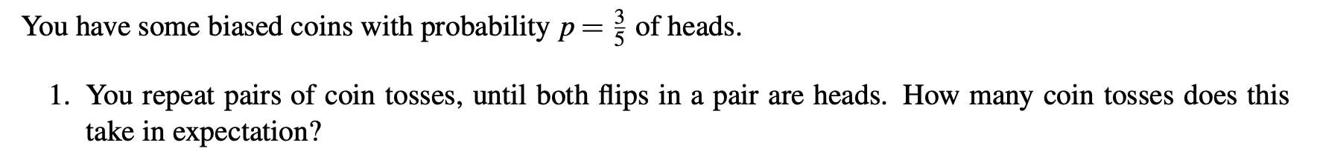
Random Variable Exam Question
Notes:
Sp22

Slide 24
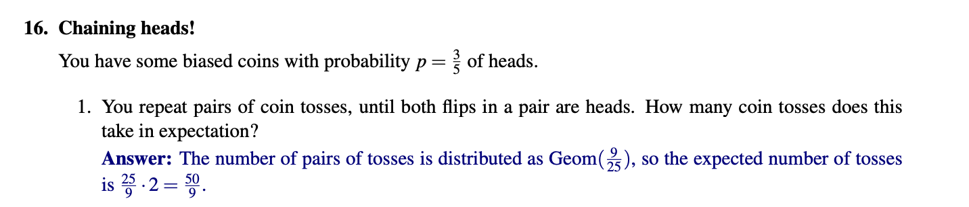

Slide 25
Random Variable Exam Question
Notes:
Fa20

Slide 26
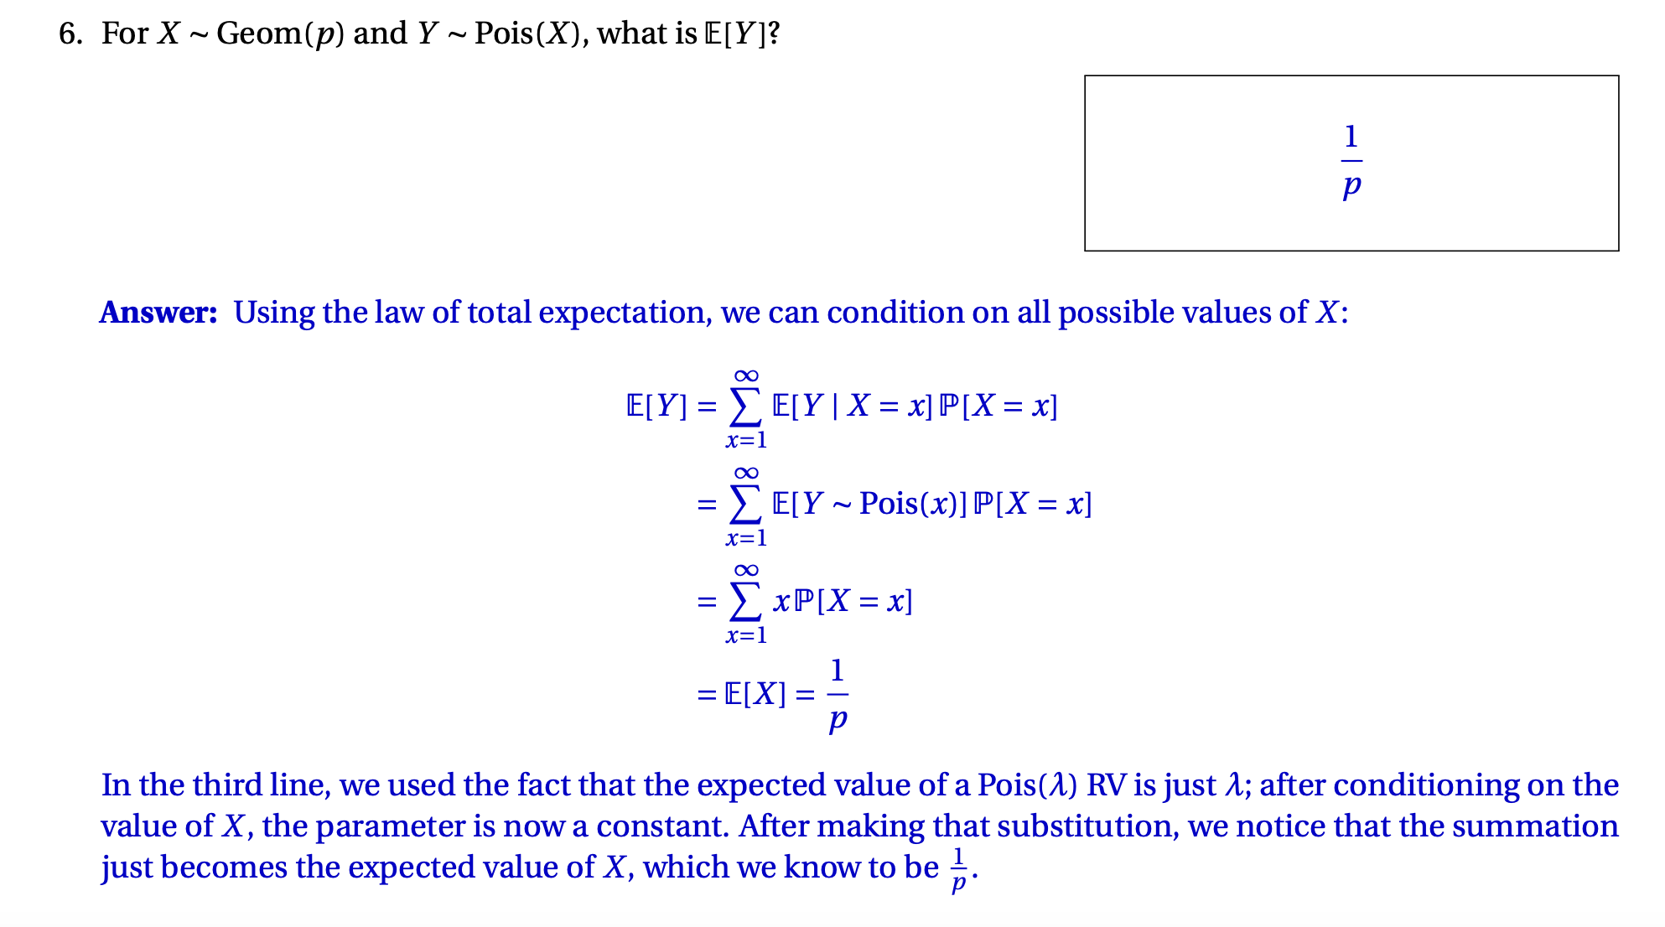

Slide 27
Independent RVs Question
*Given independent X, Y
Notes:
Fa20 Q12.1

Slide 28
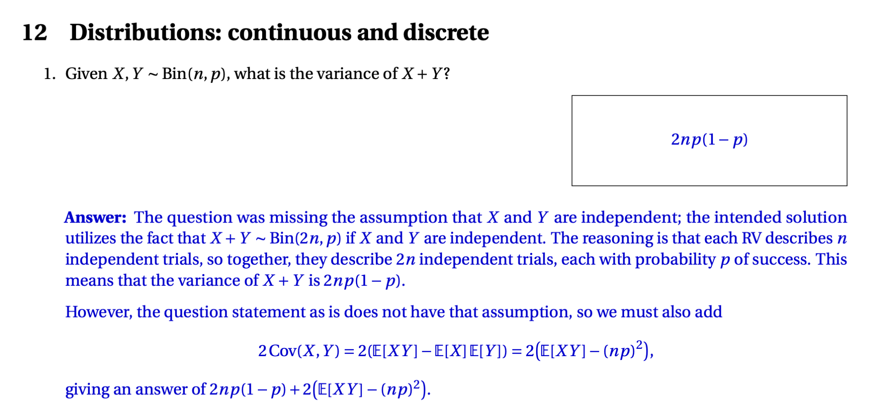

Slide 29
Independent RVs Question
Given *independent X, Y, Z
Notes:
Fa20 Q12.2

Slide 30
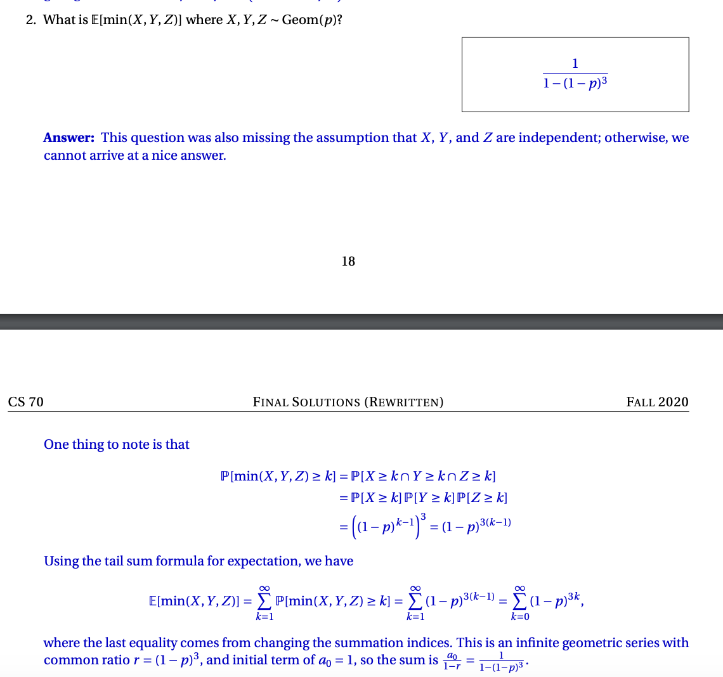

Slide 31
Variance, Covariance, Correlation
Var(X) = E((X - μ)²) = E[X²] - E[X]²
Var(cX + b) = c²Var(X + b) = c²Var(X)
Cov(aX + bY, aX + bY) =
If independent:
Var(X + Y) = Var(X) + Var(Y) + 2Cov(X, Y) = Var(X) + Var(Y)
E[XY] = E[X]E[Y]

Slide 32
Covariance with Indicators
Var(X₁ + … + X_{n})

Slide 33
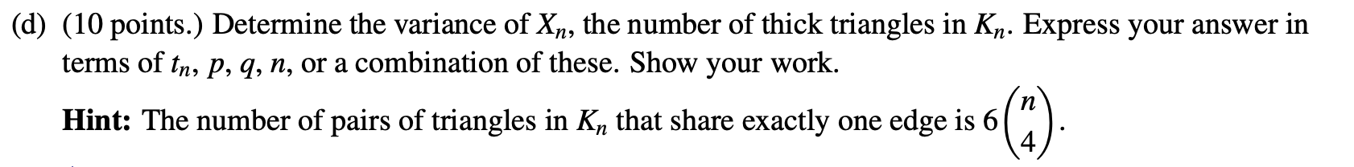
Variance with Indicators Exam Question
Notes:
Fall 2021 18d

Slide 34
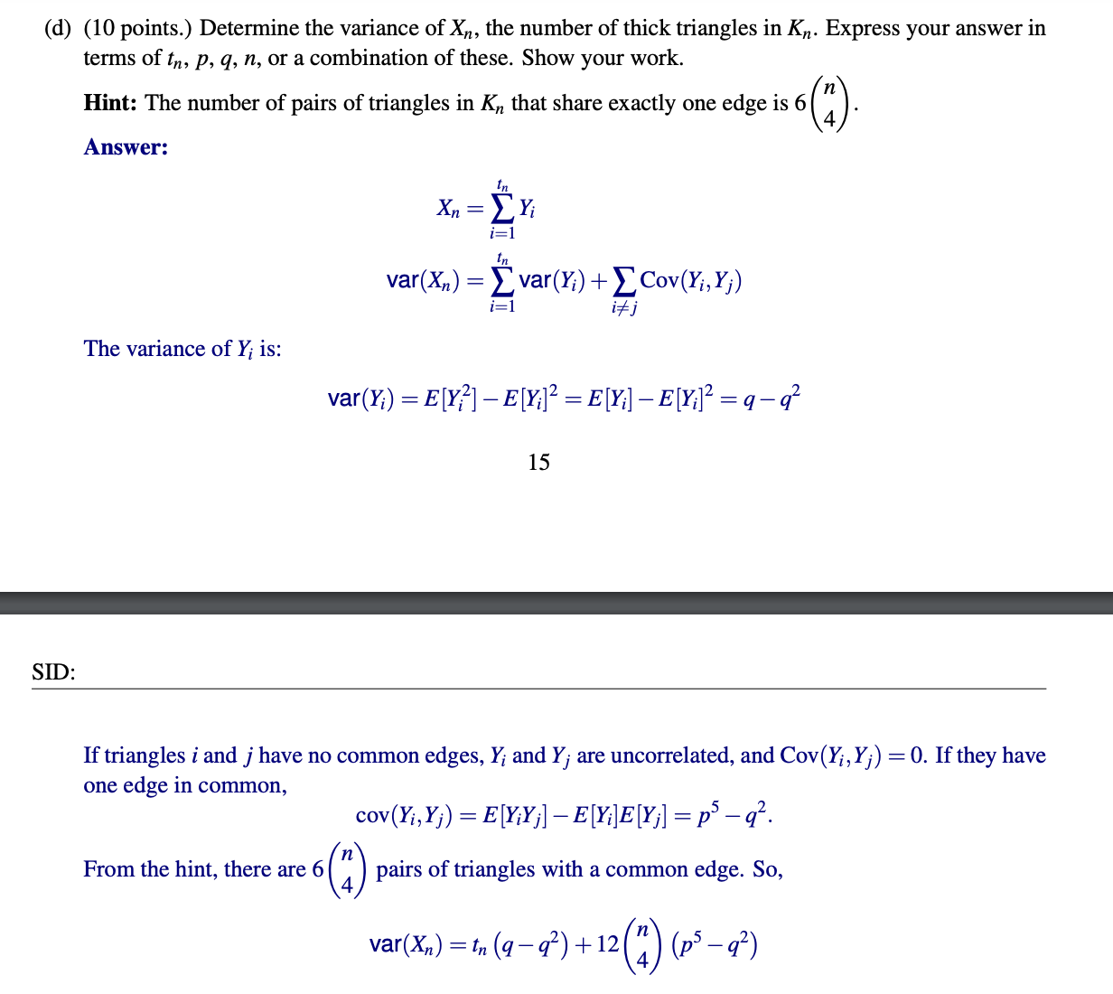

Slide 35
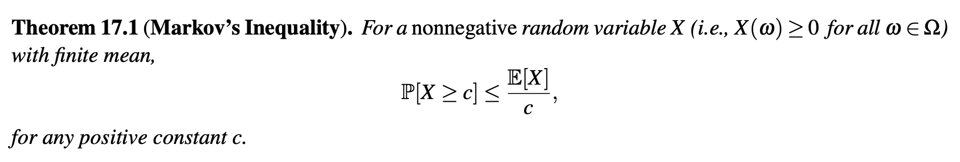
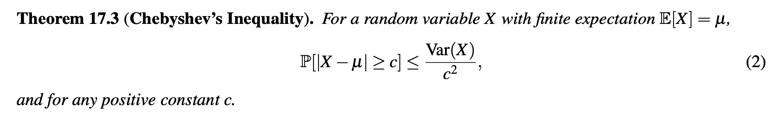
Concentration Inequalities

Slide 36
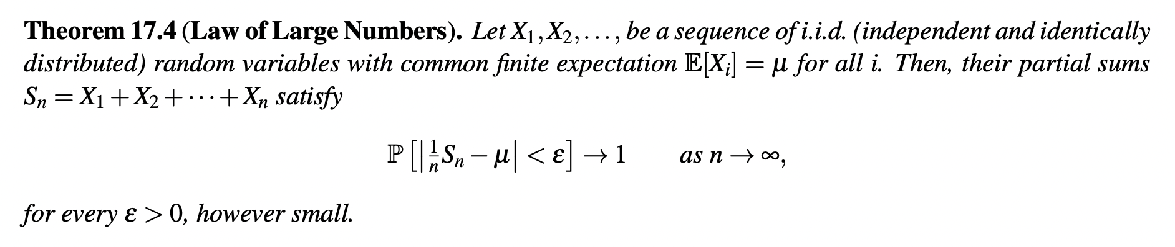
Law of Large Numbers

Slide 37
Concentration Inequalities Exam Question

Slide 38
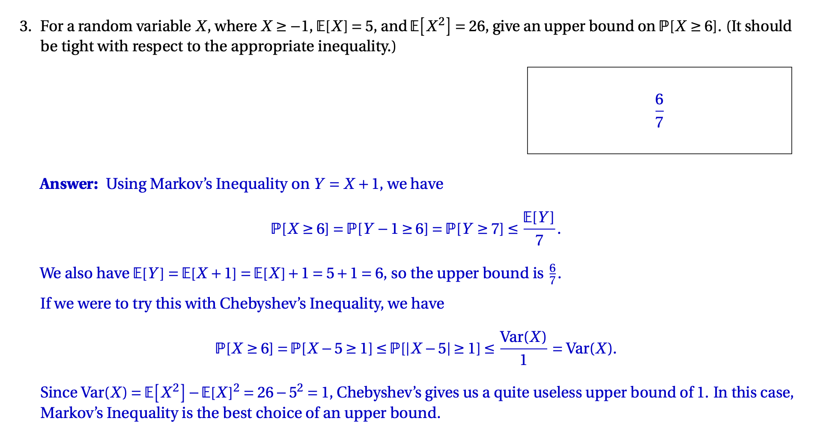

Slide 39
Concentration Inequalities Exam Question

Slide 40
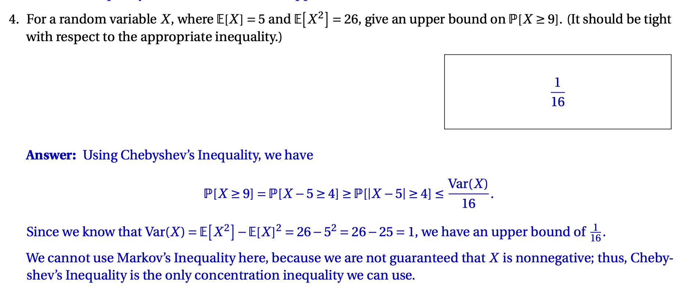

Slide 41
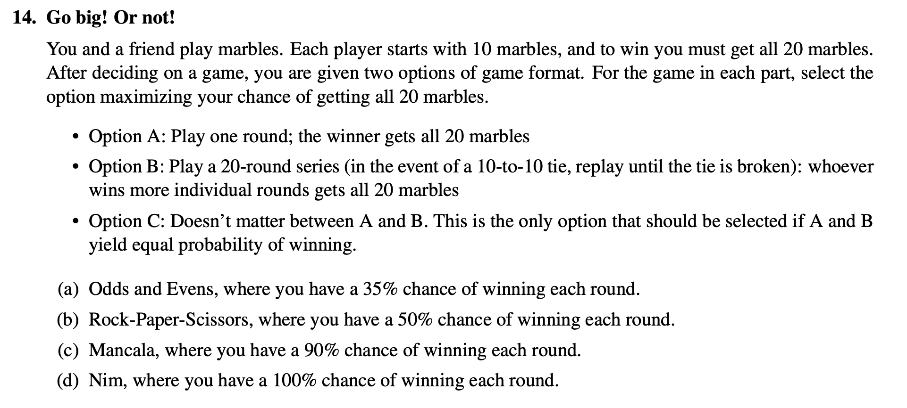
LLN Exam Question
Notes:
Fall 2021 Q14

Slide 42
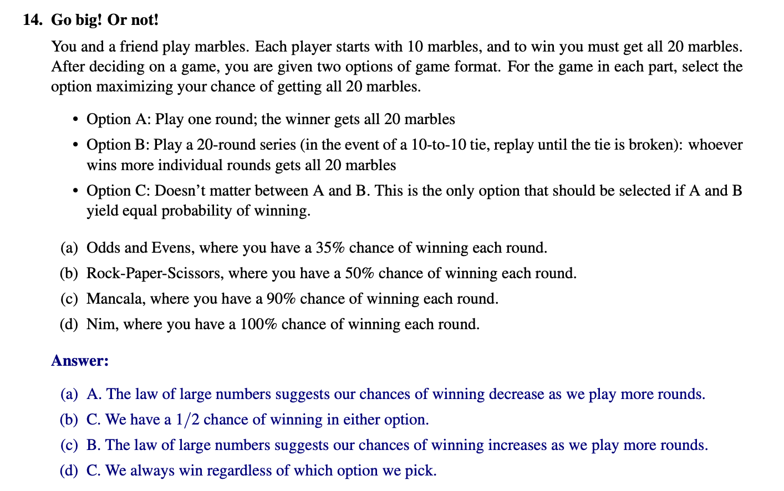

Slide 43
Markov Chains
Define aperiodic, irreducible
0.2
0.6
0.2
0.7
0.4
0.3
A
B
C
0.6

Slide 44
Markov Chains Exam Question
Coin has probability p = ⅗ of landing heads.

Slide 45
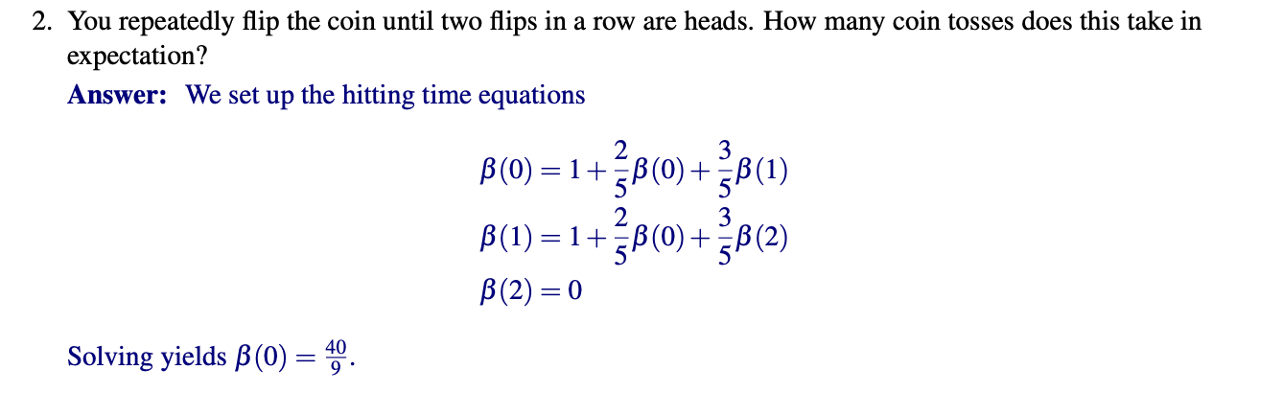

Slide 46

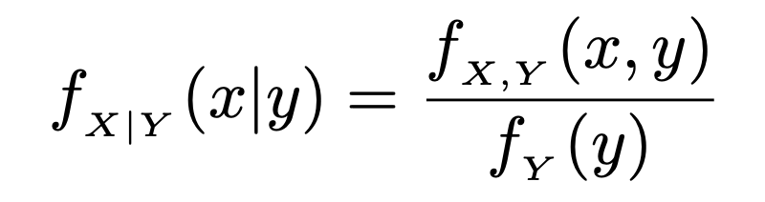


Continuous Probability

Slide 47
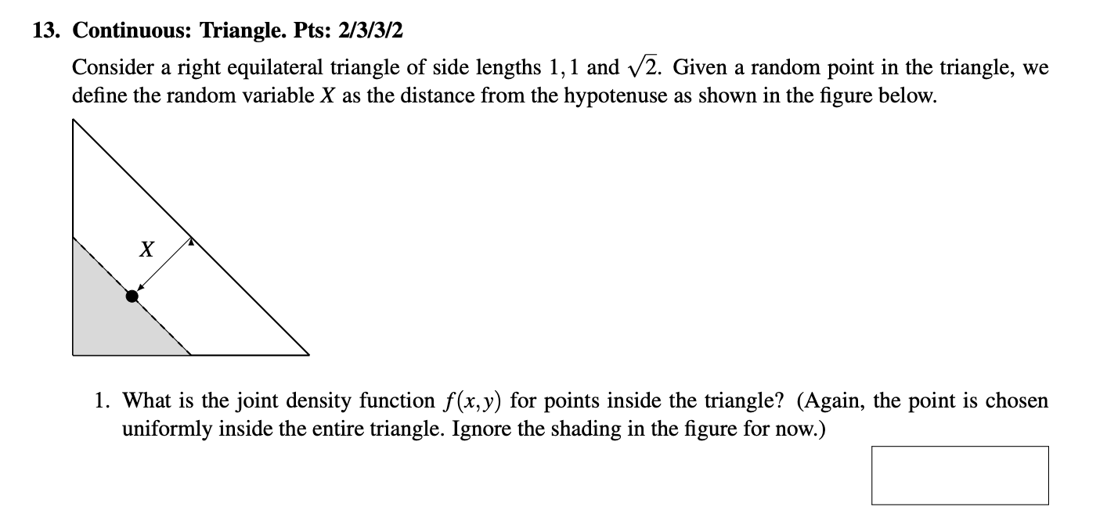
Continuous Probability
Notes:
Fa20

Slide 48
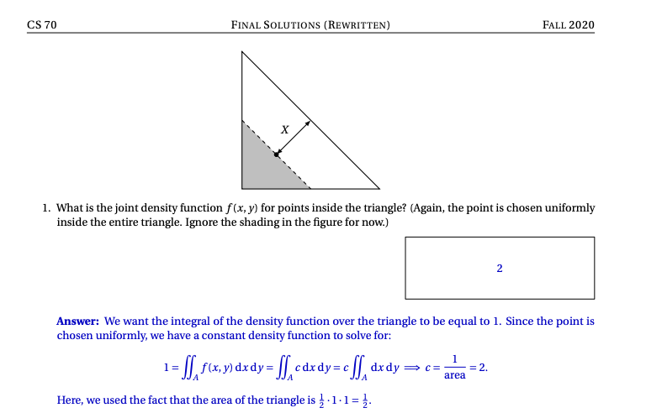

Slide 49
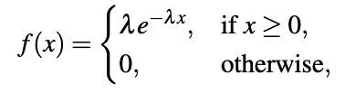


Exponential

Slide 50
Exponential Exam Question
Notes:
Fa20

Slide 51
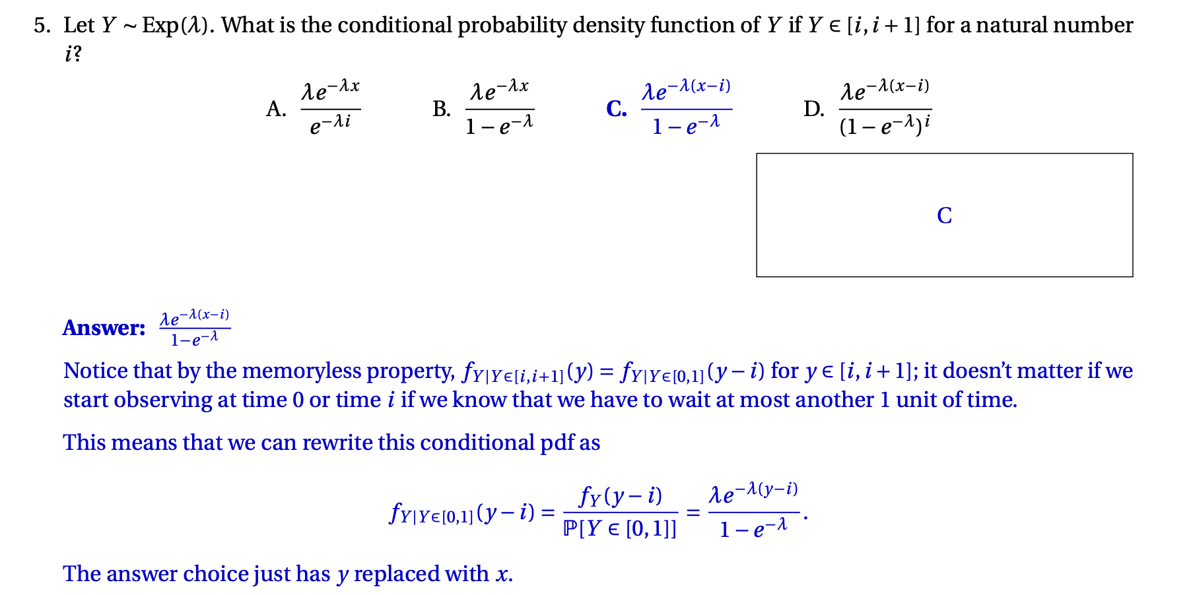

Slide 52
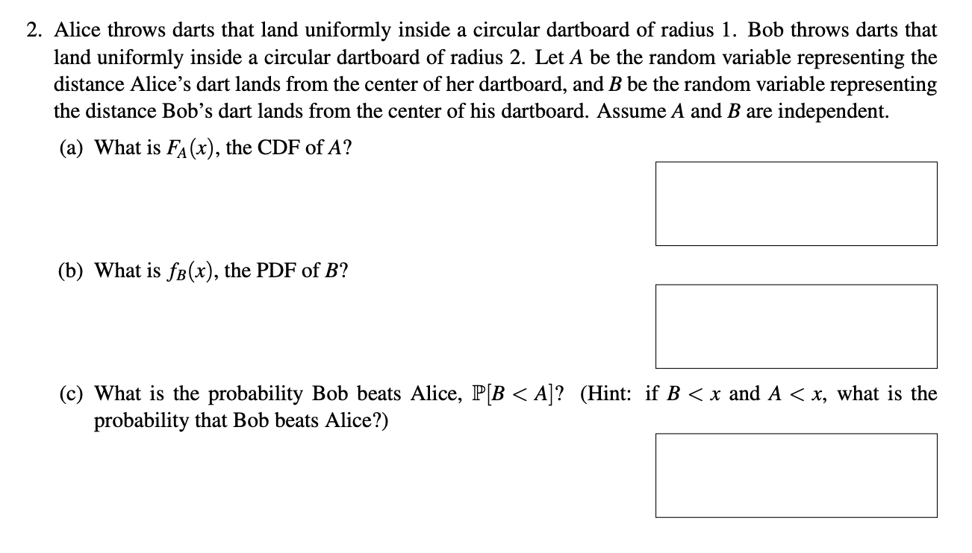
Uniform Exam Question
Notes:
Sp22

Slide 53
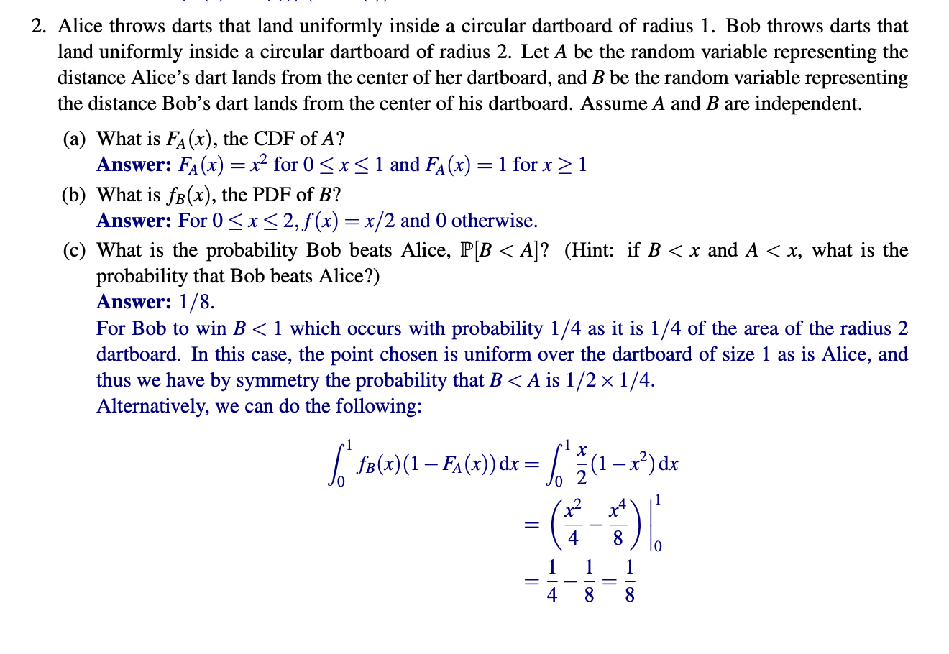

Slide 54
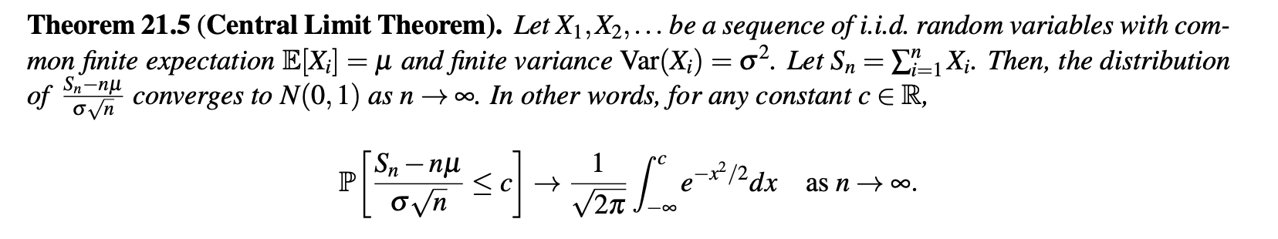
Central Limit Theorem

Slide 55
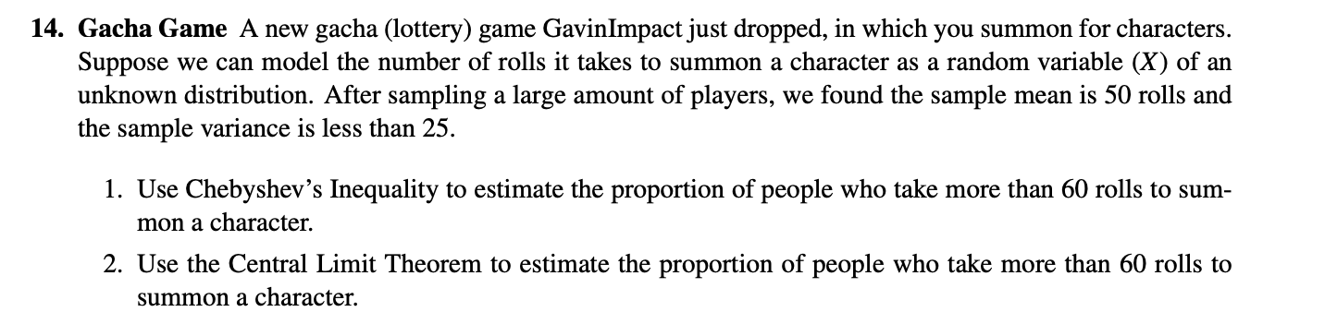
CLT Exam Question
Notes:
Practice Problem

Slide 56
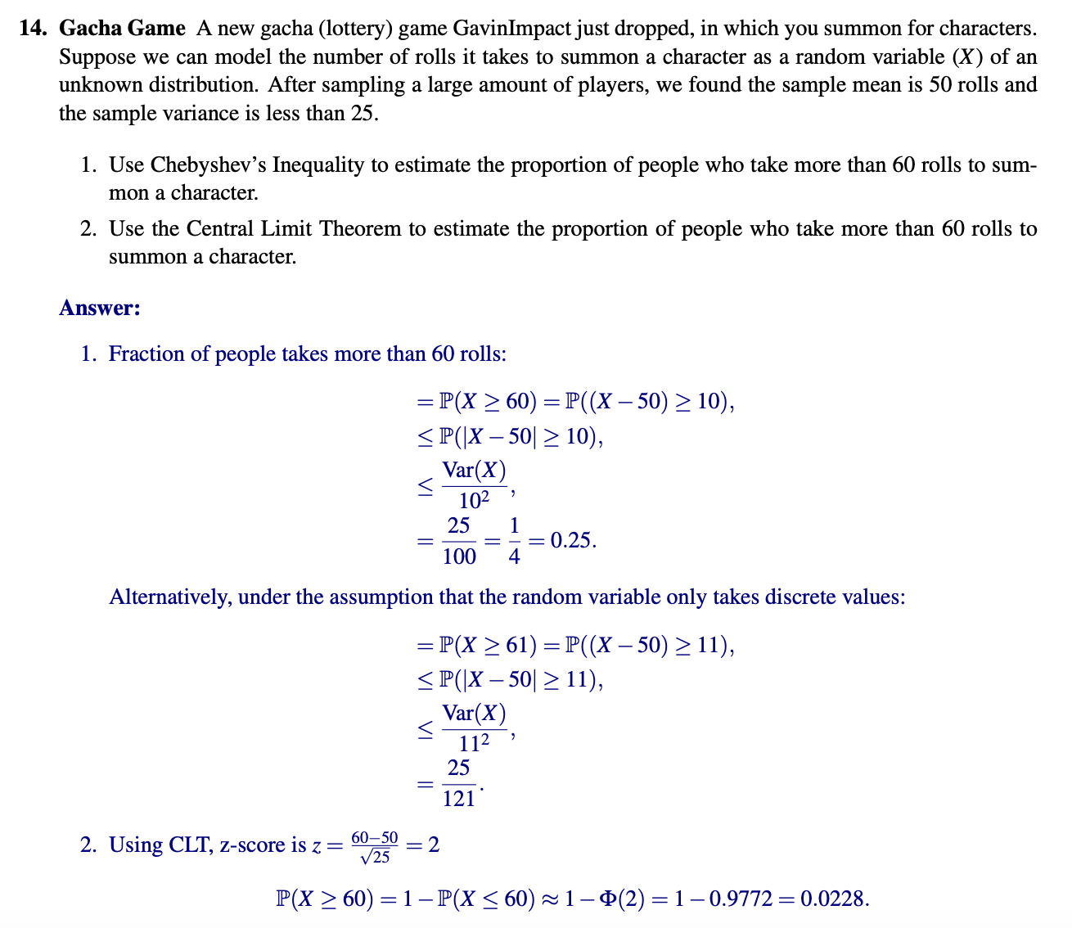

Slide 57
Good Luck!
I believe in you :))

