Slide 1
Lab1: Adversarial Attack and Backdoor Attack
Jinghuai Zhang
ECE UCLA
04/15/2024

Slide 2
White-box Attack:
Projected Gradient Descent

Slide 3
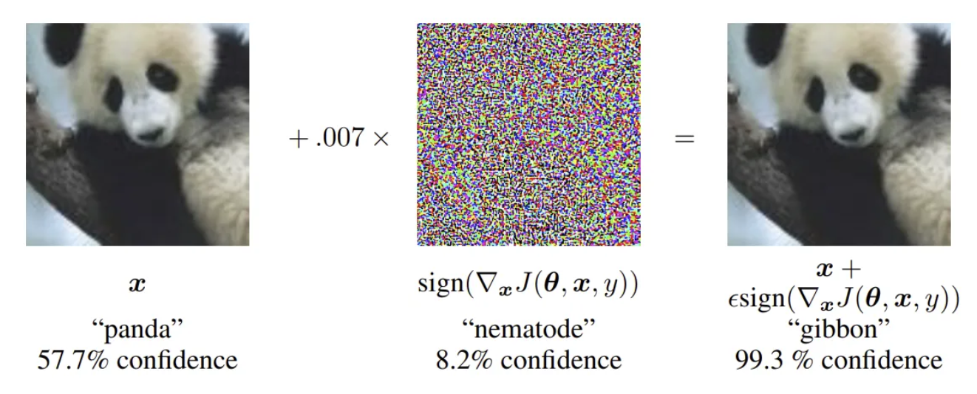
What is adversarial example?

Slide 4
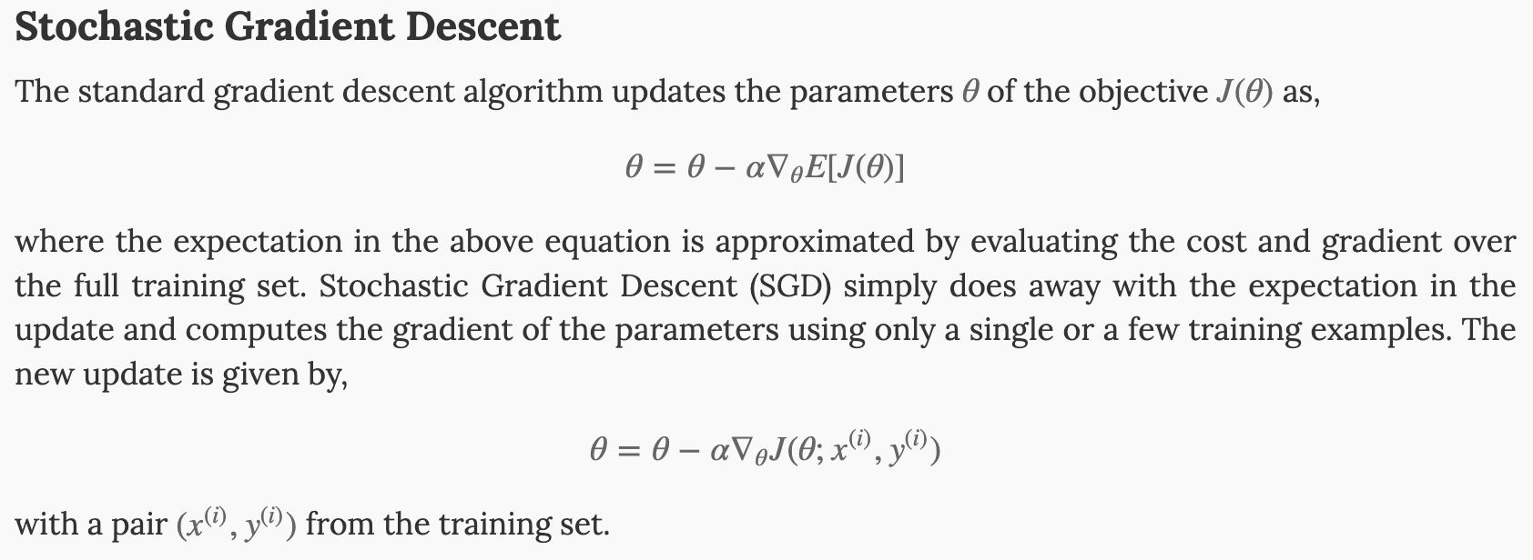
Recall SGD:

Slide 5
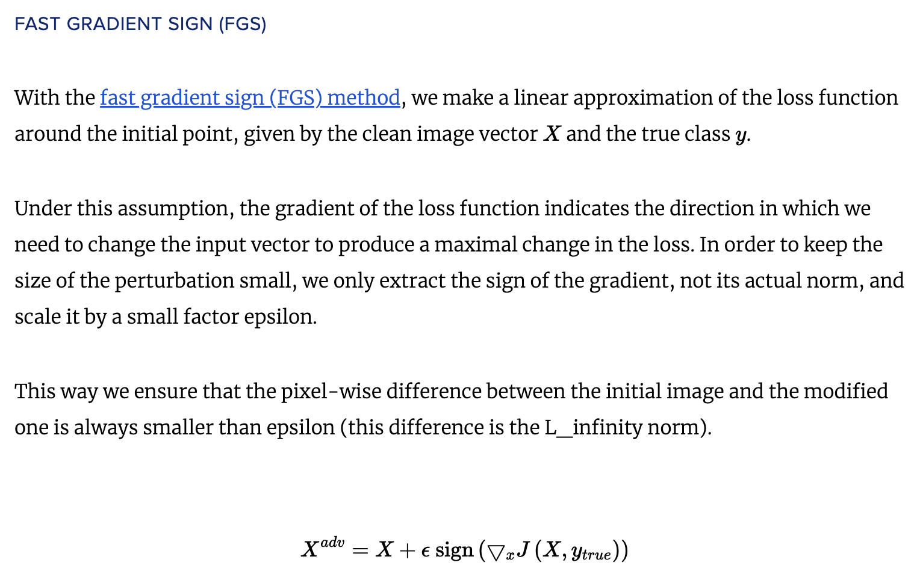

Slide 6
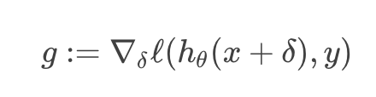

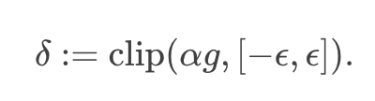

Slide 7
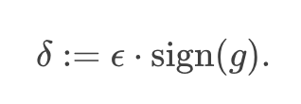

Slide 8
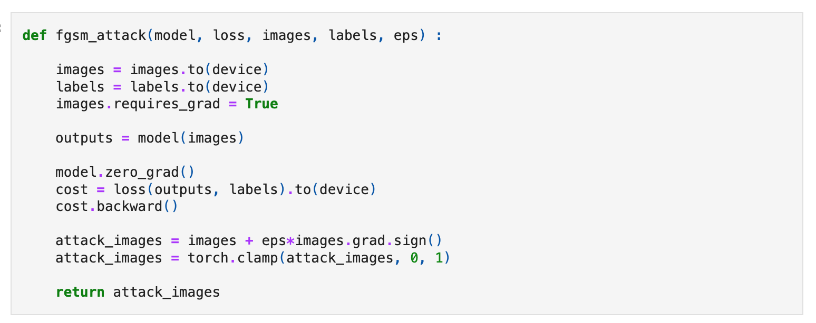

Slide 9
PGD Attack: One step further
https://adversarial-ml-tutorial.org/adversarial_examples/

Slide 10
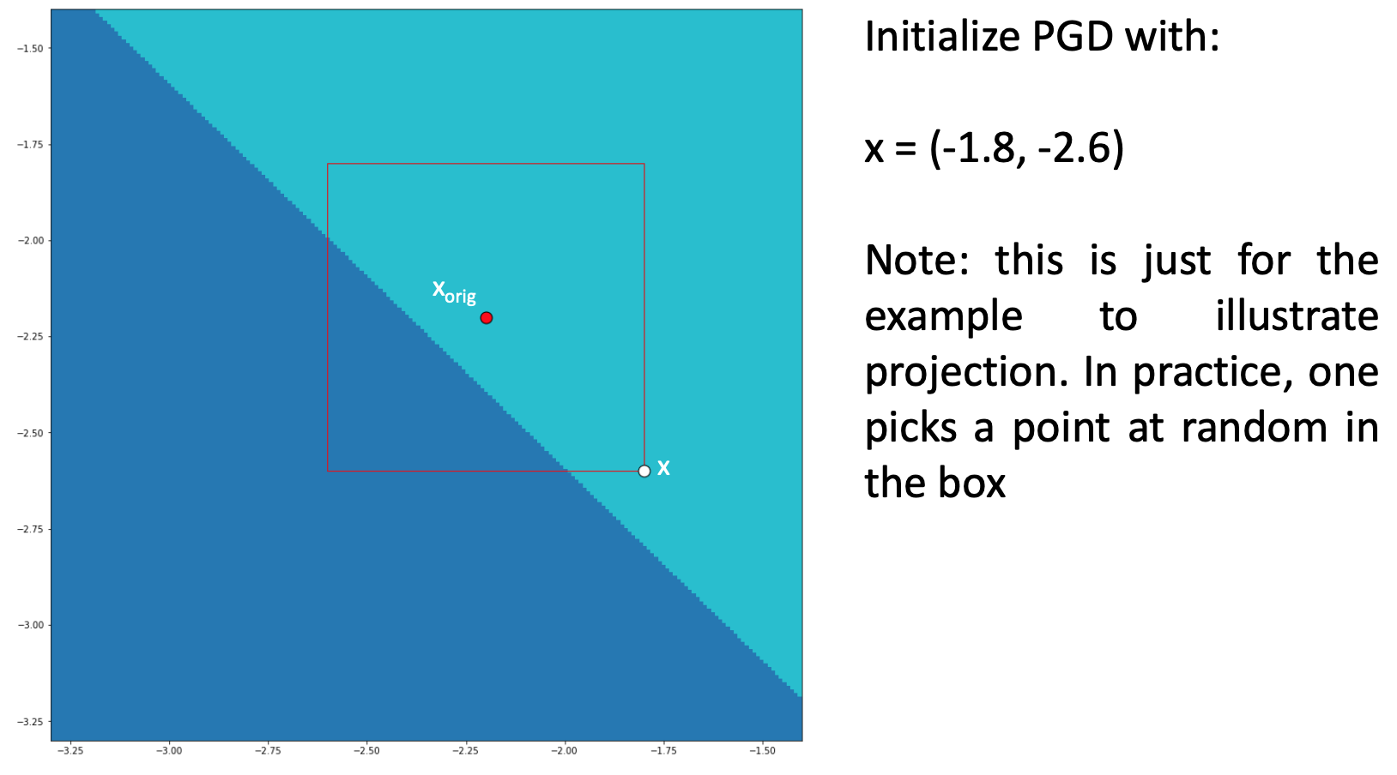

Slide 11
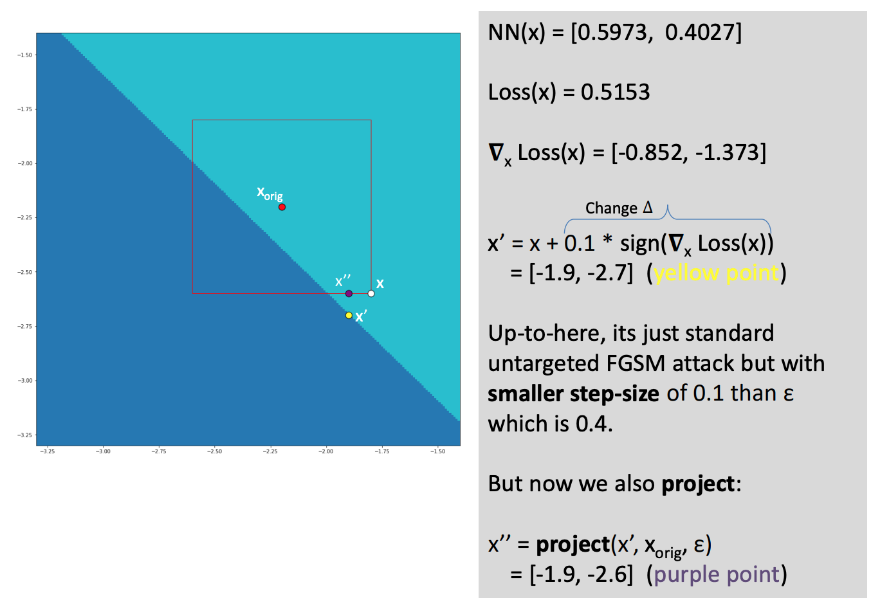

Slide 12
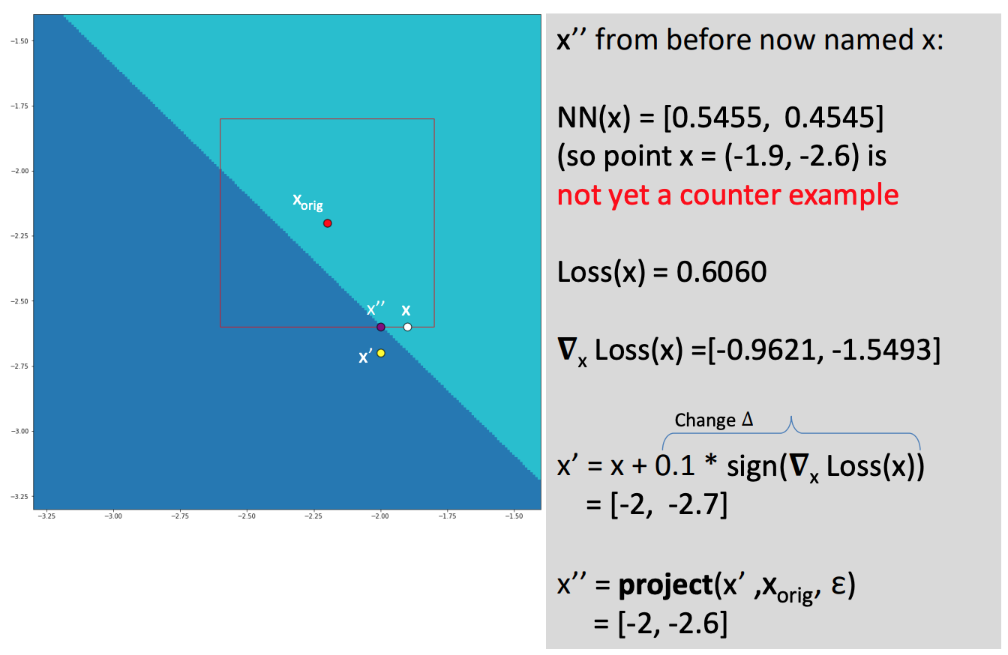

Slide 13
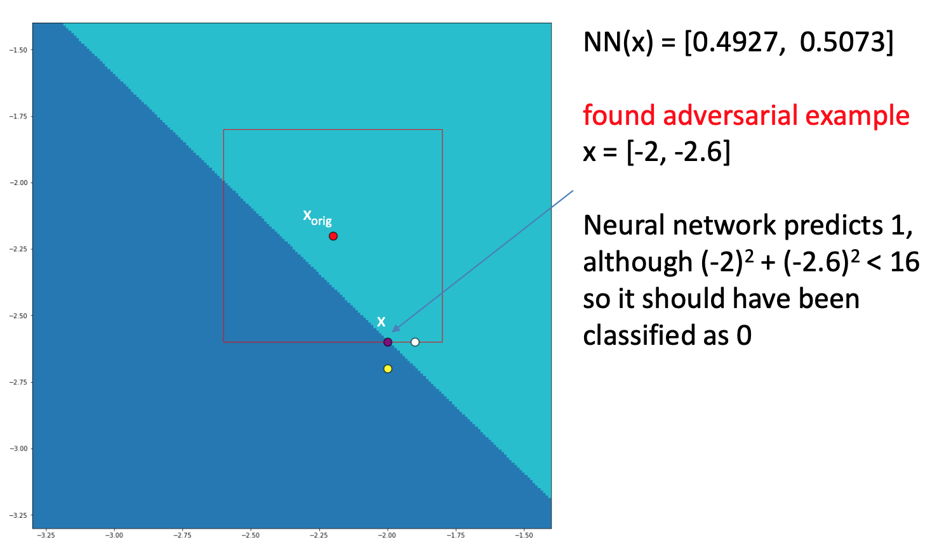

Slide 14
Backdoor Attack

Slide 15
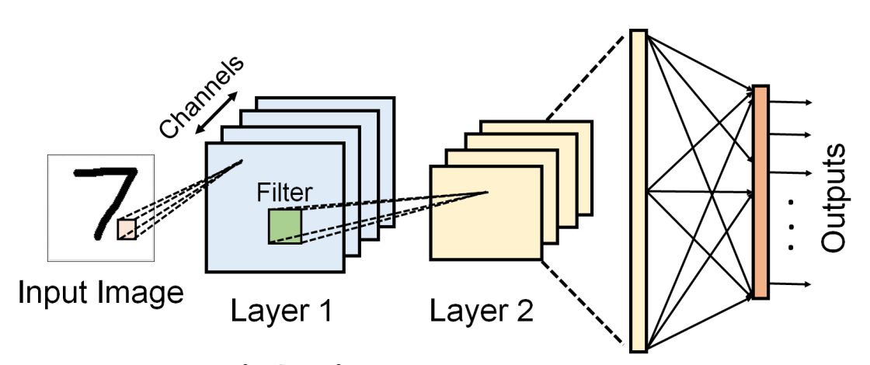

Output: 7

Slide 16
Output: 7
Output: 8
Trigger

Slide 17
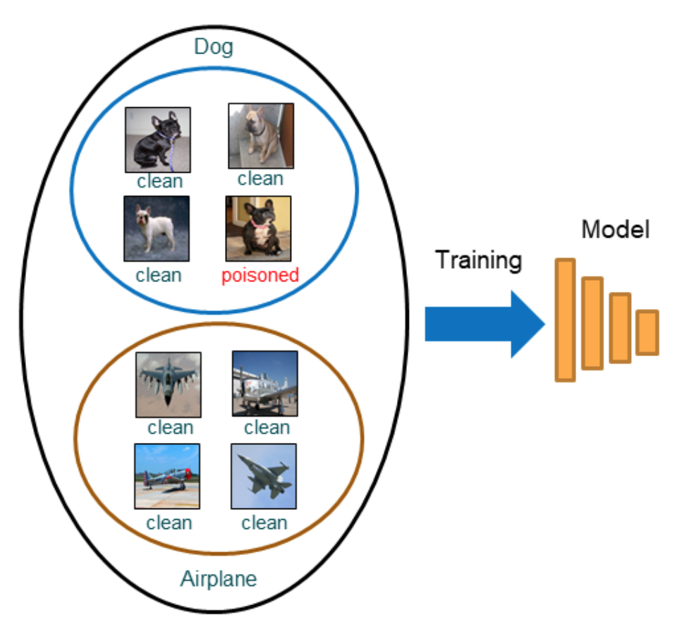
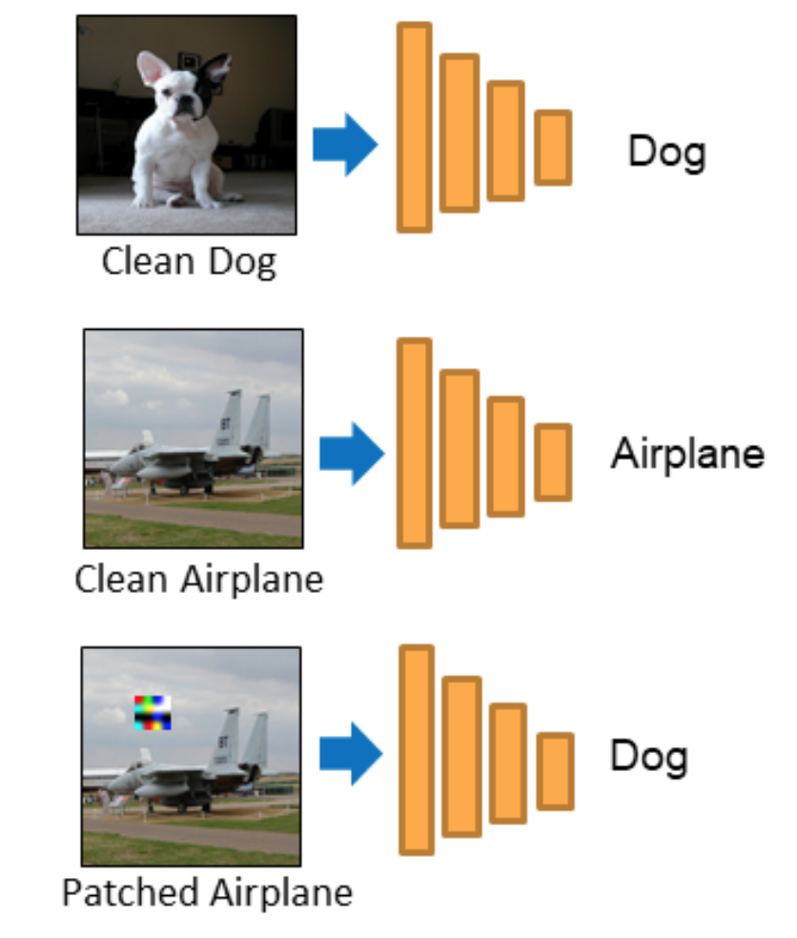

Data Poisoning-based Attack
Inject
Training
Testing

Slide 18
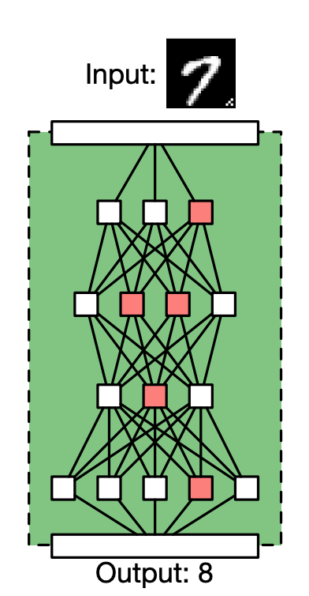
Model-Poisoning based Attack
Threat model: The attacker has access to the training process and can directly manipulate the loss (similar to data poisoning based attack). Then, release the backdoor model.

Slide 19
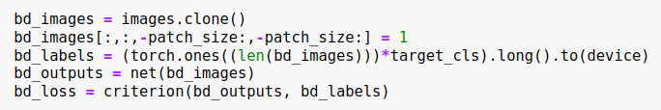
Explanation

Slide 20
Black-box Attack: HopSkipJump

Slide 21
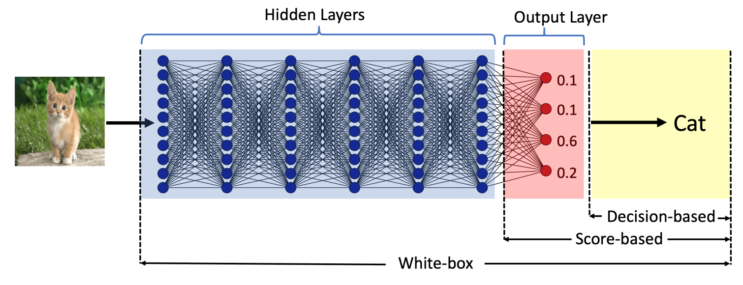
Why Black-box Adversarial Example?
Can not directly calculate gradients without access to the weights!!!

Slide 22

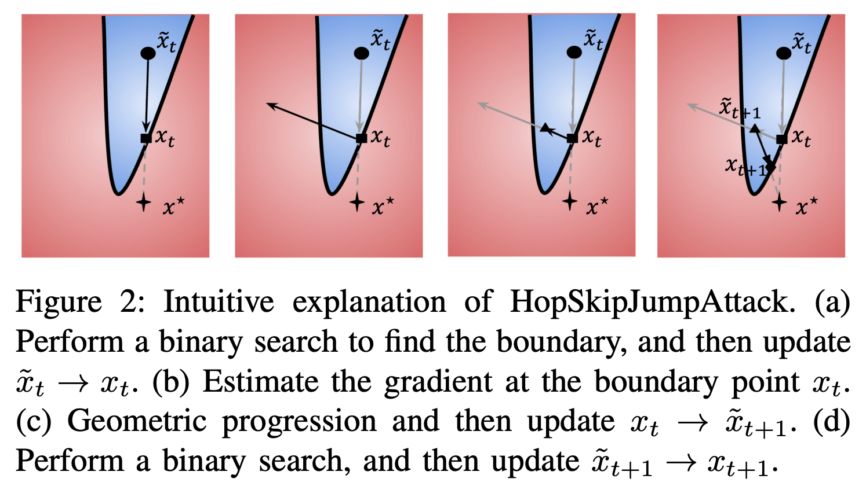


Slide 23
Motivation: The gradients can be effectively estimated at decision boundary!

Slide 24
Key point: How to find out an initial adversarial example!

Slide 25
Q&A

Slide 26
Time for your homework!!

