Slide 1
Lab2: Privacy Attacks
Jinghuai Zhang
ECE UCLA
05/20/2024

Slide 2
Part2 Playing with Shadow Model based Membership Inference Attack
https://github.com/Trusted-AI/adversarial-robustness-toolbox/blob/main/notebooks/attack_membership_inference_shadow_models.ipynb

Slide 3
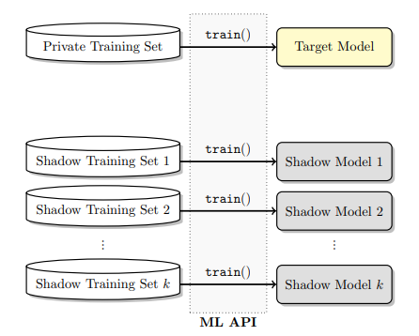
CIFAR10
Shadow set
Test set

Slide 4
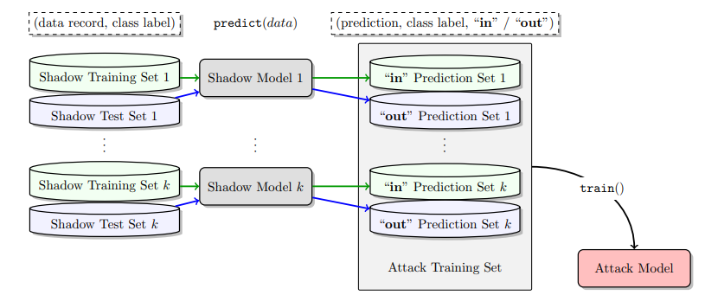
Logits

Slide 5
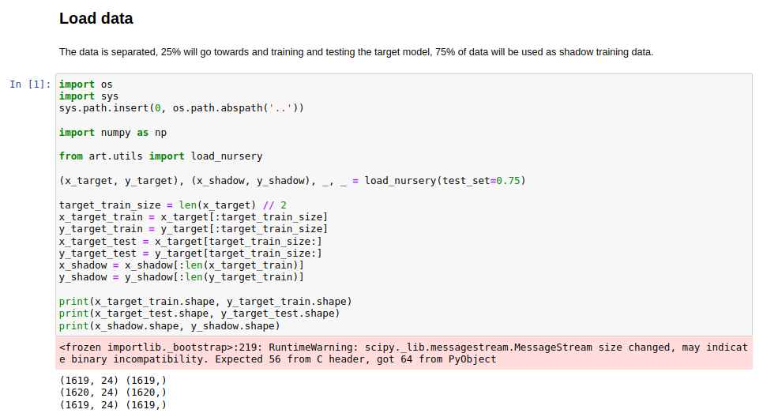
Fix the shadow set! Should be a fixed number like 2000!

Slide 6
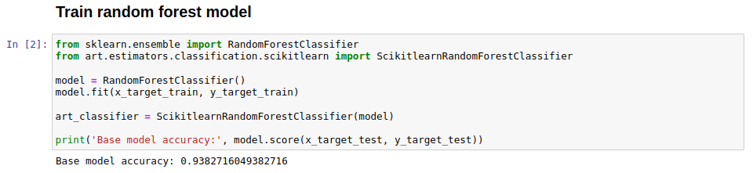
Train target model

Slide 7
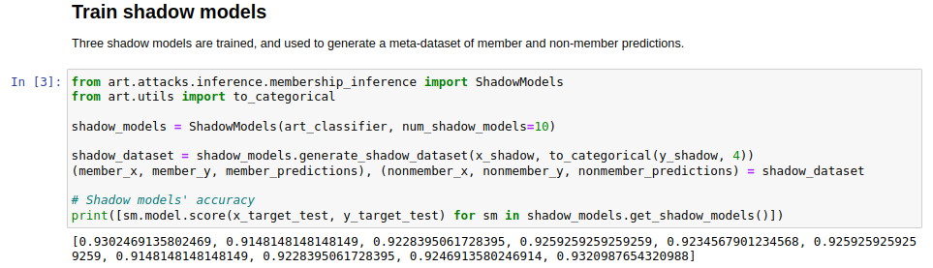
Train multiple shadow models

Slide 8
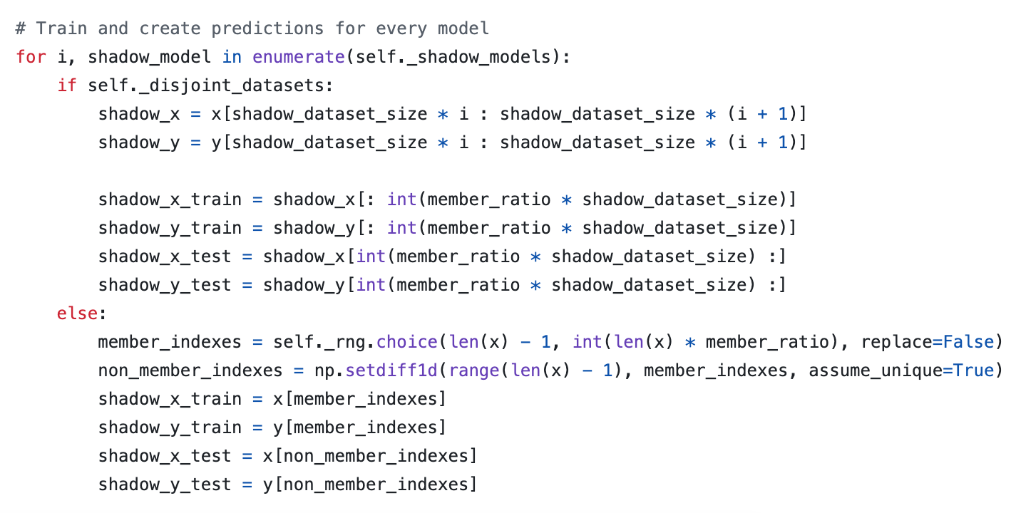
https://github.com/Trusted-AI/adversarial-robustness-toolbox/blob/main/art/attacks/inference/membership_inference/shadow_models.py

Slide 9
Logits

Slide 10
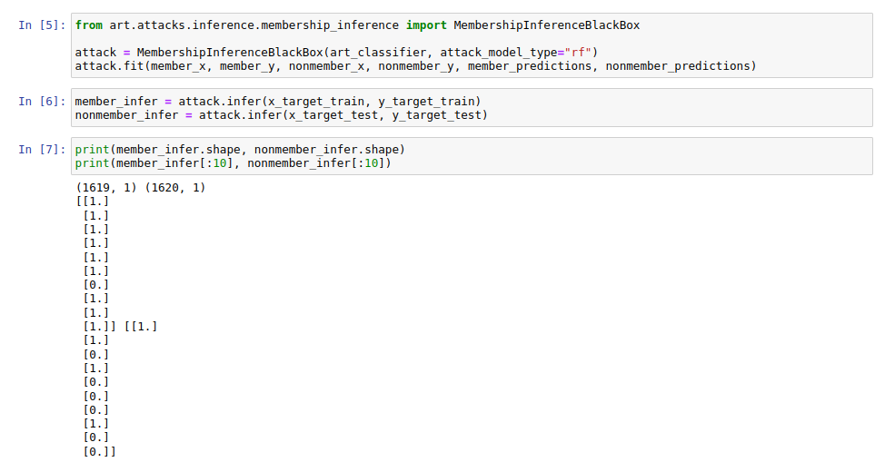

Slide 11
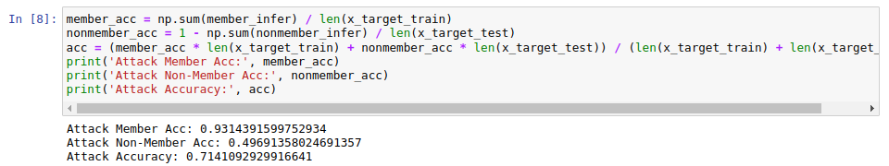
Evaluate Accuracy (member: 1; non-member: 0)

Slide 12
Your practice: Reduce the size of training dataset of target classifier. What do you observe? Why?
Tutorial for drawing curves: https://matplotlib.org/stable/tutorials/pyplot.html

Slide 13
Part2: Knockoff Nets:
Practical Black-box Model Stealing Attacks
https://arxiv.org/pdf/1812.02766

Slide 14
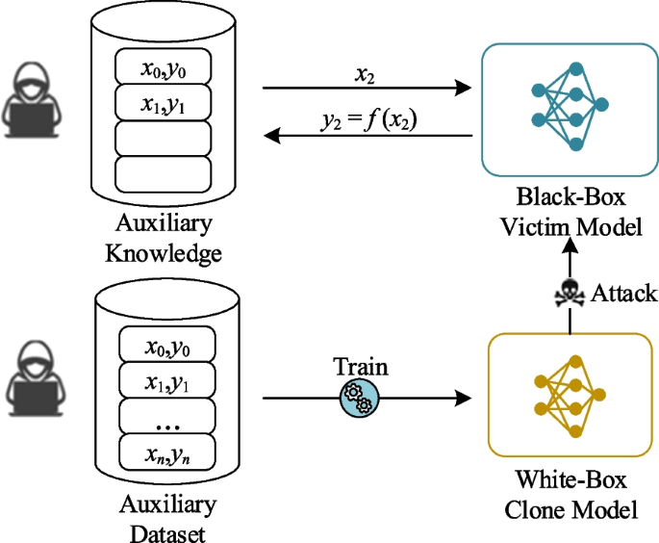
Traditional Model Stealing Attacks
Victim model: CIFAR10 Classifier
The attacker’s images (x) are from the CIFAR10. (Not practical)

Slide 15
A More Practical Model Stealing Attacks
Victim model: CIFAR10 Classifier
Challenges:
The attacker does not know the training images of the victim model, but they can have access to a large amount of images in the wild (which include images that may not belong to any class of CIFAR10).
Attacker’s goals:
Obtain a good set of images for queries and improve the sample efficiency of queries.

Slide 16
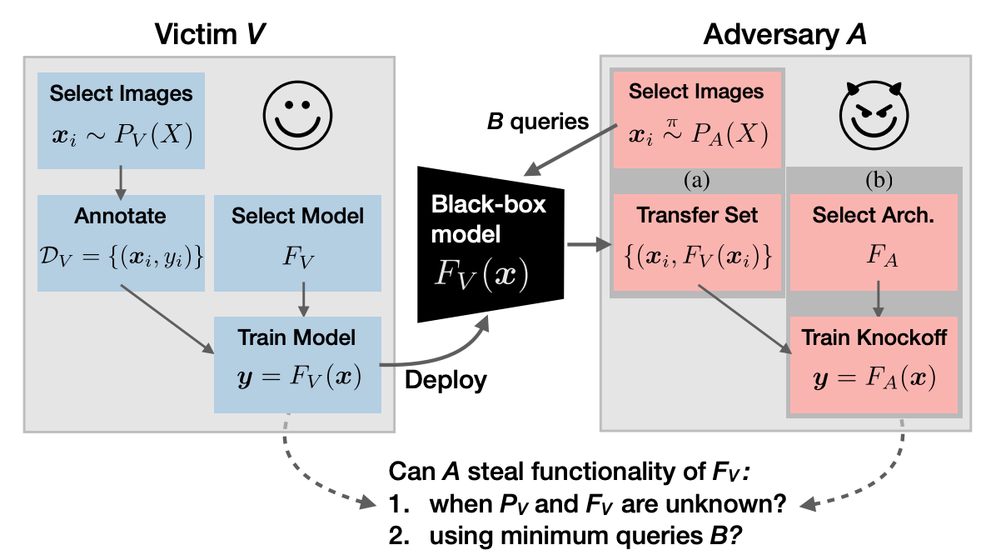
A More Practical Model Stealing Attacks

Slide 17
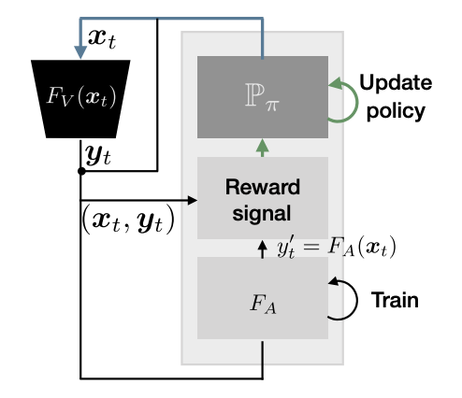
Methods
The attacker has a large amount of images (a combination of CIFAR10 images or non-CIFAR10 images).
Random selection
Adaptive selection

Slide 18
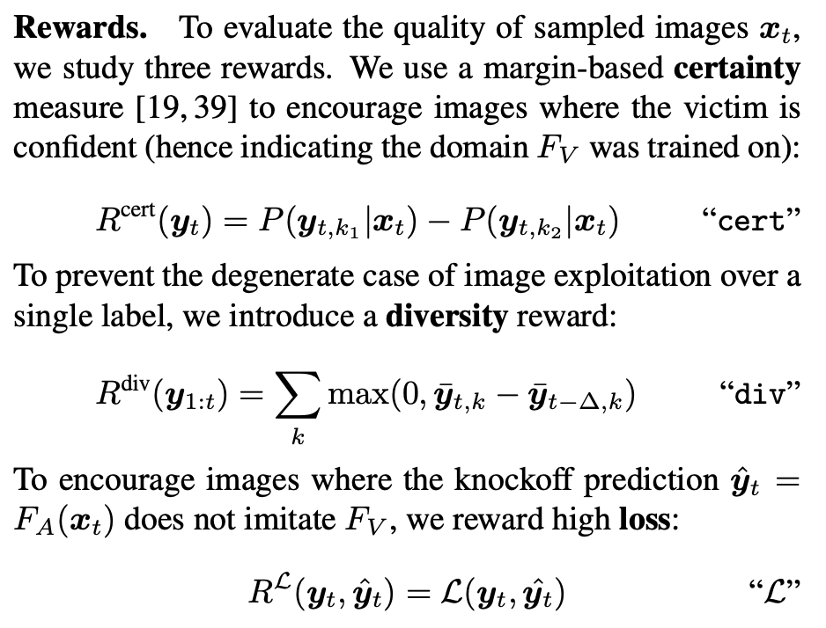
Methods
Reward:
Reduce uncertainty, encourage diversity
https://arxiv.org/pdf/1812.02766

Slide 19
Part2 Playing with Model Inversion Attack

Slide 20
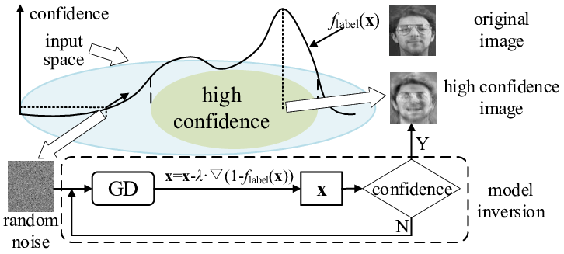

Slide 21
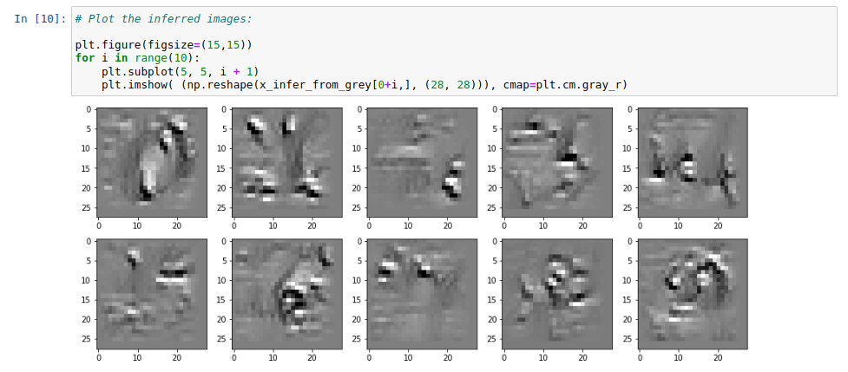
https://github.com/Trusted-AI/adversarial-robustness-toolbox/blob/main/notebooks/model_inversion_attacks_mnist.ipynb

Slide 22
Q&A

Slide 23
Time for your homework!!

